Slide 1
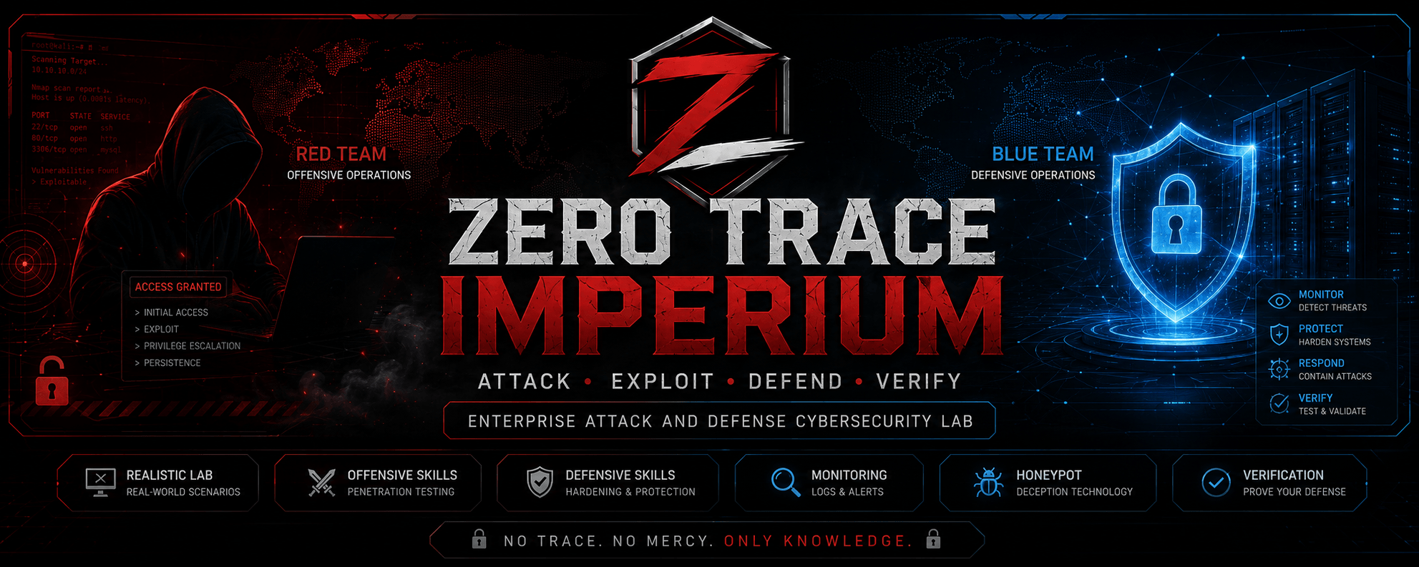
GRADUATION PROJECT
Zero Trace Imperium
Enterprise Attack & Defense Cybersecurity Laboratory
An Enterprise Inspired Red Team & Blue Team Security Assessment Lab
Yusuf Hussein · Ahmed Samy · Abdulrahman Husayn · Hossam Hassan · Seif Elddien Sherif · Mohamed Ayman

Slide 2
OVERVIEW
Project at a Glance
Zero Trace Imperium is an enterprise inspired cybersecurity laboratory demonstrating the complete attack and defense lifecycle inside an isolated VMware environment built for realism, repeatability, and rigorous documentation.
12 Assessment Phases
Red Team Operations
Full lifecycle coverage from build through recovery
Reconnaissance, exploitation, and privilege escalation
Blue Team Operations
Enterprise Documentation
Hardening, monitoring, detection, and incident response
Professional reporting and repeatable deployment

Slide 3
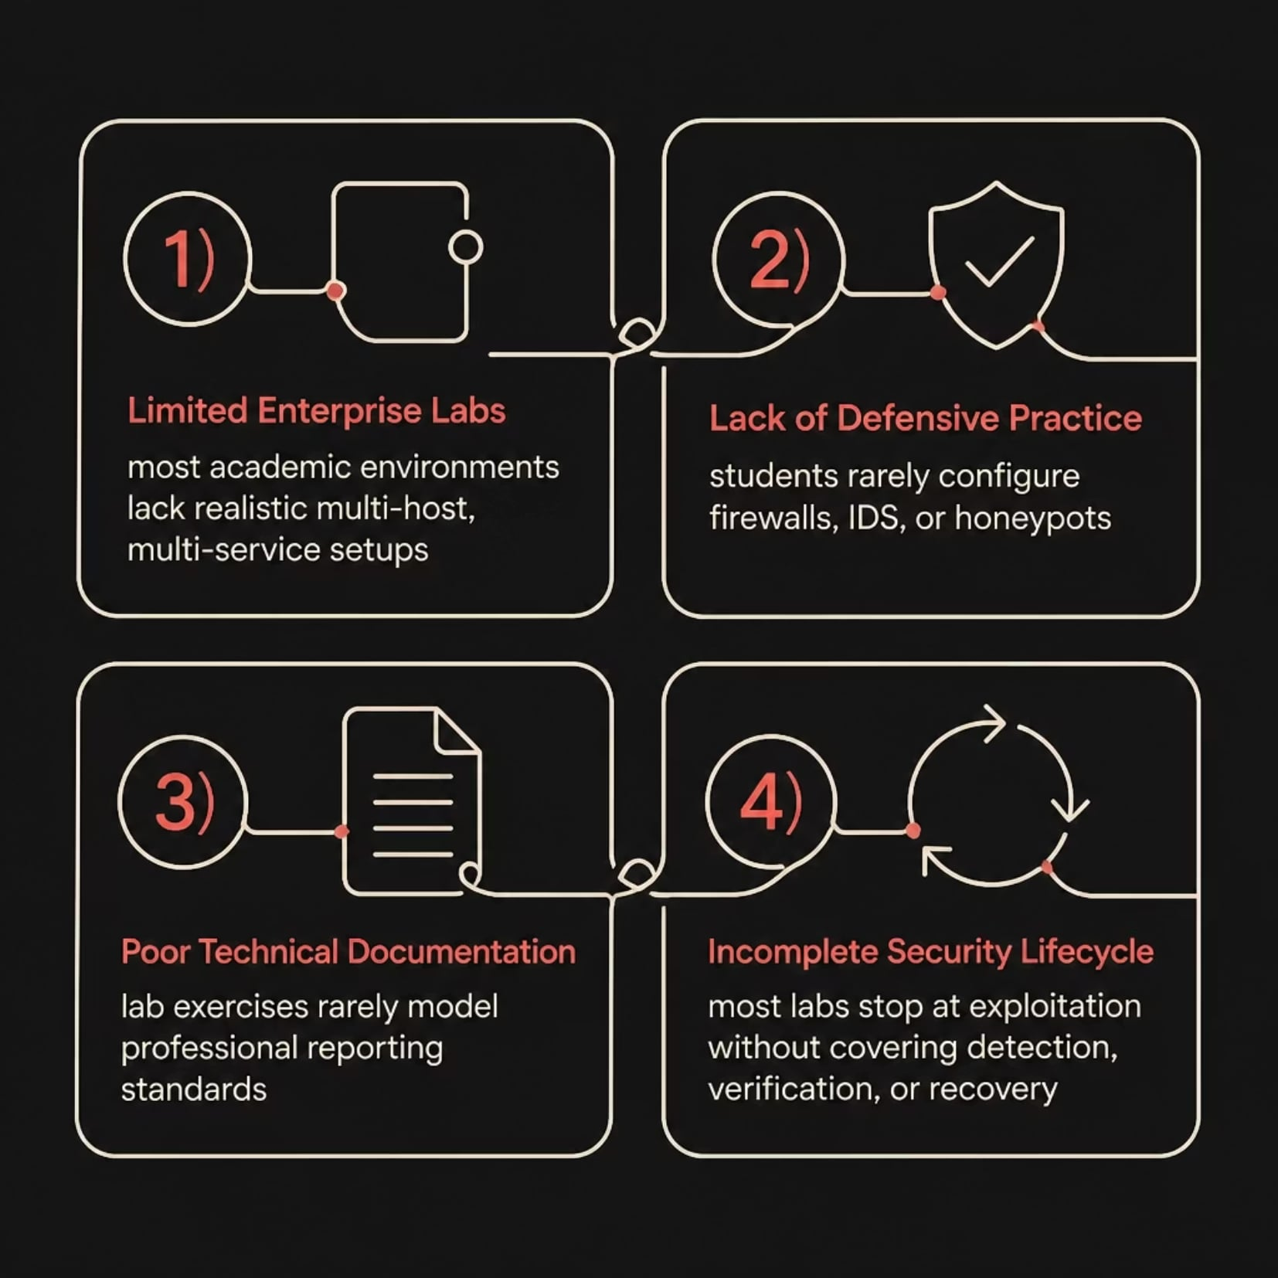
PROBLEM STATEMENT
The Gap in Cybersecurity Education
Organizations face increasingly sophisticated cyber threats.
Most academic labs focus primarily on offensive techniques.
Students receive limited exposure to enterprise defense and recovery.
Zero Trace Imperium addresses this gap through a complete attack and defense lifecycle.

Slide 4
OBJECTIVES
Project Objectives
Infrastructure
Offensive Security
Defensive Security
Build an enterprise grade VMware lab
Deploy Ubuntu Server, Kali Linux, and Windows 11
Configure an isolated NAT network
Reconnaissance & Vulnerability Assessment
Exploitation & privilege escalation
Post exploitation & persistence
Linux Hardening, UFW firewall, Fail2Ban
ModSecurity WAF with OWASP CRS
Cowrie Honeypot Deployment

Slide 5
TECHNOLOGY STACK
Tools & Technologies
Infrastructure & OS
Security Toolset
VMware Workstation Pro
Kali Linux · Ubuntu Server · Windows 11
Defense
Offense
Isolated NAT network environment
Attacker, target, and workstation VMs
UFW · Fail2Ban · ModSecurity · OWASP CRS · Cowrie
Nmap · Gobuster · Nikto · Burp Suite · Hydra · SQLMap · Metasploit · Wireshark
Web Stack
Apache – PHP - MariaDB - DVWA

Slide 6
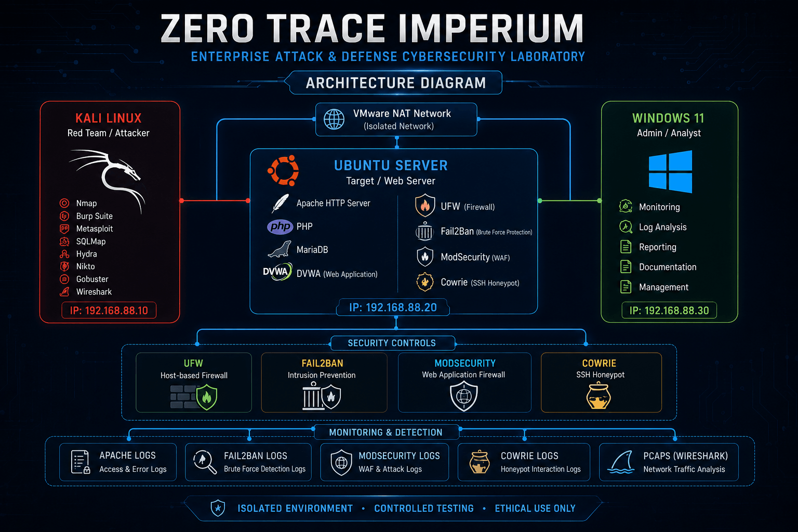

ARCHITECTURE
Enterprise Laboratory Design
Three VM Isolated Environment
All virtual machines communicate through a controlled VMware NAT network, fully isolated from production systems enabling safe, repeatable security testing.
Kali Linux : Red team attack platform
Ubuntu Server : Hardened target with full service stack
Windows 11 : Enterprise workstation simulation
Ubuntu Server hosts 9 security relevant services including DVWA,
ModSecurity, WAF, and Cowrie honeypot.

Slide 7
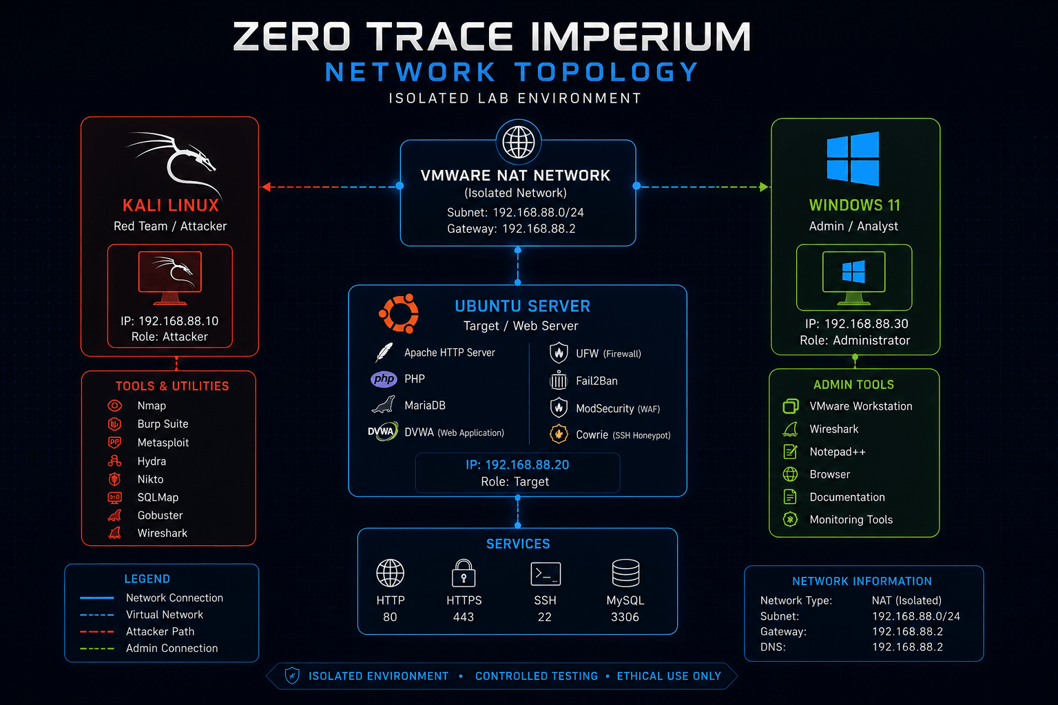
NETWORK TOPOLOGY
Secure Laboratory Network
All VMs operate within an isolated VMware NAT segment enabling controlled communication,
safe penetration testing, and enterprise style network layout with fully repeatable deployment.
Controlled Communication
Safe Testing Environment
Enterprise Layout
Repeatable Deployment

Slide 8
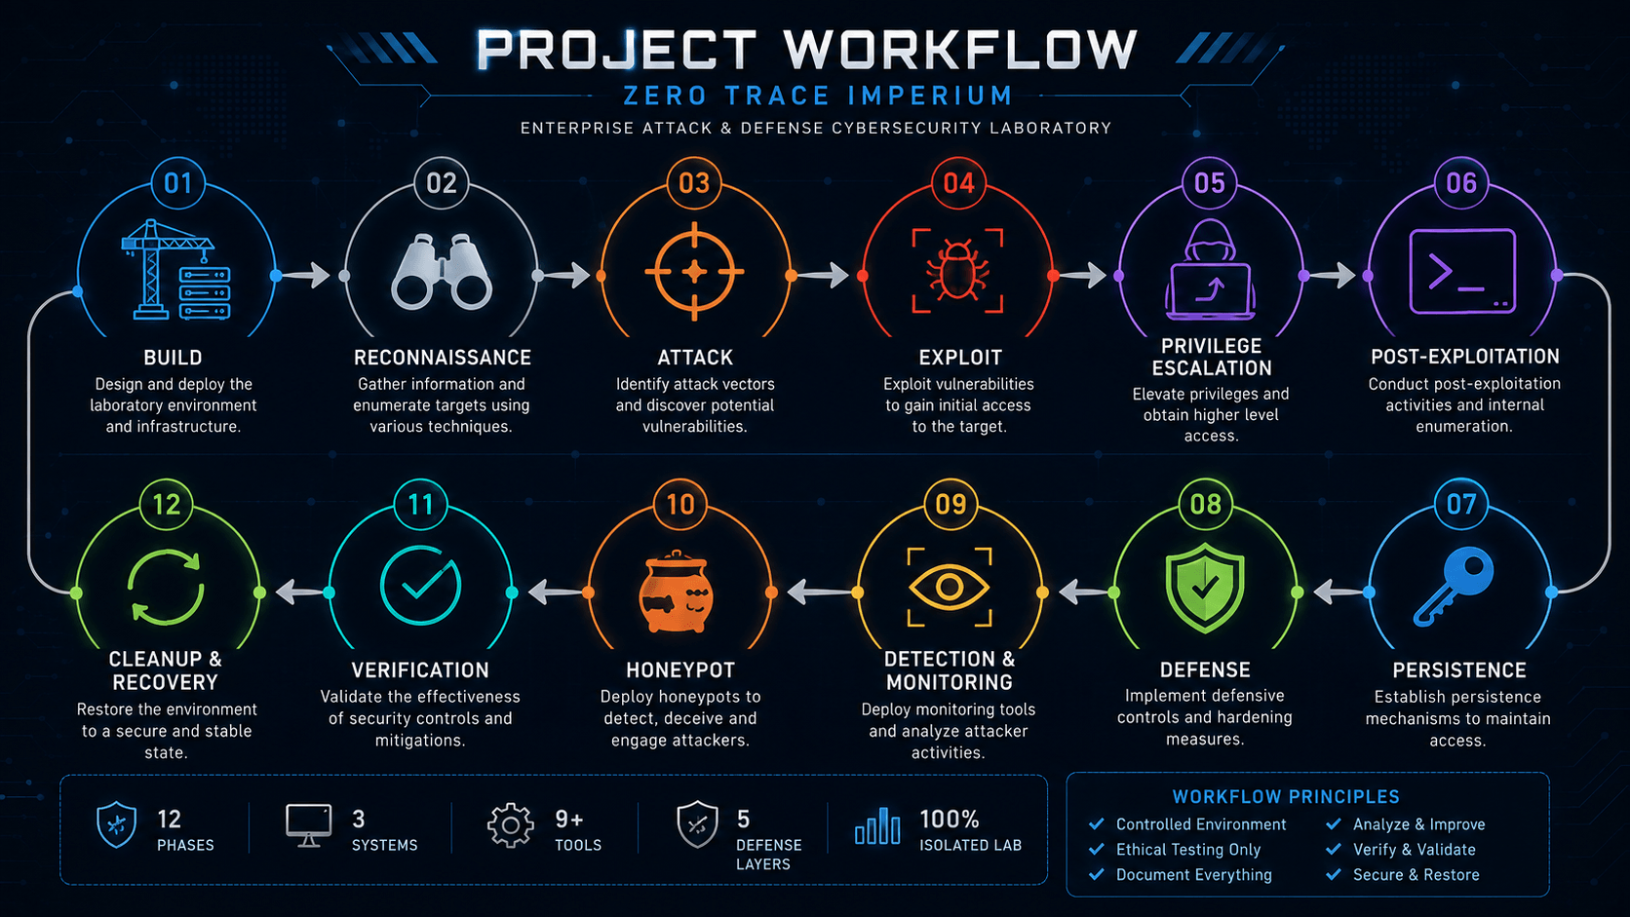
WORKFLOW
Security Assessment Lifecycle
Zero Trace Imperium covers 12 structured phases from initial infrastructure build through attack execution, defense implementation, detection, and full recovery.

Slide 9
PHASE : 01
Build
Activities
VMware Configuration
Isolated NAT network setup
Outcome
A fully operational, enterprise inspired laboratory ready for security assessment with all VMs configured, networked, and documented.
OS Deployment
Ubuntu Server, Kali Linux, Windows 11
Service Stack
Apache, MariaDB, DVWA, OpenSSH

Slide 10

PHASE : 02
Reconnaissance
The reconnaissance phase identified exposed services, running applications, and hidden resources before any exploitation was attempted.
Assessment Tools
Information Collected
Open ports & running services
Web technologies & versions
Hidden directories & endpoints
HTTP response analysis
Network traffic patterns
Nmap
Gobuster
Nikto
Burp Suite
Wireshark
Next: Attack Phase vulnerability exploitation and privilege escalation.

Slide 11
PHASE : 03
Attack Phase
Following reconnaissance, controlled attacks were performed to validate identified vulnerabilities inside an isolated laboratory environment. The objective was to demonstrate realistic attack scenarios while collecting technical evidence without impacting production systems.

Slide 12
Assessment Categories
Eight attack categories were tested in the isolated lab to validate identified vulnerabilities.
Authentication Security
SQL Injection
Password strength and login controls
Database query manipulation
Cross Site Scripting
Command Injection
Client-side script injection
OS command execution
File Upload
Local File Inclusion
Upload validation bypass
Server file access
Cross-Site Request Forgery
Session Management
Authenticated request abuse
Token and cookie security

Slide 13
AUTHENTICATION ASSESSMENT
Brute Force Attack
Weak authentication mechanisms were evaluated using controlled password guessing to identify accounts susceptible to credential based attacks.
Tool: Hydra
Objectives
Hydra is a parallelized login cracker supporting numerous protocols. It was used to automate credential testing against the target login interface.
Test password strength across user accounts
Validate authentication rate-limiting controls
Demonstrate login weaknesses with evidence

Slide 14
AUTHENTICATION ASSESSMENT : RESULTS
Brute Force Findings
Weak Credentials Identified
Successful Authentication
Authentication Policy Gaps
Multiple accounts used predictable or default passwords, enabling unauthorized access without elevated privileges.
Hydra successfully authenticated to the target system, confirming that brute force attacks are a viable threat vector.
No account lockout, rate limiting, or CAPTCHA mechanisms were observed allowing unrestricted password attempts.

Slide 15
SQL INJECTION
Database Assessment
SQL Injection testing evaluated how user supplied input interacted with backend database queries assessing whether the application properly sanitizes data before execution.
Objectives
Findings
01
Unsanitized Input
Validate input handling across all user controllable fields
User input was passed directly to SQL queries without parameterization.
02
Demonstrate potential data exposure through query manipulation
Database Interaction
03
Injection payloads returned database errors and query results.
Assess database security posture and access controls
Sensitive Data Exposure
Table structures and credentials were extractable via UNION-based injection.

Slide 16
CROSS SITE SCRIPTING
XSS Assessment
Cross Site Scripting testing evaluated whether malicious scripts could be injected and executed in the context of other users' browser sessions.
Objectives
Findings
01
Script Injection Successful
Test input and output encoding mechanisms
Malicious payloads executed within the application context.
02
Demonstrate script execution in the browser
Cookie Theft Demonstrated
03
Session cookies were exfiltrated via injected scripts.
Assess session hijacking potential
Missing Output Encoding
User input rendered without proper HTML entity encoding.

Slide 17
COMMAND INJECTION & FILE UPLOAD
Server Side Execution & Upload Testing
Command Injection and File Upload testing evaluated whether the application properly restricts system-level access and file type validation.
Command Injection
File Upload
Objectives: Test system command execution, demonstrate server compromise, assess input validation.
Findings: Command execution confirmed, system information disclosed, input filtering insufficient.
Objectives: Test file type validation, demonstrate malicious upload, assess server execution risk.
Findings: Restrictive file types bypassed, malicious files uploaded, server side execution possible.

Slide 18
FILE INCLUSION & CSRF
Local File Inclusion & Cross Site Request Forgery
LFI and CSRF testing evaluated whether the application properly restricts file access and enforces request origin validation.
Local File Inclusion
Cross Site Request Forgery
Objectives: Test file inclusion mechanisms, demonstrate sensitive file access, assess path traversal risk.
Findings: Local files accessed, system files exposed, directory traversal successful.
Objectives: Test request validation, demonstrate unauthorized actions, assess CSRF token implementation.
Findings: CSRF tokens absent, state changing requests forged, no origin verification enforced.

Slide 19
SESSION MANAGEMENT
Session Security Assessment
Session management testing evaluated how the application creates, maintains, and protects user sessions throughout the authentication lifecycle.
Objectives
Findings
01
Weak Session Tokens
Evaluate session token generation and entropy
Tokens lacked sufficient entropy and were potentially predictable.
02
Test session expiration and timeout mechanisms
Improper Expiration
03
Sessions remained active beyond expected timeout thresholds.
Assess cookie security attributes
Missing Cookie Flags
Secure, HttpOnly, and SameSite attributes were not consistently set.

Slide 20
PHASE 03 : SUMMARY
Attack Phase Outcomes
Controlled attacks across all eight categories confirmed exploitable vulnerabilities in the isolated lab. The following evidence was collected to support remediation prioritization.
Authentication
Injection Flaws
Weak credentials and missing lockout controls validated via Hydra brute force
SQL and command injection confirmed with data exposure and system access
Client-Side Risks
Server Controls
XSS and CSRF demonstrated session hijacking and unauthorized action execution
File upload bypass, LFI, and weak session management confirmed server-side gaps

Slide 21


PHASE :04
Controlled Exploitation
Objectives
Results
Establish Initial Access
Validate Vulnerability Impact
Demonstrate Remote Access
Collect Technical Evidence
Successful Meterpreter Session established
Remote Command Execution confirmed
Controlled Access Achieved on target host
Tool
All exploitation activity conducted within authorized scope under strict rules of engagement.
Metasploit Framework
Zero Trace Imperium
20

Slide 22
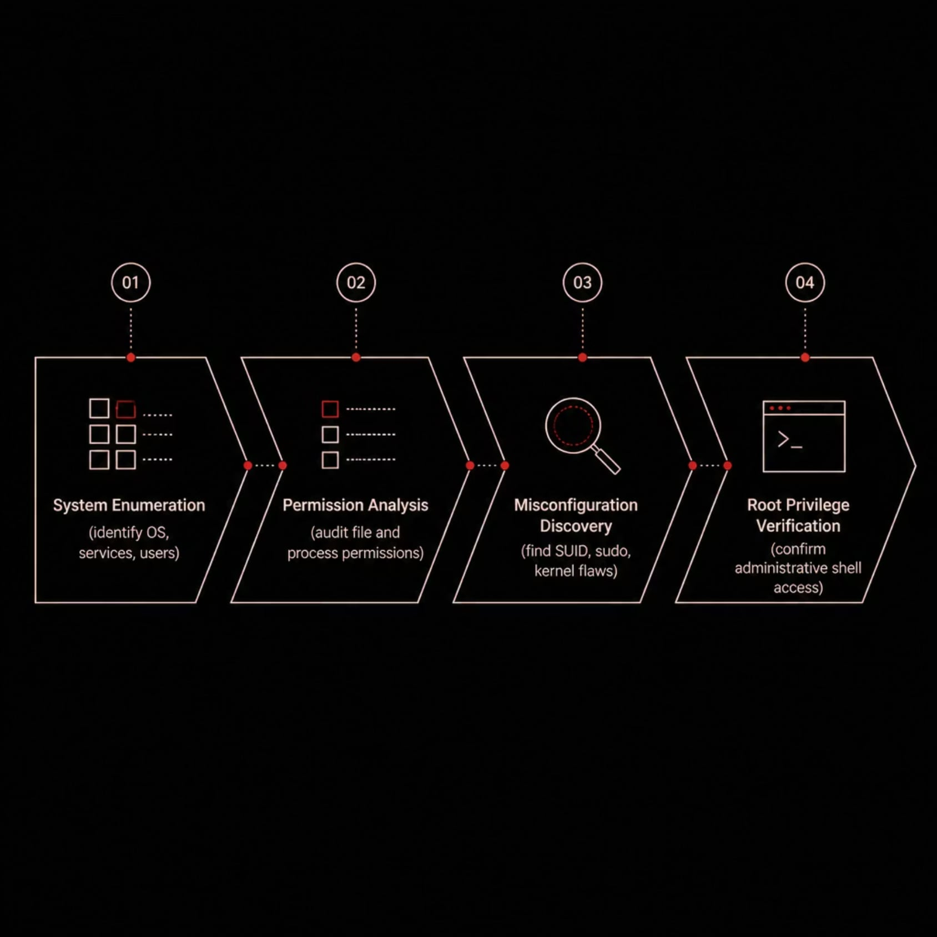
PHASE :05
Privilege Escalation
After initial access, the red team systematically elevated privileges to administrative level validating the full impact of the exploited vulnerability and demonstrating complete host compromise.
Outcomes
Administrative privileges obtained on target system
Security impact fully confirmed and documented
Evidence collected for remediation reporting
Zero Trace Imperium
21

Slide 23
LAB REPORT
Phase 06 : Post Exploitation
After gaining elevated privileges, post exploitation activities were performed to assess the full security impact on the compromised system identifying what an attacker could access, extract, and leverage from within.

Slide 24
PHASE : 06
Objectives
Assess System Exposure
Review Sensitive Information
Map accessible resources, services, and data to understand the blast radius of the compromise.
Identify credentials, configuration files, and stored secrets that could be harvested.
Evaluate Business Impact
Document Findings
Translate technical findings into risk context for stakeholders and leadership.
Capture evidence, artifacts, and remediation guidance for the final report.

Slide 25
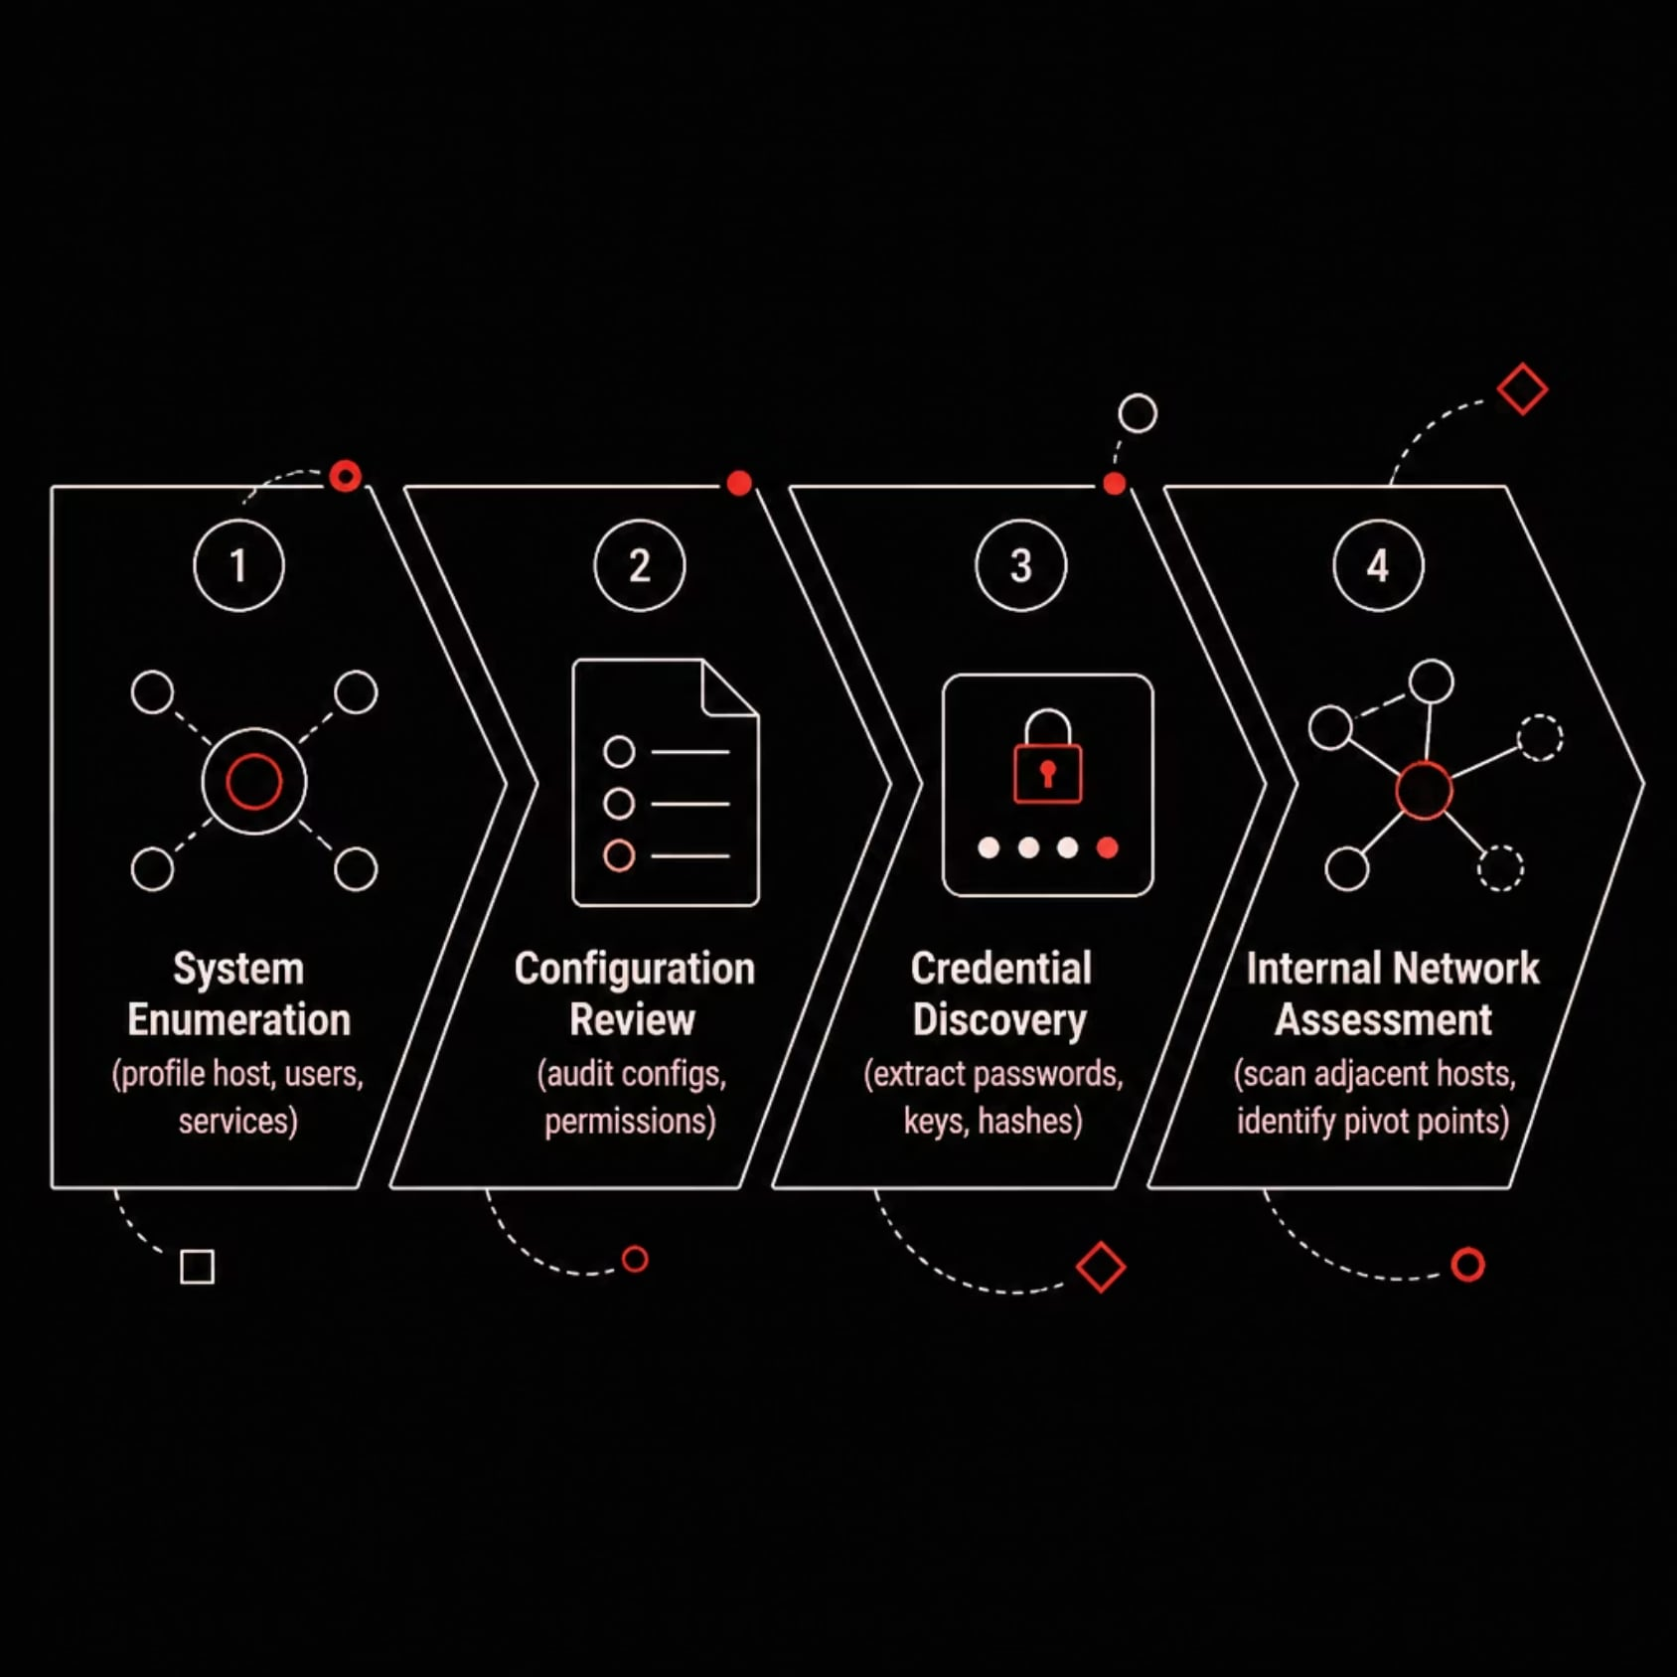
PHASE : 06
Activities Performed
System Enumeration
Configuration Review
Enumerated OS version, users, groups, installed software, and running services to profile the host.
Audited system and application configs for weak permissions, debug modes, and exposed settings.
Credential Discovery
Internal Network Assessment
Searched for plaintext passwords, hashed credentials, SSH keys, and database connection strings.
Scanned adjacent hosts and pivot points to evaluate lateral movement potential.

Slide 26
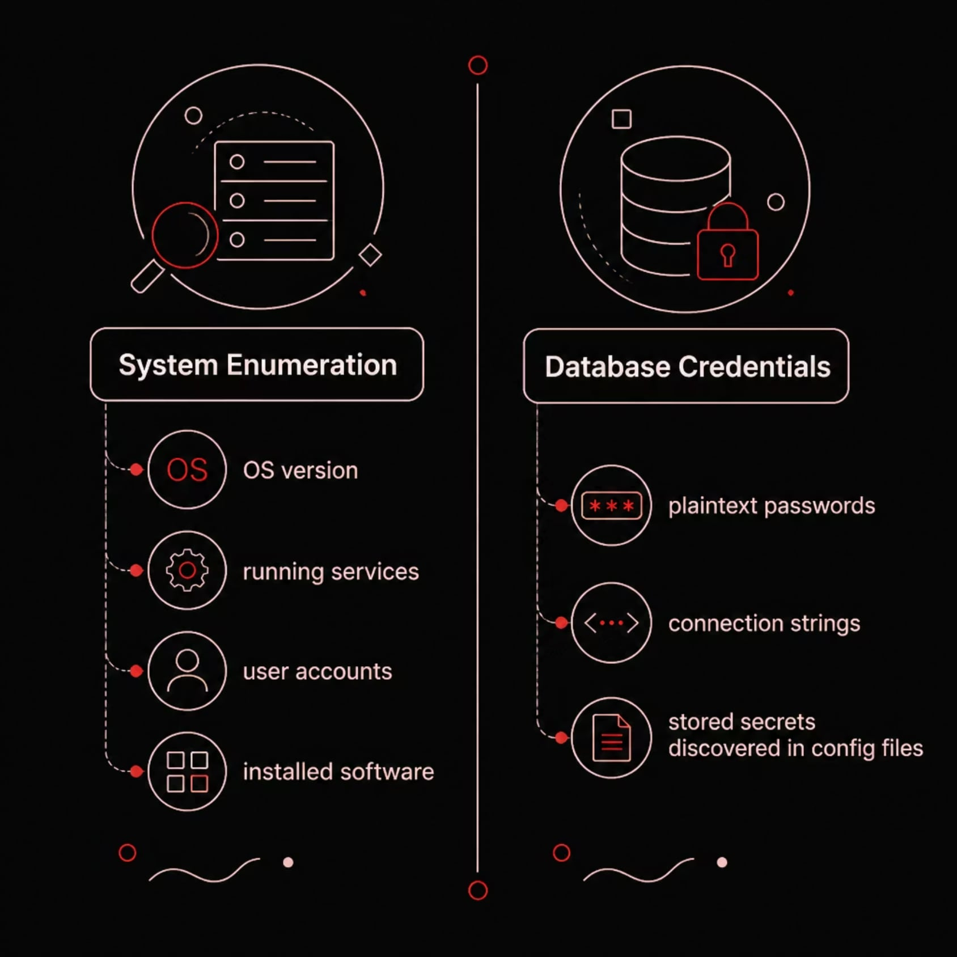
PHASE 06 : EVIDENCE
Key Findings
System Enumeration
Host profiling revealed OS details, active services, and user accounts confirming the scope of accessible resources post compromise.
Credential Exposure: Database credentials were discovered in plaintext within configuration files a critical finding enabling full data tier access.

Slide 27
LAB REPORT
Phase 07 : Persistence
Persistence techniques were demonstrated to understand how attackers maintain long term access after initial compromise and what defenders must detect to prevent it.
Demonstrate Persistence
Understand Long-Term Access
Evaluate Detection
Show real world techniques used to survive reboots and session loss.
Evaluate how adversaries establish durable footholds inside a network.
Assess whether existing monitoring and alerting would catch these techniques.

Slide 28
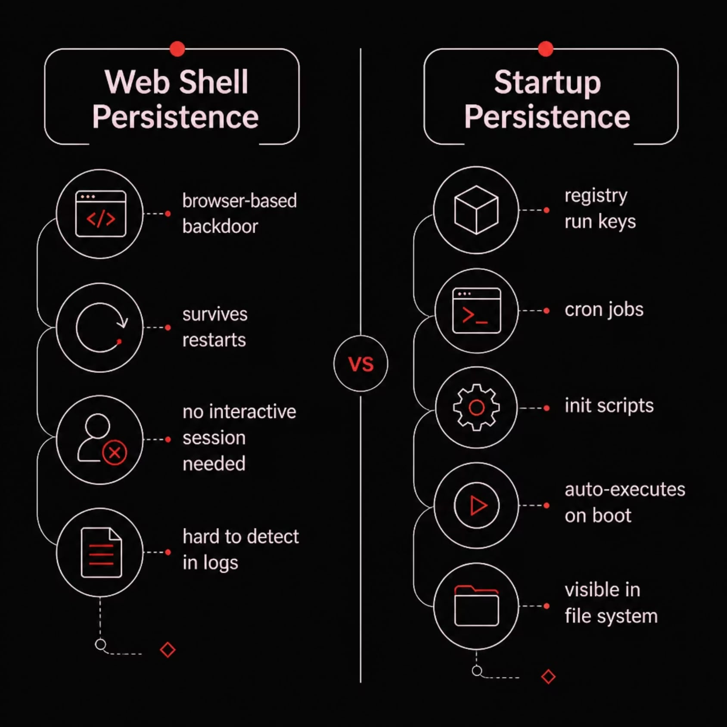
PHASE : 07
Techniques Demonstrated
1
2
Web Shell Persistence
Startup Persistence Concepts
A web accessible backdoor was deployed, allowing command execution through the browser surviving service restarts and requiring no interactive session.
Techniques such as registry run keys, cron jobs, and init scripts were reviewed to demonstrate how malware auto executes on system boot.

Slide 29
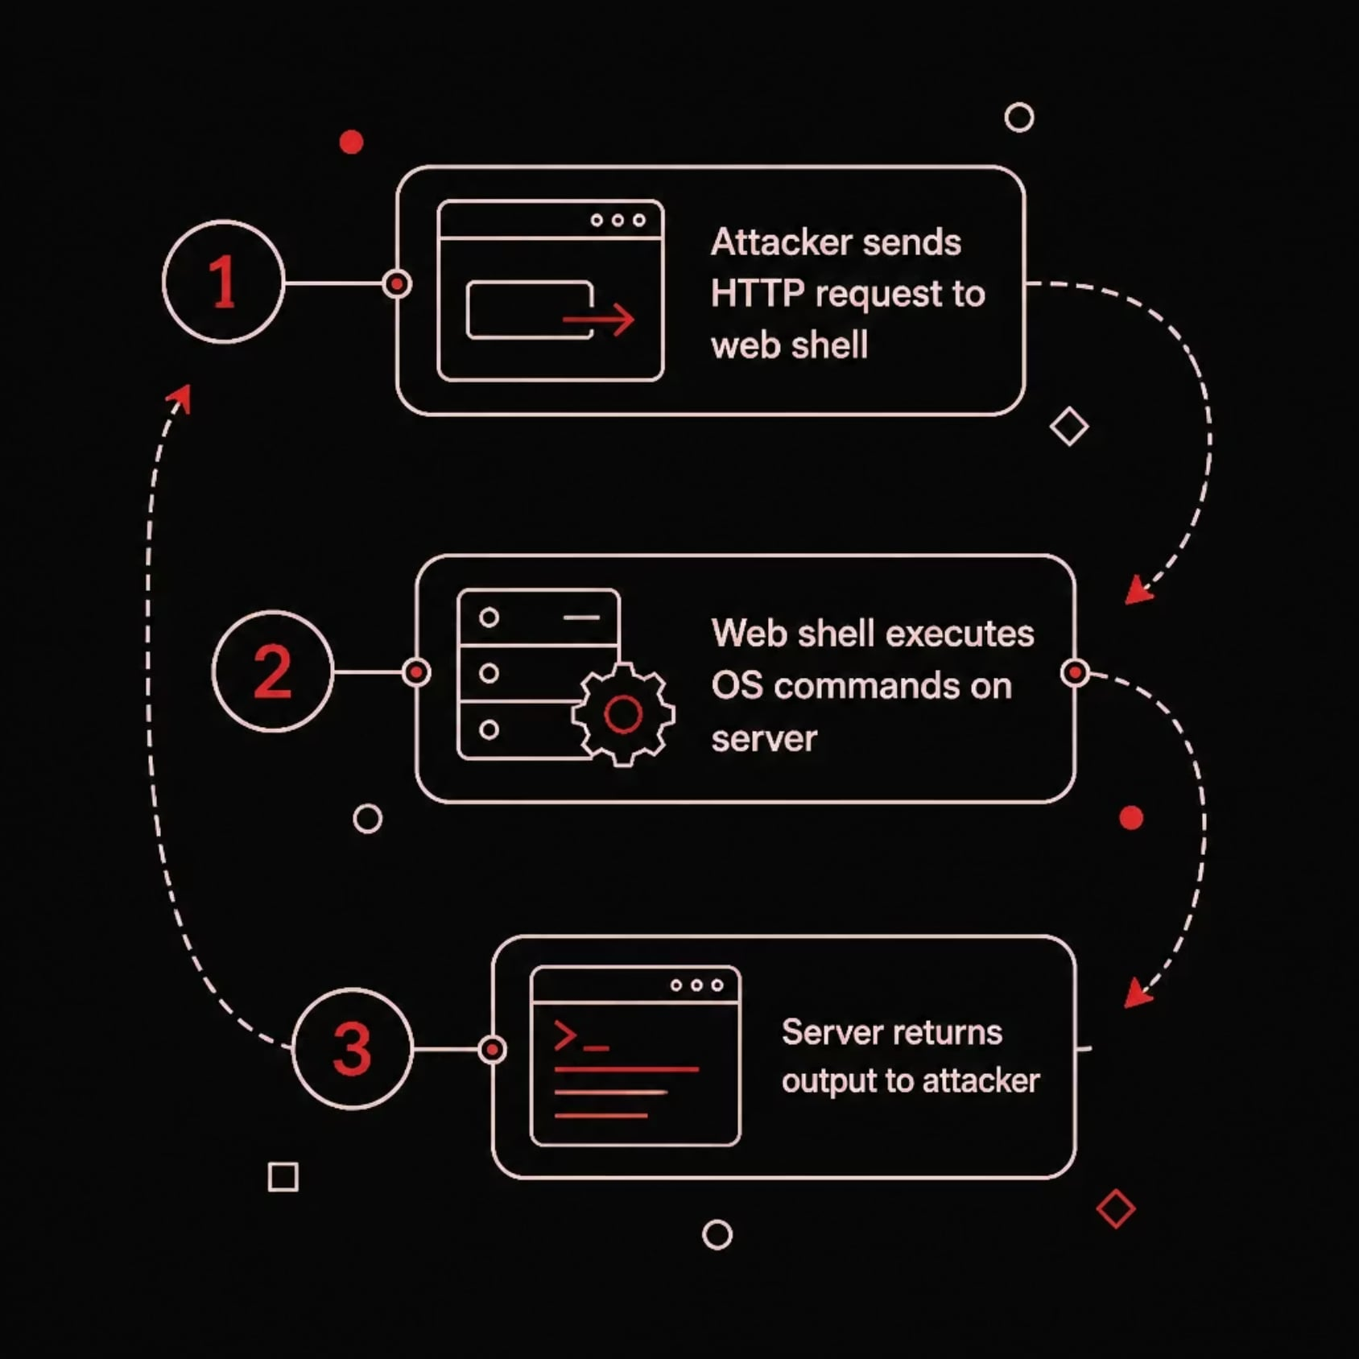
PHASE 07 : EVIDENCE
Web Shell in Action
What Was Observed
A web shell was successfully deployed and executed commands on the compromised host demonstrating how an attacker can operate remotely without a persistent interactive session.
Commands executed via HTTP/HTTPS
File upload and download capability
Session survives web service restarts

Slide 30
PHASE 07 : DEFENSE
Security Considerations
File Integrity Monitoring
Continuous Monitoring
Alert on unauthorized changes to web directories, startup scripts, and system binaries.
Deploy EDR and network monitoring to detect anomalous process and connection behavior.
Log Analysis
Configuration Auditing
Centralize and review web server, authentication, and system logs for indicators of persistence.
Regularly audit startup items, scheduled tasks, and service configs for unauthorized entries.

Slide 31
LAB REPORT
Phase 08 : Defense
The laboratory shifted from offensive operations to implementing multiple defensive security layers hardening the environment and validating detection capabilities.
🔒 Security Hardening
🛡️ Layered Defense
📋 Compliance Validation
Close attack surface through configuration changes, patching, and access control improvements.
Implement defense in depth across network, host, application, and data layers.
Verify controls meet regulatory and policy requirements through structured testing.

Slide 32
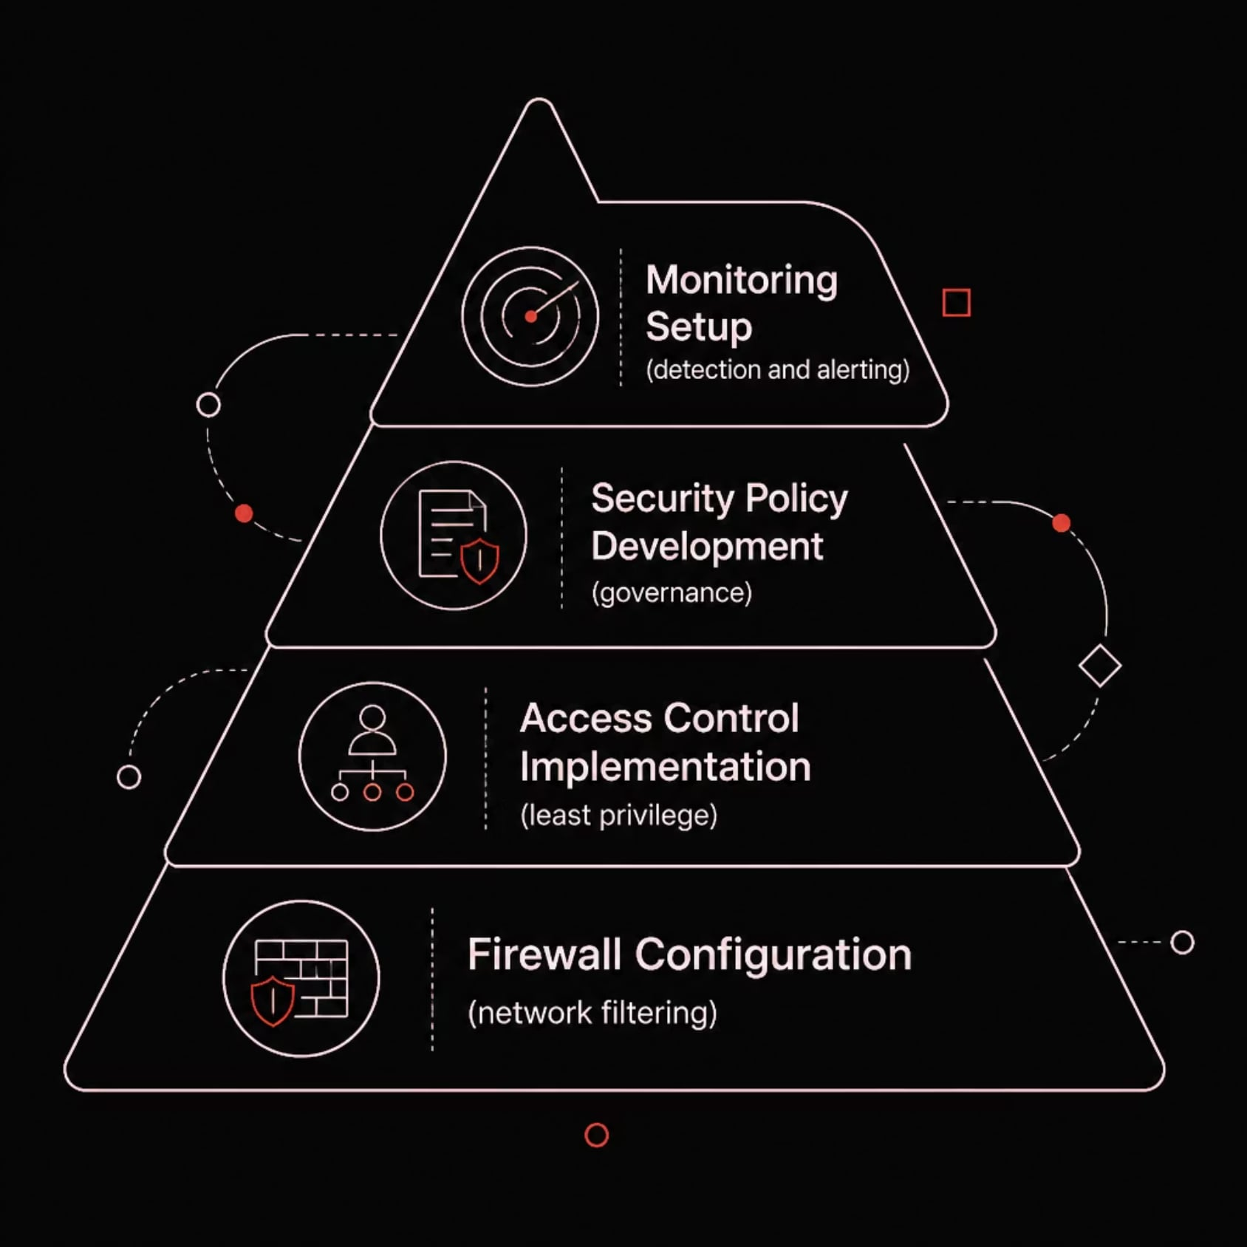
PHASE : 08
Defensive Activities
Firewall Configuration
Access Control Implementation
Restricted inbound and outbound traffic to only necessary ports and services.
Enforced least-privilege principles across users, services, and applications.
Security Policy Development
Monitoring Setup
Established formal policies governing authentication, logging, and incident response.
Deployed logging and alerting to detect future intrusion attempts.

Slide 33
PHASE : 09
Detection & Monitoring
Blue Team Visibility
The blue team validated defensive controls by monitoring network traffic, authentication events, and service logs to detect and analyze adversarial activity in near real time.
Wireshark
Apache Logs
Live packet capture and protocol analysis to detect anomalous traffic patterns.
Web server access logs reviewed for exploit attempts and reconnaissance activity.
Fail2Ban Logs
Auth Logs
Brute-forceautomated mitigation events tracked to validate blocking rules.
Authentication records analyzed to identify failed login patterns and lateral movement.
Zero Trace Imperium
32

Slide 34
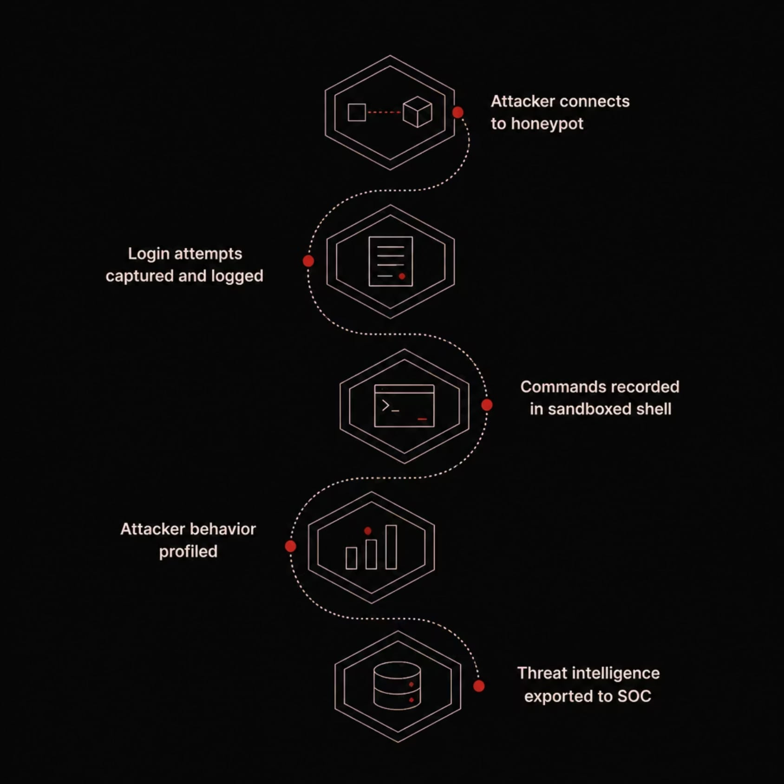
PHASE : 10
Cowrie Honeypot
Threat Intelligence Collection
Objectives
Capture brute-force login attempts
Record attacker-executed commands
Observe real world attacker behavior
Collect actionable threat intelligence
Benefits
Threat Visibility : early warning of active adversary TTPs
Security Awareness : informs detection rule development
Incident Analysis : supports forensic investigation and reporting
Zero Trace Imperium
33

Slide 35
PHASE : 11
Verification
After implementing all defensive controls, the laboratory was reassessed to verify that the identified weaknesses had been successfully mitigated confirming the effectiveness of the hardening measures applied throughout the assessment.

Slide 36
Verification Activities
Five targeted testing activities validated each defensive control against the original attack vectors.
Network Scanning
Firewall Validation
Brute Force Protection
Rescanned the environment to confirm reduced exposure and closed ports.
Verified rule enforcement and confirmed unauthorized access attempts were blocked.
Tested rate limiting and account lockout mechanisms against credential attacks.
WAF Testing
Service Availability
Simulated web based attacks to confirm the WAF detected and blocked malicious traffic.
Confirmed all hardened services remained stable and operational post mitigation.

Slide 37
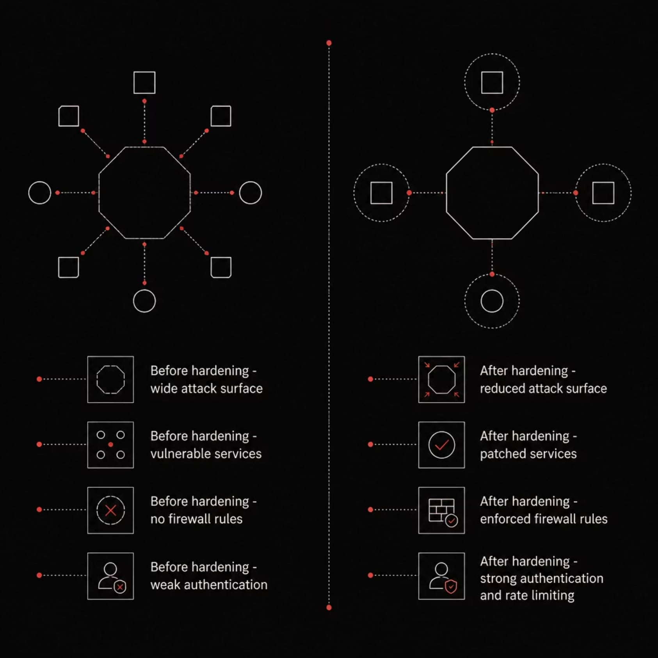
Verification Results
Reduced Attack Surface
Successful Mitigation
Unnecessary services were disabled and ports closed, significantly limiting the exploitable footprint.
All previously identified vulnerabilities were confirmed remediated through retesting.
Improved Security Posture
Stable Infrastructure
Defense in depth controls raised the overall resilience of the lab environment.
Hardening was applied without introducing service disruptions or configuration regressions.

Slide 38
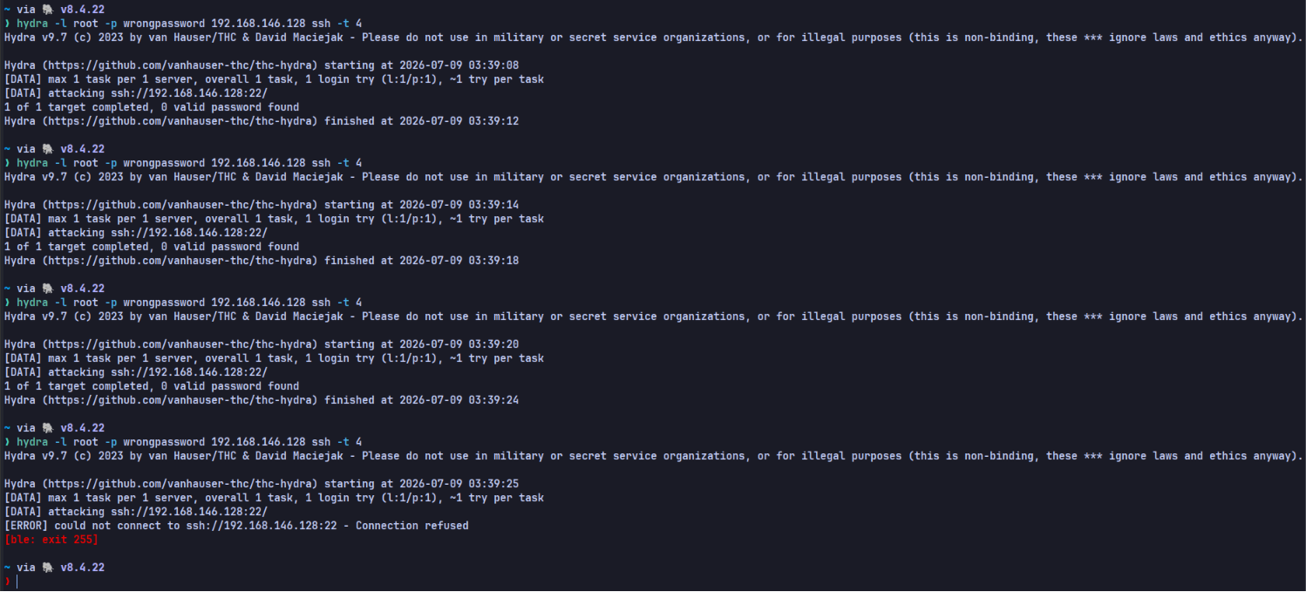
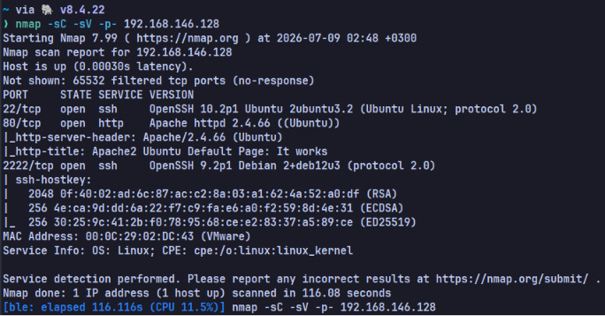
Verification Evidence
Side by side evidence demonstrates the measurable impact of hardening on the lab environment.
Security Verification
Nmap After Hardening
Post hardening validation confirming mitigations are active and effective across the lab.
Comparative scan results showing closed ports, filtered services, and reduced exposure.

Slide 39
PHASE : 12
Cleanup & Recovery
After completing all assessment activities, the laboratory was systematically restored to a clean, stable, and reusable state ensuring repeatability for future testing cycles.

Slide 40
Cleanup Tasks
A structured five step process ensured no residual artifacts remained in the lab environment.
01
02
03
Remove Test Files
Remove Temporary Artifacts
Restore Original Configurations
Deleted all payloads, scripts, and temporary files created during testing.
Cleared logs, caches, and transient data from attack and defense activities.
Reverted configuration changes to baseline settings for a clean starting state.
04
05
Restart Services
Verify System Health
Gracefully restarted all services to apply restored configurations cleanly.
Confirmed all systems were operational, stable, and ready for redeployment.

Slide 41
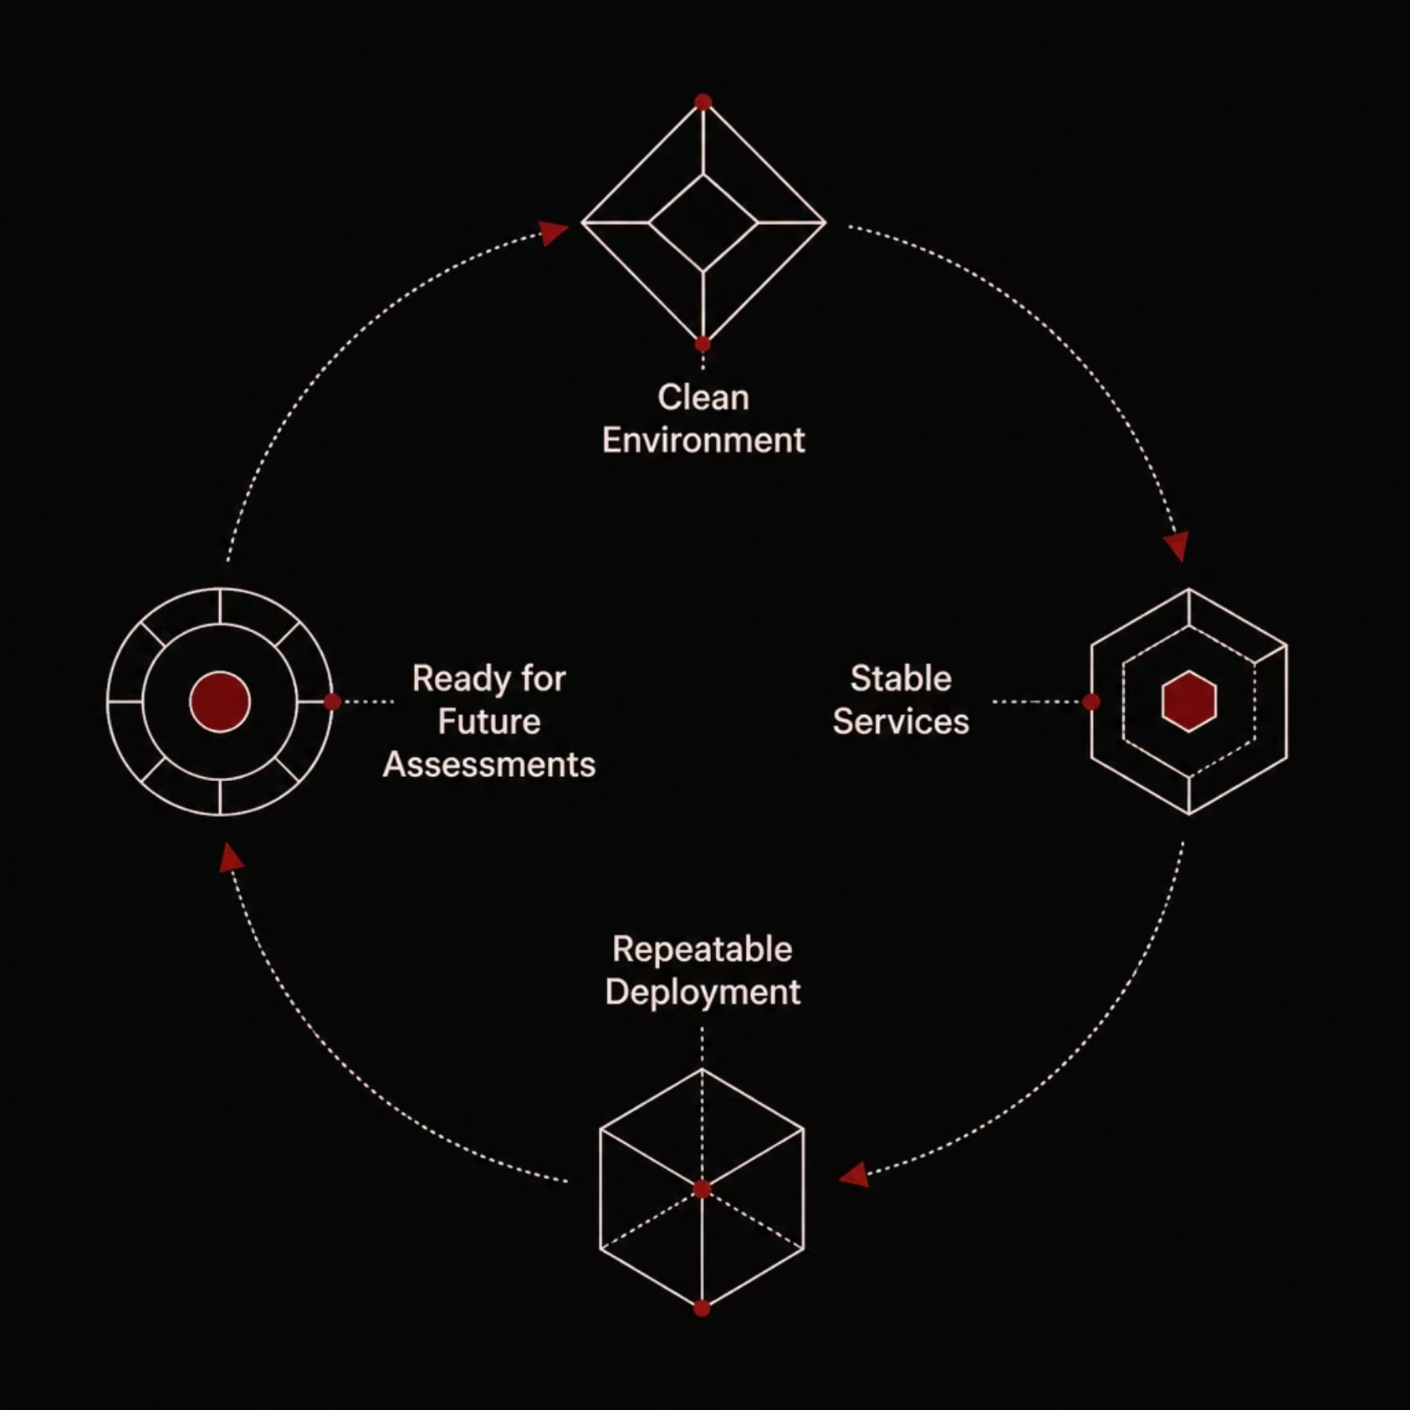
Cleanup Outcome
Clean Environment
Stable Services
No residual artifacts, test files, or modified configurations remain.
All services validated as healthy and running expected baselines.
Repeatable Deployment
Ready for Future Assessments
Lab can be redeployed identically for future assessment cycles.
Environment is fully prepared for the next round of testing.

Slide 42


Cleanup Evidence
Final screenshots confirm the lab was fully restored to a clean and operational baseline state.
System Cleanup
Service Verification
Verification that all test artifacts were removed and system state was restored to baseline.
Confirmation that all services restarted successfully and are operating within expected parameters.

Slide 43
FINAL RESULTS
Project Outcomes
Zero Trace Imperium
Successfully demonstrated a complete enterprise inspired attack and defense lifecycle inside a controlled VMware laboratory from initial reconnaissance through hardening, verification, and recovery.
2
12
8
Assessment Phases
Project Phases
Deliverables
Attack and defense phases fully executed and documented.
End to end lifecycle from setup through cleanup.
Artifacts produced across documentation, tooling, and evidence.

Slide 44
Deliverables
Eight professional artifacts document the full assessment lifecycle and support future reuse.
Enterprise Cybersecurity Laboratory
Professional GitHub Repository
Vmware based lab replicating enterprise architecture for attack/defense testing.
Version controlled code, scripts, and documentation for public reference.
Technical Documentation & Reports
Configuration Repository
Assessment reports, configuration guides, and methodology documentation.
Hardened configurations and baseline templates for repeatable deployment.
Automation Scripts
Network Diagrams & Evidence
Scripts automating setup, testing, and recovery tasks across the lab.
Topology maps and security evidence supporting all findings and conclusions.

Slide 45
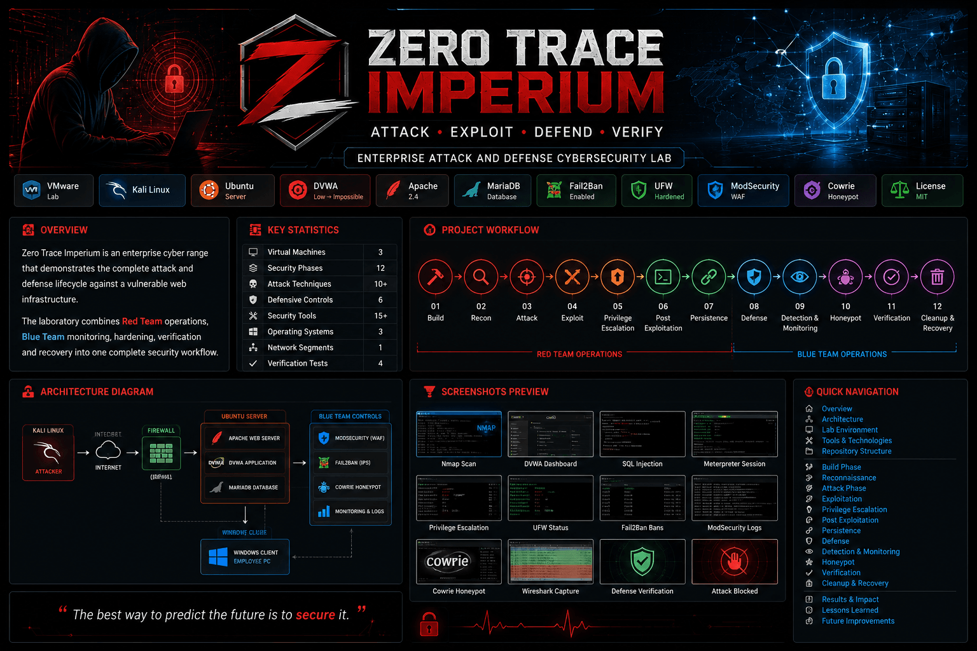

Slide 46
END
THANK YOU
Questions?
Zero Trace Team
Zero Trace Imperium
45

