Slide 1
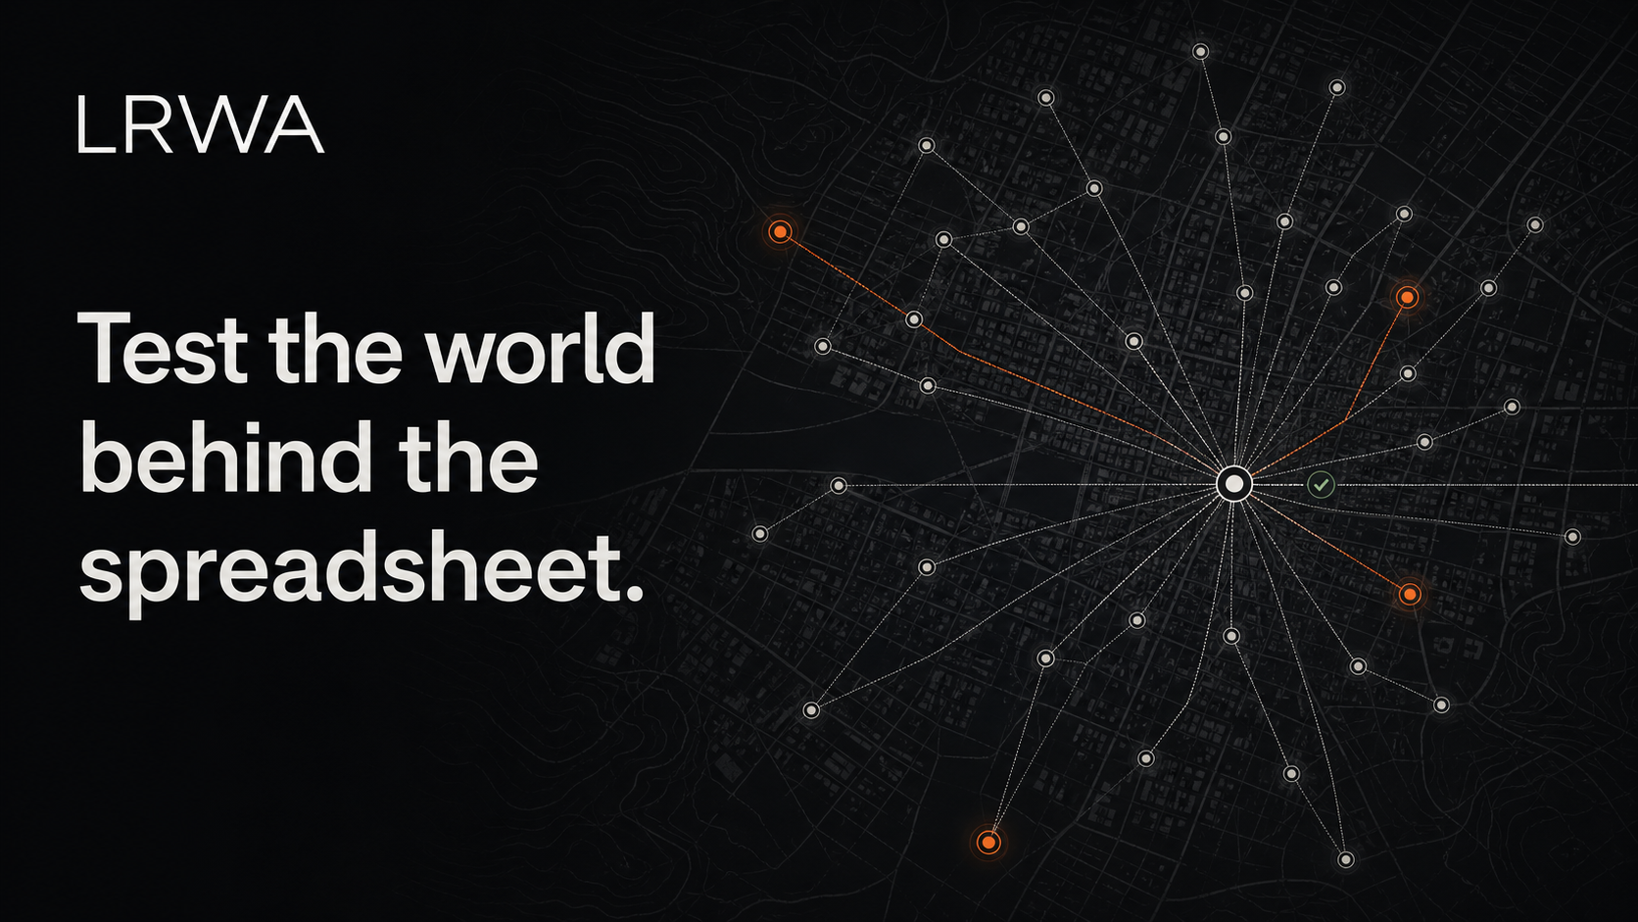
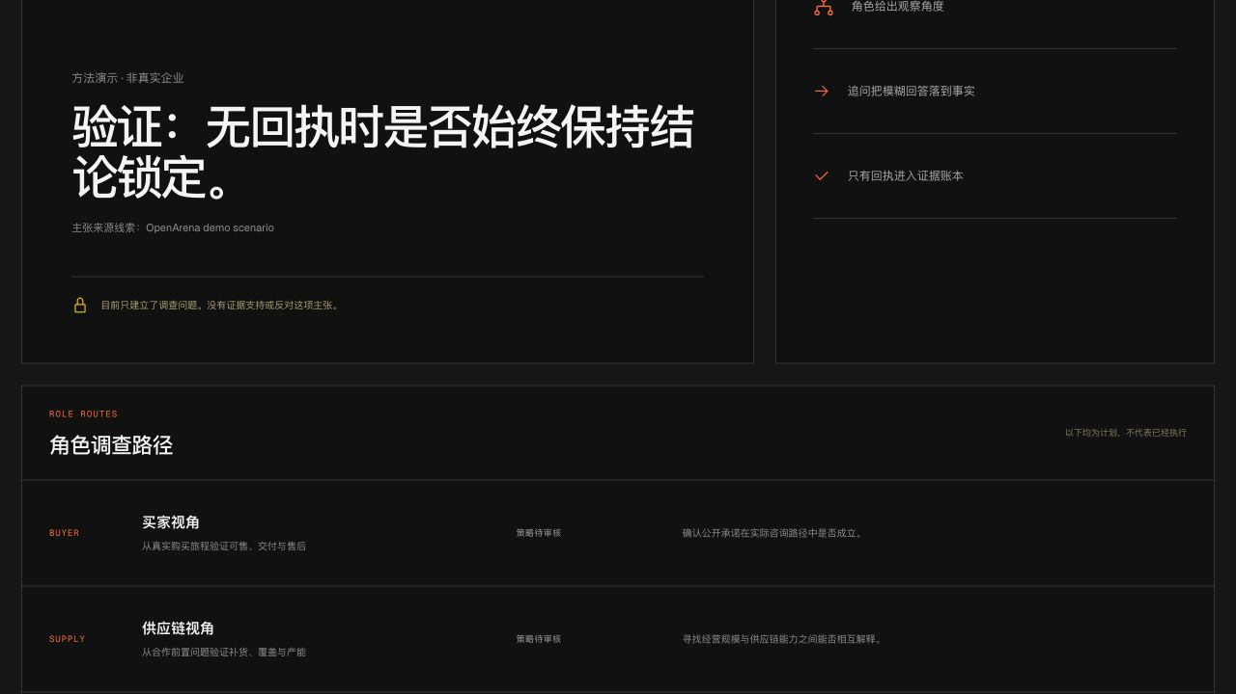
LIVE REAL-WORLD ASSURANCE
LRWA
Evidence before answers.
No receipt, no conclusion.
Four roles. Exact receipts. Human review.
SEED | OPENARENA | PUBLIC DEMO
Founder and financing details shared in private diligence.
Notes:
LRWA starts from a narrow rule: an AI plan is not evidence. The product turns one material commercial claim into four bounded role missions, then keeps preparation, external contact, receipts, integrity, and review as separate states.
[Sources]
- Current product: lrwa-agent-web source repository.
- Current evidence API: lrwa-agent/src/evidence-operations.
- User-provided LRWA brand asset: favicon.svg.
- Founder and financing details intentionally omitted from this public deck.

Slide 2
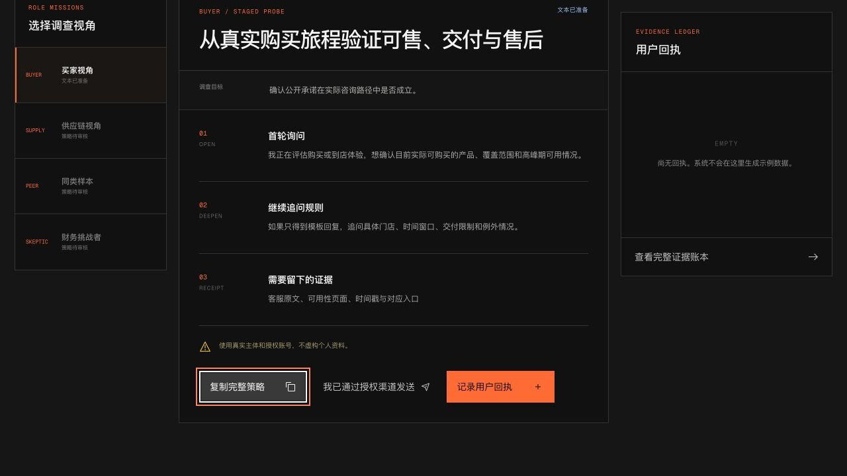
THE DECISION GAP
02 / 08
The data room is the claim.
It is not the proof.
DECISION TEAMS STILL RECONCILE
01
Financial statements
02
Expert calls
AI can test internal consistency. It cannot turn a supplied narrative into independent evidence.
03
Public data
04
Authorized field contact
05
Manual reconciliation
THE UNRESOLVED QUESTION
Which claim still lacks an inspectable receipt?
LRWA / LIVE REAL-WORLD ASSURANCE
PUBLIC DEMO DECK
Notes:
Financial statements and supplied documents can be checked for consistency, but they are not independent proof of real-world operations. LRWA is designed to make the missing external receipt visible instead of filling that gap with generated prose.
[Sources]
- Problem framing: outputs/PITCH_DECK_OUTLINE.md.
- No market-size, time-saved, customer, or traction statistic is asserted.
- User-provided LRWA brand asset: favicon.svg.

Slide 3
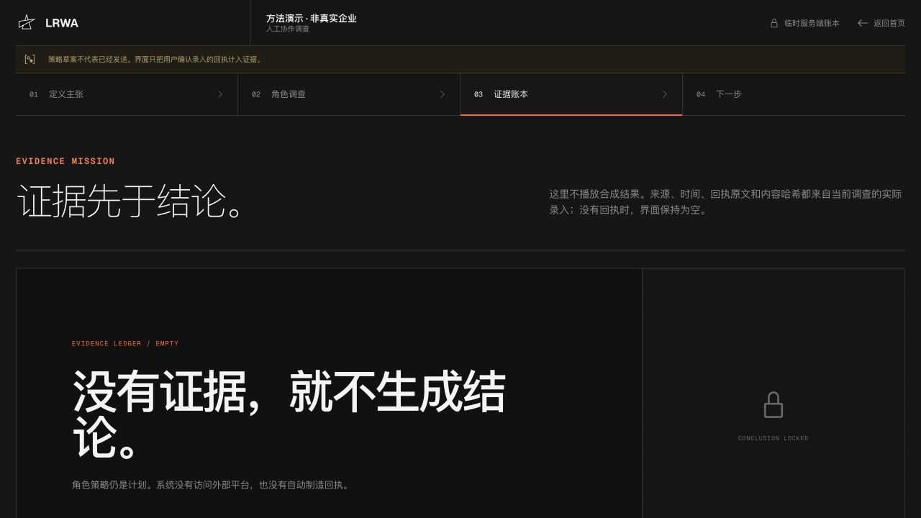
WORKING PRODUCT
03 / 08
One claim becomes a verification mission.
CURRENT PROTOTYPE · CONNECTORS OFF
01 CLAIM → ROLE PLAN
02 PREPARED ≠ SENT
03 EMPTY GATE STAYS LOCKED
CLAIM → PLAN → PREPARE → CONFIRM → RECEIPT → REVIEW
CURRENT STATE
GATE
PLAN
LOCKED
A staged evidence workflow, not a generated report.
DRAFT QUESTIONS
UNLOCK CONDITION
No receipt yet
User-submitted receipt
No claim confirmed
No metric inferred
Server hash + review
before any conclusion
DISPLAYED STATE: PREPARED, NOT SENT
EVIDENCE ROOM: EMPTY / CONCLUSION LOCKED
LRWA / LIVE REAL-WORLD ASSURANCE
PUBLIC DEMO DECK
Notes:
The shipped prototype demonstrates only truthful state transitions. A claim receives four role strategies. Copying a strategy marks it prepared, not sent. A user must confirm an authorized external contact, and only a user-submitted receipt enters the evidence room. With no receipt, the conclusion remains locked.
[Sources]
- Screenshots: lrwa-agent-video/public/screens/evidence-plan.jpg, evidence-workbench.jpg, evidence-gate.jpg.
- Frontend state model: lrwa-agent-web/lib/investigation.ts.
- No external Meituan or Google connector is represented as configured.
- User-provided LRWA brand asset: favicon.svg.

Slide 4
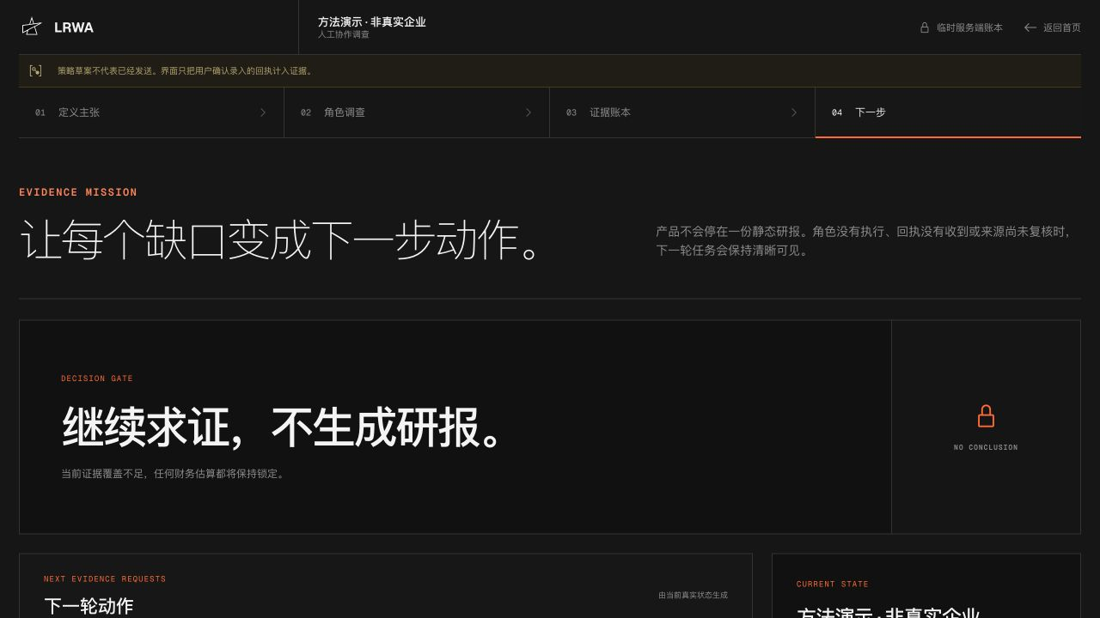
SYSTEM + MOAT
04 / 08
The moat is the truth-state loop, not the model.
AI may draft questions. Only user-confirmed contact and submitted receipts can move a claim toward review.
CLAIM
PLAN
PREPARE
CONTACT
Bound
Draft
Stage
Confirm
NEXT
REVIEW
HASH
RECEIPT
Request
Inspect
Seal
Submit
THE HONEST TRANSITION
FOUR BOUNDED ROLE ROUTES
Copying a strategy only marks it prepared. The user must confirm a real authorized contact.
BUYER
SUPPLIER
PEER / COMPETITOR
SKEPTIC
A submitted receipt receives a server-side SHA-256 hash; empty evidence keeps the gate locked.
MISSINGNESS AS SIGNAL
LRWA / LIVE REAL-WORLD ASSURANCE
PUBLIC DEMO DECK
Notes:
DeepSeek is optional and may draft role questions only when the user opts in. It cannot create evidence or claim that contact happened. The API records user-confirmed contact and hashes submitted receipt content with SHA-256. Evidence absence is preserved as a decision state.
[Sources]
- Evidence operations implementation: lrwa-agent/src/evidence-operations.
- Screenshot: lrwa-agent-video/public/screens/evidence-actions.jpg.
- Current storage is volatile in-memory and is not presented as production durability.
- User-provided LRWA brand asset: favicon.svg.

Slide 5
INITIAL WEDGE
05 / 08
Start where one contradiction can change a deal.
Investment and commercial diligence for offline and omnichannel businesses.
01
Target: design-partner fund
One material operating claim
02
Target: authorized mission
Paid, scoped verification target
03
Target: team workflow
Reusable questions and evidence history
04
Target: mission library
Calibrated claim-to-signal mappings
THE WEDGE IS A DECISION WORKFLOW
VC access is the first distribution channel.
LRWA / LIVE REAL-WORLD ASSURANCE
PUBLIC DEMO DECK
Notes:
The first commercial wedge is one material claim in one investment or commercial-diligence decision. The design-partner fund, paid mission, repeatable workflow, and vertical library are go-to-market targets, not current traction.
[Sources]
- Wedge and milestone labels: outputs/PITCH_DECK_OUTLINE.md.
- Screenshot: lrwa-agent-video/public/screens/evidence-actions.jpg.
- No customer, revenue, or renewal claim is asserted.
- User-provided LRWA brand asset: favicon.svg.

Slide 6
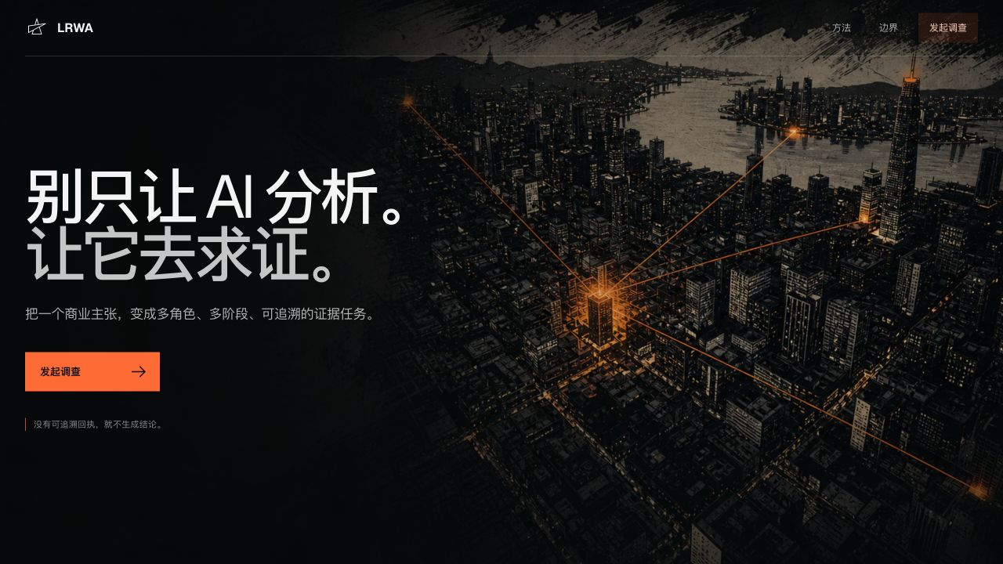
CATEGORY POSITION
06 / 08
A verification mission is a new unit of work.
LRWA does not replace financial diligence, expert networks, or data platforms. It connects a material claim to the next decision.
WHY NOW
UNIT OF WORK
01
AI can draft multi-stage role strategies
DATA-ROOM TOOLS
Document
02
Claims can be mapped to inspectable receipts
RESEARCH AGENTS
Report
03
Buyers need permission, provenance, and missingness
DATA PLATFORMS
Dataset
LRWA
Verification mission
POSITIONING HYPOTHESIS
The category is commercial verification infrastructure.
LRWA / LIVE REAL-WORLD ASSURANCE
PUBLIC DEMO DECK
Notes:
Most research products return a document, report, interview, or dataset. LRWA's positioning hypothesis is a verification mission: a claim, bounded roles, explicit action states, inspectable receipts, integrity metadata, and a human decision gate.
[Sources]
- Category framing: outputs/PITCH_DECK_OUTLINE.md.
- Current LRWA workflow: lrwa-agent and lrwa-agent-web source repositories.
- This is a positioning hypothesis, not an exclusivity or market-share claim.
- User-provided LRWA brand asset: favicon.svg.

Slide 7
BUSINESS MODEL
07 / 08
One mission engine expands across decision surfaces.
Institutional verification is the wedge. Merchant and self-service questions come later.
01
02
03
04
PAID MISSION
TEAM SUBSCRIPTION
INTEGRATIONS
LOCATION DECISIONS
One claim
One scoped plan
Reusable missions
Evidence history
Licensed sources
Authorized connectors
Merchant location
Market questions
SAME MISSION ENGINE
Commercial diligence → Supplier + channel checks → Merchant decisions
Pricing remains a hypothesis until validated in buying processes.
WHERE SHOULD I VERIFY NEXT?
LRWA / LIVE REAL-WORLD ASSURANCE
PUBLIC DEMO DECK
Notes:
Institutional diligence is the initial wedge. Team subscriptions, licensed sources, authorized connectors, and merchant location decisions are expansion hypotheses. The current prototype does not claim direct platform access.
[Sources]
- Expansion hypotheses: outputs/PITCH_DECK_OUTLINE.md.
- Screenshot: lrwa-agent-video/public/screens/evidence-home.jpg.
- No pricing, recurring revenue, platform partnership, or customer renewal claim is asserted.
- User-provided LRWA brand asset: favicon.svg.

Slide 8
PROOF PLAN + ASK
08 / 08
Prove one wedge before building the platform.
The next evidence must come from authorized real work, not a staged result.
WORKING DEMO
DESIGN PARTNER
PAID PILOT
REPEATABLE MISSION
COMPLETE
TARGET
TARGET
TARGET
WORKING TODAY
NEXT PROOF POINTS
• Running web + NestJS prototype
• Four role routes with staged states
• Manual receipt intake + SHA-256
• Empty evidence locks conclusions
• 3 design partners
• 1 paid authorized pilot
• Durable evidence store + authentication
• 1 licensed or customer-authorized connector
SEED ROUND
Terms and founder details shared privately
Help us test whether one verified contradiction changes a decision.
LRWA / LIVE REAL-WORLD ASSURANCE
PUBLIC DEMO DECK
Notes:
What exists today is a local web prototype, a NestJS evidence-operations API, four role routes, explicit prepared/contact/receipt states, manual receipt intake, server-side SHA-256 hashing, and a conclusion gate that stays locked when evidence is empty. Design partners, a paid authorized pilot, durable storage, authentication, and a licensed connector remain targets.
[Sources]
- Current implementation: lrwa-agent-web and lrwa-agent source repositories.
- Current proof plan: outputs/PITCH_DECK_OUTLINE.md.
- Future milestones are labeled targets and are not current traction.
- User-provided LRWA brand asset: favicon.svg.

