Slide 1
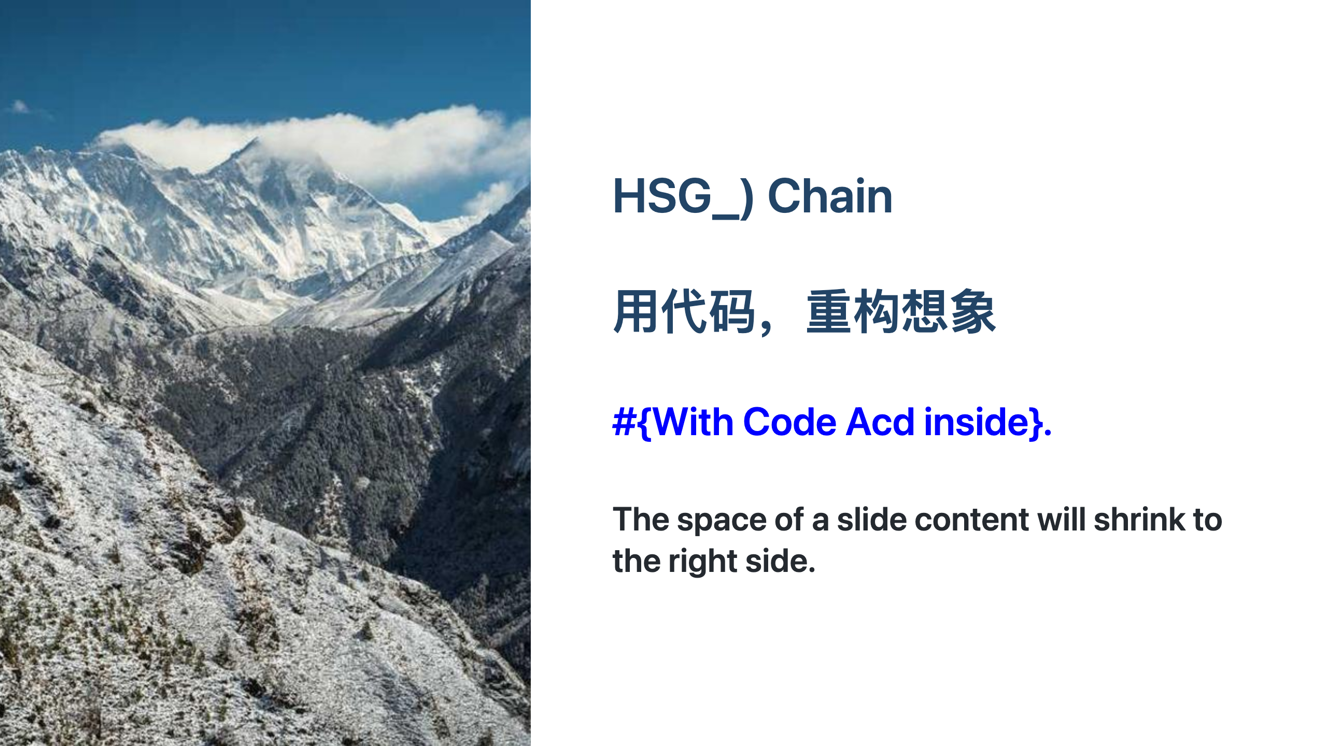
Notes:
Global style

