Slide 1
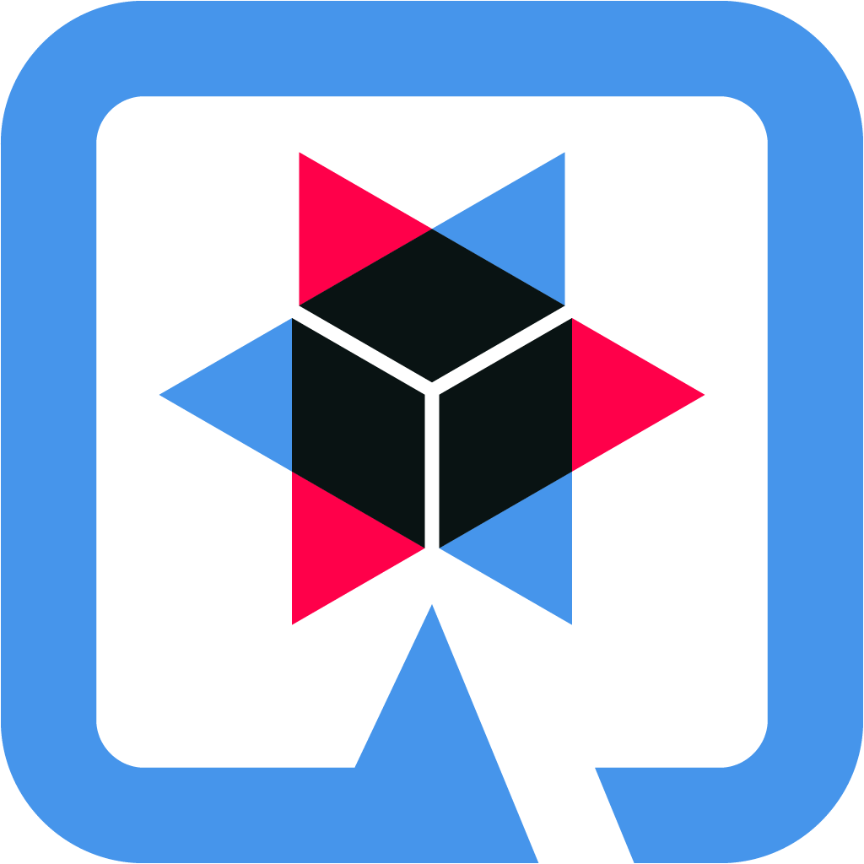


Quarkus :The Next Generation of Cloud Native Applications

Slide 2
1-Introduction
3-Architecture & GraalVM
Agenda
4-Demonstration
2-Context
5-Conclusion
2

Slide 3
Problem ?
3

Slide 4
Solution
3

