Slide 1
MOBILE CROWD SENSING
MULTI DISCIPLINARY DESIGN PRESENTATION
DOMAIN : Smart Communication Society (Mobile Crowd Sensing)
GUIDE : Mr. M. Arul Prakash
TEAM: Ankita Pal (RA1711003010611), Sri Mullapudi Roshitha (RA1711003010276)

Slide 2
Presentation Agenda
Introduction to MCS
MCS Architecture
MCS Applications
Problems in MCS
Security Analysis
Blockchain Implementation

Slide 3
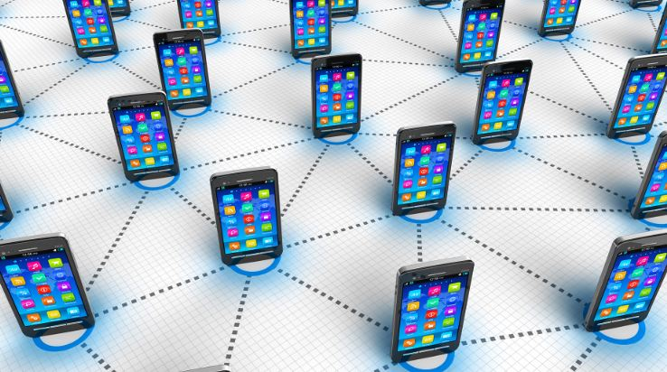

1
INTRODUCTION

Slide 4

Mobile devices have become an indispensable part of people’s lives.
Advances in communication technology such as 5G cellular networks, Wi-Fi and Bluetooth offer mobile devices direct connectivity to Internet to exchange data at high speeds any time and anywhere.

Slide 5




Mobiles equipped with abundant sensors and technologies
GPS
Bluetooth
Location
Connectivity
Camera
Voice Recorder
Photos and videos
Audio
Cameras, voice recorders, accelerometers, Bluetooth, GPS and other sensors and new technologies increase with each new release in the hands of the public and thus makes mobility easier.

Slide 6
What is Mobile Crowd Sourcing?
Mobile Crowd Sourcing (MCS) has emerged as a popular and effective method for data collection and data processing by utilizing the sensing, communication, and computing capabilities of these widely available mobile devices.

Slide 7



Combines concepts
Humans and machines
Outsourcing
Concepts of crowd sourcing and mobility are combined
It involves human intelligence called human-assisted MCS which is an effective method to perform tasks easier for humans
Allows outsourcing of a complex task that is usually difficult for a single computer or a group of specific people

Slide 8
Advantages of MCS over WSN
Why MCS better than traditional Wireless Sensor Networks
1
Saves cost
2
Wider coverage
3
Instant collection and flexible
4
Easily applied to big and temporary data

Slide 9
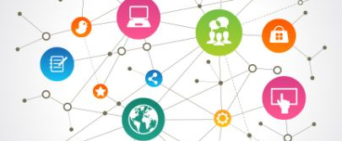
How does MCS work?
Success of MCS system depends on the effective transmission of data from mobile devices to destination nodes.
This task is made easier by the movement of large number of people with smartphones but complicated by the rapidly changing nature of networks, device connectivity and communication interfaces which challenge data transmission.

Slide 10
Special Characteristics of MCS
Network Heterogeneity
Unreliability
Mobility and Dynamic Technology
Data Massiveness
Diversity
Openness
While a few of the characteristics are an advantage to the MCS systems, the same may be the cause of a disadvantage such as openness relies on the mass participation of mobile devices and dynamic and mobile nature of workers make their management challenging.

Slide 11


2
ARCHITECTURE

Slide 12
Main components of MCS architecture
Service Provider (SP)
Provides a platform for crowd sourcing and can be any organization or corporation. Its main functions are accepting service requests from end users, collecting and processing of data from workers, and delivering final result back to the end users.
MCS Worker
These are mobile users participating in the crowd sourcing and are assigned tasks by the SP. They return the collected data by uploading computing results to the SP and act as a sensor.
End User(EU)
Request services offered by the MCS SP with a certain cost. These are individuals who lack the ability to perform certain computing or data collection work.

Slide 13
Categories of MCS Architecture
Based on type of server
Centralized Server
Distributed Server
Fully Distributed Server
MCS with centralized servers face issues like single point failure and attack on centralized server. Thus, with the emergence of fully distributed servers, both SPs and workers are served with mobile devices and in some scenarios the need of an SP is eliminated altogether.

Slide 14
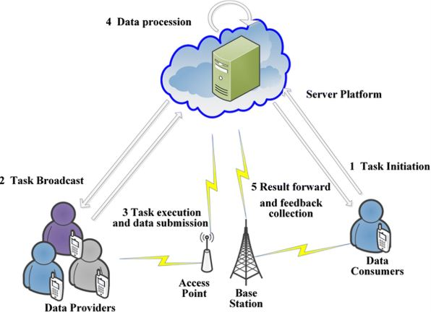
Architecture of MCS

Slide 15
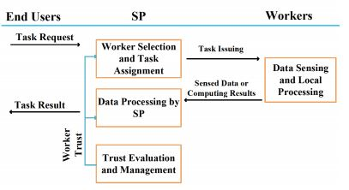
Procedure of MCS Activities

Slide 16

3
APPLICATIONS

Slide 17
Application Scenarios
Mobile Crowd Computing
Mobile crowd computing leverages spare computing power of mobile devices to complete a computing task. Nowadays, mobile devices are powerful in terms of computing capability and data transmission. Therefore, it is possible to outsource a computing task to mobile devices and collect their computing results via various networks.
Mobile Crowd Sourcing
Mobile crowd sensing is the most popular MCS system. It utilizes mobile devices as sensors to collect information about environments, infrastructures, and mobile users. It is widely applied in personal data collection, e.g., personal health data, and in environment monitoring, e.g., noise, weather and pollution.
Human Assisted Crowd Sourcing
Human-assisted crowdsourcing aims to utilize human intelligence to finish a certain task. A typical example is image annotation, in which mobile users help finish a labeling and classification task. It could well solve a problem that remains challenging for computers.

Slide 18
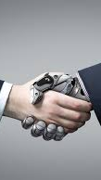
Mobile Crowd Sensing Computing (MCSC) A new application scenario
It is a new paradigm that combines data purposefully collected by the public through social media.
It broadens the concept of participatory sensing, by connecting human and machine intelligence in both the sensing and computing stages.

Slide 19



For Example…
Social Media
Visitor data services now combine information from tagged photos and conversations about points of interest on location-based social networks with traffic flow data supplied through taxi GPS systems.
Destinations
such as restaurants and stores are identified by ratings, travel distances, and time of day.
19

Slide 20
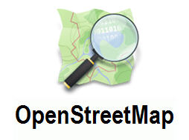
Open Street Map (OSM)
Example of volunteered geographical information
It is an international non-profit organization with the goal of collecting data for free and editable maps. Its diverse community of volunteers consisting of professionals and to engineers produce detailed maps.

Slide 21

Wikimapia
Goal of geo-referencing locations on world map
Gather and organize specialized local content like street addresses, photos and Wikipedia links for community projects and planning. Both of the platforms have become very valuable tools in crisis management.

Slide 22

Mapillary
Creates montages of street-level photographs
Allows the government and other organizations to gain valuable real time information when rapidly updated visual data is needed.

Slide 23

MISSING MAPS
Aims to map most vulnerable places in the developing world
Both OSM and Mapillary are partners in the Missing Maps Project. Humanitarian organizations use mapped information to plan risk reduction and disaster response activities to save lives.

Slide 24

CITIZEN SCIENCE

Slide 25

The GLOBE Program
International Educational Initiative
It is a part of a crowdsourcing movement where volunteers from around the world collect and contribute data for professional research. Students contribute data and participate in scientific processes with researchers on a variety of environmental issues.

Slide 26





Globe State
Countries
116
Teachers
23,825
Schools
28,825
Students
714,750
Measurements
132,601,295
Notes:
no slide master

Slide 27

iNaturalist
Species Identification System
Volunteers collect biodiversity data like photographs and recordings. They then share them on social networks with like minded communities.

Slide 28

RinkWatch
Monitors climate change at a micro level
RinkWatch is a project that Wilfred Laurier University initiated. People with backyard rinks share skate ability ratings with researchers to compare the number of skating days from rinks around the world.

Slide 29

Siftr
Social photography app for education
Similar to Instragam, it is designed as a collective tool for community-based education. It encourages user-groups like classes to go outside and examine their neighborhoods and local surroundings. Students can take pictures and invite comment and join in the conversation.

Slide 30


4
4
PROBLEMS

Slide 31

The biggest problem is PRIVACY.
People’s awareness and willingness to have information from their online social lives collected and enhanced by third parties in unimaginable ways is a growing issue.

Slide 32
Shortcomings of MCS
Privacy
Data Trust
Security
Data collected may contain sensitive information about mobile users. This gives the chance to attackers to infer user private information.
Users participating in MCS surveys may provide unreliable data.
Mobility increases the chances of attacks which further leads to serious security threats such as eavesdropping, tampered data uploading, etc.
Openness
Massiveness
Network Heterogeneity
MCS system has to rely on the mass participation of the mobile devices which may complicate the process.
Increases the difficulty of data and makes it hard to get accurate truth discovery result. So, result presented to the EU may be deviated from real values.
Trust evaluation on data becomes harder as data transmitted through different networks suffer different interferences.

Slide 33


5
SECURITY ANALYSIS

Slide 34
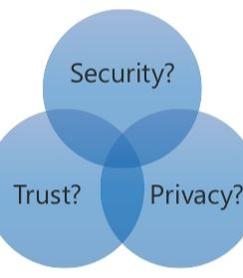
Concepts of Security, Privacy and Trust
Security means protecting collected data and MCS systems from unauthorized access, use, or disclosure and is able to resist attacks, protect the data and prevent the processed data to be leaked to unauthorized parties.
Security helps Privacy, but does not guarantee it.
Trust helps provide high quality services and attract users.

Slide 35

Security Threats
Messages transmitted in MCS could contain sensitive information about users and workers.
Most devices are still constrained in terms of computing and communication capabilities.
As an open system, it is inevitable to include malicious workers, which may destroy normal functioning of the system,
A common security threat is the outsourcing of a task to an unspecified or randomly generated group that makes the management of workers very difficult.

Slide 36
Potential Security Attacks
The unauthorized real-time interception of messages that should be transmitted confidentially
Eavesdropping
A malicious worker may launch multiple identities and then perform attacks, such as uploading false data to interfere the judgment of SP.
Sybill Attack
The free riding attack refers to that a worker receives a payment but devotes no effort to the completion of a task.
Free Riding Attack
A worker uploads outdated, tampered or even fake data to SP.
False data uploading
A malicious worker pretends to be another valid worker to upload false data or perform other misbehaviors.
Impersonation attack

Slide 37

6
BLOCKCHAIN IMPLEMENTATION

Slide 38

Bitcoin is a type of digital currency in which a record of transactions is maintained and new units of currency are generated by the solution of mathematical problems, and which operates independently of a central bank.

Slide 39


Why Blockchain
Smart Contract
Can be used to depict the process of crowdsourcing: requester posts a task with the task reward snd workers receive it by operating the contract.
Solutions provided
When the task is finished, workers give solutions to the requester in off-chain.
Blockchain Technology has provided a way to solve the biggest issue of privacy in MCS by the introduction of a new category of architecture of MCS- Blockchain based decentralized framework for Crowd Sourcing. This allows the user to finish a crowd sourcing process in logic plane and store their encrypted solutions in the data plane.

Slide 40
CrowdBC Architecture
Three Layer Architecture
Storage Layer
Consists of task data or solutions and metadata such as pointers, hash values, signatures, etc.
Blockchain Layer
Consists of the Miners, chain of blocks and Consensus Protocol, Network, and Transaction
Application Layer
Refers to the CrowdBC Client Layer which consists of the User Manager, Task Manager and Program Compiler

Slide 41
Crowdsourcing Process
Solution collection, reward assignment by efforts of the workers. Both can complete this step initiatively by publishing a transaction to the Blockchain.
Transactions are confirmed by miners. The data and status are recorded on the Blockchain permanently.
Registered workers receive the posted task by interacting with CrowdBC Client.
Step 6
Step 4
Step 2
Step 5
Step 3
Workers submit solutions before the task deadline. A hash value and pointer are stored on the Blockchain. The Requester can find the solutions by the pointer and decrypt them with his private key.
Step 1
Requesters pay reward in advance which are deposited on the Blockchain. The solution is evaluated by miners on the Blockchain instead of the requesters.
Requesters and workers register in CrowdBC, after which they are assigned with a public key pair by CrowdBC Client.

Slide 42






Security Analysis of CrowdBC
Security against attacks
No Trusted Third Party
No SPOF
Trustworthy Worker Selection
Pseudonymity
Fraud resilient

Slide 43


Challenges of CrowdBC
Challenge 2
Challenge 1
Ensuring fairness between requesters and workers under decentralized crowdsourcing system.
Performing large scale crowdsourcing process on Blockchain technology while limited data storage on block.

Slide 44
MCS Missions
Fast Globalization
Observing and collecting activities with mobile devices ranges from the personal to the scale of whole populations.
Customer Satisfaction
The increasingly connected world can provide new opportunities for community engagement and secure and active learning.
Free resources
Contributors and organizations share common expectations that apps and platforms must be free, open source, and not require special training.

Slide 45
Thank You!

