Slide 1
MIDNIGHT BUILDATHON · WAVE 2
CommonVeil
Confidential vulnerability exposure coordination on Midnight
PRIVATE
PROOF
Organizations can prove affected software exposure without publishing identity, complete inventory, or exact installed version.
Compact · Midnight Preprod · 1AM · Zero-knowledge proofs
Aje Oluwaseun Isaac · github.com/0xaje/CommonVeil

Slide 2
02
The disclosure problem
Vulnerability response needs credible evidence, but inventory disclosure creates new risk
Publish the inventory
Keep the claim private
Reveals products and versions that attackers can target
Coordinators cannot verify the affected release
Links a vulnerable system to an organization
Duplicate reports can distort aggregate response
Creates regulatory and commercial exposure
Trust moves off-chain with no enforceable proof
CommonVeil proves the private fact and publishes only the minimum accountable result.
CommonVeil · Midnight Buildathon
2/11

Slide 3
03
Why Midnight
Compact enforces the relationship between private inventory and public policy
1
2
3
4
Admission
Certification
Policy
Attestation
registerMember
certifyInventory
registerAffectedRelease
attest
Registrar admits an opaque Member credential.
Certifier commits private inventory before policy activation.
Registrar records an exact advisory release and activates policy.
Member proves the certified private release matches policy.
PRIVATE INPUTS
Secrets · salts · product · installed version
PUBLIC STATE
Opaque commitments · policy · nullifiers · accepted count
CommonVeil · Midnight Buildathon
3/11

Slide 4
04
Role-separated workflow
Selecting a workspace grants no authority; Compact verifies each role secret
Registrar
Admits credentials and publishes affected releases
CommonVeil
Compact contract
Certifier
Commits a salted inventory snapshot before policy activation
Public accountability
without public inventory
Member
Scans locally and proves affected exposure in private
Observer sees policy state, commitments, nullifiers and aggregate count
CommonVeil · Midnight Buildathon
4/11

Slide 5
05
Wave 2 progress
CommonVeil advanced from protocol proof to an operational multi-role product
01
Independent role workspaces
02
Recoverable private identities
Registrar, Certifier and Member sessions
Encrypted packages and downloaded-backup tests
03
Genuine host evidence
04
Full policy lifecycle
Package-manager scan with explicit provenance
Admission, certification and policy activation
05
Private final evaluation
06
Operational resilience
Affected proof path plus honest negative outcome
Blockfrost migration, retries and safe errors
CommonVeil · Midnight Buildathon
5/11

Slide 6
06
Engineering evidence
Real Compact execution, wallet approval and Preprod state transitions
4
3
2
0
Compact circuits
Operational roles
Separated evidence runs
Fabricated results
Compact compiler 0.31.1 generates the contract, keys and ZK-IR
1AM balances and submits operator-approved transactions on Midnight Preprod
Regression suites cover circuits, packages, providers, scanner logic and workflow state
Live-network claims remain separate from local automated verification
CommonVeil · Midnight Buildathon
6/11

Slide 7
07
Positive protocol reference
A controlled affected input exercised the complete path on Midnight Preprod
Deploy
00446828…af9c
FINALIZED
Admit Member
00ed9c01…f0ec
FINALIZED
Certify inventory
00162a6c…f66b
FINALIZED
Register 5.6.0
00ddf48a…58ea
FINALIZED
Register 5.6.1
00e7b17f…1887
FINALIZED
Private attest
009c158f…ad47
FINALIZED
Controlled 5.6.1 input demonstrated protocol behavior. It does not claim the test computer was exposed.
CommonVeil · Midnight Buildathon
7/11
Notes:
Source: https://github.com/0xaje/CommonVeil/blob/main/docs/evidence.md

Slide 8
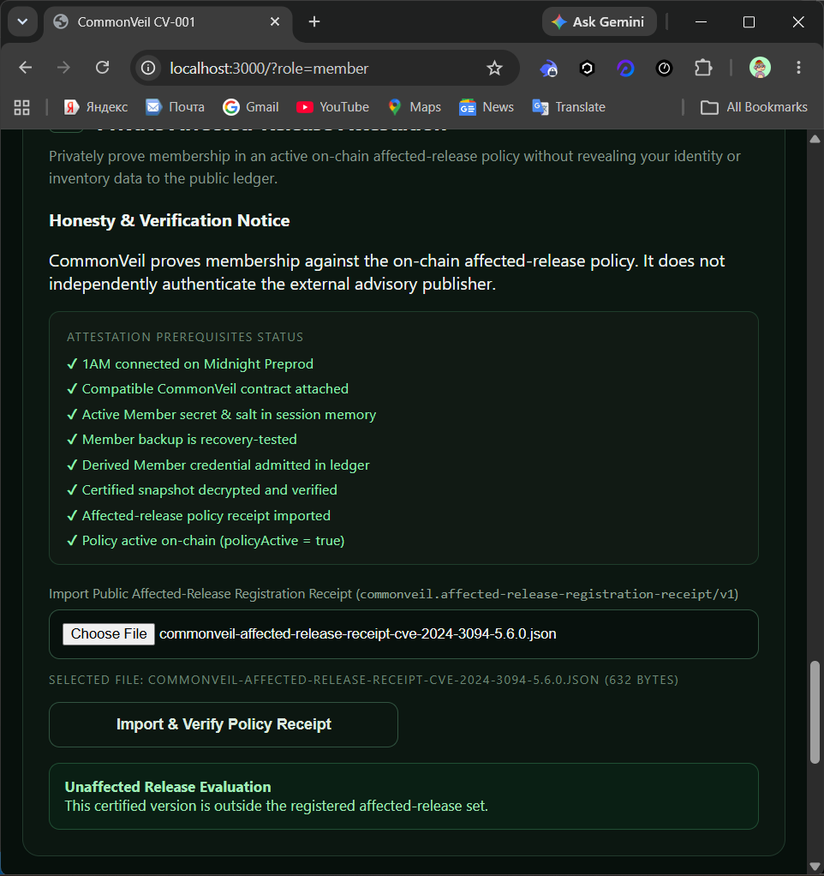
08
Genuine host result
CommonVeil preserved the measured value and blocked a false exposure claim
PROVENANCE
live-host-scan
OBSERVED
XZ Utils 5.2.5
REGISTERED POLICY
CVE-2024-3094 · 5.6.0
UN AFFECTED
No wallet approval. No attestation. No nullifier. No invented success.
CommonVeil · Midnight Buildathon
8/11
Notes:
Source: https://github.com/0xaje/CommonVeil/tree/main/docs/evidence/live-preprod-2026-10-14

Slide 9
09
Privacy and accountability
The protocol exposes enough state to verify outcomes without publishing inventory
Private or encrypted
Public on Midnight
Organizational identity and full inventory
Derived role keys and opaque credentials
Role secrets, Member salt and snapshot salt
Salted inventory and affected-release commitments
Product and installed version during attestation
Policy activation and advisory-scoped nullifiers
Backup passwords and encrypted package plaintext
Aggregate accepted count
Current scanner provenance is genuine package-manager evidence, not hardware-backed remote attestation.
CommonVeil · Midnight Buildathon
9/11

Slide 10
10
Adoption path
A focused pilot can test governance, trust and operational value before production scale
1
Pilot
2
Production controls
3
Scale
One coordinator
Signed scanner output
Reviewed version policies
Independent Certifier
Key custody and revocation
Sector and vendor programs
Small organization cohort
Monitoring and support
Managed or self-hosted deployment
Initial users: cybersecurity teams, CERT-style coordinators, regulated organizations and software vendors
CommonVeil · Midnight Buildathon
10/11

Slide 11
Private evidence.
Public accountability.
CommonVeil uses Midnight to coordinate vulnerability exposure without turning private infrastructure into public intelligence.
REPOSITORY
github.com/0xaje/CommonVeil
Compact · Preprod evidence · Honest negative result

