Slide 1

Internship Project
AdGenAI –AI Powered Advertisement and Poster Generator
Guided by:- Ms. Swetha Kulkarni
Name | USN | Roll number
Chinmay Patil | 01FE21BCS054 | 301

Slide 2

Motivation
The motivation behind this project comes from the growing need for fast, easy, and affordable banner creation in the digital world. Today’s marketing campaigns move quickly, but creating quality banners still takes a lot of time, skill, and money. Many small businesses struggle because they don’t have expert designers or expensive tools. Also, making many banners consistently is tough when done manually.
This project aims to solve these issues by using smart AI tools to make banner creation simple and professional for everyone. With AI, we can create banners faster, cheaper, and without needing design skills—while keeping the brand’s style and quality intact.

Slide 3
Problem Statement
Design and develop an AI-powered banner creation platform that generates high quality, brand-aligned advertisements with smart prompt generation, accurate text rendering, and easy customization, addressing the limitations of manual and generic automated tools.

Slide 4
Objective
To build an AI-powered platform that creates banners automatically.
To use smart prompts that generate perfect promotional text.
To ensure correct spelling using bounding box and image text replacement.
To provide professional editing tools for customizing banners.
To manage APIs smoothly with caching, queuing, and backup support.
To make the system scalable for large content needs and future updates.

Slide 5
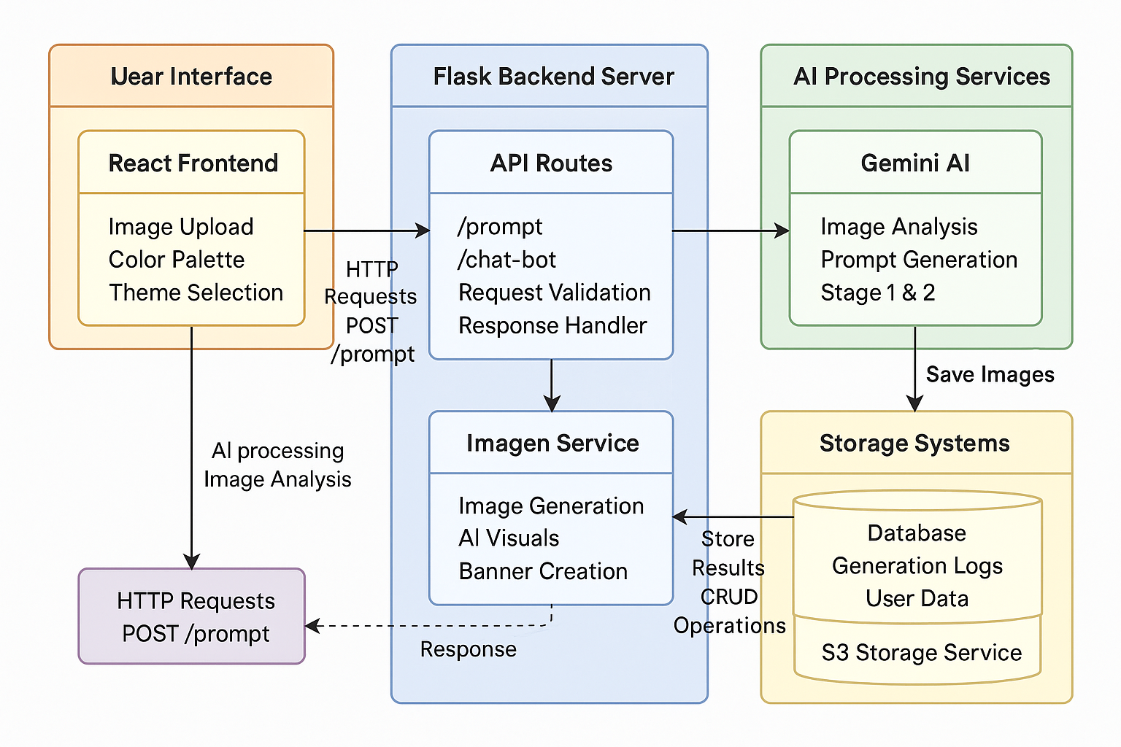
Methodology
Architecture Diagram:
User Interface

Slide 6
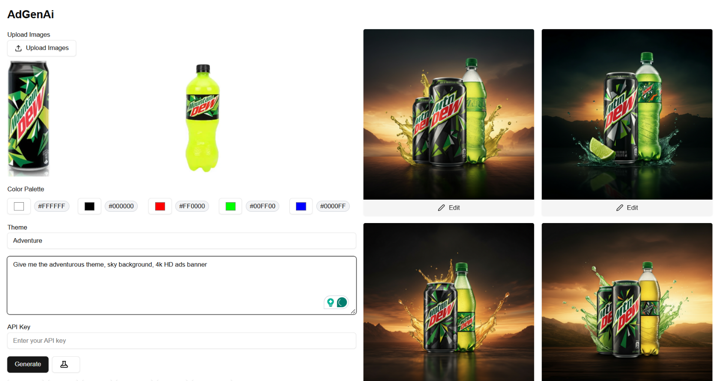
Results

Slide 7
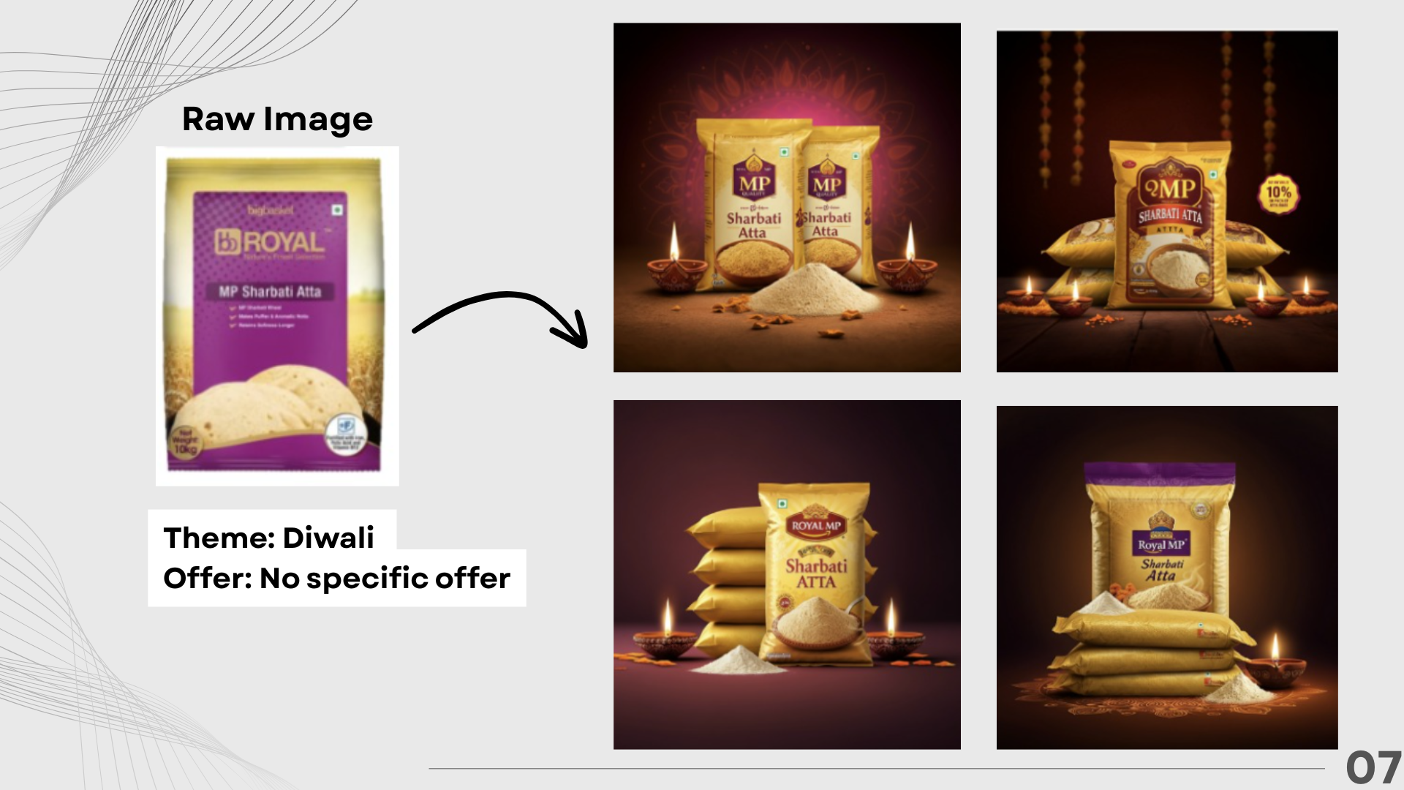
Results

Slide 8
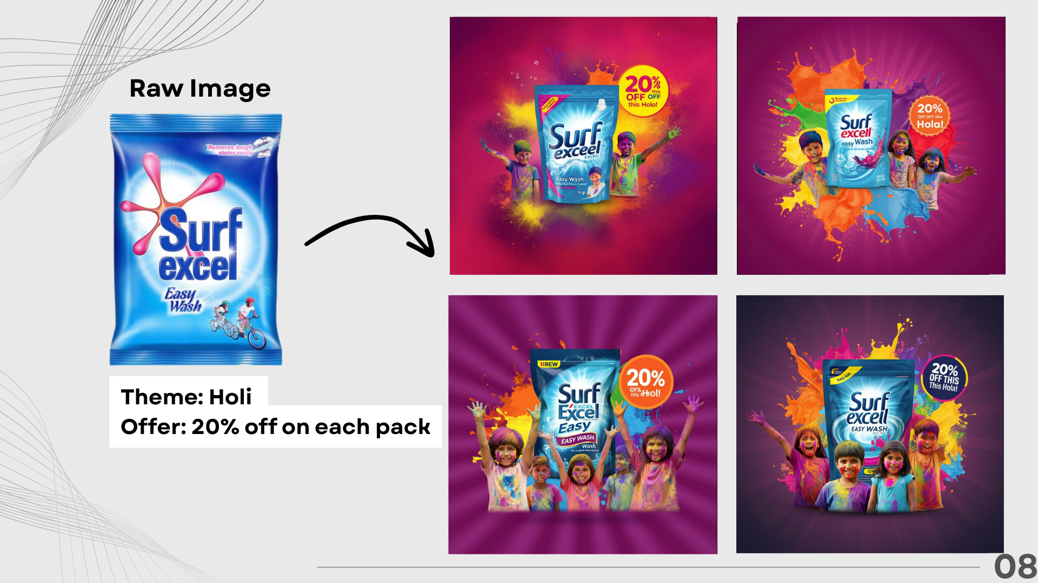
Results

Slide 9
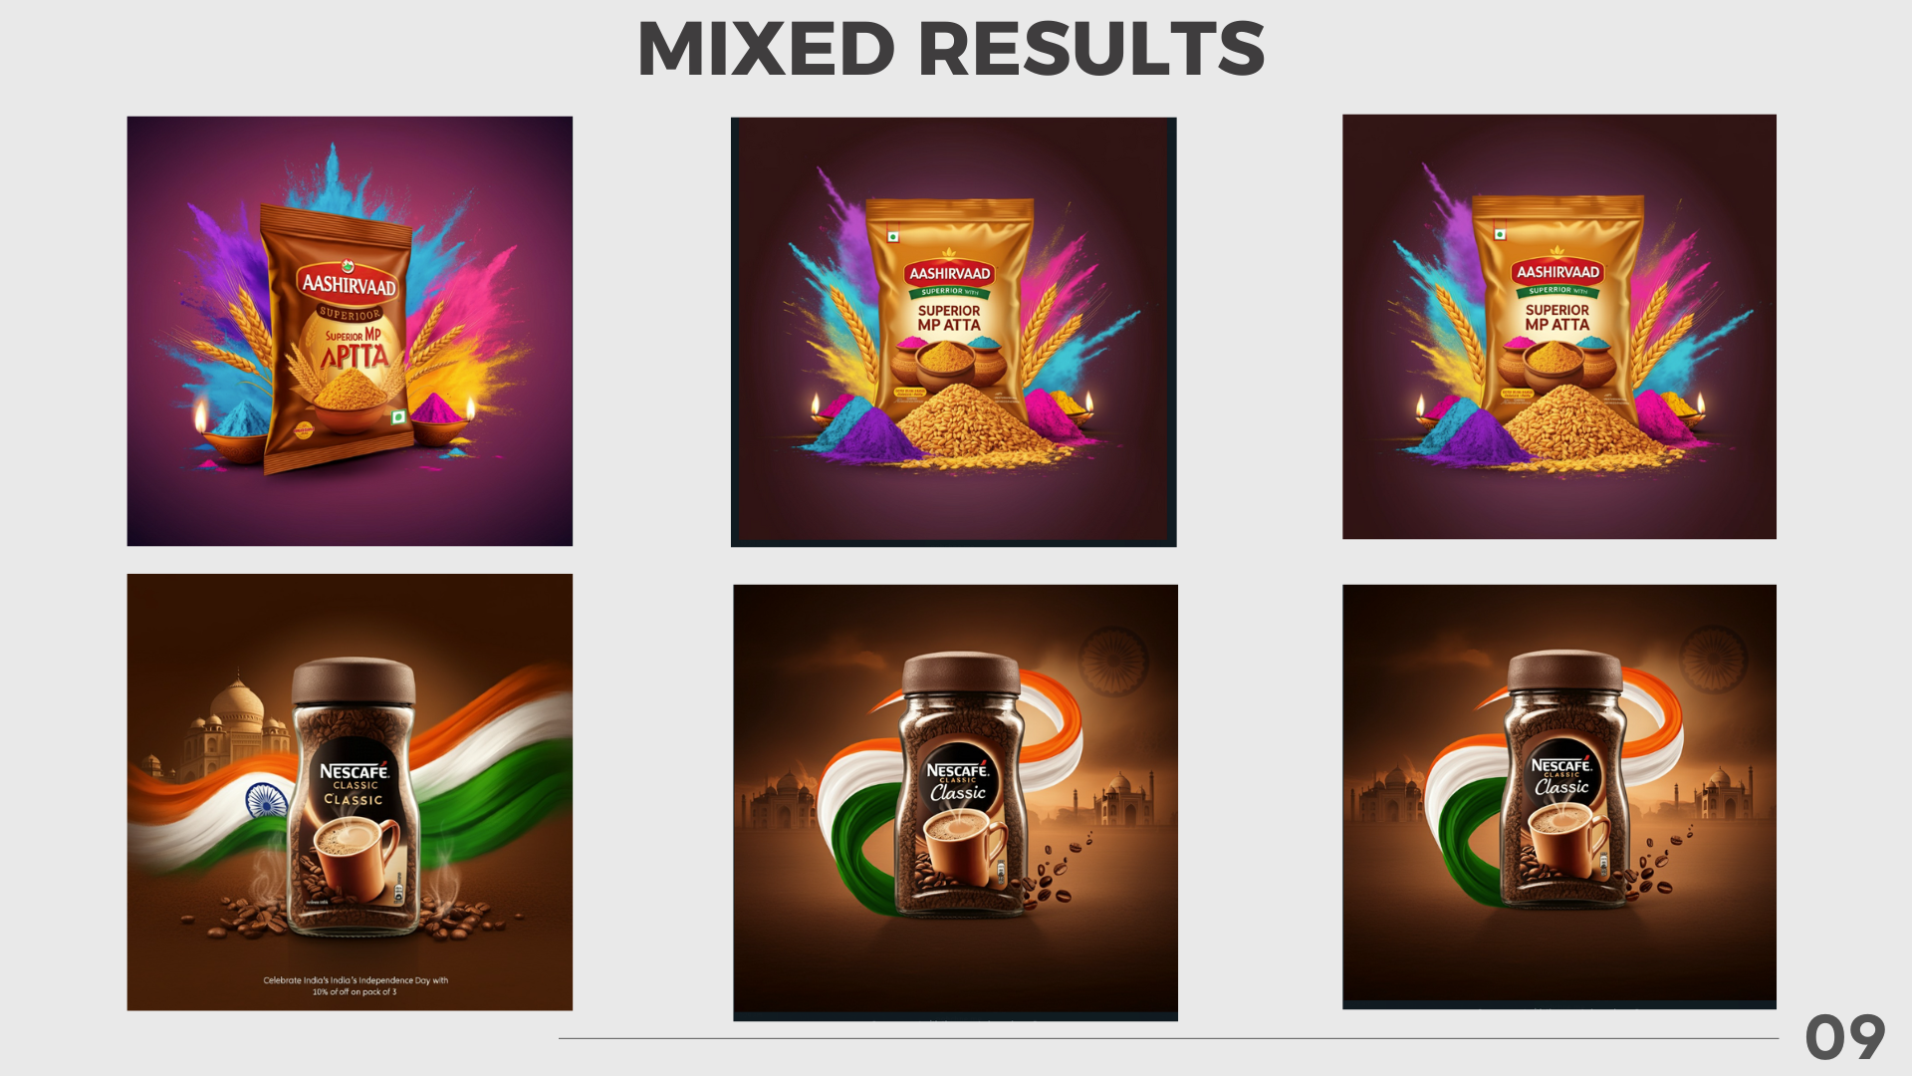
Results

Slide 10
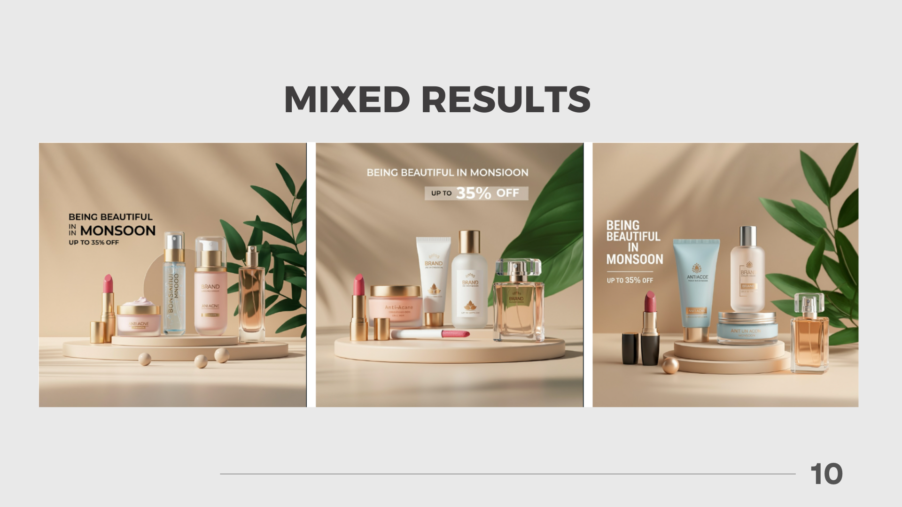
Results

Slide 11
Conclusion and Future Scope
Conclusion: AdGenAI successfully streamlines the ad and poster creation process using advanced AI technologies like Gemini and Imagen3. It delivers fast, accurate, and brand-consistent designs, reducing the need for manual effort and design expertise.
Future Scope: The platform can evolve by adding real-time collaboration, multilingual support, and integration with marketing tools. These enhancements will expand its reach and make it more versatile for businesses across diverse domains.

Slide 12
Thank You

