Slide 1
Context: DNA Nanotechnology
Project: Fabrication DNA shapes and patterns (application-independent)

Slide 2
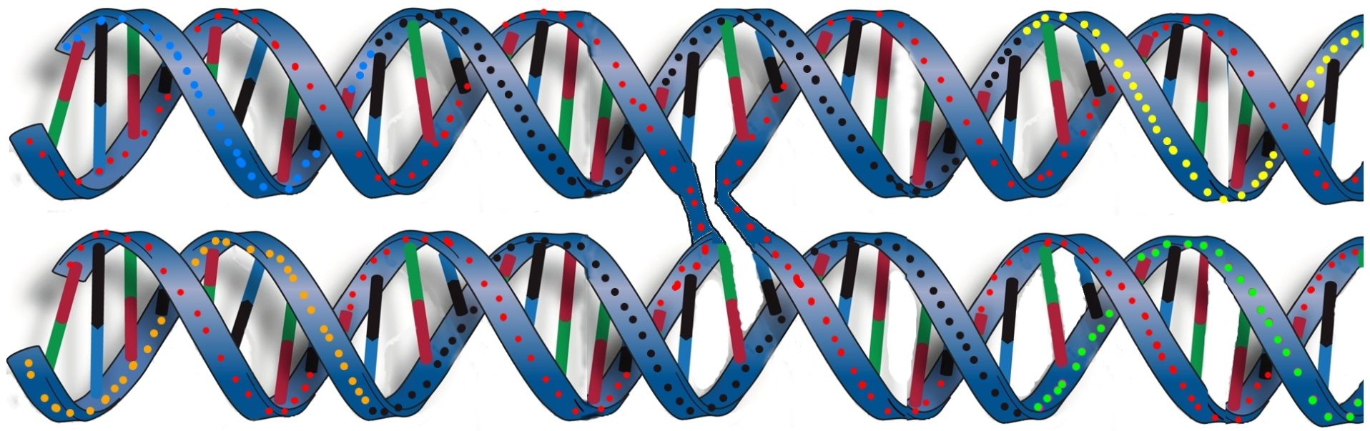
Principal Method Alternative Preliminary Results
Basic Principal: Double-crossover units
5’ ………TGTATATGTGTGGGAACAGGTTTAAT………3’
CCACACATATACA-3’
‘5-ATTAAACCTGTTC
5’-TTCTCAATATACT
GAGGACTTTACCT-3’
3’-….........AAGAGTTATATGACTCCTGAAATGGA…....5’
Crossover point

Slide 3
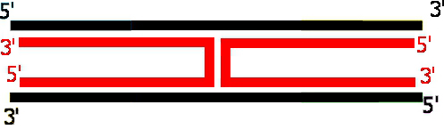
Principal Method Alternative Preliminary Results
Basic Principal: Double-crossover units
=

Slide 4
Principal Method Alternative Preliminary Results
Basic Principal: Double-crossover units
^ ^ ^
. . .
. . .
.
.
.
.
.
.
. . .
. . .
. . .

Slide 5
Principal Method Alternative Preliminary Results
Basic Principal: Double-crossover units
odd (even) half-turns between successive (every other) crossovers
1 half-turn = 5.3 bases = 1.8 nanometer
odd
even

Slide 6
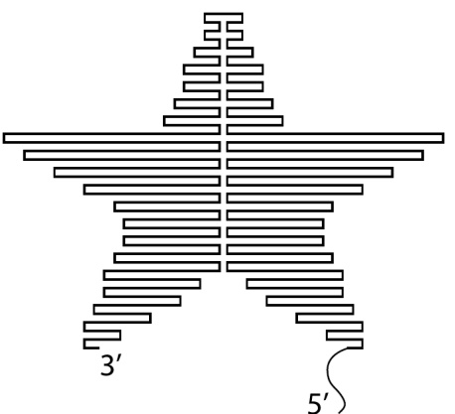
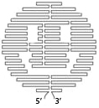


Principal Method Alternative Preliminary Results
Method: DNA Origami
5’
Rothemund, 2006
3’

Slide 7
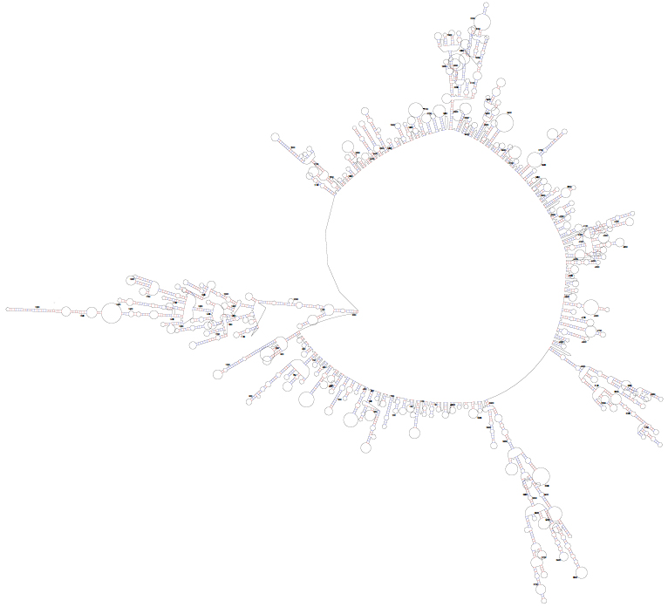
Principal Method Alternative Preliminary Results
Method: DNA Origami
The Good: Programmability, any desired shape, 6nm pixel size
The Bad: Design, must use optimization software every time (a computationally-hard task)
The Ugly: Cost, synthesis of new stapler strands for each shape (>200 strands for a 100x100 nm shape, ~1500$)

Slide 8
Principal Method Alternative Preliminary Results
An Alternative:
Design & Synthesize once … fabricate on demand

Slide 9
Principal Method Alternative Preliminary Results
An Alternative:
Design & Synthesize once … fabricate on demand

Slide 10
Principal Method Alternative Preliminary Results
An Alternative:
Design & Synthesize once … fabricate on demand
Tethering strands (staples)

Slide 11
Principal Method Alternative Preliminary Results
An Alternative:
Design & Synthesize once … fabricate on demand
Ligase
Tethering strands (staples)

Slide 12
Principal Method Alternative Preliminary Results
An Alternative:
Design & Synthesize once … fabricate on demand
Horizontal Scaffolds

Slide 13
Principal Method Alternative Preliminary Results
An Alternative:
Design & Synthesize once … fabricate on demand
Horizontal Scaffolds
Bridging strands

Slide 14
Principal Method Alternative Preliminary Results
An Alternative:
Design & Synthesize once … fabricate on demand
Horizontal Scaffolds
Ligase

Slide 15
Principal Method Alternative Preliminary Results
An Alternative:
Design & Synthesize once … fabricate on demand
3’
5’
3’
5’

Slide 16
Principal Method Alternative Preliminary Results
An Alternative:
Design & Synthesize once … fabricate on demand
Vertical Scaffolds

Slide 17
Principal Method Alternative Preliminary Results
An Alternative:
Design & Synthesize once … fabricate on demand
Horizontal Scaffolds
Vertical Scaffolds
From this point on:
No Design
No Synthesis, ever

Slide 18
Principal Method Alternative Preliminary Results
An Alternative:
Design & Synthesize once … fabricate on demand
Polymerase
Programming:
Polymerase/primers “carve out” the desired shape off of library scaffold

Slide 19
Principal Method Alternative Preliminary Results
An Alternative:
Labour =
+
Polymerase
Ligase
Material =
dNTP

Slide 20
Principal Method Alternative Preliminary Results
Testing the success of ligation

Slide 21
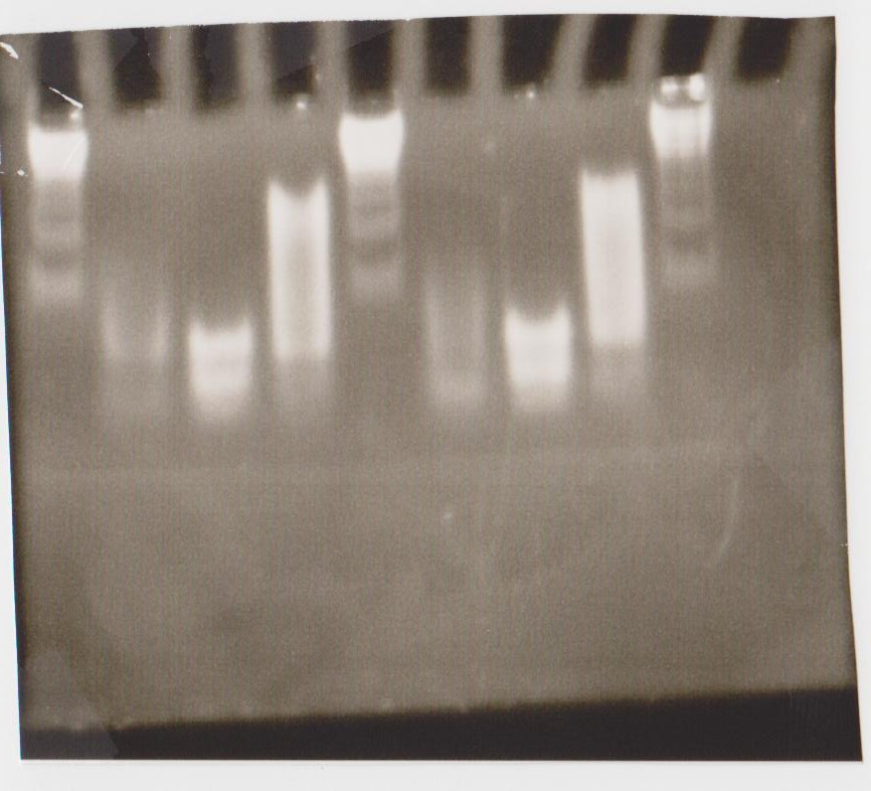
Principal Method Alternative Preliminary Results
Testing the success of ligation

Slide 22
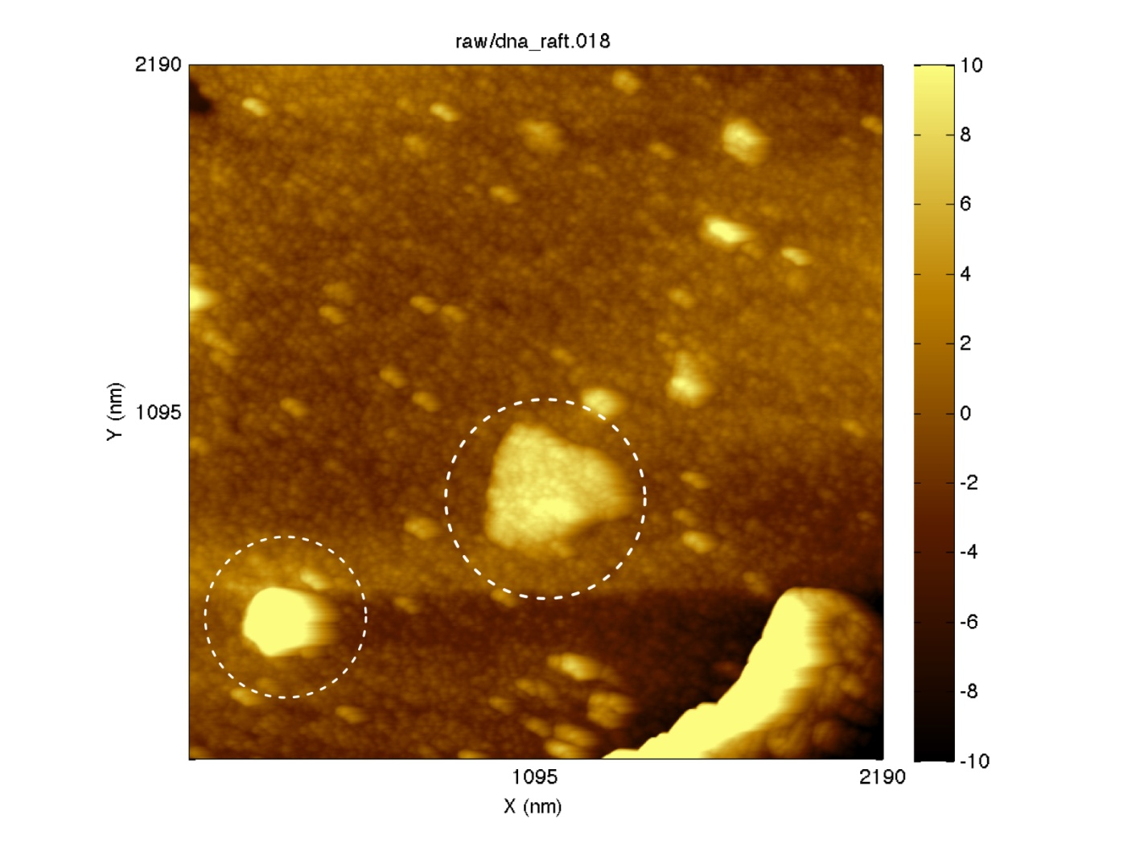
Principal Method Alternative Preliminary Results
AFM
Gold-streptavidin labeling (imaging by Antoine Roygobeil, Physics)

Slide 23
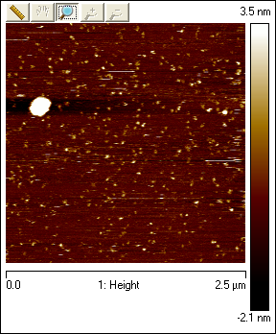
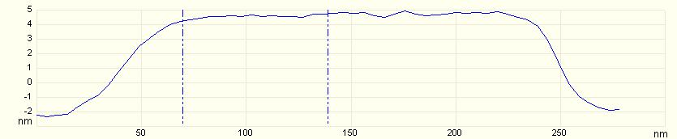
Principal Method Alternative Preliminary Results
AFM
Streptavidin labeling

Slide 24
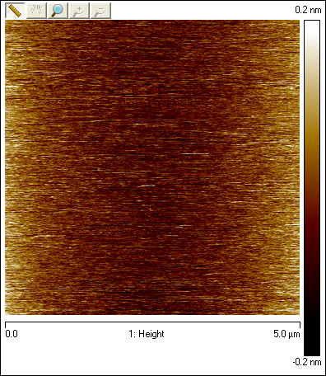
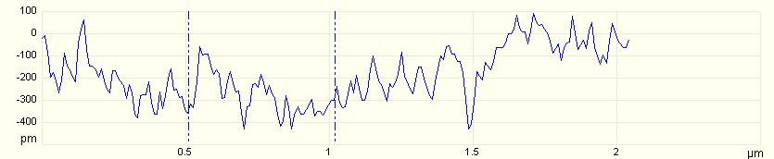
Principal Method Alternative Preliminary Results
AFM
Control (buffer only)

Slide 25
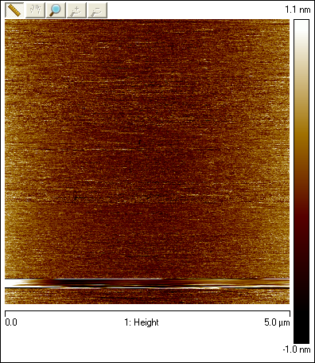
Principal Method Alternative Preliminary Results
AFM
Control (DNA only)

Slide 26
Principal Method Alternative Preliminary Results
Thanks

