Slide 1
DNA Nanotech. DNA/RNA Computing

Slide 2
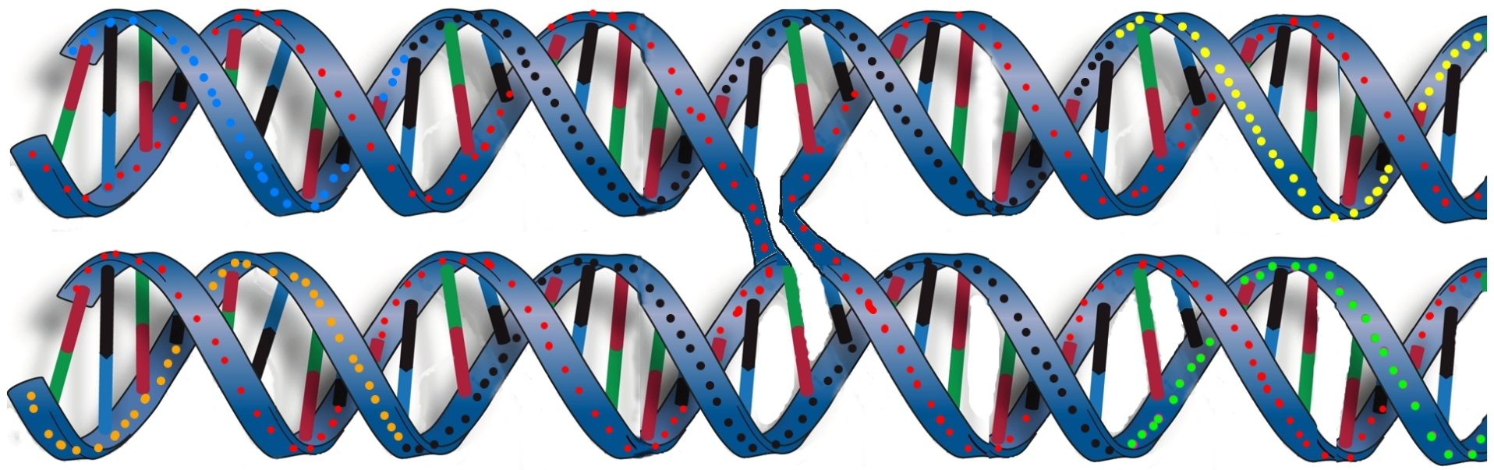
DNA Nanotech. DNA/RNA Computing
Goal: building nano-scale shapes using DNA
Basic Principal: Double-crossover units
5’ ………TGTATATGTGTGGGAACAGGTTTAAT………3’
CCACACATATACA-3’
‘5-ATTAAACCTGTTC
5’-TTCTCAATATACT
GAGGACTTTACCT-3’
3’-….........AAGAGTTATATGACTCCTGAAATGGA…....5’
Crossover point

Slide 3
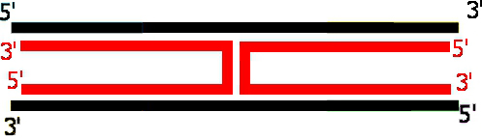
DNA Nanotech. DNA/RNA Computing
Goal: building nano-scale shapes using DNA
Basic Principal: Double-crossover units
=

Slide 4
DNA Nanotech. DNA/RNA Computing
Goal: building nano-scale shapes using DNA
Basic Principal: Double-crossover units
^ ^ ^
. . .
. . .
.
.
.
.
.
.
. . .
. . .
. . .

Slide 5
DNA Nanotech. DNA/RNA Computing
Constraint: odd (even) half-turns between successive (every other) crossovers
1 half-turn = 5.3 bases = 1.8 nanometer
odd
even

Slide 6
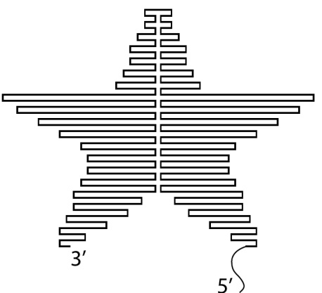
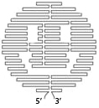

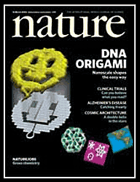
DNA Nanotech. DNA/RNA Computing
Method: DNA Origami (state-of-the-art)
5’
Rothemund, 2006
3’

Slide 7



DNA Nanotech. DNA/RNA Computing
Method: DNA Origami
The Good: Programmability, any desired shape, 6nm pixel size
The Bad: Design, must use optimization software every time (a computationally-hard task)
The Ugly: Cost, synthesis of new stapler strands for each shape (>200 strands for a 100x100 nm shape, ~1500$)

Slide 8
DNA Nanotech. DNA/RNA Computing
An Alternative:

Slide 9
DNA Nanotech. DNA/RNA Computing
An Alternative:
Ligase

Slide 10
DNA Nanotech. DNA/RNA Computing
An Alternative:
3’
5’
3’
5’

Slide 11
DNA Nanotech. DNA/RNA Computing
An Alternative:
Library Scaffold:
Vertical Strands

Slide 12
DNA Nanotech. DNA/RNA Computing
An Alternative:
Library Scaffold:
Vertical Strands
Horizental Strands

Slide 13
DNA Nanotech. DNA/RNA Computing
An Alternative:
No Design or Synthesis after this point, ever
Now: Programming
Polymerase

Slide 14
DNA Nanotech. DNA/RNA Computing
An Alternative: summary
Design and Synthesize once, Fabricate on demand
Labour =
+
Polymerase
Ligase
Material =
dNTP

Slide 15
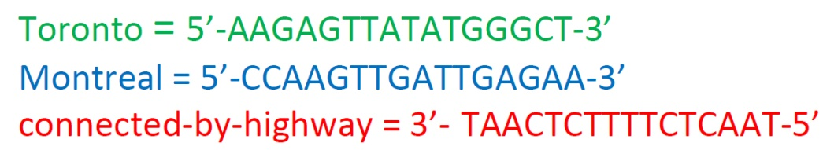
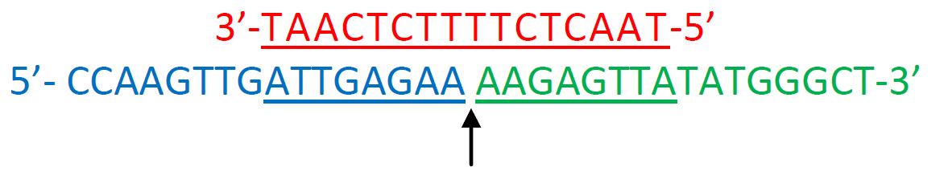
DNA Nanotech. DNA/RNA Computing
DNA/RNA Computing:
It’s a new perspective, not a technological invention
Example DNA computation: Find a tour that a) starts in Montreal b) ends in Vancouver, and
c) passes by every city in between exactly once
Ligate here

Slide 16
DNA Nanotech. DNA/RNA Computing
DNA/RNA Computing:
Another Example
Challenge: Arrange the tiles on a square board such that all adjacent edges match in color

Slide 17
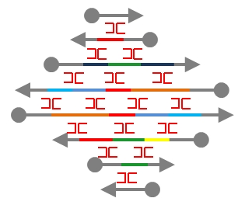
DNA Nanotech. DNA/RNA Computing
DNA/RNA Computing:
Another Example
=
DNA Solution

Slide 18
DNA Nanotech. DNA/RNA Computing
DNA/RNA Computing:
Other computational primitives: Strand displacement
.…………....
.…………....
+
If a AND b then c

Slide 19
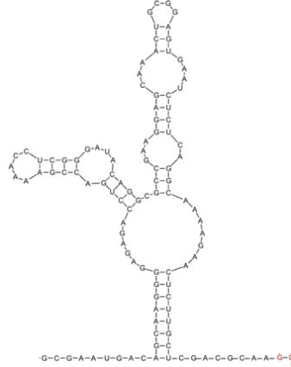
DNA Nanotech. DNA/RNA Computing
With RNA, even more is possible:
Structure determines function → manipulate structure (with presence/absence of ligands) to alter function
Riboswitch
On Off
3’ UTR
mRNA

Slide 20
DNA Nanotech. DNA/RNA Computing
With RNA, even more is possible:
Structure determines function → manipulate structure (with presence/absence of ligands) to alter function
Riboswitch
On Off
Ligand
3’ UTR
mRNA

Slide 21
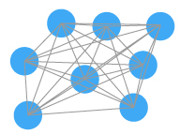
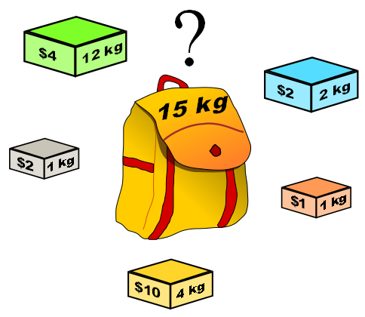
DNA Nanotech. DNA/RNA Computing
Final note: The computational weight of inquiries
1. All are same problem at heart … in different disguises
2. All are intractable

Slide 22
DNA Nanotech. DNA/RNA Computing
Final note: The computational weight of problems
# Cities | Search space size
50 | 10^15
100 | 10^30
150 | 10^45
200 | 10^60
250 | 10^75
1000 | 10^301
e.g. The Computational Weight of finding a tour in a map
. .
.
. .
.
Number of atoms in the observable universe = 10^78

Slide 23
DNA Nanotech. DNA/RNA Computing
Final note: The computational weight of problems
> What to do when facing intractability in biological inquiries?

Slide 24
DNA Nanotech. DNA/RNA Computing
Happy holidays

