Slide 2
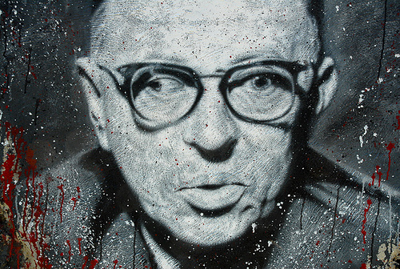
“I write in order to justify my existence”
-Jean-Paul Sartre

Slide 3
xP-Ex-

Slide 4
Take the following meaningless sentence as absolute Truth :
xP-Ex-
Hofstadter, D.R. Gödel, Escher, Bach: An Eternal Golden Braid. London: Penguin, 2000. (with modification)

Slide 5
Take the following meaningless sentence as absolute Truth :
It is composed of three letters: P, E, and Hyphen (-)
xP-Ex-

Slide 6
Take the following meaningless sentence as absolute Truth :
It is composed of three letters: P, E, and Hyphen (-)
x is not a letter, it is just a placeholder for one or more Hyphens
xP-Ex-

Slide 7
Take the following meaningless sentence as absolute Truth :
It is composed of three letters: P, E, and Hyphen (-)
x is not a letter, it is just a placeholder for one or more Hyphens
xP-Ex-
This sentence is True … self-evidently so … no questions asked.

Slide 8
Take the following meaningless sentence as absolute Truth :
Obey the following rule mechanically & blindly :
If xPyEz is True,
Then xPy-Ez- is True too
xP-Ex-

Slide 9
Take the following meaningless sentence as absolute Truth :
Obey the following rule mechanically & blindly :
If xPyEz is True,
Then xPy-Ez- is True too
xP-Ex-
x,y,z stand for one or more hyphens

Slide 10
Take the following meaningless sentence as absolute Truth :
Obey the following rule mechanically & blindly :
If xPyEz is True,
Then xPy-Ez- is True too
xP-Ex-
Examples: self-evident Truths
-P-E--
--P-E---

Slide 11
Take the following meaningless sentence as absolute Truth :
Obey the following rule mechanically & blindly :
If xPyEz is True,
Then xPy-Ez- is True too
xP-Ex-
Examples: self-evident Truths
-P-E--
-P--E---
Examples: Truths by virtue of rule
--P-E---
--P--E----

Slide 12
Take the following meaningless sentence as absolute Truth :
Obey the following rule mechanically & blindly :
If xPyEz is True,
Then xPy-Ez- is True too
xP-Ex-
-P-E--
Infinitely many Truths
-P--E---
--P-E---
--P--E----

Slide 13
Take the following meaningless sentence as absolute Truth :
Obey the following rule mechanically & blindly :
If xPyEz is True,
Then xPy-Ez- is True too
xP-Ex-
Infinitely many Truths

Slide 14
Take the following meaningless sentence as absolute Truth :
?
Obey the following rule mechanically & blindly :
If xPyEz is True,
Then xPy-Ez- is True too
xP-Ex-
What if we interpreted :
P as ‘plus’ and
E as ‘equals’ ?
- P – E --
1 + 1 = 2

Slide 15
Take the following meaningless sentence as absolute Truth :
?
Obey the following rule mechanically & blindly :
If xPyEz is True,
Then xPy-Ez- is True too
xP-Ex-
What if we interpreted :
P as ‘plus’ and
E as ‘equals’ ?
-P--E---
- P – E --
1 + 2 = 3
--P--E----
2 + 2 = 4
1 + 1 = 2
--P-E---
2 +1 = 3

Slide 16
Take the following meaningless sentence as absolute Truth :
Obey the following rule mechanically & blindly :
If xPyEz is True,
Then xPy-Ez- is True too
xP-Ex-
This is the (meaningful) set of all legal arithmetic additions over the set of natural numbers

Slide 17
Take the following meaningless sentence as absolute Truth :
Obey the following rule mechanically & blindly :
If xPyEz is True,
Then xPy-Ez- is True too
xP-Ex-
If we encode letters with numbers:
P = 101
E = 110
- = 111

Slide 18
Take the following meaningless sentence as absolute Truth :
Obey the following rule mechanically & blindly :
If xPyEz is True,
Then xPy-Ez- is True too
xP-Ex-
If we encode letters with numbers:
P = 101
E = 110
- = 111
we can treat strings as numbers,
example:
-P-E-- = 111 101 111 110 111 111
= 253887 (in decimal)

Slide 19
Take the following meaningless sentence as absolute Truth :
Obey the following rule mechanically & blindly :
If xPyEz is True,
Then xPy-Ez- is True too
xP-Ex-
Every dot here is a number which, once decoded back to P’s, E’s and hyphens, corresponds to a a self-evident or derived Truth
we can treat strings as numbers,
example:
-P-E-- = 111 101 111 110 111 111
= 253887 (in decimal)

Slide 20
The set of natural numbers N
a subset of N

Slide 21
Let’s employ a ‘bouncer’ to decide which numbers are IN and which are OUT:
The set of natural numbers N
a subset of N

Slide 22
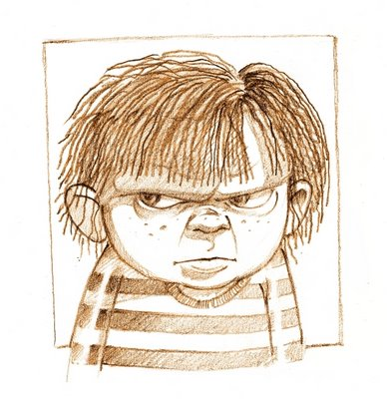
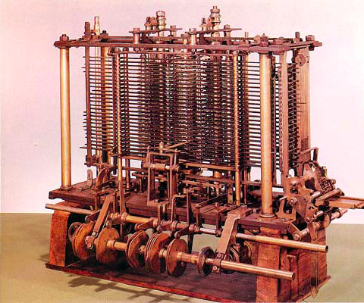
Let’s employ a ‘bouncer’ to decide which numbers are IN and which are OUT:
The set of natural numbers N
1. Take a number n as input
2. k = n in binary
3. Generate every TRUTH/TRUTH s, #digit(s) = #digits(k) put it in container C
4. Examine every element s in C
if s = k, accept n and halt.
5. Reject n
Or
a subset of N
Any machine capable of mechanically following simple unambiguous instructions would suffice, no ‘intelligence’ required

Slide 23
The language … and the machine
The set of natural numbers N
1. Take a number n as input
2. k = n in binary
3. Generate every TRUTH/TRUTH s, #digit(s) = #digits(k) put it in container C
4. Examine every element s in C
if s = k, accept n and halt.
5. Reject n
a subset of N

Slide 24
The language … and the machine
The set of natural numbers N
1. Take a number n as input
2. k = n in binary
3. Generate every TRUTH/TRUTH s, #digit(s) = #digits(k) put it in container C
4. Examine every element s in C
if s = k, accept n and halt.
5. Reject n
a subset of N
The machine instructions are themselves written using some kind of alphabet (English-ish, Java, Python, assembly … doesn’t matter)
If we encode that alphabet with numbers, then the above machine is a number itself

Slide 25
The language … and the machine
The set of natural numbers N
1. Take a number n as input
2. k = n in binary
3. Generate every TRUTH/TRUTH s, #digit(s) = #digits(k) put it in container C
4. Examine every element s in C
if s = k, accept n and halt.
5. Reject n
a subset of N
The machine instructions are themselves written using some kind of alphabet (English-ish, Java, Python, assembly … doesn’t matter)
If we encode that alphabet with numbers, then the above machine is a number itself

Slide 26
The language … and the machine
The set of natural numbers N

Slide 27
The language … and the machine
More languages and machines …
The set of natural numbers N

Slide 28
The language … and the machine
More languages and machines …
The set of natural numbers N
The English language (i.e. an infinite set of numbers each encoding one of the infinitely-many syntactically-correct English sentences)

Slide 29
The language … and the machine
More languages and machines …
The set of natural numbers N
a parser written in Java (more precisely, the number encoding for that parser’s code)
The English language (i.e. an infinite set of numbers each encoding one of the infinitely-many syntactically-correct English sentences)

Slide 30
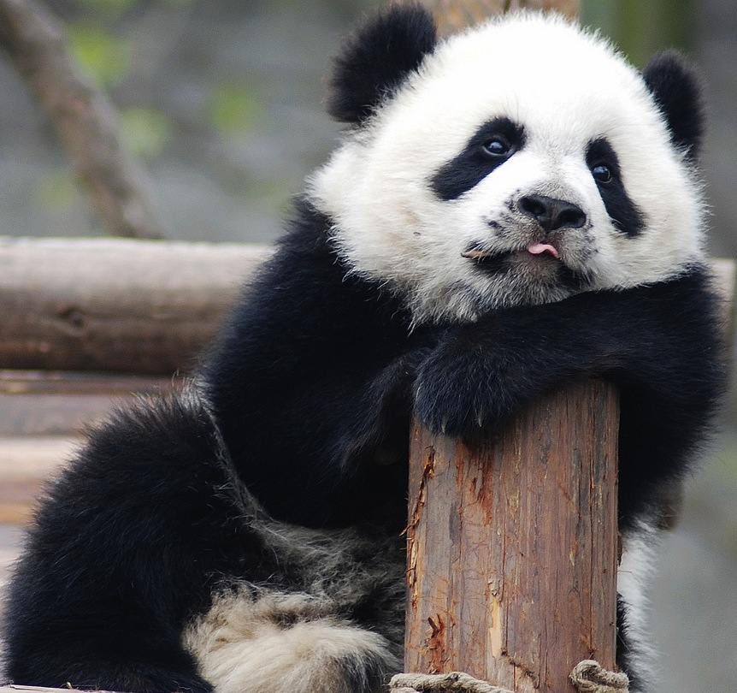
The language … and the machine
More languages and machines …
The set of natural numbers N
All DNA sequences encoding for valid Panda genomes

Slide 31
The language … and the machine
More languages and machines …
The set of natural numbers N
A number encoding bio-specs of female Panda womb (or encoding the software program simulating it)
All DNA sequences encoding for valid Panda genomes

Slide 32
The language … and the machine
More languages and machines …
The set of natural numbers N
Prime numbers (or the numbers encoding those numbers!)

Slide 33
The language … and the machine
More languages and machines …
The set of natural numbers N
Primality-testing algorithm (or the software implementation of that algorithm (more precisely: the number encoding that implementation … yadda .. yadda))
Prime numbers (or the numbers encoding those numbers!)

Slide 34
The language … and the machine
More languages and machines …
The set of natural numbers N
an infinite set of numbers each encoding a triplet (a, b, c) where c is the Greatest Common Divisor of a and b

Slide 35
The language … and the machine
More languages and machines …
The set of natural numbers N
Euclid’s method for finding greatest common divisor
an infinite set of numbers each encoding a triplet (a, b, c) where c is the Greatest Common Divisor of a and b

Slide 36
Languages
Machines

Slide 37
Languages
Machines
TRUTHS
PROOFS

Slide 38
Languages
Machines
TRUTHS
PROOFS

Slide 39
Languages
Machines
TRUTHS
PROOFS

Slide 40
Languages
Machines
TRUTHS
PROOFS
Is there a SUPER-language ? A language of all languages ?

Slide 41
Languages
Machines
TRUTHS
PROOFS
Is there a SUPER-language ? A language of all languages ?
In other words …
If we started off with a more sophisticated set of alphabet like :
∀ ∃ ∄ { } | ∩ ∪ ⊆ ⊂ ⊄ ⊇ ⊃ ⊅ \ ∈ ∉ × Ø % ⇒ ¬
plus the Greek alphabet as placeholders of objects etc

Slide 42
Languages
Machines
TRUTHS
PROOFS
Is there a SUPER-language ? A language of all languages ?
In other words …
If we started off with a more sophisticated set of alphabet like :
∀ ∃ ∄ { } | ∩ ∪ ⊆ ⊂ ⊄ ⊇ ⊃ ⊅ \ ∈ ∉ × Ø % ⇒ ¬
plus the Greek alphabet as placeholders of objects etc
And accepted few self-evident Truths (axioms)

Slide 43
Languages
Machines
TRUTHS
PROOFS
Is there a SUPER-language ? A language of all languages ?
In other words …
If we started off with a more sophisticated set of alphabet like :
∀ ∃ ∄ { } | ∩ ∪ ⊆ ⊂ ⊄ ⊇ ⊃ ⊅ \ ∈ ∉ × Ø % ⇒ ¬
plus the Greek alphabet as placeholders of objects etc
And accepted few self-evident Truths (axioms)
Is there a guarantee that every conceivable language (hence every Truth) is inside this SUPER-language ?

Slide 44
Languages
Machines
TRUTHS
PROOFS
Is there a SUPER-language ? A language of all languages ?

Slide 45
Languages
Machines
TRUTHS
PROOFS
Is there a SUPER-language ? A language of all languages ?
Is there a SUPER-machine ? A bouncer machine for SUPER-language ?

Slide 46
Languages
Machines
TRUTHS
PROOFS
Is there a SUPER-language ? A language of all languages ?
Is there a SUPER-machine ? A bouncer machine for SUPER-language ?
SUPER-machine = aware of the axioms of SUPER-language
faithful to the rules of SUPER-language

Slide 47
Languages
Machines
TRUTHS
PROOFS
Is there a SUPER-language ? A language of all languages ?
Is there a SUPER-machine ? A bouncer machine for SUPER-language ?
SUPER-machine = aware of the axioms of SUPER-language
faithful to the rules of SUPER-language
Nothing SUPER about this machine really, when consulted about whether a number is IN our OUT, it consults the axioms and applies the rules mechanically
e.g. recall the machine sketched above for the P-E language has no conception of “addition”

Slide 48
Languages
Machines
TRUTHS
PROOFS
Is there a SUPER-language ?
Is there a SUPER-machine ?
Suppose someone clever constructed a SUPER-language L
(s/he chose an alphabet, declared some axioms, and defined the rules of derivation)

Slide 49
Languages
Machines
TRUTHS
PROOFS
Is there a SUPER-language ?
Is there a SUPER-machine ?
Suppose someone clever constructed a SUPER-language L
(s/he chose an alphabet, declared some axioms, and defined the rules of derivation)
Supposedly L contains all Truths about anything:
Numbers ………………………...….arithmetic etc
Cities, People ………………………….. graphs etc
DNA Sequences ……………….. alignments etc
P-E system …………………….........……addition
.
.
objects …………………………….………….relations

Slide 50
Languages
Machines
TRUTHS
PROOFS
Is there a SUPER-language ?
Is there a SUPER-machine ?
Suppose someone clever constructed a SUPER-language L
(s/he chose an alphabet, declared some axioms, and defined the rules of derivation)
Supposedly L contains all Truths about anything:
Numbers ………………………...….arithmetic etc
Cities, People ………………………….. graphs etc
DNA Sequences ……………….. alignments etc
P-E system …………………….........……addition
.
.
objects …………………………….………….relations
Take this to your wildest most abstract imagination

Slide 51
Languages
Machines
TRUTHS
PROOFS
Is there a SUPER-language ?
Is there a SUPER-machine ?
Suppose someone clever constructed a SUPER-language L
(s/he chose an alphabet, declared some axioms, and defined the rules of derivation)
Supposedly L contains all Truths about anything:
Numbers ………………………...….arithmetic etc
Cities, People ………………………….. graphs etc
DNA Sequences ……………….. alignments etc
P-E system …………………….........……addition
.
.
objects …………………………….………….relations
Take this to your wildest most abstract imagination

Slide 52
Languages
Machines
TRUTHS
PROOFS
Is there a SUPER-language ?
Is there a SUPER-machine ?
Supposedly L contains all truths about anything:
So consider this statement which should be in L :
G = “G is not a Truth in L”
(cleverly constructed using L’s own alphabet/rules/axioms)

Slide 53
Languages
Machines
TRUTHS
PROOFS
Is there a SUPER-language ?
Is there a SUPER-machine ?
Supposedly L contains all truths about anything:
So consider this statement which should be in L :
G = “G is not a Truth in L”
(cleverly constructed using L’s own alphabet/rules/axioms)
If L said G is True, it would have effectively shot itself in the foot and proven its own inconsistency !
Why ?

Slide 54
Languages
Machines
TRUTHS
PROOFS
Is there a SUPER-language ?
Is there a SUPER-machine ?
Supposedly L contains all truths about anything:
So consider this statement which should be in L :
G = “G is not a Truth in L”
If L said G is True, it would have effectively shot itself in the foot and proven its own inconsistency !
Why ? Because both G and NOT(G) would be True … d’oh!
Logical blackhole (!)

Slide 55
G is basically the Liar’s Paradox stated mathematically :
Socrates: “All Greeks are liars”

Slide 56
G is basically the Liar’s Paradox stated mathematically :
Socrates: “All Greeks are liars”
Neither True nor False … but something weird in between

Slide 57
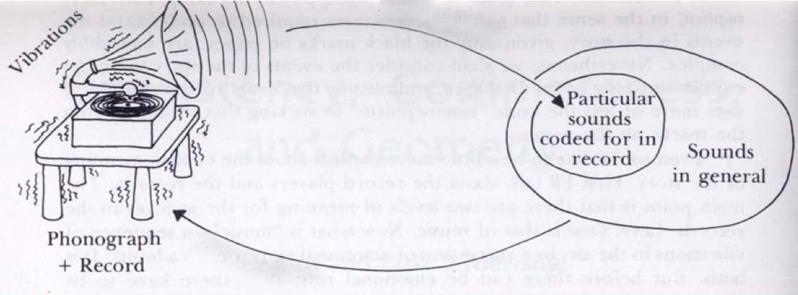
A metaphor ..
“For any universal record player, realized or yet to be, there exists a record which, if played, will result in the player’s indirect self-destruction.”
Hofstadter, D.R. Gödel, Escher, Bach: An Eternal Golden Braid. London: Penguin, 2000. (with modification)

Slide 58
Languages
Machines
TRUTHS
PROOFS
Is there a SUPER-language ?
Is there a SUPER-machine ?
No
Some Truths are beyond provability

Slide 59
Languages
Machines
TRUTHS
PROOFS
Is there a SUPER-language ?
Is there a SUPER-machine ?

Slide 60
Languages
Machines
TRUTHS
PROOFS
Is there a SUPER-language ?
Is there a SUPER-machine ?
Let’s settle for a super-language (in small letters) ..
(ignore those logical blackholes, when was the last time someone bumped into one anyway, practically speaking ? )

Slide 61
Languages
Machines
TRUTHS
PROOFS
Is there a SUPER-language ?
Is there a SUPER-machine ?
Let’s settle for a super-language (in small letters) ..
super-language = all Truths (disclaimer: minus some weird “problematic Truths”)

Slide 62
Languages
Machines
TRUTHS
PROOFS
Is there a SUPER-language ?
Is there a SUPER-machine ?
Let’s settle for a super-language (in small letters) ..
super-language = all Truths (disclaimer: minus some weird “problematic Truths”)
super-language can describe everything, including machines

Slide 63
Languages
Machines
TRUTHS
PROOFS
Is there a SUPER-language ?
Is there a SUPER-machine ?
Every conceivable sentence
∞
 | 1 | 2 | 3 | 4 | 5 | . | . | n | . | .
1
2
3
4
.
.
.
n
.
.
Every conceivable machine
∞

Slide 64
Languages
Machines
TRUTHS
PROOFS
Is there a SUPER-language ?
Is there a SUPER-machine ?
Every conceivable sentence
This is the result returned by
machine number 2 when supplied with 1 as input
∞
 | 1 | 2 | 3 | 4 | 5 | . | . | n | . | .
1 | 0 | 0 | 89 | 3 | 0 | . | . | 0 | . | .
2 | 10 | 1 | 0 | 0 | 0 | . | . | 0 | . | .
3 | 0 | 0 | 0 | 0 | 0 | . | . | 0 | . | .
4 | 20 | 0 | 4 | 1 | 0 | . | . | 56 | . | .
. | 60 | 0 | 0 | 0 | 0 | . | . | 3 | . | .
. | 0 | 0 | 0 | 0 | 6 | . | . | 0 | . | .
. | 30 | 0 | 0 | 3 | 0 | . | . | 3 | . | .
n | 0 | 9 | 0 | 0 | 2 | . | . | 40 | . | .
. | . | . | . | . | . | . | . | . | . | .
. | . | . | . | . | . | . | . | . | . | .
Every conceivable machine
∞

Slide 65
Languages
Machines
TRUTHS
PROOFS
Is there a SUPER-language ?
Is there a SUPER-machine ?
Consider machine number k which operates as follows:
∞
 | 1 | 2 | 3 | 4 | 5 | . | . | n | . | .
1 | 0 | 0 | 89 | 3 | 0 | . | . | 0 | . | .
2 | 10 | 1 | 0 | 0 | 0 | . | . | 0 | . | .
3 | 0 | 0 | 0 | 0 | 0 | . | . | 0 | . | .
4 | 20 | 0 | 4 | 1 | 0 | . | . | 56 | . | .
. | 60 | 0 | 0 | 0 | 0 | . | . | 3 | . | .
. | 0 | 0 | 0 | 0 | 6 | . | . | 0 | . | .
. | 30 | 0 | 0 | 3 | 0 | . | . | 3 | . | .
n | 0 | 9 | 0 | 0 | 2 | . | . | 40 | . | .
. | . | . | . | . | . | . | . | . | . | .
. | . | . | . | . | . | . | . | . | . | .
∞

Slide 66
Languages
Machines
TRUTHS
PROOFS
Is there a SUPER-language ?
Is there a SUPER-machine ?
Consider machine number k which operates as follows:
1. It receives sentence n
∞
 | 1 | 2 | 3 | 4 | 5 | . | . | n | . | .
1 | 0 | 0 | 89 | 3 | 0 | . | . | 0 | . | .
2 | 10 | 1 | 0 | 0 | 0 | . | . | 0 | . | .
3 | 0 | 0 | 0 | 0 | 0 | . | . | 0 | . | .
4 | 20 | 0 | 4 | 1 | 0 | . | . | 56 | . | .
. | 60 | 0 | 0 | 0 | 0 | . | . | 3 | . | .
. | 0 | 0 | 0 | 0 | 6 | . | . | 0 | . | .
. | 30 | 0 | 0 | 3 | 0 | . | . | 3 | . | .
n | 0 | 9 | 0 | 0 | 2 | . | . | 40 | . | .
. | . | . | . | . | . | . | . | . | . | .
. | . | . | . | . | . | . | . | . | . | .
∞

Slide 67
Languages
Machines
TRUTHS
PROOFS
Is there a SUPER-language ?
Is there a SUPER-machine ?
Consider machine number k which operates as follows:
1. It receives sentence n
2. It feeds sentence n to machine n
∞
 | 1 | 2 | 3 | 4 | 5 | . | . | n | . | .
1 | 0 | 0 | 89 | 3 | 0 | . | . | 0 | . | .
2 | 10 | 1 | 0 | 0 | 0 | . | . | 0 | . | .
3 | 0 | 0 | 0 | 0 | 0 | . | . | 0 | . | .
4 | 20 | 0 | 4 | 1 | 0 | . | . | 56 | . | .
. | 60 | 0 | 0 | 0 | 0 | . | . | 3 | . | .
. | 0 | 0 | 0 | 0 | 6 | . | . | 0 | . | .
. | 30 | 0 | 0 | 3 | 0 | . | . | 3 | . | .
n | 0 | 9 | 0 | 0 | 2 | . | . | 40 | . | .
. | . | . | . | . | . | . | . | . | . | .
. | . | . | . | . | . | . | . | . | . | .
∞

Slide 68
Languages
Machines
TRUTHS
PROOFS
Is there a SUPER-language ?
Is there a SUPER-machine ?
Consider machine number k which operates as follows:
1. It receives sentence n
2. It feeds sentence n to machine n
3. It adds 1 to the result (diagonal+1)
∞
 | 1 | 2 | 3 | 4 | 5 | . | . | n | . | .
1 | 0 | 0 | 89 | 3 | 0 | . | . | 0 | . | .
2 | 10 | 1 | 0 | 0 | 0 | . | . | 0 | . | .
3 | 0 | 0 | 0 | 0 | 0 | . | . | 0 | . | .
4 | 20 | 0 | 4 | 1 | 0 | . | . | 56 | . | .
. | 60 | 0 | 0 | 0 | 0 | . | . | 3 | . | .
. | 0 | 0 | 0 | 0 | 6 | . | . | 0 | . | .
. | 30 | 0 | 0 | 3 | 0 | . | . | 3 | . | .
n | 0 | 9 | 0 | 0 | 2 | . | . | 40 | . | .
. | . | . | . | . | . | . | . | . | . | .
. | . | . | . | . | . | . | . | . | . | .
∞

Slide 69
Languages
Machines
TRUTHS
PROOFS
Is there a SUPER-language ?
Is there a SUPER-machine ?
Consider machine number k which operates as follows:
1. It receives sentence n
2. It feeds sentence n to machine n
3. It adds 1 to the result (diagonal+1)
4. It terminates
∞
 | 1 | 2 | 3 | 4 | 5 | . | . | n | . | .
1 | 0 | 0 | 89 | 3 | 0 | . | . | 0 | . | .
2 | 10 | 1 | 0 | 0 | 0 | . | . | 0 | . | .
3 | 0 | 0 | 0 | 0 | 0 | . | . | 0 | . | .
4 | 20 | 0 | 4 | 1 | 0 | . | . | 56 | . | .
. | 60 | 0 | 0 | 0 | 0 | . | . | 3 | . | .
. | 0 | 0 | 0 | 0 | 6 | . | . | 0 | . | .
. | 30 | 0 | 0 | 3 | 0 | . | . | 3 | . | .
n | 0 | 9 | 0 | 0 | 2 | . | . | 40 | . | .
. | . | . | . | . | . | . | . | . | . | .
. | . | . | . | . | . | . | . | . | . | .
∞

Slide 70
Languages
Machines
TRUTHS
PROOFS
Is there a SUPER-language ?
Is there a SUPER-machine ?
Consider machine number k which operates as follows:
1. It receives sentence n
2. It feeds sentence n to machine n
3. It adds 1 to the result (diagonal+1)
4. It terminates
∞
 | 1 | 2 | 3 | 4 | 5 | . | . | n | . | .
1 | 0 | 0 | 89 | 3 | 0 | . | . | 0 | . | .
2 | 10 | 1 | 0 | 0 | 0 | . | . | 0 | . | .
3 | 0 | 0 | 0 | 0 | 0 | . | . | 0 | . | .
4 | 20 | 0 | 4 | 1 | 0 | . | . | 56 | . | .
. | 60 | 0 | 0 | 0 | 0 | . | . | 3 | . | .
. | 0 | 0 | 0 | 0 | 6 | . | . | 0 | . | .
. | 30 | 0 | 0 | 3 | 0 | . | . | 3 | . | .
n | 0 | 9 | 0 | 0 | 2 | . | . | 40 | . | .
. | . | . | . | . | . | . | . | . | . | .
. | . | . | . | . | . | . | . | . | . | .
In other words, in shorthand notation :
m_{k} (n) = m_{n} (n) + 1
∞

Slide 71
Languages
Machines
TRUTHS
PROOFS
Is there a SUPER-language ?
Is there a SUPER-machine ?
What happens if we supply sentence k to m_{k} ?
∞
 | 1 | 2 | 3 | 4 | 5 | . | . | n | . | .
1 | 0 | 0 | 89 | 3 | 0 | . | . | 0 | . | .
2 | 10 | 1 | 0 | 0 | 0 | . | . | 0 | . | .
3 | 0 | 0 | 0 | 0 | 0 | . | . | 0 | . | .
4 | 20 | 0 | 4 | 1 | 0 | . | . | 56 | . | .
. | 60 | 0 | 0 | 0 | 0 | . | . | 3 | . | .
. | 0 | 0 | 0 | 0 | 6 | . | . | 0 | . | .
. | 30 | 0 | 0 | 3 | 0 | . | . | 3 | . | .
n | 0 | 9 | 0 | 0 | 2 | . | . | 40 | . | .
. | . | . | . | . | . | . | . | . | . | .
. | . | . | . | . | . | . | . | . | . | .
∞

Slide 72
Languages
Machines
TRUTHS
PROOFS
Is there a SUPER-language ?
Is there a SUPER-machine ?
What happens if we supply sentence k to m_{k} ?
∞
 | 1 | 2 | 3 | 4 | 5 | . | . | n | . | .
1 | 0 | 0 | 89 | 3 | 0 | . | . | 0 | . | .
2 | 10 | 1 | 0 | 0 | 0 | . | . | 0 | . | .
3 | 0 | 0 | 0 | 0 | 0 | . | . | 0 | . | .
4 | 20 | 0 | 4 | 1 | 0 | . | . | 56 | . | .
. | 60 | 0 | 0 | 0 | 0 | . | . | 3 | . | .
. | 0 | 0 | 0 | 0 | 6 | . | . | 0 | . | .
. | 30 | 0 | 0 | 3 | 0 | . | . | 3 | . | .
n | 0 | 9 | 0 | 0 | 2 | . | . | 40 | . | .
. | . | . | . | . | . | . | . | . | . | .
. | . | . | . | . | . | . | . | . | . | .
m_{k} (k) = m_{k} (k) + 1
∞

Slide 73
Languages
Machines
TRUTHS
PROOFS
Is there a SUPER-language ?
Is there a SUPER-machine ?
What happens if we supply sentence k to m_{k} ?
∞
 | 1 | 2 | 3 | 4 | 5 | . | . | n | . | .
1 | 0 | 0 | 89 | 3 | 0 | . | . | 0 | . | .
2 | 10 | 1 | 0 | 0 | 0 | . | . | 0 | . | .
3 | 0 | 0 | 0 | 0 | 0 | . | . | 0 | . | .
4 | 20 | 0 | 4 | 1 | 0 | . | . | 56 | . | .
. | 60 | 0 | 0 | 0 | 0 | . | . | 3 | . | .
. | 0 | 0 | 0 | 0 | 6 | . | . | 0 | . | .
. | 30 | 0 | 0 | 3 | 0 | . | . | 3 | . | .
n | 0 | 9 | 0 | 0 | 2 | . | . | 40 | . | .
. | . | . | . | . | . | . | . | . | . | .
. | . | . | . | . | . | . | . | . | . | .
m_{k} (k) = m_{k} (k) + 1
(!)
Logical blackhole, so m_{k} does not, could not, exist!
∞

Slide 74
Languages
Machines
TRUTHS
PROOFS
Is there a SUPER-language ?
Is there a SUPER-machine ?
No
No
There are more languages than there are machines to decide them
Some Truths are beyond provability

Slide 75
Languages
Machines
TRUTHS
PROOFS
Is there a SUPER-language ?
Is there a SUPER-machine ?
No
No
There are more languages than there are machines to decide them
Some Truths are beyond provability
These are questions about the the foundation of mathematics itself
Computer Science was born out of answers to these questions in the 1930’s (Kurt Gödel, Alain Turing, and Alonso Church)

Slide 76
Logical blackholes (unprovable Truths)
Boundary of the provable (what’s inside is decidable/solvable/provable… in principle)

Slide 77
Chess
Protein folding
Sequence alignment
Arithmetic

Slide 78
The closer the language is to this boundary, the harder (more computationally expensive) it is for a decider to tell who is IN and who is OUT
Chess
Protein folding
Sequence alignment
Arithmetic

Slide 79
This, for computer scientists, is what the Periodic Table is to physicists

Slide 80
Let’s conclude with one final language, call it H

Slide 81
Let’s conclude with one final language, call it H
“H = all numbers encoding graphs that have at least one path that begins at some node a and ends at some node b while in the process visiting every other node in the graph exactly once“

Slide 82
Let’s conclude with one final language, call it H
“H = all numbers encoding graphs that have at least one path that begins at some node a and ends at some node b while in the process visiting every other node in the graph exactly once“
The set of natural numbers N
H

Slide 83
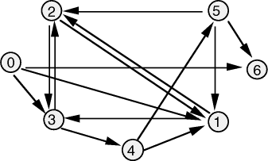
Let’s conclude with one final language, call it H
“H = all numbers encoding graphs that have at least one path that begins at some node a and ends at some node b while in the process visiting every other node in the graph exactly once“
The set of natural numbers N
?
H
Is this graph (i.e. its number) IN or OUT?

Slide 84
We can build a bouncer (decider/proofer/machine/solver etc. ) for H using DNA .. RNA .. and Protein
The set of natural numbers N
?
H
Is this graph (i.e. its number) IN or OUT?

Slide 85
We can build a bouncer (decider/proofer/machine/solver etc. ) for H using DNA .. RNA .. and Protein
“But why would you do that anyway!?”, asks the taxpayer.
The set of natural numbers N
?
H
Is this graph (i.e. its number) IN or OUT?

Slide 86
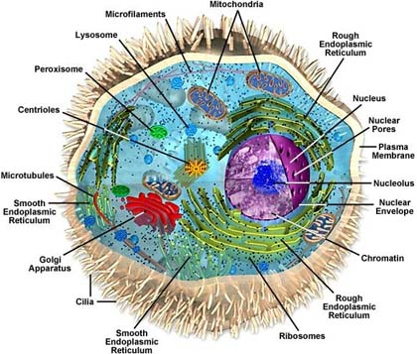
The cell …
What is the language .. ?
What is the machine .. ?

Slide 87
Thanks

Slide 88
[Demonstrate on the white board how a bouncer (decider/proofer/machine/solver etc. ) for H can be constructed using: DNA .. RNA .. and Protein]
Discussion: Computer Science vs. Physics
The set of natural numbers N
?
H
Is this graph (i.e. its number) IN or OUT?

