Slide 1
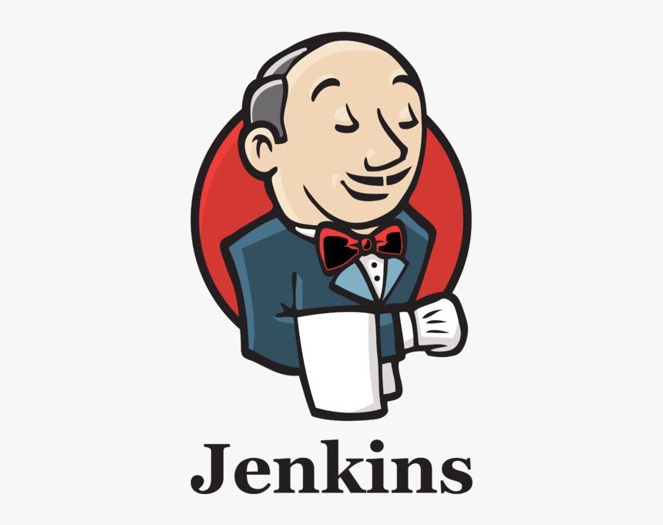

task: Web Server Setup and CI/CD Pipeline using Jenkins and ansible
By: Amr Hassan

Slide 2
Project Overview
- Provision 3 VMs (VM1, VM2, VM3) with specific services
- Implement user management on VM3
- Integrate GitLab with Jenkins for CI/CD
- Create a Git repository and Ansible playbook
- Configure Jenkins pipeline for automation
- Notify on pipeline failures

Slide 3
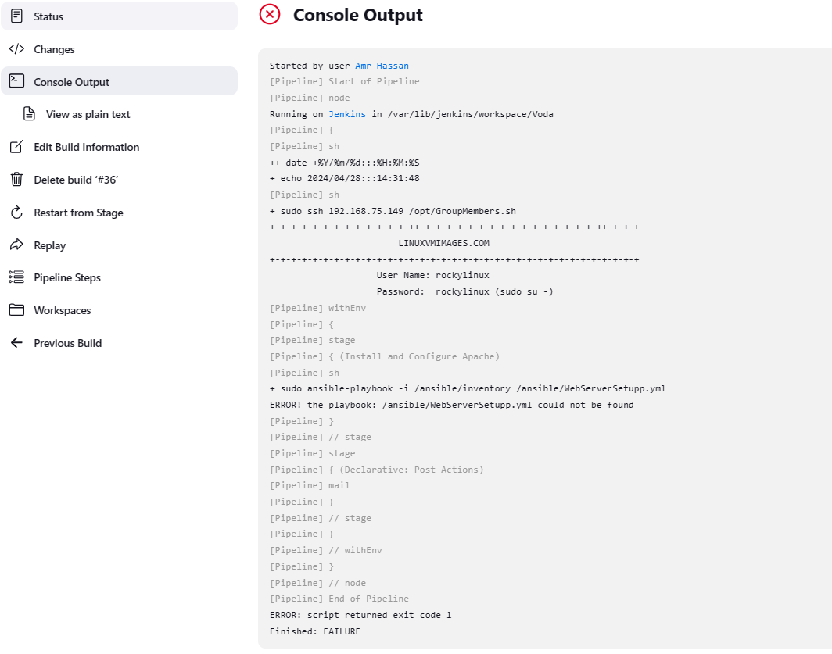
Failure case:

Slide 4
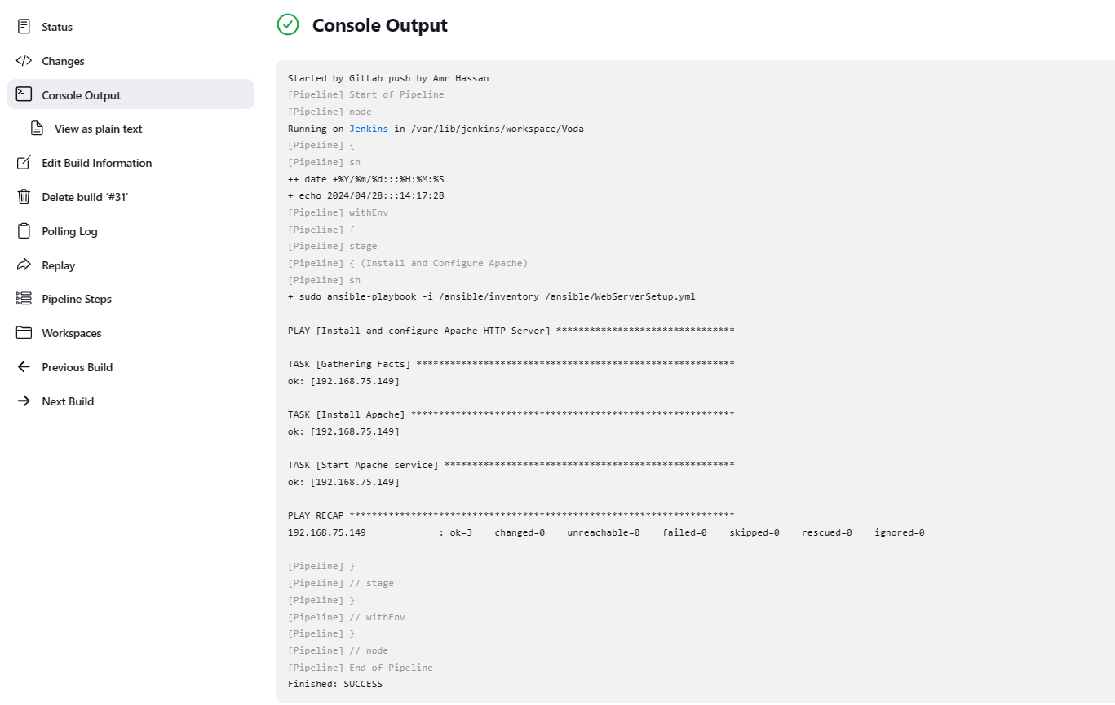
Success case:

Slide 5
VM Setup
- VM1: Jenkins Server for CI/CD pipeline orchestration
- VM2: Private GitLab instance for hosting Git repositories
- VM3: Deploy Apache HTTP Server using Ansible
- Ensure VMs are running RockyLinux

Slide 6
User Management on VM3
- Create users "DevTeam" and "OpsTeam" using a Bash script
- Create a group "webAdmins" and assign users to it
- Fetch list of users in "webAdmins" group using a Bash script

Slide 7
CI/CD Pipeline Configuration
- Configure Jenkins to monitor GitLab repository
- On code commit, Jenkins pipeline will:
- Execute Ansible playbook to install Apache on VM3
- Generate email notification on failure

Slide 8
Email Notification on Failure
- Subject: Pipeline Failed: [Build Name]
- Body:
- Pipeline failed reason
- Current build date
- List of users in "webAdmins" group

