Slide 1


Slide 2


Slide 3

Processor
Memory
Bus
I/O de
vice 1
I/O de
vice
n
Multiple I/O devices may be connected to the processor and the memory via a bus.
Bus consists of three sets of lines to carry address, data and control signals.
Each I/O device is assigned an unique address.
To access an I/O device, the processor places the address on the address lines.
The device recognizes the address, and responds to the control signals.

Slide 4
Accessing I/O devices (contd..)
I/O devices and the memory may share the same address space:
Memory-mapped I/O.
  Any machine instruction that can access memory can be used to transfer data to or from an I/O device.
  Simpler software.
I/O devices and the memory may have different address spaces:
  I/O mapped I/O.
  Special instructions to transfer data to and from I/O devices.
  I/O devices may have to deal with fewer address lines.
  I/O address lines need not be physically separate from memory address lines.
  In fact, address lines may be shared between I/O devices and memory, with a control signal to indicate whether it is a memory address or an I/O address.

Slide 5

Address lines
Bus
Data lines
Control lines
Address
Control
Data and
I/O
decoder
circuits
status registers
int
erface
Input device
I/O device is connected to the bus using an I/O interface circuit which has:
- Address decoder, control circuit, and data and status registers.
Address decoder -decodes the address placed on the address lines thus enabling the
device to recognize its address.
Data register -holds the data being transferred to or from the processor.
Status register -holds information necessary for the operation of the I/O device.
Data and status registers are connected to the data lines, and have unique addresses.
I/O interface circuit coordinates I/O transfers.

Slide 6
Accessing I/O devices (contd..)
Mechanisms used for Interfacing I/O devices / synchronize data transfers.
Program-controlled I/O:
  Processor repeatedly monitors a status flag to achieve the necessary synchronization.
  its called as Processor polls the I/O device.
  Disadvantage- Processor waste time in checking the status flag
Two other mechanisms used for synchronizing data transfers between the processor and memory:
  Interrupts-INTR SIGNAL
  Direct Memory Access- Transfer data directly to/from memory.

Slide 7


Slide 8
Interrupts
In program-controlled I/O, when the processor continuously monitors the status of the device, it does not perform any useful tasks.
An alternate approach would be for the I/O device to alert the processor when it becomes ready.
  Do so by sending a hardware signal called an interrupt to the processor.
  At least one of the bus control lines, called an interrupt-request line is dedicated for this purpose.
Processor can perform other useful tasks while it is waiting for the device to be ready.

Slide 9

Program 1
Interrupt Service routine
1
2
Interrupt
occurs
i
here
i
+
1
M
Processor is executing the instruction located at address i when an interrupt occurs.
Routine executed in response to an interrupt request is called the interrupt-service routine.
When an interrupt occurs, control must be transferred to the interrupt service routine.
But before transferring control, the current contents of the PC (i+1), must be saved in a known
location.
This will enable the return-from-interrupt instruction to resume execution at i+1.
Return address, or the contents of the PC are usually stored on the processor stack.

Slide 10
Interrupts (contd..)
Treatment of an interrupt-service routine is very similar to that of a subroutine.
However there are significant differences:
  A subroutine performs a task that is required by the calling program.
  Interrupt-service routine may not have anything in common with the program it interrupts.
  Interrupt-service routine and the program that it interrupts may belong to different users.
  As a result, before branching to the interrupt-service routine, not only the PC, but other information such as condition code flags, and processor registers used by both the interrupted program and the interrupt service routine must be stored.
  This will enable the interrupted program to resume execution upon return from interrupt service routine.

Slide 11
Interrupts (contd..)
Saving and restoring information can be done automatically by the processor or explicitly by program instructions.
Saving and restoring registers involves memory transfers:
  Increases the total execution time.
  Increases the delay between the time an interrupt request is received, and the start of execution of the interrupt-service routine. This delay is called interrupt latency.
In order to reduce the interrupt latency, most processors save only the minimal amount of information:
  This minimal amount of information includes Program Counter and processor status registers.

Slide 12
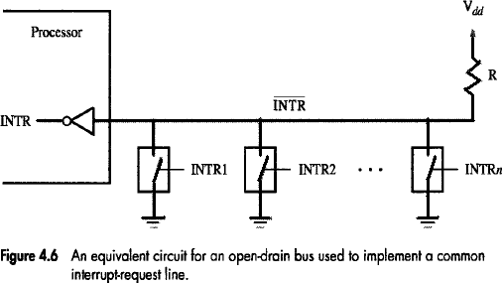
Interrupts (contd..)
INTERRUPT HARDWARE
Most computers have several I/O devices that can request an interrupt.
A single interrupt-request (IR) line may be used to serve n devices (Figure 4.6).
All devices are connected to IR line via switches to ground.
To request an interrupt, a device closes its associated switch.
Thus, if all IR signals are inactive, the voltage on the IR line will be equal to V_{dd}.

Slide 13
Interrupts (contd..)
INTERRUPT HARDWARE
When a device requests an interrupt, the voltage on the line drops to 0.
This causes the INTR received by the processor to go to 1.
The value of INTR is the logical OR of the requests from individual devices.
INTR=INTR₁+ INTR₂₊ . . . . . +INTR_{n}
A special gates known as open-collector or open-drain are used to drive the INTR line.
The Output of the open collector control is equal to a switch to the ground that is
→ open when gates input is in ”0‟ state and
→ closed when the gates input is in “1‟ state.
Resistor R is called a Pull-up Resistor because it pulls the line voltage up to the high-voltage state when the switches are open

Slide 14


Slide 15
Direct Memory Access (contd..)
Direct Memory Access (DMA):
  A special control unit may be provided to transfer a block of data directly between an I/O device and the main memory, without continuous intervention by the processor.
Control unit which performs these transfers is a part of the I/O device’s interface circuit. This control unit is called as a DMA controller.
DMA controller performs functions that would be normally carried out by the processor:
  For each word, it provides the memory address and all the control signals.
  To transfer a block of data, it increments the memory addresses and keeps track of the number of transfers.
Notes:
This alternative approach is called as direct memory access. DMA consists of a special control unit which is provided to transfer a block of data directly between an I/O device and the main memory without continuous intervention by the processor.
A control unit which performs these transfers without the intervention of the processor is a part of the I/O device’s interface circuit, and this controller is called as the DMA controller.
DMA controller performs functions that would be normally be performed by the processor. The processor will have to provide a memory address and all the control signals. So, the DMA controller will also provide with the memory address where the data is going to be stored along with the necessary control signals. When a block of data needs to be transferred, the DMA controller will also have to increment the memory addresses and keep track of the number of words that have been transferred.

Slide 16
Direct Memory Access (contd..)
DMA controller can transfer a block of data from an external device to the processor, without any intervention from the processor.
  However, the operation of the DMA controller must be under the control of a program executed by the processor. That is, the processor must initiate the DMA transfer.
To initiate the DMA transfer, the processor informs the DMA controller of:
  Starting address,
  Number of words in the block.
  Direction of transfer (I/O device to the memory, or memory to the I/O device).
Once the DMA controller completes the DMA transfer, it informs the processor by raising an interrupt signal.
Notes:
Repeat DMA controller.
DMA controller can be used to transfer a block of data from an external device to the processor, without requiring any help from the processor. As a result the processor is free to execute other programs. However, the DMA controller should perform the task of transferring data to or from an I/O device for a program that is being executed by a processor. That is, the DMA controller does not and should not have the capability to determine when a data transfer operation should take place. The processor must initiate DMA transfer of data, when it is indicated or required by the program that is being executed by the processor.
When the processor determines that the program that is being executed requires a DMA transfer, it informs the DMA controller which sits in the interface circuit of the device of three things, namely, the starting address of the memory location, the number of words that needs to be transferred, and the direction of transfer that is, whether the data needs to be transferred from the I/O device to the memory or from the memory to the I/O device.
After initiating the DMA transfer, the processor suspends the program that initiated the transfer, and continues with the execution of some other program. The program whose execution is suspended is said to be in the blocked state.

Slide 17

Main
Processor
memory
System bus
Disk/DMA
DMA
Printer
Keyboard
controller
controller
Disk
Disk
Network
Interface
DMA controller connects a high-speed network to the computer bus.
Disk controller, which controls two disks also has DMA capability. It provides two
DMA channels.
It can perform two independent DMA operations, as if each disk has its own DMA
controller.
They are 3 registers used to store the memory address, word count and status and
control information are duplicated.
Notes:
Let us consider a memory organization with two DMA controllers. In this memory organization, a DMA controller is used to connect a high speed network to the computer bus. In addition, disk controller which also controls two disks may have DMA capability. The disk controller controls two disks and it also has DMA capability. The disk controller provides two DMA channels. The disk controller can two independent DMA operations, as if each disk has its own DMA controller. Each DMA controller has three registers, one to store the memory address, one to store the word count, and the last to store the status and control information. There are two copies of these three registers in order to perform independent DMA operations. That is, these registers are duplicated.

Slide 18
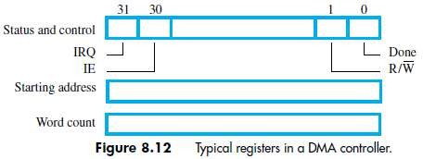
Direct Memory Access (contd..)
The R/W bit determines direction of transfer.
If R/W=1, controller performs a read-operation (i.e. it transfers data from memory to I/O), Otherwise, controller performs a write-operation (i.e. it transfers data from I/O to memory).
If Done=1, the controller
→ has completed transferring a block of data and
→ is ready to receive another command. (IE à Interrupt Enable).
If IE=1, controller raises an interrupt after it has completed transferring a block of data.
If IRQ=1, controller requests an interrupt.
Notes:
Processor also has to transfer data to and from the main memory. Also, the DMA controller is responsible for transferring data to and from the I/O device to the main memory. Both the processor and the DMA controller have to use the external bus to talk to the main memory. Usually, DMA controllers are given higher priority than the processor to access the bus. Now, we also need to decide the priority among different DMA devices that may need to use the bus. Among these different DMA devices, high priority is given to high speed peripherals such as a disk or a graphics display device.
Usually, the processor originates most cycles on the bus. The DMA controller can be said to steal memory access cycles on from the bus. Thus, the processor and the DMA controller use the bus in an interwoven fashion. This interweaving technique is called as cycle stealing.
An alternate approach would be to provide DMA controllers exclusive capability to initiate transfers on the bus, and hence exclusive access to the main memory. This is known as the block mode or the burst mode of operation.

Slide 19
Direct Memory Access (contd..)
  DMA devices are given higher priority than the processor to access the bus.
  There are 2 ways in which the DMA operation can be carried out:
Processor originates most memory-access cycles.
  DMA controller is said to "steal" memory cycles from processor. Hence, this technique is usually called Cycle Stealing.
DMA controller is given exclusive access to main-memory to transfer a block of data without any interruption. This is known as Block Mode (or burst mode).
Notes:
Processor also has to transfer data to and from the main memory. Also, the DMA controller is responsible for transferring data to and from the I/O device to the main memory. Both the processor and the DMA controller have to use the external bus to talk to the main memory. Usually, DMA controllers are given higher priority than the processor to access the bus. Now, we also need to decide the priority among different DMA devices that may need to use the bus. Among these different DMA devices, high priority is given to high speed peripherals such as a disk or a graphics display device.
Usually, the processor originates most cycles on the bus. The DMA controller can be said to steal memory access cycles on from the bus. Thus, the processor and the DMA controller use the bus in an interwoven fashion. This interweaving technique is called as cycle stealing.
An alternate approach would be to provide DMA controllers exclusive capability to initiate transfers on the bus, and hence exclusive access to the main memory. This is known as the block mode or the burst mode of operation.

Slide 20
Bus arbitration
Processor and DMA controllers both need to initiate data transfers on the bus and access main memory.
The device that is allowed to initiate transfers on the bus at any given time is called the bus master.
When the current bus master relinquishes its status as the bus master, another device can acquire this status.
  The process by which the next device to become the bus master is selected and bus mastership is transferred to it is called bus arbitration.
Centralized arbitration:
  A single bus arbiter performs the arbitration.
Distributed arbitration:
  All devices participate in the selection of the next bus master.
A conflict may arise if both the processor and a DMA controller or two DMA controllers try to use the bus at the same time to access the main-memory.
To resolve this, an arbitration procedure is implemented on the bus to coordinate the activities of all devices requesting memory transfers.
The bus arbiter may be the processor or a separate unit connected to the bus
Notes:
Processor and DMA controllers both need to initiate data transfers on the bus and access main memory. The process of using the bus to perform a data transfer operation is called as the initiation of a transfer operation. At any point in time only one device is allowed to initiate transfers on the bus. The device that is allowed to initiate transfers on the bus at any given time is called the bus master. When the current bus master releases control of the bus, another device can acquire the status of the bus master. How does one determine which is the next device which will acquire the status of the bus master. Note that there may be several DMA controllers plus the processor which requires access to the bus. The process by which the next device to become the bus master is selected and bus mastership is transferred to it is called bus arbitration. There are two types of bus arbitration processes. Centralized arbitration and distributed arbitration. In case of centralized arbitration, a single bus arbiter performs the arbitration. Whereas in case of distributed arbitration all devices which need to initiate data transfers on the bus participate or are involved in the selection of the next bus master.

Slide 21
Centralized Bus Arbitration
B
B
S
Y
B
R
Processor
DMA
DMA
controller
controller
BG1
1
BG2
2

Slide 22
Centralized Bus Arbitration
A single bus-arbiter performs the required arbitration (Figure)
Normally, processor is the bus-master.
Processor may grant bus-mastership to one of the DMA controllers.
A DMA controller indicates that it needs to become bus-master by activating BR line.
The signal on the BR line is the logical OR of bus-requests from all devices connected to it.
Then, processor activates BG1 signal indicating to DMA controllers to use bus when it becomes free.
BG1 signal is connected to all DMA controllers using a daisy-chain arrangement.
Arbiter ensures that only 1 request is granted at any given time according to a priority scheme. (BR à Bus-Request, BG à Bus-Grant, BBSY à Bus Busy).

Slide 23
Centralized Bus Arbitration
If DMA controller-1 is requesting the bus,
Then, DMA controller-1 blocks propagation of grant-signal to other devices. Otherwise, DMA controller-1 passes the grant downstream by asserting BG2.
Current bus-master indicates to all devices that it is using bus by activating BBSY line.
The bus-arbiter is used to coordinate the activities of all devices requesting memory transfers.
Arbiter ensures that only 1 request is granted at any given time according to a priority scheme. (BR à Bus-Request, BG à Bus-Grant, BBSY à Bus Busy).

Slide 24

DMA controller 2
asserts the BR signal.
T
ime
Processor asserts
the BG1 signal
B
R
BG1
BG1 signal propagates
to DMA#2.
BG2
B
B
S
Y
Bus
master
Processor
DMA controller 2
Processor
Processor relinquishes control
of the bus by setting BBSY to 1.

Slide 25
Distributed arbitration
All devices waiting to use the bus share the responsibility of carrying out the arbitration process.
  Arbitration process does not depend on a central arbiter and hence distributed arbitration has higher reliability.
Each device is assigned a 4-bit ID number.
All the devices are connected using 5 lines, 4 arbitration lines to transmit the ID, and one line for the Start-Arbitration signal.
To request the bus a device:
  Asserts the Start-Arbitration signal.
  Places its 4-bit ID number on the arbitration lines.
The pattern that appears on the arbitration lines is the logical-OR of all the 4-bit device IDs placed on the arbitration lines.

Slide 26
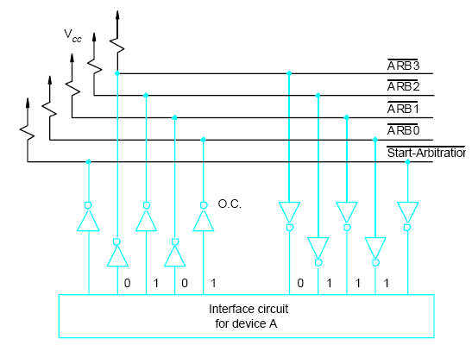
Distributed arbitration

Slide 27
Distributed arbitration(Contd.,)
Arbitration process:
  Each device compares the pattern that appears on the arbitration lines to its own ID, starting with MSB.
  If it detects a difference, it transmits 0s on the arbitration lines for that and all lower bit positions.
  The pattern that appears on the arbitration lines is the logical-OR of all the 4-bit device IDs placed on the arbitration lines.

Slide 28

Device A has the ID 5 and wants to request the bus:
- Transmits the pattern 0101 on the arbitration lines.
Device B has the ID 6 and wants to request the bus:
- Transmits the pattern 0110 on the arbitration lines.
Pattern that appears on the arbitration lines is the logical OR of the patterns:
- Pattern 0111 appears on the arbitration lines.
Arbitration process:
Each device compares the pattern that appears on the arbitration lines to its own
ID, starting with MSB.
If it detects a difference, it transmits 0s on the arbitration lines for that and all lower
bit positions.
Device A compares its ID 5 with a pattern 0101 to pattern 0111.
It detects a difference at bit position 0, as a result, it transmits a pattern 0100 on the
arbitration lines.
The pattern that appears on the arbitration lines is the logical-OR of 0100 and 0110,
which is 0110.
This pattern is the same as the device ID of B, and hence B has won the arbitration.

Slide 29


Slide 30
Buses
Bus is used to interconnect -Processor, main memory, and I/O devices.
Bus provides a communication path for the transfer of data-primary function.
  Bus also includes lines to support interrupts and arbitration.
A bus protocol is the set of rules that govern the behavior of various devices connected to the bus, as when to place information on the bus, as when assert control signals, etc.

Slide 31
Buses (contd..)
Bus lines may be grouped into three types:
  Data
  Address
  Control
Control signals specify:
  Whether it is a read or a write operation.
  Required size of the data, when several operand sizes (byte, word, long word) are possible.
  Timing information to indicate when the processor and I/O devices may place data or receive data from the bus.
Schemes for timing of data transfers over a bus can be classified into:( types of buses)
  Synchronous,
  Asynchronous.
Notes:
Recall that one device plays the role of a master. The device that initiates the data transfer on the bus by issuing read or write control signals is called as a master. The device that is being addressed by the master is called a slave or a target.

Slide 32
Synchronous bus
Bus clock
Bus cycle
All devices derive timing information from a common clock line.
The clock line has equally spaced pulses which define equal time intervals.
  In a simple synchronous bus, each of these pulses constitutes a bus cycle.
One data transfer can take place during one bus cycle.

Slide 33

T
ime
Bus clock
Address and
command
Data
t
0
t
1
t
2
Master places the
device address and
command on the bus,
and indicates that
it is a Read operation.
Bus cycle
Addressed slave places
data on the data lines
Master “strobes” the data
on the data lines into its
input buffer, for a Read
operation.
In case of a Write operation, the master places the data on the bus along with the
address and commands at time t₀.
The slave strobes the data into its input buffer at time t₂.

Slide 34
Synchronous bus (contd..)
Once the master places the device address and command on the bus, it takes time for this information to propagate to the devices:
  This time depends on the physical and electrical characteristics of the bus.
Also, all the devices have to be given enough time to decode the address and control signals, so that the addressed slave can place data on the bus.
Width of the pulse t₁ - t₀ depends on:
  Maximum propagation delay between two devices connected to the bus.
  Time taken by all the devices to decode the address and control signals, so that the addressed slave can respond at time t₁.

Slide 35
Synchronous bus (contd..)
At the end of the clock cycle, at time t₂, the master strobes the data on the data lines into its input buffer if it’s a Read operation.
  “Strobe” means to capture the values of the data and store them into a buffer.
When data are to be loaded into a storage buffer register, the data should be available for a period longer than the setup time of the device.
Width of the pulse t₂ - t₁ should be longer than:
  Maximum propagation time of the bus plus
  Set up time of the input buffer register of the master.

Slide 36

T
ime
Address &
command
appear on the
bus.
Bus clock
Data reaches
the master.
Seen by
master
t
AM
Address and
command
Address &
command reach
the slave.
Data
t
DM
Seen by slave
t
AS
Data appears
on the bus.
Address and
command
Data
t
DS
t
t
1
t
0
Signals do not appear on the bus as soon as they are placed on the bus, due to the
propagation delay in the interface circuits.
Signals reach the devices after a propagation delay which depends on the
characteristics of the bus.
Data must remain on the bus for some time after t₂ equal to the hold time of the buffer.
2

Slide 37
Synchronous bus (contd..)
Data transfer has to be completed within one clock cycle.
  Clock period t2 - t0 must be such that the longest propagation delay on the bus and the slowest device interface must be accommodated.
  Forces all the devices to operate at the speed of the slowest device.
Processor just assumes that the data are available at t2 in case of a Read operation, or are read by the device in case of a Write operation.

Slide 38
Synchronous bus (contd..)
Most buses have control signals to represent a response from the slave.
Control signals serve two purposes:
  Inform the master that the slave has recognized the address, and is ready to participate in a data transfer operation.
  Enable to adjust the duration of the data transfer operation based on the speed of the participating slaves.
High-frequency bus clock is used:
  Data transfer spans several clock cycles instead of just one clock cycle as in the earlier case.

Slide 39

Address & command
requesting a Read
operation appear on
the bus.
T
ime
1
2
3
4
Clock
Address
Command
Master strobes data
into the input buffer.
Data
Sla
v
e-ready
Slave places the data on the bus,
and asserts Slave-ready signal.
Clock changes are seen by all the devices
at the same time.
Notes:
Slave-ready signal is an acknowledgement from the slave to the master to confirm that the valid data has been sent. Depending on when the slave-ready signal is asserted, the duration of the data transfer can change.

Slide 40
Asynchronous bus
Data transfers on the bus is controlled by a handshake between the master and the slave.
Common clock in the synchronous bus case is replaced by two timing control lines:
  Master-ready,
  Slave-ready.
Master-ready signal is asserted by the master to indicate to the slave that it is ready to participate in a data transfer.
Slave-ready signal is asserted by the slave in response to the master-ready from the master, and it indicates to the master that the slave is ready to participate in a data transfer.

Slide 41
Asynchronous bus (contd..)
Data transfer using the handshake protocol:
  Master places the address and command information on the bus.
  Asserts the Master-ready signal to indicate to the slaves that the address and command information has been placed on the bus.
  All devices on the bus decode the address.
  Address slave performs the required operation, and informs the processor it has done so by asserting the Slave-ready signal.
  Master removes all the signals from the bus, once Slave-ready is asserted.
  If the operation is a Read operation, Master also strobes the data into its input buffer.

Slide 42

T
ime
Address
and command
Master-ready
Slave-ready
Data
t
0
t
1
t
2
t
3
t
4
t
5
Bus cycle
t₀ - Master places the address and command information on the bus.
t₁ - Master asserts the Master-ready signal. Master-ready signal is asserted at t₁ instead of t₀
t₂ - Addressed slave places the data on the bus and asserts the Slave-ready signal.
t₃ - Slave-ready signal arrives at the master.
t₄ - Master removes the address and command information.
t₅ - Slave receives the transition of the Master-ready signal from 1 to 0. It removes the data and the Slave-ready signal from the bus.

Slide 43
Asynchronous vs. Synchronous bus
Advantages of asynchronous bus:
  Eliminates the need for synchronization between the sender and the receiver.
  Can accommodate varying delays automatically, using the Slave-ready signal.
Disadvantages of asynchronous bus:
  Data transfer rate with full handshake is limited by two-round trip delays.
  Data transfers using a synchronous bus involves only one round trip delay, and hence a synchronous bus can achieve faster rates.

Slide 44


Slide 45
Interface circuits
I/O interface consists of the circuitry required to connect an I/O device to a computer bus.
Side of the interface which connects to the computer has bus signals for:
  Address,
  Data
  Control
Side of the interface which connects to the I/O device has:
  Datapath and associated controls to transfer data between the interface and the I/O device.
  This side is called as a “port”.
Ports can be classified into two:
  Parallel port,
  Serial port.

Slide 46
Interface circuits (contd..)
Parallel port transfers data in the form of a number of bits, normally 8 or 16 to or from the device.
Serial port transfers and receives data one bit at a time.
Processor communicates with the bus in the same way, whether it is a parallel port or a serial port.
  Conversion from the parallel to serial and vice versa takes place inside the interface circuit.

Slide 47

Data
Address
D
A
T
AIN
Data
Encoder
Processor
R
/
W
SIN
and
K
e
yboard
debouncing
switches
Master
-ready
V
alid
circuit
Sla
v
e-ready
Input
interf
ace
Keyboard is connected to a processor using a parallel port.
Processor is 32-bits and uses memory-mapped I/O and the asynchronous bus
protocol.
On the processor side of the interface we have:
- Data lines.
- Address lines
- Control or R/W line.
- Master-ready signal and
- Slave-ready signal.

Slide 48

Data
Address
D
A
T
AIN
Data
Encoder
Processor
R
/
W
SIN
and
K
e
yboard
debouncing
switches
Master
-ready
V
alid
circuit
Sla
v
e-ready
Input
interf
ace
On the keyboard side of the interface:
- Encoder circuit which generates a code for the key pressed.
- Debouncing circuit which eliminates the effect of a key bounce (a single key
stroke may appear as multiple events to a processor).
- Data lines contain the code for the key.
- Valid line changes from 0 to 1 when the key is pressed. This causes the code to
be loaded into DATAIN and SIN to be set to 1.

Slide 49

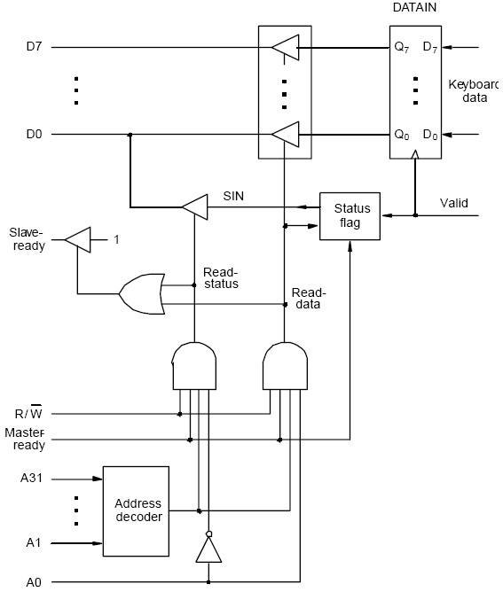
Output lines of DATAIN are
are connected to the data lines of
the bus by means of 3 state drivers
Drivers are turned on when the
processor issues a read signal and
the address selects this register.
SIN signal is generated using a status flag circuit.
It is connected to line D₀ of the processor bus
using a three-state driver.
Address decoder selects the input interface based
on bits A₁ through A₃₁.
Bit A0 determines whether the status or data
register is to be read, when Master-ready is
active.
In response, the processor activates the Slave-ready
signal, when either the Read-status or Read-data
is equal to 1, which depends on line A₀.

Slide 50

Data
Address
D
A
T
A
OUT
Data
Processor
R
/
W
SOUT
CPU
V
alid
Printer
Master
-ready
Output
Idle
Sla
v
e-ready
interf
ace
Printer is connected to a processor using a parallel port.
Processor is 32 bits, uses memory-mapped I/O and asynchronous bus protocol.
On the processor side:
- Data lines.
- Address lines
- Control or R/W line.
- Master-ready signal and
- Slave-ready signal.

Slide 51

Data
Address
D
A
T
A
OUT
Data
Processor
R
/
W
SOUT
CPU
V
alid
Printer
Master
-ready
Output
Idle
Sla
v
e-ready
interf
ace
On the printer side:
- Idle signal line which the printer asserts when it is ready to accept a character.
This causes the SOUT flag to be set to 1.
- Processor places a new character into a DATAOUT register.
- Valid signal, asserted by the interface circuit when it places a new character
on the data lines.

Slide 52

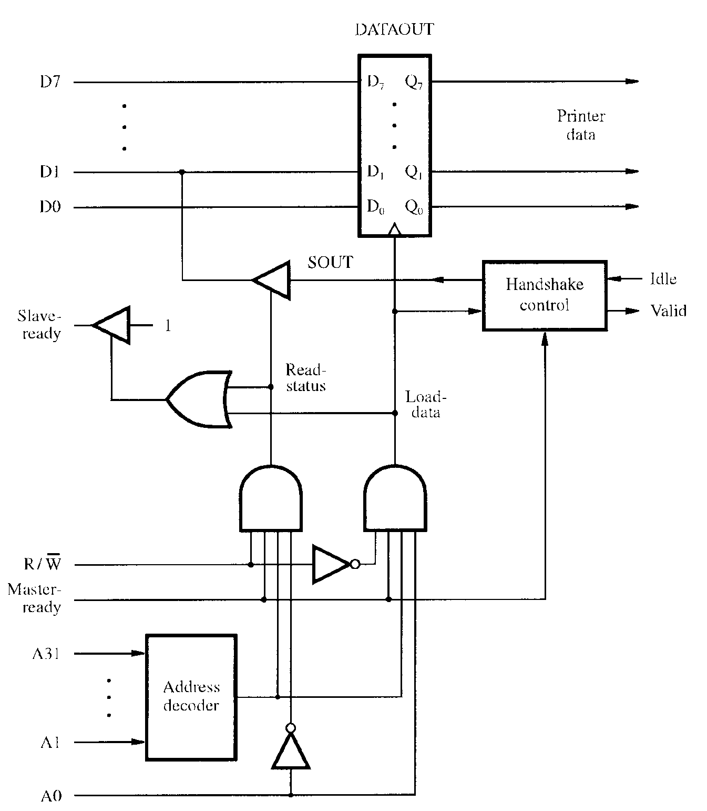
Data lines of the processor bus
are connected to the DATAOUT
register of the interface.
The status flag SOUT is connected
to the data line D1 using a three-state
driver.
The three-state driver is turned on,
when the control Read-status line is
1.
Address decoder selects the output
interface using address lines A1
through A31.
Address line A0 determines whether
the data is to be loaded into the
DATAOUT register or status flag is
to be read.
If the Load-data line is 1, then the
Valid line is set to 1.
If the Idle line is 1, then the status
flag SOUT is set to 1.

Slide 53
D7
Bus
P
A7
D
A
T
AIN
D1
D0
P
A0
Combined I/O interface circuit.
Address bits A2 through A31, that is
30 bits are used to select the overall
interface.
Address bits A1 through A0, that is, 2
bits select one of the three registers,
namely, DATAIN, DATAOUT, and
the status register.
Status register contains the flags SIN and
SOUT in bits 0 and 1.
Data lines PA0 through PA7 connect the
input device to the DATAIN register.
DATAOUT register connects the data
lines on the processor bus to lines PB0
through PB7 which connect to the output
device.
Separate input and output data lines for
connection to an I/O device.
SIN
Input
CA
status
PB7
D
A
T
A
OUT
PB0
SOUT
Handshak
e
CB1
control
CB2
Sla
v
e-
1
Ready
Master
-
Ready
R
/
W
A31
Address
My-address
decoder
A2
A1
RS1
A0
RS0

Slide 54
D7
Data lines to I/O device are bidirectional.
Data lines P7 through P0 can be used for
both input, and output.
In fact, some lines can be used for input &
some for output depending on the pattern
in the Data Direction Register (DDR).
Processor places an 8-bit pattern into a DDR.
If a given bit position in the DDR is 1, the
corresponding data line acts as an output
line, otherwise it acts as an input line.
C1 and C2 control the interaction between
the interface circuit and the I/O devices.
Ready and Accept lines are the handshake
control lines on the processor bus side, and
are connected to Master-ready & Slave-ready.
Input signal My-address is connected to the
output of an address decoder.
Three register select lines that allow up to 8
registers to be selected.
P7
D
A
T
AIN
D0
P0
D
A
T
A
OUT
Data
Direction
Re
gister
My-address
RS2
C1
RS1
Re
gister
Status
RS0
select
and
R
/
W
control
Ready
C2
Accept
INTR

Slide 55
Serial port
Serial port is used to connect the processor to I/O devices that require transmission of data one bit at a time.
Serial port communicates in a bit-serial fashion on the device side and bit parallel fashion on the bus side.
  Transformation between the parallel and serial formats is achieved with shift registers that have parallel access capability.

Slide 56
Input shift re
gister
Serial
input
Input shift register accepts input one bit
at a time from the I/O device.
Once all the 8 bits are received, the
contents of the input shift register are
loaded in parallel into DATAIN register.
Output data in the DATAOUT register
are loaded into the output shift register.
Bits are shifted out of the output shift
register and sent out to the I/O device one
bit at a time.
As soon as data from the input shift reg.
are loaded into DATAIN, it can start
accepting another 8 bits of data.
Input shift register and DATAIN registers
are both used at input so that the input
shift register can start receiving another
set of 8 bits from the input device after
loading the contents to DATAIN, before
the processor reads the contents of
DATAIN. This is called as double-
buffering.
D
A
T
AIN
D7
D0
My-address
D
A
T
A
OUT
RS1
RS0
Chip and
R
/
W
re
gister
Output shift re
gister
Serial
Ready
select
Accept
Recei
ving clock
I
N
T
R
Status
and
ransmission clock
control
T

Slide 57
Serial port (contd..)
Serial interfaces require fewer wires, and hence serial transmission is convenient for connecting devices that are physically distant from the computer.
Speed of transmission of the data over a serial interface is known as the “bit rate”.
  Bit rate depends on the nature of the devices connected.
In order to accommodate devices with a range of speeds, a serial interface must be able to use a range of clock speeds.
Several standard serial interfaces have been developed:
  Universal Asynchronous Receiver Transmitter (UART) for low-speed serial devices.
  RS-232-C for connection to communication links.

Slide 58
Standard I/O interfaces
I/O device is connected to a computer using an interface circuit.
Do we have to design a different interface for every combination of an I/O device and a computer?
A practical approach is to develop standard interfaces and protocols.
A personal computer has:
  A motherboard which houses the processor chip, main memory and some I/O interfaces.
  A few connectors into which additional interfaces can be plugged.
Processor bus is defined by the signals on the processor chip.
  Devices which require high-speed connection to the processor are connected directly to this bus.

Slide 59
Standard I/O interfaces (contd..)
Because of electrical reasons only a few devices can be connected directly to the processor bus.
Motherboard usually provides another bus that can support more devices.
  Processor bus and the other bus (called as expansion bus) are interconnected by a circuit called “bridge”.
  Devices connected to the expansion bus experience a small delay in data transfers.
Design of a processor bus is closely tied to the architecture of the processor.
  No uniform standard can be defined.
Expansion bus however can have uniform standard defined.

Slide 60
Standard I/O interfaces (contd..)
A number of standards have been developed for the expansion bus.
  Some have evolved by default.
  For example, IBM’s Industry Standard Architecture.
Three widely used bus standards:
  PCI (Peripheral Component Interconnect)
  SCSI (Small Computer System Interface)
  USB (Universal Serial Bus)

Slide 61

Processor
Main
memory
Bridge circuit translates
signals and protocols from
processor bus to PCI bus.
Processor bus
Bridge
PCI bus
Expansion bus on
the motherboard
Additional
SCSI
Ethernet
USB
ISA
memory
controller
Interface
controller
Interface
SCSI b
us
IDE
V
ideo
disk
Disk
CD-R
OM
controller
controller
Disk 1
Disk 2
CD-
K
e
yboard
Game
R
OM

Slide 62
PCI Bus
Peripheral Component Interconnect
Introduced in 1992
Low-cost bus
Processor independent
Plug-and-play capability
In today’s computers, most memory transfers involve a burst of data rather than just one word. The PCI is designed primarily to support this mode of operation.
The bus supports three independent address spaces: memory, I/O, and configuration.
we assumed that the master maintains the address information on the bus until data transfer is completed. But, the address is needed only long enough for the slave to be selected. Thus, the address is needed on the bus for one clock cycle only, freeing the address lines to be used for sending data in subsequent clock cycles. The result is a significant cost reduction.
A master is called an initiator in PCI terminology. The addressed device that responds to read and write commands is called a target.

Slide 63
Data transfer signals on the PCI bus.
Name
F
unction
CLK
A
33-MHz
or
66-MHz
clock.
FRAME#
Sent
b
y
the
initiator
to
indicate
the
duration
of
a
transaction.
AD
32
address/data
lines,
which
may
b
e
optionally
increased
to
64.
C/BE#
4
command/byte-enable
lines
(8
for
a
64-bit
bus).
IRD
Y#,
TRD
Y#
Initiator-ready
and
Target-ready
signals.
DEVSEL#
A
response
from
the
device
indicating
that
it
has
recognized
its
address
and
is
ready
for
a
data
transfer
transaction.
IDSEL#
Initialization
Device
Select.

Slide 64
1
2
3
4
5
6
7
CLK
Frame#
AD
Adress
#1
#2
#3
#4
C/BE#
Cmnd
Byte enable
IRD
Y#
TRD
Y#
DEVSEL#
A read operation on the PCI bus

Slide 65
Device Configuration
When an I/O device is connected to a computer, several actions are needed to configure both the device and the software that communicates with it.
PCI incorporates in each I/O device interface a small configuration ROM memory that stores information about that device.
The configuration ROMs of all devices are accessible in the configuration address space. The PCI initialization software reads these ROMs and determines whether the device is a printer, a keyboard, an Ethernet interface, or a disk controller. It can further learn bout various device options and characteristics.
Devices are assigned addresses during the initialization process.
This means that during the bus configuration operation, devices cannot be accessed based on their address, as they have not yet been assigned one.
Hence, the configuration address space uses a different mechanism. Each device has an input signal called Initialization Device Select, IDSEL#
Electrical characteristics:
  PCI bus has been defined for operation with either a 5 or 3.3 V power supply

Slide 66
SCSI Bus
The acronym SCSI stands for Small Computer System Interface.
It refers to a standard bus defined by the American National Standards Institute (ANSI) under the designation X3.131 .
In the original specifications of the standard, devices such as disks are connected to a computer via a 50-wire cable, which can be up to 25 meters in length and can transfer data at rates up to 5 megabytes/s.
The SCSI bus standard has undergone many revisions, and its data transfer capability has increased very rapidly, almost doubling every two years.
SCSI-2 and SCSI-3 have been defined, and each has several options.
Because of various options SCSI connector may have 50, 68 or 80 pins.

Slide 67
SCSI Bus (Contd.,)
Devices connected to the SCSI bus are not part of the address space of the processor
The SCSI bus is connected to the processor bus through a SCSI controller. This controller uses DMA to transfer data packets from the main memory to the device, or vice versa.
A packet may contain a block of data, commands from the processor to the device, or status information about the device.
A controller connected to a SCSI bus is one of two types – an initiator or a target.
An initiator has the ability to select a particular target and to send commands specifying the operations to be performed. The disk controller operates as a target. It carries out the commands it receives from the initiator.
The initiator establishes a logical connection with the intended target.
Once this connection has been established, it can be suspended and restored as needed to transfer commands and bursts of data.
While a particular connection is suspended, other device can use the bus to transfer information.
This ability to overlap data transfer requests is one of the key features of the SCSI bus that leads to its high performance.

Slide 68
SCSI Bus (Contd.,)
Data transfers on the SCSI bus are always controlled by the target controller.
To send a command to a target, an initiator requests control of the bus and, after winning arbitration, selects the controller it wants to communicate with and hands control of the bus over to it.
Then the controller starts a data transfer operation to receive a command from the initiator.

Slide 69
SCSI Bus (Contd.,)
Assume that processor needs to read block of data from a disk drive and that data are stored in disk sectors that are not contiguous.
The processor sends a command to the SCSI controller, which causes the following sequence of events to take place:
  The SCSI controller, acting as an initiator, contends for control of the bus.
  When the initiator wins the arbitration process, it selects the target controller and hands over control of the bus to it.
  The target starts an output operation (from initiator to target); in response to this, the initiator sends a command specifying the required read operation.
  The target, realizing that it first needs to perform a disk seek operation, sends a message to the initiator indicating that it will temporarily suspend the connection between them. Then it releases the bus.
  The target controller sends a command to the disk drive to move the read head to the first sector involved in the requested read operation. Then, it reads the data stored in that sector and stores them in a data buffer. When it is ready to begin transferring data to the initiator, the target requests control of the bus. After it wins arbitration, it reselects the initiator controller, thus restoring the suspended connection.

Slide 70
SCSI Bus (Contd.,)
  The target transfers the contents of the data buffer to the initiator and then suspends the connection again
  The target controller sends a command to the disk drive to perform another seek operation. Then, it transfers the contents of the second disk sector to the initiator as before. At the end of this transfers, the logical connection between the two controllers is terminated.
  As the initiator controller receives the data, it stores them into the main memory using the DMA approach.
  The SCSI controller sends as interrupt to the processor to inform it that the requested operation has been completed

Slide 71
Operation of SCSI bus from H/W point of view
Category
Name
F
unction
Data
–
DB(0)
to
Data
lines:
Carry
one
b
yte
of
information
–
DB(7)
during
the
information
transfer
phase
and
iden
tify
device
during
arbitration,
selection
and
reselection
phases
–
DB(P)
P
arit
y
bit
for
the
data
bus
Phase
–
BSY
Busy:
Asserted
when
the
bus
is
not
free
–
SEL
Selection:
Asserted
during
selection
and
reselection
Information
–
C/D
Con
trol/Data:
Asserted
during
transfer
of
type
con
trol
information
(command,
status
or
message)
–
MSG
Message:
indicates
that
the
information being
transferred
is
a
message
Table 4. The SCSI bus signals.

Slide 72
Table 4. The SCSI bus signals.(cont.)
Category
Name
F
unction
Handshake
–
REQ
Request:
Asserted
b
y
a
target
to
request
a
data
transfer
cycle
–
A
CK
Ac
kno
wledge:
Asserted
b
y
the
initiator
when
it
has
completed
a
data
transfer
op
eration
Direction of
–
I/O
Input/Output:
Asserted
to
indicate
an
input
transfer
op
eration
e
(relativ
to
the
initiator)
–
Other
A
TN
A
tten
tion:
Asserted
b
y
an
initiator
when
it
wishes
to
send
a
message
to
a
target
–
RST
Reset:
Causes
all
device
con
trols
to
disconnect
from
the
bus
and
assume
their
start-up
state

Slide 73
Main Phases involved
Arbitration
  A controller requests the bus by asserting BSY and by asserting it’s associated data line
  When BSY becomes active, all controllers that are requesting bus examine data lines
Selection
  Controller that won arbitration selects target by asserting SEL and data line of target. After that initiator releases BSY line.
  Target responds by asserting BSY line
  Target controller will have control on the bus from then
Information Transfer
  Handshaking signals are used between initiator and target
  At the end target releases BSY line
Reselection

Slide 74
Targets examine ID
D
B
2
D
B
5
D
B
6
B
S
Y
S
E
L
Free
Arbitration
Selection
Figure 42. Arbitration and selection on the SCSI bus.
Device 6 wins arbitration and selects device 2.

Slide 75
USB
Universal Serial Bus (USB) is an industry standard developed through a collaborative effort of several computer and communication companies, including Compaq, Hewlett-Packard, Intel, Lucent, Microsoft, Nortel Networks, and Philips.
Speed
    Low-speed(1.5 Mb/s)
    Full-speed(12 Mb/s)
    High-speed(480 Mb/s)
Port Limitation
Device Characteristics
Plug-and-play

Slide 76
Universal Serial Bus tree structure
Host computer
Root
hub
Hub
Hub
Hub
de
I/O
I/O
I/O
I/O
vice
de
vice
de
vice
de
vice
de
I/O
I/O
vice
de
vice

Slide 77
Universal Serial Bus tree structure
To accommodate a large number of devices that can be added or removed at any time, the USB has the tree structure as shown in the figure.
Each node of the tree has a device called a hub, which acts as an intermediate control point between the host and the I/O devices. At the root of the tree, a root hub connects the entire tree to the host computer. The leaves of the tree are the I/O devices being served (for example, keyboard, Internet connection, speaker, or digital TV)
In normal operation, a hub copies a message that it receives from its upstream connection to all its downstream ports. As a result, a message sent by the host computer is broadcast to all I/O devices, but only the addressed device will respond to that message. However, a message from an I/O device is sent only upstream towards the root of the tree and is not seen by other devices. Hence, the USB enables the host to communicate with the I/O devices, but it does not enable these devices to communicate with each other.

Slide 78
Addressing
When a USB is connected to a host computer, its root hub is attached to the processor bus, where it appears as a single device. The host software communicates with individual devices attached to the USB by sending packets of information, which the root hub forwards to the appropriate device in the USB tree.
Each device on the USB, whether it is a hub or an I/O device, is assigned a 7-bit address. This address is local to the USB tree and is not related in any way to the addresses used on the processor bus.
A hub may have any number of devices or other hubs connected to it, and addresses are assigned arbitrarily. When a device is first connected to a hub, or when it is powered on, it has the address 0. The hardware of the hub to which this device is connected is capable of detecting that the device has been connected, and it records this fact as part of its own status information. Periodically, the host polls each hub to collect status information and learn about new devices that may have been added or disconnected.
When the host is informed that a new device has been connected, it uses a sequence of commands to send a reset signal on the corresponding hub port, read information from the device about its capabilities, send configuration information to the device, and assign the device a unique USB address. Once this sequence is completed the device begins normal operation and responds only to the new address.

Slide 79
USB Protocols
All information transferred over the USB is organized in packets, where a packet consists of one or more bytes of information. There are many types of packets that perform a variety of control functions.
The information transferred on the USB can be divided into two broad categories: control and data.
  Control packets perform such tasks as addressing a device to initiate data transfer, acknowledging that data have been received correctly, or indicating an error.
  Data packets carry information that is delivered to a device.
A packet consists of one or more fields containing different kinds of information. The first field of any packet is called the packet identifier, PID, which identifies the type of that packet.
They are transmitted twice. The first time they are sent with their true values, and the second time with each bit complemented
The four PID bits identify one of 16 different packet types. Some control packets, such as ACK (Acknowledge), consist only of the PID byte.

Slide 80
PID
PID
PID
PID
PID
0
1
2
3
PID
0
PID
PID
PID
0
1
2
3
(a) Packet identifier field
Bits
8
7
4
5
Control packets used for controlling data transfer operations are called token packets.
PID
ADDR
ENDP
CRC16
(b) Token packet, IN or OUT
Bits
8
0 to 8192
16
PID
D
A
T
A
CRC16
(c) Data packet
Figure 45. USB packet format.

Slide 81
Host
Hub
I/O De
vice
T
ok
en
Data0
A
CK
Time
T
ok
en
Data0
A
CK
T
ok
en
Figure: An output
transfer
Data1
A
CK
T
ok
en
Data1
A
CK

Slide 82
Isochronous Traffic on USB
One of the key objectives of the USB is to support the transfer of isochronous data.
Devices that generates or receives isochronous data require a time reference to control the sampling process.
To provide this reference. Transmission over the USB is divided into frames of equal length.
A frame is 1ms long for low-and full-speed data.
The root hub generates a Start of Frame control packet (SOF) precisely once every 1 ms to mark the beginning of a new frame.
The arrival of an SOF packet at any device constitutes a regular clock signal that the device can use for its own purposes.
To assist devices that may need longer periods of time, the SOF packet carries an 11-bit frame number.
Following each SOF packet, the host carries out input and output transfers for isochronous devices.
This means that each device will have an opportunity for an input or output transfer once every 1 ms.

Slide 83
Electrical Characteristics
The cables used for USB connections consist of four wires.
Two are used to carry power, +5V and Ground.
  Thus, a hub or an I/O device may be powered directly from the bus, or it may have its own external power connection.
The other two wires are used to carry data.
Different signaling schemes are used for different speeds of transmission.
  At low speed, 1s and 0s are transmitted by sending a high voltage state (5V) on one or the other o the two signal wires. For high-speed links, differential transmission is used.

