Slide 1
Pipelining: Basic and Intermediate Concepts
Computer Architecture: A Quantitative Approach by Hennessey and Patterson
Appendix A
(adapted from J. Rhinelander’s slides)

Slide 2
What Is A Pipeline?
Pipelining is used by virtually all modern microprocessors to enhance performance by overlapping the execution of instructions.
A common analogue for a pipeline is a factory assembly line. Assume that there are three stages:
    Welding
    Painting
    Polishing
For simplicity, assume that each task takes one hour.
ENGR9861 Winter 2007 RV

Slide 3
What Is A Pipeline?
If a single person were to work on the product it would take three hours to produce one product.
If we had three people, one person could work on each stage, upon completing their stage they could pass their product on to the next person (since each stage takes one hour there will be no waiting).
We could then produce one product per hour assuming the assembly line has been filled.
ENGR9861 Winter 2007 RV

Slide 4
Characteristics Of Pipelining
If the stages of a pipeline are not balanced and one stage is slower than another, the entire throughput of the pipeline is affected.
In terms of a pipeline within a CPU, each instruction is broken up into different stages. Ideally if each stage is balanced (all stages are ready to start at the same time and take an equal amount of time to execute.) the time taken per instruction (pipelined) is defined as:
Time per instruction (unpipelined) / Number of stages
ENGR9861 Winter 2007 RV

Slide 5
Characteristics Of Pipelining
The previous expression is ideal. We will see later that there are many ways in which a pipeline cannot function in a perfectly balanced fashion.
In terms of a CPU, the implementation of pipelining has the effect of reducing the average instruction time, therefore reducing the average CPI.
EX: If each instruction in a microprocessor takes 5 clock cycles (unpipelined) and we have a 4 stage pipeline, the ideal average CPI with the pipeline will be 1.25 .
ENGR9861 Winter 2007 RV

Slide 6
RISC Instruction Set Basics
(from Hennessey and Patterson)
Properties of RISC architectures:
  All ops on data apply to data in registers and typically change the entire register (32-bits or 64-bits).
  The only ops that affect memory are load/store operations. Memory to register, and register to memory.
  Load and store ops on data less than a full size of a register (32, 16, 8 bits) are often available.
  Usually instructions are few in number (this can be relative) and are typically one size.
ENGR9861 Winter 2007 RV

Slide 7
RISC Instruction Set Basics
Types Of Instructions
ALU Instructions:
    Arithmetic operations, either take two registers as operands or take one register and a sign extended immediate value as an operand. The result is stored in a third register.
    Logical operations AND OR, XOR do not usually differentiate between 32-bit and 64-bit.
Load/Store Instructions:
    Usually take a register (base register) as an operand and a 16-bit immediate value. The sum of the two will create the effective address. A second register acts as a source in the case of a load operation.
ENGR9861 Winter 2007 RV

Slide 8
RISC Instruction Set Basics
Types Of Instructions (continued)
    In the case of a store operation the second register contains the data to be stored.
Branches and Jumps
    Conditional branches are transfers of control. As described before, a branch causes an immediate value to be added to the current program counter.
Appendix A has a more detailed description of the RISC instruction set. Also the inside back cover has a listing of a subset of the MIPS64 instruction set.
ENGR9861 Winter 2007 RV

Slide 9
RISC Instruction Set Implementation
We first need to look at how instructions in the MIPS64 instruction set are implemented without pipelining. We’ll assume that any instruction of the subset of MIPS64 can be executed in at most 5 clock cycles.
The five clock cycles will be broken up into the following steps:
    Instruction Fetch Cycle
    Instruction Decode/Register Fetch Cycle
    Execution Cycle
    Memory Access Cycle
    Write-Back Cycle
ENGR9861 Winter 2007 RV

Slide 10
Instruction Fetch (IF) Cycle
The value in the PC represents an address in memory. The MIPS64 instructions are all 32-bits in length. Figure 2.27 shows how the 32-bits (4 bytes) are arranged depending on the instruction.
First we load the 4 bytes in memory into the CPU.
Second we increment the PC by 4 because memory addresses are arranged in byte ordering. This will now represent the next instruction. (Is this certain???)
ENGR9861 Winter 2007 RV

Slide 11
Instruction Decode (ID)/Register Fetch Cycle
Decode the instruction and at the same time read in the values of the register involved. As the registers are being read, do equality test incase the instruction decodes as a branch or jump.
The offset field of the instruction is sign-extended incase it is needed. The possible branch effective address is computed by adding the sign-extended offset to the incremented PC. The branch can be completed at this stage if the equality test is true and the instruction decoded as a branch.
ENGR9861 Winter 2007 RV

Slide 12
Instruction Decode (ID)/Register Fetch Cycle (continued)
Instruction can be decoded in parallel with reading the registers because the register addresses are at fixed locations.
ENGR9861 Winter 2007 RV

Slide 13
Execution (EX)/Effective Address Cycle
If a branch or jump did not occur in the previous cycle, the arithmetic logic unit (ALU) can execute the instruction.
At this point the instruction falls into three different types:
    Memory Reference: ALU adds the base register and the offset to form the effective address.
    Register-Register: ALU performs the arithmetic, logical, etc… operation as per the opcode.
    Register-Immediate: ALU performs operation based on the register and the immediate value (sign extended).
ENGR9861 Winter 2007 RV

Slide 14
Memory Access (MEM) Cycle
If a load, the effective address computed from the previous cycle is referenced and the memory is read. The actual data transfer to the register does not occur until the next cycle.
If a store, the data from the register is written to the effective address in memory.
ENGR9861 Winter 2007 RV

Slide 15
Write-Back (WB) Cycle
Occurs with Register-Register ALU instructions or load instructions.
Simple operation whether the operation is a register-register operation or a memory load operation, the resulting data is written to the appropriate register.
ENGR9861 Winter 2007 RV

Slide 16
Looking At The Big Picture
Overall the most time that an non-pipelined instruction can take is 5 clock cycles. Below is a summary:
    Branch - 2 clock cycles
    Store - 4 clock cycles
    Other - 5 clock cycles
EX: Assuming branch instructions account for 12% of all instructions and stores account for 10%, what is the average CPI of a non-pipelined CPU?
ANS: 0.12*2+0.10*4+0.78*5
= 4.54
ENGR9861 Winter 2007 RV

Slide 17
The Classical RISC 5 Stage Pipeline
In an ideal case to implement a pipeline we just need to start a new instruction at each clock cycle.
Unfortunately there are many problems with trying to implement this. Obviously we cannot have the ALU performing an ADD operation and a MULTIPLY at the same time. But if we look at each stage of instruction execution as being independent, we can see how instructions can be “overlapped”.
ENGR9861 Winter 2007 RV

Slide 18
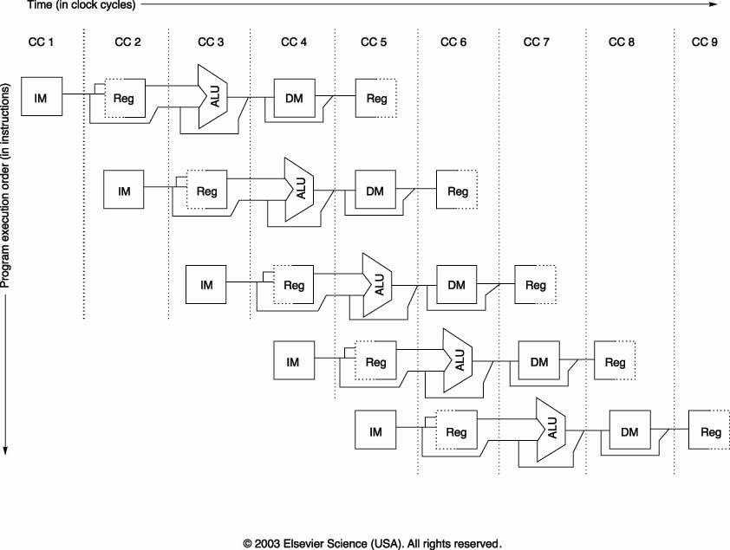
ENGR9861 Winter 2007 RV

Slide 19
Problems With The Previous Figure
The memory is accessed twice during each clock cycle. This problem is avoided by using separate data and instruction caches.
It is important to note that if the clock period is the same for a pipelined processor and an non-pipelined processor, the memory must work five times faster.
Another problem that we can observe is that the registers are accessed twice every clock cycle. To try to avoid a resource conflict we perform the register write in the first half of the cycle and the read in the second half of the cycle.
ENGR9861 Winter 2007 RV

Slide 20
Problems With The Previous Figure (continued)
We write in the first half because therefore an write operation can be read by another instruction further down the pipeline.
A third problem arises with the interaction of the pipeline with the PC. We use an adder to increment PC by the end of IF. Within ID we may branch and modify PC. How does this affect the pipeline?
The use if pipeline registers allow the CPU of have a memory to implement the pipeline. Remember that the previous figure has only one resource use in each stage.
ENGR9861 Winter 2007 RV

Slide 21
Pipeline Hazards
The performance gain from using pipelining occurs because we can start the execution of a new instruction each clock cycle. In a real implementation this is not always possible.
Another important note is that in a pipelined processor, a particular instruction still takes at least as long to execute as non-pipelined.
Pipeline hazards prevent the execution of the next instruction during the appropriate clock cycle.
ENGR9861 Winter 2007 RV

Slide 22
Types Of Hazards
There are three types of hazards in a pipeline, they are as follows:
    Structural Hazards: are created when the data path hardware in the pipeline cannot support all of the overlapped instructions in the pipeline.
    Data Hazards: When there is an instruction in the pipeline that affects the result of another instruction in the pipeline.
    Control Hazards: The PC causes these due to the pipelining of branches and other instructions that change the PC.
ENGR9861 Winter 2007 RV

Slide 23
A Hazard Will Cause A Pipeline Stall
Some performance expressions involving a realistic pipeline in terms of CPI. It is a assumed that the clock period is the same for pipelined and unpipelined implementations.
Speedup = CPI Unpipelined / CPI pipelined
= Pipeline Depth / ( 1 + Stalls per Ins)
= Ave Ins Time Unpipelined / Ave Ins Time Pipelined
ENGR9861 Winter 2007 RV

Slide 24
A Hazard Will Cause A Pipeline Stall (continued)
We can look at pipeline performance in terms of a faster clock cycle time as well:
CPI unpipelined
Clock cycle time unpipelined
Speedup =
x
CPI pipelined
Clock cycle time pipelined
Clock cycle time unpipelined
Clock cycle pipelined =
Pipeline Depth
1
Speedup =
x
Pipeline Depth
1 + Pipeline stalls per Ins
ENGR9861 Winter 2007 RV

Slide 25
Dealing With Structural Hazards
Structural hazards result from the CPU data path not having resources to service all the required overlapping resources.
Suppose a processor can only read and write from the registers in one clock cycle. This would cause a problem during the ID and WB stages.
Assume that there are not separate instruction and data caches, and only one memory access can occur during one clock cycle. A hazard would be caused during the IF and MEM cycles.
ENGR9861 Winter 2007 RV

Slide 26
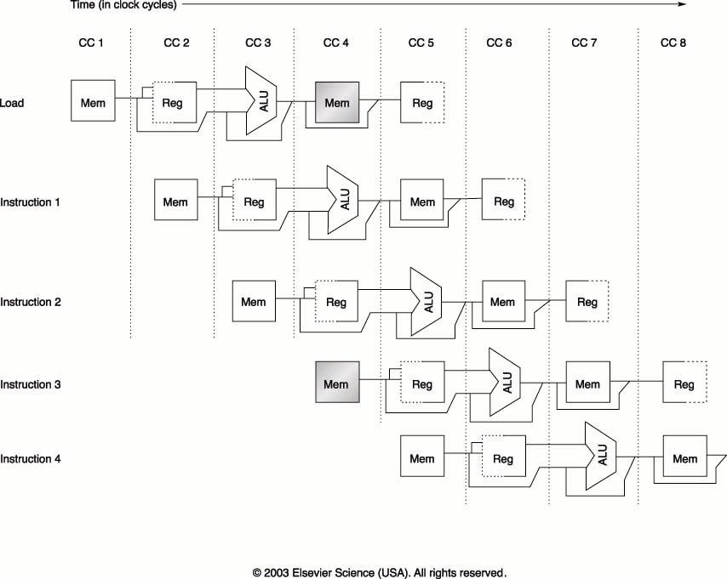
ENGR9861 Winter 2007 RV

Slide 27
Dealing With Structural Hazards
A structural hazard is dealt with by inserting a stall or pipeline bubble into the pipeline. This means that for that clock cycle, nothing happens for that instruction. This effectively “slides” that instruction, and subsequent instructions, by one clock cycle.
This effectively increases the average CPI.
EX: Assume that you need to compare two processors, one with a structural hazard that occurs 40% for the time, causing a stall. Assume that the processor with the hazard has a clock rate 1.05 times faster than the processor without the hazard. How fast is the processor with the hazard compared to the one without the hazard?
ENGR9861 Winter 2007 RV

Slide 28
Dealing With Structural Hazards (continued)
CPI no haz
Clock cycle time no haz
Speedup =
x
CPI haz
Clock cycle time haz
1
1
Speedup =
x
1+0.4*1
1/1.05
= 0.75
ENGR9861 Winter 2007 RV

Slide 29
Dealing With Structural Hazards (continued)
We can see that even though the clock speed of the processor with the hazard is a little faster, the speedup is still less than 1.
Therefore the hazard has quite an effect on the performance.
Sometimes computer architects will opt to design a processor that exhibits a structural hazard. Why?
A: The improvement to the processor data path is too costly.
B: The hazard occurs rarely enough so that the processor will still perform to specifications.
ENGR9861 Winter 2007 RV

Slide 30
Data Hazards (A Programming Problem?)
We haven’t looked at assembly programming in detail at this point.
Consider the following operations:
DADD R1, R2, R3
DSUB R4, R1, R5
AND R6, R1, R7
OR R8, R1, R9
XOR R10, R1, R11
ENGR9861 Winter 2007 RV

Slide 31
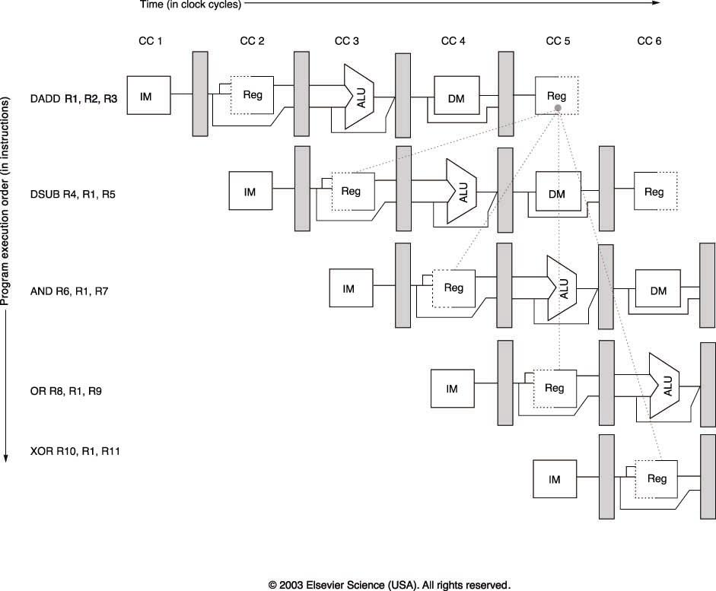
Pipeline Registers
What are the problems?
ENGR9861 Winter 2007 RV

Slide 32
Data Hazard Avoidance
In this trivial example, we cannot expect the programmer to reorder his/her operations. Assuming this is the only code we want to execute.
Data forwarding can be used to solve this problem.
To implement data forwarding we need to bypass the pipeline register flow:
  Output from the EX/MEM and MEM/WB stages must be fed back into the ALU input.
  We need routing hardware that detects when the next instruction depends on the write of a previous instruction.
ENGR9861 Winter 2007 RV

Slide 33
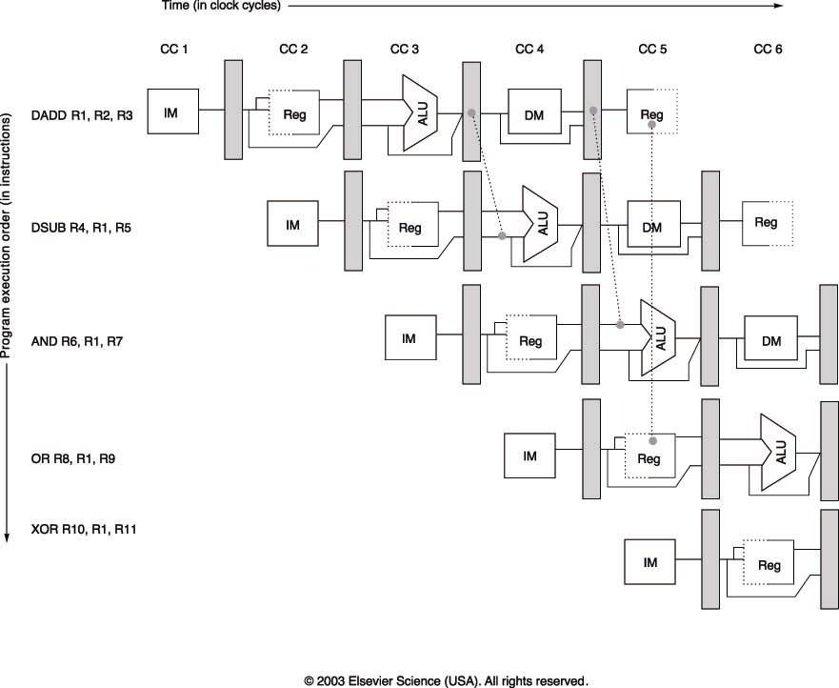
ENGR9861 Winter 2007 RV

Slide 34
General Data Forwarding
It is easy to see how data forwarding can be used by drawing out the pipelined execution of each instruction.
Now consider the following instructions:
DADD R1, R2, R3
LD R4, O(R1)
SD R4, 12(R1)
ENGR9861 Winter 2007 RV

Slide 35
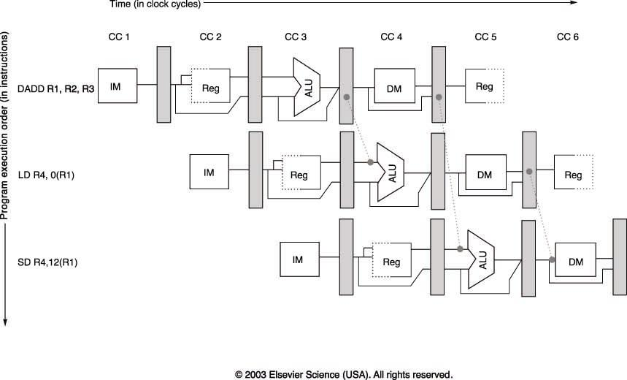
ENGR9861 Winter 2007 RV

Slide 36
Problems
Can data forwarding prevent all data hazards?
NO!
The following operations will still cause a data hazard. This happens because the further down the pipeline we get, the less we can use forwarding.
LD R1, O(R2)
DSUB R4, R1, R5
AND R6, R1, R7
OR R8, R1, R9
ENGR9861 Winter 2007 RV

Slide 37
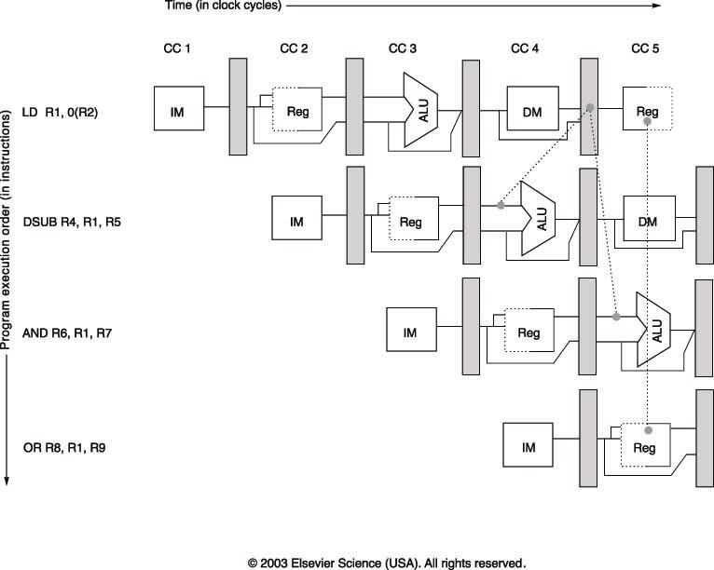
ENGR9861 Winter 2007 RV

Slide 38
Problems
We can avoid the hazard by using a pipeline interlock.
The pipeline interlock will detect when data forwarding will not be able to get the data to the next instruction in time.
A stall is introduced until the instruction can get the appropriate data from the previous instruction.
ENGR9861 Winter 2007 RV

Slide 39
Control Hazards
Control hazards are caused by branches in the code.
During the IF stage remember that the PC is incremented by 4 in preparation for the next IF cycle of the next instruction.
What happens if there is a branch performed and we aren’t simply incrementing the PC by 4.
The easiest way to deal with the occurrence of a branch is to perform the IF stage again once the branch occurs.
ENGR9861 Winter 2007 RV

Slide 40
Performing IF Twice
We take a big performance hit by performing the instruction fetch whenever a branch occurs. Note, this happens even if the branch is taken or not. This guarantees that the PC will get the correct value.
IF ID EX MEM WB
branch
IF ID EX MEM WB
IF IF ID EX MEM WB
ENGR9861 Winter 2007 RV

Slide 41
Performing IF Twice
This method will work but as always in computer architecture we should try to make the most common operation fast and efficient.
With MIPS64 branch instructions are quite common.
By performing IF twice we will encounter a performance hit between 10%-30%
Next class we will look at some methods for dealing with Control Hazards.
ENGR9861 Winter 2007 RV

Slide 42
Control Hazards (other solutions)
These following solutions assume that we are dealing with static branches. Meaning that the actions taken during a branch do not change.
We already saw the first example, we stall the pipeline until the branch is resolved (in our case we repeated the IF stage until the branch resolved and modified the PC)
The next two examples will always make an assumption about the branch instruction.
ENGR9861 Winter 2007 RV

Slide 43
Control Hazards (other solutions)
What if we treat every branch as “not taken” remember that not only do we read the registers during ID, but we also perform an equality test in case we need to branch or not.
We can improve performance by assuming that the branch will not be taken.
What in this case we can simply load in the next instruction (PC+4) can continue. The complexity arises when the branch evaluates and we end up needing to actually take the branch.
ENGR9861 Winter 2007 RV

Slide 44
Control Hazards (other solutions)
If the branch is actually taken we need to clear the pipeline of any code loaded in from the “not-taken” path.
Likewise we can assume that the branch is always taken. Does this work in our “5-stage” pipeline?
No, the branch target is computed during the ID cycle. Some processors will have the target address computed in time for the IF stage of the next instruction so there is no delay.
ENGR9861 Winter 2007 RV

Slide 45
Control Hazards (other solutions)
The “branch-not taken” scheme is the same as performing the IF stage a second time in our 5 stage pipeline if the branch is taken.
If not there is no performance degradation.
The “branch taken” scheme is no benefit in our case because we evaluate the branch target address in the ID stage.
The fourth method for dealing with a control hazard is to implement a “delayed” branch scheme.
In this scheme an instruction is inserted into the pipeline that is useful and not dependent on whether the branch is taken or not. It is the job of the compiler to determine the delayed branch instruction.
ENGR9861 Winter 2007 RV

Slide 46
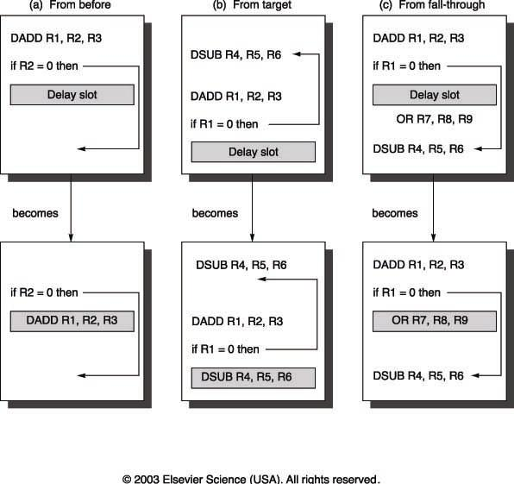
ENGR9861 Winter 2007 RV

Slide 47
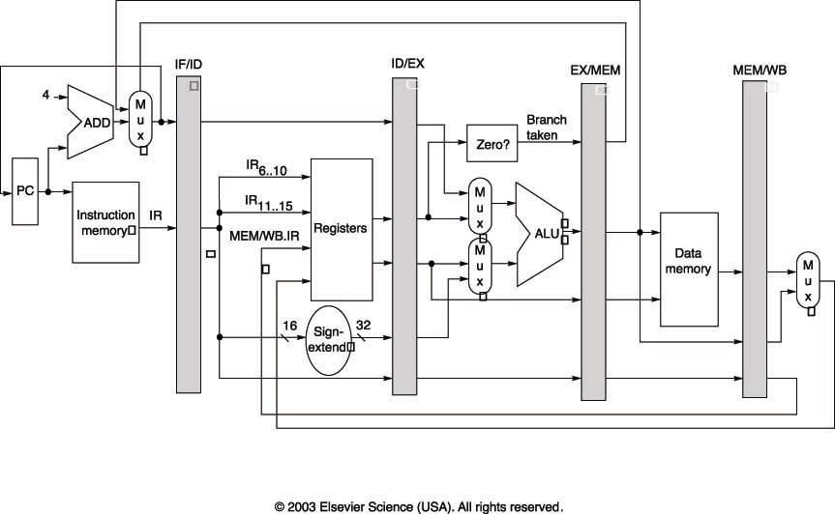
How To Implement a Pipeline
From page A-29 in the text we will now look at the data path implementation of a 5 stage pipeline.
ENGR9861 Winter 2007 RV

Slide 48
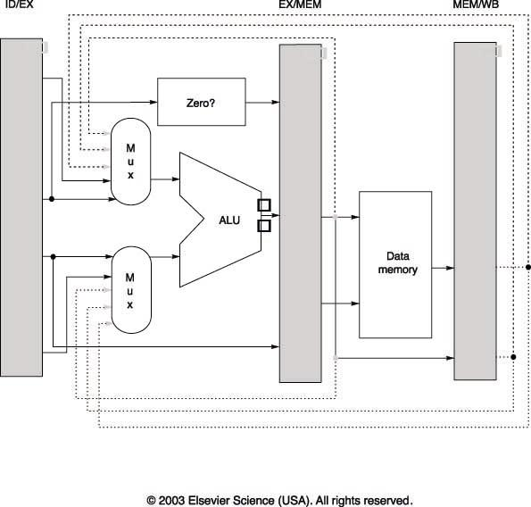
How To Implement a Pipeline
ENGR9861 Winter 2007 RV

Slide 49
Multi-clock Operations
Sometimes operations require more than one clock cycle to complete. Examples are:
    Floating Point Multiply
    Floating Point Divide
    Floating Point Add
We can assume that there is hardware available on the processor for performing the operations.
Assume that the FP Mul and Add are fully pipelined, and the divide is un-pipelined.
ENGR9861 Winter 2007 RV

Slide 50
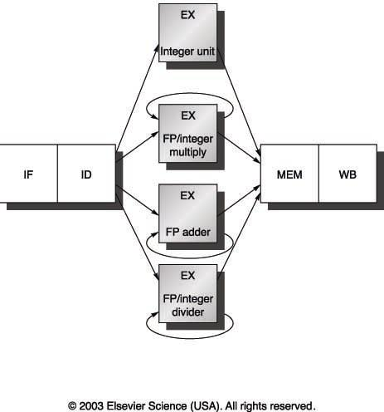
ENGR9861 Winter 2007 RV

Slide 51
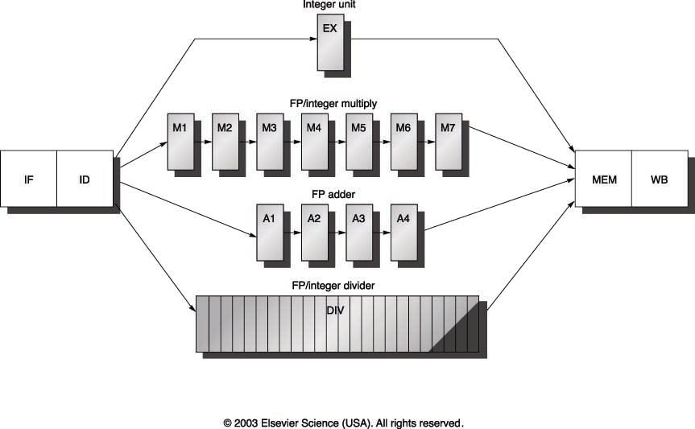
ENGR9861 Winter 2007 RV

Slide 52
Avoiding Structural Hazards
The multiplier and the divider are fully pipelined. The divider is not pipelined at all.
Take a look at figure A.34 for a good example of how pipelining will function in the case of longer instruction execution. The author assumes a single floating point register port.
Structural hazards are avoided in the ID stage by assigning a memory bit in a shift register. Incoming instructions can then check to see if they should stall.
ENGR9861 Winter 2007 RV

Slide 53
Instruction Level Parallelism (ILP)
Chapter 3
The reason why we can implement pipelining in a microprocessor is due to instruction level parallelism.
Since operations can be overlapped in execution, they exhibit ILP.
ILP is mostly exploited in the use of branches. A “basic block” is a block of code that has no branches into or out of except for at the start and the end.
In MIPS, an average basic block is 4-7 separate instructions.
ENGR9861 Winter 2007 RV

Slide 54
Dependences and Hazards
Data Dependence:
  Instruction i produces a result the instruction j will use or instruction i is data dependent on instruction j and vice versa.
Name Dependence:
  Occurs when two instructions use the same register and memory location. But there is no flow of data between the instructions. Instruction order must be preserved.
    Antidependence: i writes to a location that j reads.
    Output Dependence: two instructions write to the same location.
ENGR9861 Winter 2007 RV

Slide 55
Dependences and Hazards
Types of data hazards:
  RAW: read after write
  WAW: write after write
  WAR: write after read
We have already seen a RAW hazard. WAW hazards occur due to output dependence.
WAR hazards do not usually occur because of the amount of time between the read cycle and write cycle in a pipeline.
ENGR9861 Winter 2007 RV

Slide 56
Control Dependence
Assume we have the following piece of code:
If p1{
S1
}
If p2{
S2
}
S1 is dependent on p1 and S2 is dependent on p2.
ENGR9861 Winter 2007 RV

Slide 57
Control Dependence
Control Dependences have the following properties:
  An instruction that is control dependent on a branch cannot be moved in front of the branch, so that the branch no longer controls it.
  An instruction that is control dependent on a branch cannot be moved after the branch so that the branch controls it.
ENGR9861 Winter 2007 RV

Slide 58
Dynamic Scheduling
The previous example that we looked at was an example of statically scheduled pipeline.
Instructions are fetched and then issued. If the users code has a data dependency / control dependence it is hidden by forwarding.
If the dependence cannot be hidden a stall occurs.
Dynamic Scheduling is an important technique in which both dataflow and exception behavior of the program are maintained.
ENGR9861 Winter 2007 RV

Slide 59
Dynamic Scheduling (continued)
Data dependence can cause stalling in a pipeline that has “long” execution times for instructions that dependencies.
EX: Consider this code ( .D is floating point) ,
DIV.D F0,F2,F4
ADD.D F10,F0,F8
SUB.D F12,F8,F14
ENGR9861 Winter 2007 RV

Slide 60
Dynamic Scheduling (continued)
Longer execution times of certain floating point operations give the possibility of WAW and WAR hazards. EX:
Longer execution times of certain floating point operations give the possibility of WAW and WAR hazards. EX:
DIV.D F0, F2, F4
ADD.D F6, F0, F8
SUB.D F8, F10, F14
MUL.D F6, F10, F8
ENGR9861 Winter 2007 RV

Slide 61
Dynamic Scheduling (continued)
If we want to execute instructions out of order in hardware (if they are not dependent etc…) we need to modify the ID stage of our 5 stage pipeline.
Split ID into the following stages:
  Issue: Decode instructions, check for structural hazards.
  Read Operands: Wait until no data hazards, then read operands.
IF still precedes ID and will store the instruction into a register or queue.
ENGR9861 Winter 2007 RV

Slide 62
Still More Dynamic Scheduling
Tomasulo’s Algorithim was invent by Robert Tomasulo and was used in the IBM 360/391.
The algorithm will avoid RAW hazards by executing an instruction only when it’s operands are available. WAR and WAW hazards are avoided by register renaming.
DIV.D F0,F2,F4
ADD.D F6,F0,F8
S.D F6,0(R1)
SUB.D F8,F10,F14
MUL.D F6,F10,F8
DIV.D F0,F2,F4
ADD.D Temp,F0,F8
S.D Temp,0(R1)
SUB.D Temp2,F10,F14
MUL.D F6,F10,Temp2
ENGR9861 Winter 2007 RV

Slide 63
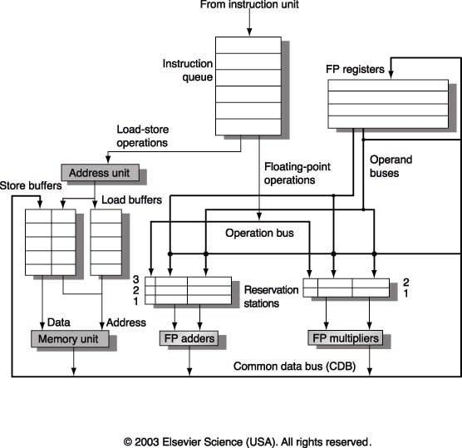
ENGR9861 Winter 2007 RV

Slide 64
Branch Prediction In Hardware
Data hazards can be overcome by dynamic hardware scheduling, control hazards need also to be addressed.
Branch prediction is extremely useful in repetitive branches, such as loops.
A simple branch prediction can be implemented using a small amount of memory and the lower order bits of the address of the branch instruction.
The memory only needs to contain one bit, representing whether the branch was taken or not.
ENGR9861 Winter 2007 RV

Slide 65
Branch Prediction In Hardware
If the branch is taken the bit is set to 1. The next time the branch instruction is fetched we will know that the branch occurred and we can assume that the branch will be taken.
This scheme adds some “history” to our previous discussion on “branch taken” and “branch not taken” control hazard avoidance.
This single bit method will fail at least 20% of the time. Why?
ENGR9861 Winter 2007 RV

Slide 66
2-bit Prediction Scheme
This method is more reliable than using a single bit to represent whether the branch was recently taken or not.
The use of a 2-bit predictor will allow branches that favor taken (or not taken) to be mispredicted less often than the one-bit case.
ENGR9861 Winter 2007 RV

Slide 67
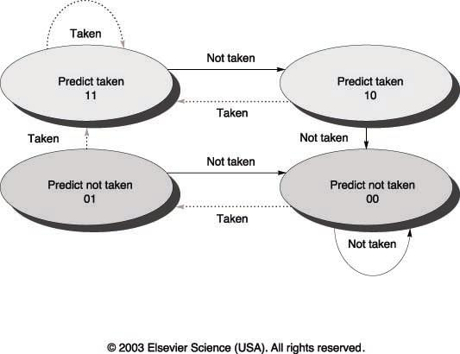
ENGR9861 Winter 2007 RV

Slide 68
Branch Predictors
The size of a branch predictor memory will only increase it’s effectiveness so much.
We also need to address the effectiveness of the scheme used. Just increasing the number of bits in the predictor doesn’t do very much either.
Some other predictors include:
  Correlating Predictors
  Tournament Predictors
ENGR9861 Winter 2007 RV

Slide 69
Branch Predictors
Correlating predictors will use the history of a local branch AND some overall information on how branches are executing to make a decision whether to execute or not.
Tournament Predictors are even more sophisticated in that they will use multiple predictors local and global and enable them with a selector to improve accuracy.
ENGR9861 Winter 2007 RV

