Slide 1
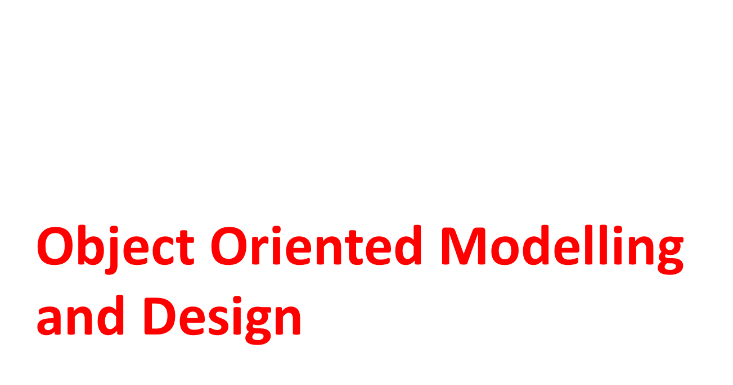

Slide 2
Module-2 : Introduction-Modeling Concepts, class Modeling
What is Object Orientation? What is OO development? OO themes; Evidence for usefulness of OO development; OO modeling history
Modeling as Design Technique: Modeling; abstraction; The three models.
Class Modeling: Object and class concepts; Link and associations concepts; Generalization and inheritance; A sample class model; Navigation of class models; Practical tips.

Slide 3
Object-Oriented Modelling and Design
Object-Oriented Modelling and Design is a way of thinking about problems using models organized around real world concepts. The fundamental construct is the object, which combines both data and behaviour.

Slide 4
Objects
An object has:
  state - descriptive characteristics
  behaviors - what it can do (or what can be done to it)
The state of a bank account includes its account number and its current balance
The behaviors associated with a bank account include the ability to make deposits and withdrawals
Note that the behavior of an object might change its state

Slide 5
Objects
Objects have three responsibilities:
What they know about themselves – (e.g., Attributes)
What they do – (e.g., Operations)
What they know about other objects – (e.g., Relationships)

Slide 6
Objects
Software objects model read-world objects or abstract concepts
  dog, bicycle, Bank account
Real-world objects have states and behaviors
  Dogs' states: name, color, breed, hungry
  Dogs' behaviors: barking fetching
Other examples of objects are:
  myself – an instructor object.
  you – a student object
  this room – a room object
  this university
  your car, etc.

Slide 7
What is Object-Orientation about?
One of the key challenges faced by Computer Scientist is how to handle complexity.
Two main concepts used to manage complexity are Modularity and Abstractions.
  Modularity means breaking a large system up into smaller pieces until each peace becomes simple enough to be handled easily.
  Abstraction focus on essential aspects of an application while ignoring details.
Over the years, computer scientists have developed a number of approaches to achieve modularity and abstraction.
The latest of these approaches is Object-Orientation or OO for short.
The key concept in OO is of course Object,

Slide 8
Object-Oriented
Software is organized as a collection of discrete objects that incorporate both State and behavior.
Four aspects (characteristics) required by an OO approach are -
Identity
Classification
Polymorphism
Inheritance

Slide 9
Identity
Identity means that data is organized into discrete, distinguishable entities called objects.
E.g. for objects: personal computer, bicycle
• Objects can be concrete (such as a file in a file system) or conceptual (such as scheduling policy in a multiprocessing OS). Each object has its own inherent identity. (i.e two objects are distinct even if all their attribute values are identical).

Slide 10
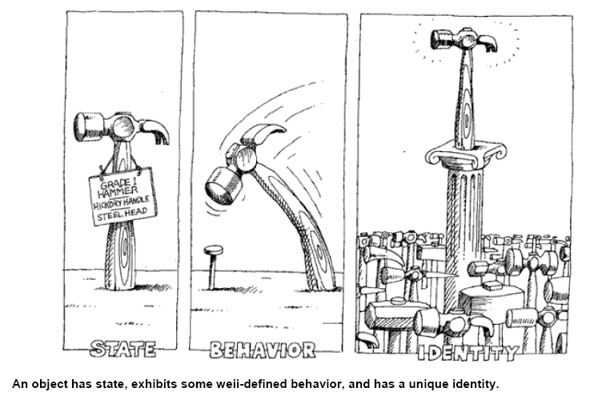

Slide 11
Classification
It means that objects with same data structure (attribute) and behavior (operations) are grouped into a class.
Each object is said to be an instance of its class.
A class is simply a representation of a type of object. It is the blueprint/ plan/ template that describe the details of an object.
A class is the blueprint from which the individual objects are created.

Slide 12
Classes – Example
Class
Attributes
Account
+Owner: Person
+Amount: double
+suspend()
+deposit(sum:double)
+withdraw(sum:double)
Operations
Notes:
(c) 2006 National Academy for Software Development - http://academy.devbg.org
(c) 2006 National Academy for Software Development - http://academy.devbg.org

Slide 13
Classes and Objects – Example
Object
Class
ivanAccount
+Owner=“ABC"
+Amount=5000.0
Account
+Owner: Person
+Amount: double
Object
peterAccount
+suspend()
+deposit(sum:double)
+withdraw(sum:double)
+Owner=“XYZ"
+Amount=1825.33
kirilAccount
Object
+Owner=“CSE”
+Amount=25.0
Notes:
(c) 2006 National Academy for Software Development - http://academy.devbg.org
(c) 2006 National Academy for Software Development - http://academy.devbg.org

Slide 14
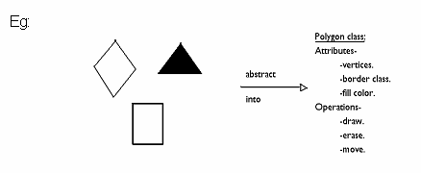
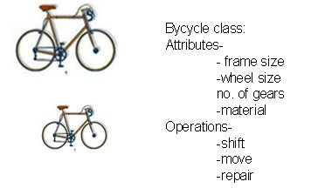

Slide 15
Object-Oriented Development
Development refers to Software Life Cycle.
OOD approach encourages software developers to work and think in terms of the application domain through most of the software engineering life cycle.

Slide 16
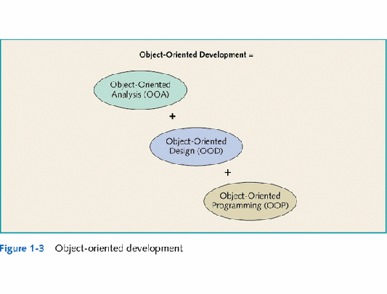

Slide 17
Object-Oriented Methodology
The process for OO development and graphical notation for representing OO concepts consists of building a model of an application and then adding details to it during design.
The methodology has the following stages:
System conception : Software development begins with business analysis or users conceiving an application and formulating tentative requirements
Analysis : The analyst must work with the requestor to understand the problem, because problem statements are rarely complete or correct.
The analysis model is a precise abstraction of what the desired system must do, not how it will be done.
It should not contain implementation decisions.

Slide 18
Object-oriented methodology
System design: The development teams devise a high – level strategy – the system architecture for solving the application problem.
They also establish policies that will serve as a default for the subsequent, more detailed portions of design.
The system designer must decide what performance characteristics to optimize, choose a strategy of attacking the problem and make tentative resource allocations.
Class design : The class designer adds details to the analysis model in accordance with the system design strategy.
The focus of class design is the data structures and algorithms needed to implement each class.

Slide 19
Object-oriented methodology
Implementation : Implementers translate the classes and relationships developed during class design into particular programming language, database or hardware.
During implementation, it is important to follow good software engineering practice so that traceability to the design is apparent and so that the system remains flexible and extensible.

Slide 20
Object oriented Themes
Abstraction: let’s focus on essential aspects of an application while ignoring details.
Encapsulation :( Information Hiding) separates the external aspects of an object , that are accessible to other objects from internal implementation details.
Sharing (reuse)
Emphasis on the essence of an object: OO technology stresses what an object is, rather than how it is used.
Synergy: Identity, classification, polymorphism, and inheritance characterize OO languages. Use all together.

Slide 21
Evidence for usefulness of OOD
Evidence for usefulness of OO development
Applications at General Electric Research and Development Center.(1990)
OO techniques for developing compilers, graphics, user interfaces, databases ,an OO language, etc.
OO technology is a part of the computer science and software engineering mainstream.
Important forums: (OOPSLA,ECOOP) Object Oriented Programming systems, Languages and applications. European Conference on OOP.

Slide 22
OO Modeling history
Work at GE R&D led to OMT(Object-Modeling Technique) in 1991.
Rumbaugh, Grady Booch on unifying the OMT and Booch Notaions in 1994.
In 1996 the OMG(Object Management Group) issued a request for the proposals for a standard OO modeling notation.
1997 UML was accepted by OMG as a standard.
In 2001 OMG released UML
Added features and released UML in 2004.
www.omg.org

Slide 23


Slide 24
What is Modeling
Modeling consists of building an abstraction of reality.
Abstractions are simplifications because:
  They ignore irrelevant details and
  They only represent the relevant details.
What is relevant or irrelevant depends on the purpose of the model.

Slide 25
What is a Model
A model is a simplification of reality.
A model may provide
  blueprints of a system
  Organization of the system
  Dynamic of the system

Slide 26
MODEL
A model is an abstraction, before building any system a prototype may be developed. The main purpose of model is for understanding of the system.
Designer build different kinds of models for various purposes before constructing things.
For example car , airplane, blueprints of machine parts, Plan for house construction etc., Models serve many purposes

Slide 27


Slide 28
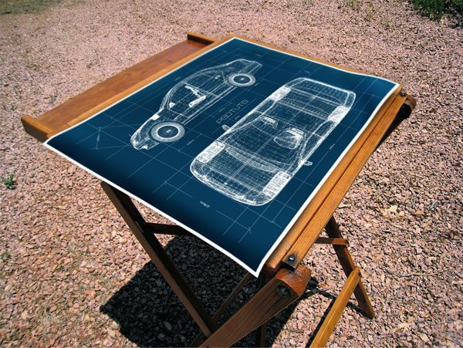

Slide 29
Importance of Modeling
Models help us
  to visualize a system as it is or as we want it to be.
  to specify the structure or behavior of a system.
  in providing a template that guides us in constructing a system.
  in providing documenting the decisions we have made.

Slide 30
Purpose of Modeling
Designers build many kinds of models for various purposes before constructing things.
Models serve several purposes –
Testing a physical entity before building (simulation)
Communication with customer
Visualization
Reduction of complexity
Better understanding of the problem

Slide 31
Purpose of Modeling
Communication with customers
Architects and product designers build models to show their customers. Mock ups are demonstration products that imitate some or all of the external behaviour of a system.

Slide 32
Purpose of Modeling
Visualization
Storyboards of movies, television shows and advertisements let writers see how their ideas flow. They can modify awkward transitions, and unnecessary segments before detailed writing begins.

Slide 33
Purpose of Modeling
Reduction of complexity
The main reason for modeling is to deal with systems that are too complex to understand directly. Models reduce complexity by separating out a small number of important things to deal with at a time.

Slide 34
Three models
We use three kinds of models to describe a system from different view points.
1.Class Model for the objects in the system & their relationships.
2. State model—for the life history of objects.
    Show how systems behave internally
3. Interaction Model—for the interaction among objects.
    Show the behaviour of systems in terms of how objects interact with each other

Slide 35
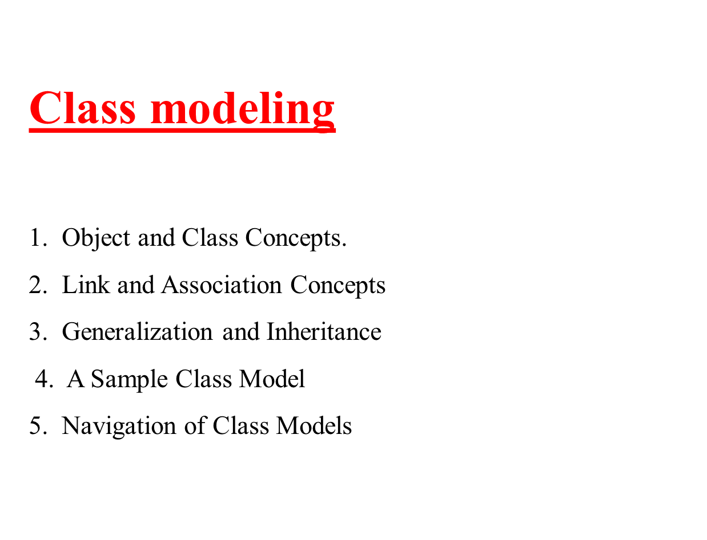

Slide 36
Class diagrams
Class diagrams provide a graphic notation for modeling classes and their relationships, thereby describing possible objects
Note: An object diagram shows individual objects and their relationships.

Slide 37
Class diagrams
A class is a description of a set of
objects that share the same attributes,
operations, relationships, and semantics.
Graphically, a class is rendered as a
rectangle, usually including its name,
attributes, and operations in separate,
designated compartments.
ClassName
attributes
operations

Slide 38
Class Names
ClassName
The name of the class is the only required tag in the graphical representation of a class. It always appears in the top-most compartment.
attributes
operations

Slide 39
Class Attributes
Person
An attribute is a named property of a
class that describes the object being modeled.
In the class diagram, attributes appear in
the second compartment just below the
name-compartment.
name : String
address : Address
birthdate : Date
ssn : Id

Slide 40
Class Operations
Person
name : String
address : Address
birthdate : Date
ssn : Id
Operations describe the class behavior
and appear in the third compartment.
eat
sleep
work
play

Slide 41
An example of Class
Name
Account_Name
- Custom_Name
- Balance
Attributes
+AddFunds( )
+WithDraw( )
+Transfer( )
Operations

Slide 42


Slide 43
Links and Association
Links and associations are the means for establishing relationships among objects and classes.
A link is a physical or conceptual connection among objects.
E.g. JoeSmith WorksFor Simplex Company.
An association is a description of a group of links with common structure and common semantics.
E.g. a person WorksFor a company.

Slide 44
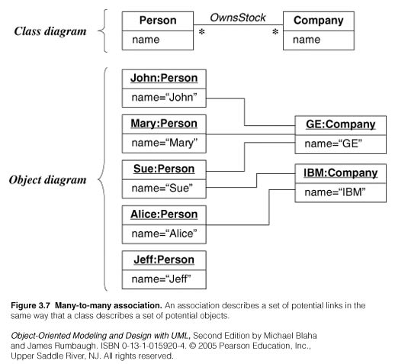
Conventions used (UML):
Link is a line between objects
Association connects related classes and is also denoted by a line.
Show link and association names in italics.

Slide 45
Association
Associations are inherently bi-directional.
The association name is usually read in a particular direction but the binary association may be traversed in either direction.

Slide 46
UML Association Notation
In the UML, a navigable association is represented by an open arrow.
BankAccount
Person
Notes:
Basic association notation.

Slide 47
UML Binary Association Notation
A binary association is drawn as a solid path connecting two classes or both ends may be connected to the same class.
Company
Person
Self Associated involving class Person
Person
Notes:
Association notation.
In practice use either names or roles (or neither).

Slide 48
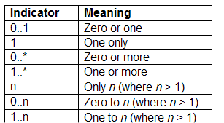
Associations: Multiplicity
Multiplicity defines the number of objects associated with an instance of the association.
UML diagrams explicitly list multiplicity at the end of association lines.
Intervals are used to express multiplicity:
transports
Car
Person
passenger
transports
5
Car
Person
passenger
transports
*
Car
Person
passenger
transports
1..*
Car
Person
passenger
transports
2..5
Car
Person
passenger

Slide 49
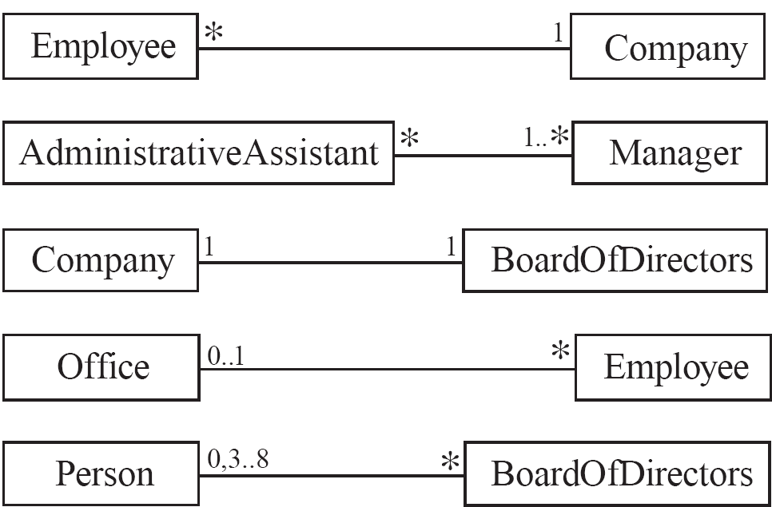
Associations and Multiplicity
An association is used to show how two classes are related to each other
  Symbols indicating multiplicity are shown at each end of the association

Slide 50

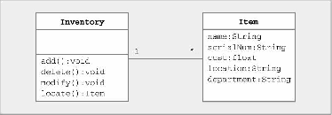
Many-to-one
– Bank has many ATMs, ATM knows only 1 bank
One-to-many
– Inventory has many items, items know 1 inventory

Slide 51
Association Relationships
If two classes in a model need to communicate with each other, there must be link between them.
An association denotes that link.
Student
Instructor

Slide 52
Association Relationships (Cont’d)
We can indicate the multiplicity of an association by adding multiplicity relationships to the line denoting the association.
The example indicates that a Student has one or more Instructors:
Student
Instructor
1..*

Slide 53
Association Relationships (Cont’d)
The example indicates that every Instructor has one or more Students:
Student
Instructor
1..*

Slide 54
Association Relationships (Cont’d)
We can also indicate the behavior of an object in an association (i.e., the role of an object) using rolenames.
teaches
learns from
Student
Instructor
1..*
1..*

Slide 55
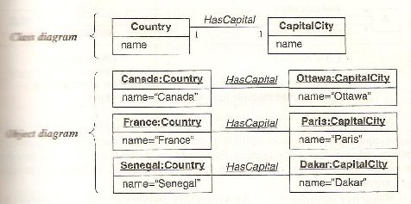
one-to-one multiplicity

Slide 56
Multiplicity Constraints
is registered for>
Student
Semester
1..*
0..*
1
takes>
is held during>
0..8
1..*
teaches>
Class Section
Instructor
1..3
0..6
1..*
<works for
is instance of>
1
sponsors>
1
1..*
Department
Course
Coming up: Questions

Slide 57
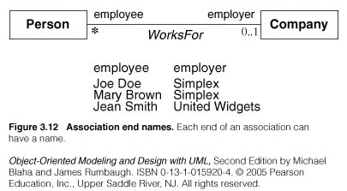
Association Ends
Associations have ends. They are called ‘Association Ends’.
They may have names (which often appear in problem descriptions).

Slide 58
Association Ends
Use of association end names is optional.
But association end names are useful for traversing associations.
Association end names are necessary for associations between objects of the same class.
When constructing class diagrams you should properly use association end names and not introduce a separate class for each reference. Two instances represent a person with a child one for child and one for parent.
In the correct model, one person instance participates in2 or more links, twice as a parent and zero or more times as a child.

Slide 59
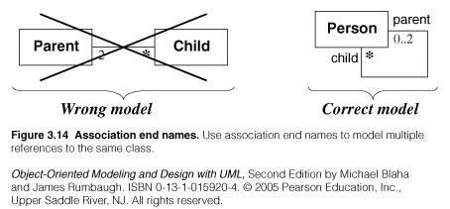
Example of association ends use

Slide 60
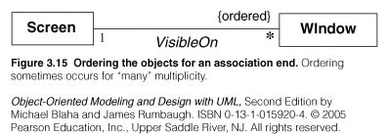
Association: ordering, bag, sequence
On a ‘many” association end, sometimes, it is required that objects have an explicit order. In this case the ordering is an inherent part of the association
A workstation screen contains a number of overlapping windows. Each window on a screen occurs at most once. The windows have an explicit order so only the topmost window is visible.
The ordering is an inherent part of the association. If objects indicate ordered set objects by
writing ―{ordered}‖ next to appropriate association end.
Example:

Slide 61
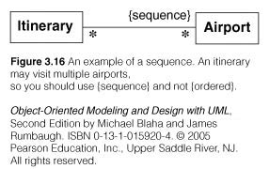
Association: ordering, bag, sequence
A bag is a collection of elements with duplicates allowed.
A sequence is an ordered collection of elements with duplicates allowed
Bag: collection of elements with duplicates allowed.
• Sequence: ordered collection of elements with duplicate allowed eg. An itinerary is a sequence of airports and the same airport can be visited more than once.
• Sequence is ordered bag allow duplicates, {ordered} and {sequence}
only difference is sequence allows duplicates as shown in figure 14.

Slide 62
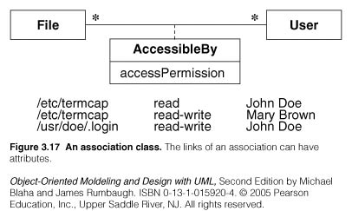
Association class
UML offers the ability to describe links of association with attributes like any class.
An association class is an association that is also a class.

Slide 63
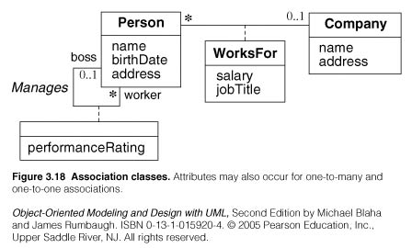
Association class
Examples:

Slide 64
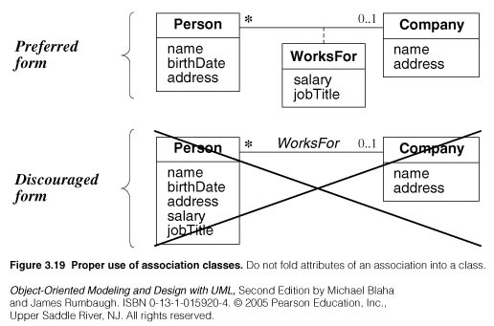
Association class
Example

Slide 65
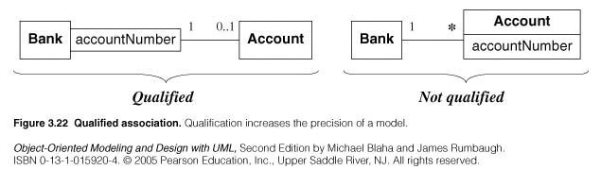
Qualified Association
A qualified association is an association in which an attribute called Qualifier the objects for a ‘many’ association’ end.
A qualifier selects among the target objects, reducing the effective multiplicity from ‘many’ to ‘one’.
Both below models are acceptable but the qualified model adds information.

Slide 66
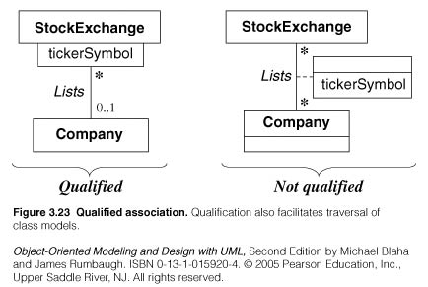
Qualified Association
Example:

Slide 67
W
ithout qualification
1
*
File
Directory
filename
W
ith qualification
1
0..1
Directory
filename
File
Figure 5-9. Example of how a qualified association reduces multiplicity (UML class diagram). Adding a qualifier clarifies the class diagram and increases the conveyed information. In this case, the model including the qualification denotes that the name of a file is unique within a directory.

Slide 68

Generalization
Deriving a class out of a parent class having some inherited property(from the parent class) and some new property of the derived class.
The term generalization is for the inheritance in the bottom to the up direction i.e. from derived class to the parent class.
Generalization is the relationship between a class (superclass) and one or more variations of the class (subclasses).
A superclass holds common attributes, attributes and associations.
The subclasses adds specific attributes, operations, and associations. They inherit the features of their superclass.
Generalization is called a “IS A” relationship

Slide 69

It is represented by a solid line with a large arrow head pointing towards the parent class.
Example:
Vehicle
Car
Truck

Slide 70
Generalization
Customer
Corporate
Customer
Personal
Customer
Notes:
Generalisatie impliceert specificatie.
Een nieuwe klasse die de gezamenlijke kenmerken bevat.
Bijvoorbeeld er zijn verschillen tussen twee typen klanten maar ook hebben ook veel overeenkomsten. De overeenkomsten kunnen worden ondergebracht in de algemene klasse.
De andere klanten kunnen als subtypen van dit supertype worden gedeclareerd
-----

Slide 71
Generalization Relationships
Person
A generalization connects a subclass
to its superclass. It denotes an
inheritance of attributes and behavior
from the superclass to the subclass and
indicates a specialization in the subclass
of the more general superclass.
Student
Software Design (UML)

Slide 72
Generalization Relationships
Vehicle
Bus
Truck
Car
BoeingAirplane
Boeing 737
Boeing 757
Boeing 767
Notes:
Generalization notation: “Kind-of” relationships.

Slide 73
Supertype
Example:
Customer
Regular
Customer
Loyalty
Customer
Subtype1
Subtype2
-

Slide 74
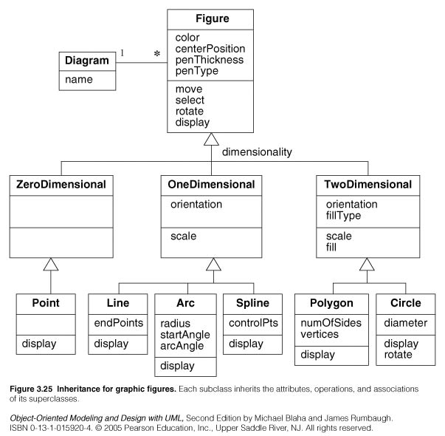

Slide 75
Incident
LowPriority
Emergency
Disaster
CatInTree
EarthQuake
ChemicalLeak
TrafficAccident
BuildingFire
Figure 5-10. An example of a generalization hierarchy (UML class diagram). The root of the hierarchy represents the most general concept, whereas the leaves nodes represent the most specialized concepts.

Slide 76
Use of generalization
Used for three purposes:
  Support of polymorphism:
    polymorphism increases the flexibility of software.
    Adding a new subclass and automatically inheriting superclass behavior.
  Structuring the description of objects:
    Forming a classification, organizing objects according to their similarities. It is much more profound than modeling each class individually and in isolation of other similar classes.
  Enabling code reuse:
    Reuse is more productive than repeatedly writing code from scratch.

Slide 77
Generalization, Specialization, and Inheritance
The terms generalization, specialization, and inheritance all refer to aspects of the same idea.
Generalization and specialization concern a relationship among classes and take opposite perspectives, viewed from the superclass or from the subclasses.
Generalization derives from the fact that the superclass generalizes the subclasses
Specialization refers to the fact that the subclasses refine or specialize the superclass.
Inheritance is the mechanism for sharing attributes, operations, and associations via the generalization/specialization relationship.
  Generalization represents a relationship at the conceptual level
  Inheritance is an implementation technique

Slide 78
Poor Generalization Example
(violates the “is a” or “is a kind of” heuristic)
Person
attributes
operations
Arm
Leg
Head
attributes
attributes
attributes
operations
operations
operations

Slide 79
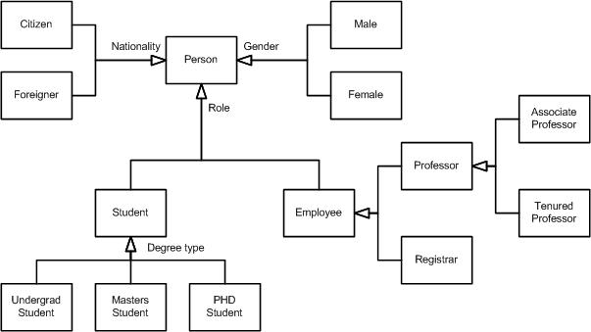

Slide 80
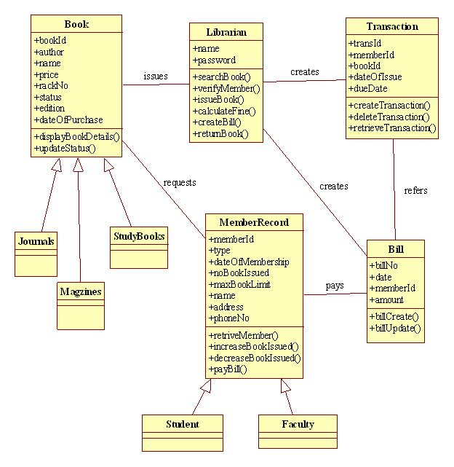

Slide 81
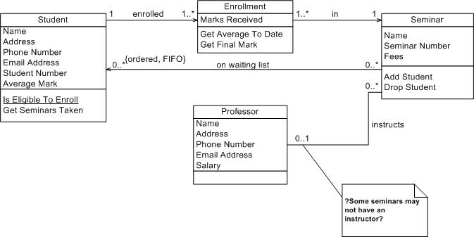

Slide 82
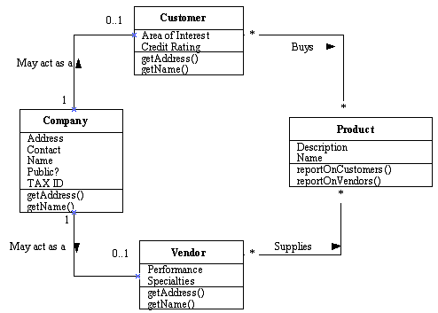

Slide 83
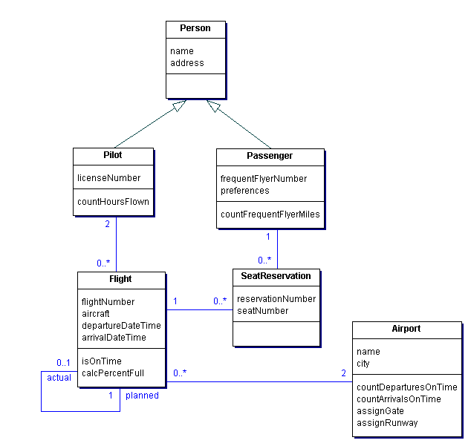

Slide 84
Class model for managing credit card accounts
address
Institution
MailingAddress
CreditCardAccount
name
1 *
accountNumber
0..1 1
address
maximumCredit
phoneNumber
phoneNumber
currentBalance
*
*
statementDate
accountHolder
Transaction
transactionDate
explanation
amount
Customer
Statement
paymentDueDate
financeCharge
minimumPayment
name
transactionNumber
1 0..1
CashAdvance
Interest
Purchase
Fee
Adjustment
feeType
*
1
Merchant
name

Slide 85
Overloading vs. Overriding
Overloading deals with multiple methods in the same class with the same name but different signatures
Overloading lets you define a similar operation in different ways for different data
Overriding deals with two methods, one in a parent class and one in a child class, that have the same signature
Overriding lets you define a similar operation in different ways for different object types

