Slide 1
POLYMORPHISM
PRESENTED BY:
SIMRAN PARDESHI (36)

Slide 2
INTRODUCTION
In programming, polymorphism means the same function name (but different signatures) being used for different types.
In Python, Polymorphism lets us define methods in the child class that have the same name as the methods in the parent class. In inheritance, the child class inherits the methods from the parent class. However, it is possible to modify a method in a child class that it has inherited from the parent class.

Slide 3
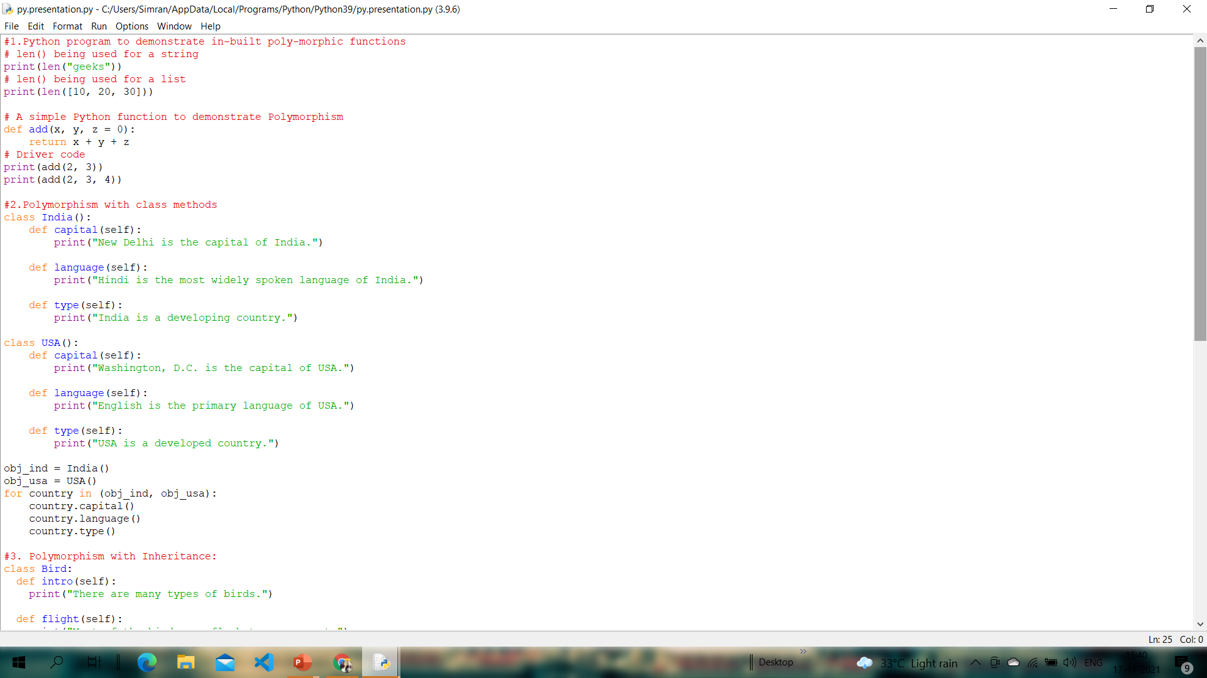
Example of inbuilt polymorphic functions:
CODE:

Slide 4
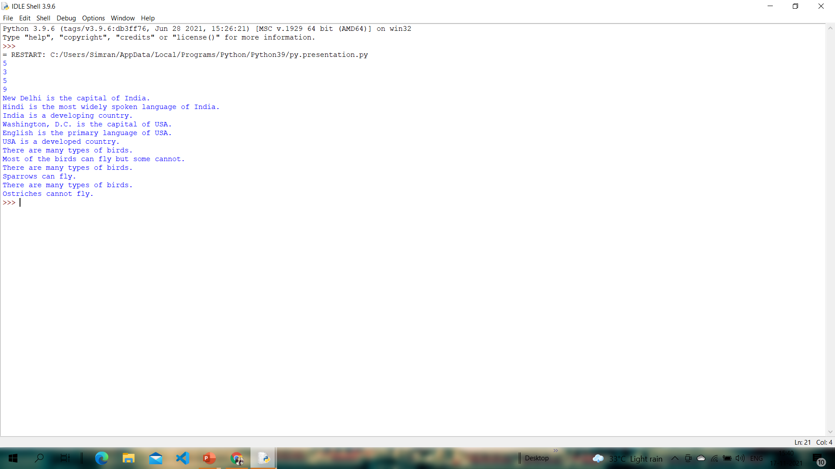
OUTPUT:

Slide 5
Polymorphism with class methods:
The below code shows how Python can use two different class types, in the same way. We create a for loop that iterates through a tuple of objects. Then call the methods without being concerned about which class type each object is. We assume that these methods actually exist in each class.
CODE:

Slide 6
OUTPUT:

Slide 7
Polymorphism with Inheritance:
In Python, Polymorphism lets us define methods in the child class that have the same name as the methods in the parent class. In inheritance, the child class inherits the methods from the parent class. However, it is possible to modify a method in a child class that it has inherited from the parent class. This is particularly useful in cases where the method inherited from the parent class doesn’t quite fit the child class. In such cases, we re-implement the method in the child class. This process of re-implementing method in the child class is known as Method Overriding.

Slide 8
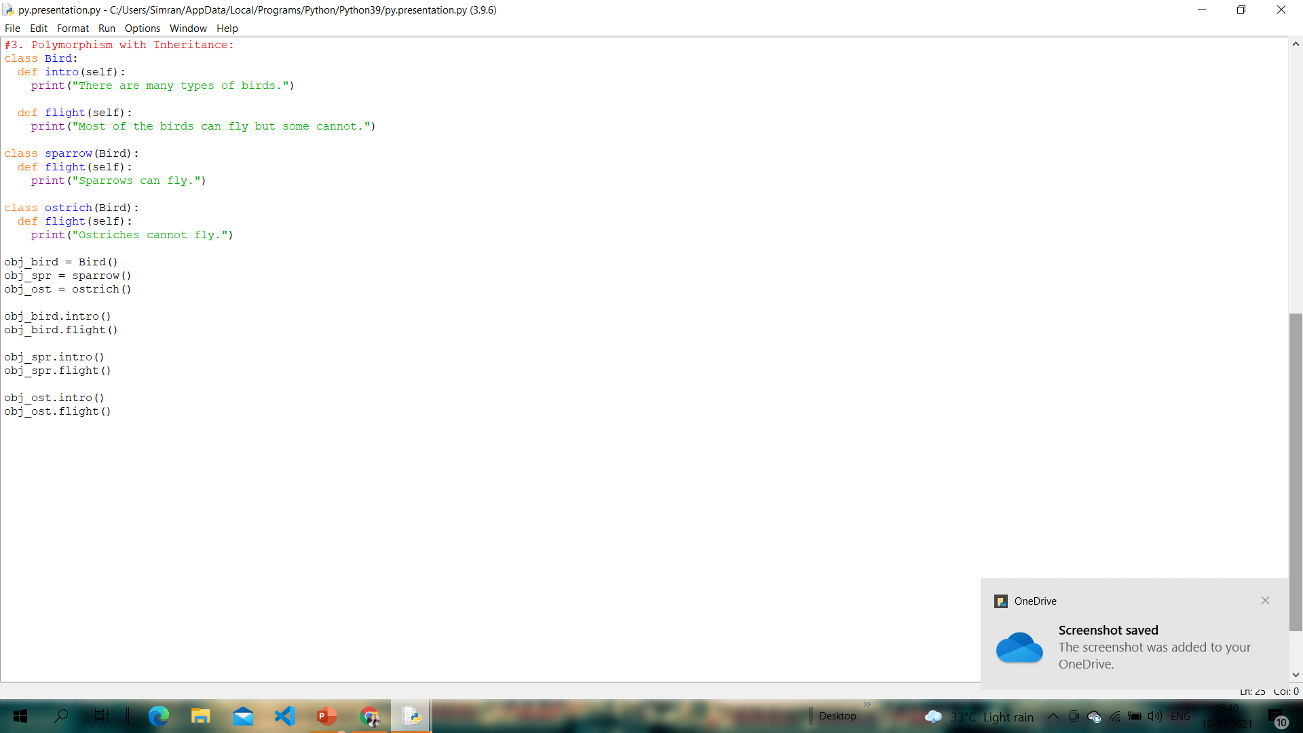
CODE:

Slide 9
OUTPUT:

Slide 10
CONCLUSION
Polymorphism is a very important concept in Object-Oriented Programming. We can use the concept of polymorphism while creating class methods as Python allows different classes to have methods with the same name.

Slide 11
THANK YOU!

