Slide 1
PYTHON-INHERITANCE

Slide 2
What is Inheritance
Inheritance is the ability to ‘inherit’ features or attributes from already written classes into newer classes we make. These features and attributes are defined data structures and the functions we can perform with them, a.k.a. Methods. It promotes code reusability, which is considered one of the best industrial coding practices as it makes the codebase modular.
In python inheritance, new class/es inherits from older class/es. The new class/es copies all the older class's functions and attributes without rewriting the syntax in the new class/es. These new classes are called derived classes, and old ones are called base classes.

Slide 3
Types of Inheritance in Python
Single Inheritance
Multiple Inheritance
Multi Level Inheritance
Hierarchical Inheritance in Python
Hybrid Inheritance in Python
Parent1 -> Child1 : Single Inheritance
Parent1 -> Child1 -> Child2 : Multi – Level Inheritance
Parent1 -> Child2 <- Parent2 : Multiple Inheritance

Slide 4
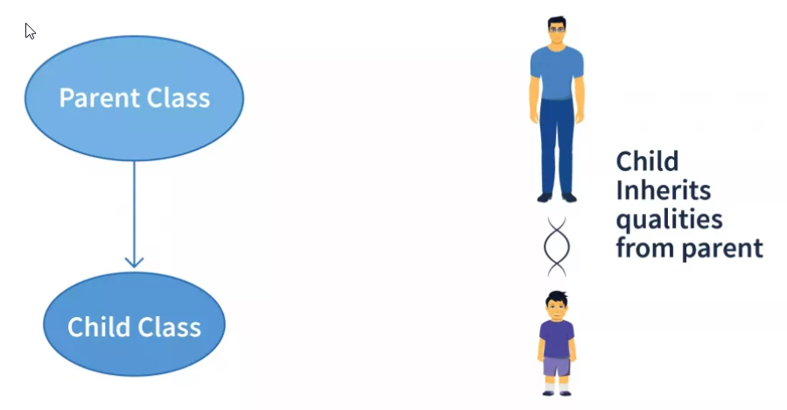
Single Inheritance in python
Single Inheritance is the simplest form of inheritance where a single child class is derived from a single parent class. Due to its candid nature, it is also known as Simple Inheritance.

Slide 5
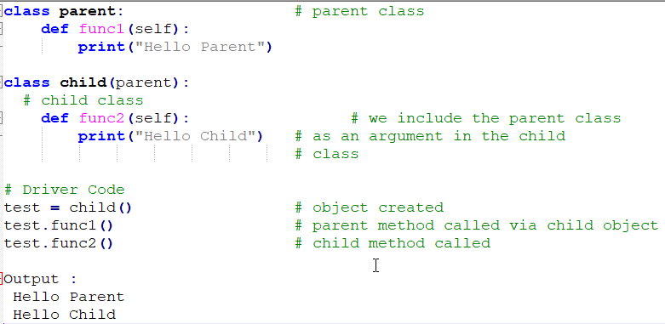
Single Inheritance Example

Slide 6
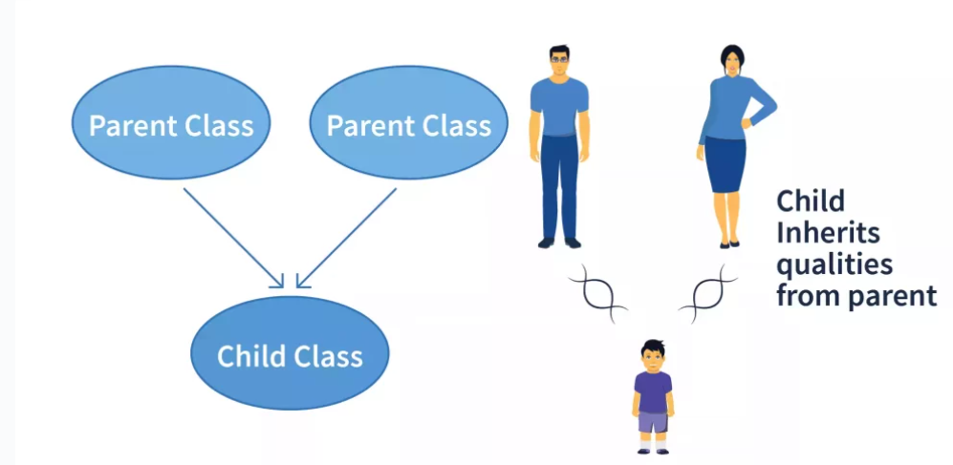
Multiple Inheritance in Python
In multiple inheritance, a single child class is inherited from two or more parent classes. It means the child class has access to all the parent classes' methods and attributes.

Slide 7
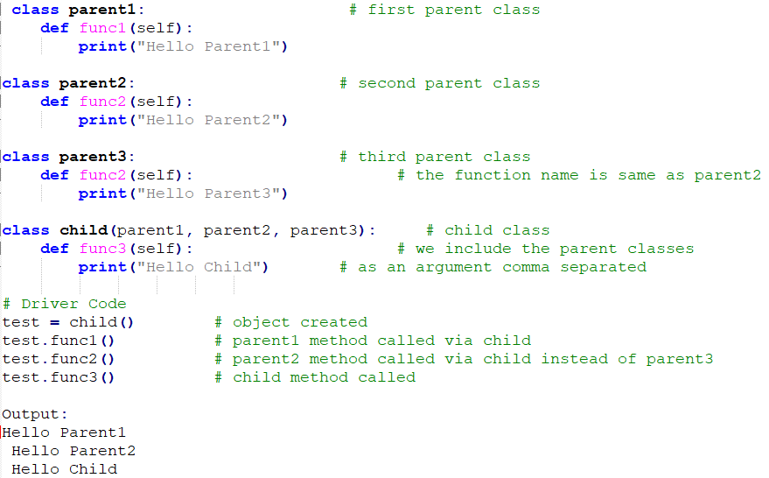
Multiple Inheritance Example

Slide 8
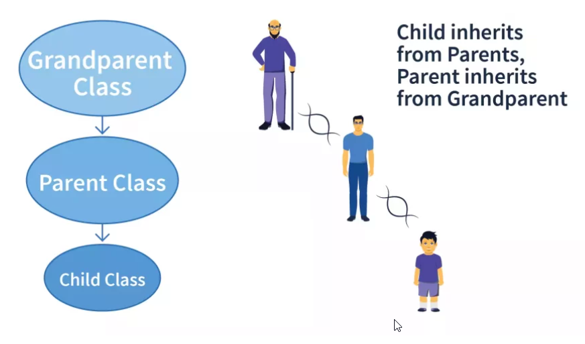
Multilevel Inheritance in Python
In multilevel inheritance, we go beyond just a parent-child relation. We introduce grandchildren, great-grandchildren, grandparents, etc. We have seen only two levels of inheritance with a superior parent class/es and a derived class/es, but here we can have multiple levels where the parent class/es itself is derived from another class/es.

Slide 9
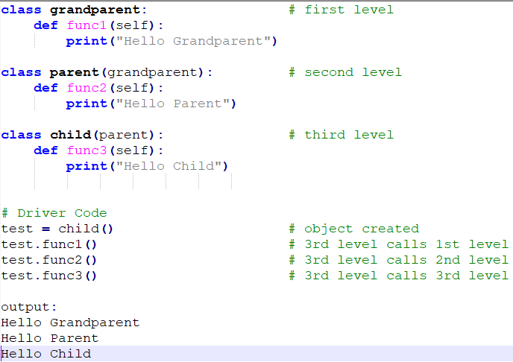
Example for MultiLevel Inheritance

Slide 10
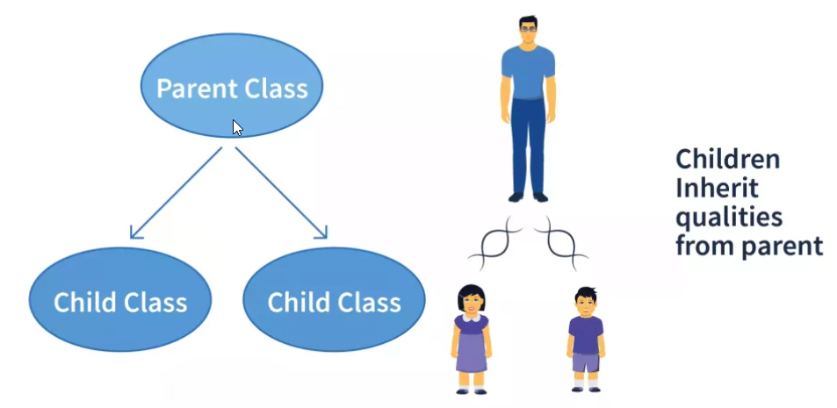
Hierarchical Inheritance
Hierarchical Inheritance is the right opposite of multiple inheritance. It means that, there are multiple derived child classes from a single parent class.

Slide 11
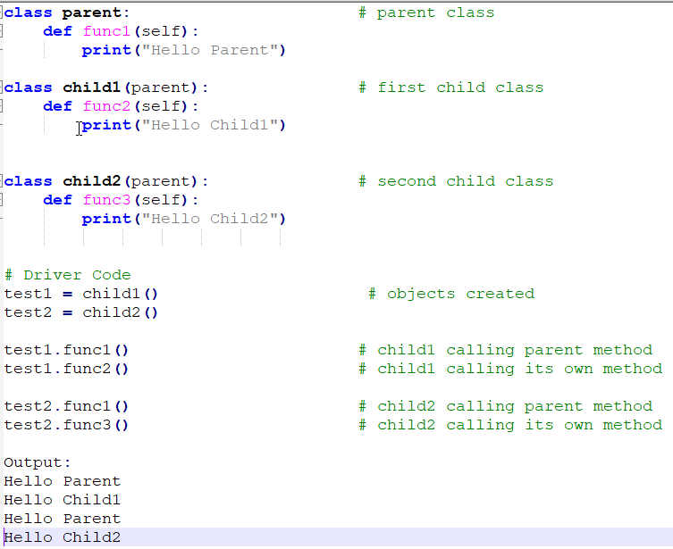
Example for Hierarchical Inheritance

Slide 12
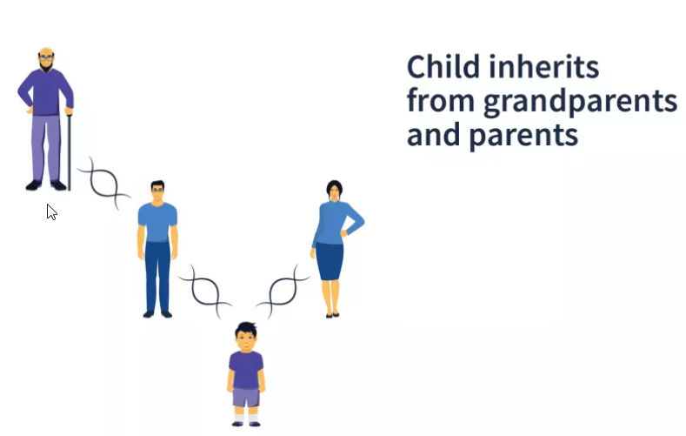
Hybrid Inheritance in Python
Hybrid Inheritance is the mixture of two or more different types of inheritance. Here we can have many relationships between parent and child classes with multiple levels.

Slide 13
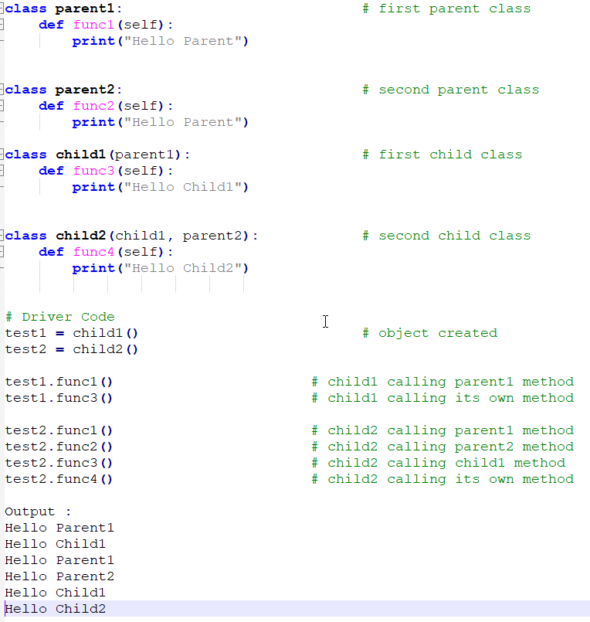
Example for Hybrid Inheritance

Slide 14
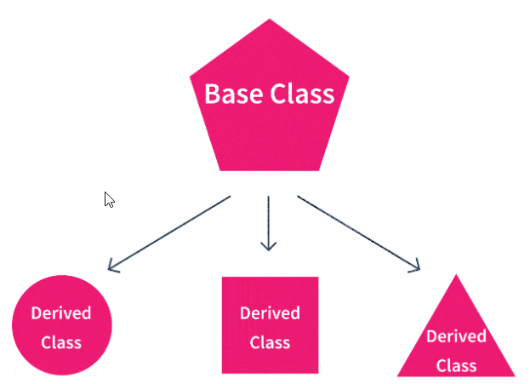
Advantage of Inheritance in Python
Modular Codebase:
Increases modularity, i.e., breaking down codebase into modules, making it easier to understand. Here, each class we define becomes a separate module that can be inherited separately by one or many classes.
Code Reusability: the child class copies all the attributes and methods of the parent class into its class and use. It saves time and coding effort by not rewriting them, thus following modularity paradigms.
Less Development and Maintenance Costs: changes need to be made in the base class; all derived classes will automatically follow.

Slide 15
Disadvantage of Inheritance in Python
Decreases the Execution Speed: loading multiple classes because they are interdependent
Tightly Coupled Classes: this means that even though parent classes can be executed independently, child classes cannot be executed without defining their parent classes.

