Slide 1
Object Oriented Programming in Python

Slide 2
Contents
What is OOP?
Different Paradigms: Differences Procedure vs Object Oriented Programming
Features of OOP
Fundamental Concepts of OOP in Python
What is Class
What is Object
Methods in Classes
Instantiating objects with __init__
self
Encapsulation
Data Abstraction
Public, Protected and Private Data
Inheritance
Polymorphism
Operator Overloading

Slide 3
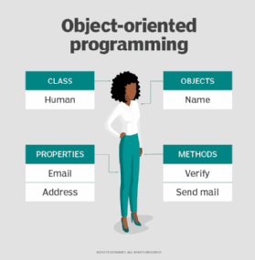

What is OOP
Object-oriented programming (OOP) is a programming paradigm based on the concept of objects that interact with each other to perform program functions. Each object can be characterized by a state and behavior. An object’s current state is represented by its fields, and an object’s behavior is represented by its methods.

Slide 4
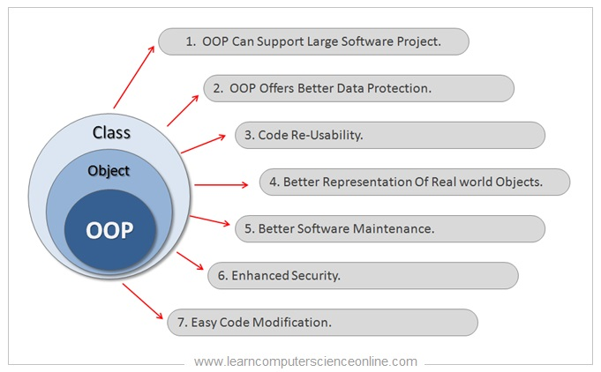

Slide 5
Difference between Procedure Oriented and Object Oriented Programming
Procedural programming creates a step-by-step program that guides the application through a sequence of instructions. Each instruction is executed in order.
Procedural programming also focuses on the idea that all algorithms are executed with functions and data that the programmer has access to and is able to change.
Object-oriented programming is much more similar to the way the real world works; it is analogous to the human brain. Each program is made up of many entities called objects.
Instead, a message must be sent requesting the data, just like people must ask one another for information; we cannot see inside each other’s heads.

Slide 6
Featuers of OOP
Ability to simulate real-world event much more effectively
Code is reusable thus less code may have to be written
Data becomes active
Better able to create GUI (graphical user interface) applications
Programmers are able to produce faster, more accurate and better-written applications

Slide 7

Fundamental concepts of OOP in Python
The four major principles of object orientation are:
Encapsulation
Data Abstraction
Inheritance
Polymorphism

Slide 8
What is an Object..?
Objects are the basic run-time entities in an object-oriented system.
They may represent a person, a place, a bank account, a table of data or any item that the program must handle.
When a program is executed the objects interact by sending messages to one another.
Objects have two components:
- Data (i.e., attributes)
Behaviors (i.e., methods)

Slide 9
Object Attributes and Methods Example
Object Attributes
Object Methods
Store the data for that object
Example (taxi):
Driver
OnDuty
NumPassengers
Location
Define the behaviors for the object
Example (taxi):
- PickUp
- DropOff
- GoOnDuty
- GoOffDuty
- GetDriver
- SetDriver
- GetNumPassengers

Slide 10
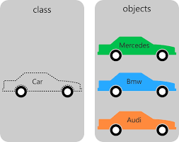
What is a Class..?
A class is a special data type which defines how to build a certain kind of object.
The class also stores some data items that are shared by all the instances of this class
Instances are objects that are created which follow the definition given inside of the class
Python doesn’t use separate class interface definitions as in some languages
You just define the class and then use it

Slide 11
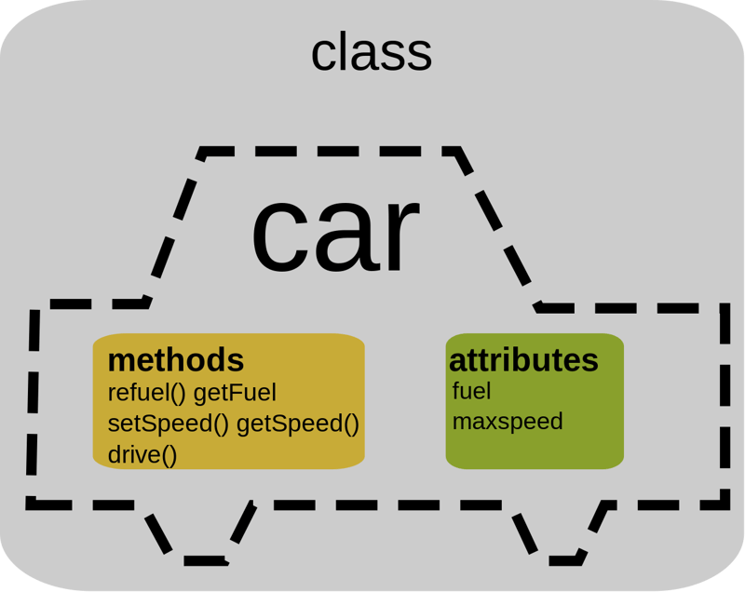
Methods in Classes
Define a method in a class by including function definitions within the scope of the class block
There must be a special first argument self in all of method definitions which gets bound to the calling instance
There is usually a special method called __init__ in most classes

Slide 12
A Simple Class def: Student
class student: “““A class representing a student ””” def __init__(self , n, a): self.full_name = n self.age = a def get_age(self): #Method return self.age
Define class:
Class name, begin with capital letter, by convention
object: class based on (Python built-in type)
Define a method
Like defining a function
Must have a special first parameter, self, which provides way for a method to refer to object itself

Slide 13
Instantiating Objects with ‘__init__’
__init__ is the default constructor
__init__ serves as a constructor for the class. Usually does some initialization work
An __init__ method can take any number of arguments
However, the first argument self in the definition of __init__ is special

Slide 14
Self
The first argument of every method is a reference to the current instance of the class
By convention, we name this argument self
In __init__, self refers to the object currently being created; so, in other class methods, it refers to the instance whose method was called
Similar to the keyword this in Java or C++
But Python uses self more often than Java uses this
You do not give a value for this parameter(self) when you call the method, Python will provide it.
Continue…

Slide 15
…Continue
Although you must specify self explicitly when defining the method, you don’t include it when calling the method.
Python passes it for you automatically
Defining a method: Calling a method:
(this code inside a class definition.)
def get_age(self, num): >>> x.get_age(23) self.age = num

Slide 16
Deleting instances: No Need to “free”
When you are done with an object, you don’t have to delete or free it explicitly.
Python has automatic garbage collection.
Python will automatically detect when all of the references to a piece of memory have gone out of scope. Automatically frees that memory.
Generally works well, few memory leaks
There’s also no “destructor” method for classes

Slide 17
Syntax for accessing attributes and methods
>>> f = student(“Python”, 14)
>>> f.full_name # Access attribute
“Python”
>>> f.get_age() # Access a method
14

Slide 18
Encapsulation
Important advantage of OOP consists in the encapsulation of data. We can say that object-oriented programming relies heavily on encapsulation.
The terms encapsulation and abstraction (also data hiding) are often used as synonyms. They are nearly synonymous, i.e. abstraction is achieved though encapsulation.
Data hiding and encapsulation are the same concept, so it's correct to use them as synonyms
Generally speaking encapsulation is the mechanism for restricting the access to some of an objects's components, this means, that the internal representation of an object can't be seen from outside of the objects definition.

Slide 19
Access to this data is typically only achieved through special methods: Getters and Setters
By using solely get() and set() methods, we can make sure that the internal data cannot be accidentally set into an inconsistent or invalid state.
C++, Java, and C# rely on the public, private, and protected keywords in order to implement variable scoping and encapsulation
It's nearly always possible to circumvent this protection mechanism

Slide 20
Public, Protected and Private Data
If an identifier doesn't start with an underscore character "_" it can be accessed from outside, i.e. the value can be read and changed
Data can be protected by making members private or protected. Instance variable names starting with two underscore characters cannot be accessed from outside of the class.
At least not directly, but they can be accessed through private name mangling.
That means, private data __A can be accessed by the following name construct: instance_name._classname__A

Slide 21
If an identifier is only preceded by one underscore character, it is a protected member.
Protected members can be accessed like public members from outside of class
Example:
class Encapsulation(object):
def __init__(self, a, b, c):
self.public = a
self._protected = b
self.__private = c

Slide 22
The following interactive sessions shows the behavior of public, protected and private members:
>>> x = Encapsulation(11,13,17)
>>> x.public
11
>>> x._protected
13
>>> x._protected = 23
>>> x._protected
23
>>> x.__private
Traceback (most recent call last):
File "<stdin>", line 1, in <module>
AttributeError: 'Encapsulation' object has no attribute '__private‘
>>>

Slide 23
The following table shows the different behavior Public, Protected and Private Data
Name | Notation | Behavior
name | Public | Can be accessed from inside and outside
_name | Protected | Like a public member, but they shouldn't be directly accessed from outside
__name | Private | Can't be seen and accessed from outside
Notes:
Need improve difference between protected vs public/private

Slide 24
Inheritance
Inheritance is a powerful feature in object oriented programming
It refers to defining a new class with little or no modification to an existing class.
The new class is called derived (or child) class and the one from which it inherits is called the base (or parent) class.
Derived class inherits features from the base class, adding new features to it.
This results into re-usability of code.
Syntax:
class Baseclass(Object):
body_of_base_class
class DerivedClass(BaseClass):
body_of_derived_clas

Slide 25
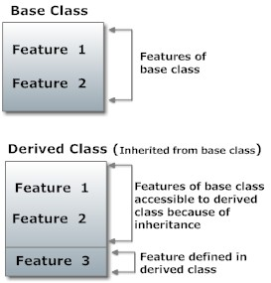
While designing a inheritance concept, following key pointes keep it in mind
A sub type never implements less functionality than the super type
Inheritance should never be more than two levels deep
We use inheritance when we want to avoid redundant code.

Slide 26
Two built-in functions isinstance() and issubclass() are used to check inheritances.
Function isinstance() returns True if the object is an instance of the class or other classes derived from it.
Each and every class in Python inherits from the base class object.

Slide 27
Polymorphism
Polymorphism in Latin word which made up of ‘ploy’ means many and ‘morphs’ means forms
From the Greek , Polymorphism means many(poly)
shapes (morph)
This is something similar to a word having several different meanings depending on the context
Generally speaking, polymorphism means that a method or function is able to cope with different types of input.

Slide 28

A simple word ‘Cut’ can have different meaning depending where it is used
If any body says “Cut” to these people
Surgeon: The Surgeon would begin to make an incision
Hair Stylist: The Hair Stylist would begin to cut someone’s hair
Cut
Actor: The actor would abruptly stop acting out the current scene, awaiting directional guidance

Slide 29
In OOP , Polymorphism is the characteristic of being able to assign a different meaning to a particular symbol or operator in different contexts specifically to allow an entity such as a variable, a function or an object to have more than one form.
There are two kinds of Polymorphism
Overloading :
Two or more methods with different signatures
Overriding:
Replacing an inherited method with another having the same signature

Slide 30
Operator Overloading
Python operators work for built-in classes.
But same operator behaves differently with different types. For example, the + operator will, perform arithmetic addition on two numbers, merge two lists and concatenate two strings. This feature in Python, that allows same operator to have different meaning according to the context is called operator overloading
One final thing to mention about operator overloading is that you can make your custom methods do whatever you want. However, common practice is to follow the structure of the built-in methods.

Slide 31
Explanation for Operator Overloading Sample Program
What actually happens is that, when you do p1 - p2, Python will call p1.__sub__(p2) which in turn is Point.__sub__(p1,p2). Similarly, we can overload other operators as well. The special function that we need to implement is tabulated below.
Operator | Expression | Internally
Addition | p1 + p2 | p1.__add__(p2)
Subtraction | p1 – p2 | p1.__sub__(p2)
Multiplication | p1 * p2 | p1.__mul__(p2)
Power | p1 ** p2 | p1.__pow__(p2)
Division | p1 / p2 | p1.__truediv__(p2)

