Slide 1
NeXt UI Toolkit Workshop
NeXt Team
2015-06-01

Slide 2
Agenda
NeXt Brief
Download NeXt package and create first web app
Create a static topology
Connect to APIC-EM
Draw a path on top of Topology
[Advance] Display topology on top of a map
[Advance] Connect to ODL

Slide 3
NeXt Brief

Slide 4
”NeXt means embedded User eXperience in Network. It is HTML5/JavaScript based toolkit for network Web Application.”

Slide 5
NeXt UI Toolkit Advantage
Design combine Develop
Specify for network visualization
Easy to build network web application (Effort saving)
Topology component & UI components
OOP/Data binding/MVC mechanism to support web application development
High Performance

Slide 6
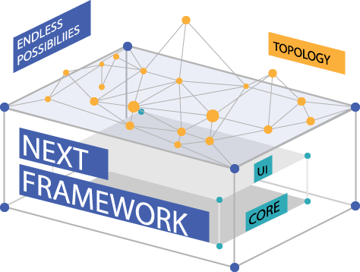
Architecture
Web Applications
Topology Component
UI Core
UI Component/View Engine/DOM/AOP/Application Support
JavaScript Core
OOP/MVVM/Data Binding/Data Type

Slide 7
Concepts from advanced languages/frameworks
OOP Concept from C#
“Magic methods” concept from Python
MVVM concept from WPF

Slide 8
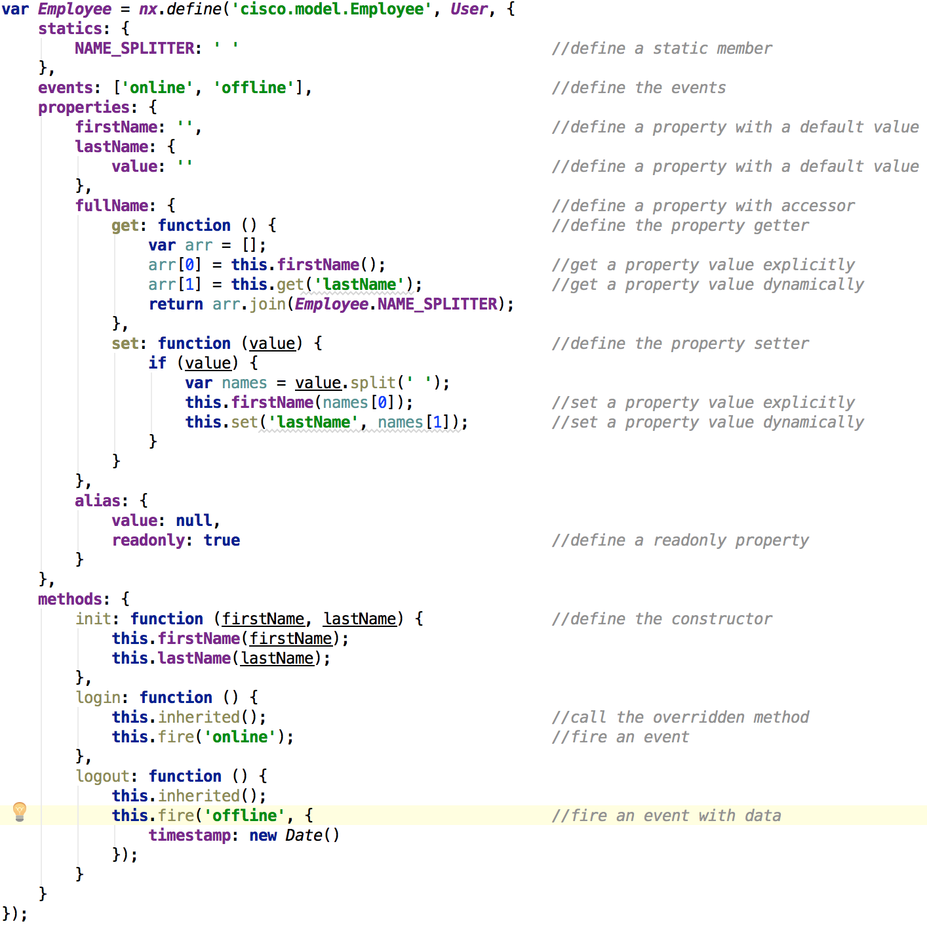
OOP in NeXt
Class definition and inheritance
Static member support.
Built-in pub/sub mechanism.(events)
Properties with simple default value or accessors.
Methods with inheritance and overriding.

Slide 9
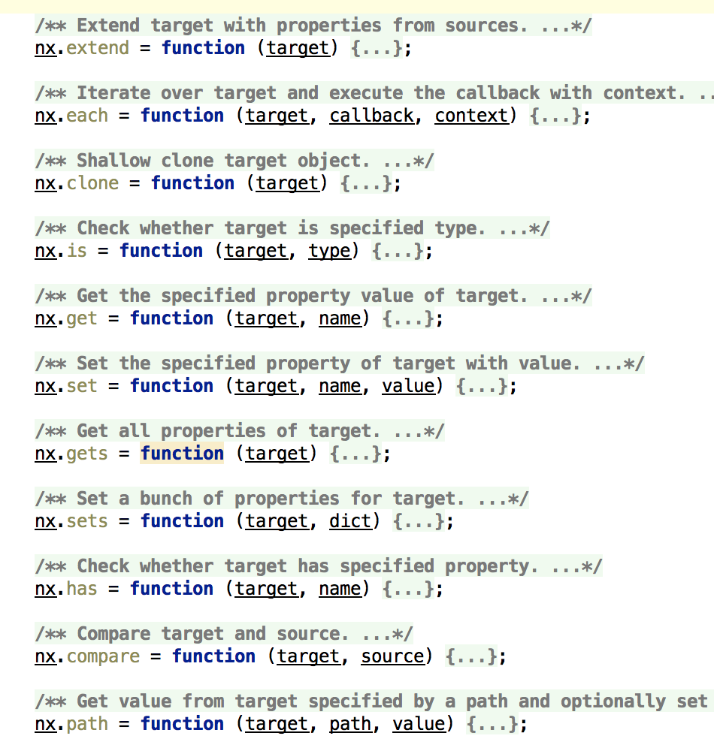
“Magic methods” in NeXt
These methods accept ANY JavaScript native objects.
These methods accept ANY instances of NeXt classes.
To override the behavior of these methods, just override the method “__xxx__” (e.g. __each__) in your class.

Slide 10
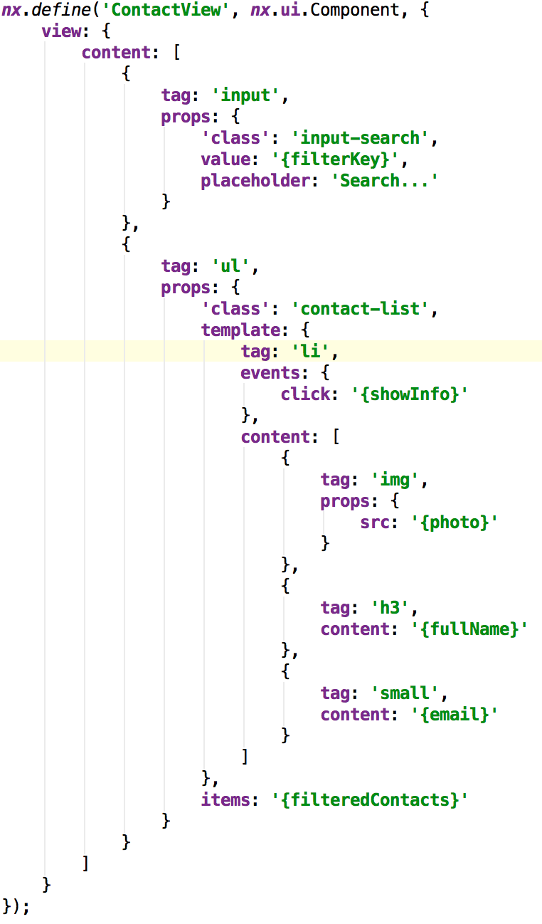
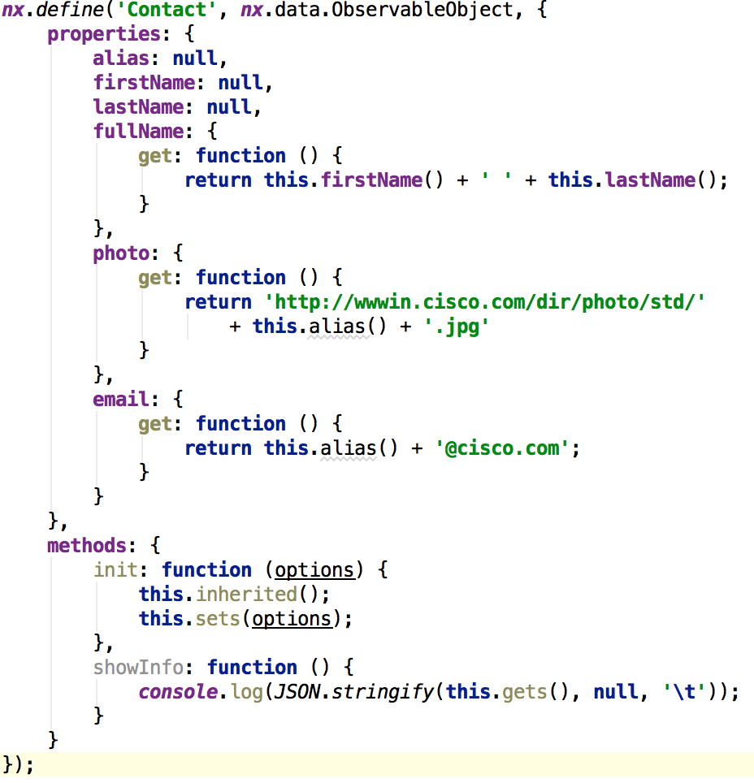
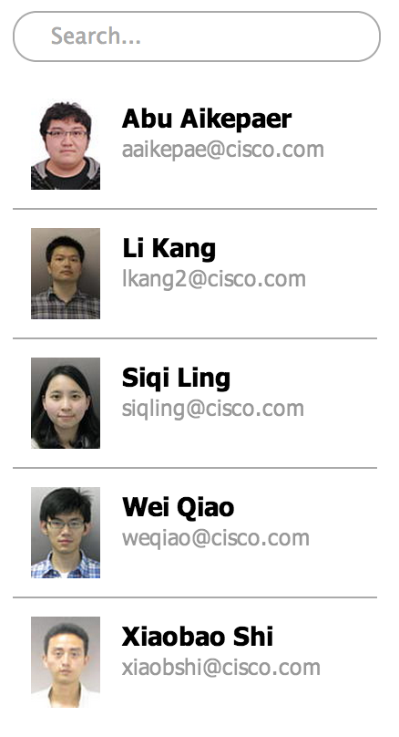
MVVM in NeXt
MVVM is a concept first introduced in Microsoft’s WPF framework.
Completely separate the presentation layer and business logic layer.
Model-driven design make it very easy for testing and automation.
See the SURPRISE demo

Slide 11
Features
Topology basic graph visualization and interaction
Multiple layout present (Force auto layout / Enterprise network layout/ Hierarchical Layout)
Large network scaling support (aggregation/progressive rendering)
Path / traffic / tunnel / group visualization
Build-in Map overlay (US map)
Build-in interaction behaviors and extend interface (drag/zoom/hover/click/select/aggregate)
Build-in 20+ icon and 5 themes
Build-in tooltip manager / layout manager / node & link extendibility

Slide 12
NeXt UI Toolkit Topology Architecture
Tooltip Manager
Node/Link/NodeSet/LinkSet
Layout manager
Force/Hierarchical/Map/Enterprise Network
Plugin
Navigation/Thumbnail/3D
UI Components
Popup/Font Icon
Scene
Default Scene/Selection Scene/Select Node Scene/Zoom Scene
Path Layer
NodeSet Layer
Layers
Node layer
LinkSet Layer
Link Layer
Group Layer
Topology
Observable Graph
SVG Renderer
Stage/Group/Rectangle/Circle/Icon/Bezier Curves
Geometry
Vertex
Edge
VertexSet
EdgeSet
EdgeSet Collection
nx.graphic.Component

Slide 13
Task1 Download NeXt package and create a APP

Slide 14
http://developer.cisco.com/site/next

Slide 15
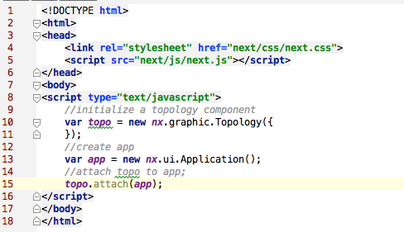
Code snippet

Slide 16
Hello world
http://jsfiddle.net/nextsupport/zp9bw4h3/

Slide 17
Task2 Create a static topology

Slide 18
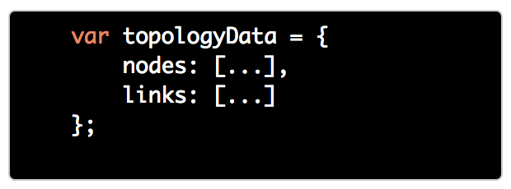
Prepare topology data (Common Topology Model)
NeXt define an Common Topology Model (CTM) to describe and design topology. It follow Graph abstract data type in JSON format. The model has two major properties, namely nodes and links, which refers to graph's vertices and edges. -- Define

Slide 19
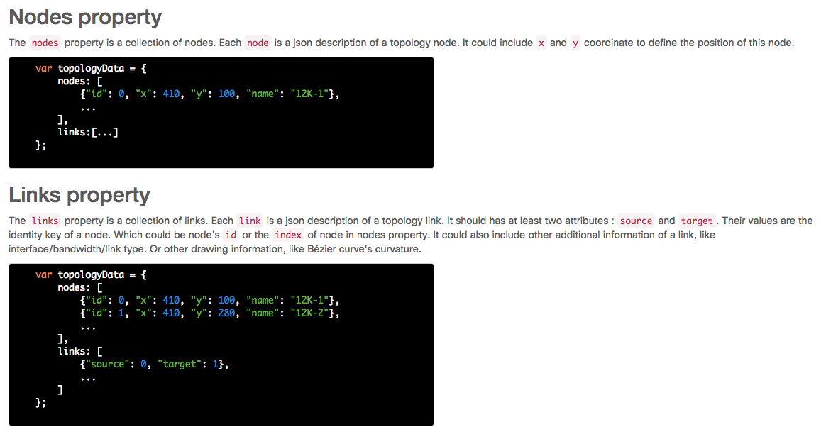

Slide 20
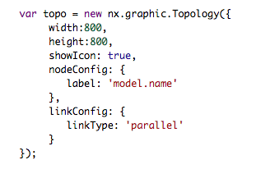

Config topology and set data

Slide 21
Run
Live Demo : http://jsfiddle.net/nextsupport/LcgyhvLd/

Slide 22
Task3 Connect to APIC-EM

Slide 23
Task4 Draw a path on top of Topology

Slide 24
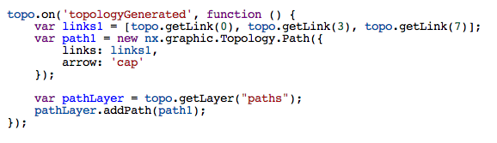
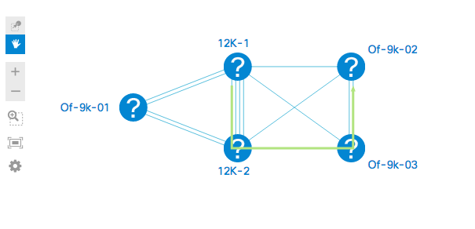
Add a path on top of topology

Slide 25
Task5 [Advance] Display topology on top of a map

Slide 26
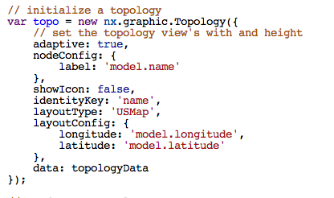
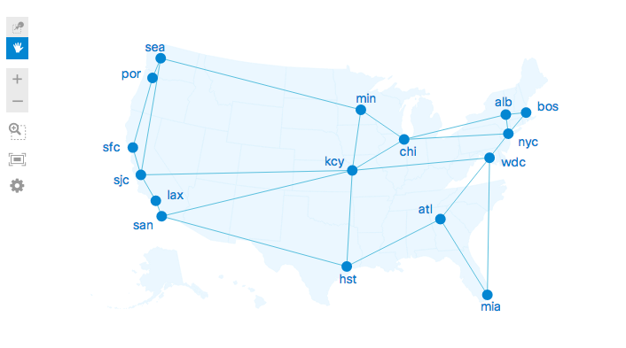
Config topology’s property to display a map

Slide 27
Task6 [Advance] Connect to ODL

