Slide 1
Food Safety Compliance System (FoSCoS)
Major Changes and Migration Strategy
Workshop (19th February 2020)

Slide 2
Major Changes in
Filing of Application
Simplified Login page for petty FBOs. (Registration purpose)
Addition of New KoBs
  Food Supplements/Nutraceuticals,
  Substances Added to Food
  Novel food for manufacturers
Selection of Standardised Products under Manufacturing KoB
Modification of License for existing Licensed FBOs under Manufacturing KoB
Provision of capturing GST, PAN and CIN number is added in license application. (non-mandatory at present)
Provision for Capturing FSM ID/FoSTaC Certificate number/Head Office in Form B
KoB-wise documents. Declaration based documents are converted to Tick based.
Instant Availability of Inspection Reports to FBO
Pan-India Uniform Format of Licenses and Registration Certificates.

Slide 3
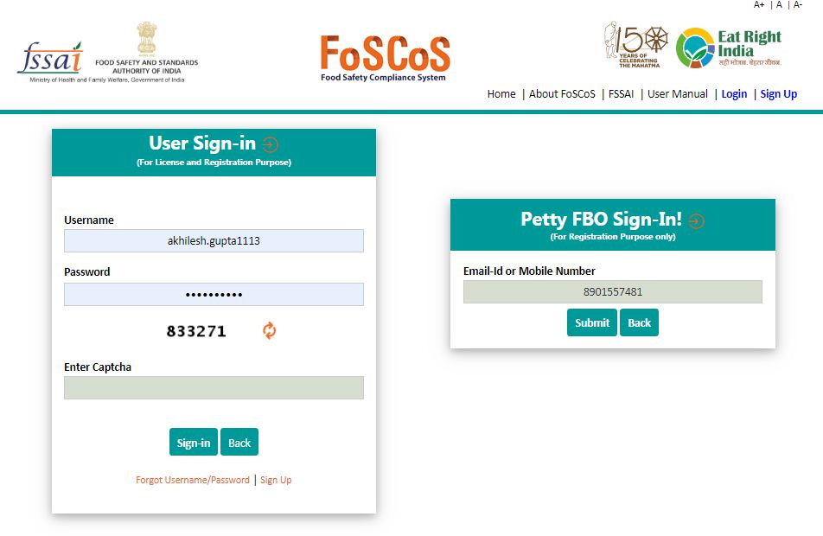
Login page

Slide 4
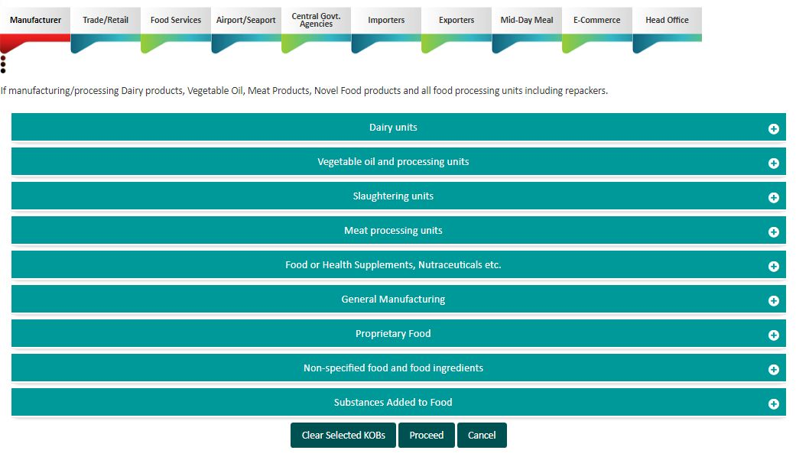
Addition of New KoBs – under Manufacturing Group Head

Slide 5
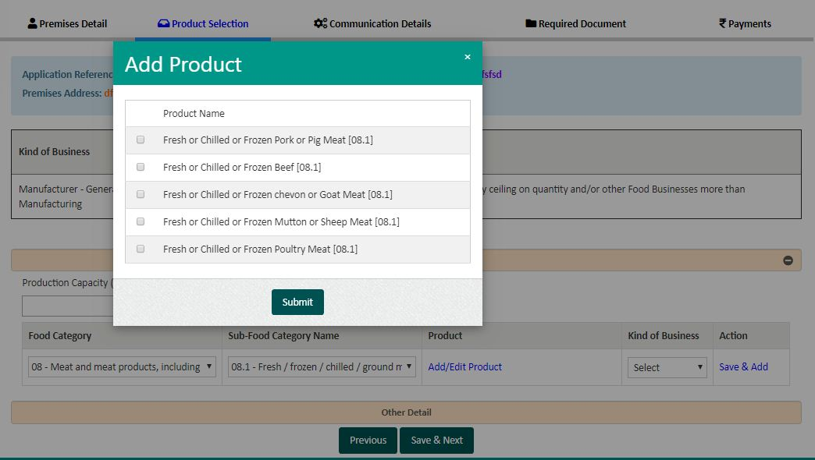
Selection of Standardised Products for Manufacturers

Slide 6
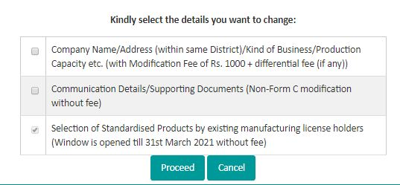
Modification of License for existing Licensed FBOs under Manufacturing KoB

Slide 7
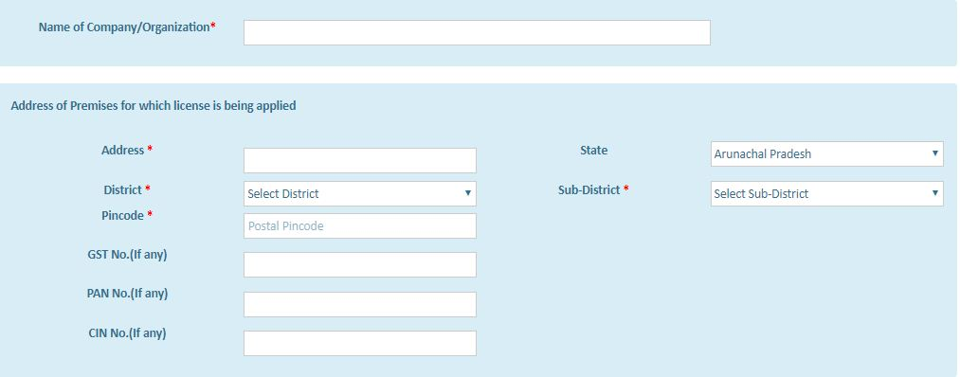
Capturing GST, PAN and CIN number in license application. (Non-mandatory at present)

Slide 8
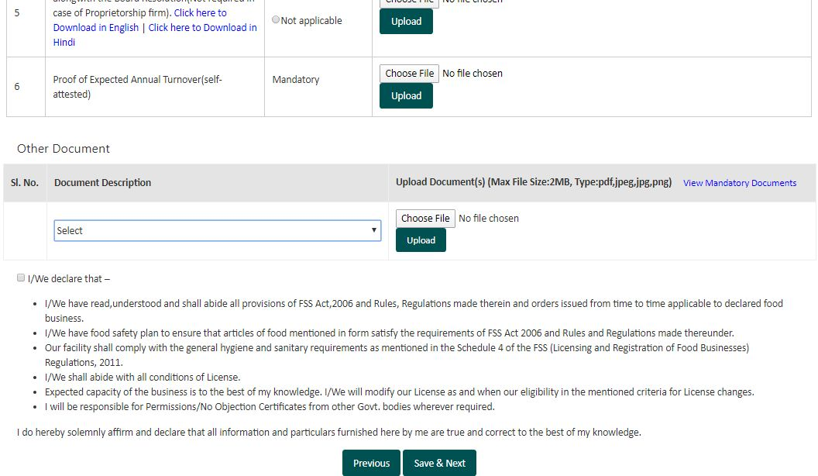
KoB wise documents. Declaration based documents are converted to Tick based.

Slide 9
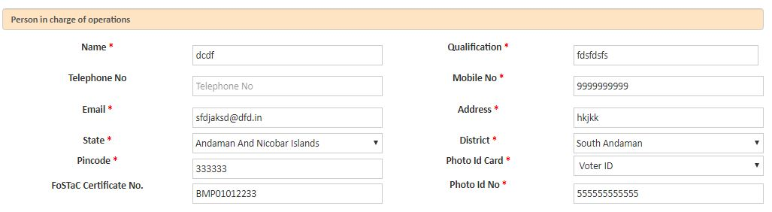
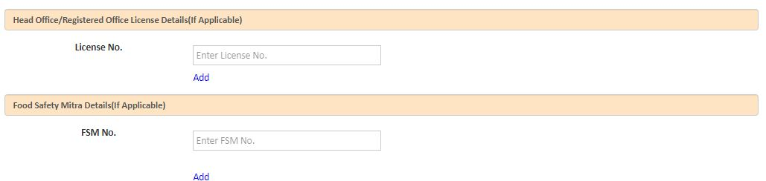
Capturing FSM ID/FoSTaC Certificate number/ Head Office

Slide 10
Major Changes in Processing of Application
Dashboard reflecting pendency at different stages
Integration of FoSCoRIS with FoSCoS
A comprehensive search tool limited to their area of jurisdiction. Reports can be fetched from the tool and exported to excel.
Licenses can be generated directly from Document and Inspection Scrutinisation page. Removal of License Generation bin.
Sequencing of applications for scrutinisation has been set as First in First Out (FIFO).

Slide 11
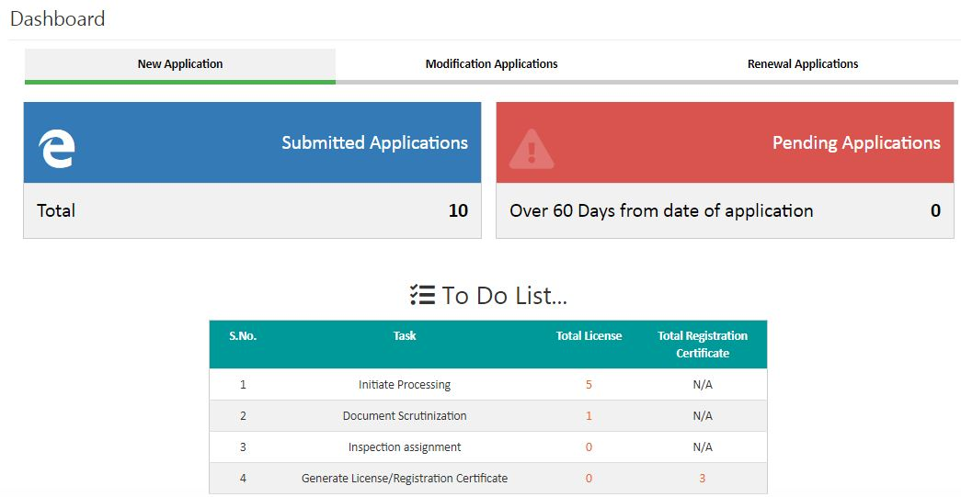
Dashboard reflecting pendency at different stages

Slide 12
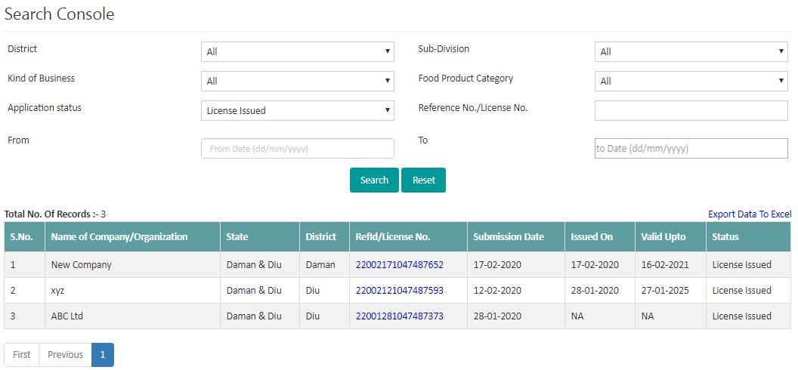
Search Console. Reports can also be fetched from the tool and exported to excel.

Slide 13
Migration Strategy
In case of SL/Registration – Live applications with DO/FSO/FBO shall be moved to Stage 1
In case of CL – Live applications with DO/TO/FBO shall be moved to Stage 2
This also means that applications pending at ‘Generate License’ Stage will be transferred to Stage 1, thus requiring reprocessing from initial stage.
Manufacturing License Applications shall be reverted back to FBO for selection of products.
At present, around 60,000 pending applications in FLRS. Authorities shall take all necessary steps to clear the pendencies to avoid reprocessing of applications in FoSCoS.
Applications pending with FBOs for more than 30 days are being rejected by system automatically. Long pending applications at DO/FSO end shall be rejected to minimise the count of pending applications.
Authorities shall avoid re-inspections of FBOs’ units whose application has been migrated to Stage-1.

Slide 14
Licensing based on standardized product list
  Public consultation: Assam, HP, CLA- Chennai, AIFPA, CII, ITC, NRAI
  Proposal: For Manufacturer: licensing based on standardized list of products
    Standardized list of products: Rule level
    Sub Rule OR individual product if – only FCS is different or sensitive product
    For Manufacturers only- other KoB still on broad category
    New Category 100 introduced for products whose Food Product Category is not available at present such as Pan Masala
    Category 99- still on text box approach
    Some concordance based on interpretations- consultation with Standards
    Existing State Licenses under Category 15-16: FBOs required to opt under correct KoB and FPC. FBO may also be needed to migrate from SL to CL due to products falling under proprietary food
    Migration
      Renewal- for a year in case FBO does not migrate his products to standardised products selection based approach.
      Modification without payment of fee: might take new products also
    Cheat Codes closure- some resistance expected.

Slide 15
Roll out plan
Going Live with UT of Dadar and Nagar Haveli and Daman and Diu.
Probable States/UTs in second round – Maharashtra, Karnataka, Delhi, Goa and Chandigarh
Pan-India launch with all States/UTs
Migration of Indian and Konkan Railways after stabilization of FoSCoS
Food Concerns/ Viewing of Document/Application History can still be viewed from FLRS
Provision for submission of Online Annual Returns is expected to be available by 1st April 2020.

Slide 16
Points to be discussed
Applications are arranged in FoSCoS on the basis of FIFO
Removal of Provision of Inactivating/Activating an application
Physical Submission to be strictly prohibited
Removal of Generate License Stage
Mapping issue of RA – one per district
Common Reports required on daily basis

Slide 17
Do It Yourself
Training URL: https://fcstraining.fssai.gov.in/
File Applications in your area of jurisdiction by creating user-id
  Manufacturing License application
  Other than Manufacturing License application
  Registration Application through OTP
Test Payment
  RazorPay or PayuBiz
  Card no. 5123456789012346
  Expiry date: 05/20
  CVV: 123
  Process the applications and Generate License/Reg, User ids are same as in FLRS and Passwords are admin.
  Mail your feedback at
  foscosfeedback.fssai@gmail.com and
  foscos-helpline@fssai.gov.in

