Slide 1
Food Safety and Compliance System (FoSCoS)
FSSAI
Version 1.0

Slide 2











Table of Contents
01
About FoSCoS
02
Guidance Notes for:
Food Business Operators (FBO)
Designated Officers (DO) / Registering Authorities (RA)
Food Safety Officers (FSO)
03
Support from FSSAI
Disclaimer: The guidance document is intended for the use of officers of FSSAI, food safety department of States/ UTs and Food Business Operators who shall be using the FoSCoS application. This document provides an overview of the application functions and features along with policy or regulatory aspects. This document, however, does not supersede any direction, official orders or regulations as issued by FSSAI. Furthermore, the guidance document shall not be considered valid for any legal redressal or as evidence in any legal proceeding. This document is only for guiding users on FoSCoS application by providing general information that may be helpful in using the application. This document is expected to be updated from time to time, please check the latest version before use. In case any error or omission is noted, please bring it to the notice of FoSCoS team on helpdesk-foscos@fssai.gov.in for rectification.

Slide 3

About FoSCoS

Slide 4
Objective of FoSCoS
Improved Service Delivery
Build centralised application to enable delivery for full spectrum of services through single platform
Minimum physical documentation and seamless application processing for ease of doing business.
Technology Upgrade
Build technically advanced application with integration capabilities, higher user traffic capability and has potential for future upgrades.
Enhance UI and make application process simpler and efficient.
Enhanced Communication
Enable application to focus on target specific communication through email, SMS, reminder for annual returns, etc.
User Centric Approach
Adopt Standardized product approach rather than text box approach.
Capture Business details
Enable application to seed business specific details to ensure 360⁰ profiling of FBOs.

Slide 5
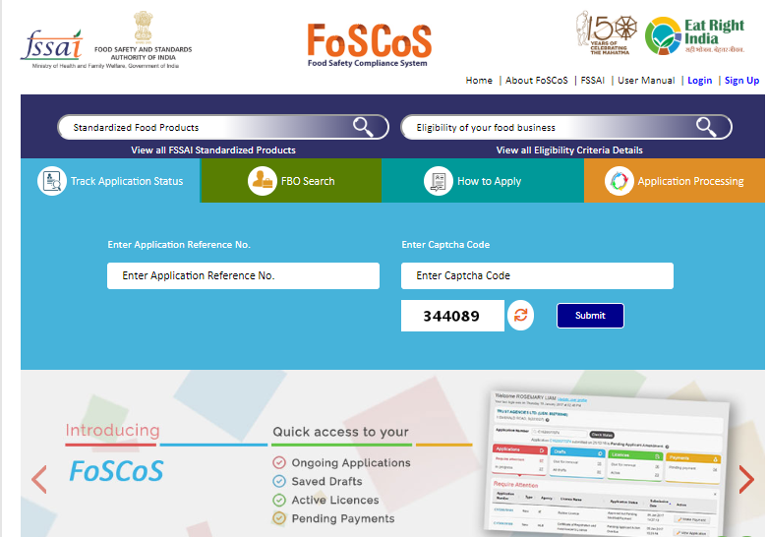
Introduction
Change in focus from Licensing platform to a Centralized Food Safety Compliance Regulatory platform
Robust and technically advanced application.
Focuses on Ease of Doing Business for FBOs.
Application is built with Integral capabilities to merge with other IT systems.
Architectural capability to withstand higher user traffic and achieve performance excellence.
Intuitive and centralized application for various functions.
Application enables seamless interoperability for all stakeholders for application processing.

Slide 6
New features
  User Centric Approach
  Improved Operational Capabilities
  Enhanced Technology platform
  Standardized product approach rather than text box approach.
  KoB wise documentation required.
  Document based declarations revised to check box declarations.
  Enhanced segregations of KoBs.
  Addition of Nutraceuticals and Non- Specified (Novel Foods) as separate business category under manufacturing.
  New feature to submit annual returns online.
  Upgradation of hardware and Software for Enhanced processing speed and Higher user traffic capability
  FBO will be able to view inspection report online on FoSCoS as FoSCoRIS is now integrated.
  Scalable Architecture to meet future upgrades, new functionalities and integration with other IT systems.
  Home page is redesigned specific to user queries/ functions.
  Enhanced and user friendly interfaces.
  Smart search option for Standardized Products and Business Eligibility Criteria for any food business is given
  Application has been enabled to seed business specific details such as PAN No., CIN No. and GST numbers to ensure 360º profiling.

Slide 7
Guidance to use FoSCoS

Slide 8
Search Standardized food products and Business eligibility criteria
1
Search Standardized food products
Provides list of all standardized food products using key words as entered in search box.
Provide food category, sub food category and products for FBOs.
For e.g. If FBO searches for Milk, application will provide list of all products where “Milk” as keyword is inclusive.
1
2
2
Search Business Eligibility Criteria
Intelligent Search option which provide list of all KoBs with keywords as entered in search box.
Promote transparency in system by providing business eligibility criteria, whether required registration or license, type of license required as per capacity and fee per annum for FBOs.

Slide 9
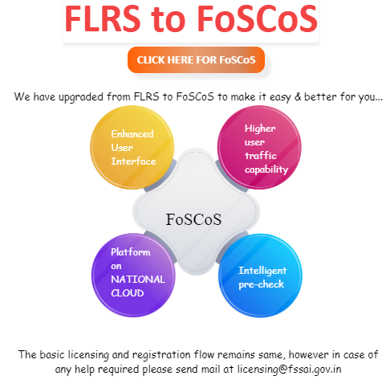
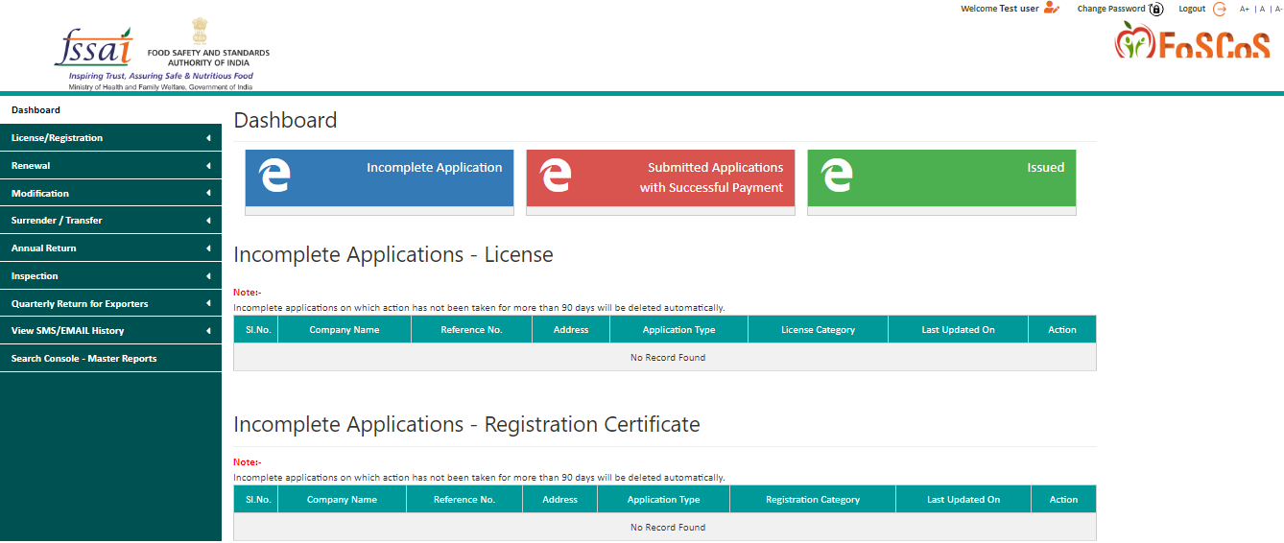
Quick Login to FoSCoS
Redirected to FoSCoS
Url: https://foscos.fssai.gov.in/
1
1
Home Page
Users will be redirected to the login page of FoSCoS
Existing Users to login through same credentials as used for FLRS application.
New FBO can create credentials using Sign-up option.
User can retrieve username or password using combination of email ID and mobile no.
Dashboard is the default landing page.
For Detailed process flow, Click
2
2
3
3
FoSCoS Landing Page

Slide 10
Guidance for Food business Operators (FBO)

Slide 11
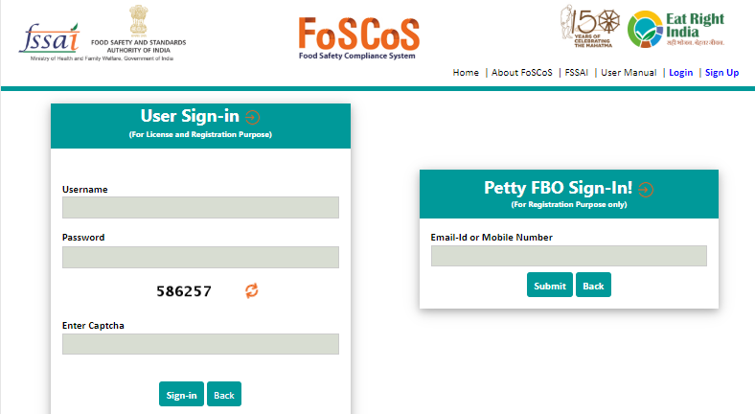
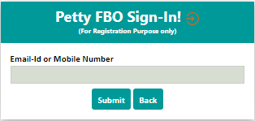
Petty FBO Sign-In
Petty FBOs are small business etc. who are encouraged to apply for registrations.
Applicant turnover must be less than Rs. 12 Lacs per annum
Petty FBOs can login using mobile no. or email ID with OTP validation. Such Users are not required to create login and remembering password.
For detailed process flow, Click
Login Screen for Petty FBOs
Process Flow
Login using mobile ID/ email ID
Select Jurisdiction, KoB, business category and Enter business details
Submit Application and Fees
Receive Registration

Slide 12
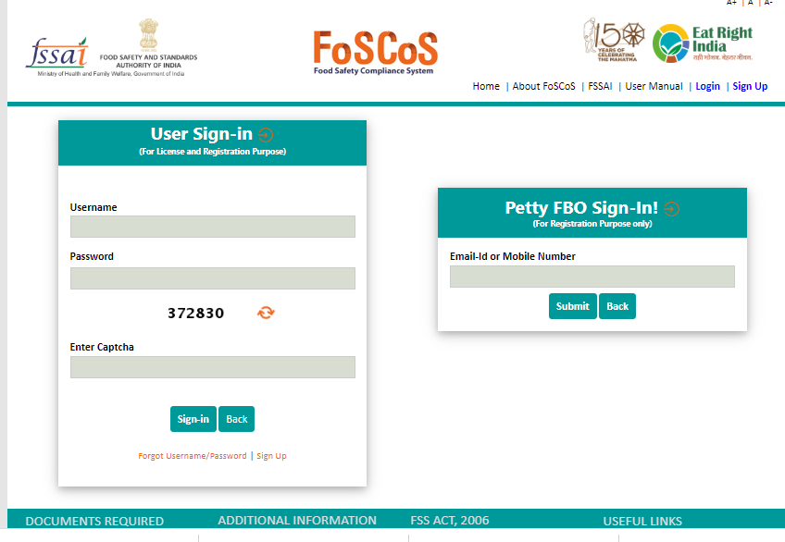
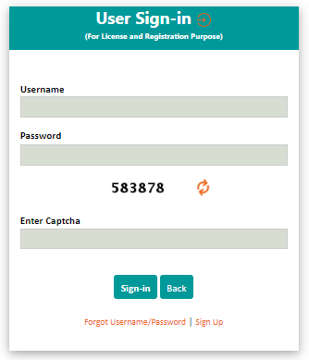
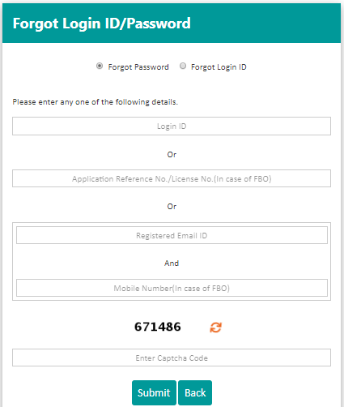
How to retrieve user name or password
FBO has an option to retrieve user name or password.
Password can be retrieved by entering combination of Login ID/ Application ref no./ registered email ID AND Mobile No.
User name can be retrieved by entering combination of Application ref no./ registered email ID AND Mobile No.

Slide 13
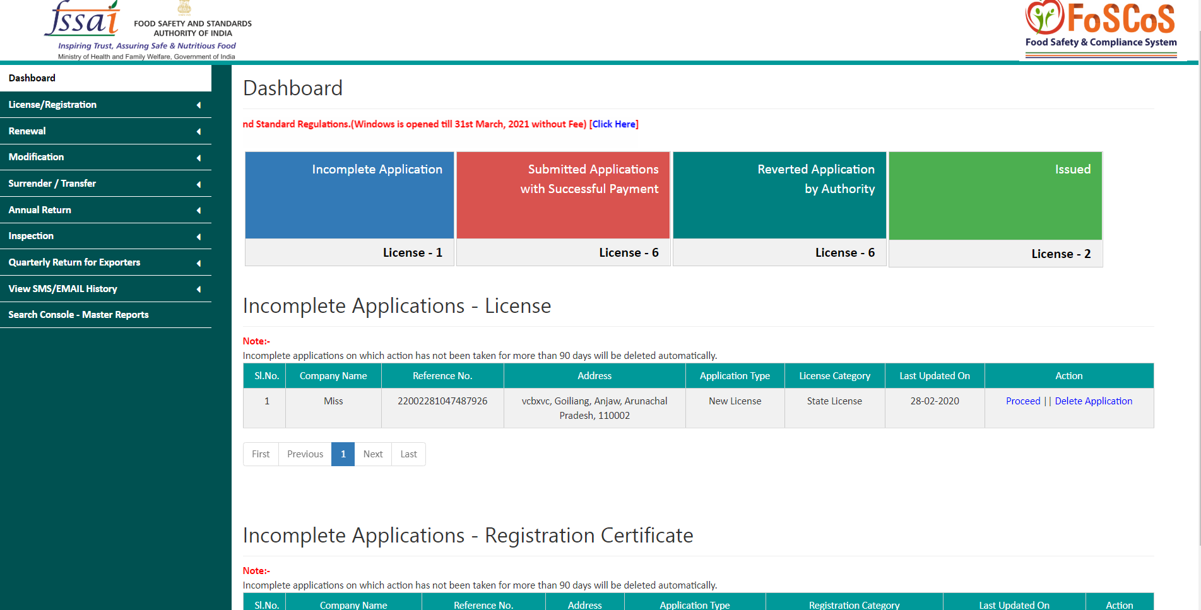
Dashboard is the default landing page
Key Notes:
        Incomplete application for licenses/ registration for more than 90 days will be auto deleted from system.
        Reverted applications which are not responded by FBOs within 30 days will be auto rejected.
Dashboard gives you quick access for
        Incomplete application
        Submitted Applications with Successful Payment
        Reverted applications by Authority
        Registrations/ licenses Issued

Slide 14
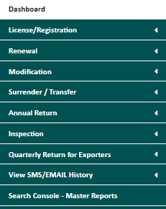
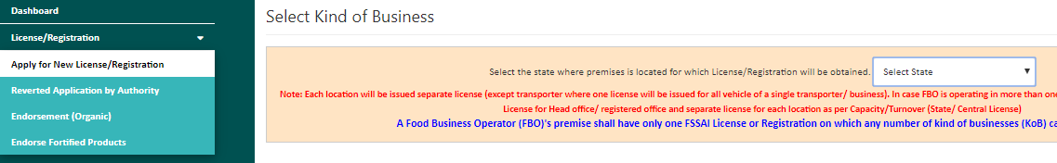
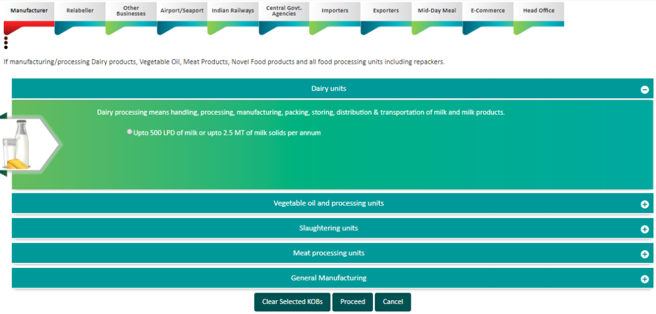
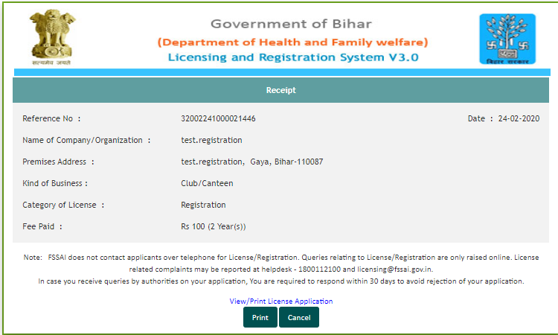
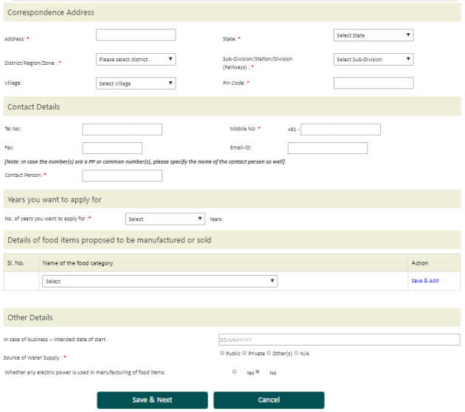
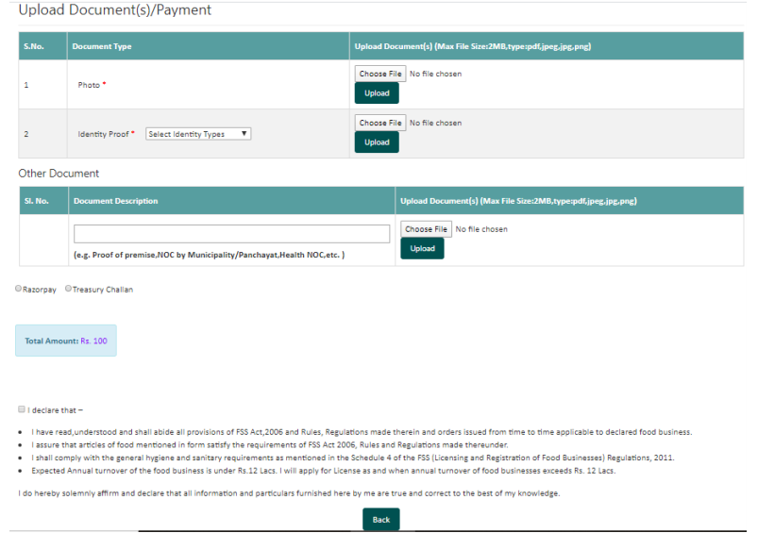
How to Submit new application?
Application Login
Apply for license/ registration
Select KoB and Enter Form Details
Submit Fees Online
Application Acknowledgement
Key Notes:
Head office added as separate KoB.
Addition of new categories under manufacturing i.e. Nutraceuticals and Non-specified/ Novel Food are added.
Only KoB wise list of documents will be shown to applicant instead of complete list to ease out the process. Provision of uploading additional documents as required by local authorities is also available.
For detailed process flow, Click

Slide 15
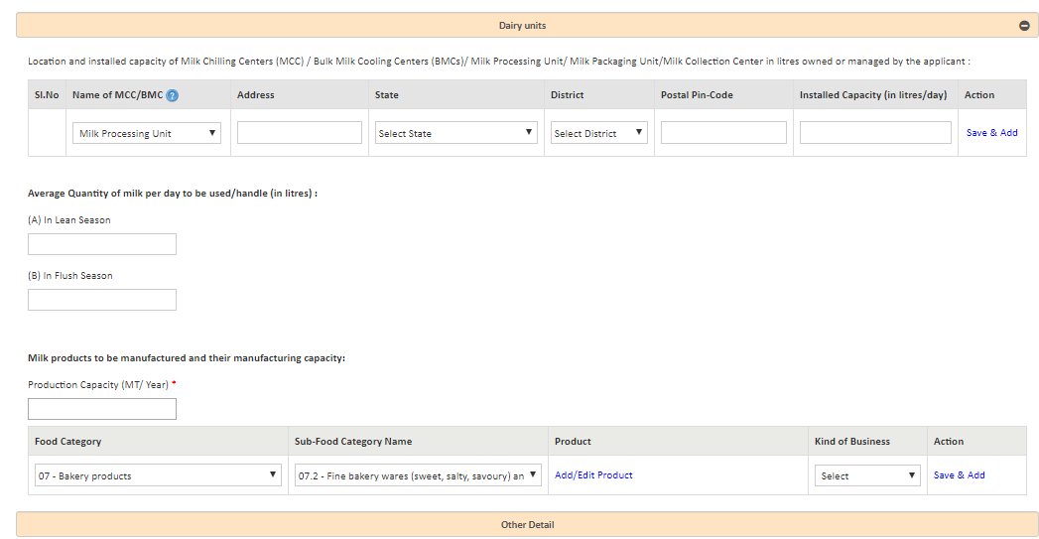
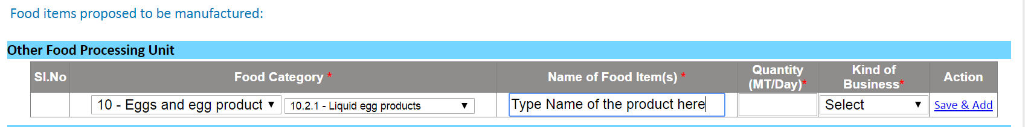
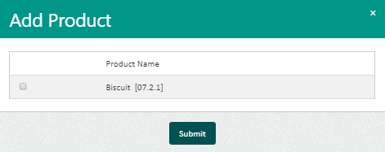
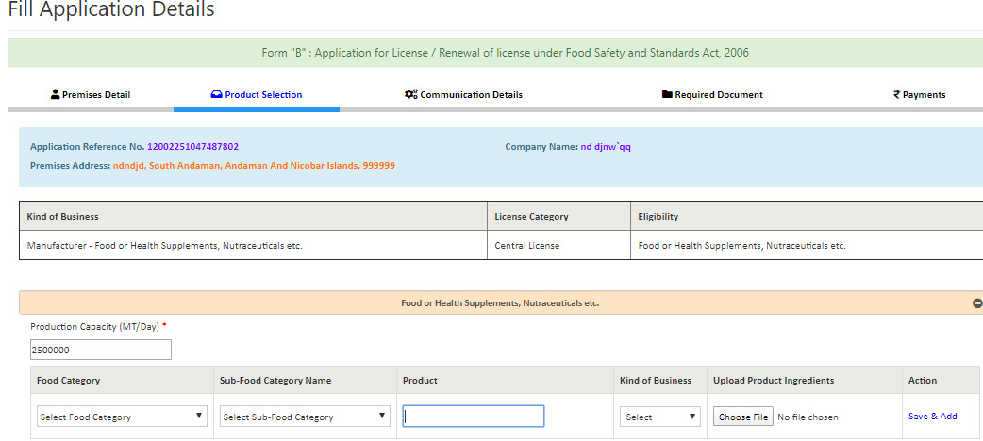
Check box vs text box approach for Manufacturers
FLRS Approach
FoSCoS Approach
Check Box to select product details
For manufacturers, Standardised products are specified under regulations.
Text Box Approach is retained for very few categories i.e. Proprietary, Non-Specified (Novel Foods), Nutraceuticals, Substances added to food
Text Box to enter product details

Slide 16
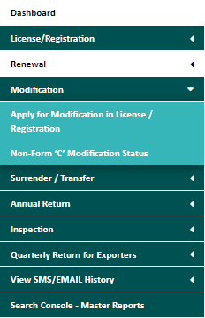
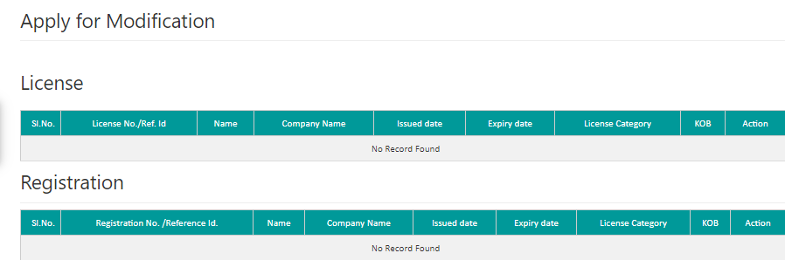
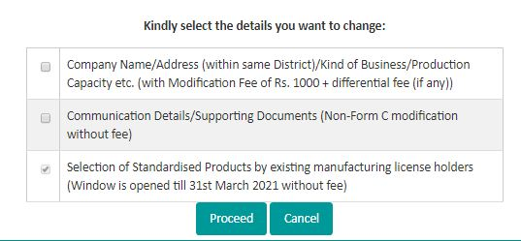

Apply Modification of License
Application Login
Select the License to be modified
Select type of modification
Submit Fees Online if Form-C modification
Application Acknowledgement
Key Notes:
Three types of modifications allowed i.e. Form-C, Non Form-C and Selection of Standardised products by existing manufacturing license holders.
Form-C modifications is the type wherein any details printed on the license needs to be changed
Manufacturers must apply for modification in licenses for suitable standardised product.
For detailed process flow, Click
1
✓
1
2
2
DO
Licensing Authority

Slide 17
What have we covered in this section..
1
Petty FBO Login: Petty FBOs are small business owners whose annual turnover is less than INR 12 Lacs per annum.
2
Dashboard: New dashboard with enhanced features to see status/ receipts related to applications on single page.
3
Head office is added as separate KoB. Nutraceuticals and Non- Specified (Novel foods) are the newly added food business categories.
4
Modification of License: Form-C (Chargeable at INR 1000) and Non Form-C.
5
Existing Manufacturers must apply for modification in their licenses by selecting their products from the available list of standardised products.

Slide 18
FoSCoS for Designated Officers (DO)

Slide 19
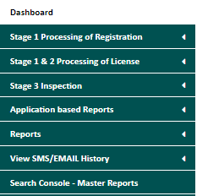
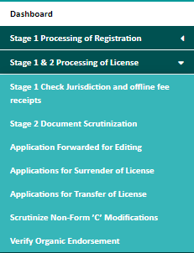
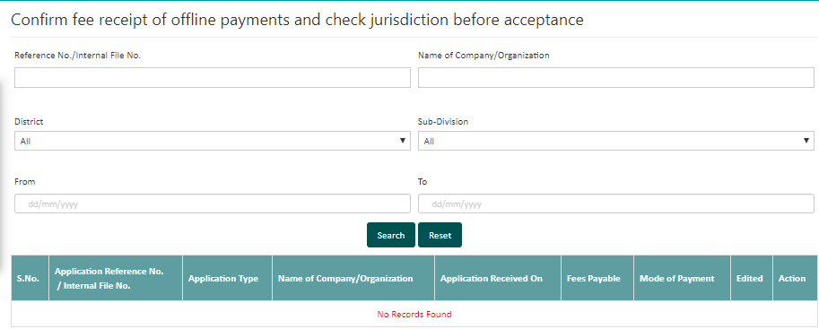
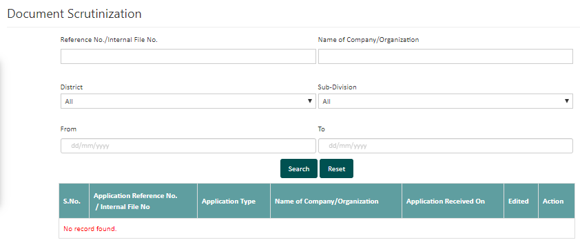
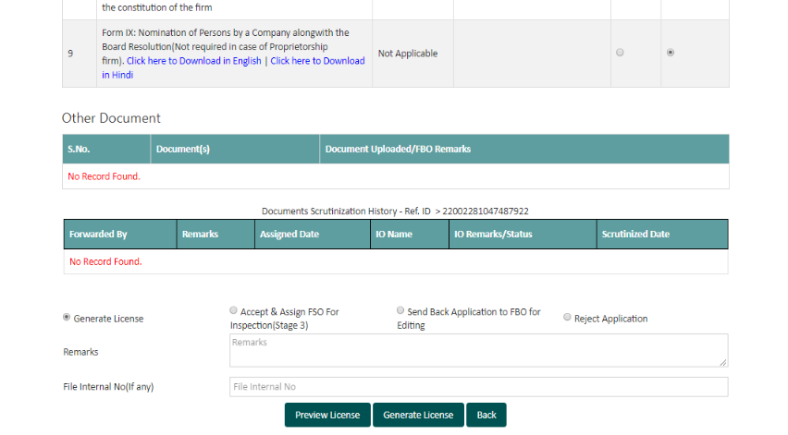
Processing of license in ONLY two stages
Stage-1: Check Jurisdiction and fees receipt
Stage-2: Document Scrutinization
Proceed to Generate License
Key Notes:
Two Stage process for DO to generate license If inspection is not required.
Sequencing of applications for scrutinization has been set as First in First Out (FIFO).
All application under processing in FLRS will be shifted to Stage-1 ( for State Licenses/ Registrations) and Stage 2 (for Central Licenses) of FoSCoS.
For detailed process flow, click
Click to Generate

Slide 20
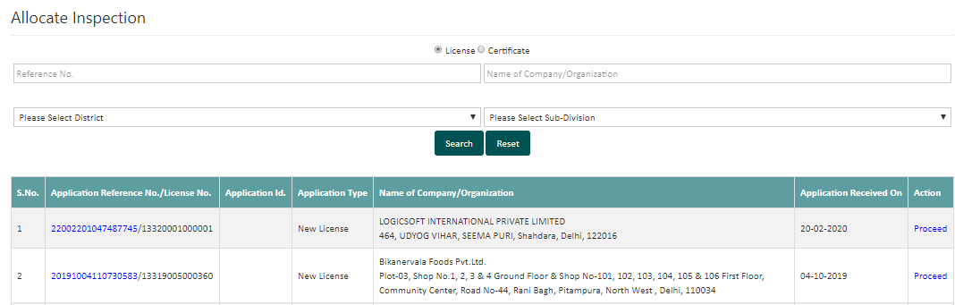
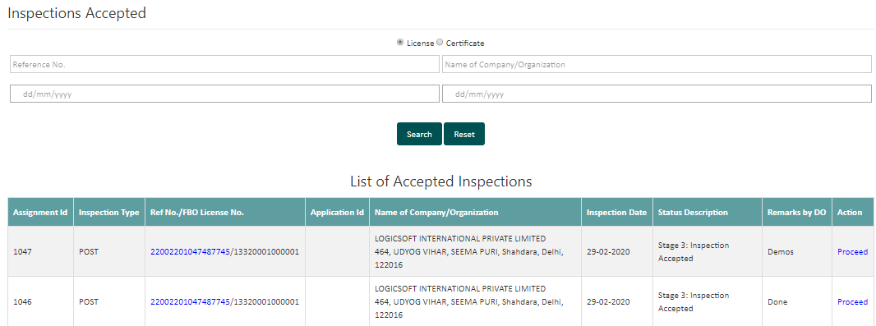
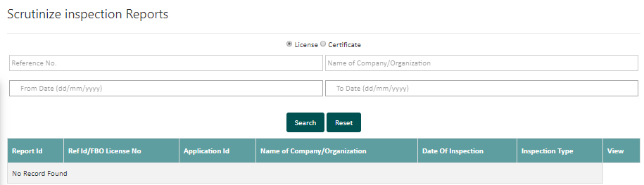
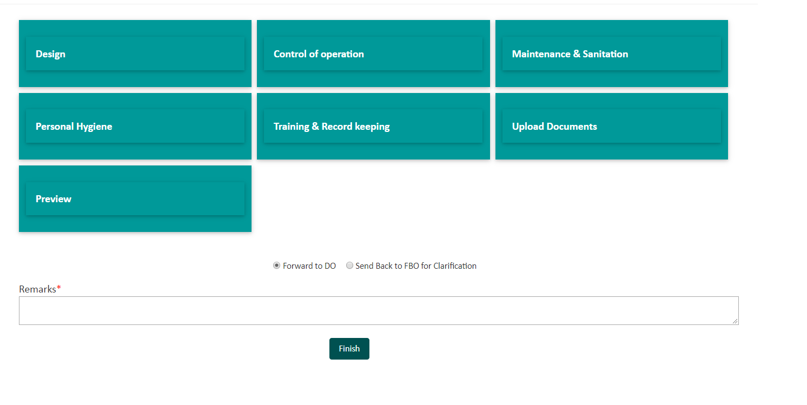
Processing of license if inspection is required
Check jurisdiction and fees receipt
Document Scrutinization
Forward to FSO for inspection
Forward for License generation
Generate License
Key Notes:
FoSCoS is fully synced with FoSCoRIS for conducting inspections.
OTP based Verification of Inspection Reports
DO has the provision to reassign the application for re-inspection if deemed necessary.
For detailed process flow, click

Slide 21
Process Modification Request
Check Online fees, type of modification
Document Scrutinization
Forward to FSO for inspection
Forward for License generation
Generate License
Key Notes:
Form-C modification process is similar to new license generation. Applications listed along with the applications of new license / renewals.
Non Form-C modification is similar to FLRS. Applications received will be available under ‘Scrutinize Non-Form ‘C’ applications tab.
For detailed process flow, click

Slide 22
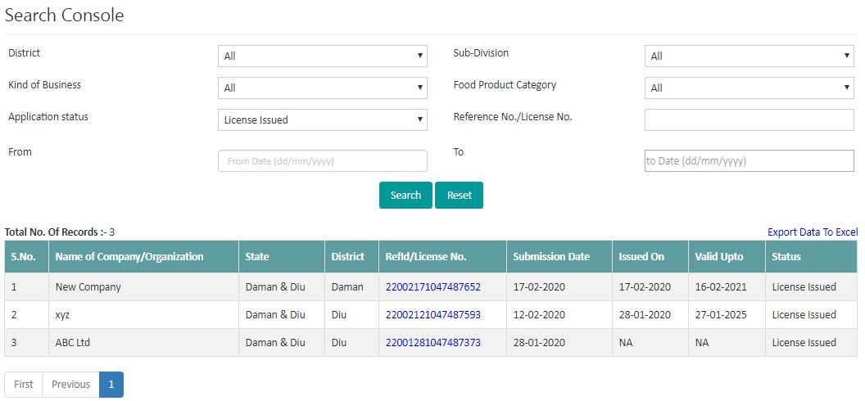
Search Console with export to excel feature
Key Notes:
Search Console- Master Reports is the new feature of FoSCoS
Enables DO to view and download reports as per application status
Export to Excel feature is provided.
Feature to view/ download consolidated reports upto district level.
Custom date range option.

Slide 23
What have we covered in this section..
1
Sequencing of applications for scrutinization has been set as First in First Out (FIFO). All pending state licenses/ registrations applications from FLRS shall be shifted to stage-1 in FoSCoS.
2
All central licenses applications under processing shall be migrated to stage-2 in FoSCoS. In case of State License, under processing applications shall be shifted to Stage 1, thus requiring reprocessing from initial stage.
3
Application pending with FBOs for more than 30 days are being rejected automatically by System.
4
Authorities shall avoid re-inspections of FBOs’ units whose application has been migrated to Stage-1.
5
Inspections carried out on FoSCoRIS shall be updated automatically on FoSCoS.
6
Search Console for master reports is the new feature added to provide ease to download reports based on application status.

Slide 24
FoSCoS for Food Safety Officers (FSO)

Slide 25
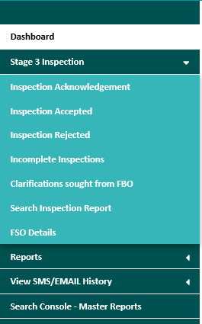
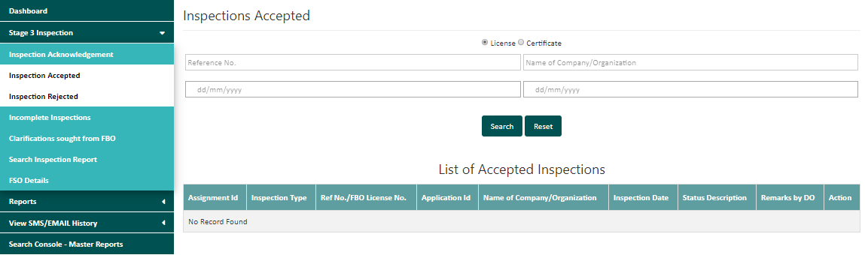
Inspection module
Check allocated inspections
Accept Inspection
Use FoSCoRIS or physical checklist
Check Form-B details
Forward the application to DO
Key Notes:
FoSCoRIS is now integrated with FoSCoS
FoSCoRIS (Inspection System) integrated with FoSCoS to enable allocation of inspections, viewing of inspection report within the licensing system.
OTP based Verification of Inspection Reports
Instant availability of Inspection reports to FBOs.
For detailed process flow, click
√
DO

Slide 26
What have we covered in this section..
1
Integration: FoSCoRIS (Inspection System) integrated with FoSCoS to enable allocation of inspections, viewing of inspection report.
2
Provision for seeking clarifications from FBO: FSO has provision to seek out for clarifications on inspection conducted from FBO. The listing of such clarifications sought from FBO by FSO is also made available to DO for viewing purpose.
3
Accept/Reject: FSO can accept or reject the inspection allocated to him/her under ‘Inspection Acknowledgement’ tab. If he wants to reject the inspection allocated, he/she can do so by putting the remarks.
4
FSO must update manual Inspection reports on FoSCoS and Inspections carried out on FoSCoRIS shall be updated automatically on FoSCoS.
4
Search Console: Comprehensive search tool made available to every FSO limited to their area of jurisdiction

Slide 27
Registering Authority

Slide 28
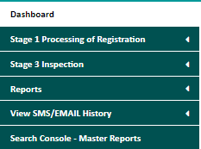
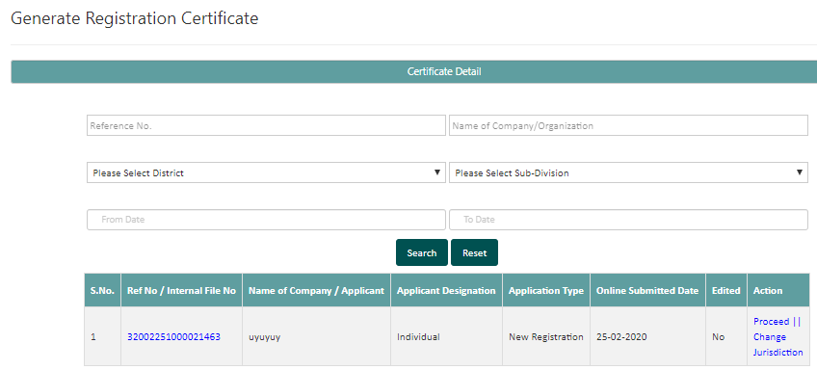
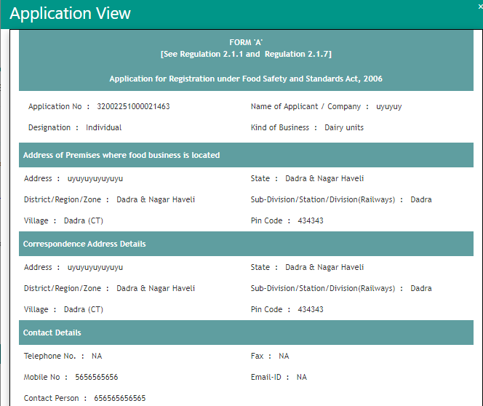
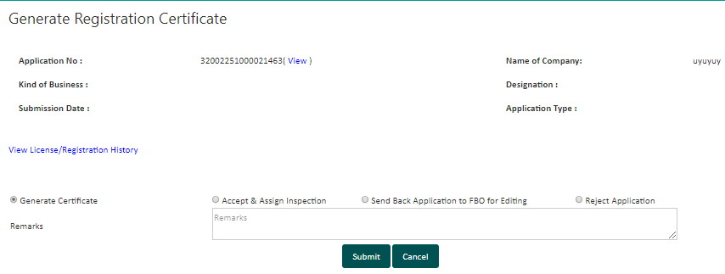
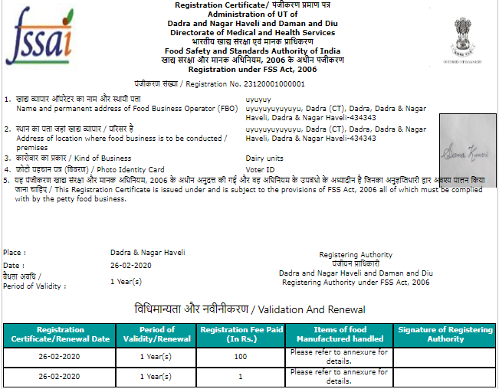
Generating Registration Certificates
Check jurisdiction and fees receipt
Document Scrutinization
Assign inspection to FSO if required.
Generate Registration
Jurisdiction can be changed.
Key Notes:
FoSCoRIS is now integrated. Inspection reports shall be visible.
RA can also assign the inspection to FSO for inspection wherever required.
Search Console- Master Reports is the new feature for searching reports as per application status.
Jurisdiction can also be changed.

Slide 29
Support from FSSAI

Slide 30
Support from FSSAI
User Manual
Find user manual on “How to use FosCoS” at https://foscos.fssai.gov.in/user-manual
Video Tutorial
Find video tutorials at https://foscos.fssai.gov.in/user-manual
Guidance Document
Find Guidance Document at https://foscos.fssai.gov.in/user-manual
Call Center
1800112100
07:00 to 23:00 hrs
helpdesk-foscos@fssai.gov.in
We want your feedback
foscosfeedback.fssai@gmail.com
Helpdesk-foscos@fssai.gov.in

Slide 32
Process flow for Petty FBO Log-in
Back

Slide 33
FBO/ DO/ FSO Login
Back

Slide 34
FBO New Application
Back

Slide 35
Submit Modification Application
Back

Slide 36
To process new application
Back

Slide 37
To process modification request
Back

Slide 38
Inspection
Back

Slide 39
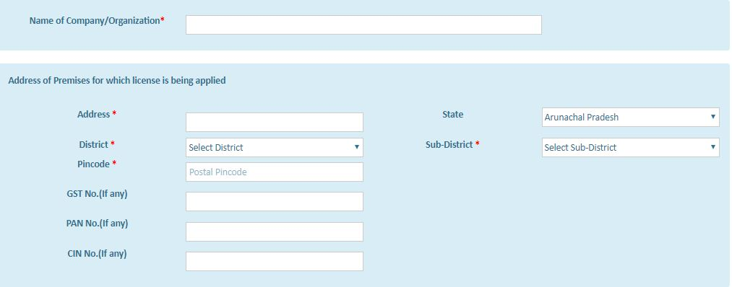
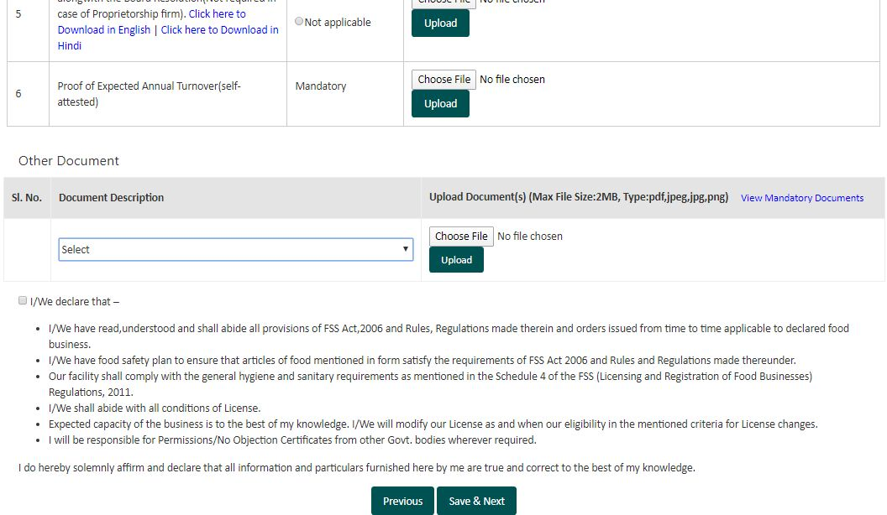
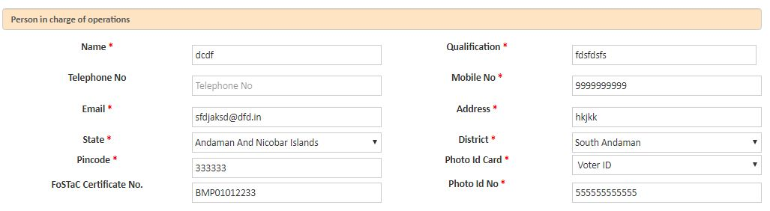
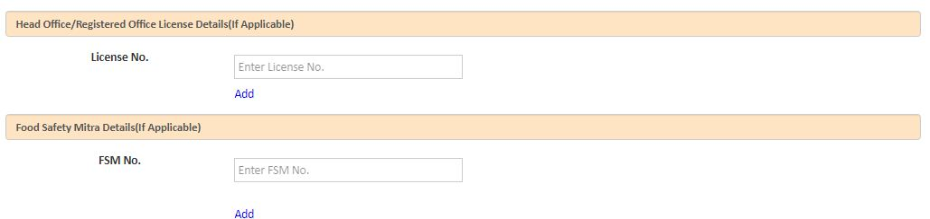
FoSCoS Key Features (Continued)
1
Capturing FBO business specific details such as CIN, GST and PAN No.
1
1
1
KoB wise Documentation
2
Check box declarations
2
1
1
Capturing FoSTaC certificate No.
2
Capturing FSM ID
2

