Slide 1

Artificial intelligence-based spam filtering with neurolinguistic approach using PyTorch framework
Tóth Balázs

Slide 2
CONTENTS
About the project
Data collection and preprocessing
Model architecture
Training process
Comparisons
Further improvements

Slide 3


About the project
Stack
PyTorch, Flask (API)
Goals
Easy implementation to any application
Prevent users from malicious emails

Slide 4
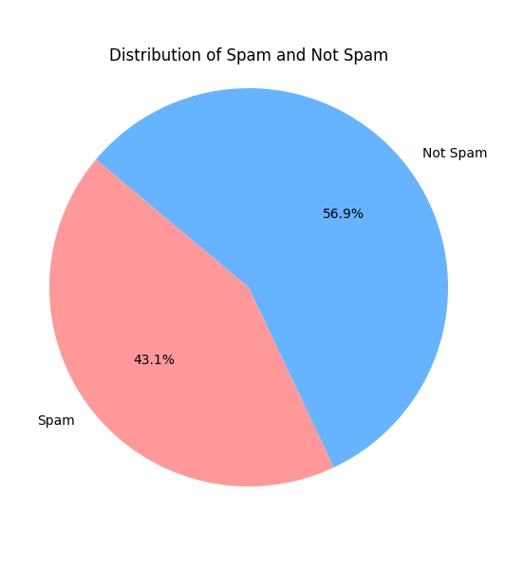
Data collection and preprocessing
Text classification labels
Text, the message
Class, the classification of the message (0 or 1)
Preprocessing
Classification
Extracting features from text (CountVectorizer)
Converting data to PyTorch tensors

Slide 5
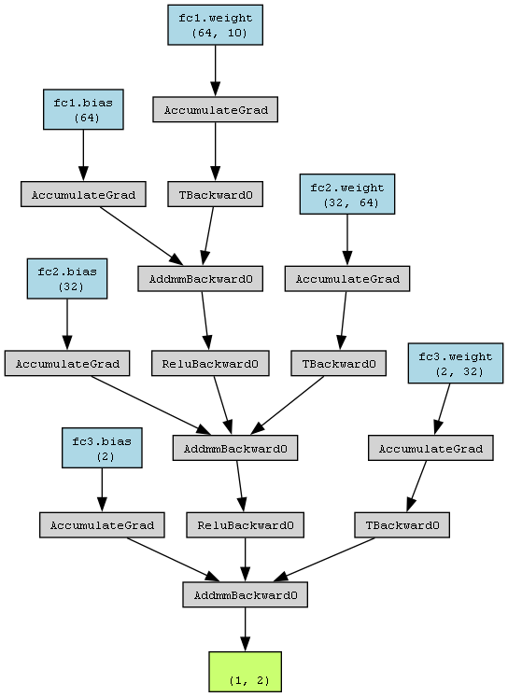
Model architecture
Three layered neural network
First, 64 (most complex layer)
Second, 32
Third, 2 (based on 0 and 1)

Slide 6
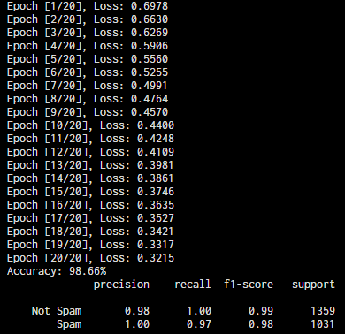
Training process
Epochs (20)
Loss function
CrossEntropyLoss (because of classifications)
Optimizer function
Adam (learning rate is 0.001)

Slide 7
Comparisons

