Slide 1

Python/TKinter based Hungarian NLP dataset generation and pre-processing tools and data visualization development
Balázs Tóth
MWZX0D

Slide 2
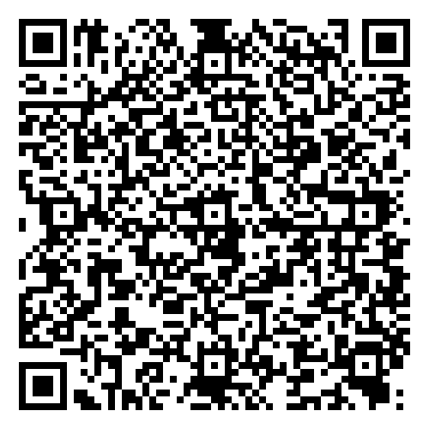
Documentation

Slide 3
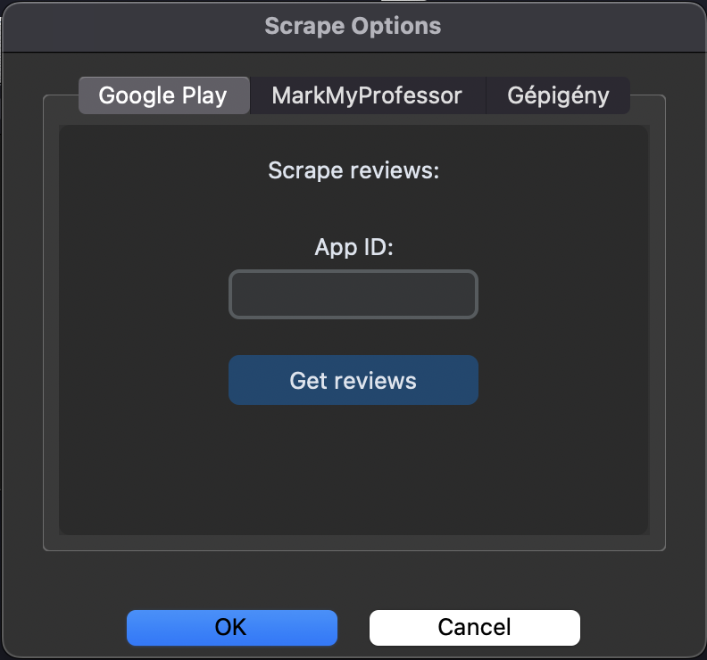
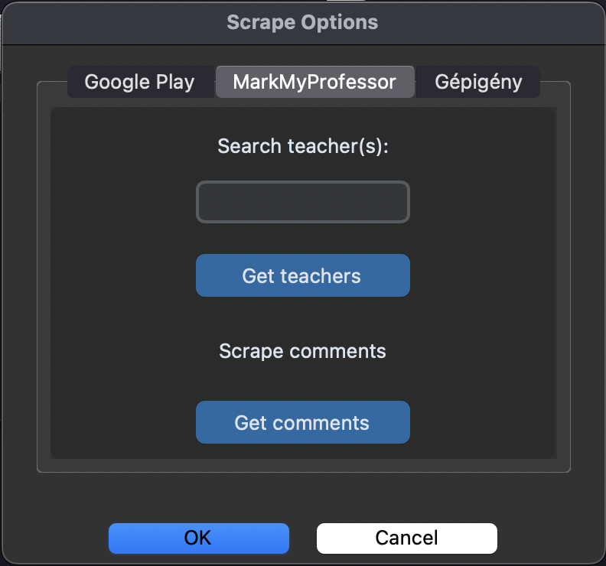
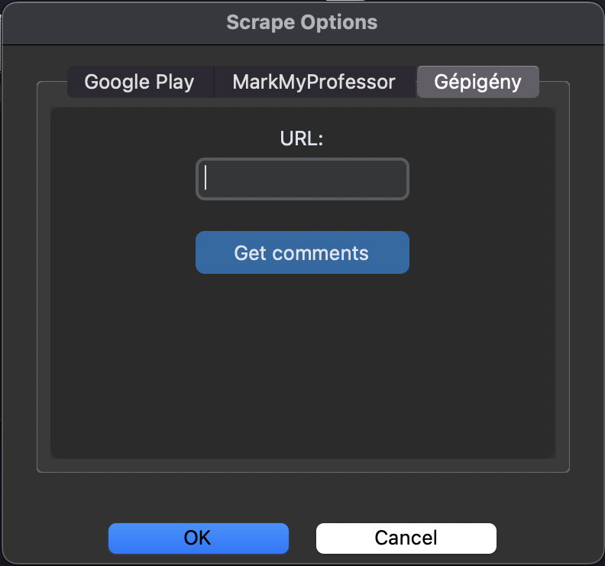
Data collection
Scraping data collection method
Google Play: Scraping comments by specific application.
Markmyprofessor: Scraping teacher’s comments, ratings.
Gépigény: Scraping comments by specific game.

Slide 4
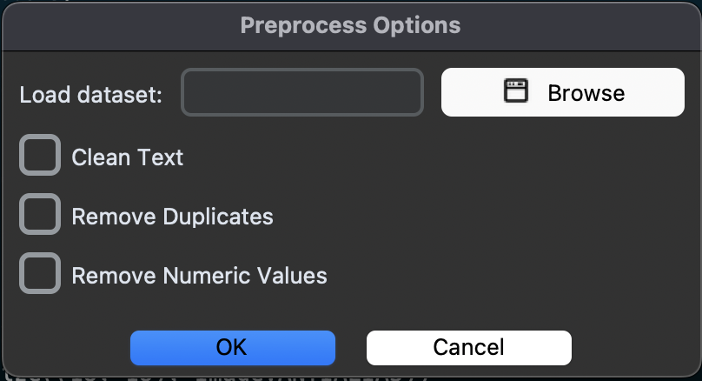
Data preprocessing

Slide 5
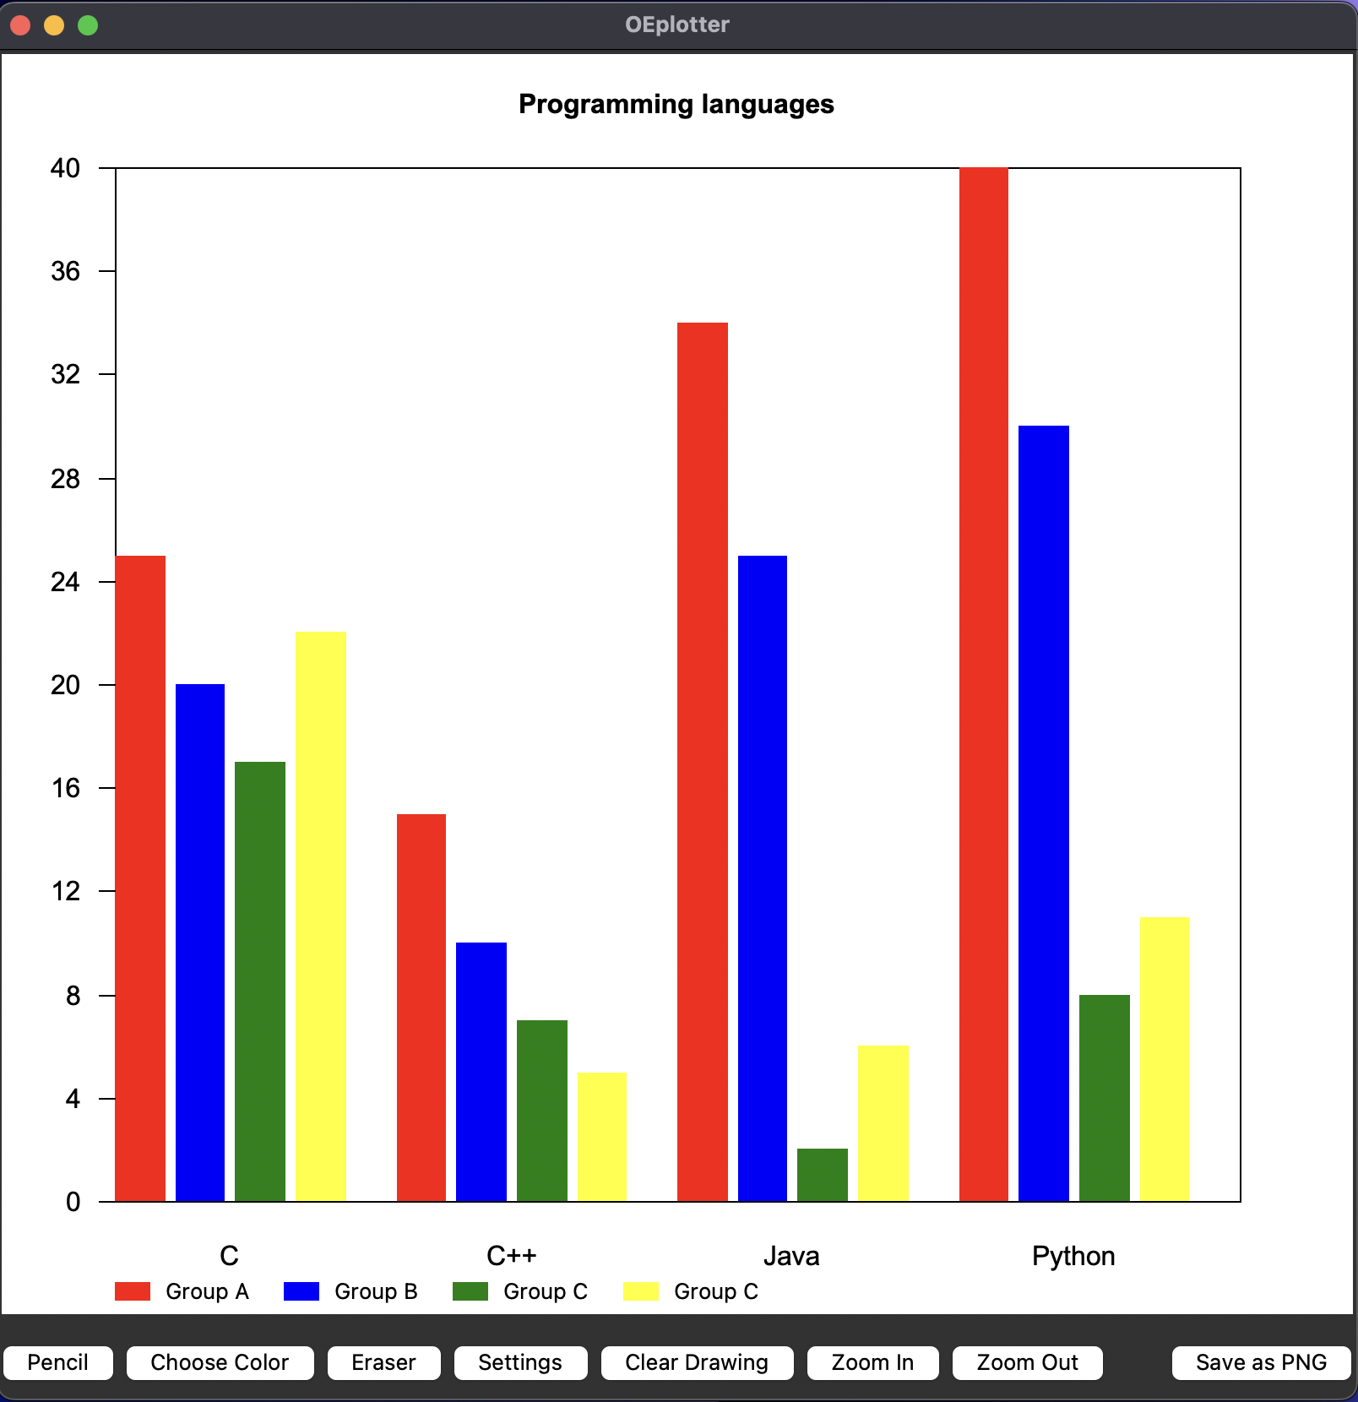
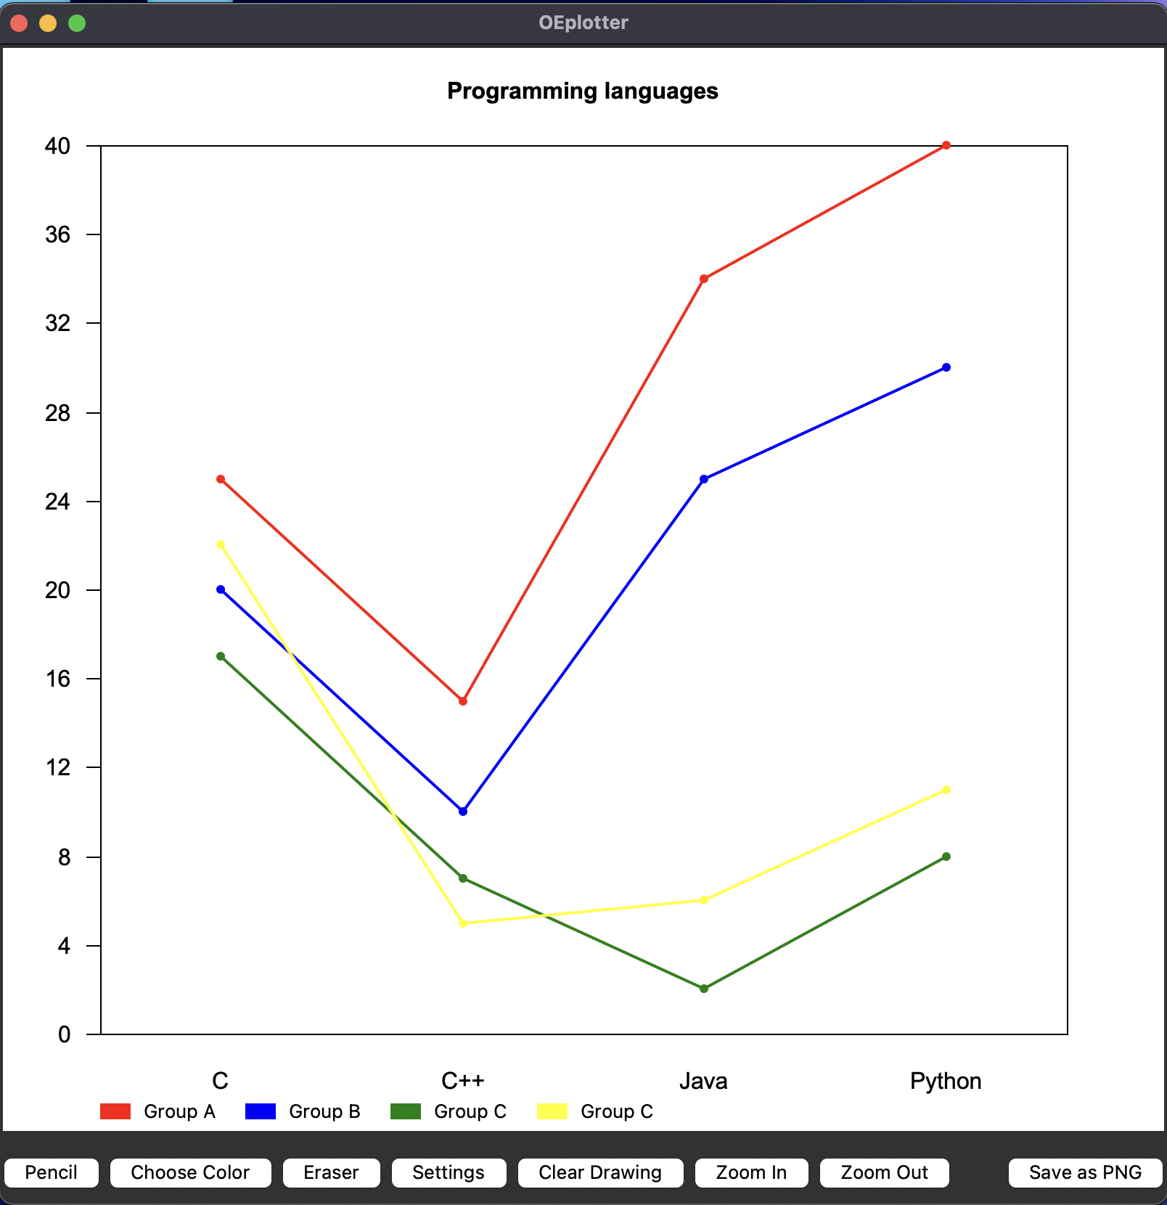
Data visualization
Supports barchart and linechart

Slide 6
The end
Thank you for your attention!

