Slide 1
Module 1 – Environment build and configuration
Use region: US (Oregon) / us-west-2
https://amzn.to/2M1gMQo
https://github.com/aws-samples/aws-security-workshops/tree/master/forensics-wksp
Directions:
Browse to the above URL
Read through the workshop scenario
Click on Environment Build and Configuration at page bottom
Follow the steps to deploy the CloudFormation stack
Please use a non-production account for this workshop!
Notes:
[Allow ~15 mins for them to do this]
We’ll go fairly quick through this since there is a lot to cover - If not finished with a section before we move on, feel free to keep working and if you have any problems ask one of the facilitators to help – you will be able to work on this workshop outside of this event at any time.

Slide 2
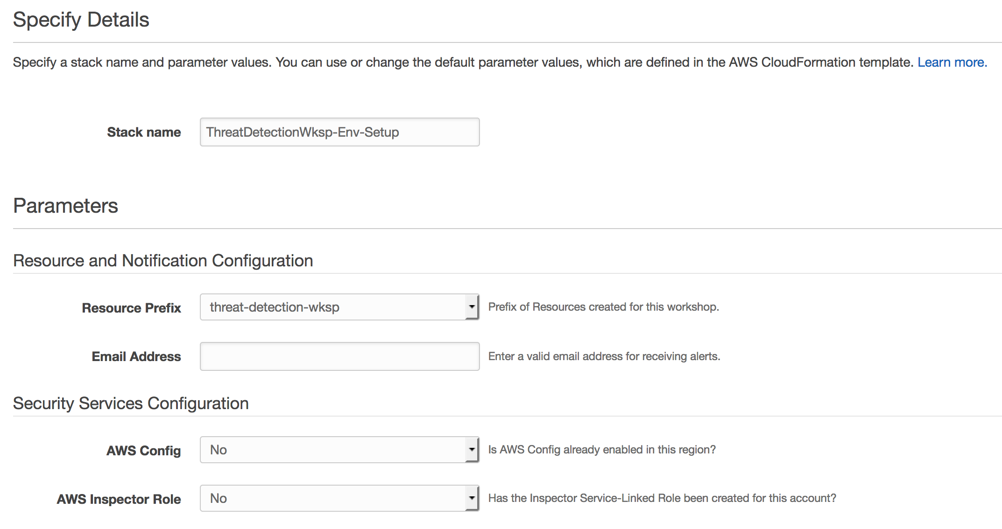
Module 1 – Important!
Use region: US (Oregon) / us-west-2
https://amzn.to/2M1gMQo
https://github.com/aws-samples/aws-security-workshops/tree/master/forensics-wksp
Notes:
[Emphasize that they should follow the instructions closely here and complete the parameters accordingly]

Slide 3
Cloud-powered Forensics Workshop
BlackHat Las Vegas
Jeff Puchalski and Nathan Case – AWS Security
August 8, 2018

Slide 4
Workshop agenda
Quick introduction to the workshop
Module 1: Environment build and configuration (15 min)
Run CloudFormation template and some setup
Module 2: Attack simulation and detection (25 min)
Run CloudFormation template, followed by presentation
Module 3: Forensics and remediation (45 min)
Investigate and respond to the attack
Module 4: Review and discussion (15 min)
Presentation / group Q&A
Cleanup

Slide 5
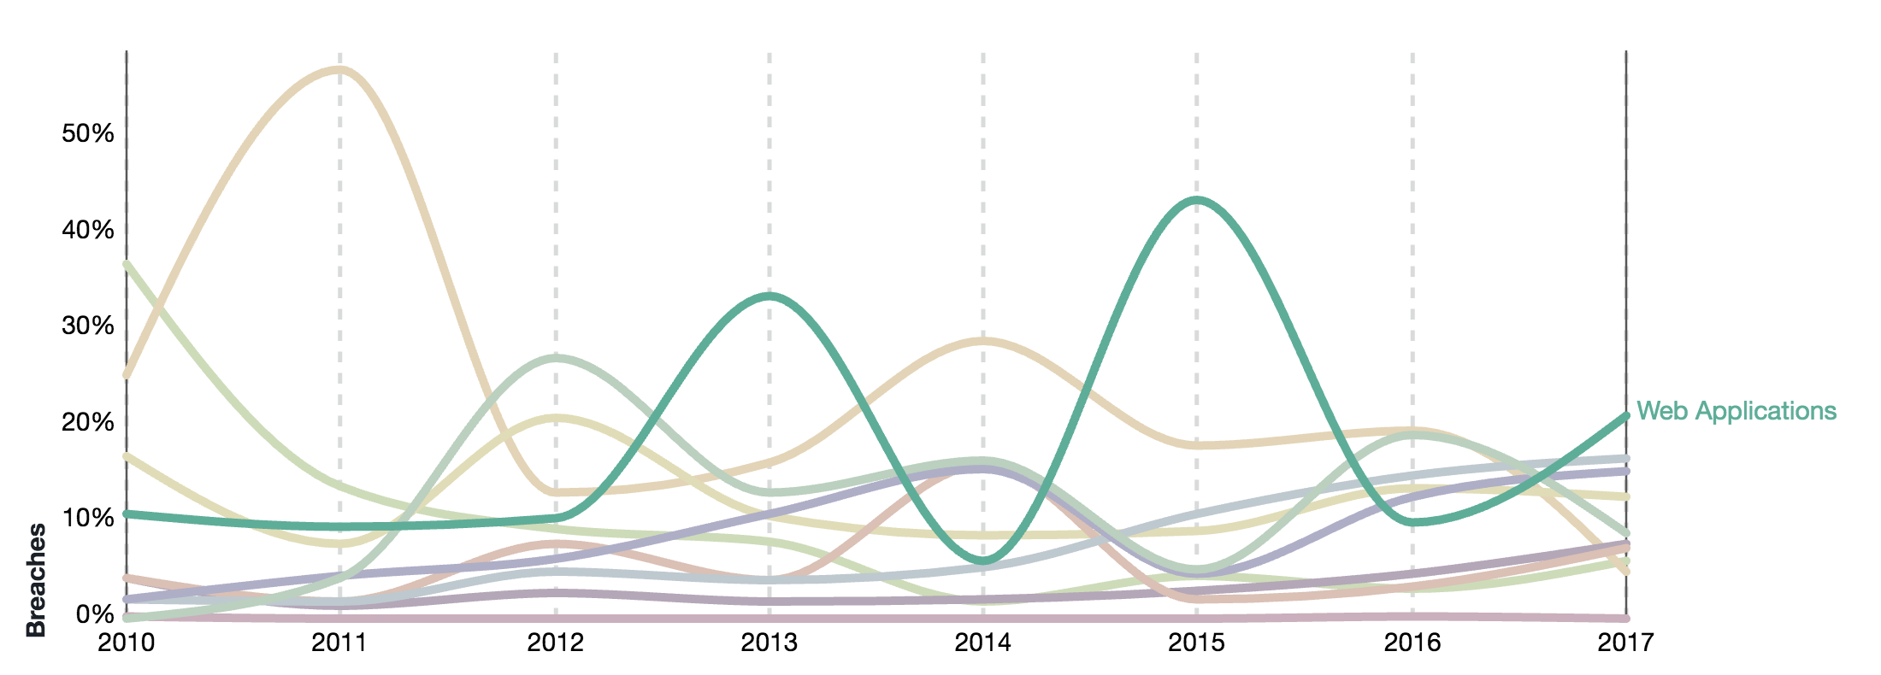
Verizon Report
Verizon - 2018 Data Breach Investigations Report
Data Breach Patterns
https://www.verizonenterprise.com/resources/reports/rp_DBIR_2018_Report_en_xg.pdf
Notes:
Data Breach: incident results in confirmed disclosure of data to an unauthorized party (not just potential exposure) Incident: security event that compromises the confidentiality, integrity or availability of an information asset.
This chart shows the data breach patterns from the 2018 Verizon Data Breach Investigations Report.
One of the leading data breach patterns is attacks on Web Applications –green line. Brown line is Point of Sale devices. Clearly web apps are an important target. That is one of the reasons we will use a web site in the scenario for this workshop (although the actual threat vector exploited could be done against any server)

Slide 6
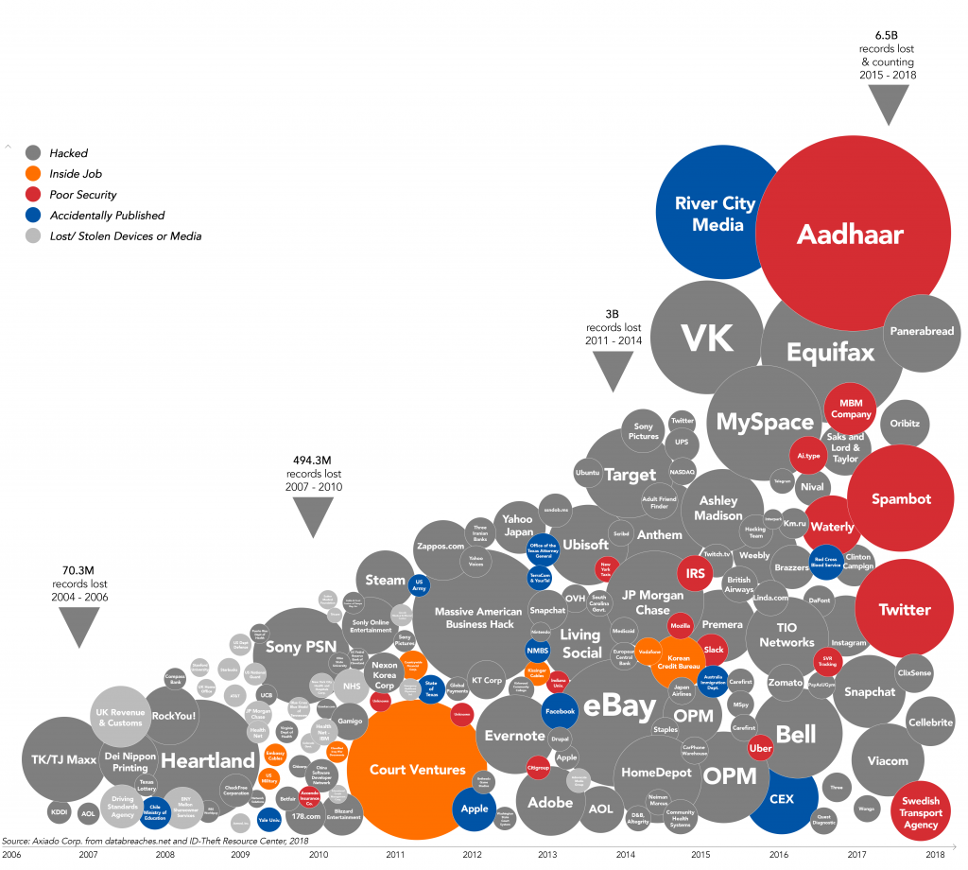
Data Breaches
https://axiado.com/blog/complexity-may-be-the-biggest-issue-of-cybersecurity/
Notes:
Data Breach: incident results in confirmed disclosure of data to an unauthorized party (not just potential exposure) Incident: security event that compromises the confidentiality, integrity or availability of an information asset.
This chart shows the data breach patterns from a report by Axiado.

Slide 7
Resources at your fingertips
Lots of info available about ways to prevent incidents in the first place
AWS-specific events that offer lots of material that is also available freely online!
Re:Invent, AWS Security Summits, Security Week at the AWS Lofts
https://www.youtube.com/user/AmazonWebServices
AWS Security Blog Best Practices
https://aws.amazon.com/blogs/security/tag/best-practices/

Slide 8
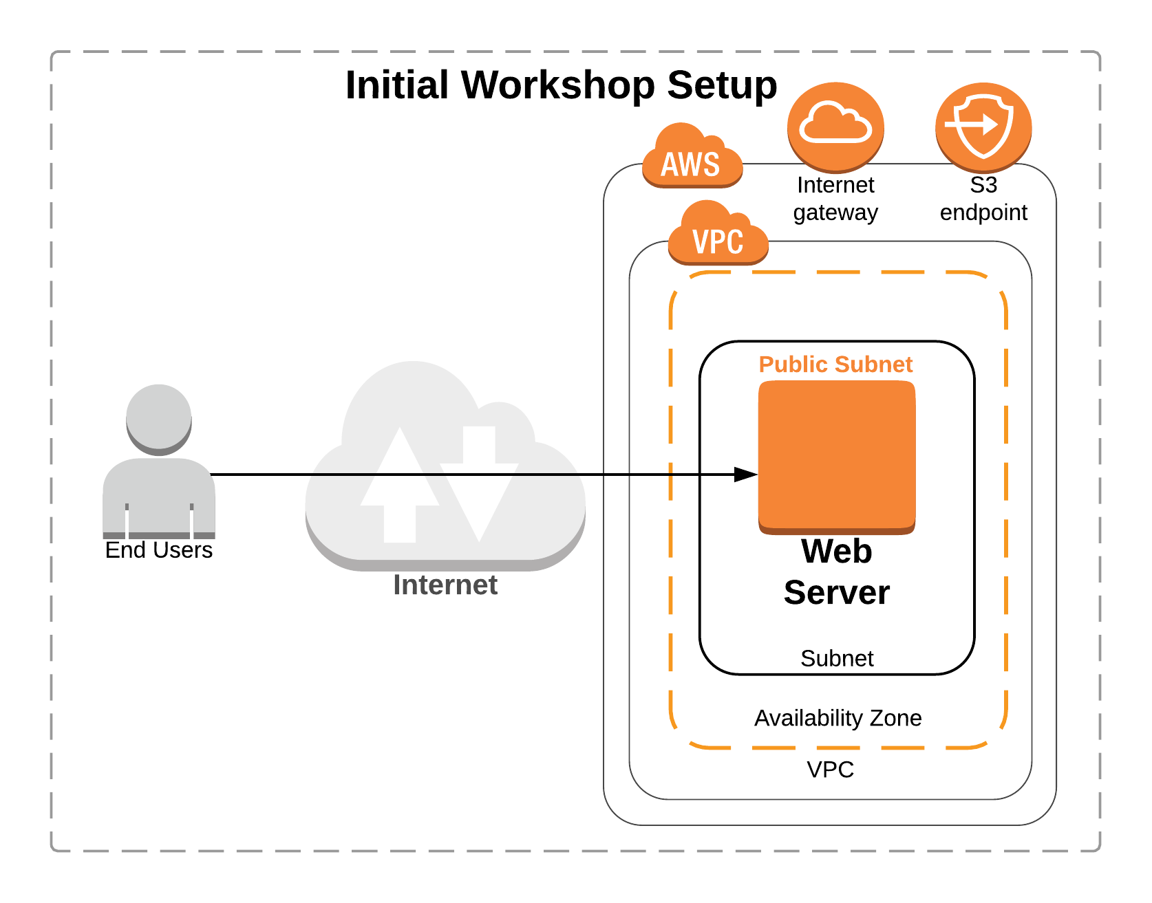
What could possibly go wrong here?
Notes:
So what are we doing in this Workshop?
Think of a hypothetical situation where the engineering teams in your org are trying to figure out how to move on-prem applications to the cloud from an existing data center. Your team wants to go ahead with a simple proof of concept.
They start with building a minimal architecture with a web server within a VPC that’s hosting a website. Also the webserver uses data that’s stored on an S3 bucket.
In this lab your job is to put on the hat of a security engineer and use AWS services to perform forensics on the incident to determine the nature of the attack that is occurring.

Slide 9
Module 2 – Attack Simulation
Use region: US (Oregon) / us-west-2
https://amzn.to/2M1gMQo
https://github.com/aws-samples/aws-security-workshops/tree/master/forensics-wksp
Directions:
Browse to the above URL
Click on Attack Simulation at page bottom
Follow the steps to deploy the CloudFormation stack
Notes:
[Allow ~15 mins for them to do this]

Slide 10
Threat Detection

Slide 11



Why is threat detection so hard?
Large datasets
Signal to noise
Skills shortage
Notes:
Threat detection has always been difficult and it is becoming more and more of a challenge.
More connected systems and devices - produce large data sets needing to be analyzed.
Difficult to find the threats in all the data.
Alert fatigue from so many notifications and false alarms. What’s really important?
Difficult to find and hire people with the skills needed to interpret all of this data.

Slide 12
Spectrum of Attacks
DDoS
Targeted Attacks
Reflection and
amplification
HTTP floods
Application exploits
Spear
Phishing
Layer 3 & 4
floods
SQL injection
Authorization exploits
Bots and probes
Certificate
hijacking
Slowloris
XSS
CSRF
SSL abuse
RFI/LFI
Amazon CloudFront
Elastic Load Balancing
AWS Shield
Web Application Firewall AWS WAF
Amazon Inspector
Amazon Macie
AWS Certificate Manager
AWS Marketplace: IDS/IPS, Anti-malware
CloudFront, ELB, Shield and WAF are not covered here – these services cover network and application level threats
Notes:
Flaws that allow this spectrum of network attacks to succeed are quite widespread.
In this section, we’ll look at AWS services that can be leveraged to detect and mitigate common reflection attacks that attempt to produce a volume of traffic capable of congesting network interfaces and inhibiting legitimate traffic.
As well as best practices for using WAF to mitigate other frequently exploited injection attack vectors, such as:
Cross site scripting which sends malicious code to a different end user or
SQL injections to read, alter, or delete sensitive data.

Slide 13





AWS Security Solutions
https://www.nist.gov/cyberframework
Identify
Protect
Detect
Respond
Recover
AWS Systems Manager
AWS Config
AWS Systems Manager
Amazon Inspector
VPC
KMS
AWS CloudHSM
IAM
AWS Organizations
AWS Cognito
AWS Directory Service
AWS Single Sign-On
Certificate Manager
Amazon Inspector
AWS CloudTrail
AWS Config Rules
Amazon CloudWatch Logs
Amazon GuardDuty
VPC Flow Logs
Amazon Macie
AWS Shield
AWS WAF
AWS Config Rules
AWS Lambda
AWS Systems Manager
Amazon CloudWatch Events
Amazon Athena
AWS Step Functions
AWS Lambda
AWS DR and Backup Solutions
AWS Systems Manager
Notes:
If we did a rough alignment of AWS services to the NIST Cybersecurity Framework core functions (v1.1 was just released in April of 2018) we might come up with something like this. This shows the breakdown of services and where most services lie, There is definitely overlap and the same services that fall into multiple categories. The services in bold are ones we will cover in this workshop
NIST Cybersecurity Framework: standards, guidelines, and best practices to manage cybersecurity-related risk. - Similar to the CAF Components (not Epics) – Directive, Preventive, Detective, Responsive

Slide 14




Log Data Inputs
AWS CloudTrail
CloudWatch Logs
DNS Logs
VPC Flow Logs
Track user activity and API usage
IP traffic to/from network interfaces in your VPC
Monitor apps using log data, store & access log files
Log of DNS queries in a VPC when using the VPC DNS resolver
Notes:
AWS logs - data source inputs for a threat detection
Does anyone know of an AWS service that detects threats by analyzing three out of four of the logs?
CloudTrail provides visibility into user activity by recording actions taken on your account. - Audit
Virtual Private Cloud (VPC) Flow Logs:
Capture information about the IP traffic going to and from network interfaces in your VPC.
Used to monitor the traffic that is reaching your EC2 instances,
With CloudWatch Logs, you can monitor your logs, in near real-time, for specific phrases, values or patterns to create metrics and implement alarms.
DNS Logs are used by GuardDuty as part of the analysis for continuous threat detection and include all DNS queries to the DNS resolver provided within your VPC.

Slide 15
Log Data Inputs
Services/Account
Infrastructure
Application
AWS CloudTrail
CloudWatch Logs
DNS Logs
VPC Flow Logs
Track user activity and API usage
Monitor apps using log data, store & access log files
IP traffic to/from network interfaces in your VPC
Log of DNS queries in a VPC when using the VPC DNS resolver
Notes:
AWS logs - data source inputs for a threat detection
Does anyone know of an AWS service that detects threats by analyzing three out of four of the logs?
CloudTrail provides visibility into user activity by recording actions taken on your account. - Audit
Virtual Private Cloud (VPC) Flow Logs:
Capture information about the IP traffic going to and from network interfaces in your VPC.
Used to monitor the traffic that is reaching your EC2 instances,
With CloudWatch Logs, you can monitor your logs, in near real-time, for specific phrases, values or patterns to create metrics and implement alarms.
DNS Logs are used by GuardDuty as part of the analysis for continuous threat detection and include all DNS queries to the DNS resolver provided within your VPC.

Slide 16

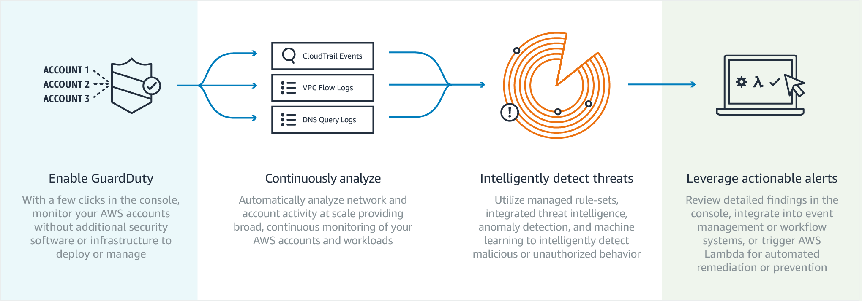
Amazon GuardDuty
Notes:
GuardDuty continuously monitors for malicious or unauthorized behavior to help you protect your AWS accounts and workloads.
It uncovers activity such as unusual API calls or potentially unauthorized deployments that indicate a possible account compromise. It also detects potentially compromised instances and reconnaissance by attackers.
GuardDuty analyzes billions of events across AWS accounts for signs of risk.
You can easily enable GuardDuty in the console and authorize it to monitor your accounts without additional security software or infrastructure to deploy or manage.
It can analyze and correlate billions of events from CloudTrail, VPC Flow Logs, and DNS Logs across all of your associated AWS accounts.
Performs continuous monitoring using managed rule-sets, integrated threat intelligence, anomaly detection, and machine learning to detect malicious or unauthorized behavior.
Review details findings in the console, integrate into event management or workflow systems, or trigger Lambda for automated remediation or prevention.

Slide 17
What Can Amazon GuardDuty Detect?
Connect to blacklisted site
Anonymizing proxy
Malicious or
suspicious IP
Unusual ISP caller
Unusual traffic volume
RDP brute force
RAT Installed
Exfiltrate data over DNS
Probe API with temp creds
Attempt to compromise account
Bitcoin activity
Recon
DNS exfiltration
Unusual ports
Unusual instance launch
Temp credentials
used off-instance
Notes:
GuardDuty can help identify potentially malicious activity throughout an attack lifecycle.
Starting with reconnaissance & infiltration, whether a user was Phished or credentials leaked, once in, attackers commonly work to connect to the network, anonymize their access, and deploy their Remote Access Trojan to establish a back door to command & control.
Then, more reconnaissance to figure out what’s there - get user lists, scout targets, and find vulnerabilities.
Lateral movement looking for ways to access instances with credentials that provide more privileged access.
Mission target: access to transfer critical data to an external location.

Slide 18


Tracking Changes and Event Triggers
Amazon CloudWatch Events Delivers a near real-time stream of system events that describe changes in AWS resources
AWS Config rules
Continuously tracks your resource configuration changes and if they violate any of the conditions in your rules
AWS Config rules
Continuously tracks your resource configuration changes and if they violate any of the conditions in your rules
Notes:
Config Rules and CloudWatch Events can both be used to trigger automated threat response.
Highlights:
CloudWatch Event timing vs. CloudTrail and use cases
Config multi-region, multi-account
A Config Rule represents desired configurations for a resource and is evaluated against configuration changes recorded by AWS Config.
Use Config Rules to assess overall compliance and risk status from a configuration perspective,
View compliance trends over time and pinpoint which configuration change caused a resource to drift out of compliance with a rule.
CloudWatch becomes aware of changes as they occur for near real-time response
Take corrective action by activating functions, making changes, and capturing state information.

Slide 19


Amazon CloudWatch Events
GuardDuty findings
CloudWatch Event
Lambda function (forensics or responder)
{
"source": [
"aws.guardduty"
]
}
Notes:
CloudWatch Events delivers a near real-time stream of system events that describe changes in your AWS resources.
Using simple rules that are quick to set up, you can match events and route them to one or more target functions or streams.
Respond to changes, take corrective action by sending messages to activate functions, make changes, capture state information and pass notifications to collaboration and communication tools.
This example shows a GuardDuty finding, but it could just as easily be an event from another service.

Slide 20






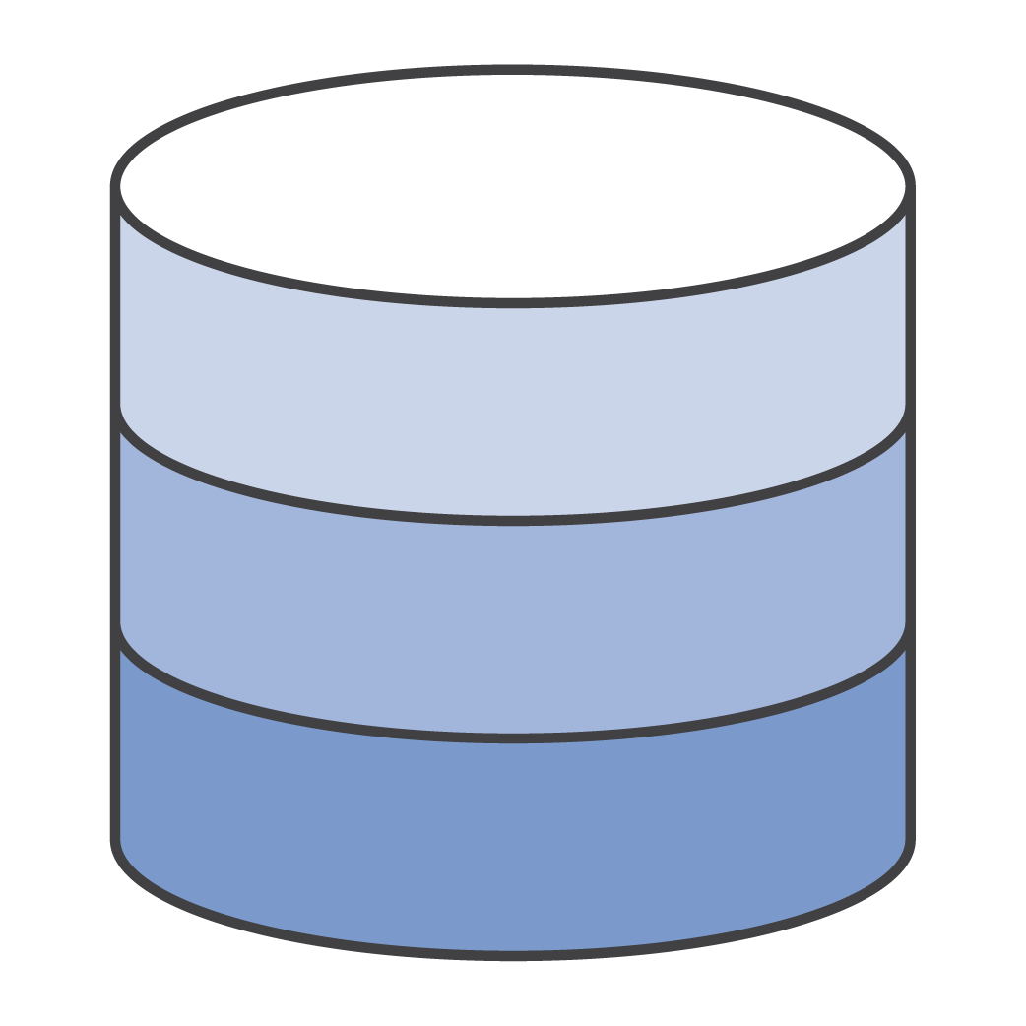




AWS Config Rules
A continuous recording and assessment service
Notifications
Normalized
AWS Config
Changing resources
AWS Config rules
API access
How are my resources configured over time?
Is a change that just occurred to a resource, compliant?
History snapshot
Notes:
Evaluation of a Config rule determines whether a resource is compliant at a particular point in time.
Config Rules will capture and store the result of each evaluation.
Result includes the resource, rule, time of evaluation and a link to non-compliant resources.
A rule can be setup as a change-triggered rule or as a periodic rule.
Change-triggered rules are executed when AWS Config records a configuration change for any of the resources specified.
Periodic rules are triggered at the frequency you specify, anywhere from an hour to a day.
Create your own rules to customize what is being checked or use AWS Managed rules
Enables changes to the environment to kick off lambda scripts

Slide 21



Lambda + Systems Manager + CloudWatch
Amazon GuardDuty
Amazon CloudWatch
AWS
Lambda
AWS Systems Manager
Instance:~ ec2-user$ _
documents
Events Rule
Lambda function
EC2 instance contents
Notes:
In this progression of slides, note that customers may approach this differently, but there's a lot of power at your fingertips with control plane mechanisms that you can change that an adversary cannot. Similarly, lots of remediation options (e,g,, isolate, sandbox, snapshot + nuke from orbit, etc.). Depends on goals and needs (e.g., observe and monitor vs. isolate quickly).
From adversary's perspective it might not be obvious that something has changed.
Also, resources in a cloud environment should be considered ephemeral.

Slide 22
Lambda + Systems Manager + CloudWatch
Amazon GuardDuty
Amazon CloudWatch
AWS
Lambda
AWS Systems Manager
Instance:~ ec2-user$ _
documents
Events Rule
Lambda function
EC2 instance contents

Slide 23
Lambda + Systems Manager + CloudWatch
Amazon GuardDuty
Amazon CloudWatch
AWS
Lambda
AWS Systems Manager
Instance:~ ec2-user$ _
documents
Events Rule
Lambda function
EC2 instance contents

Slide 24

Lambda + Systems Manager + CloudWatch
Amazon GuardDuty
Amazon CloudWatch
AWS
Lambda
AWS Systems Manager
Instance:~ ec2-user$ _
documents
Events Rule
Lambda function
ENI
EC2 instance contents
ENI

Slide 25

Lambda + Systems Manager + CloudWatch
Amazon GuardDuty
Amazon CloudWatch
AWS
Lambda
AWS Systems Manager
Instance:~ ec2-user$ _
documents
Events Rule
Lambda function
ENI
EC2 instance contents
EBS Volume
ENI

Slide 26
Lambda + Systems Manager + CloudWatch
Amazon GuardDuty
Amazon CloudWatch
AWS
Lambda
AWS Systems Manager
Instance:~ ec2-user$ _
documents
Events Rule
Lambda function
ENI
80, 443->WebSG
EC2 instance contents
EBS Volume
ENI

Slide 27
Lambda + Systems Manager + CloudWatch
Amazon GuardDuty
Amazon CloudWatch
AWS
Lambda
AWS Systems Manager
Instance:~ ec2-user$ _
documents
Events Rule
Lambda function
ENI
80, 443->WebSG
EC2 instance contents
3389 -> 0.0.0.0/0
EBS Volume
ENI

Slide 28
Lambda + Systems Manager + CloudWatch
Amazon GuardDuty
Amazon CloudWatch
AWS
Lambda
AWS Systems Manager
Instance:~ ec2-user$ _
documents
Events Rule
Lambda function
ENI
80, 443->WebSG
EC2 instance contents
EBS Volume
Notes:
ENI can go away… Or

Slide 29
Lambda + Systems Manager + CloudWatch
Amazon GuardDuty
Amazon CloudWatch
AWS
Lambda
AWS Systems Manager
Instance:~ ec2-user$ top
Instance:~ ec2-user$ pcap
Instance:~ ec2-user$ lime
Instance:~ ec2-user$ ps –ef
documents
Events
Lambda function
ENI
null->QuarantineSG
Forensics Volume
EC2 instance contents
ENI
EBS Volume
Notes:
In this set of slide we walkthrough a automatic remediation of a finding. We could just as easily show Macie, inspector or any other service that produces cloudtrail items. Literally the same process. Keep in mind the out come here is discssuing the eni’s on the EC2 instance, for Macie it would show an s3 bucket maybe. Effectively these slide walk a audience through the automated process. The biggest issue I have with using a demo here, is that all of the services are different screens and its hard to follow even knowing all the screens. Also when I kick the demo off, its complete before I can refresh most times.
This is more instructive.
Also note that ASM (SSM) is used to actinside the OS of an instance. This ability is imperative in the remediation of issue with an environment, with out this we are just playing wak-a-mole. With this we can patch automate a patch and deliver to a whole environment based on tags.

Slide 30
Lambda + Systems Manager + CloudWatch
Amazon GuardDuty
Amazon CloudWatch
AWS
Lambda
AWS Systems Manager
Instance:~ ec2-user$ top
Instance:~ ec2-user$ pcap
Instance:~ ec2-user$ lime
Instance:~ ec2-user$ ps –ef
documents
Events
Lambda function
ENI
null->QuarantineSG
EC2 instance contents
EBS Volume
ENI
Notes:
We can act inside the system now.
Best to change the ec2 instance with the lambda instead of AWS api as this requires to much access

Slide 31
Lambda + Systems Manager + CloudWatch
Amazon GuardDuty
Amazon CloudWatch
AWS
Lambda
AWS Systems Manager
documents
Events
Lambda function
EC2 instance contents
EBS Volume
Notes:
We can act inside the system now.
Best to change the ec2 instance with the lambda instead of AWS api as this requires to much access
Controlling the instance with lambda allows only one Lambda to have access to the ability to remove ENI’s, Storage etc. Making it hard to weaponise.

Slide 32

Lambda + Systems Manager + CloudWatch
Amazon GuardDuty
Amazon CloudWatch
AWS
Lambda
AWS Systems Manager
documents
Events
Lambda function
Amazon EBS snapshot
EBS Volume
Notes:
We can act inside the system now. And thus adding the info gained there it is important to put it somewhere safe. THAT DOES NOT MEAN A VOLUME HANGING OUT IN A THE SAME ACCOUNT. Do not leave a loaded weapon out for other to accidently use it.
Please turn it into a snapshot and ship it to a forensics account and then burn it

Slide 33
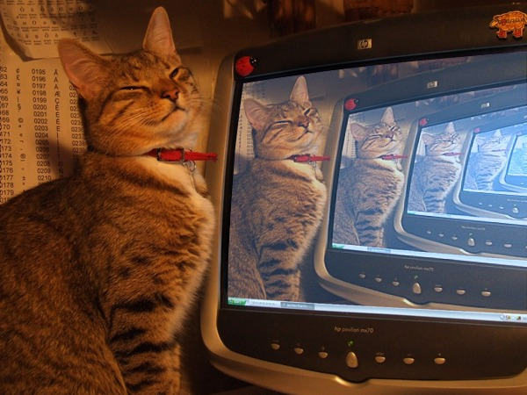

Forensics Preparation
There are two ways to practice Incident Response; you get to choose one of them ☺
Keep a pre-configured forensics account, AMIs, and EBS volumes on hand
Pre-installed tools & scripts for data/metadata gathering, memory dumps, network traffic capture, etc.
Define forensic workflows and how they fit into your incident response process
Create IAM role for incident responders and for the forensic workstation
ThreatResponse – free, open source tool suite for AWS incident response
https://github.com/ThreatResponse
Notes:
For offline analysis, this will be what is used to launch the forensic instance. For online analysis, this is the “practice” workstation. The scripts and software loaded here will be what to install on the compromised instance.
Online vs offline. Have a playbook.
IAM roles for forensics should have carefully scoped permissions to be able to investigate without any problems. The instance (in both online and offline) will need to make API calls.

Slide 34
Third Party Tools
Response
AWS IR (ThreatResponse)
Case Management
Incident Pony (ThreatResponse)
Networking
Moloch
Wireshark
Enterprise
Mandiant
EnCase
Forensic Tool Kit
Google Rapid Response
Memory Capture
Fastdump
FTK Imager
LiME
Margarita Shotgun (ThreatResponse)
Volatility

Slide 35
Security Incident Response Simulations (SIRS)
Internal events that provide a structured opportunity to practice your incident response plan during a realistic scenario
SIRS are about preparation and iteratively improving your response capabilities
Validate readiness
Develop confidence, agility, speed, communication – learn from and train staff
SIRS should be relevant, realistic, thoroughly tested, and run live
NOT in production environment, but as close to production as possible
If you are planning SIRS:
Obtain permission to perform penetration testing/scanning
Confirm the SIRS does not violate the AWS Acceptable Use Policy
Practice, practice, practice!
Notes:
For offline analysis, this will be what is used to launch the forensic instance. For online analysis, this is the “practice” workstation. The scripts and software loaded here will be what to install on the compromised instance.
Online vs offline. Have a playbook.
IAM roles for forensics should have carefully scoped permissions to be able to investigate without any problems. The instance (in both online and offline) will need to make API calls.
Before we dive into examples…I better explain the basic ingredients of a Security Incident Response Simulation.
1. Important issue – What is the trigger issue - phishing attempt on a corporate laptop, responding to reported abuse…
2. Skilled security geeks – need a builder and need a tester
3. If your simulation is not realistic your team will most likely mock you which is contrary to the goal of gaining confidence through simulations. If you are too minimalist you become trivial.
4. Build elements – build the logging artifacts, produce the emails and alerts, build the run book e.g. wiki with commands to run, etc.
5.-6. Invite everyone who needs to train. It is particularly fun to run parallel games with say 10 security engineers.
7. Make it a habit.

Slide 36
Forensics and Remediation

Slide 37


Forensics-oriented Services
AWS
Lambda
AWS Systems Manager
Amazon
Inspector
Amazon Athena
Run code for virtually any kind of application or backend service – zero administration
Gain operational insights and take action on AWS resources
Automate security assessments of EC2 instances
Query data in S3, such as CloudTrail logs, using serverless SQL queries
Notes:
Automate your threat remediation with these AWS services.
Lambda:
Add prevention mechanisms to security boundary services
WAF, Security Groups, S3 bucket policies
Invoke deeper inspection of the AWS estate
Systems Manager, Inspector
Systems Manager:
Proactively mitigate threats at instance level
Patching system
Amazon Inspector
Automated security assessment service
Helps improve the security and compliance of applications deployed on AWS.

Slide 38



The High-Level Playbook
Adversary
Your environment
CloudWatch Events
Lambda function
Notes:
This is the basic anatomy for your security event response automation. You have someone doing something egregious, malicious or otherwise to your environment. You will ultimately author a series of CloudWatch events that listen to what is interesting to you, and then execute some sort of function, whether it is observe & report, or even take action, or both.
Next I’ll show you a demo of two Lambdas responders that restart CloudTrail and send a notification as triggered by CloudWatch Events.

Slide 39







Responding to Findings: Remediation
AWS CloudTrail
Amazon Athena
Detection
Alerting
Remediation
Countermeasures
Forensics
VPC Flow Logs
Team collaboration
(Slack etc.)
AWS Step Functions
AWS WAF
Amazon CloudWatch
Lambda Function
AWS Shield
AWS APIs
Amazon GuardDuty
AWS Config
Amazon EC2 Systems Manager
Amazon EC2

Slide 40
Review Questions
How can you create custom rules for Config?
What services can help with performing forensics after an incident?
What services are important for automation of remediations?
What performance impact does GuardDuty have on your account if you have more then 100 VPCs?
Which of the services discussed have direct access to your EC2 Instances?

Slide 41
Module 3 – Forensics and Remediation
Use region: US (Oregon) / us-west-2
https://amzn.to/2M1gMQo
https://github.com/aws-samples/aws-security-workshops/tree/master/forensics-wksp
Directions:
Browse to the URL above
Click on Forensics and Remediation at page bottom
Work through the exercises described
Notes:
[Allow ~30 mins for them to do this]

Slide 42
Review Questions
How can you create custom rules for Config?
What services are important for automation of remediations?
What performance impact does GuardDuty have on your account if you have more then 100 VPCs?
Which of the services discussed have direct access to your EC2 Instances?

Slide 43
Review and Clean-up

Slide 44
Module 4 – Review and Clean-up
Use region: US (Oregon) / us-west-2
https://amzn.to/2M1gMQo
https://github.com/aws-samples/aws-security-workshops/tree/master/forensics-wksp
Directions:
Browse to the URL above
Click on Review and Cleanup at page bottom
Read through the recap and description of the attack
Perform the clean-up steps to avoid charges to your account from the resources used during this workshop!
Notes:
45 mins
Use the Oregon region

Slide 45
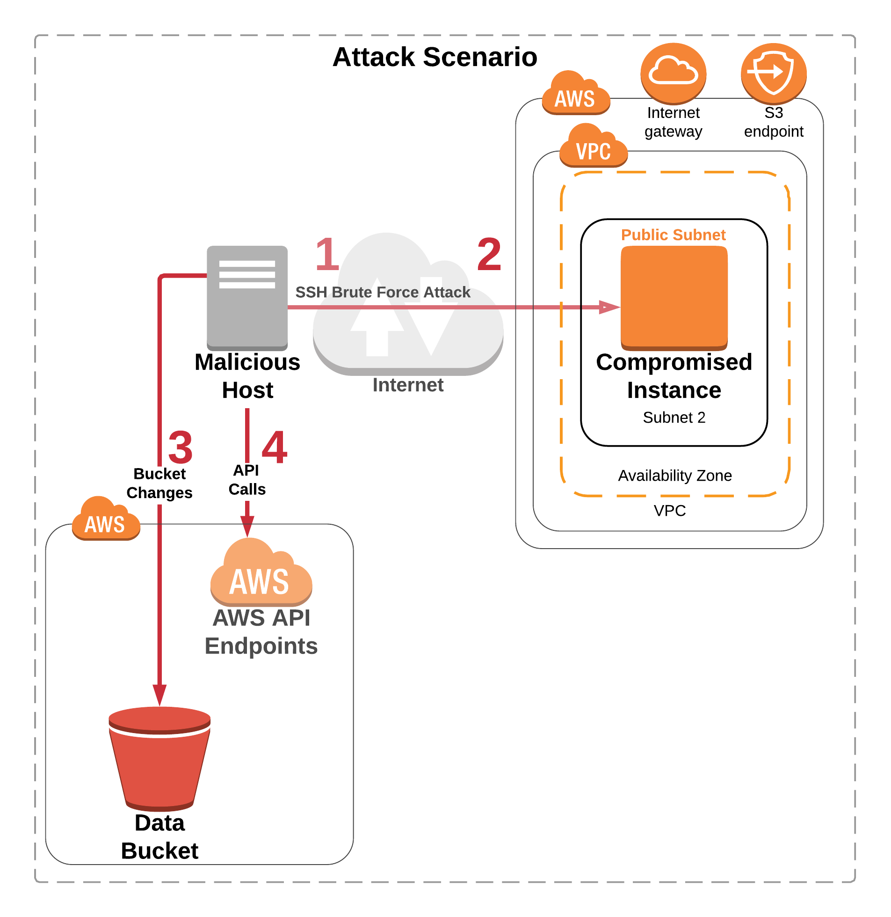
The Attack

Slide 46
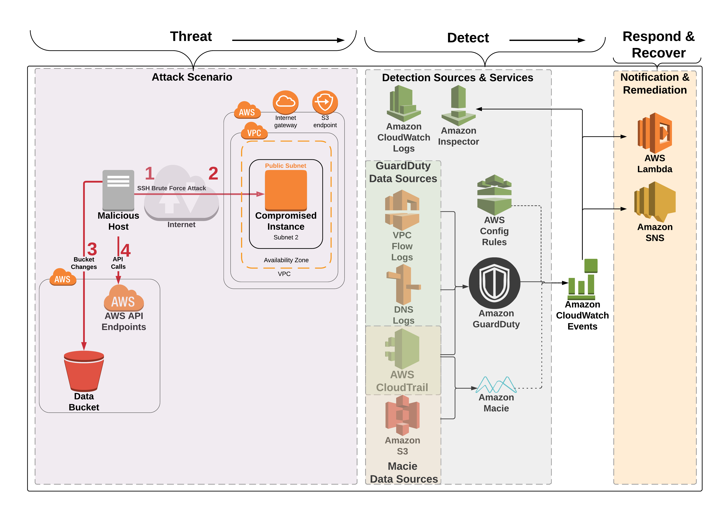
Module 2 setup

Slide 47
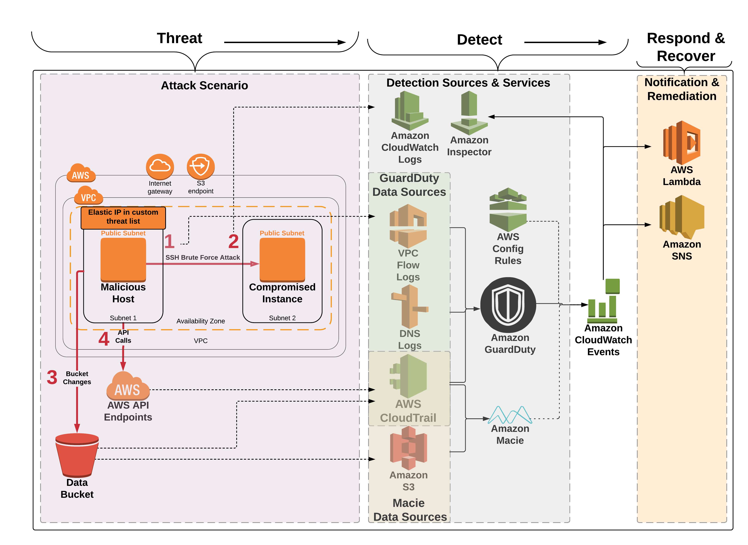
What really happened?
Notes:
Attack Recap
1. Module 2 CloudFormation template creates two EC2 instances. They are in the same VPC but different subnets. The Malicious Host represents the attacker which we pretend is on the Internet. The Elastic IP on the Malicious Host is in a custom threat list in GuardDuty (in order to generate . The other instance named Compromised Instance represents the web server that was lifted and shifted into AWS.
2. Although company policy is that only certificate authentication should be enabled for SSH, at some point password authentication for SSH was enabled on the Compromised Instance
3. The Malicious Host performed a brute force SSH password attack against the Compromised Instance. The brute force attack is designed to be successful
4. The SSH brute force attack was successful and the attacker was able to log in to the Compromised Instance
5. We pretend here that the attacker then copied the temp credentials (that came from IAM Role for EC2) from the instance to an S3 bucket - in reality the API calls from the Malicious Host use the temp creds from the IAM Role for EC2 attached to the Malicious Host
6. The CloudFormation template that we ran in Module 2 enables encryption for the Data bucket and then the EC2 instance removes the encryption. In addition the CloudFormation template made the Data bucket public. This is used for the Macie part of the investigation in Module 3. We pretend that the attacker made the bucket public and removed the default encryption from the bucket.
7. The API Calls that generated the API findings come from the Malicious Host. The calls use the temp creds from the IAM role for EC2 running on the Malicious Host. The GuardDuty findings are generated because the EIP on the Malicious Host is in a custom threat list.

Slide 48
Workshop questions
Why did the API calls from the “malicious host” generate GuardDuty findings?
Notes:
Use this question to have a discussion in custom threat lists – and threat intelligence in general

Slide 49
Workshop questions
Which two AWS services provide a historical configuration change audit?
Which of the two is really designed (and much easier to use) for analysis of configuration changes?
Notes:
Which two AWS services provide a historical configuration change audit?
Config and Systems Manager

Slide 50
Workshop questions
Let’s assume the company policy in this scenario is that EC2 instances running Linux can only use certificate authentication. At some point somebody must have enabled password authentication on the web server.
How could you determine when this was changed and by whom?

Slide 51
Workshop questions
Would you consider a single SSH brute force attack finding by itself be enough to kick off an automated action to add an ACL to block the source of the attack?
What combination of data points regarding a threat would lead you to consider automatically terminating a compromised instance?

Slide 52
Call to Action
Enable GuardDuty and examine its findings
Free for first 30 days
Develop processes and runbooks for incident response workflows
Take inventory - understand your environment and business needs
Processes include forensics and remediation
Create SIRS to iteratively refine and improve those processes
SIRS and runbooks are living documents – practice them regularly and consistently
Look for opportunities to automate workflows
Get humans away from data!

Slide 53
Thank you!
Notes:
You can keep working on the lab but please cleanup your resources as soon as you are done to avoid charges – the instructions are in the Module 4 doc.

Slide 54
Workshop walkthrough

Slide 55
The initial setup

Slide 56
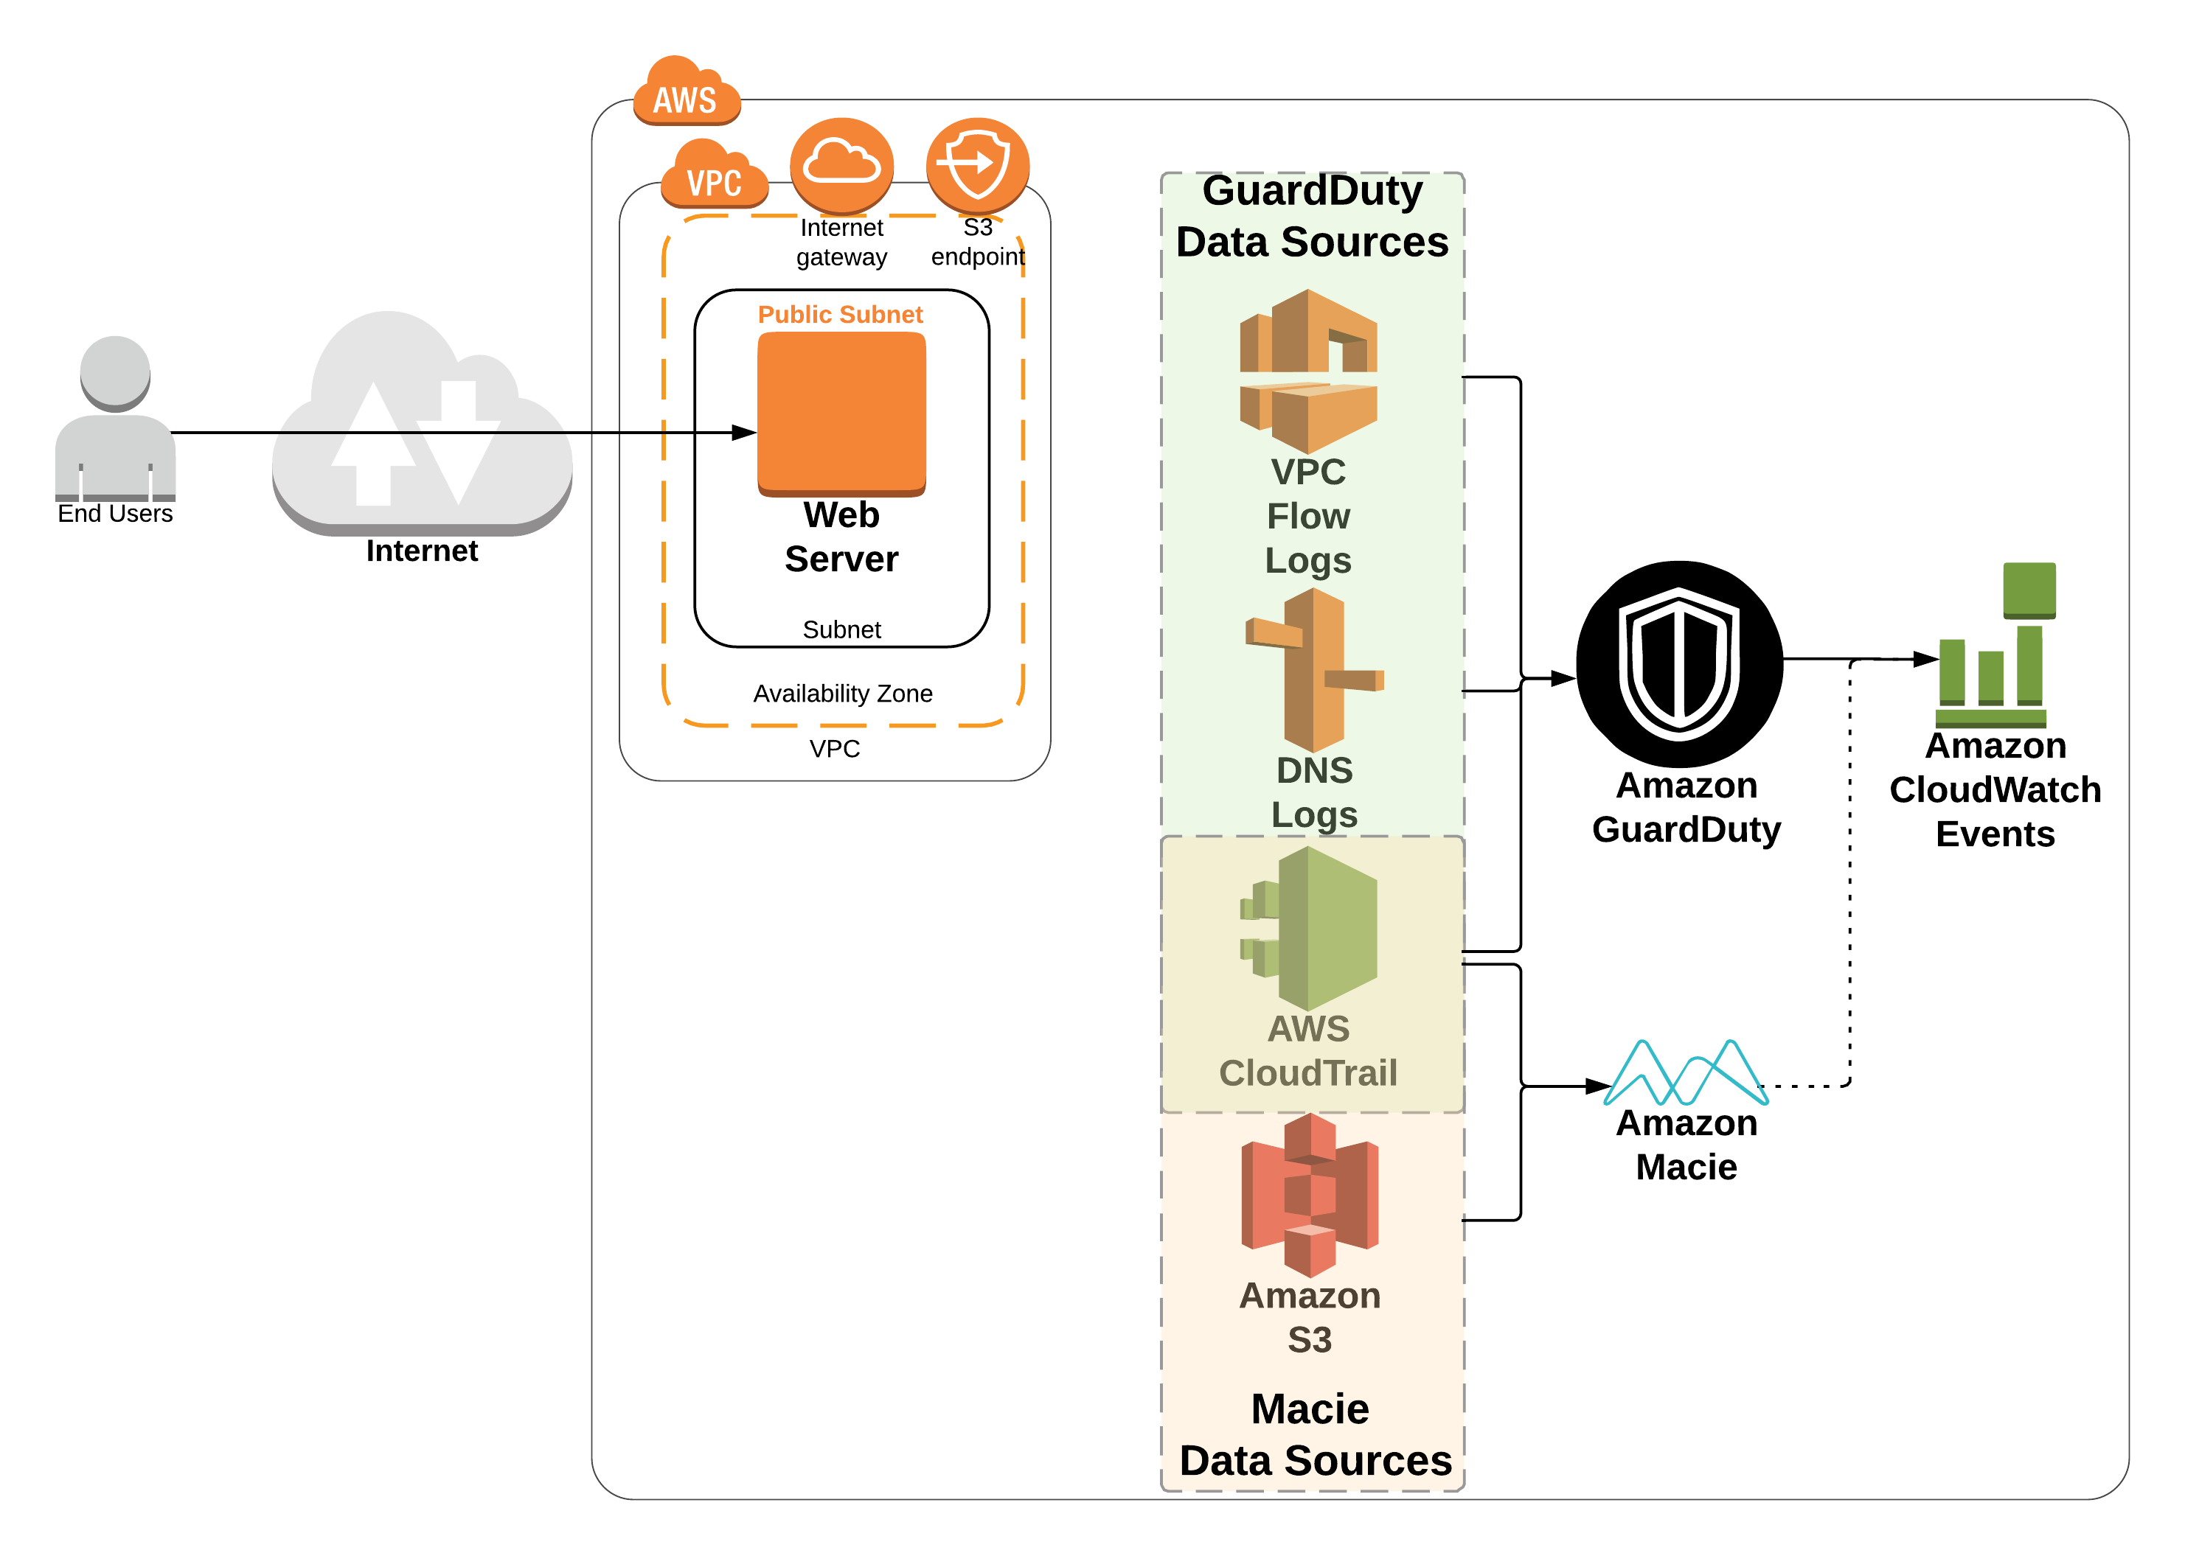
Module 1 setup
Notes:
An attack is about to occur

