Slide 1
Threat Detection and Remediation Workshop
Module 4 – Review, Discussion, Questions & Cleanup

Slide 2
Agenda
Review & Discussion – 5 min
Questions – 15 min
Cleanup

Slide 3
Review & Discussion
Notes:
Ask room how many people completed the workshop. If <50% do Review, if >50% Review and Questions

Slide 4
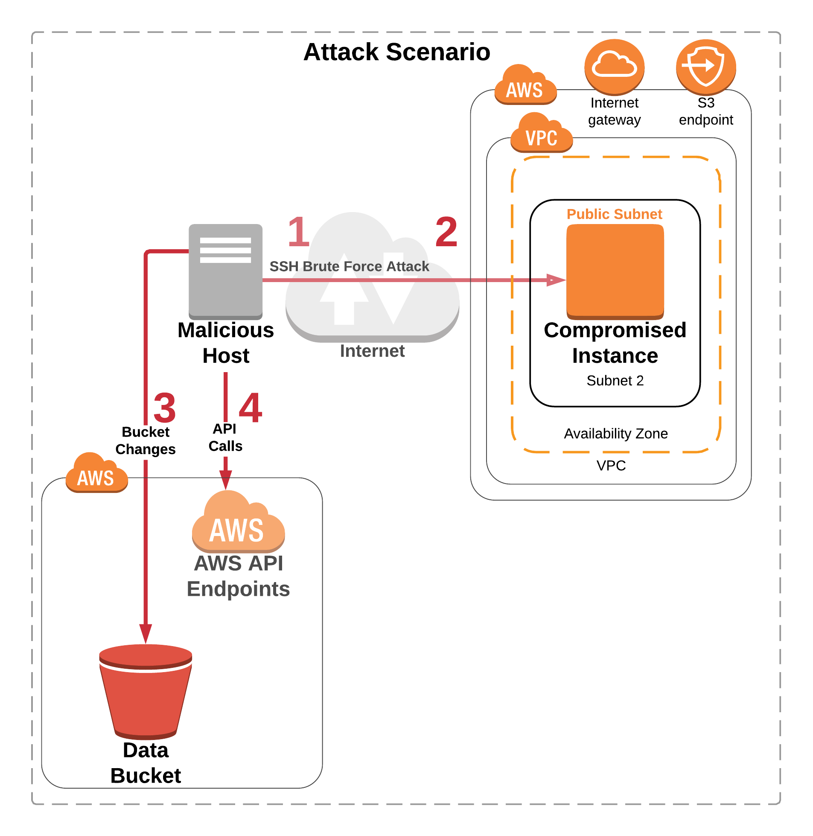
The Attack

Slide 5
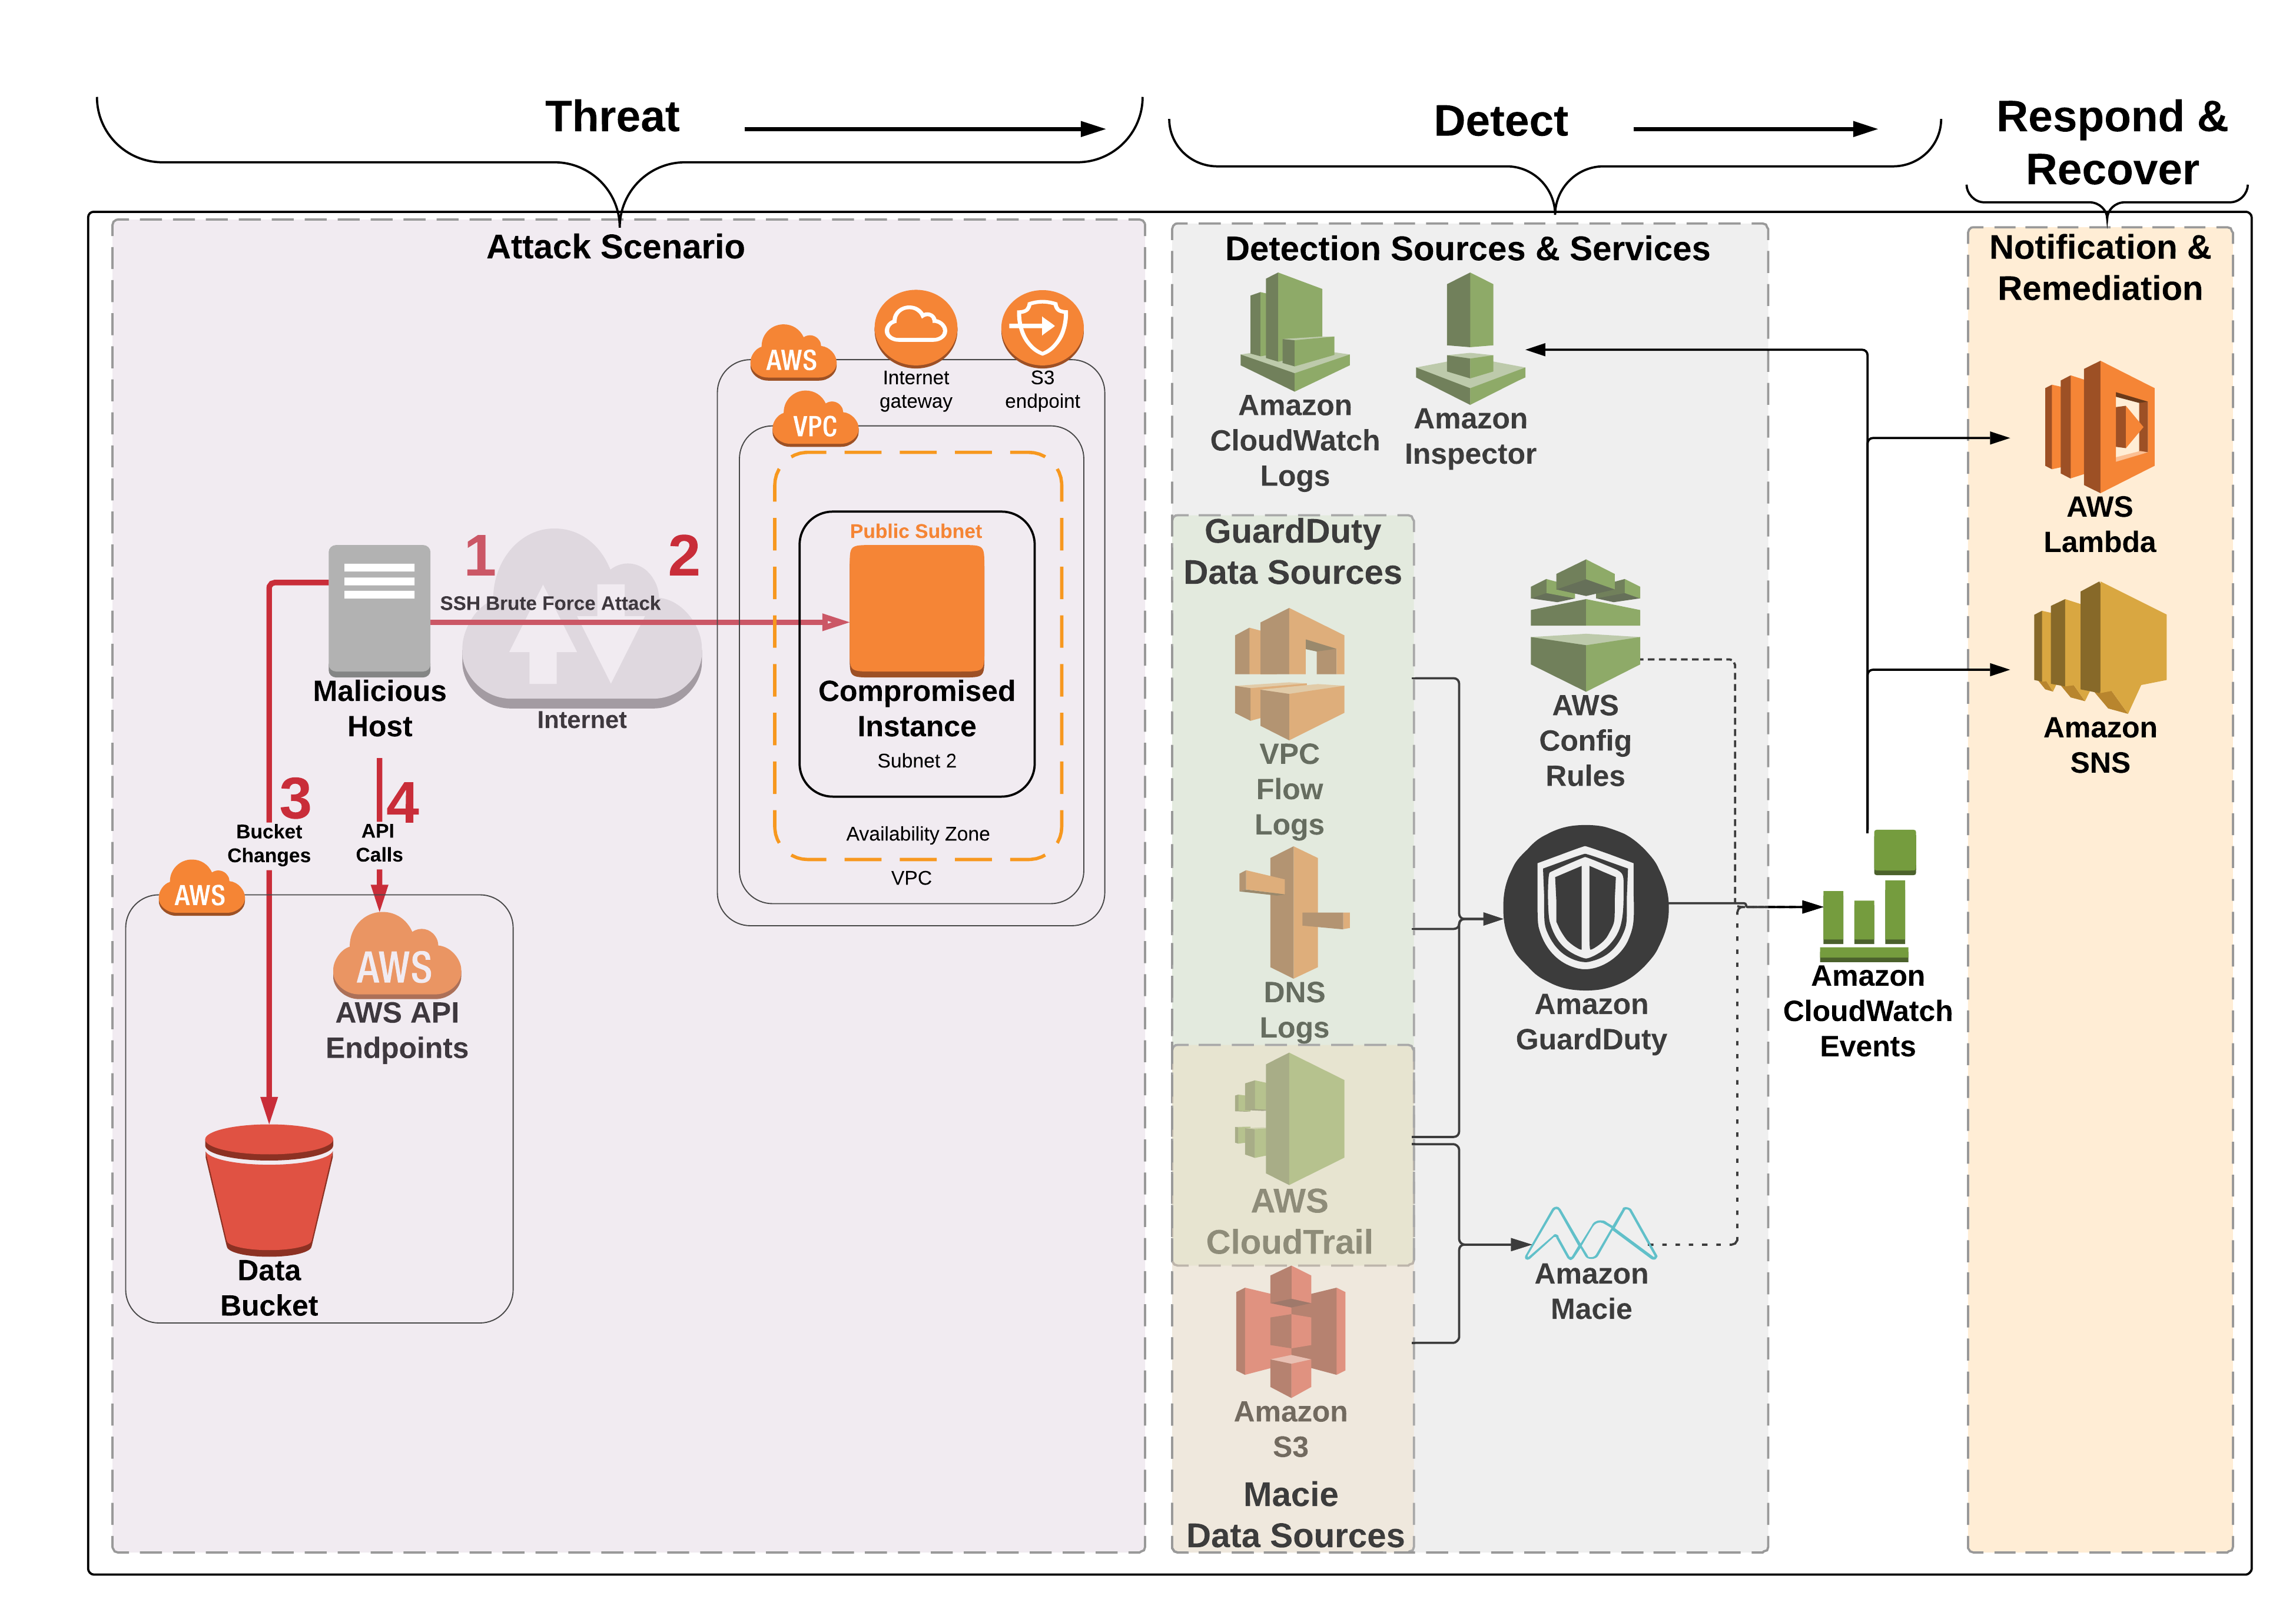
Module 2 setup

Slide 6
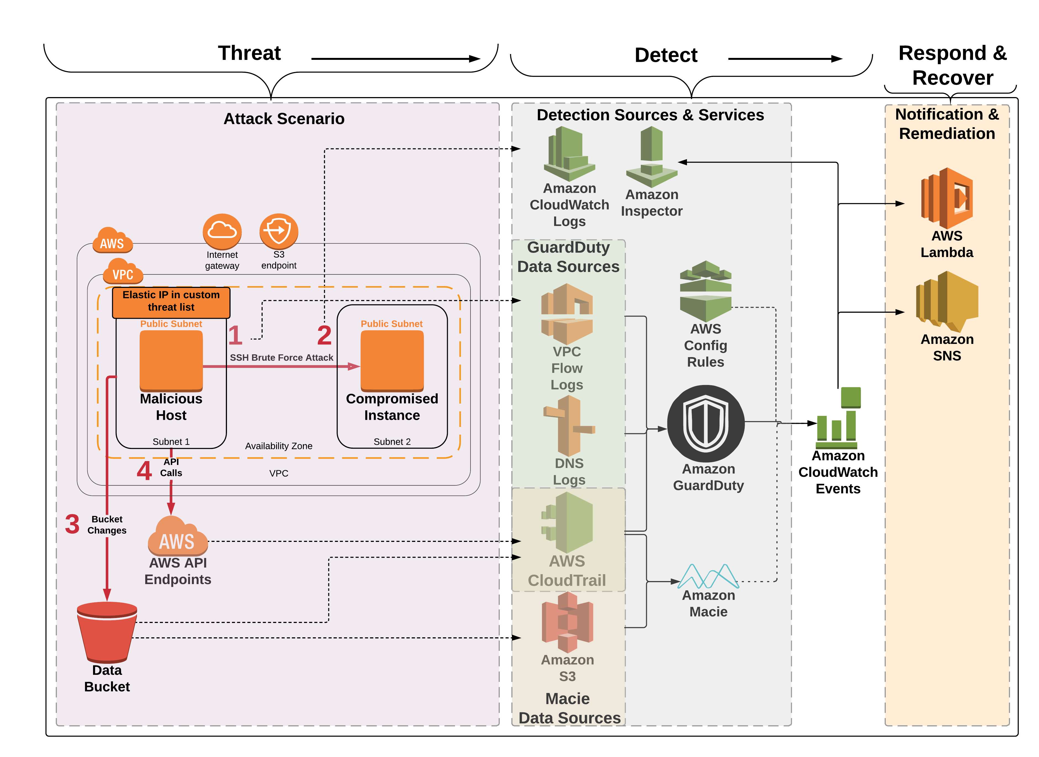
What really happened?
Notes:
Attack Recap
1. Module 2 CloudFormation template creates two EC2 instances. They are in the same VPC but different subnets. The Malicious Host represents the attacker which we pretend is on the Internet. The Elastic IP on the Malicious Host is in a custom threat list in GuardDuty (in order to generate . The other instance named Compromised Instance represents the web server that was lifted and shifted into AWS.
2. Although company policy is that only certificate authentication should be enabled for SSH, at some point password authentication for SSH was enabled on the Compromised Instance
3. The Malicious Host performed a brute force SSH password attack against the Compromised Instance. The brute force attack is designed to be successful
4. The SSH brute force attack was successful and the attacker was able to log in to the Compromised Instance
5. We pretend here that the attacker then copied the temp credentials (that came from IAM Role for EC2) from the instance to an S3 bucket - in reality the API calls from the Malicious Host use the temp creds from the IAM Role for EC2 attached to the Malicious Host
6. The CloudFormation template that we ran in Module 2 enables encryption for the Data bucket and then the EC2 instance removes the encryption. In addition the CloudFormation template made the Data bucket public. This is used for the Macie part of the investigation in Module 3. We pretend that the attacker made the bucket public and removed the default encryption from the bucket.
7. The API Calls that generated the API findings come from the Malicious Host. The calls use the temp creds from the IAM role for EC2 running on the Malicious Host. The GuardDuty findings are generated because the EIP on the Malicious Host is in a custom threat list.

Slide 7
Questions

Slide 8
Workshop questions
Why did the API calls from the “malicious host” generate GuardDuty findings?
Notes:
Use this question to have a discussion in custom threat lists – and threat intelligence in general

Slide 9
Workshop questions
The lab mentions you can ignore the high severity SSH brute force attack finding? Why?
Why is this a ”side-effect” of the simulated attack in this workshop? (hint: how does that differ from the low severity brute force finding we investigated?)

Slide 10
Workshop questions
Which two AWS services provide a historical configuration change audit?
Which of the two is really designed (and much easier to use) for analysis of configuration changes?

Slide 11
Workshop questions
Let’s assume the company policy in this scenario is that EC2 instances running Linux can only use certificate authentication. At some point somebody must have enabled password authentication on the web server.
How could you determine when this was changed and by whom?

Slide 12
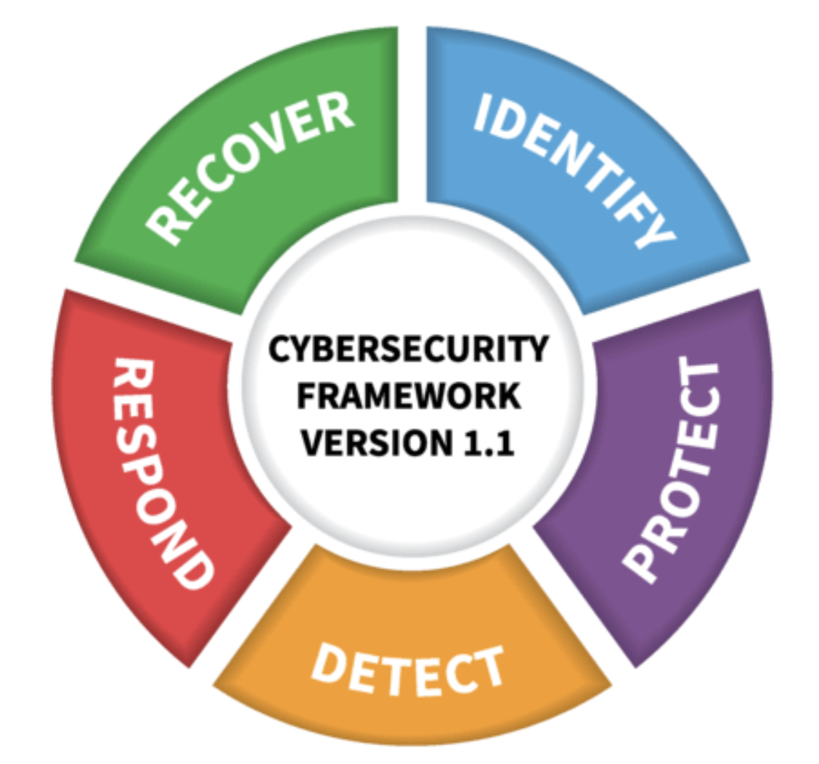
Workshop questions
We use Inspector to investigate the threat. Is Inspector a protect or detect service (or both – or other)?
Source: NIST Cybersecurity Framework, 2018 - https://www.nist.gov/cyberframework

Slide 13
Workshop questions
Would you consider a single SSH brute force attack finding by itself enough to kick off an automated action to add an ACL to block the source of the attack?
What combination of data points regarding a threat would lead you to consider automatically stop a compromised instance?

Slide 14
Workshop questions
Macie had an alert for “S3 Bucket IAM policy grants global read rights.” We investigated that bucket in the workshop. Were the objects in the bucket actually publicly accessible?
What about the encrypted objects in the bucket?

Slide 15
Cleanup
Notes:
You can keep working on the lab but please cleanup your resources as soon as you are done to avoid charges – the instructions are in the module 4 doc.

Slide 16
Links for items we discussed
https://aws.amazon.com/security/
https://www.verizonenterprise.com/resources/reports/rp_DBIR_2018_Report_en_xg.pdf
https://www.nist.gov/cyberframework
https://d0.awsstatic.com/whitepapers/AWS_CAF_Security_Perspective.pdf
https://www.forbes.com/forbesinsights/bmc_security/index.html

Slide 17
Useful Links
All Findings
https://docs.aws.amazon.com/guardduty/latest/ug/guardduty_findings.html
GuardDuty to Slack Integration:
https://github.com/aws-samples/amazon-guardduty-to-slack
Multi-Account script:
https://github.com/aws-samples/amazon-guardduty-multiaccount-scripts
GuardDuty Testing Scripts:
https://github.com/awslabs/amazon-guardduty-tester
Macie blog with test data :
https://aws.amazon.com/blogs/security/classify-sensitive-data-in-your-environment-using-amazon-macie/

Slide 18
Thank you!

