Slide 1
Threat Detection and Remediation Workshop
Module 1
Notes:
Mention previous threat detect workshop – how this expands on that

Slide 2

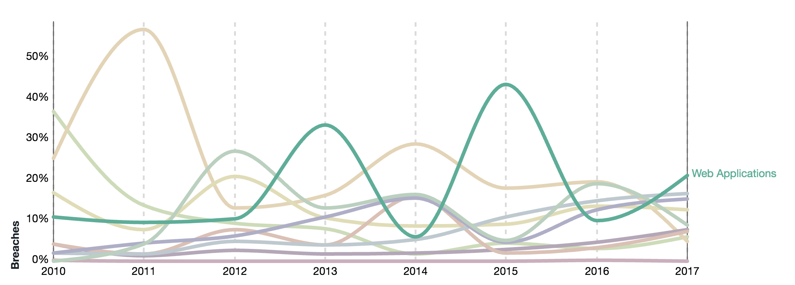
Verizon Report
Verizon - 2018 Data Breach Investigations Report
Data Breach Patterns
https://www.verizonenterprise.com/resources/reports/rp_DBIR_2018_Report_en_xg.pdf
Notes:
I recently went through the 2018 Verizon Data Breach Investigations Report – link below – I’ll be referencing this a few times
Data Breach: incident results in confirmed disclosure of data to an unauthorized party (not just potential exposure) Incident: security event that compromises the confidentiality, integrity or availability of an information asset.
One of the leading data breach patterns is attacks on Web Applications –green line. Brown line is Point of Sale devices. Clearly web apps are an important target. That is one of the reasons we will use a web site in the scenario for this workshop (although the actual threat vector exploited could be done against any server)

Slide 3
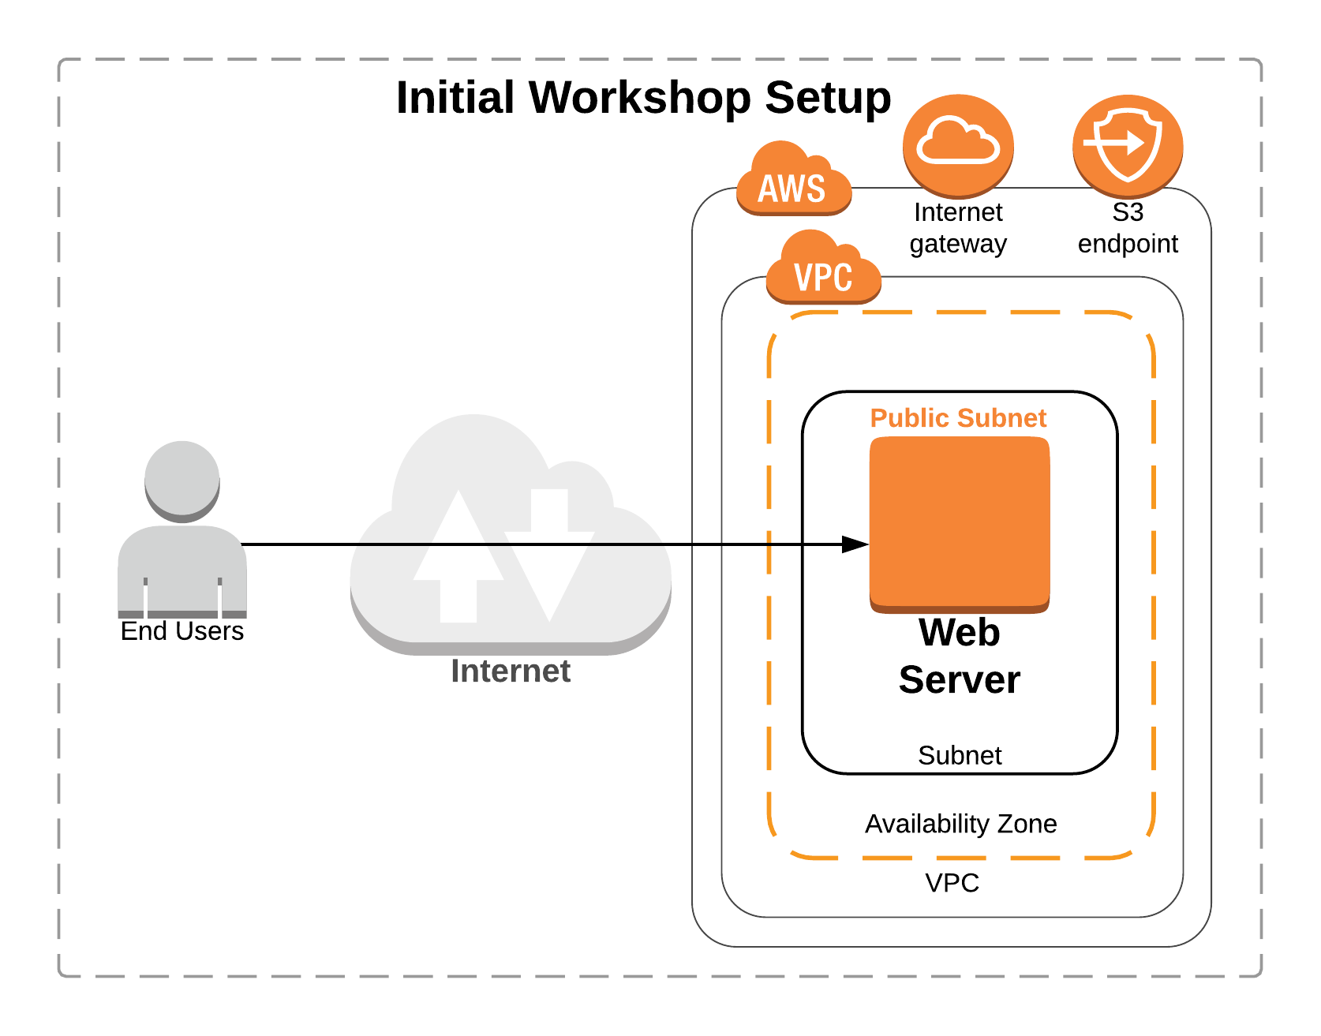
Initial setup
Notes:
So what are we doing in this lab ?
Think of a hypothetical situation where the engineering teams in your org are trying to figure out how to move on-prem applications to the cloud from an existing data center . Your team wants to go ahead with a simple POC
They starts with building a bare minimum architecture with a web server within a VPC that’s hosting a website. Also the webserver uses data that’s stored on an S3 bucket.
In this lab your job is to put on the hat of a security engineer and use AWS services to figure out the nature of the attack that is occurring and properly remediate the threats

Slide 4
Workshop agenda
Quick introduction to the workshop
Module 1: Environment build and configuration (20 min)
Run CloudFormation template and some setup
Module 2: Attack simulation (and presentation) (40 min)
Run CloudFormation template
Presentation and live role playing exercise
Module 3: Detection and remediation (45 min)
Investigate the attack
Module 4: Review and discussion (15 min)
Presentation / group Q&A
Cleanup
Notes:
Environment Build and Configuration
Attack Simulation
Detection and Remediation
Review and Discussion

Slide 5
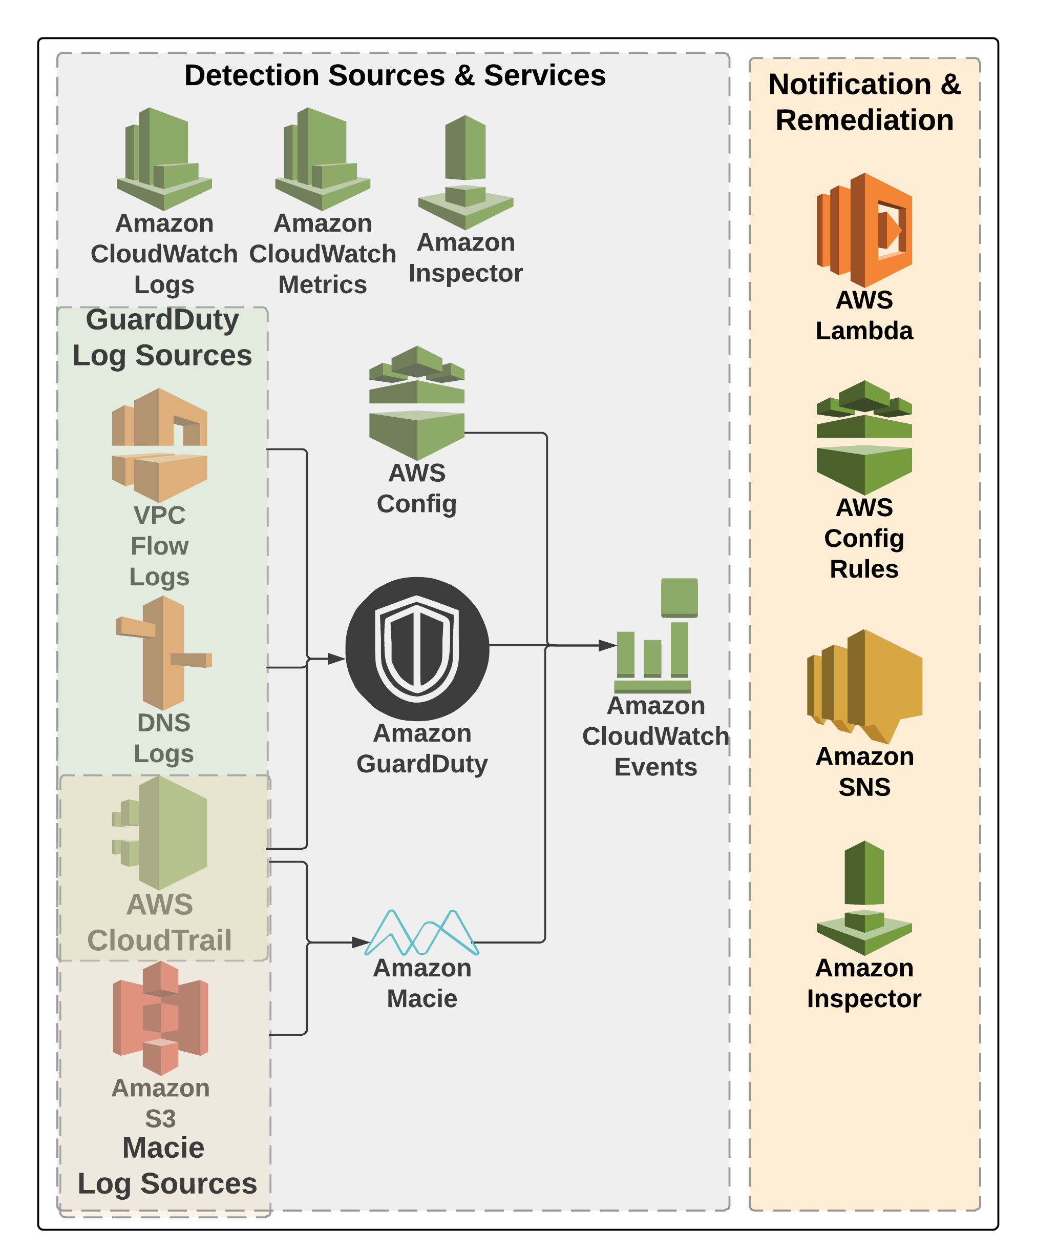
Threat detection and remediation services
Notes:
If you think about threats in your AWS environments there are both external and internal threats and as these threats progress , it leads to either AWS services that assume roles, federated users, IAM users or users in public internet performing malicious actions within your AWS account that could inturn lead to loss of availability for your application or data loss.
What’s important is that as a security team you want to have good visibility into your AWS environment at all times and u want to use services that can help enhance that visibility.
Amazon Guardduty, Amazon Macie, Config and inspector helps you achieve and enhance that visibility into your AWS account and make it easy for you as a customer to detect threats and achieve better security four your data.
As you go through this lab you will get exposure to these services and hopefully you can take this learning back to your organization and create better security postures for your AWS account.

Slide 6
Start module 1
use
us-west-2
https://tinyurl.com/y84cc3pj
(https://github.com/aws-samples/aws-security-workshops/tree/master/threat-detection-wksp)
Directions:
Browse to https://tinyurl.com/y84cc3pj
Read through the workshop scenario
Click on Environment Build and Configuration at the end
Complete module (~15 min) then stop
We will later start module 2 and do a presentation
Notes:
15 mins for this
Use the Oregon region
We’ll go fairly quick through this since there is a lot to cover - If not finished with a section before we move on, feel free to keep working and if you have any problems ask one of the facilitators to help – you will be able to work on this workshop outside of this event at any time
PLEASE FOLLOW DIRECTIONS – esp in the first part on the parameters screen

Slide 7
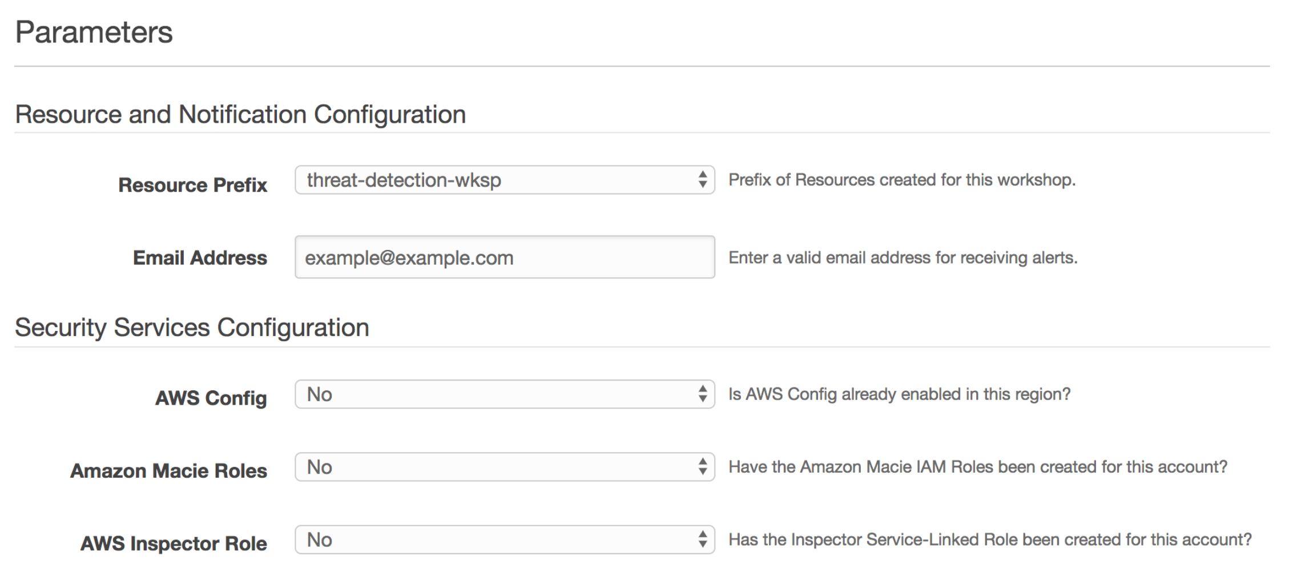
Start module 1
use
us-west-2
https://tinyurl.com/y84cc3pj
(https://github.com/aws-samples/aws-security-workshops/tree/master/threat-detection-wksp)
Notes:
PLEASE FOLLOW DIRECTIONS – esp in the first part on the parameters screen

Slide 8
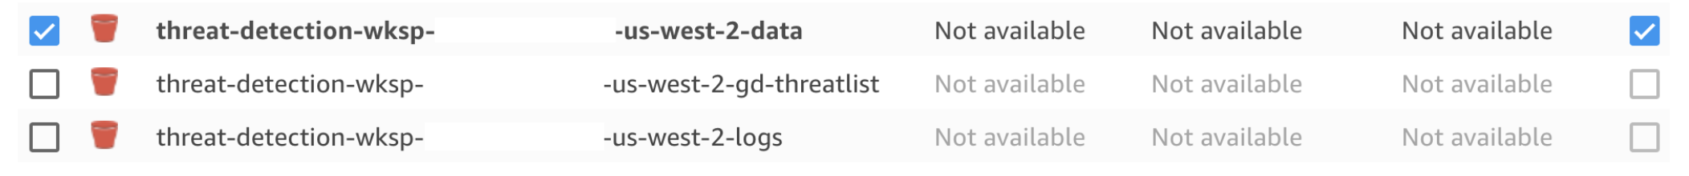
Start module 1 – Important!
use
us-west-2
https://tinyurl.com/y84cc3pj
(https://github.com/aws-samples/aws-security-workshops/tree/master/threat-detection-wksp)
Notes:
PLEASE FOLLOW DIRECTIONS – esp in the first part on the parameters screen

