Slide 1
Threat Detection and Remediation Workshop
Module 2

Slide 2
Agenda
Module 2: Run the CloudFormation template (~5 min)
Threat detection and remediation intro presentation (~25 min)
Workshop walkthrough (~10 min)
Notes:
* Scenario
* Who are you
* Past Intrusion
* GD
* Macie
* Inspector
* Config
* CloudWatch Events

Slide 3
Start module 2
use
us-west-2
https://tinyurl.com/y84cc3pj
(https://github.com/aws-samples/aws-security-workshops/tree/master/threat-detection-wksp)
Directions:
Browse to https://tinyurl.com/y84cc3pj
Click on Attack Simulation at the end
Complete this module (~5 min) then stop
We will then do a presentation
Notes:
20 mins
Use the Oregon region

Slide 4
GDPR and threat detection & remediation
Under GDPR Controllers and Processors are required to implement appropriate Technical and Organizational Measures (“TOMs”)
(1) Pseudonymisation and encryption of personal data | (2) Ensure ongoing confidentiality, integrity, availability, and resilience of processing systems and services
(3) Ability to restore availability and access to personal data in a timely manner in the event of a physical or technical incident | (4) Process for regularly testing, assessing, and evaluating the effectiveness of TOMs
Notes:
GDPR just become effective (May 25) – there is a lot in GDPR and we won’t be covering it in this workshop but it’s important to know one important connection between GDPR and this workshop. Threat detection and remediation can help with three of the four GDPR example TOMs (Technical and Organizational Measures) for GDPR
From Chapter 4, Article 32: Taking into account the state of the art, the costs of implementation and the nature, scope, context and purposes of processing as well as the risk of varying likelihood and severity for the rights and freedoms of natural persons, the controller and the processor shall implement appropriate technical and organisational measures to ensure a level of security appropriate to the risk, including inter alia as appropriate:

Slide 5
Threat Detection and Remediation Intro

Slide 6

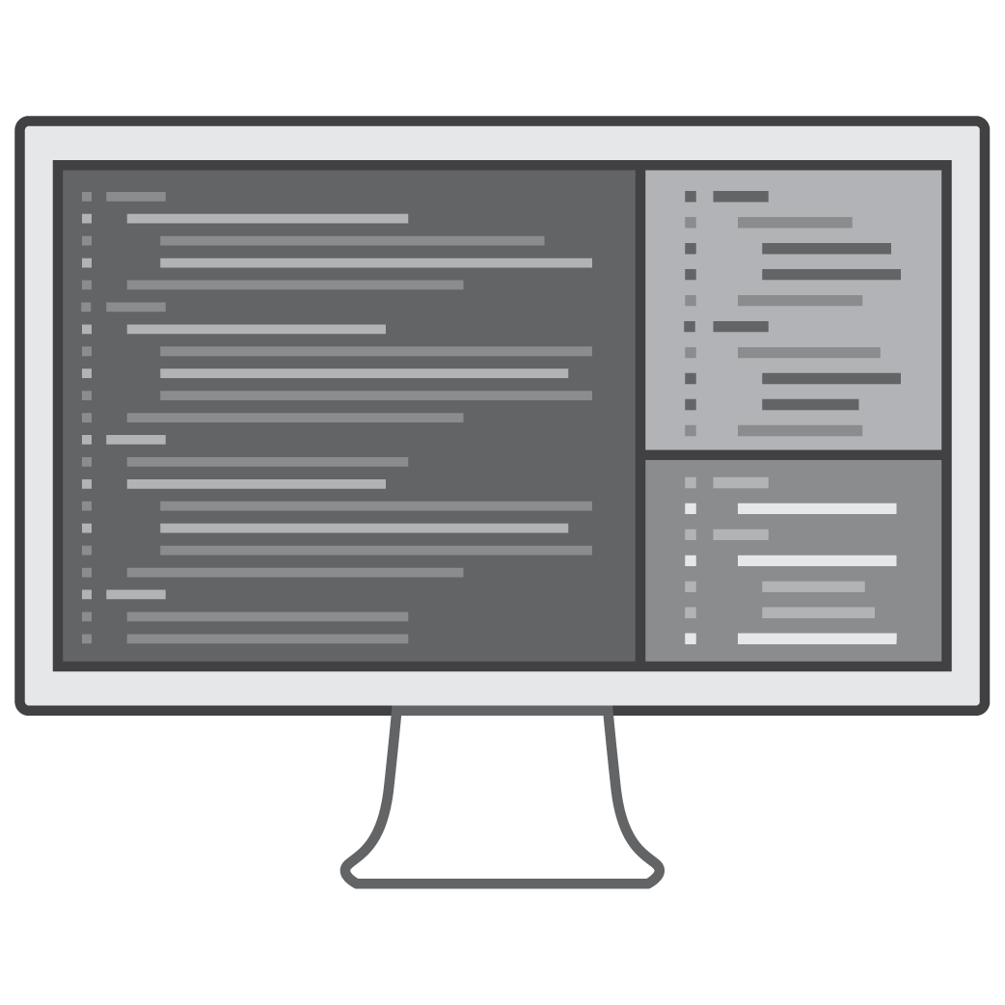

Why is threat detection so hard?
Large datasets
Signal to noise
Skills shortage
Notes:
Threat detection has always been difficult and it is becoming more and more of a challenge.
More connected systems and devices - produce large data sets needing to be analyzed.
Difficult to find the threats in all the data. Alert fatigue from so many notifications and false alarms. What’s really important?
Difficult to find and hire people with the skills needed to interpret all of this data.
Machine learning and real-time streaming log data inputs can help efficiently detect threats and automation and can rapidly remediate threats in AWS.

Slide 7




Get humans away from the data and analysis
AWS CISO Stephen Schmidt, at re:Invent 2017: “It's people who make mistakes, it's people who have good intentions but get phished, it's people who use the same credentials in multiple locations and don't use a hardware token for a multi-factor authentication… Get the humans away from the data.”
Notes:
Let’s expand on these three problems (skills shortage, signal to noise issue and large datasets)
AWS CISO Stephen Schmidt, at re:Invent 2017: “It's people who make mistakes, it's people who have good intentions but get phished, it's people who use the same credentials in multiple locations and don't use a hardware token for a multi-factor authentication… Get the humans away from the data.”
That applies to the analysis of logs for threats and the remediations

Slide 8
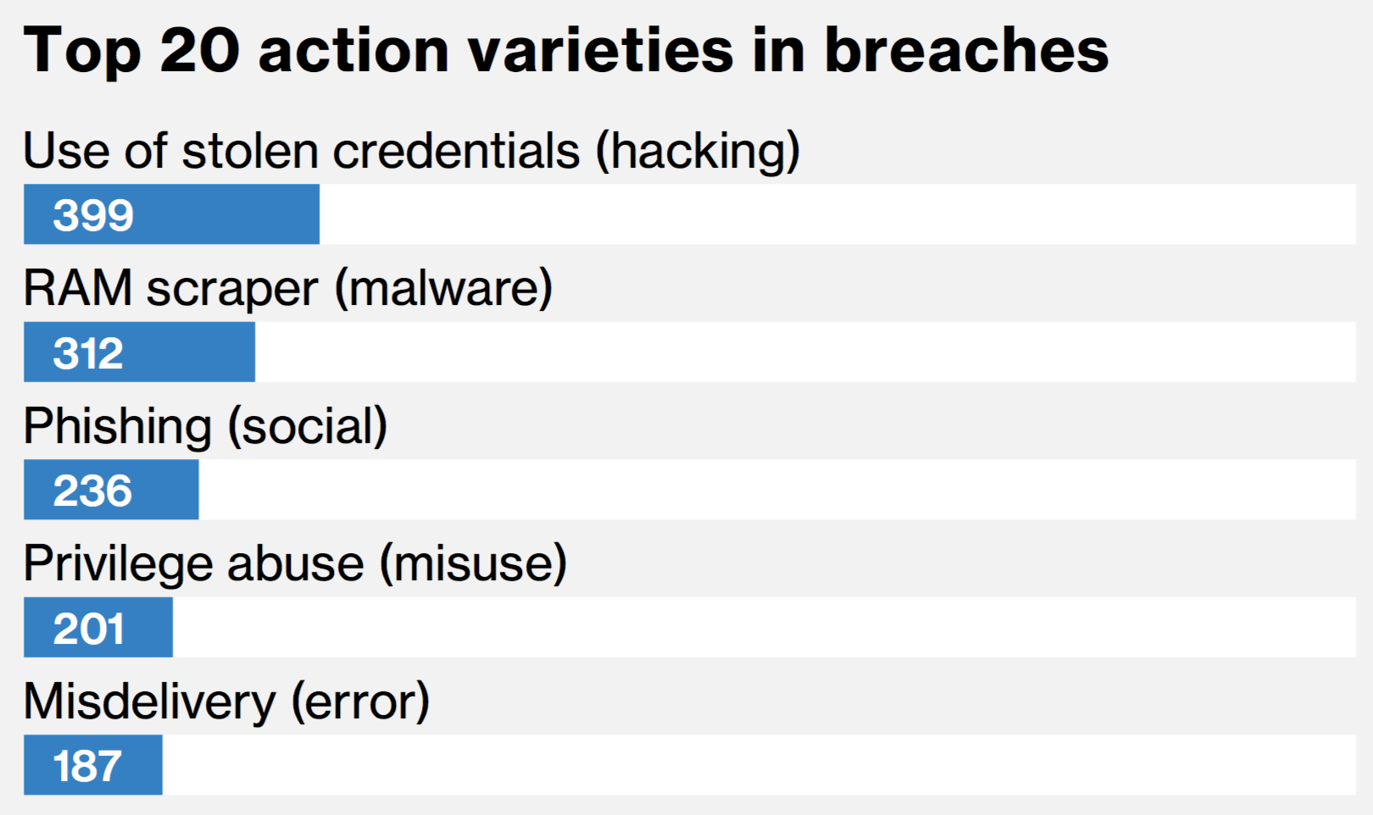

Get humans away from the data and analysis
2018 Verizon Data Breach Investigations Report
https://www.verizonenterprise.com/resources/reports/rp_DBIR_2018_Report_en_xg.pdf
Notes:
From the 2018 Verizon Data Breach Investigations Report
Three of the top five action varieties (top 5 of the top 20) for breaches (breaches not incidents) are related to people
Humans are a top opportunity for attackers.
In general, and this is pretty obvious, you want to reduce the need for people to analyze raw data and perform repetitive, manual tasks.
Machine learning, threat intelligence and anomaly detection: can provide threat alerts that have both high coverage or volume of true positives as well as high accuracy resulting in fewer false positives.
Alerts include the context needed to automate the response process.

Slide 9
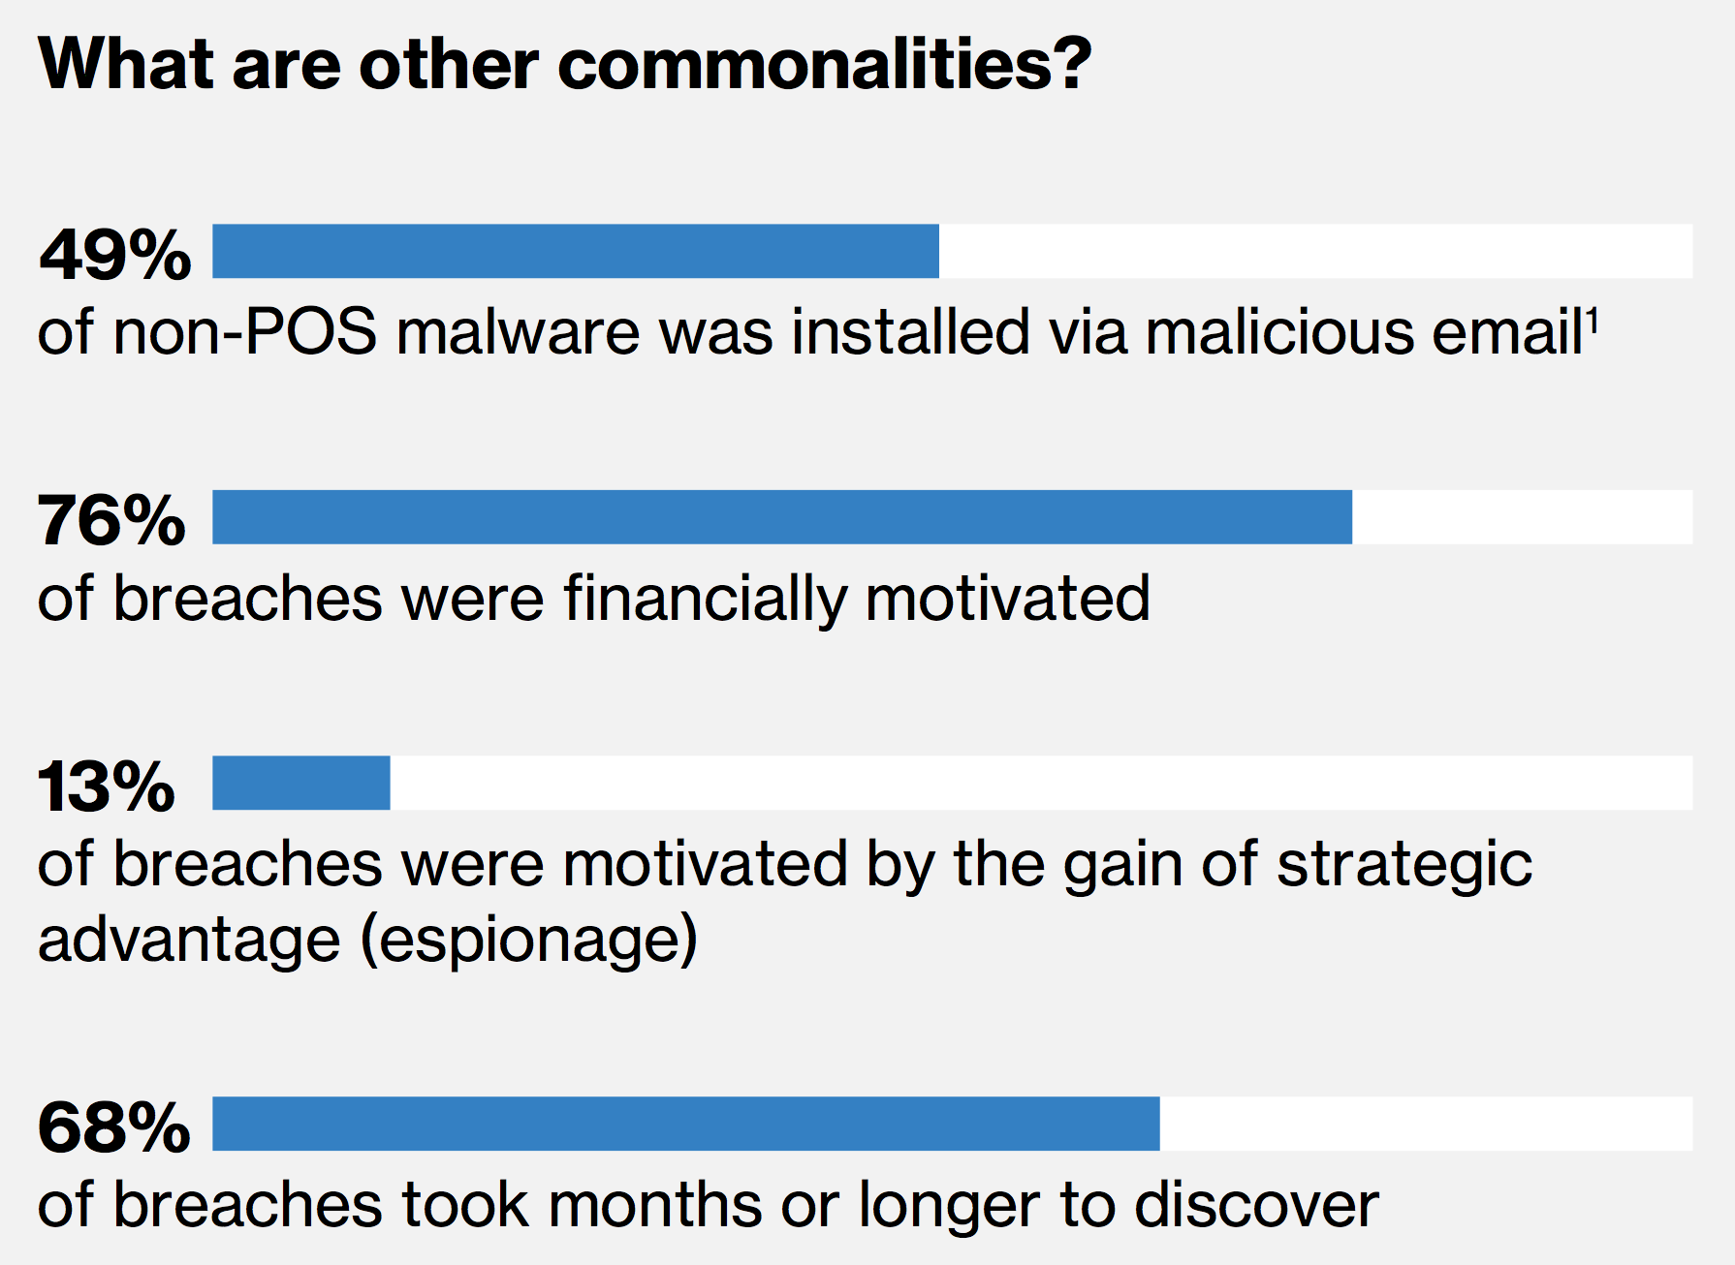
Detecting breaches
https://www.verizonenterprise.com/resources/reports/rp_DBIR_2018_Report_en_xg.pdf
https://www.verizonenterprise.com/resources/reports/rp_DBIR_2018_Report_en_xg.pdf
https://www.verizonenterprise.com/resources/reports/rp_DBIR_2018_Report_en_xg.pdf
https://www.verizonenterprise.com/resources/reports/rp_DBIR_2018_Report_en_xg.pdf
Notes:
One other thought – also from the 2018 Verizon Data Breach Investigations Report
It’s not just about taking humans out of the mix – it’s about detecting the breaches
https://www.verizonenterprise.com/resources/reports/rp_DBIR_2018_Report_en_xg.pdf
Again this is regarding Data Breaches (not just incidents): confirmed disclosure of data to an unauthorized party (not just potential exposure)

Slide 10

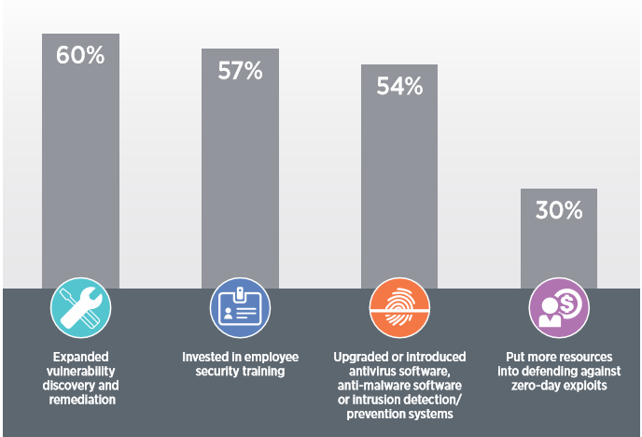
Top Actions Taken to Address Security Issues
2017 Forbes Insights – “Enterprises Reengineer Security in the Age of Digital Transformation”
Source: 2017 Forbes Insights – “Enterprises Reengineer Security in the Age of Digital Transformation”
Notes:
Source: 2017 Forbes Insights – “Enterprises Reengineer Security in the Age of Digital Transformation”
The top action taken by enterprises has been about vulnerability discovery and remediation – so this is already a priority and it’s important to be aware of the technologies that can help in this realm

Slide 11


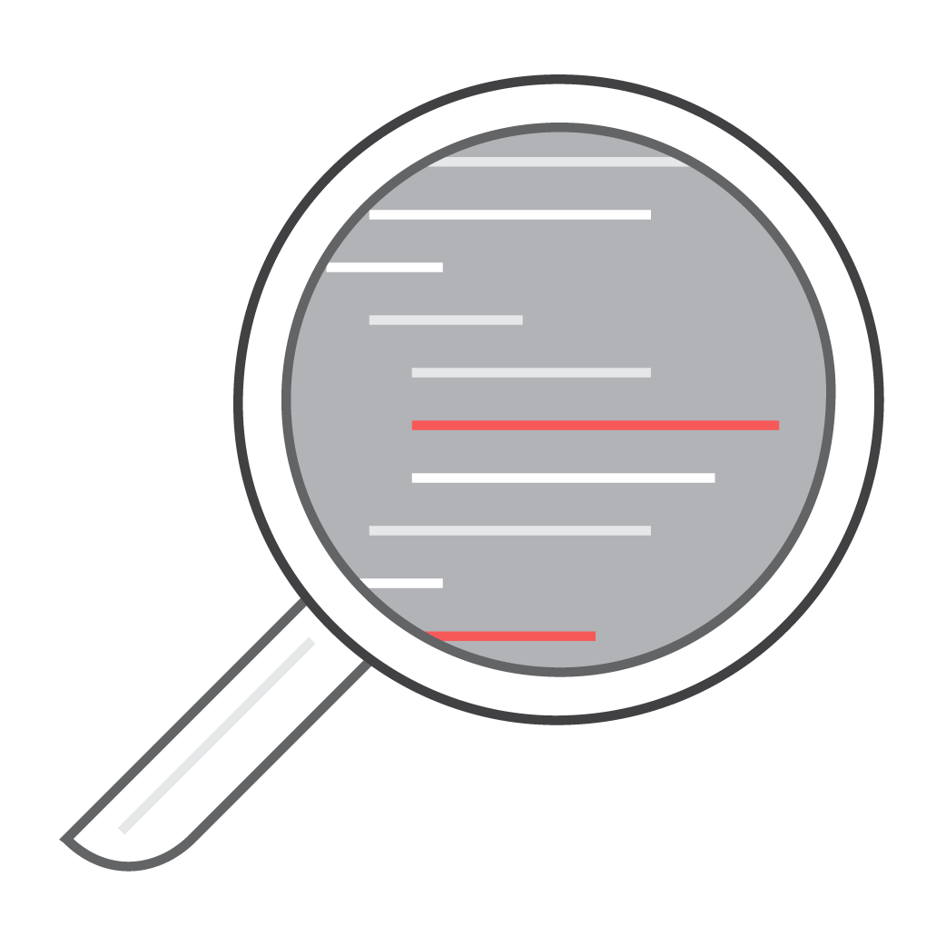


AWS Security Solutions
https://www.nist.gov/cyberframework
Identify
Protect
Detect
Respond
Recover
AWS Systems Manager
AWS Config
AWS Systems Manager
Amazon Inspector
VPC
KMS
AWS CloudHSM
IAM
AWS Organizations
AWS Cognito
AWS Directory Service
AWS Single Sign-On
Certificate Manager
Amazon Inspector
Amazon Macie
AWS CloudTrail
AWS Config Rules
Amazon CloudWatch Logs
Amazon GuardDuty
VPC Flow Logs
Amazon Macie
AWS Shield
AWS WAF
AWS Config Rules
AWS Lambda
AWS Systems Manager
Amazon CloudWatch Events
AWS Config Rules
AWS Lambda
Notes:
If we did a rough alignment of AWS services to the NIST Cybersecurity Framework core functions (v1.1 was just released in April of 2018) we might come up with something like this,
This shows the breakdown of services and where most services lie, There is definitely overlap and the same services that fall into multiple categories.
The services in bold are the ones we will cover in this workshop
NIST Cybersecurity Framework: standards, guidelines, and best practices to manage cybersecurity-related risk. - CAF aligns to this

Slide 12
Threat Detection Services

Slide 13




Threat Detection: Log Data Inputs
AWS CloudTrail
Track user activity and API usage
CloudWatch Logs
Monitor apps using log data, store & access log files
VPC Flow Logs
IP traffic to/from network interfaces in your VPC
DNS Logs
Log of DNS queries in a VPC when using the VPC DNS resolver
Notes:
AWS logs - data source inputs for a threat detection
Does anyone know of an AWS service that detects threats by analyzing three out of four of the logs?
CloudTrail provides visibility into user activity by recording actions taken on your account. - Audit
Virtual Private Cloud (VPC) Flow Logs:
Capture information about the IP traffic going to and from network interfaces in your VPC.
Used to monitor the traffic that is reaching your EC2 instances,
With CloudWatch Logs, you can monitor your logs, in near real-time, for specific phrases, values or patterns to create metrics and implement alarms.
DNS Logs are used by GuardDuty as part of the analysis for continuous threat detection and include all DNS queries to the DNS resolver provided within your VPC.

Slide 14
Threat Detection: Machine Learning
Amazon GuardDuty
Intelligent threat detection and continuous monitoring to protect your AWS accounts and workloads
Amazon Macie
Machine learning-powered security service to discover, classify & protect sensitive data
Notes:
AWS security services, GuardDuty and Macie, use the power of machine learning to detect threats.
GuardDuty continuously monitors for malicious or unauthorized behavior to help you protect your AWS accounts and workloads.
It uncovers activity such as unusual API calls or potentially unauthorized deployments that indicate a possible account compromise. It also detects potentially compromised instances and reconnaissance by attackers.
GuardDuty analyzes billions of events across AWS accounts for signs of risk.
Macie:
Helps you better understand where sensitive information is stored
Shows you how your data is being accessed, including user authentications and access patterns
Macie’s user behavior analytics can also identify indications of compromise

Slide 15
Live Role Playing Exercise

Slide 16
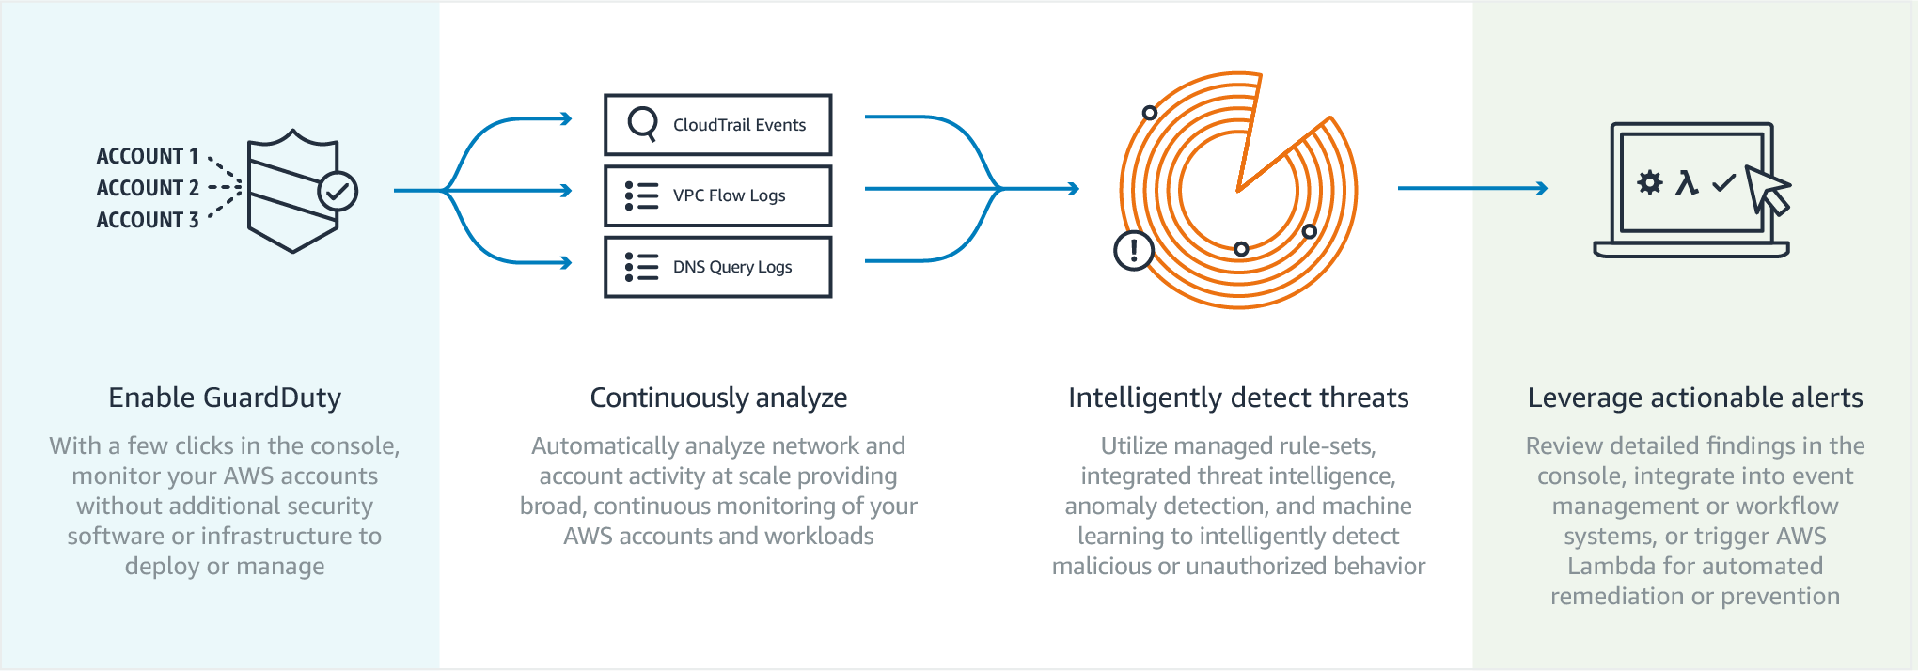
Amazon GuardDuty
Notes:
You can easily enable GuardDuty in the console and authorize it to monitor your accounts without additional security software or infrastructure to deploy or manage.
It can analyze and correlate billions of events from CloudTrail, VPC Flow Logs, and DNS Logs across all of your associated AWS accounts.
Performs continuous monitoring using managed rule-sets, integrated threat intelligence, anomaly detection, and machine learning to detect malicious or unauthorized behavior.
Review details findings in the console, integrate into event management or workflow systems, or trigger Lambda for automated remediation or prevention.

Slide 17
What Can Amazon GuardDuty Detect?
Connect to blacklisted site
Anonymizing proxy
Malicious or
suspicious IP
Unusual ISP caller
Unusual traffic volume
RDP brute force
RAT Installed
Exfiltrate data over DNS
Probe API with temp creds
Attempt to compromise account
Bitcoin activity
Recon
DNS exfiltration
Unusual ports
Unusual instance launch
Temp credentials
used off-instance
Notes:
GuardDuty can help identify potentially malicious activity throughout an attack lifecycle
Starting with reconnaissance & infiltration, whether a user was Phished or credentials leaked, once in, attackers commonly work to:
connect to the network, anonymize their access, and deploy their Remote Access Trojan to establish a back door to command & control.
Then, more reconnaissance to figure out what’s there - get user lists, scout targets, and find vulnerabilities.
Lateral movement looking for ways to access instances with credentials that provide more privileged access.
Mission target - access to transfer critical data to an external location.

Slide 18
Detecting Known Threats
Threat intelligence
Feeds:
AWS Security
Commercial - CrowdStrike, Proofpoint
Open source
Customer provided - "format": "[TXT|STIX|OTX_CSV|ALIEN_VAULT|PROOF_POINT|FIRE_EYE]",
Known malware infected hosts
Anonymizing proxies
Sites hosting malware and hacker tools
Cryptocurrency mining pools and wallets
Notes:
GuardDuty detections incorporate threat intelligence - Lists of known malicious IP addresses provided by AWS Security, 3rd party threat intelligence partners, or your own
It will alert you if it detects remote API calls from a known malicious IP address indicating potentially compromised AWS credentials.
Also detects threats to your AWS environment indicating a compromised instance, such as an EC2 instance sending encoded data within DNS queries.

Slide 19

Amazon Macie
Understand your data
Natural Language Processing (NLP)
Understand data access
Predictive User Behavior Analytics (UBA)
Notes:
Amazon Macie uses machine learning to automatically classify and provide visibility into where important business data exists across an AWS environment.
It is built on frameworks created by our deep learning team
Natural Language Processing can detect high value data, such as credentials, in content.
It combines the knowledge of what data is actually important with knowledge of the data access patterns.
By combining these 2 pieces of information, Macie can have additional context about whether a user is exhibiting unusual behavior and if that behavior is targeted at critical data.

Slide 20
Macie Content Classification
PII and personal data
Source code
SSL certificates, private keys
iOS and Android app signing keys
Database backups
OAuth and Cloud SaaS API Keys
Notes:
Amazon Macie uses machine learning to automatically classify and provide visibility into where important business data exists across an AWS environment.
It is built on frameworks created by our deep learning team
Natural Language Processing can detect high value data, such as credentials, in content.
It combines the knowledge of what data is actually important with knowledge of the data access patterns.
By combining these 2 pieces of information, Macie can have additional context about whether a user is exhibiting unusual behavior and if that behavior is targeted at critical data.

Slide 21


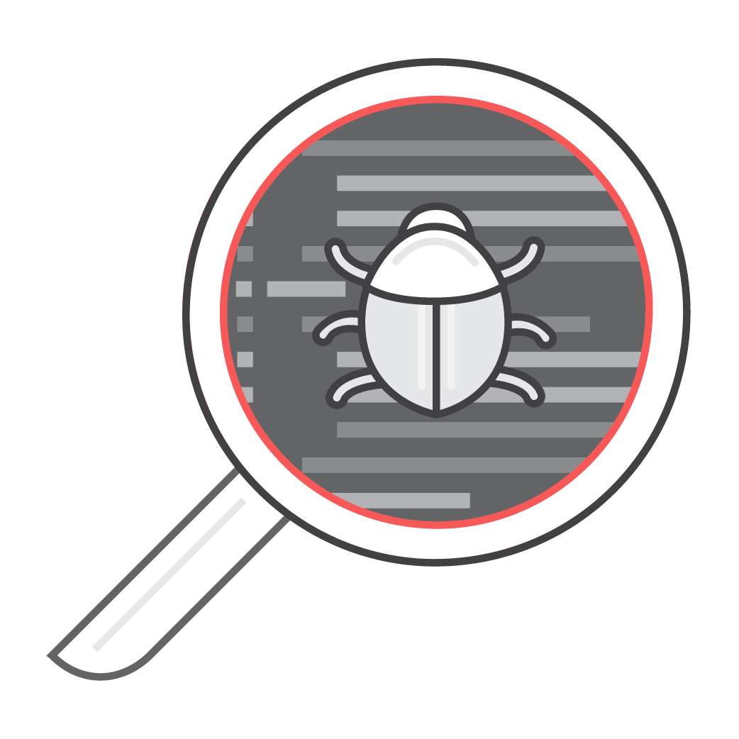
Discover and Alert on Global Permissions
Works on Amazon S3 bucket AND object policies
Use AWS Lambda to approve or automatically remediate overly permissive policies
Delete the object
Revoke access—bucket or object
Update IAM policies
Suspend user
Prioritize by PII impact and Data Loss Prevention (DLP) risk
Notes:
Macie helps with security and compliance visibility by identifying:
Overly permissive policies associated with an S3 bucket or object in context
CloudWatch Events can trigger a Lambda function to automatically remediate Macie findings by revoking access or updating policies
Macie currently supports S3 and CloudTrail. Plan to add user and content protection for EC2 Elastic Block Store (EBS), DynamoDB, Relational Database Service (RDS), Elastic File System (EFS), and Glue in the future.

Slide 22


Threat Detection: Evocations/Triggers
AWS Config rules Continuously tracks your resource configuration changes and if they violate any of the conditions in your rules
Amazon CloudWatch Events Delivers a near real-time stream of system events that describe changes in AWS resources
Notes:
Config Rules and CloudWatch Events can both be used to trigger automated threat response.
Highlights:
Cloudwatch event timing vs Cloudtrail and use cases
Config multi-region, multi-account
A Config Rule represents desired configurations for a resource and is evaluated against configuration changes recorded by AWS Config.
Use Config Rules to assess overall compliance and risk status from a configuration perspective,
View compliance trends over time and pinpoint which configuration change caused a resource to drift out of compliance with a rule.
CloudWatch becomes aware of changes as they occur for near real-time response
Take corrective action by activating functions, making changes, and capturing state information.

Slide 23





Amazon CloudWatch Events
GuardDuty findings
CloudWatch Event
Lambda function
{
"source": [
"aws.guardduty"
]
}
Notes:
CloudWatch Events delivers a near real-time stream of system events that describe changes in your AWS resources.
Using simple rules that are quick to set up, you can match events and route them to one or more target functions or streams.
Respond to changes, take corrective action by sending messages to activate functions, make changes, capture state information and
pass notifications to collaboration and communication tools.
This example shows a GuardDuty finding, but it could just as easily be a Macie event.

Slide 24






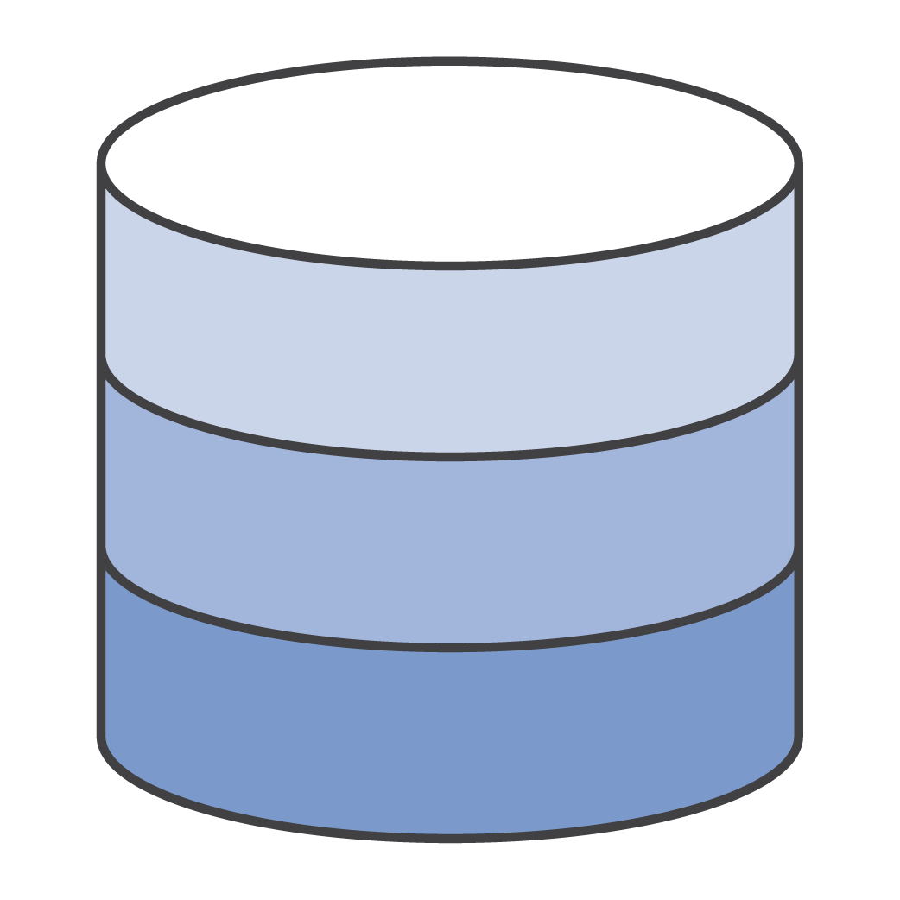




AWS Config Rules
A continuous recording and assessment service
Notifications
Normalized
AWS Config
Changing resources
AWS Config rules
API access
How are my resources configured over time?
Is a change that just occurred to a resource, compliant?
History snapshot
Notes:
Evaluation of a Config rule determines whether a resource is compliant at a particular point in time.
Config Rules will capture and store the result of each evaluation.
Result includes the resource, rule, time of evaluation and a link to non-compliant resources.
A rule can be setup as a change-triggered rule or as a periodic rule.
Change-triggered rules are executed when AWS Config records a configuration change for any of the resources specified.
Periodic rules are triggered at the frequency you specify, anywhere from an hour to a day.
Create your own rules to customize what is being checked or use AWS Managed rules
Enables changes to the environment to kick off lambda scripts

Slide 25
Spectrum of Attacks
DDoS
Targeted Attacks
Reflection and
amplification
HTTP floods
Application exploits
Spear
Phishing
Layer 3 & 4
floods
SQL injection
Authorization exploits
Bots and probes
Certificate
hijacking
Slowloris
XSS
CSRF
SSL abuse
RFI/LFI
Amazon CloudFront
Elastic Load Balancing
AWS Shield
Web Application Firewall AWS WAF
Amazon Inspector
Amazon Macie
AWS Certificate Manager
AWS Marketplace: IDS/IPS, Anti-malware
CloudFront, ELB, Shield and WAF are not covered here – these services cover network and application level threats
Notes:
Flaws that allow this spectrum of network attacks to succeed are quite widespread.
In this section, we’ll look at AWS services that can be leveraged to detect and mitigate common reflection attacks that attempt to produce a volume of traffic capable of congesting network interfaces and inhibiting legitimate traffic.
As well as best practices for using WAF to mitigate other frequently exploited injection attack vectors, such as:
Cross site scripting which sends malicious code to a different end user or
SQL injections to read, alter, or delete sensitive data.

Slide 26
Threat Remediation Services

Slide 27


Threat Remediation Services
AWS
Lambda
Run code for virtually any kind of application or backend service – zero administration
AWS Systems Manager
Gain operational insights and take action on AWS resources
Amazon
Inspector
Automate security assessments of EC2 instances
Notes:
Automate your threat remediation with these AWS services.
Lambda:
Add prevention mechanisms to security boundary services
WAF, Security Groups, S3 bucket policies
Invoke deeper inspection of the AWS estate
Systems Manager, Inspector
Systems Manager:
Proactively mitigate threats at instance level
Patching system
Amazon Inspector
Automated security assessment service
Helps improve the security and compliance of applications deployed on AWS.

Slide 28



High-Level Playbook
Adversary or intern
Your environment
CloudWatch Events
Lambda function
Notes:
Anyone can have an ‘intern moment’ and the explanation often starts with, “I was in a hurry to meet a deadline…”
Next I’ll show you a demo of two Lambdas responders that restart CloudTrail and send a notification as triggered by CloudWatch Events.

Slide 29




High-Level Playbook
AWS CloudTrail
Detection
Alerting
Remediation
Countermeasures
Forensics
Team collaboration
(Slack etc.)
VPC Flow Logs
Amazon GuardDuty
Amazon CloudWatch
Lambda function
AWS APIs
AWS Config
Amazon
Inspector
Notes:
Shield CloudWatch metrics provide details about every incident.
Automate the addition of the bad IPs as indicated by Shield to add to blacklists elsewhere (WAF, VPC or your own Data Center)
advantage of the cloud is having the ability to capture automated events and notifications of changes to your infrastructure.
You can then feed those changes to a Lambda function.
This Lambda function could do any number of things such as Detection, Alerting, Remediation, Countermeasures, or Forensics.
By having the ability to pull together these changes in configuration information and act upon them allows you to ensure you have your security policies are automated from beginning to end and have continuous insight into your environment.

Slide 30
Review Questions
How can you create custom rules for Config?
How do GuardDuty and Macie differ?
What services are important for automation of remediations?
What performance impact does GuardDuty have on your account if you have more then 100 VPCs?
Which of the services discussed have direct access to your EC2 Instances?

Slide 31
Workshop walkthrough

Slide 32
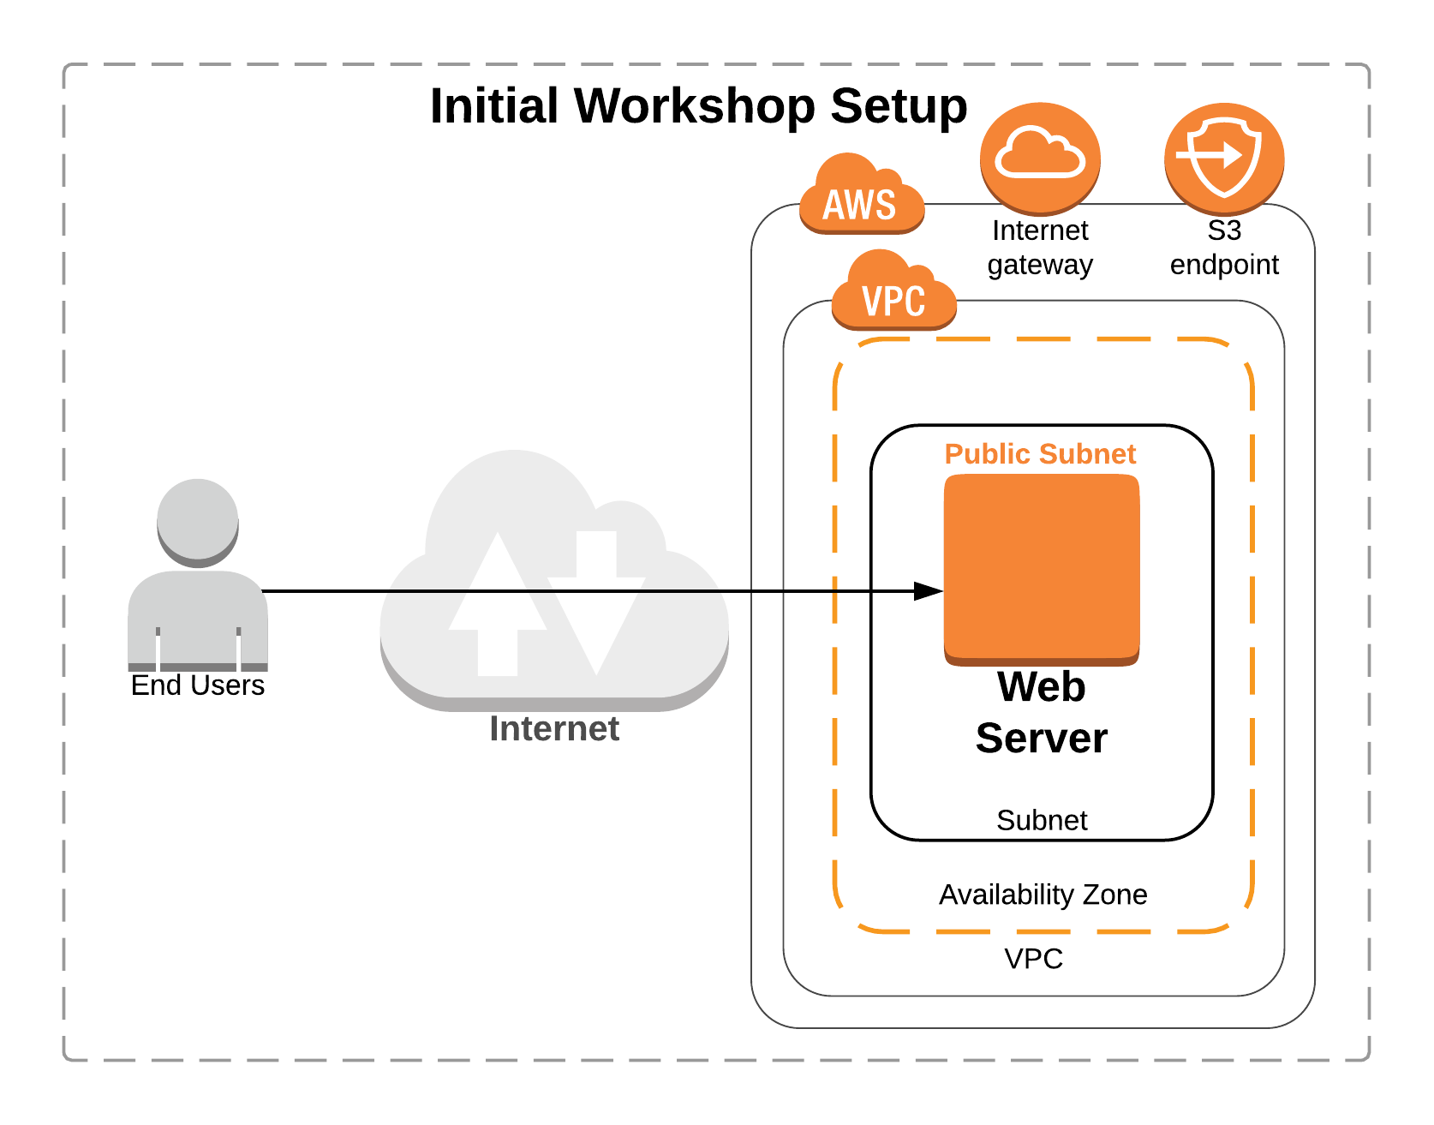
The initial setup

Slide 33
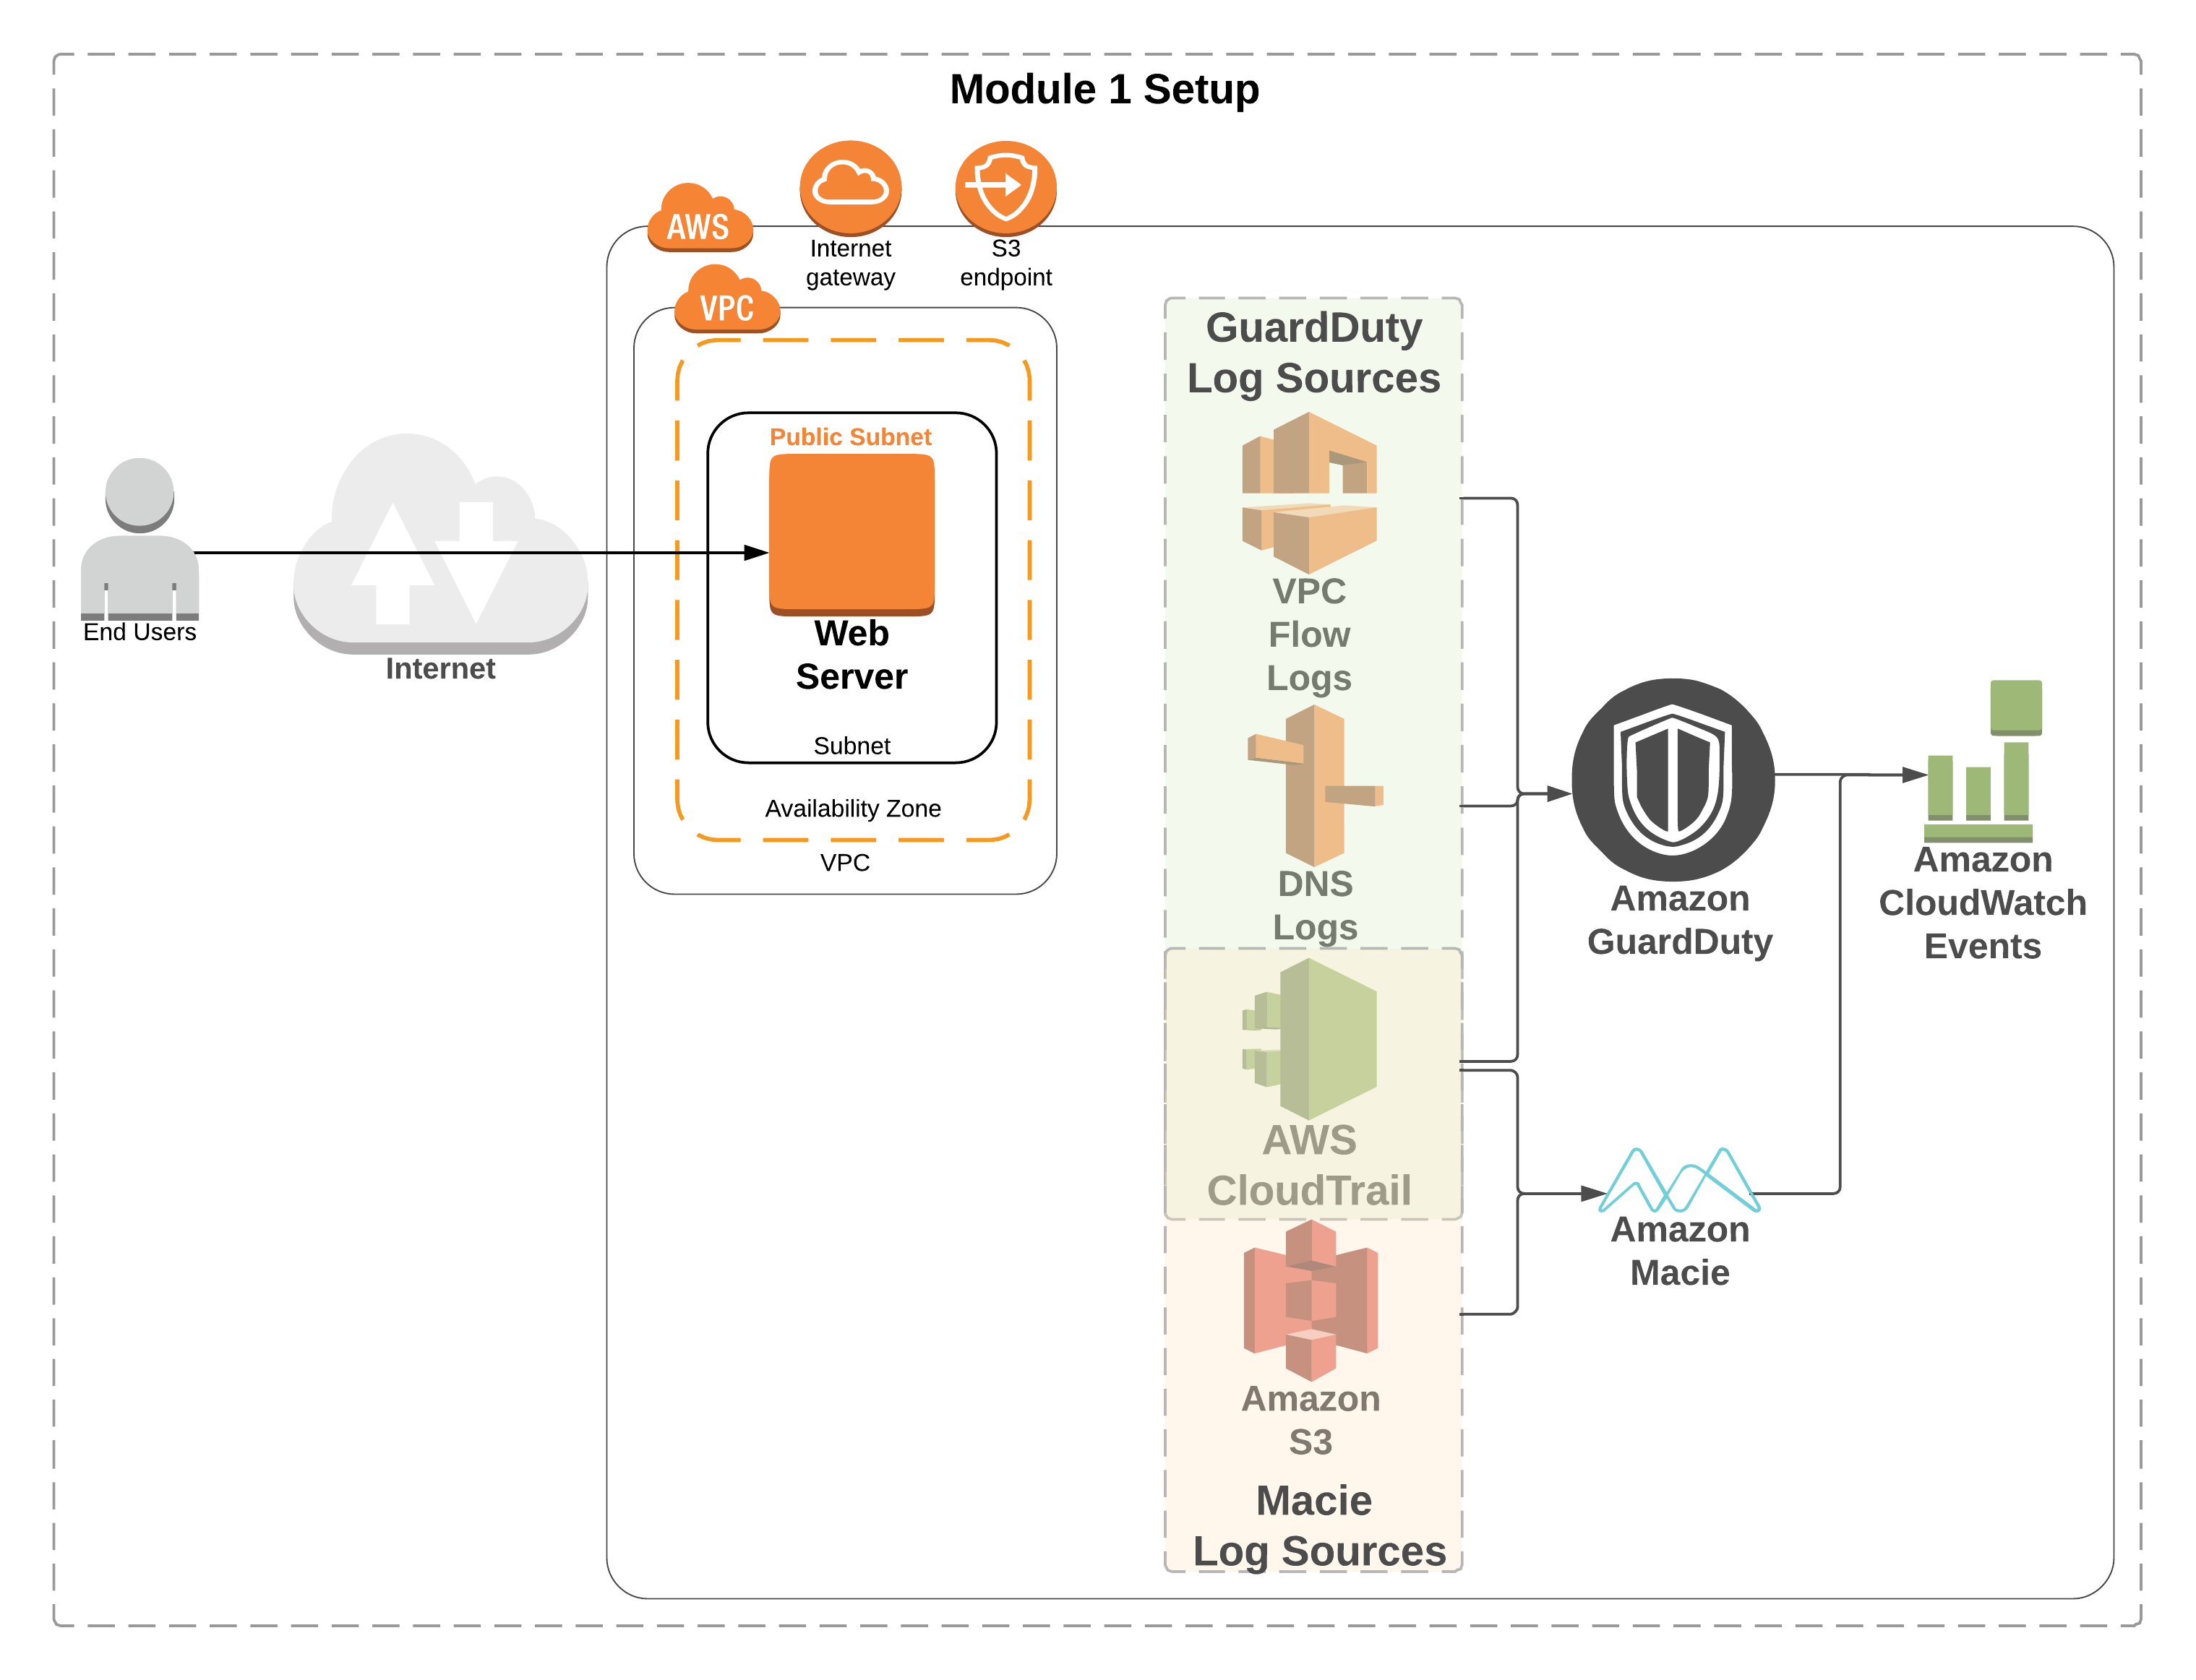
Module 1 setup

Slide 34
Start module 3
use
us-west-2
https://tinyurl.com/y84cc3pj
(https://github.com/aws-samples/aws-security-workshops/tree/master/threat-detection-wksp)
Directions:
Browse to https://tinyurl.com/y84cc3pj
Click on Detection & Remediation at the end
Run through this module (~45 min)
We will then finish up with module 4 and cleanup
Notes:
45 mins
Use the Oregon region

