Slide 1

PCA-Based Dimensionality Reduction: A Mathematical and Practical Approach
Mathematics and Statistics for AI
Othman EL-Kurdi & Brahim Ahmad
Dr. Issam AlAzouni

Slide 2
Outlines
Introduction
Project Scope
What is PCA?
Motivation
Mathematical definition
MSE Results by Component Count
2D PCA Projection of Dog Images
Top 5 Eignevalues
Result
References

Slide 3
Introduction to Principal Component Analysis (PCA) in Image Processing
PCA is a fundamental dimensionality-reduction technique in data science, computer vision, and machine learning.
Goal: To demonstrate how reconstruction quality varies as the number of principal components increases.

Slide 4
Project Scope
Applied PCA to a dataset of grayscale images.
Data Processing: Images resized to 64x64 pixels and flattened into 4096-dimensional feature vectors.

Slide 5
What is PCA and Why Use It?
Definition: PCA (Principal Component Analysis) is a linear transformation method designed to reduce the dimensionality of high-dimensional data while maximizing retained variability (information).
Mechanism: It identifies new orthogonal axes, known as Principal Components, which align with the directions of maximum variance within the dataset.

Slide 6
Motivation
Redundancy Reduction: High-dimensional data (like images) often contains redundant information (e.g., correlated pixel intensities).
Compression: PCA compresses data by eliminating this redundancy.
Structure Preservation: It projects data onto a lower-dimensional space, effectively preserving the essential structure while discarding less critical information.

Slide 7
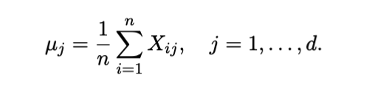
Compute the mean vector μ

Slide 8

Center the data
where 1n ∈ Rn×1 is a column vector of ones.

Slide 9
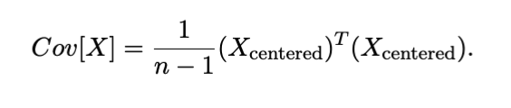
Compute the covariance matrix
This results in a symmetric matrix Cov[X] ∈ R^{d×d.}

Slide 10

Find eigenvalues and eigenvectors
where:
• Cov[X] : is the covariance matrix from step 3
• v : is the eigenv ector, which we need to calculate
• λ : is the eigenvalue, which we need to calculate too.

Slide 11
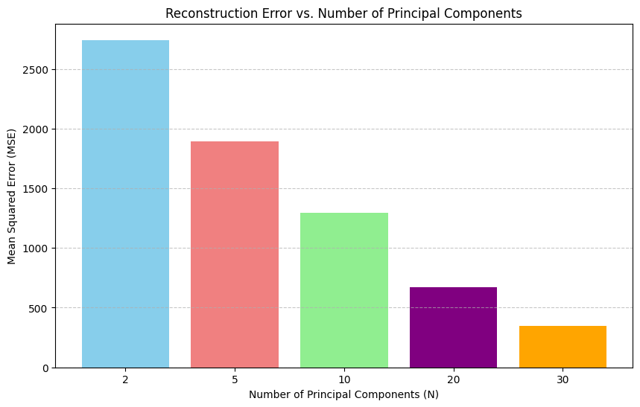
MSE Results by Component Count

Slide 12
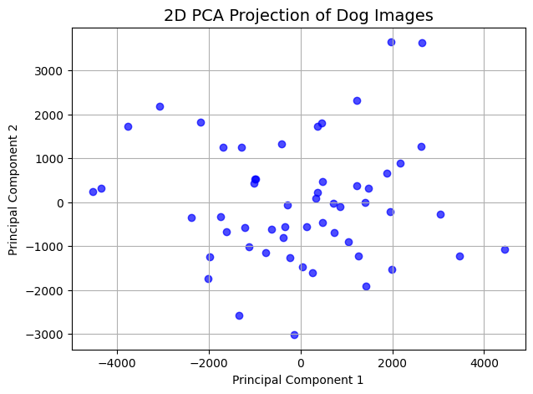
2D PCA Projection of Dog Images

Slide 13
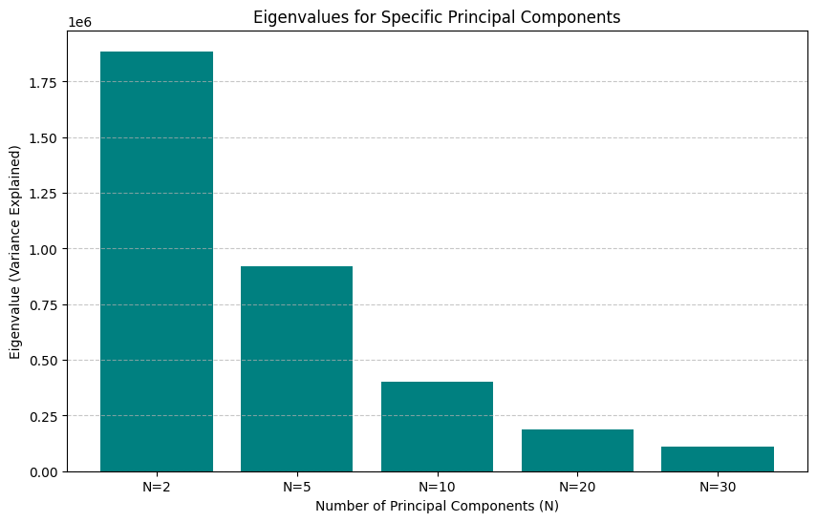
Top 5 Eignevalues
The top 5 eigenvalues can be displayed as follows:
• λ1 = 3.53e+06
• λ2 = 1.89e+06
• λ3 = 1.40e+06
• λ4 = 1.21e+06
• λ5 = 9.20e+05

Slide 14
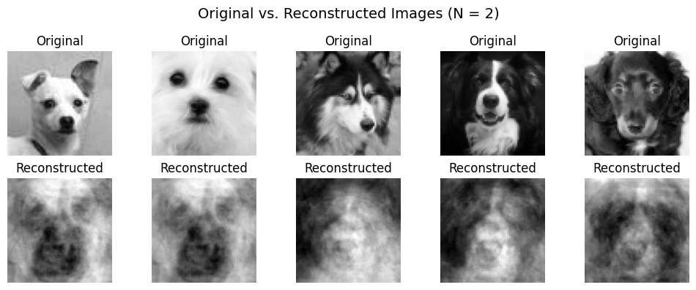
Result

Slide 15
Result
when the principal components increase, the eigenvalue will decrease. Thus, it is recommended to use more number of principal components.
After applying the PCA, the images resolution is constructed, but still preserved andcan be turned into the original images.

Slide 16
References
S. Marukatat, “Tutorial on PCA and approximate PCA and approximate kernel PCA,”Artificial Intelligence Review, vol. 56, no. 6, pp. 5445–5477, 2023.
M. P. Deisenroth, A. A. Faisal, and C. S. Ong, Mathematics for Machine Learning. Cam-bridge, UK: Cambridge University Press, 2020.

Slide 17
Thank you!
Questions?

