Slide 1
Atypical Mitosis Classification in Histopathology Using Deep Learning

Slide 2
Problem Statement
Accurate identification of atypical mitotic figures in histopathology images is crucial for assessing tumor aggressiveness, but their irregular and diverse morphologies make manual classification difficult and inconsistent. This project focuses on developing a deep learning model to distinguish typical from atypical mitotic figures using the MIDOG 2025 dataset.
Challenges include - Handling the high visual variability of atypical mitoses, their similarity to typical figures, class imbalance, and domain differences in staining and imaging.
Goal - To build a robust and generalizable deep learning classifier that can accurately identify atypical mitotic figures, thereby improving diagnostic consistency and supporting more objective tumor grading.

Slide 3
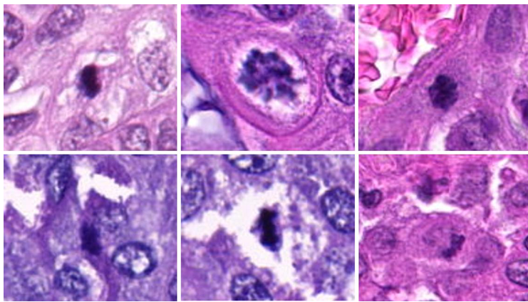
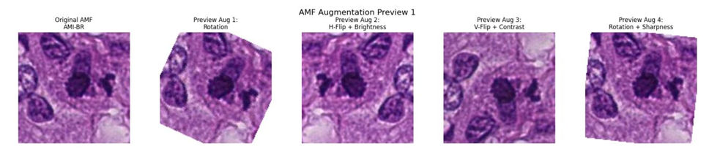
Dataset
Dataset Overview :
MIDOG++ Atypical Benchmark
Combines data from MIDOG25, MIDOG21, TUPAC16, and AMI-BR
~14,000 annotated 224×224 PNG images of mitotic figures
2 classes :AMF(Atypical Mitotic Figures)and NMF(Normal Mitotic Figures)
Stratified split: ~9000/~3000/~3000 (Train/Validation/Test respectively)
Augmented Training Dataset :
Augmentation Strategy (4× per AMF image) : I. Random rotation (15°–30°) II. Horizontal flip + brightness adjustment III. Vertical flip + contrast adjustment IV. Rotation + sharpness enhancement
Final Balanced Dataset: 19,162 total images. Training: 13,586 (balanced 1:1 ; NMF:AMF) Validation and Test : 2788
Sample image from Dataset
Sample image from Augmented Dataset

Slide 4
Motivation
Identifying atypical mitotic figures is an important part of diagnosing how aggressive a tumor is, but these cells often look very irregular and are easy to miss, even for experienced pathologists. This makes the process slow, tiring, and sometimes inconsistent. With the amount of digital pathology data growing, it becomes even harder to manually review everything accurately. This project is motivated by the need for a reliable, automated system that can support pathologists by reducing their workload, improving consistency, and helping ensure patients receive faster and more accurate cancer assessments.

Slide 5
Literature Survey
Title | Year & Authors | Summary
Improving CNN-Based Mitosis Detection Through Rescanning Annotated Glass Slides and Atypical Mitosis Subtyping | 2024 & Rutger R. H. Fick, Christof Bertram, Marc Aubreville | The paper improves mitosis detection by rescanning annotated slides across multiple scanners to create a cleaner, more robust dataset and filtering out unreliable labels. It also adds a secondary task that classifies mitotic figures as normal or atypical, which strengthens overall detection performance. Using this approach, the authors achieve strong and consistent results across diverse scanners, organs, and species.
Reference Algorithms for the Mitosis Domain Generalization (MIDOG) 2022 Challenge | 2022 & Jonas Ammeling, Frauke Wilm, Jonathan Ganz, Katharina Breininger, Marc Aubreville | This paper presents baseline and reference algorithms for the MIDOG 2022 challenge, evaluating multiple detection models across diverse scanners and tissue types to establish standard benchmarks for mitosis domain generalization. It provides reliable performance baselines, highlights key domain-shift challenges, and supports fair comparison for competing methods.
A Deep Learning-Based Ensemble Model for Generalized Mitosis Detection in H&E-Stained Whole Slide Images | 2022 & Sujatha Kotte, V. G. Saipradeep, Naveen Sivadasan, Thomas Joseph, Hrishikesh Sharma, Vidushi Walia, Binuja Varma, Geetashree Mukherjee | This paper proposes an ensemble mitosis-detection system that combines multiple deep learning models to improve robustness across different scanners and tissue types. Trained for the MIDOG 2022 challenge, the ensemble achieves strong cross-domain performance, demonstrating the effectiveness of multi-model fusion for generalized mitosis detection.

Slide 6
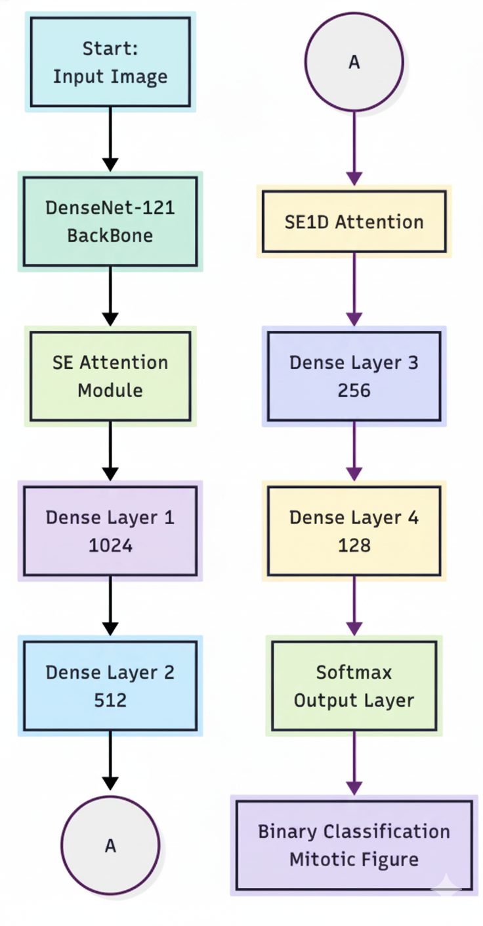
Flowchart
Notes:
Trains using focal loss early stopping lr plateau adams optimizer

Slide 7
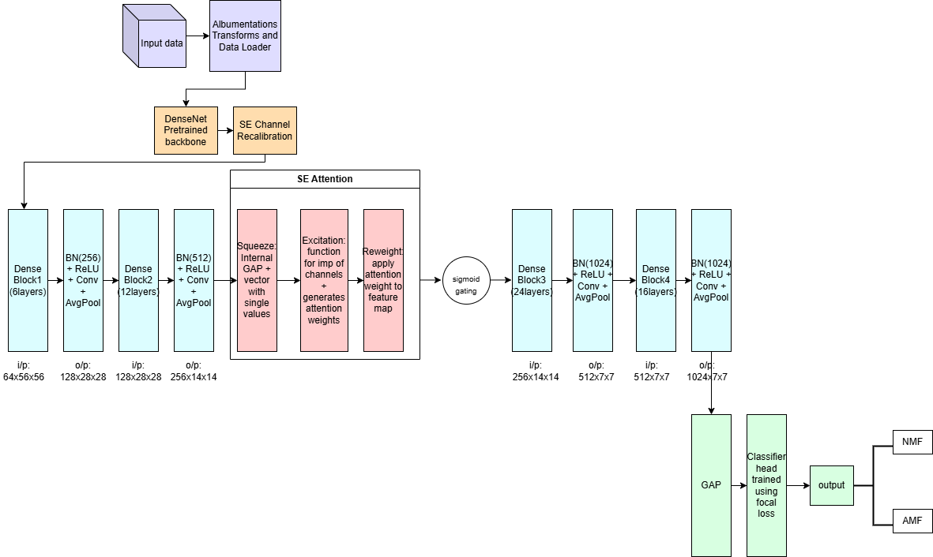
Model Architecture
DenseNet – 121 Backbone

Slide 8
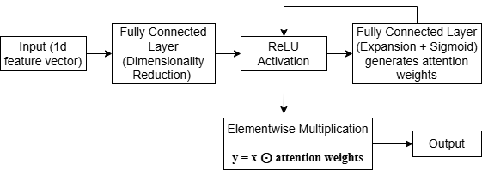
Model Architecture
SE (Squeeze-and-Excitation) Attention

Slide 9
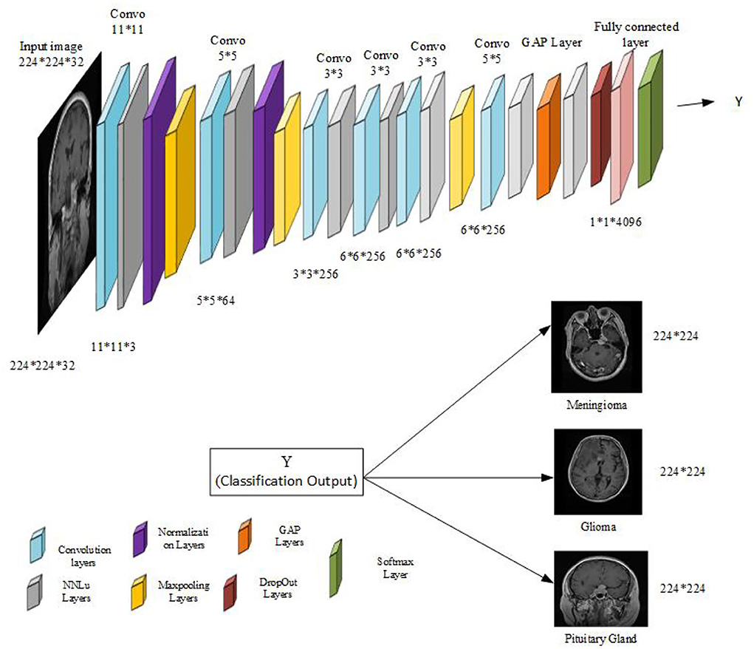
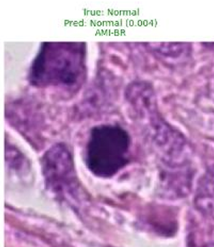
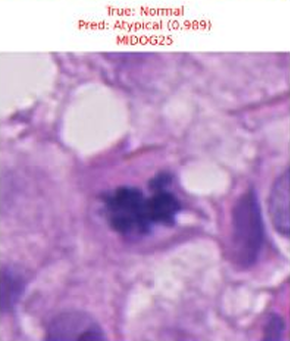
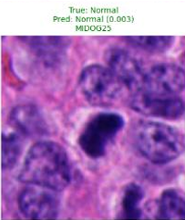
Model Architecture
Global Average Pooling Layer

Slide 10
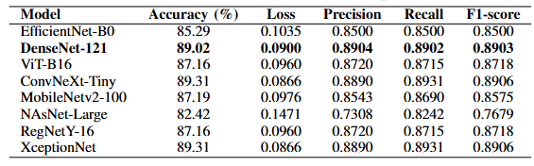
Baseline Model Results

Slide 11
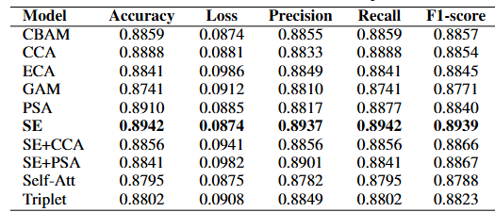
Convolutional Attention

Slide 12
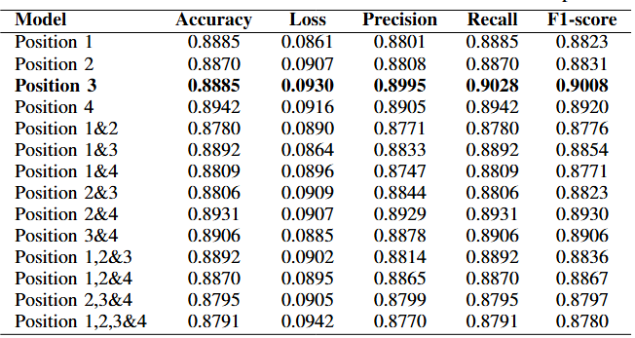
Best Position for Attention

Slide 13
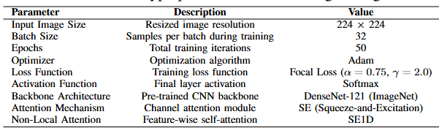
Model Hyperparameters and Training Configurations

Slide 14
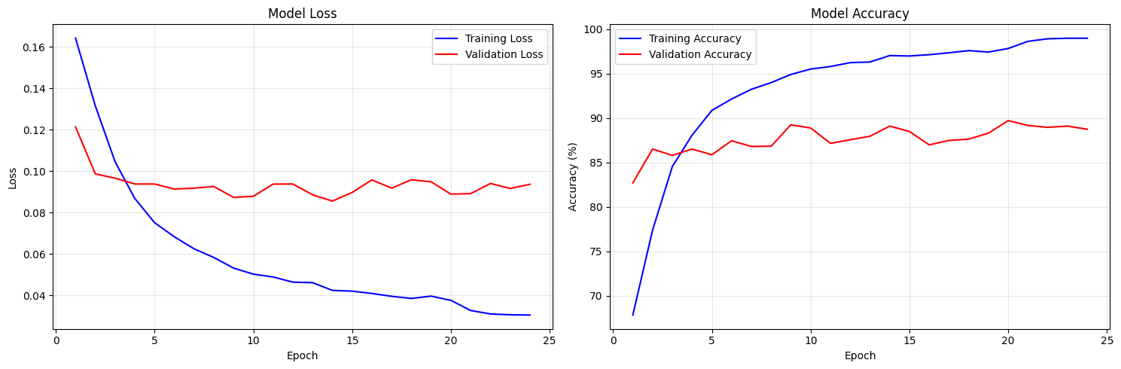
Results
Model loss/ accuracy plots

Slide 15
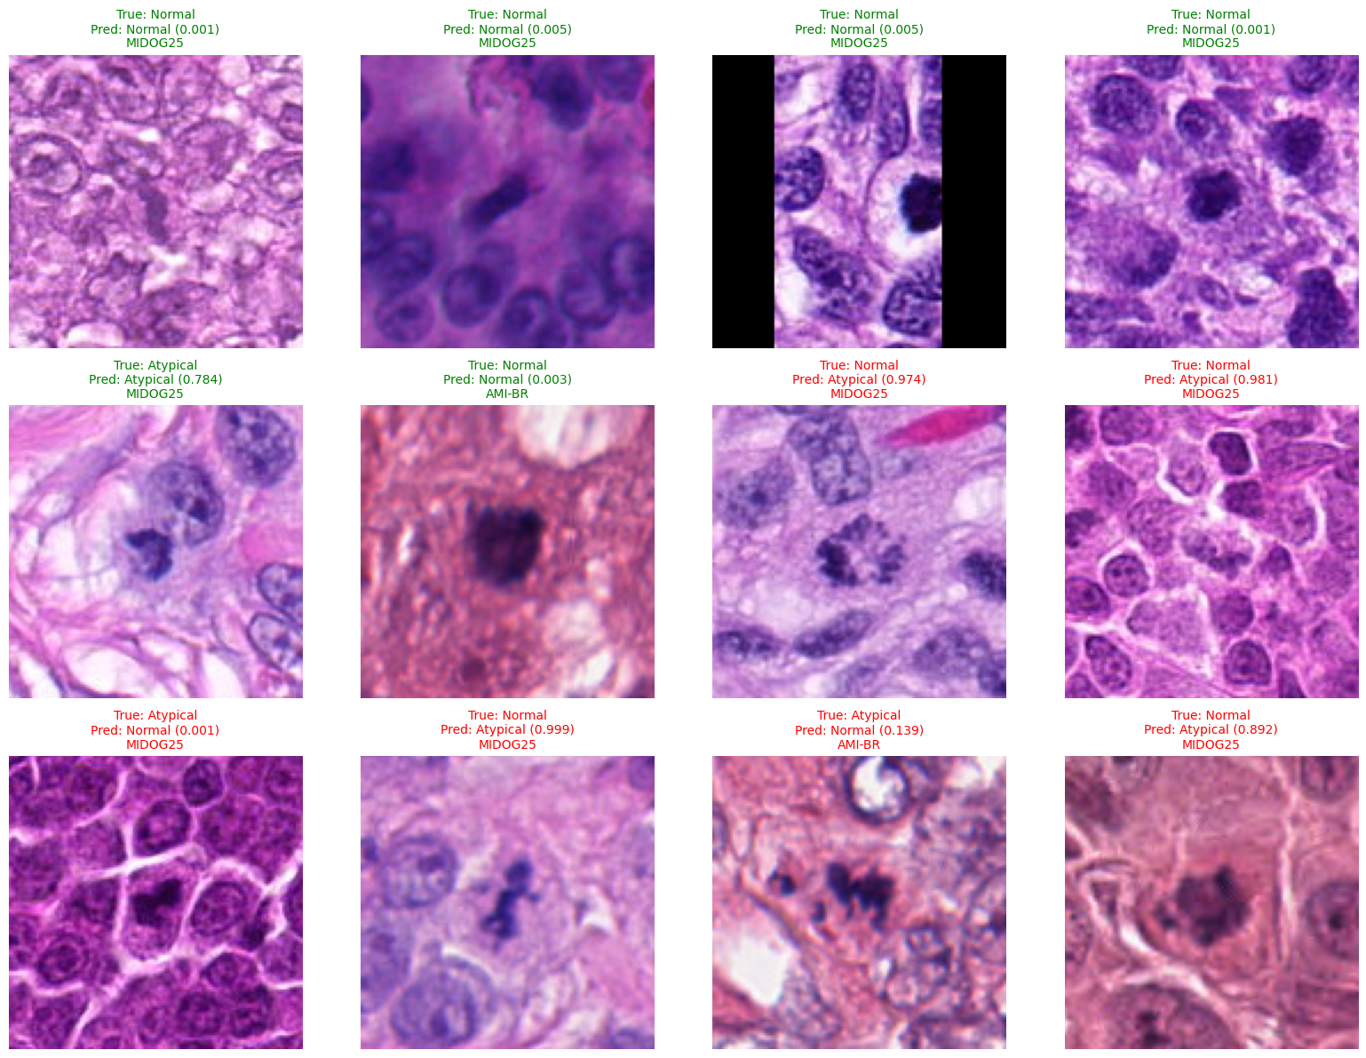
Results
Some Model Predictions

Slide 16
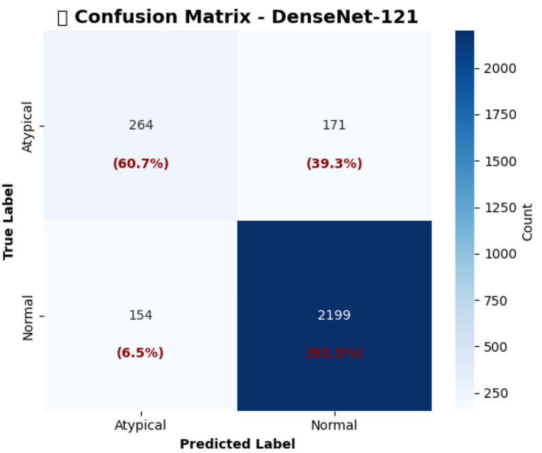
Results
Confusion Matrix

Slide 17
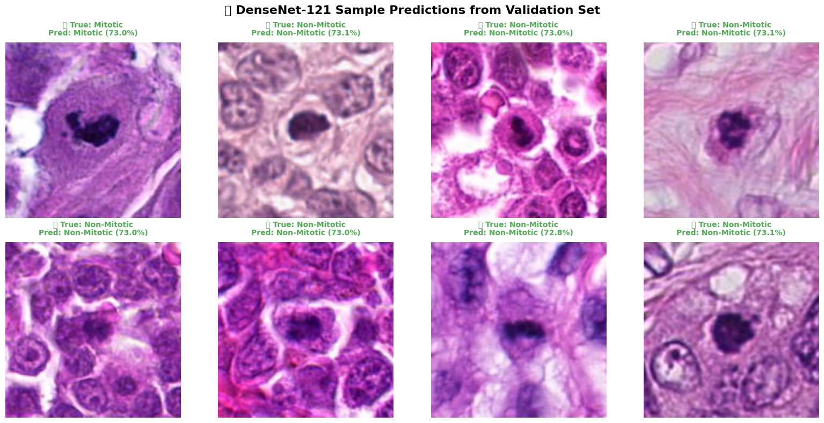
Results
DenseNet-121 Predictions from Validation set with confidence scores

Slide 18
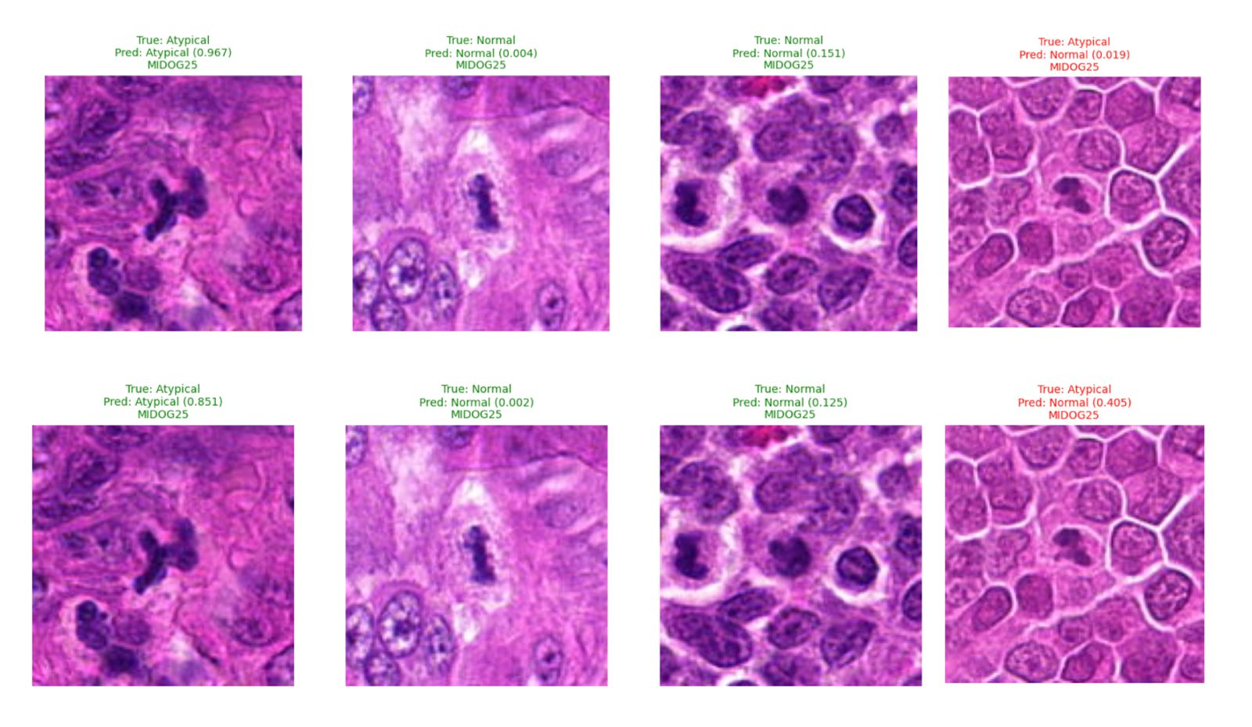
Result Inference
Comparison of our baseline model with DenseNet-121

Slide 19
Conclusion
The final model achieved strong overall performance with 92.3% test accuracy, demonstrating reliable atypical–typical mitosis classification.
High precision (0.91) and recall (0.89) indicate consistent detection with minimal false positives and false negatives.
An F1-score of 0.90 and AUC of 0.95 reflect excellent discriminative capability, even with challenging atypical morphologies.
The model remains computationally efficient, using 7.9M parameters and running at 45 FPS, supporting practical deployment.
Overall, the results show that the system is both accurate and efficient, making it suitable for real-world pathology assistance and improving consistency in mitotic figure assessment.

