Slide 1
Android Overview
by
Sunil Singh

Slide 2
References
This tutorial is a brief overview of some major concepts…Android is much richer and more complex
Developer’s Guide
http://developer.android.com/guide/index.html
API Reference
http://developer.android.com/reference/packages.html

Slide 3
Tools
Phone
Eclipse ( http://www.eclipse.org/downloads/ )
Android Plugin (ADT)
Android SDK ( http://developer.android.com/sdk/index.html )
Install everything except Additional SDK Platforms, unless you want to
Windows Users: may need to install Motorola Driver directly ( http://www.motorola.com/Support/US-EN/Support-Homepage/Software_and_Drivers/USB-and-PC-Charging-Drivers )

Slide 4
Android SDK
Once installed open the SDK Manager
Install the desired packages
Create an Android Virtual Device (AVD)

Slide 5
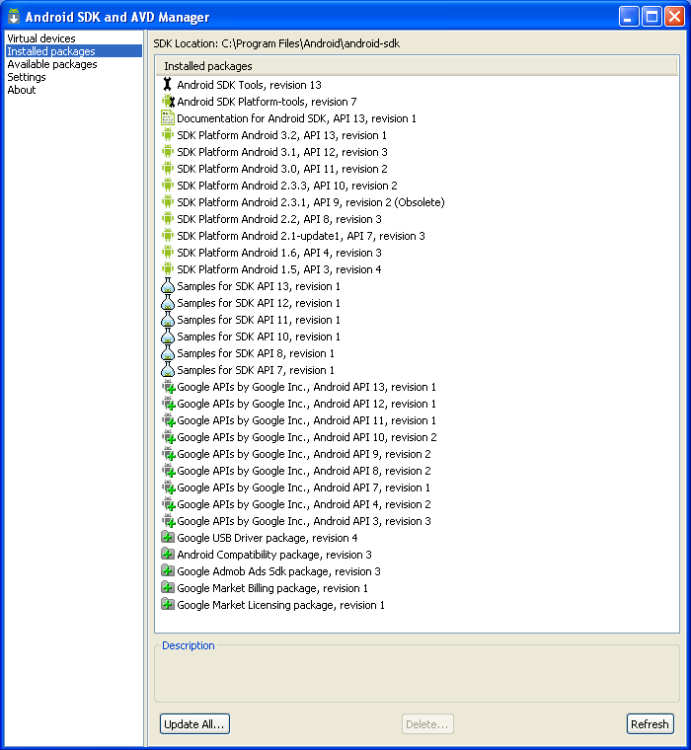
SDK Manager

Slide 6
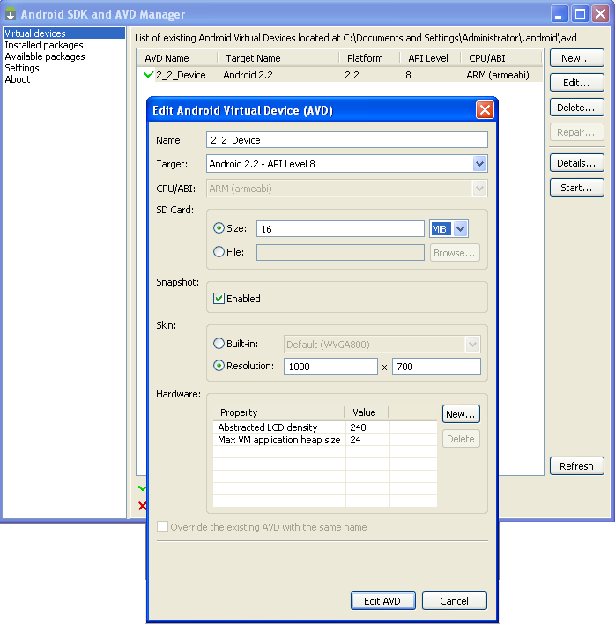
AVD

Slide 7
ADT Plugin (1)
In Eclipse, go to Help -> Install New Software
Click ‘Add’ in top right
Enter:
Name: ADT Plugin
Location: https://dl-ssl.google.com/android/eclipse/
Click OK, then select ‘Developer Tools’, click Next
Click Next and then Finish
Afterwards, restart Eclipse
Specify SDK location (next 3 slides)
Must do this every time start a new project in a new location (at least in Windows)

Slide 8
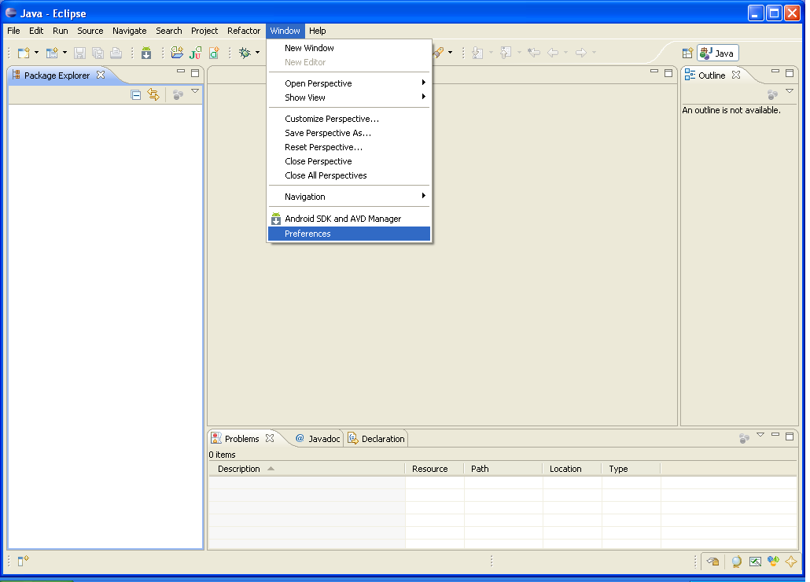
ADT Plugin (2)

Slide 9
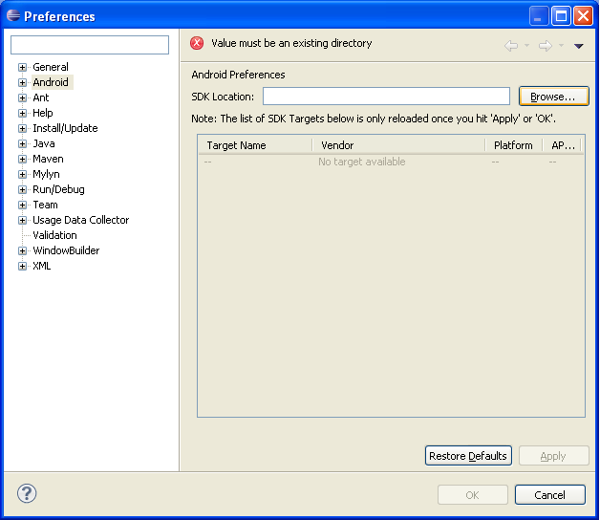
ADT Plugin (3)

Slide 10
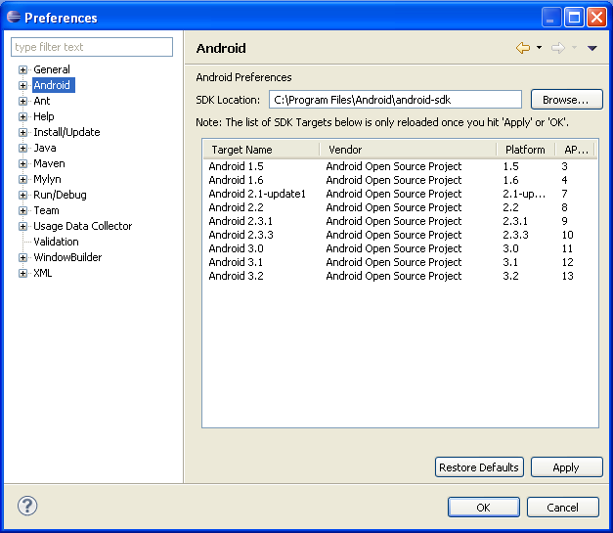
ADT Plugin (4)

Slide 11
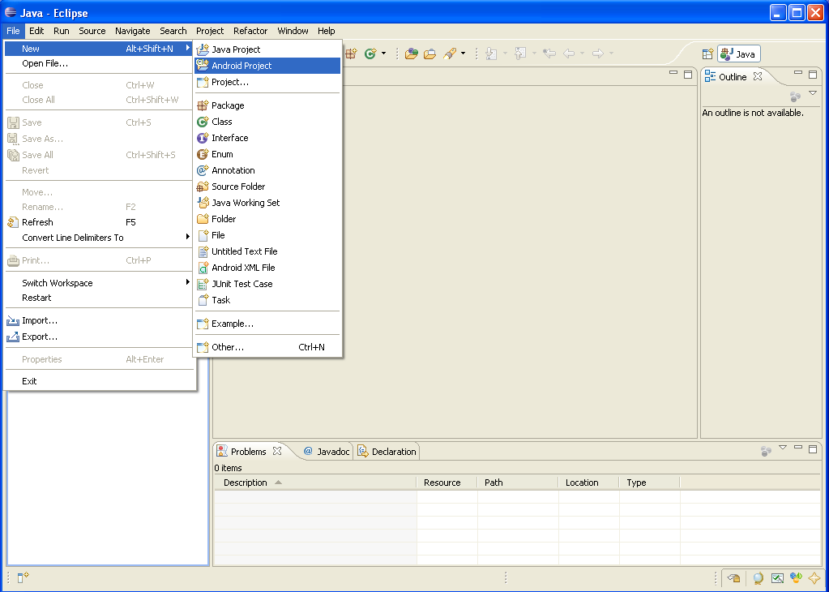
Creating a Project (1)

Slide 12
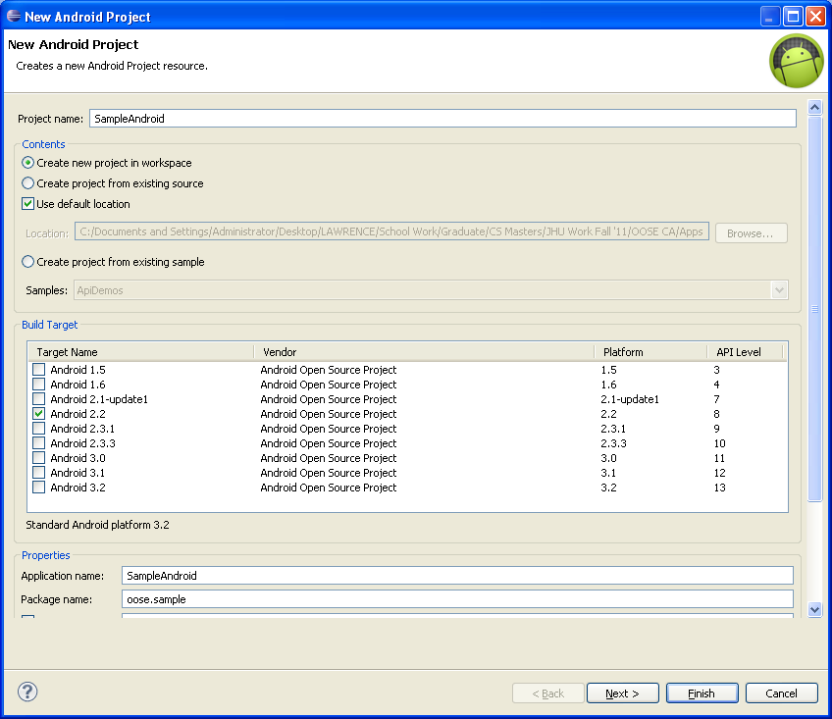
Creating a Project (2)
Need
the
items
circled
Then
click
Finish

Slide 13
Project Components
src – your source code
gen – auto-generated code (usually just R.java)
Included libraries
Resources
Drawables (like .png images)
Layouts
Values (like strings)
Manifest file

Slide 14
XML
Used to define some of the resources
Layouts (UI)
Strings
Manifest file
Shouldn’t usually have to edit it directly, Eclipse can do that for you
Preferred way of creating UIs
Separates the description of the layout from any actual code that controls it
Can easily take a UI from one platform to another

Slide 15
R Class
Auto-generated: you shouldn’t edit it
Contains IDs of the project resources
Enforces good software engineering
Use findViewById and Resources object to get access to the resources
Ex. Button b = (Button)findViewById(R.id.button1)
Ex. getResources().getString(R.string.hello));

Slide 16
Layouts (1)
Eclipse has a great UI creator
Generates the XML for you
Composed of View objects
Can be specified for portrait and landscape mode
Use same file name, so can make completely different UIs for the orientations without modifying any code

Slide 17
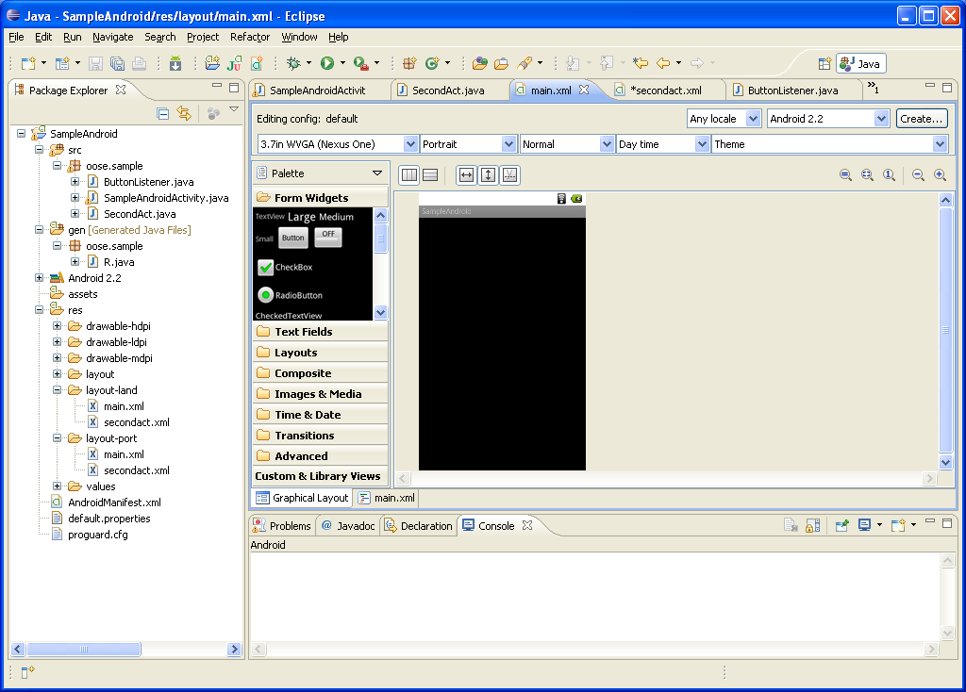
Layouts (2)

Slide 18
Layouts (3)
Click ‘Create’ to make layout modifications
When in portrait mode can select ‘Portrait’ to make a res sub folder for portrait layouts
Likewise for Landscape layouts while in landscape mode
Will create folders titled ‘layout-port’ and ‘layout-land’
Note: these ‘port’ and ‘land’ folders are examples of ‘alternate layouts’, see here for more info
http://developer.android.com/guide/topics/resources/providing-resources.html
Avoid errors by making sure components have the same id in both orientations, and that you’ve tested each orientation thoroughly

Slide 19
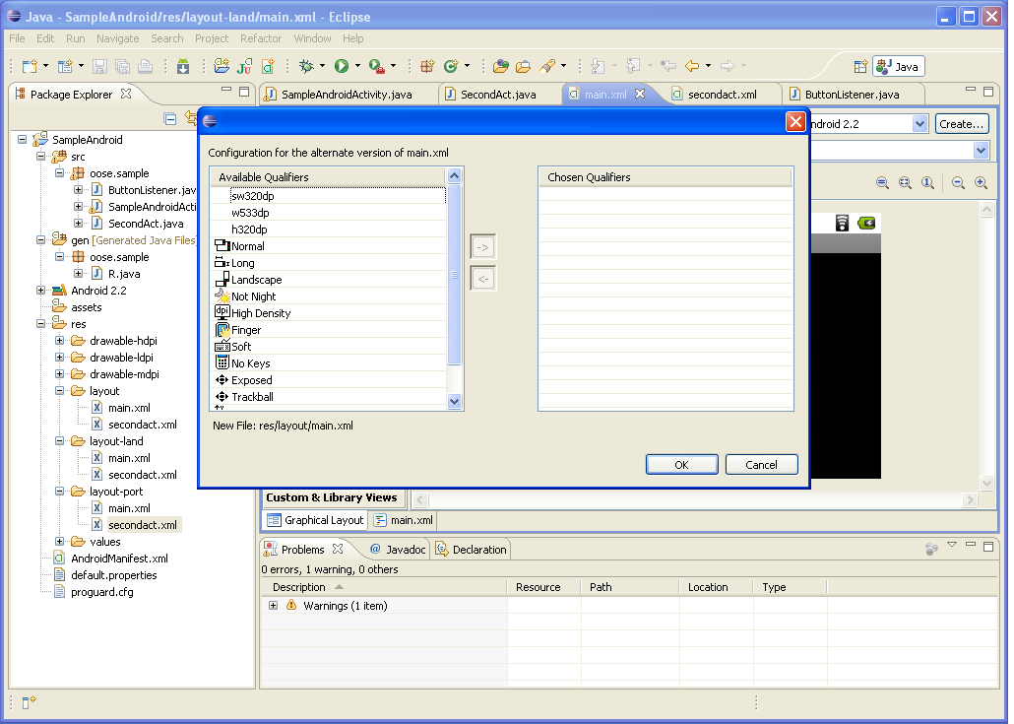
Layouts (4)

Slide 20
Strings
In res/values
strings.xml
Application wide available strings
Promotes good software engineering
UI components made in the UI editor should have text defined in strings.xml
Strings are just one kind of ‘Value’ there are many others

Slide 21
Manifest File (1)
Contains characteristics about your application
When have more than one Activity in app, NEED to specify it in manifest file
Go to graphical view of the manifest file
Add an Activity in the bottom right
Browse for the name of the activity
Need to specify Services and other components too
Also important to define permissions and external libraries, like Google Maps API

Slide 22
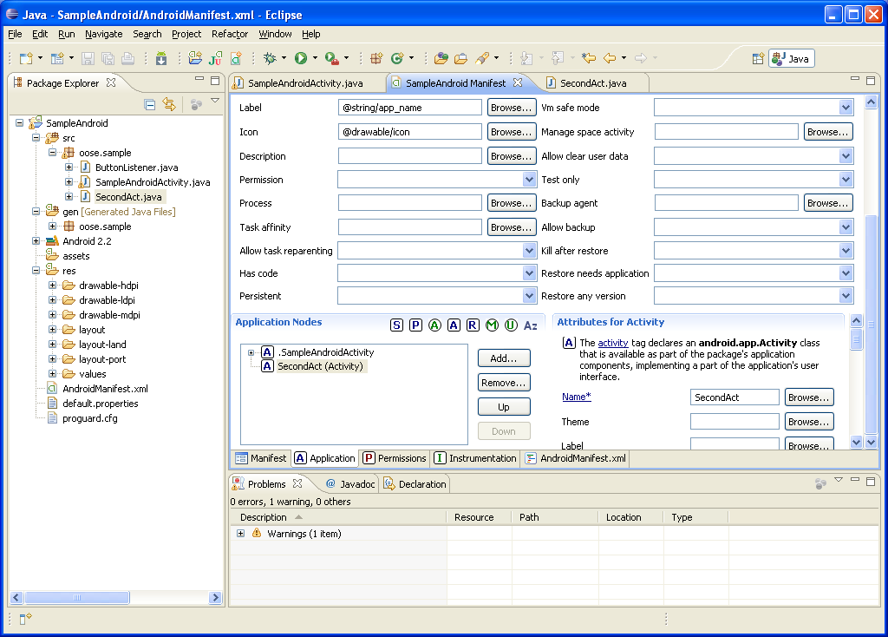
Manifest File (2) – Adding an Activity

Slide 23
Android Programming Components
Activity
http://developer.android.com/guide/topics/fundamentals/activities.html
Service
http://developer.android.com/guide/topics/fundamentals/services.html
Content Providers
Broadcast Receivers
Android in a nutshell:
http://developer.android.com/guide/topics/fundamentals.html

Slide 24
Activities (1)
The basis of android applications
A single Activity defines a single viewable screen
the actions, not the layout
Can have multiple per application
Each is a separate entity
They have a structured life cycle
Different events in their life happen either via the user touching buttons or programmatically

Slide 25
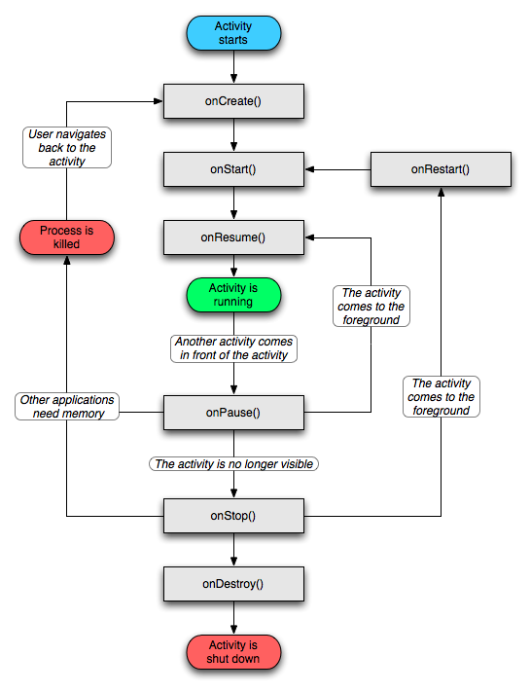
Activities (2)

Slide 26
Services (1)
Run in the background
Can continue even if Activity that started it dies
Should be used if something needs to be done while the user is not interacting with application
Otherwise, a thread is probably more applicable
Should create a new thread in the service to do work in, since the service runs in the main thread
Can be bound to an application
In which case will terminate when all applications bound to it unbind
Allows multiple applications to communicate with it via a common interface
Needs to be declared in manifest file
Like Activities, has a structured life cycle

Slide 27
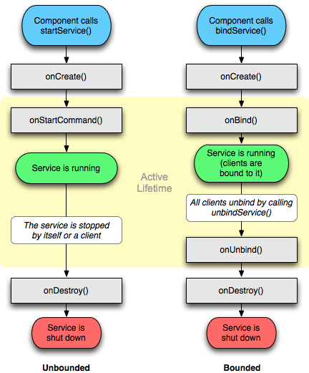
Services (2)

Slide 28
Running in Eclipse (1)
Similar to launching a regular Java app, use the launch configurations
Specify an Android Application and create a new one
Specify activity to be run
Can select a manual option, so each time program is run, you are asked whether you want to use the actual phone or the emulator
Otherwise, it should be smart and use whichever one is available

Slide 29
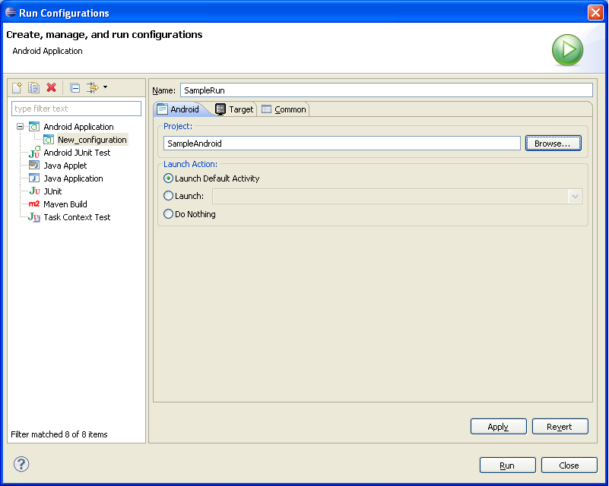
Running in Eclipse (2)

Slide 30
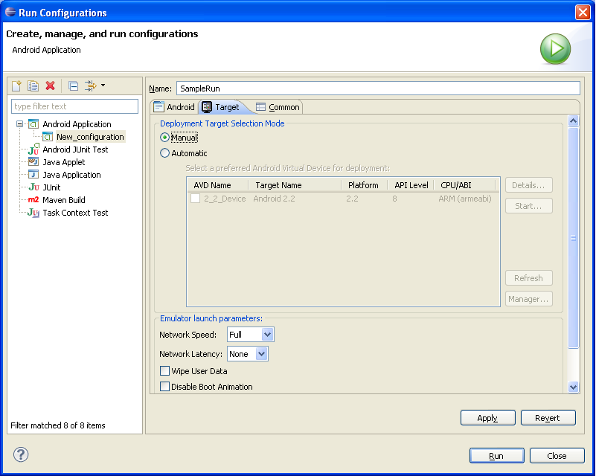
Running in Eclipse (3)

Slide 31
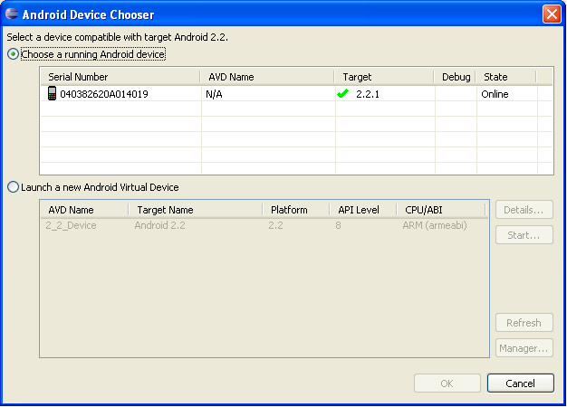
Running in Eclipse (4)

Slide 32
USB Debugging
Should be enabled on phone to use developer features
In the main apps screen select Settings -> Applications -> Development -> USB debugging (it needs to be checked)

Slide 33
Android Debug Bridge
Used for a wide variety of developer tasks
Read from the log file
Show what android devices are available
Install android applications (.apk files)
In the ‘platform-tools’ directory of the main android sdk directory
Recommend putting this directory and the ‘tools’ directory on the system path
adb.exe

Slide 34
Debugging
Instead of using traditional System.out.println, use the Log class
Imported with android.util.Log
Multiple types of output (debug, warning, error, …)
Log.d(<tag>,<string>)
Can be read using logcat.
Print out the whole log, which auto-updates
adb logcat
Erase log
adb logcat –c
Filter output via tags
adb logcat <tag>:<msg type> *:S
can have multiple <tag>:<msg type> filters
<msg type> corresponds to debug, warning, error, etc.
If use Log.d(), then <msg type> = D
Reference
http://developer.android.com/guide/developing/debugging/debugging-log.html

Slide 35
Screen Shots
Some say you need to root the phone – that is not true
One option: Android Screen Capture
http://www.mightypocket.com/2010/08/android-screenshots-screen-capture-screen-cast/
It’s slow, but fine for screenshots of applications whose screens aren’t changing fast
Read their installation help, following the extra steps if need be (I had to copy adb.exe and some dll files, as they explain)

Slide 36
Maps Example (1)
Using Google Maps in your app
Setup project to use ‘Google API’ version
Edit Manifest file
To indicate the app will use maps and the internet
Get a maps API key
Note: Google Maps API can display a map and draw overlays, but is not the full Google Maps experience you enjoy on the web
For example, there does not seem to be inherent support for drawing routes between points (if you find it let me know)…however, you can draw lines between points and almost any type of overlay, but that’s different than street routes
The directions API is a web service, which is different, among several other Google web services
Read the Google API terms of use

Slide 37
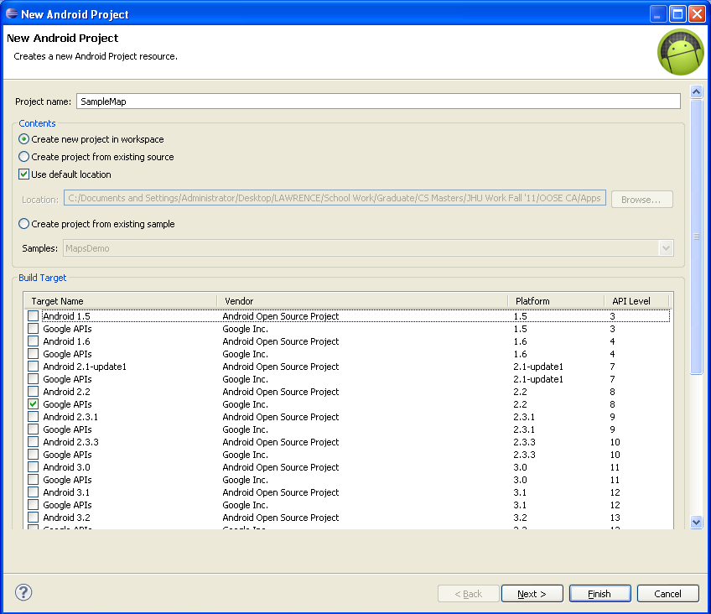
Maps Example (2)

Slide 38
Maps Example (3) – Manifest (1)
Open Manifest file
Add map library tag
Add the ‘Uses Library’ com.google.android.maps
Indicate the app will access the internet
Add the ‘Permission’ android.permission.lNTERNET
End goal is to add the following two lines to XML file, under the <manifest> and <application tags>, respectively
Under the <manifest> tag
<uses-permission android:name="android.permission.INTERNET"></uses-permission>
Under the <application> tag
<uses-library android:name="com.google.android.maps"></uses-library>
Following is GUI way to add them

Slide 39
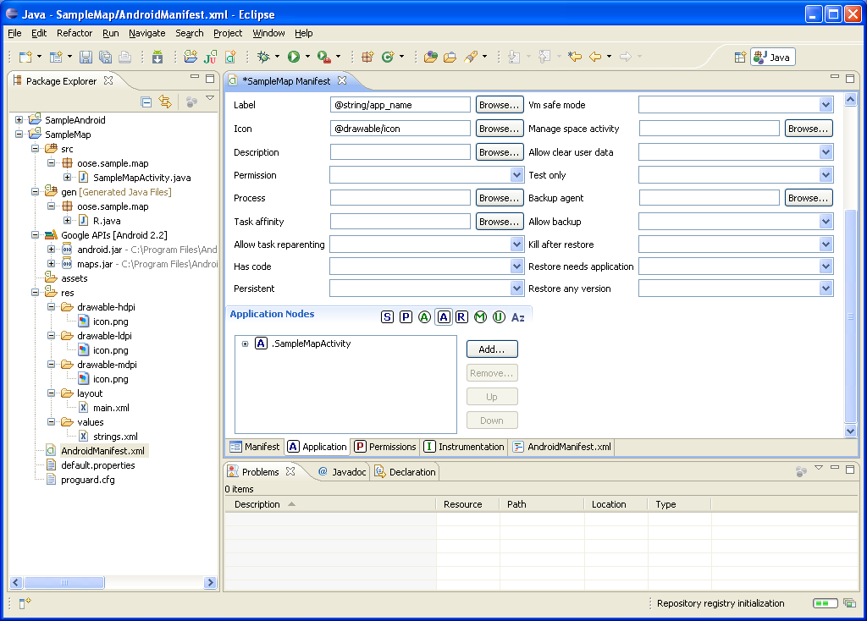
Maps Example (4) – Manifest (2)
1
2

Slide 40
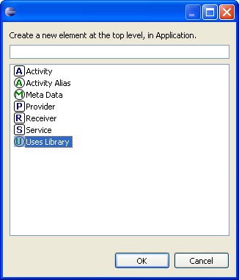
Maps Example (5) – Manifest (3)
Select ‘Add’ under ‘Uses Library’ (last slide)
Then select ‘Uses Library at this prompt
Set name as: com.google.android.maps (next slide) and save

Slide 41
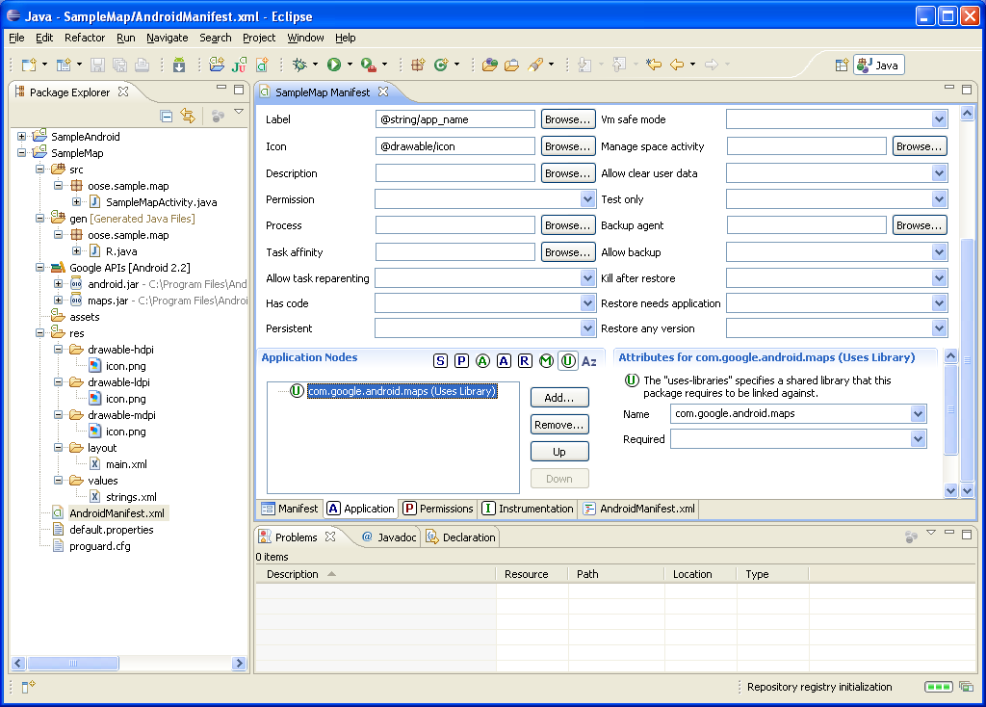
Maps Example (6) – Manifest (4)

Slide 42
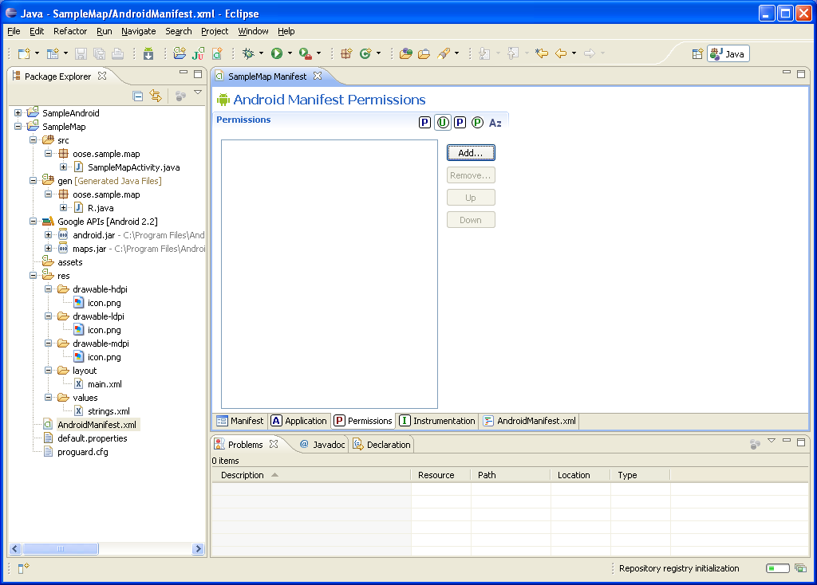
Maps Example (7) – Manifest (5)
2
1

Slide 43
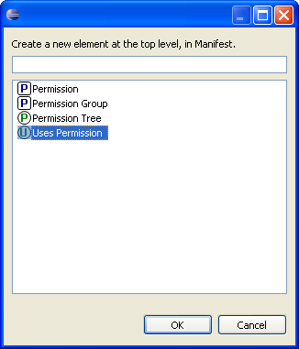
Maps Example (8) – Manifest (6)
Select ‘Permissions’ and then ‘Add’ (last slide)
Select ‘Uses Permissions’ at this prompt
Set name to: android.permission.INTERNET and save (next slide)

Slide 44
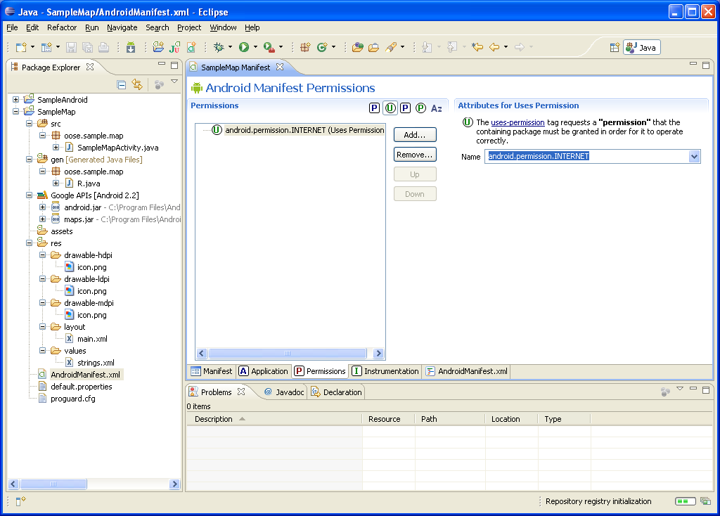
Maps Example (9) – Manifest (7)

Slide 45
Maps Example (10) – Maps API Key (1)
All Android applications need to be signed
The debug mode signs for you with special debug certificate
All MapView elements in map applications need to have an API key associated with them
That key must be registered with the certificate used to sign the app
When releasing app, need to sign with a release certificate and get a new API Key

Slide 46
Maps Example (11) – Maps API Key (2)
For debug mode, get the MD5 fingerprint of the debug certificate
Locate the ‘keystore’
Windows Vista: C:\Users\<user>\.android\debug.keystore
Windows XP: C:\Documents and Settings\<user>\.android\debug.keystore
OS X and Linux: ~/.android/debug.keystore
Use Keytool (comes with Java, in the bin directory with the other Java tools, should put that dir on system PATH) to get fingerprint
keytool -list –v -alias androiddebugkey -keystore “<path_to_debug_keystore>” -storepass android -keypass android
If don’t include –v option, then will probably get only 1 fingerprint, and if it’s not MD5, then need –v (Java 7 needs –v)
Extract the MD5 fingerprint, SHA will not work unfortunately
Go to https://code.google. com/android/maps-api-signup.html , agree to terms and paste MD5 fingerprint, you will then be given an API Key

Slide 47
Maps Example (12)
Need to put MapView tag in XML
com.google.android.maps.MapView
MapView is the basic view that represents a Google Map display
Must include API Key in XML, inside a layout
<com.google.android.maps.MapView
android:id="@+id/mapview"
android:layout_width="fill_parent"
android:layout_height="fill_parent"
android:clickable="true"
android:apiKey=“<api key>”/>
Maps API Reference
http://code.google.com/android/add-ons/google-apis/reference/index.html

Slide 48
Acknowledgements
Android Developer’s Website
Activity and Service life-cycle flow charts
Tons of other Android info
Google Maps API external library
http://code.google.com/android/add-ons/google-apis/maps-overview.html
MightyPocket
http://www.mightypocket.com/2010/08/android-screenshots-screen-capture-screen-cast/
Numerous Forums & other developer sites, including:
http://www.javacodegeeks.com/2011/02/android-google-maps-tutorial.html
http://efreedom.com/Question/1-6070968/Google-Maps-Api-Directions
http://www.mail-archive.com/android-developers@googlegroups.com/msg28487.html
http://android.bigresource.com/ threads
http://groups.google.com/group/android-developers threads
Many http://stackoverflow.com threads
http://www.anddev.org/google_driving_directions_-_mapview_overlayed-t826.html
Zainan Victor Zhou – for advice and his own tutorial

