Slide 1

Android Application Development Tutorial
By
Sunil Singh

Slide 2
Topics
Introduction to Android
Background
Versions of Android
Limitations
Android features
Android Architecture
Overview of Sensors
Programming Tutorial 1: Tracking location with GPS and Google Maps
Overview of Networking
Programming Tutorial 2: Downloading from the Internet
Programming Tutorial 3: Sending/Receiving SMS Messages
Resources

Slide 3
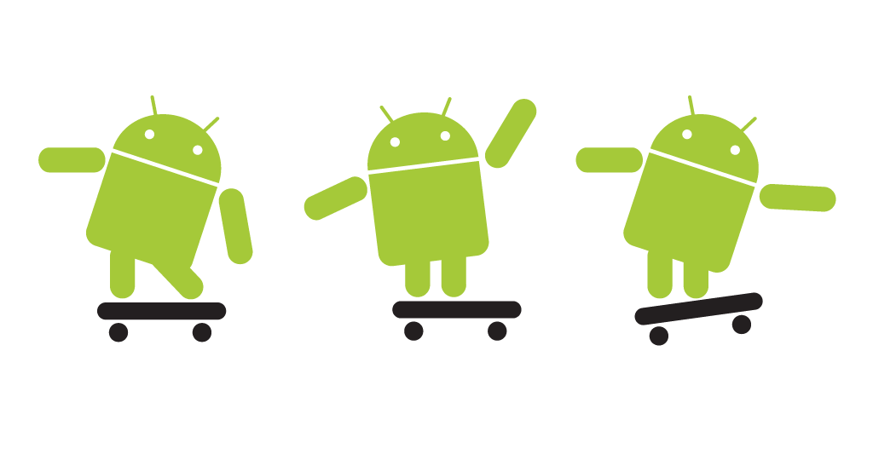
Introduction to Android
A brief guide to the Android Application Development Environment

Slide 4
Background
Software platform from Google and the Open Handset Alliance
July 2005, Google acquired Android, Inc.
November 2007, Open Handset Alliance formed to develop open standards for mobile devices
October 2008, Android available as open source
December 2008, 14 new members joined Android project
Notes:
Android is the software platform from Google and the Open Handset Alliance that some say has the potential to revolutionize the global cell phone market.
Android is a software environment built for mobile devices. It is not a hardware platform. While components of the underlying OS
are written in C or C++, user applications are built for Android in Java.
In July 2005, Google acquired Android, Inc., a small startup company based in Palo Alto, CA. 4 of Android's co-founders went to work at Google.
At Google, the team developed a mobile device platform powered by the Linux kernel which they marketed to handset makers and carriers on the premise of providing a flexible, upgradeable system.
On 5 November 2007, the Open Handset Alliance, a consortium of several companies including Texas Instruments, Google, Intel, Motorola, and Sprint Nextel (just to name a few) announced the goal to develop open standards for mobile devices and unveiled their first product, Android, a mobile device platform built on the Linux kernel.
Open Handset Alliance is an alliance of approximately 30 organizations committed to bringing a “better” and “open” mobile phone to market. A quote taken from its website says it best: “Android was built from the ground up with the explicit goal to be the first open, complete, and free platform created specifically for mobile devices.”
Android has been available as open source since October 2008. Google opened the entire source code under an Apache License.
With the Apache License, vendors are free to add proprietary extensions without submitting those back to the open source community.
On 9 December 2008, 14 new members joined the Android project including Garmin, Sony Ericsson, Toshiba, and Vodafone Group.

Slide 5

VERSIONS OF ANDROID
Android Beta
First Version of Android.
The focus of Android beta is testing incorporating usability.
Android beta will generally have many more problems on speed and performance.
Android Astro 1.0
First full version of android.
Released on September 23, 2008.
Wi-Fi and Bluetooth support.
Quite slow in operating.
copy and paste feature in the web browser is not present.

Slide 6


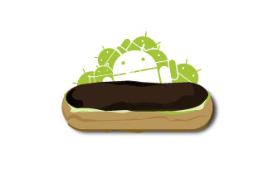
Android Cupcake 1.5
Released on April 30, 2009.
Added auto-rotation option.
Copy and Paste feature added in the web browser.
Increased speed and performance but not upto required level.
Android Donut 1.6
Released on September 15, 2009.
Voice search and Search box were added.
Faster OS boot times and fast web browsing experience.
Typing is quite slower.
Android Éclair 2.0/2.1
Released on October 26, 2009.
Bluetooth 2.1 support.
Improved typing speed on virtual keyboard, with smarter dictionary.
no Adobe flash media support.

Slide 7
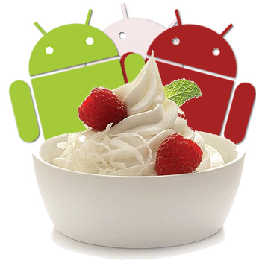


Android Froyo 2.2
Released on May 20, 2010.
Support for Adobe Flash 10.1
Improved Application launcher with better browser
No internet calling.
Android Gingerbread 2.3
Released on December 6, 2010.
Updated User Interface with high efficiency and speed
Internet calling
One touch word selection and copy/paste.
New keyboard for faster word input.
More successful version of Android than previous versions.
not supports multi-core processors.
Android Honeycomb 3.0
Released on February 22, 2011.
Support for multi-core processors
Ability to encrypt all user data.
This version of android is only available for tablets.

Slide 8


Android IceCreamSandwich(ICS) 4.0
Released on November 14, 2011.
Virtual button in the UI.
A new typeface family for the UI, Roboto.
Ability to shut down apps that are using data in the background.
Android JellyBean 4.1
Released on June 27, 2012.
Latest version of Android.
Smoother user interface.

Slide 9
LIMITATIONS:-
Making source code available to everyone inevitably invites the attention of hackers.
Android operating system uses more amount of battery as compared to normal mobile phones.
As there are so many user sometimes it becomes difficult to connect all the users.
As we call Android is world of applications we continuously need to connected with the internet which is not possible for all the users.

Slide 10
Android and the Hardware
Built-in Apps ≡ Apps created in SDK
Leverage Linux kernel to interface with hardware
Open source platform promotes development from global community
Notes:
In the Android platform, there is no difference between the built-in applications and applications created with the SDK. This means that powerful applications can be written to tap into the resources available on the device.
Android is software only.
Leveraging its Linux kernel to interface with the hardware, you can expect Android to run on many different devices from multiple cell phone manufacturers.
Android is an open source platform; missing elements can and will be provided by the global developer community. Android’s Linux kernel–based OS does not come with a sophisticated shell environment, but because the platform is open, shells can be written and installed on a device. Likewise, multimedia codecs can be supplied by third-party developers and do not need to rely on Google or anyone else to provide new functionality. That is the power of an open source platform brought to the mobile market.
Ableson, Frank; Collins, Charlie; Sen, Robi. Unlocking Android, A Developer’s Guide. Greenwich: Manning Publications Co. 2009.

Slide 11
Android Features
Reuse and replacement of components
Dalvik virtual machine
Integrated browser
Optimized graphics
Media support
GSM Telephony
Bluetooth, EDGE, 3G, and WiFi
Camera, GPS, compass, and accelerometer
Rich development environment
Notes:
Enables reuse and replacement of components
Dalvik virtual machine optimized for mobile devices
Integrated browser based on the open source WebKit engine
Optimized graphics powered by a custom 2D graphics library; 3D graphics based on the OpenGL ES 1.0 specification (hardware acceleration optional)
SQLite for structured data storage
Media support for common audio, video, and still image formats (MPEG4, H.264, MP3, AAC, AMR, JPG, PNG, GIF)
GSM Telephony (hardware dependent)
Bluetooth, EDGE, 3G, and WiFi (hardware dependent)
Camera, GPS, compass, and accelerometer (hardware dependent)
Rich development environment including a device emulator, tools for debugging, memory and performance profiling, and a plugin for the Eclipse IDE

Slide 12
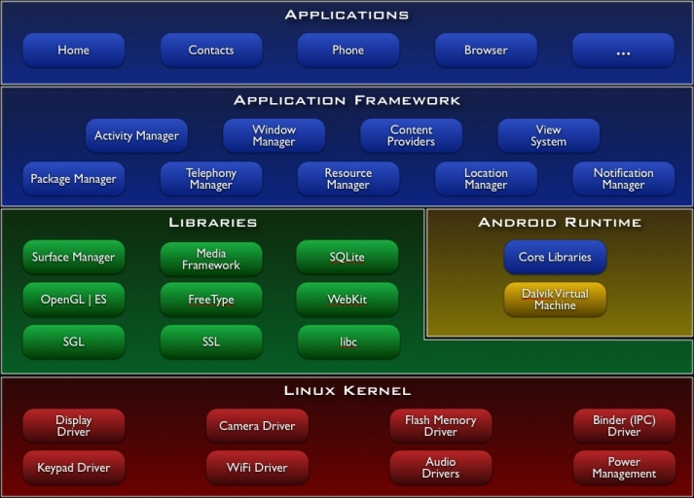
Android Architecture
Notes:
Applications
Android will ship with a set of core applications including an email client, SMS program, calendar, maps, browser, contacts, and others. All applications are written using the Java programming language.
Application Framework
By providing an open development platform, Android offers developers the ability to build extremely rich and innovative applications. Developers are free to take advantage of the device hardware, access location information, run background services, set alarms, add notifications to the status bar, and much, much more.
Developers have full access to the same framework APIs used by the core applications. The application architecture is designed to simplify the reuse of components; any application can publish its capabilities and any other application may then make use of those capabilities (subject to security constraints enforced by the framework). This same mechanism allows components to be replaced by the user.
Underlying all applications is a set of services and systems, including:
A rich and extensible set of Views that can be used to build an application, including lists, grids, text boxes, buttons, and even an embeddable web browser
Content Providers that enable applications to access data from other applications (such as Contacts), or to share their own data
A Resource Manager, providing access to non-code resources such as localized strings, graphics, and layout files
A Notification Manager that enables all applications to display custom alerts in the status bar
An Activity Manager that manages the lifecycle of applications and provides a common navigation backstack
Libraries
Android includes a set of C/C++ libraries used by various components of the Android system. These capabilities are exposed to developers through the Android application framework. Some of the core libraries are listed below:
System C library - a BSD-derived implementation of the standard C system library (libc), tuned for embedded Linux-based devices
Media Libraries - based on PacketVideo's OpenCORE; the libraries support playback and recording of many popular audio and video formats, as well as static image files, including MPEG4, H.264, MP3, AAC, AMR, JPG, and PNG
Surface Manager - manages access to the display subsystem and seamlessly composites 2D and 3D graphic layers from multiple applications
LibWebCore - a modern web browser engine which powers both the Android browser and an embeddable web view
SGL - the underlying 2D graphics engine
3D libraries - an implementation based on OpenGL ES 1.0 APIs; the libraries use either hardware 3D acceleration (where available) or the included, highly optimized 3D software rasterizer
FreeType - bitmap and vector font rendering
SQLite - a powerful and lightweight relational database engine available to all applications
Android Runtime
Android includes a set of core libraries that provides most of the functionality available in the core libraries of the Java programming language.
Every Android application runs in its own process, with its own instance of the Dalvik virtual machine. Dalvik has been written so that a device can run multiple VMs efficiently. The Dalvik VM executes files in the Dalvik Executable (.dex) format which is optimized for minimal memory footprint. The VM is register-based, and runs classes compiled by a Java language compiler that have been transformed into the .dex format by the included "dx" tool.
The Dalvik VM relies on the Linux kernel for underlying functionality such as threading and low-level memory management.
Linux Kernel
Android relies on Linux version 2.6 for core system services such as security, memory management, process management, network stack, and driver model. The kernel also acts as an abstraction layer between the hardware and the rest of the software stack.

Slide 13
Application Fundamentals
Apps are written in Java
Bundled by Android Asset Packaging Tool
Every App runs its own Linux process
Each process has it’s own Java Virtual Machine
Each App is assigned a unique Linux user ID
Apps can share the same user ID to see each other’s files
Notes:
Android applications are written in the Java programming language.
The compiled Java code — along with any data and resource files required by the application — is bundled by the Android Asset Packaging Tool into an Android package, an archive file marked by an .apk suffix. This file is the vehicle for distributing the application and installing it on mobile devices; it's the file users download to their devices. All the code in a single .apk file is considered to be one application.
In many ways, each Android application lives in its own world:
By default, every application runs in its own Linux process. Android starts the process when any of the application's code needs to be executed, and shuts down the process when it's no longer needed and system resources are required by other applications.
Each process has its own Java virtual machine (VM), so application code runs in isolation from the code of all other applications.
By default, each application is assigned a unique Linux user ID. Permissions are set so that the application's files are visible only that user, only to the application itself — although there are ways to export them to other applications as well.
It's possible to arrange for two applications to share the same user ID, in which case they will be able to see each other's files. To conserve system resources, applications with the same ID can also arrange to run in the same Linux process, sharing the same VM.

Slide 14
Application Components
Activity
Present a visual user interface for one focused endeavor the user can undertake
Example: a list of menu items users can choose from
Services
Run in the background for an indefinite period of time
Example: calculate and provide the result to activities that need it
Broadcast Receivers
Receive and react to broadcast announcements
Example: announcements that the time zone has changed
Content Providers
Store and retrieve data and make it accessible to all applications
Example: Android ships with a number of content providers for common data types (e.g., audio, video, images, personal contact information, etc.)
Intents
Hold the content of a message
Example: convey a request for an activity to present an image to the user or let the user edit some text
Notes:
Application Components
A central feature of Android is that one application can make use of elements of other applications (provided those applications permit it). For example, if your application needs to display a scrolling list of images and another application has developed a suitable scroller and made it available to others, you can call upon that scroller to do the work, rather than develop your own. Your application doesn't incorporate the code of the other application or link to it. Rather, it simply starts up that piece of the other application when the need arises.
For this to work, the system must be able to start an application process when any part of it is needed, and instantiate the Java objects for that part. Therefore, unlike applications on most other systems, Android applications don't have a single entry point for everything in the application (no main() function, for example). Rather, they have essential components that the system can instantiate and run as needed. There are four types of components:
Activities An activity presents a visual user interface for one focused endeavor the user can undertake. For example, an activity might present a list of menu items users can choose from or it might display photographs along with their captions. A text messaging application might have one activity that shows a list of contacts to send messages to, a second activity to write the message to the chosen contact, and other activities to review old messages or change settings. Though they work together to form a cohesive user interface, each activity is independent of the others. Each one is implemented as a subclass of the Activity base class. An application might consist of just one activity or, like the text messaging application just mentioned, it may contain several. What the activities are, and how many there are depends, of course, on the application and its design. Typically, one of the activities is marked as the first one that should be presented to the user when the application is launched. Moving from one activity to another is accomplished by having the current activity start the next one.
Services A service doesn't have a visual user interface, but rather runs in the background for an indefinite period of time. For example, a service might play background music as the user attends to other matters, or it might fetch data over the network or calculate something and provide the result to activities that need it. Each service extends the Service base class. A prime example is a media player playing songs from a play list. The player application would probably have one or more activities that allow the user to choose songs and start playing them.
Broadcast receivers A broadcast receiver is a component that does nothing but receive and react to broadcast announcements. Many broadcasts originate in system code — for example, announcements that the timezone has changed, that the battery is low, that a picture has been taken, or that the user changed a language preference.
Content providers A content provider makes a specific set of the application's data available to other applications. Android ships with a number of content providers for common data types (audio, video, images, personal contact information, etc.)
Intents
Activities, services, and broadcast receivers — are activated by asynchronous messages called intents. An intent is an Intent object that holds the content of the message. For activities and services, it names the action being requested and specifies the URI of the data to act on, among other things. For example, it might convey a request for an activity to present an image to the user or let the user edit some text. For broadcast receivers, the Intent object names the action being announced. For example, it might announce to interested parties that the camera button has been pressed.

Slide 15
Installation
http://developer.android.com/sdk/installing.html
Preparing your system and system requirements
Downloading and Installing the SDK
Installing ADT plug-in for Eclipse
Adding Platforms and Components
Exploring the SDK
Completing tutorials
Troubleshooting
Notes:
The installation documentation provided by Android for the SDK is excellent. If you navigate to the website shown on the slide, you will find information about…
Follow the instructions exactly, and you will creating you first Android app in no time.

Slide 16
Overview of Sensors
The Android Sensor Platform and how to use it

Slide 17
Hardware-oriented Features
Feature | Description
Camera | A class that enables your application to interact with the camera to snap a photo, acquire images for a preview screen, and modify parameters used to govern how the camera operates.
Sensor | Class representing a sensor. Use getSensorList(int) to get the list of available Sensors.
SensorManager | A class that permits access to the sensors available within the Android platform.
SensorEventListener | An interface used for receiving notifications from the SensorManager when sensor values have changed. An application implements this interface to monitor one or more sensors available in the hardware.
SensorEvent | This class represents a sensor event and holds information such as the sensor type (e.g., accelerometer, orientation, etc.), the time-stamp, accuracy and of course the sensor's data.
MediaRecorder | A class, used to record media samples, that can be useful for recording audio activity within a specific location (such as a baby nursery). Audio clippings can also be analyzed for identification purposes in an access-control or security application. For example, it could be helpful to open the door to your time-share with your voice, rather than having to meet with the realtor to get a key.
GeomagneticField | This class is used to estimated estimate magnetic field at a given point on Earth, and in particular, to compute the magnetic declination from true north.
FaceDetector | A class that permits basic recognition of a person's face as contained in a bitmap. Using this as a device lock means no more passwords to remember — biometrics capability on a cell phone.
Notes:
This table describes some of the hardware-oriented features exposed in the Android SDK.

Slide 18
Sensor and SensorManager
Sensor type (Sensor class)
Orientation, accelerometer, light, magnetic field, proximity, temperature, etc.
Sampling rate
Fastest, game, normal, user interface.
When an application requests a specific sampling rate, it is really only a hint, or suggestion, to the sensor subsystem. There is no guarantee of a particular rate being available.
Accuracy
High, low, medium, unreliable.
Notes:
The Sensor and Sensor Manager classes contains several constants, which represent different aspects of Android's sensor system, including:

Slide 19
Programming Tutorial
Simulating an Android application that accesses positioning sensors

Slide 20
Preparing for the Tutorial
Must have Eclipse IDE installed
Must have Android SDK installed
Must have knowledge of Java
Must have the external Google Maps library installed in your SDK environment. The Maps library is included with the Google APIs add-on, which you can install using the Android SDK and AVD Manager.

Slide 21
Get a Google Maps API Key
A Google Maps API key is required to integrate Google Maps into your Android application.
To apply for a key:
Locate the SDK debug certificate in the default folder of "C:\Documents and Settings\<username>\Local Settings\Application Data\Android". The filename of the debug keystore is debug.keystore.
Copy the debug.keystore file to a folder named C:\Android\.
Open the command window and navigate to C:\Program Files\Java\<JDK_version_number>\bin to locate the Keytool.exe.
Execute the following to extract the MD5 fingerprint:
keytool.exe -list -alias androiddebugkey -keystore "C:\Android\debug.keystore" -storepass android -keypass android
Copy the MD5 certificate fingerprint and navigate your web browser to: http://code.google.com/android/maps-api-signup.html.
Follow the instructions on the page to complete the application and obtain the Google Maps key.
For more information on using Google Maps in Android application development:
http://mobiforge.com/developing/story/using-google-maps-android

Slide 22
Create an Android Virtual Device (AVD)
Defines the system image and device settings used by the Emulator
To create an AVD in Eclipse:
Select Window > Android SDK and AVD Manager.
The Android SDK and AVD Manager displays.
Make sure the entry for Virtual Devices is selected and click New.
The Create new AVD window displays.
Enter a Name for the AVD.
Select Google APIs (API level 3) as the Target.
Click Create AVD.
Close the Android SDK and AVD Manager.

Slide 23
Create the Android Project
To create the project in Eclipse:
Select File > New > Project.
Select Android Project in the Android folder and click Next.
Enter GPSSimulator as the Project Name.
Select Google APIs (Platform 1.5) as the Build Target.
Enter GPSSimulator as the Application name.
Enter com.android.gpssimulator as the Package name.
Enter GPSSimulator as the Activity name.
Click Finish.
Notes:
The ADT plugin provides a New Project Wizard that you can use to quickly create a new Android project (or a project from existing code). To create a new project:
Select File > New > Project.
Select Android > Android Project, and click Next.
Select the contents for the project:
Enter a Project Name. This will be the name of the folder where your project is created.
Under Contents, select Create new project in workspace. Select your project workspace location.
Under Target, select an Android target to be used as the project's Build Target. The Build Target specifies which Android platform you'd like your application built against. Unless you know that you'll be using new APIs introduced in the latest SDK, you should select a target with the lowest platform version possible, such as Android 1.1.
Note: You can change your the Build Target for your project at any time: Right-click the project in the Package Explorer, select Properties, select Android and then check the desired Project Target.
Under Properties, fill in all necessary fields.
Enter an Application name. This is the human-readable title for your application — the name that will appear on the Android device.
Enter a Package name. This is the package namespace (following the same rules as for packages in the Java programming language) where all your source code will reside.
Select Create Activity (optional, of course, but common) and enter a name for your main Activity class.
Enter a Min SDK Version. This is an integer that indicates the minimum API Level required to properly run your application. Entering this here automatically sets the minSdkVersion attribute in the <uses-sdk> of your Android Manifest file. If you're unsure of the appropriate API Level to use, copy the API Level listed for the Build Target you selected in the Target tab.
Click Finish.

Slide 24
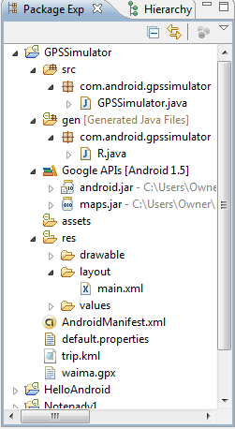
The New Android Project
Notes:
Once you complete the New Project Wizard, ADT creates the following folders and files in your new project:
src/ Includes your stub Activity Java file. All other Java files for your application go here.
<Android Version>/ (e.g., Android 1.1/) Includes the android.jar file that your application will build against. This is determined by the build target that you have chosen in the New Project Wizard.
gen/ This contains the Java files generated by ADT, such as your R.java file and interfaces created from AIDL files. A project's R.java file is an index into all the resources defined in the file. You use this class in your source code as a sort of short-hand way to refer to resources you've included in your project. This is particularly powerful with the code-completion features of IDEs like Eclipse because it lets you quickly and interactively locate the specific reference you're looking for.
assets/ This is empty. You can use it to store raw asset files.
res/ A folder for your application resources, such as drawable files, layout files, string values, etc.
The difference between "resources" and "assets" isn't much on the surface, but in general, you'll use resources to store your external content much more often than you'll use assets. The real difference is that anything placed in the resources directory will be easily accessible from your application from the R class, which is compiled by Android. Whereas, anything placed in the assets directory will maintain its raw file format. So keeping files and data in resources (res/) makes them easily accessible.
AndroidManifest.xml The Android Manifest for your project. Every application must have an AndroidManifest.xml file (with precisely that name) in its root directory. The manifest presents essential information about the application to the Android system, information the system must have before it can run any of the application's code. Among other things, the manifest does the following:
It names the Java package for the application. The package name serves as a unique identifier for the application.
It describes the components of the application — the activities, services, broadcast receivers, and content providers that the application is composed of. It names the classes that implement each of the components and publishes their capabilities (for example, which Intent messages they can handle). These declarations let the Android system know what the components are and under what conditions they can be launched.
It determines which processes will host application components.
It declares which permissions the application must have in order to access protected parts of the API and interact with other applications.
It also declares the permissions that others are required to have in order to interact with the application's components.
It lists the Instrumentation classes that provide profiling and other information as the application is running. These declarations are present in the manifest only while the application is being developed and tested; they're removed before the application is published.
It declares the minimum level of the Android API that the application requires.
It lists the libraries that the application must be linked against.
default.properties This file contains project settings, such as the build target. This files is integral to the project, as such, it should be maintained in a Source Revision Control system. It should never be edited manually — to edit project properties, right-click the project folder and select "Properties".

Slide 25
Modify the AndroidManifest.xml File
Add permissions for GPS
To modify the AndroidManifest.xml file:
Click on the res folder in the GPSSimulator project.
Double-click AndroidManifest.xml to display the GPSSimulator Manifest.
Enter the following lines before the application tag.
<uses-permission android:name=“android.permission.ACCESS_FINE_LOCATION” />
Save the changes to the file.
Notes:
To use GPS functionality in your Android application, you'll need to add the ACCESS_FINE_LOCATION permission to the AndroidManifest.xml file:
Open Listing4 file
Open AndroidManifest.xml.
Copy line into xml file.

Slide 26
Add LocationManager to get Updates
public class GPSSimulator extends Activity
{
private LocationManager lm;
private LocationListener locationListener;
// Called when the activity is first created.
@Override
public void onCreate(Bundle savedInstanceState) {
super.onCreate(savedInstanceState);
setContentView(R.layout.main);
// use the LocationManager class to obtain GPS locations
lm = (LocationManager)
getSystemService(Context.LOCATION_SERVICE);
locationListener = new MyLocationListener();
lm.requestLocationUpdates(
LocationManager.GPS_PROVIDER, 0, 0, locationListener);
}
}
Notes:
Show GPSSimulator.java
The first thing you will see when you open the GPSSimulator.java file is that an onCreate() method has already been added. The onCreate() method is called by the system when the service is first created and permits the application to perform initialization-type tasks. Once inside the onCreate() method, the setContentView() method is where we will associate the XML layout file main.
Override is an annotation type used to mark methods that override a method declaration in a superclass. Here, after the Activity, complete with necessary views, is started, the lifecycle takes over and the onCreate() method is invoked. This is one of a series of important lifecycle methods the Activity class provides. Every Activity will override onCreate(), where component initialization steps are invoked.
Android gives your applications access to the location services supported by the device through the classes in the android.location package. The central component of the location framework is the LocationManager system service, which provides an API to determine location and bearing if the underlying device (if it supports location capabilities). Using the LocationManager class, your application can obtain periodic updates of the device's geographical locations as well as fire an intent when it enters the proximity of a certain location.
Listing1.txt
In the GPSSimulator.java file, first obtain a reference to the LocationManager class using the getSystemService() method. To be notified whenever there is a change in location, you need to register for a request for changes in locations using the requestLocationUpdates() method so that your program can be notified periodically.
The requestLocationUpdates() method takes in four parameters:
provider: The name of the provider with which you register
minTime: The minimum time interval for notifications, in milliseconds.
minDistance: The minimum distance interval for notifications, in meters.
listener: An object whose onLocationChanged() method will be called for each location update.

Slide 27
Add MyLocationListener
private class MyLocationListener implements LocationListener {
@Override
public void onLocationChanged(Location loc) {
if (loc != null) {
Toast.makeText(getBaseContext(),
"Location changed : Lat: " + loc.getLatitude() +
" Lng: " + loc.getLongitude(),
Toast.LENGTH_SHORT).show();
}
}
@Override
public void onProviderDisabled(String provider) {
// TODO Auto-generated method stub
}
@Override
public void onProviderEnabled(String provider) {
// TODO Auto-generated method stub
}
@Override
public void onStatusChanged(String provider, int status, Bundle extras) {
// TODO Auto-generated method stub
}
}
Notes:
Listing 2
We also need to add the MyLocationListener class.
The MyLocationListener class implements the LocationListener abstract class. There are four methods that you need to override in this implementation:
onLocationChanged(Location location): This method is called when the location has changed. When a location changes you will display a small dialog on the screen showing the new location information: latitude and longitude. You show this dialog using the Toast class.
onProviderDisabled(String provider): This method is called when the provider is disabled by the user.
onProviderEnabled(String provider): This method is called when the provider is enabled by the user.
onStatusChanged(String provider, int status, Bundle extras): This method is called when the provider status changes.
In this example, you're more interested in what happens when a location changes, so you'll write some code in the onLocationChanged() method (Listing 2).

Slide 28
Test the GPSSimulator
To test in Eclipse:
Switch to DDMS view.
Find the Location Controls in the Emulator Control tab.
Click the GPX tab and click Load GPX.
Locate and select the GPX file.
Click Play to begin sending coordinates to the Emulator.
Notes:
To test the application, press F11 in Eclipse to debug the application on the Android emulator. While at the time of writing this article, you may not have a real Android device to test, there are a number of ways to test GPS functionality on your Android application.
The DDMS tool in the Android plug-in for Eclipse allows you to test GPS functionality very easily. In Eclipse, switch to the DDMS view and locate the Location Controls section in the Emulator Control tab (see Figure 1).
There are three separate tabs in the Location Controls section. First, you can manually send in the coordinates by specifying the latitude and longitude. When the GPS data is received on the Android emulator, the application will display the latitude and longitude obtained (see Figure 2).
Another way to send in geographical locations is to use a .GPX file. GPX (GPS Exchange Format) is a light-weight XML data format for interchange of GPS data. You can download GPS samples here. Once a .GPX file is downloaded, click the Load GPX… button to load the .GPX file (see Figure 3).
You can click the Play button to send a series of coordinates to the Android emulator at regular time intervals. The Android Eclipse plug-in also supports KML (Keyhole Markup Language) files. You can download a sample .KML file here. Like the .GPX file, you can also send a series of coordinates to the Android emulator by clicking on the Play button (see Figure 4).

Slide 29
Add ability to use Google Maps
Update the Manifest with two lines.
<?xml version="1.0" encoding="utf-8"?>
<manifest xmlns:android="http://schemas.android.com/apk/res/android"
package="com.android.GPSSimulator">
<uses-permission
android:name="android.permission.INTERNET" />
<uses-permission
android:name="android.permission.ACCESS_FINE_LOCATION" />
<application android:icon="@drawable/icon"
android:label="@string/app_name">
<uses-library android:name="com.google.android.maps" />
<activity android:name=".GPS" android:label="@string/app_name">
<intent-filter>
<action android:name="android.intent.action.MAIN" />
<category android:name="android.intent.category.LAUNCHER" />
</intent-filter>
</activity>
</application>
</manifest>
Notes:
Simply displaying the latitude and longitude when a location has changed is not very interesting. A much more interesting thing to do would be to couple the data together with the Google Maps application.
For Google Maps to work, you need to add the ACCESS_FINE_LOCATION permission (which we added earlier) and then use the Google Maps library . We will also need to add a permission to access the Internet.
Open listing 3 and add Internet permission above ACCESS_FINE_LOCATION and Google Maps code in application but before activity.

Slide 30
Add MapView to main.xml
<?xml version="1.0" encoding="utf-8"?>
<LinearLayout xmlns:android="http://schemas.android.com/apk/res/android"
android:orientation="vertical"
android:layout_width="fill_parent"
android:layout_height="fill_parent"
>
<com.google.android.maps.MapView
android:id="@+id/mapview1"
android:layout_width="fill_parent"
android:layout_height="fill_parent"
android:enabled="true"
android:clickable="true"
android:apiKey=“Your API Key Here" />
</LinearLayout>
Notes:
In main.xml, replace the <TextView> element with the <MapView> element:
Main.xml is where you define a layout for application display.
Open Listing 4 and replace TextView code with MapView code before </LinearLayout>

Slide 31
Modify GPSSimulator to use Google Maps
public class GPSSimulator extends MapActivity {
private LocationManager lm;
private LocationListener locationListener;
private MapView mapView;
private MapController mc;
// Called when the activity is first created.
@Override
public void onCreate(Bundle savedInstanceState) {
super.onCreate(savedInstanceState);
setContentView(R.layout.main);
// use the LocationManager class to obtain GPS locations
lm = (LocationManager)
getSystemService(Context.LOCATION_SERVICE);
locationListener = new MyLocationListener();
lm.requestLocationUpdates(
LocationManager.GPS_PROVIDER, 0, 0, locationListener);
mapView = (MapView) findViewById(R.id.mapview1);
mc = mapView.getController();
}
@Override
protected boolean isRouteDisplayed() {
return false;
}
private class MyLocationListener implements LocationListener {
@Override
public void onLocationChanged(Location loc) {
if (loc != null) {
Toast.makeText(getBaseContext(),
"Location changed : Lat: " + loc.getLatitude() +
" Lng: " + loc.getLongitude(),
Toast.LENGTH_SHORT).show();
GeoPoint p = new GeoPoint(
(int) (loc.getLatitude() * 1E6),
(int) (loc.getLongitude() * 1E6));
mc.animateTo(p);
mc.setZoom(16);
mapView.invalidate();
}
}
@Override
public void onProviderDisabled(String provider) {
}
@Override
public void onProviderEnabled(String provider) {
}
@Override
public void onStatusChanged(String provider, int status, Bundle extras) {
}
}
}
Notes:
Finally, modify the GPS.java file to incorporate Google Maps (see Listing 5).
We need to change the GPSSimulator class to extend MapActivity, which is a special subclass of Activity.
We create a new MapView object as well as and MapController object.
The key class in the Maps package is com.google.android.maps.MapView, a subclass of ViewGroup. A MapView displays a map with data obtained from the Google Maps service. When the MapView has focus, it will capture keypresses and touch gestures to pan and zoom the map automatically, including handling network requests for additional maps tiles. It also provides all of the UI elements necessary for users to control the map. Your application can also use MapView class methods to control the MapView programmatically and draw a number of Overlay types on top of the map.
In general, the MapView class provides a wrapper around the Google Maps API that lets your application manipulate Google Maps data through class methods, and it lets you work with Maps data as you would other types of Views.
MapController is a utility class to manage panning and zooming of a map.
We call the MapView method getController(), which returns the MapController for this map.
The isRouteDisplayed() method is required, so add it inside the class as well. This method is required for some accounting from the Maps service to see if you're currently displaying any route information. In this case, you're not, so return false.
In the MyLocationListener class we have to add a GeoPoint object as well as support for the Google Maps.
A GeoPoint object represents a geographical location. GeoPoint defines the map coordinates and are specified in microdegrees. For this tutorial, we use the getLatitude() and getLongitude() methods to retrieve the coordinates from the input. Then, we do the calculation to convert to microdegrees (degrees * 1e6) and save the result to a point p.
We then call the MapController method animateTo() to start animating the map towards the given point p. And, call setZoom() to configure the zoom level of the map.
Finally, we call the invalidate() method to remove the old map data if there is new data to load.

Slide 32
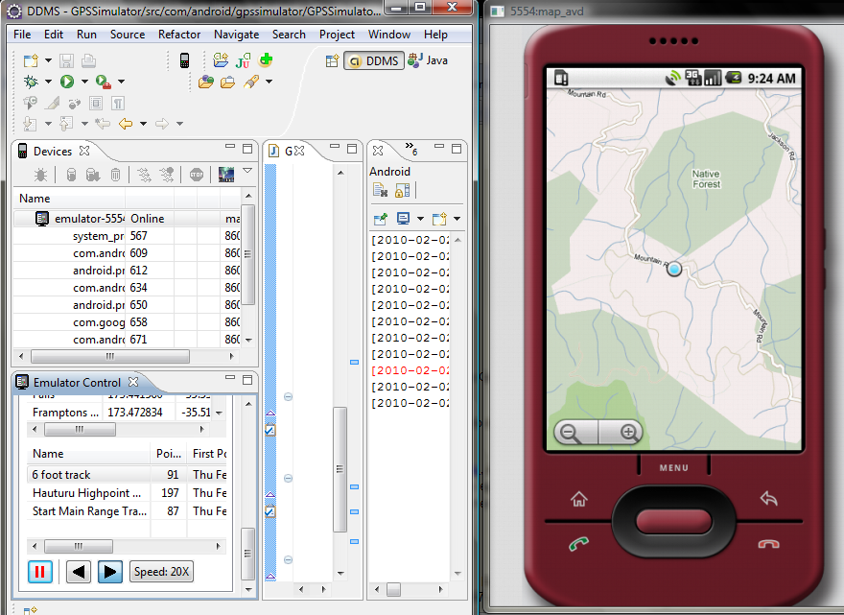
View the Location on the Map
Notes:
In the above, when a location changes, the latitude and longitude is sent to the Google Maps application, which then displays the map of the current location.

Slide 33
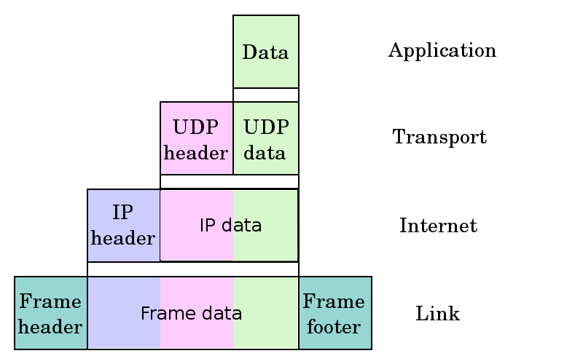
Internet Layers
The Internet, is based on a layered architecture called the TCP/IP stack.
Link Layer
Protocols: ARP and RARP
Internet Layer
Protocols: IP, ping, etc.
Transport
Protocols: TCP and UDP
Application Layer
Protocols: HTTP, FTP, DNS, etc.

Slide 34
Client-Server Communication
A server machine is identified on the Internet by some IP address
Daemons are the processes running in the background which are listening all the time for connection requests from clients on a particular port number.
Once a connection request comes into the server on a given port, the corresponding daemon can choose to accept it, and if so, a connection is established.
Then the application layer protocol is typically used for the client to get or send data to the server.

Slide 35
Programming Tutorial 2
Accessing a website from the Android Emulator

Slide 36
Required Packages
Package | Description
org.apache.* | Represents a number of packages that provide fine control and functions for HTTP communications. You might recognize Apache as the popular open source Web server.
android.net | Contains additional network access sockets beyond the core java.net.* classes. This package includes the URI class, which is used frequently in Android application development beyond traditional networking.
android.net.http | Contains classes for manipulating SSL certificates.
android.net.wifi | Contains classes for managing all aspects of WiFi (802.11 wireless Ethernet) on the Android platform. Not all devices are equipped with WiFi capability, particularly as Android makes headway in the "flip-phone" strata of cell phones from manufacturers like Motorola and LG.
android.telephony | Contains classes required for managing and sending SMS (text) messages. Over time, an additional package will likely be introduced to provide similar functions on non-GSM networks, such as CDMA, or something like android.t lephony.cdma.

Slide 37
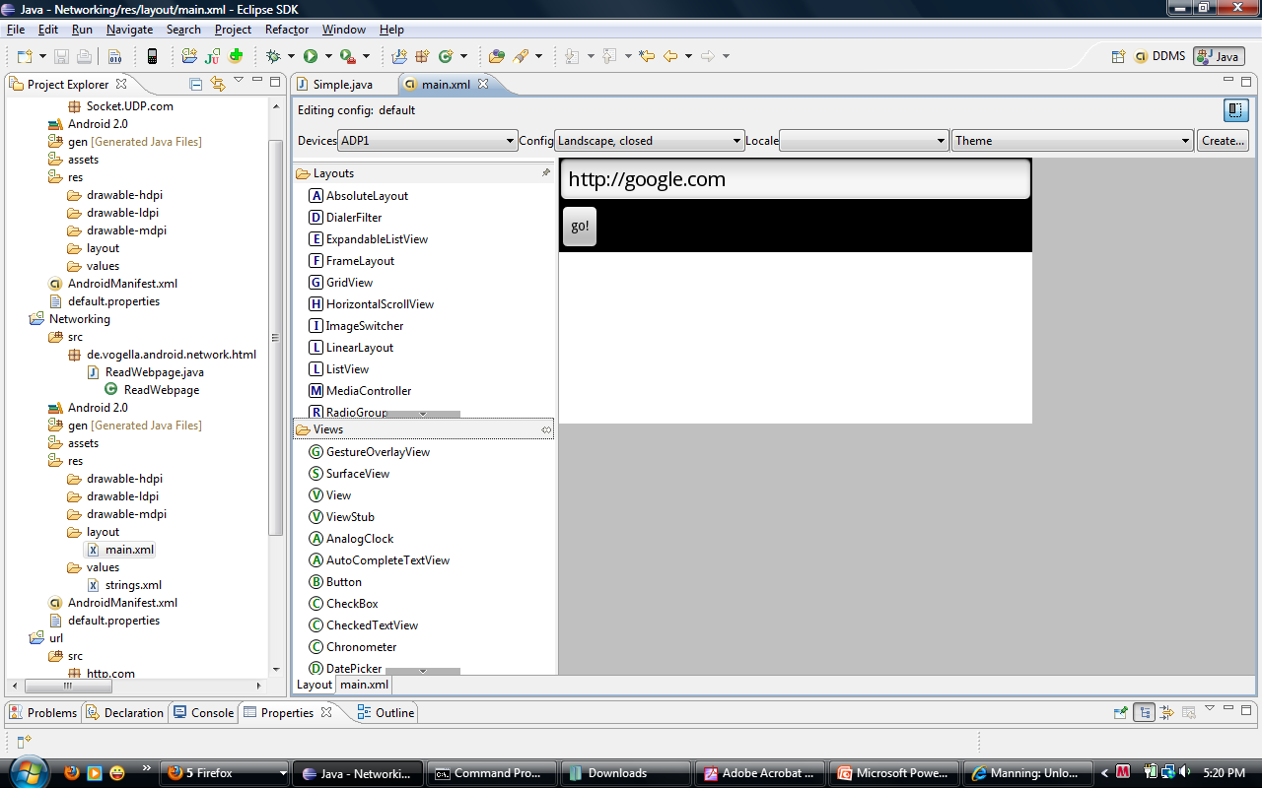
Layout

Slide 38
Link Activity and View
View object may have an integer ID associated with it
android:id="@+id/my_button“
To get the reference of the view object in activity
Button myButton = (Button)findViewById(R.id.my_button);

Slide 39
Adding Event to View Object
View.OnClickListener()
Interface definition for a callback to be invoked when a view is clicked.
onClick(View v)
Called when a view has been clicked. Inside this function you can specify what actions to perform on a click.

Slide 40
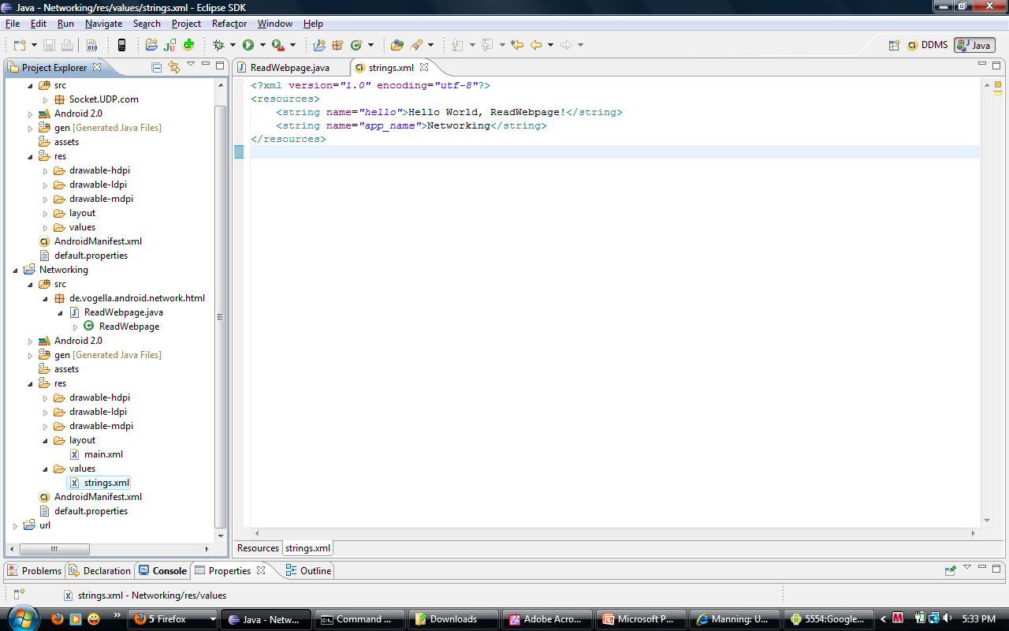
Strings.xml

Slide 41
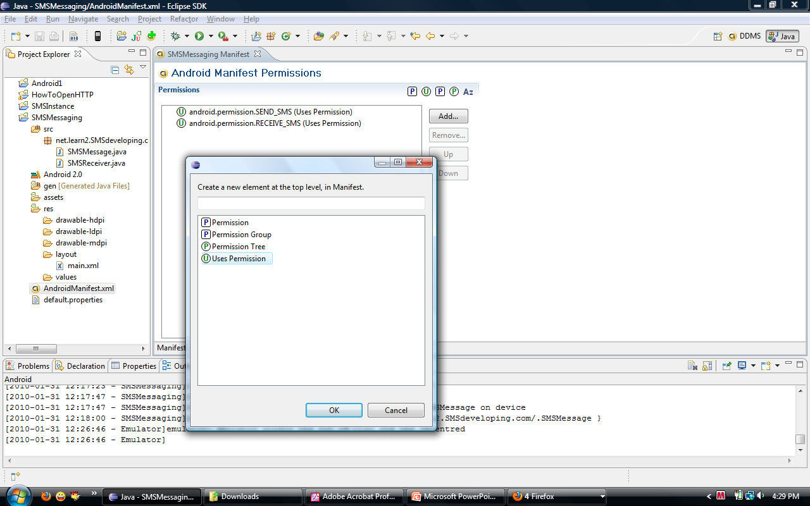
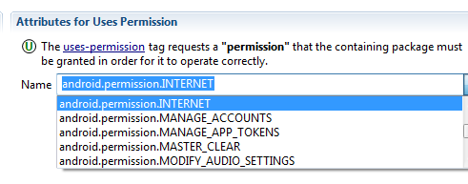
AndroidManifest.xml

Slide 42
Network Settings
If you are using the emulator then there are limitations. Each instance of the emulator runs behind a virtual router/firewall service that isolates it from your development machine's network interfaces and settings and from the internet.
Communication with the emulated device may be blocked by a firewall program running on your machine.
Reference

Slide 43
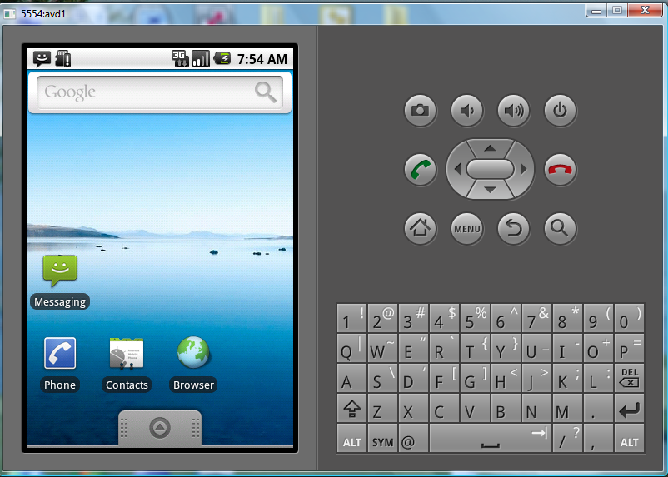
Behind Proxy Server

Slide 44
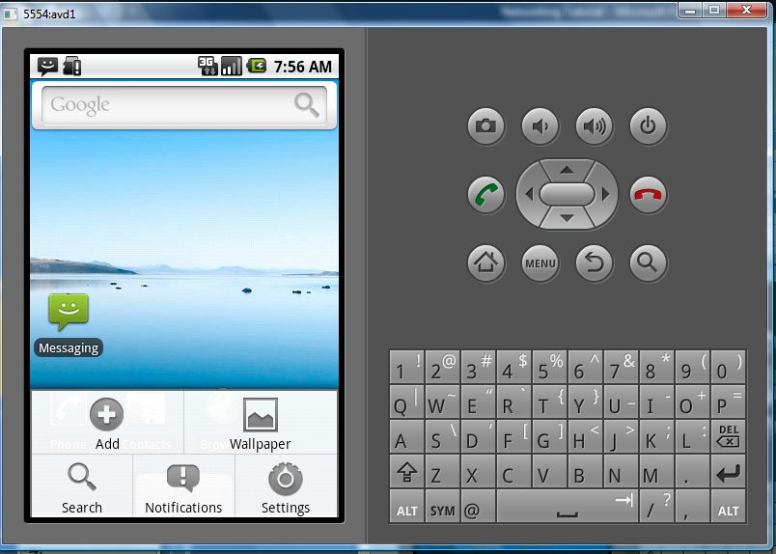
Behind Proxy Server

Slide 45
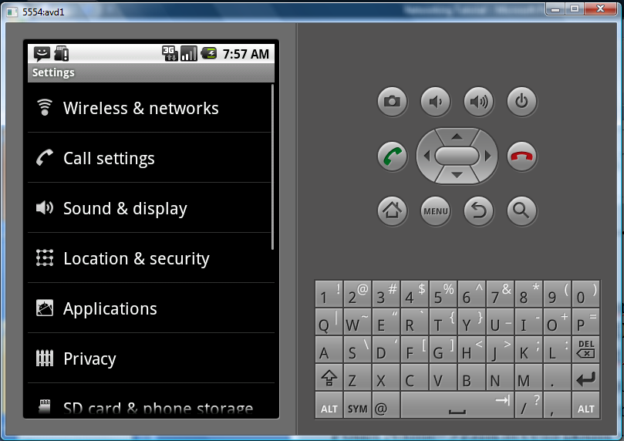
Behind Proxy Server

Slide 46
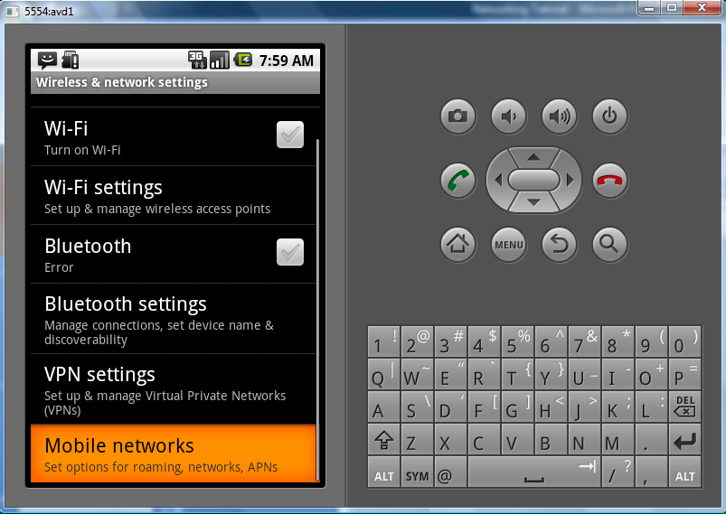
Behind Proxy Server

Slide 47
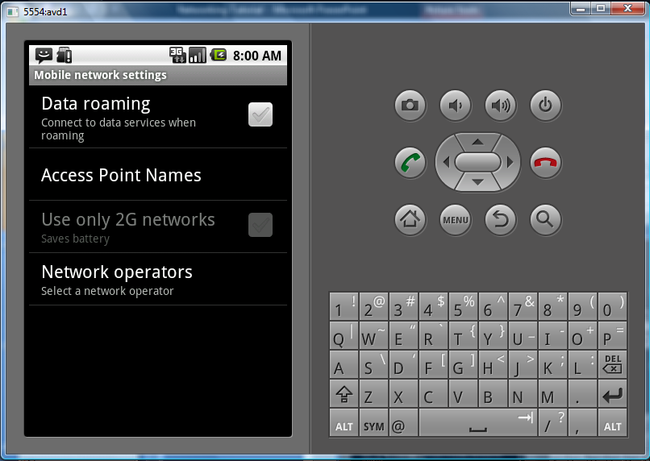
Behind Proxy Server

Slide 48
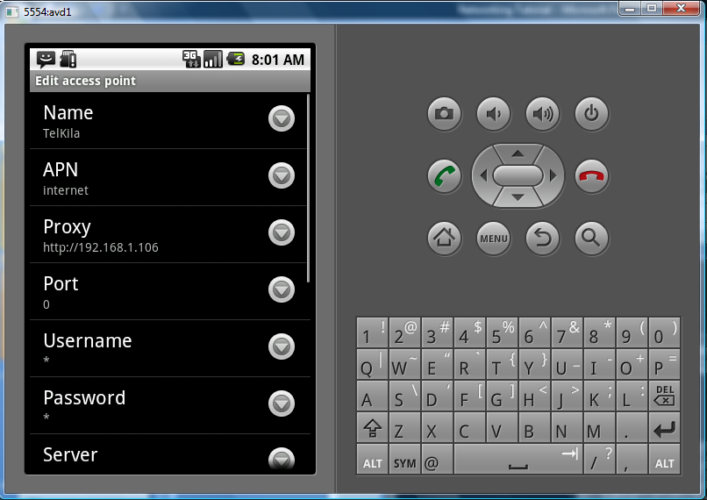
Behind Proxy Server

Slide 49
App to Download jpg file
Step1 Add permissions to AndroidManifest.xml
<uses-permission android:name="android.permission.INTERNET" />
Step 2 Import files
import java.io.IOException;
import java.io.InputStream;
import java.io.InputStreamReader;
import java.net.HttpURLConnection;
import java.net.URL;
import java.net.URLConnection;
import android.app.Activity;
import android.graphics.Bitmap;
import android.graphics.BitmapFactory;
import android.os.Bundle;
import android.widget.ImageView;
import android.widget.TextView;
import android.widget.Toast;

Slide 50
App to Download jpg file
Step 3 Writing OpenHttpConnection()
To open a connection to a HTTP server using OpenHttpConnection()
We first create an instance of the URL class and initialize it with the URL of the server
When the connection is established, you pass this connection to an URLConnection object. To check if the connection established is using a HTTP protocol.
The URLConnection object is then cast into an HttpURLConnection object and you set the various properties of the HTTP connection.
Next, you connect to the HTTP server and get a response from the server. If the response code is HTTP_OK, you then get the InputStream object from the connection so that you can begin to read incoming data from the server
The function then returns the InputStream object obtained.

Slide 51
App to Download jpg file
public class HttpDownload extends Activity {
/** Called when the activity is first created.*/
@Override
public void onCreate(Bundle savedInstanceState) {
super.onCreate(savedInstanceState);
setContentView(R.layout.main);
}
private InputStream OpenHttpConnection(String urlString) throws IOException {
InputStream in = null;
int response = -1;
URL url = new URL(urlString);
URLConnection conn = url.openConnection();
if (!(conn instanceof HttpURLConnection))
throw new IOException("Not an HTTP connection");
try{
HttpURLConnection httpConn = (HttpURLConnection) conn;
httpConn.setAllowUserInteraction(false);
httpConn.setInstanceFollowRedirects(true);
httpConn.setRequestMethod("GET");
httpConn.connect();
response = httpConn.getResponseCode();
if (response == HttpURLConnection.HTTP_OK) {
in = httpConn.getInputStream();
}
} catch (Exception ex) {
throw new IOException("Error connecting");
}
return in;
}
}

Slide 52
App to Download jpg file
Step 4 Modify the Main.xml code
<?xml version="1.0" encoding="utf-8"?>
<LinearLayout xmlns:android="http://schemas.android.com/apk/res/android"
android:orientation="vertical"
android:layout_width="fill_parent"
android:layout_height="fill_parent"
>
<ImageView
android:id="@+id/img"
android:layout_width="wrap_content"
android:layout_height="wrap_content"
android:layout_gravity="center"
/>
<TextView
android:id="@+id/text"
android:textStyle="bold"
android:layout_width="wrap_content"
android:layout_height="wrap_content"
/>
</LinearLayout>

Slide 53
App to Download jpg file
Step 5 writing DownloadImage()
The DownloadImage() function takes in a string containing the URL of the image to download.
It then calls the OpenHttpConnection() function to obtain an InputStream object for reading the image data.
The InputStream object is sent to the decodeStream() method of the BitmapFactory class.
The decodeStream() method decodes an InputStream object into a bitmap.
The decoded bitmap is then returned by the DownloadImage() function.
private Bitmap DownloadImage(String URL) {
Bitmap bitmap = null;
InputStream in = null;
try {
in = OpenHttpConnection(URL);
bitmap = BitmapFactory.decodeStream(in);
in.close();
} catch (IOException e1) {
e1.printStackTrace();
}
return bitmap;
}

Slide 54
Step 6 Test the DownloadImage() function, modify the onCreate() event as follows
@Override
public void onCreate(Bundle savedInstanceState) {
super.onCreate(savedInstanceState);
setContentView(R.layout.main);
Bitmap bitmap = DownloadImage(
"http://www.streetcar.org/mim/cable/images/cable-01.jpg");
img = (ImageView) findViewById(R.id.img);
img.setImageBitmap(bitmap);
}

Slide 55
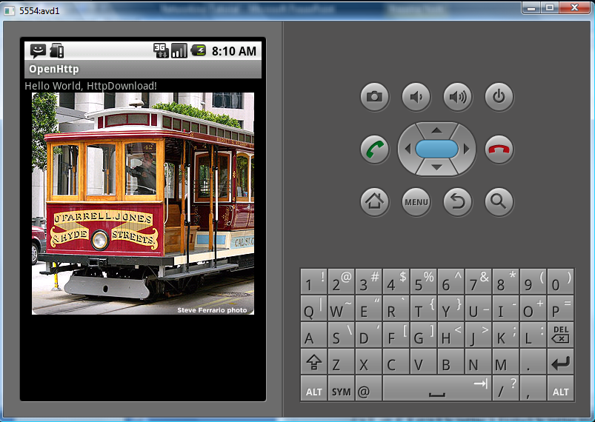
App to Download jpg file
Step 7:Output

Slide 56
Programming Tutorial 3
Transmitting SMS messages across the network

Slide 57
Intent and IntentFilter
Intents request for an action to be performed and supports interaction among the Android components.
For an activity it conveys a request to present an image to the user
For broadcast receivers, the Intent object names the action being announced.
Intent Filter Registers Activities, Services and Broadcast Receivers(as being capable of performing an action on a set of data).

Slide 58
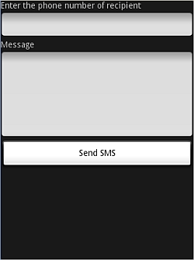
SMS Sending
STEP 1
In the AndroidManifest.xml file, add the two permissions - SEND_SMS and RECEIVE_SMS.
STEP 2
In the main.xml, add Text view to display "Enter the phone number of recipient“ and "Message"
EditText with id txtPhoneNo and txtMessage
Add the button ID "Send SMS“

Slide 59
SMS Sending
Step 3 Import Classes and Interfaces
import android.app.Activity;
import android.app.PendingIntent;
import android.content.Intent;
import android.os.Bundle;
import android.telephony.SmsManager;
import android.view.View;
import android.widget.Button;
import android.widget.EditText;
import android.widget.Toast;

Slide 60
SMS Sending
Step 4 Write the SMS class
public class SMS extends Activity {
Button btnSendSMS;
EditText txtPhoneNo;
EditText txtMessage;
/** Called when the activity is first created. */
@Override
public void onCreate(Bundle savedInstanceState) {
super.onCreate(savedInstanceState);
setContentView(R.layout.main);
btnSendSMS = (Button) findViewById(R.id.btnSendSMS);
txtPhoneNo = (EditText) findViewById(R.id.txtPhoneNo);
txtMessage = (EditText) findViewById(R.id.txtMessage);
btnSendSMS.setOnClickListener(new View.OnClickListener() {
public void onClick(View v) {
String phoneNo = txtPhoneNo.getText().toString();
String message = txtMessage.getText().toString();
if (phoneNo.length()>0 && message.length()>0)
sendSMS(phoneNo, message);
else
Toast.makeText(getBaseContext(),
"Please enter both phone number and message.",
Toast.LENGTH_SHORT).show();
}
});
}
}
Input from the user (i.e., the phone no, text message and sendSMS is implemented).

Slide 61
SMS Sending
Step 5
To send an SMS message, you use the SmsManager class. And to instantiate this class call getDefault() static method.
The sendTextMessage() method sends the SMS message with a PendingIntent.
The PendingIntent object is used to identify a target to invoke at a later time.
private void sendSMS(String phoneNumber, String message) {
PendingIntent pi = PendingIntent.getActivity(this, 0,
new Intent(this, SMS.class), 0);
SmsManager sms = SmsManager.getDefault();
sms.sendTextMessage(phoneNumber, null, message, pi, null);
}

Slide 62
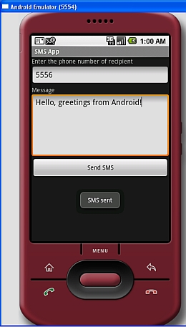
SMS Sending

Slide 63
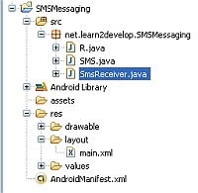
Receiving SMS
Step 1

Slide 64
Receiving SMS
Step 2
In the AndroidManifest.xml file add the <receiver> element so that incoming SMS messages can be intercepted by the SmsReceiver class.
<receiver android:name=".SmsReceiver">
<intent-filter>
<action android:name=
"android.provider.Telephony.SMS_RECEIVED" />
</intent-filter>
</receiver>

Slide 65
Receiving SMS
Step 3
import android.content.BroadcastReceiver;
import android.content.Context;
import android.content.Intent;
import android.telephony.SmsMessage;
import android.widget.Toast;

Slide 66
Receiving SMS
Step 4
public class SmsReceiver extends BroadcastReceiver {
@Override
public void onReceive(Context context, Intent intent) {
//---get the SMS message passed in---
Bundle bundle = intent.getExtras();
SmsMessage[] msgs = null;
String str = "";
if (bundle != null){
//---retrieve the SMS message received---
Object[] pdus = (Object[]) bundle.get("pdus");
msgs = new SmsMessage[pdus.length];
for (int i=0; i<msgs.length; i++) {
msgs[i] = SmsMessage.createFromPdu((byte[])pdus[i]);
str += "SMS from " + msgs[i].getOriginatingAddress();
str += " :";
str += msgs[i].getMessageBody().toString();
str += "\n";
}
//---display the new SMS message---
Toast.makeText(context, str, Toast.LENGTH_SHORT).show();
}
}
}
In the SmsReceiver class, extend the BroadcastReceiver class and override the onReceive() method. The message is attached to the Intent
The messages are stored in a object array PDU format. To extract each message, you use the static createFromPdu() method from the SmsMessage class. The SMS message is then displayed using the Toast class

Slide 67
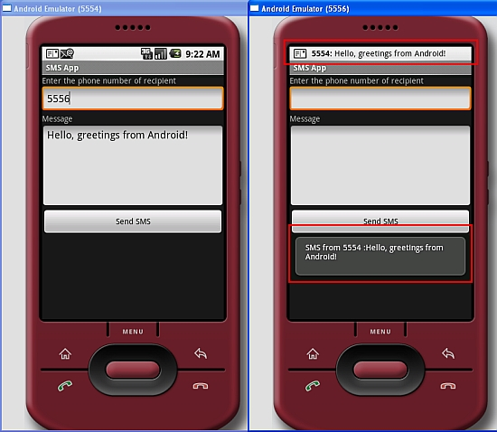
Receiving SMS

Slide 68
Resources
Ableson, Frank. “Tapping into Android’s sensors.” www.ibm.com. January 30, 2010. http://www.ibm.com/developerworks/opensource/library/os-android-sensor/index.html
Ableson, Frank; Collins, Charlie; Sen, Robi. Unlocking Android, A Developer’s Guide. Greenwich: Manning Publications Co. 2009.
Android Development Guide. January 30, 2010. http://developer.android.com/guide/index.html
Lee, Wei-Meng. “Using Google Maps in Android.” mobiforge.com. January 30, 2010. http://mobiforge.com/developing/story/using-google-maps-android
Lee, Wei-Meng. “You Are Here: Using GPS and Google Maps in Android.” www.devx.com. January 30, 2010. http://www.devx.com/wireless/Article/39239/1954
Lee, Wei-Meng “SMS Messaging in Android” mobiforge.com. January 30, 2010
http://mobiforge.com/developing/story/sms-messaging-android
Lee, Wei-Meng “Connecting to the Web: I/O Programming in Android” November 5, 2008 Android”http://www.devx.com/wireless/Article/39810
Open Handset Alliance, http://www.openhandsetalliance.com/
Patterson, Don. “Android Development Guide.” getsatisfaction.com. January 30, 2010. http://getsatisfaction.com/luci/topics/android_development_guide
www.androidcompetencycenter.com. January 30, 2010. http://www.androidcompetencycenter.com/2009/06/accessing-device-sensors
Xianhua Shu; Zhenjun Du; Rong Chen, "Research on Mobile Location Service Design Based on Android," Wireless Communications, Networking and Mobile Computing, 2009. WiCom '09. 5th International Conference on , vol., no., pp.1-4, 24-26 Sept. 2009 http://ieeexplore.ieee.org/stamp/stamp.jsp?arnumber=5302615&isnumber=5300799

Slide 69
Thank You Any Queries?

