Slide 1
Images for Kactus context helps
March 2013
Created by Erno Salminen

Slide 2
Purpose
Images orientate users better than text
They provide simplified overlook what is the main idea in each editor

Slide 3
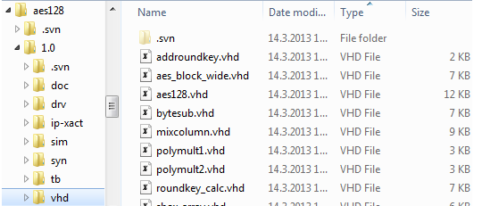
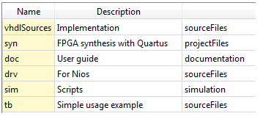
Filesets

Slide 4

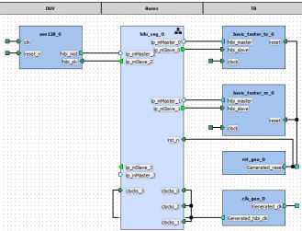
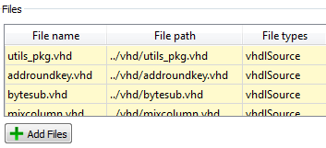
Views
component AccelA
Fileset
Design
View V0
(non-hier)
Fileset ref.
View V1 (hier)
Hier. ref.

Slide 5

SW Views
component GizmoCpu
SW View SV0
SW Design
Hier. ref.

Slide 6
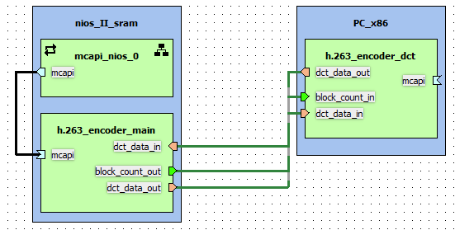
SystemViews
component CoolProduct
System Design
System View SyV0
Hier. ref.

Slide 7
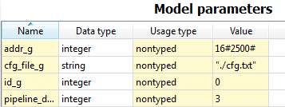
Generic editor
library ieee;
use ieee.std_logic_1164.all;
entity bar is
generic (
id_g : integer;
addr_g : integer;
cfg_file_g : string := "";
pipeline_depth_g : integer;
. . .
);
port ( . . .
sad

Slide 8
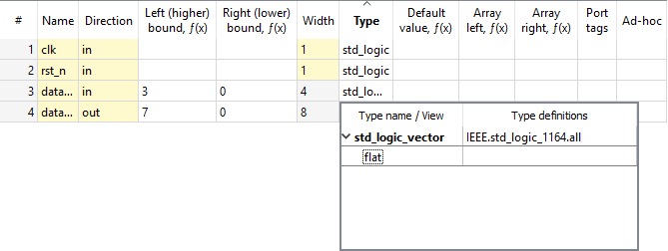
Ports editor
library ieee;
use ieee.std_logic_1164.all;
entity foo is
port (
clk : in std_logic;
rst_n : in std_logic;
data_in : in std_logic_vector (3 downto 0);
data_out : out std_logic_vector (7 downto 0)
);
end foo;
Relation between code and Kactus should be obvious

Slide 9
Memory map
component AccelA
memory map MM0
r0
slave RegsIF
r1
r2
memory map MM1
mem
a

Slide 10
Address space
component CPU0
component NetN
component Acc0
addr space AS0
memmap
seg0
seg1
master MainIF
component Acc1
memmap
a

Slide 11
Subspace map
component OpaqueBridge
slave accessIF
memory map MM0
ab0
ssm0
Address space
AS0
Master ref
master outIF
seg0
seg1

Slide 12
CPUs
component DualCoreSoC
component DualCoreSoC
cpuA
Address space AS0
…
cpuA
Memory map MM0
Subspace map SSM0
…
cpuB
Address space AS1
Local mem map
cpuB
Memory map MM1
a

Slide 13
Relation between bus interface and ports
component Sender
component Sender
master bus interface MBIF
port data_out
port req_out
port ack_in
initiator bus interface IBIF
port data_out
port req_out
port ack_in
port maps
=
port maps
=
component Sender
component Interconnect
component Receiver
component Sender
component Interconnect
component Receiver
MIF
MSIF
IIF
MTIF
MMIF
SIF
MIIF
TIF

Slide 14
Indirect interfaces
component Accelerator
component Bridge
slave accessIF
memory map MM0
slave accessIF
memory map MM0
r0
r0
r1
r1
data address
data address
Indirect
interface II0
memory map MM1
Indirect
interface II0
master outIF
#(addr)
r6: (data)
transparent bridge
r7
…

Slide 15
Other clock driver
clockPeriod = 10 ns
component Foo
clockPulseDuration = 5 ns
port ClkIn
clk0
clk_gen.vhd
clockPeriod = 10 ns
clk0
clk1
clockPulseDuration = 4 ns
*.vhd
clk1
clockPulseOffset = 1 ns

Slide 16


COM interfaces

Slide 17


API interfaces

