Slide 1
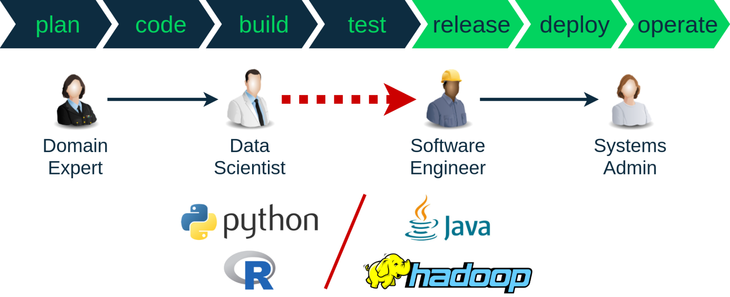
OFFICIAL: Sensitive
Ineffective Data Science Pipeline
Difficult and costly to put data science (models) to use in scalable systems
Limited feedback mechanisms for detection problems and updating models
High risk of failure, mistrust in ML/analytics
OFFICIAL: Sensitive

Slide 2

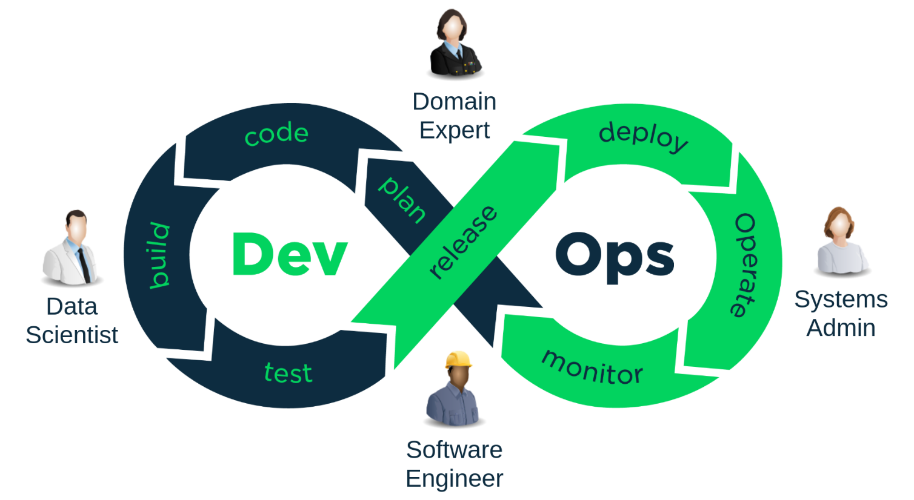

OFFICIAL: Sensitive
Seamless pull-through of data science (models) in scalable systems
Continuous feedback mechanisms for detection problems and updating models
Enabling teamwork to support ML models in production settings
OFFICIAL: Sensitive

Slide 3
OFFICIAL: Sensitive
PRESENTATION
TITLE GOES HERE
Presented by Name
1 July 2018
OFFICIAL: Sensitive

Slide 4
OFFICIAL: Sensitive
SECTION TITLE GOES HERE
Section sub-heading
OFFICIAL: Sensitive

Slide 5
Slide title goes here
Heading level 2
Body copy
Bullet level 1
Bullet level 2
Bullet level 2
Bullet level 2

