Slide 1

AI Practitioner
“One of way of learning AI”

Slide 2

Road Map
Self learning
Introduction
Data Analysis
  Visualization
  Data Manipulation (Wrangling)
Machine Learning
  A project walkthrough
Deep Learning
  A project walkthrough
CHESS & AI

Slide 3
Self Learning

Slide 4
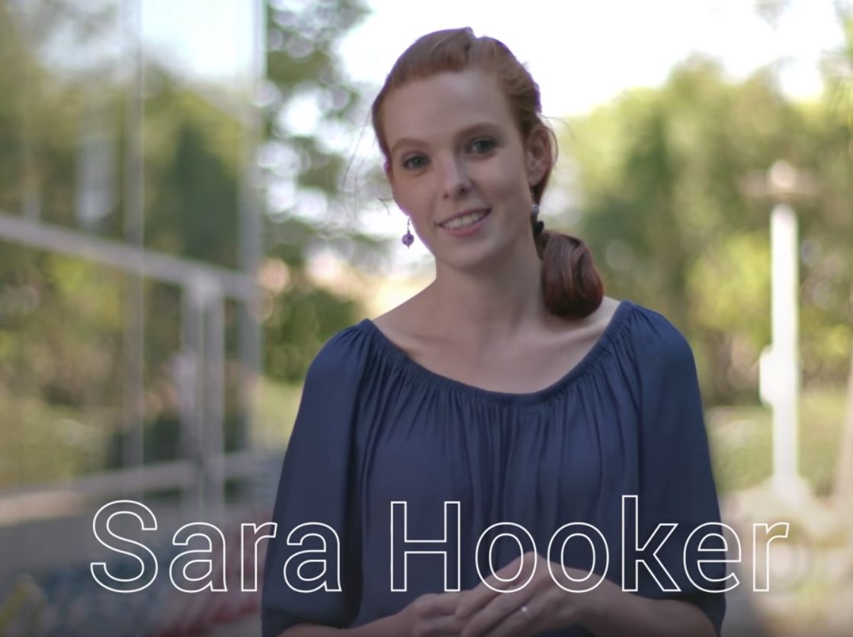
Her Story
Self Learning
Grew Up in Africa
  Mozambique, Lesotho, Swaziland, Liberia and SA
Studied Arts & Economics in Minnesota
Prior to PhD joined Silicon Valley
Volunteered as a “Data Analyst”
Joined “Udemy” as a “Data Analyst”
  Developed a Spam detection
  Developed interests to learn Python (end to end development)
  Woke up 4 AM every day to start coding in Python before her full time job
“Delta”
  Smartphones to educate kids, Illegal Deforestation (4 years) (Immediate results ; false promise)

Slide 5
hard truth is that effort alone rarely fully explains someone’s achievements. Many people believed in me along the way, pushed me out of my comfort zone, and gave me the opportunity to work on high-impact, non-trivial problems that showcased my ability

Slide 6
Get Help | Self-Branding | Opportunities
Self Study
Get Help
Online Courses
Coursera, fastai
Stanford cs231n (CV) (2016)
Books/Paper
ArXiv Sanity Preserver
Reddit
GitHub/Twitter
Networking
COE guest lectures
Self Brand
Blogging (Towards Data Science)
Online Competitions / Hackathons
Tech talks / meetups
Opportunities
Study Programs / Summer schools
Google AI Residency Program
Open AI, Uber, Shell, Microsoft
Idea Pitching
EF
Notes:
talk about university courses
Stanford, MIT,
Open Kaggle,
Open Google AI,

Slide 7
Introduction

Slide 8
Evolution of AI
& the journey continues..!
Introduction
Data Analysis
Machine Learning
Deep Learning
Small data sets
Structured / Semi structured data
Manual feature engineering
Low computational power
Structured/ Semi-structured and Unstructured (text)
Manual & Auto feature engineering
Low/High computational power
Structured/ Semi-structured and Unstructured data
Images, Vidoes, Audio, Signal, Space
High Computational power

Slide 9
Programming, Infrastructure ++
Introduction
Languages
  Python (Python 3.6+)
  R
  C, C++
Infrastructure
  CPU (laptop)
  GPU (powerful laptop)
  Cloud (AWS, Paperspace)
Jupyter Notebook
  Thought process (text, images, video, audio, animations ++)
  Reproduce results easily (research papers)
Anaconda GUI

Slide 10
Data Analysis
Python

Slide 11
Python Data Analysis
to be added

Slide 12
Machine Learning

Slide 13
ML Algorithms
Machine Learning
Regression and Classification
Decision Tree
Random Forest
XG Boosting
Support Vector Machine
KNN

Slide 14
Scikit Learn (a ML Library)
Machine Learning
Scikit Learn
Decision Tree
Random Forest
XG Boosting
Support Vector Machine
KNN

Slide 15
Project Workflow (end-to-end)
Machine Learning
Regression and Classification
Decision Tree
Random Forest
XG Boosting
Support Vector Machine
KNN

Slide 16
MACHINE LEARNING
a project walk through

Slide 17
Deep Learning Learning

Slide 18
Neural Networks
Deep Learning
Artificial Ne
Decision Tree
Random Forest
XG Boosting
Support Vector Machine
KNN

Slide 19
DL
Projects
Regression and Classification
Decision Tree
Random Forest
XG Boosting
Support Vector Machine
KNN

Slide 20
DEEP LEARNING
a project walk through

Slide 21
Bringing value to CHESS & NTU
Voice assisted tools
Up-coding (ICD Classification)
BNL Basel II (mitigating operational risk)
Network analysis (geometric deep learning)
AI enabled games
Document classification (healthcare, financial invoices)
  extracts meaning from invoices
Customer satisfaction (looking at walking customers)
Early customer lifetime value (CLV prediction)
Voice difficulties

Slide 22
Takeaways!
Voice assisted tools
Up-coding (ICD Classification)
BNL Basel II (mitigating operational risk)
Network analysis (geometric deep learning)
AI enabled games
Document classification (healthcare, financial invoices)
  extracts meaning from invoices
Customer satisfaction (looking at walking customers)
Early customer lifetime value (CLV prediction)
Voice difficulties

Slide 23
Thank You!
Acknowledgement
Prof. Theng Y Leng
COOL ASIA

