Slide 1
CPS 109 - Lab 1

Slide 2
Agenda
0 - Housekeeping/SSH
1 - Terminology
2 - Setting Up Python
3 - IDEs/Text Editors To Use
4 - Data Types
5 - Keywords
6 - Syntax
7 - Examples

Slide 3
Housekeeping
There are a few things that you should know:
1 - These slides won’t be posted to D2L.
2 - We have set up a GitHub Repo with some examples! You don’t need to know how to use GitHub to look at them. Just click this link and go into the folders you want to see:
https://github.com/cassLaffan/CPS109

Slide 4
Secure Shell (SSH)
The lab suggests SSHing into a Ryerson machine.
We recommend it, too, if you want to pursue CS further (SSHing is everywhere in industry).
It’s very easy! Open your terminal (Powershell for Windows users), type in “ssh -l YourUserName ServerAddress”

Slide 5
Secure Shell (SSH)
In this case, to SSH into the Ryerson server:
It will prompt you for your password, then voila! You’re in like hackerman.
Note that your default password will be of the form: MMDDXXXX (where MM/DD are your birth month/day, and XXXX are the last 4 digits of your student number)
Notes:
https://drive.google.com/drive/u/1/folders/1WmDneVZyp2KEyihlMhZqqj7Y2XSEGscA Link to CS tutorial for undergrads (note requires Ryerson gmail account)
Email for if you have problems setting up your account: request@cs.ryerson.ca

Slide 6
Some Quick Terminology
Program - A set of instructions that a computer can interpret and execute
Programming/Coding - The act of writing a program
Python - The programming language we will be using for this course

Slide 7
Setting Up Python
Go to Python.Org and click the big download button.
If you run Linux (and somehow don’t have Python installed), you can also install it through your terminal.

Slide 8
IDEs? Text Editors?
Now you’ll need some way to write Python code now that you’ve installed it. You have two choices: an IDE or a text editor.

Slide 9
Integrated Development Environments (IDEs)
This is where you can type code and the computer will tell you if you have typos or errors and even run the program for you.
IDLE is the default for most Python beginners and can be found at Python.org

Slide 10
Text Editors
You type your code into a text editor and then run it elsewhere (typically your terminal/CMD)
This option is more for students who want to learn programming while familiarizing themselves with navigating the terminal/CMD.
I suggest VSCode or Atom (both free), because they still underline typos or errors without being intrusive like an IDE.

Slide 11
Data Types
Integer: A whole number (e.x. 2 or -5)
Float: A “decimal” number (e.x. 4.3 or 2.22222…)
Boolean: A value of either True or False

Slide 12
Data Types
String: A “string” of any numbers or characters as denoted by quotes (‘’ or “”)
E.x. “Hello World” or ‘3.14’ or “:)” or ‘F’
Note: You can turn integers or floats into strings via the syntax: str(x)

Slide 13
Keywords
These are reserved by Python so it can follow your instructions. For example:
“and”, “or”, “not” and “return”
To see a list of all keywords, type help() into your python prompt and then “keywords”

Slide 14
Python Syntax
We have several instances of syntax examples posted on the GitHub. We encourage you to use them as references when doing your labs!
If we went over each individual syntax example one at a time, you wouldn’t have time to do your labs! So here are a few examples.

Slide 15
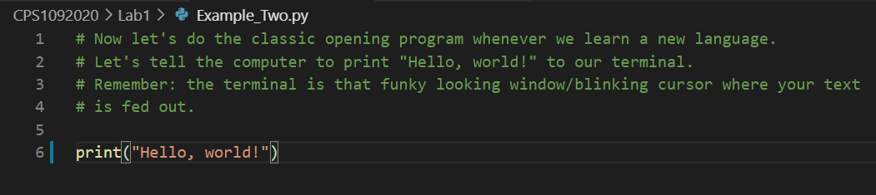
“Hello World” Example

Slide 16
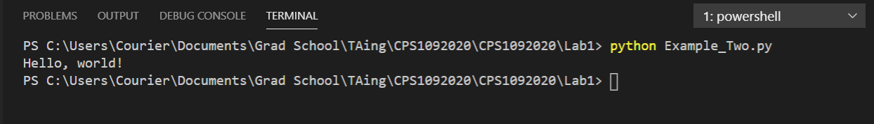
“Hello World” Output

Slide 17
The Anatomy of an “if” Statement
“if” statements are an extremely useful part of most programming languages, and are vital for most programs
Consider the following example:
x = 3 # Declaring the variable x to be equal to 3
if (x == 3):
print(“x is equal to 3”)
if (x <= 2):
print(“x is less than or equal to 2”)
elif (x == 4):
print(“x is equal to 4”)
else:
print(“x is greater than 2 but not equal to 4”)
if (x == 3):
print(“and x is equal to 3!”)
print(“FIN”)
The syntax is as follows:
if/elif/else (condition):
things to do if condition is True
more things to do if condition is True
things that will happen regardless
Notice: indentation, the colon
Example output:
x is equal to 3
x is greater than 2 but not equal to 4
and x is equal to 3!
FIN

Slide 18
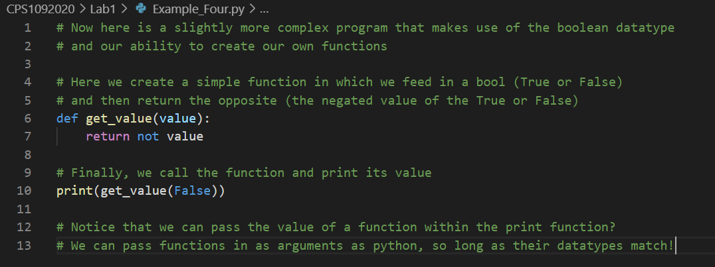
Def Function Example

Slide 19
The Anatomy of a Function
Recall the function from the previous slide:
def get_value(value):
return not value
def is a keyword that indicates the beginning of a function
get_value is the name of this function
value is the input to this function. Any variables you want to use within the function should be here. You can have multiple variables, separated by commas
e.x. (value_1, value_2, value_3)
notice the indentation. Much like with if statements everything within the function should match its indentation level (or be further right, if there are internal colons)
don’t forget the colon!
return will exit the function, and the output will be whatever variable follows the keyword return. In this case, if you call the function with
get_value(False) , your output will be: True

Slide 20
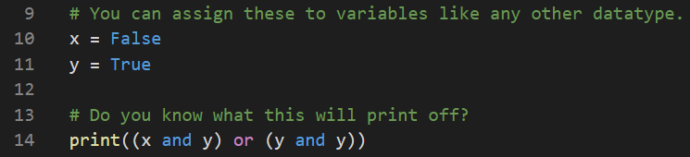
Logic Example

Slide 21
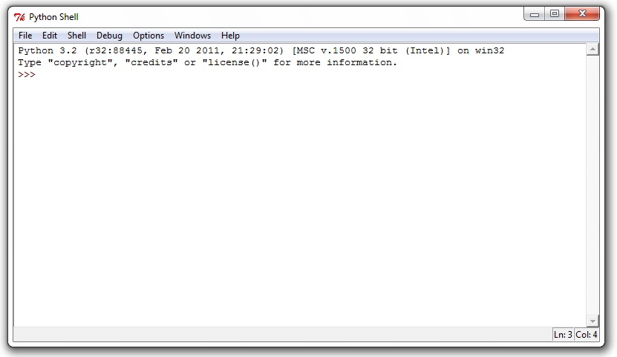
Writing in the Shell
The shell is that funky text area where you can type things in your IDE(or if you’re using a terminal, the weird prompt that comes up when you type “python”). It looks like this:

Slide 22
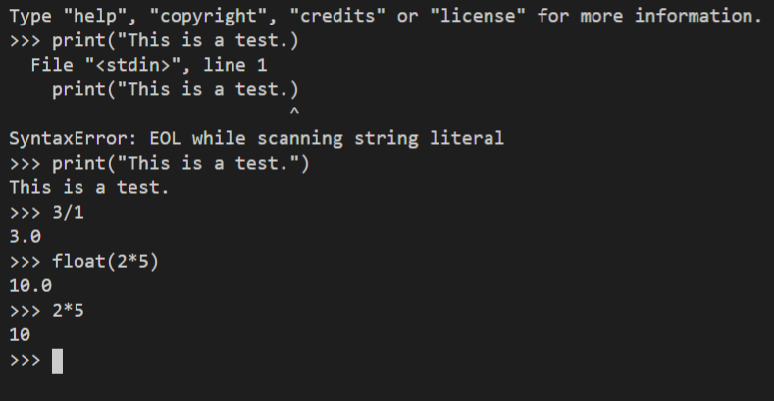
Writing in the Shell

