Slide 1
Intro to
HEAP
Unlink Pattern
Code slightly modified from from pwnable.kr/unlink challenge
Available at: github.com/0xdaedel/heap_unlink1

Slide 2
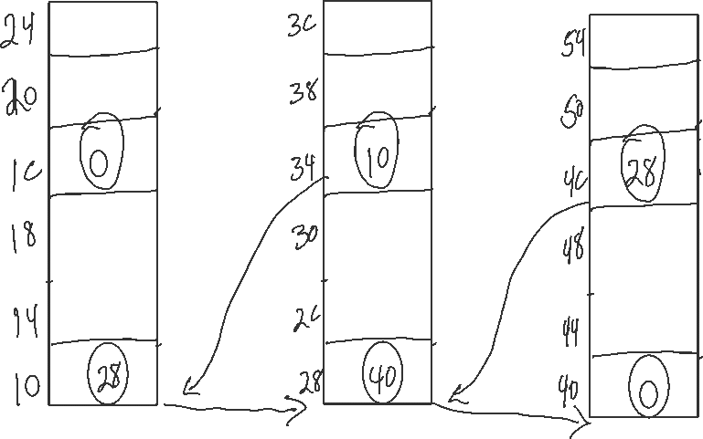
Doubly Linked List

Slide 3
void unlink(OBJ* P){ OBJ* tBkwd; OBJ* tFwd; tBkwd=P->bk; tFwd=P->fd; tFwd->bk=tBkwd; tBkwd->fd=tFwd; }
Proper Data
Node #1
Node #2
Node #3
bk
buf
fd

Slide 4
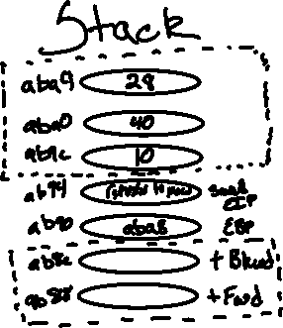
void unlink(OBJ* P){ OBJ* tBkwd; OBJ* tFwd; tBkwd=P->bk; tFwd=P->fd; ← tFwd->bk=tBkwd; tBkwd->fd=tFwd; }
Proper Data
Node #1
Node #2
Node #3
bk
buf
10
40
fd

Slide 5
void unlink(OBJ* P){ OBJ* tBkwd; OBJ* tFwd; tBkwd=P->bk; tFwd=P->fd; ← tFwd->bk=tBkwd; tBkwd->fd=tFwd; }
Proper Data
Node #1
Node #2
Node #3
bk
buf
10
40
fd

Slide 6
void unlink(OBJ* P){ OBJ* tBkwd; OBJ* tFwd; tBkwd=P->bk; tFwd=P->fd; tFwd->bk=tBkwd; ← tBkwd->fd=tFwd; }
Proper Data
Node #1
Node #2
Node #3
bk
buf
10
40
fd

Slide 7
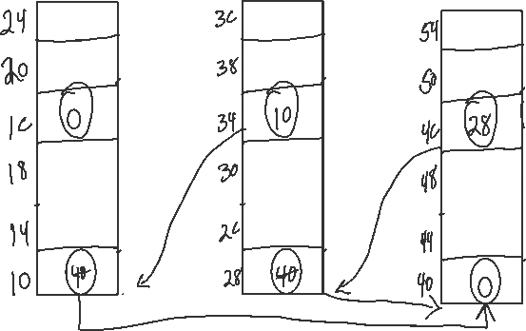
void unlink(OBJ* P){ OBJ* tBkwd; OBJ* tFwd; tBkwd=P->bk; tFwd=P->fd; tFwd->bk=tBkwd; ← tBkwd->fd=tFwd; }
Proper Data
Node #1
Node #2
Node #3

Slide 8
void unlink(OBJ* P){ OBJ* tBkwd; OBJ* tFwd; tBkwd=P->bk; tFwd=P->fd; tFwd->bk=tBkwd; tBkwd->fd=tFwd; ← }
Proper Data
Node #1
Node #2
Node #3
10
40

Slide 9
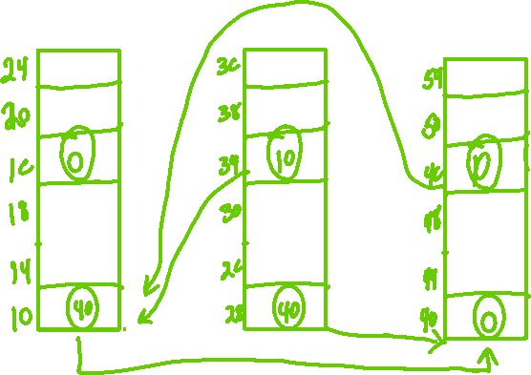
void unlink(OBJ* P){ OBJ* tBkwd; OBJ* tFwd; tBkwd=P->bk; tFwd=P->fd; tFwd->bk=tBkwd; tBkwd->fd=tFwd; ← }
Proper Data
Node #1
Node #2
Node #3
10
40

Slide 10
void unlink(OBJ* P){ OBJ* tBkwd; OBJ* tFwd; tBkwd=P->bk; tFwd=P->fd; tFwd->bk=tBkwd; tBkwd->fd=tFwd; ← }
Proper Data
Node #1
Node #2
Node #3
10
40

Slide 11
void unlink(OBJ* P){ OBJ* tBkwd; OBJ* tFwd; tBkwd=P->bk; tFwd=P->fd; tFwd->bk=tBkwd; tBkwd->fd=tFwd; }
Evil Data
Node #1
Node #2
Node #3
bk
buf
fd

Slide 12
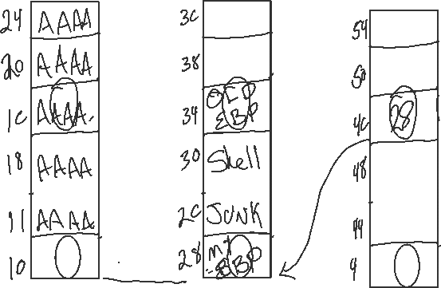
void unlink(OBJ* P){ OBJ* tBkwd; OBJ* tFwd; tBkwd=P->bk; tFwd=P->fd; tFwd->bk=tBkwd; tBkwd->fd=tFwd; }
Evil Data
Node #1
Node #2
Node #3
bk
buf
fd

Slide 13
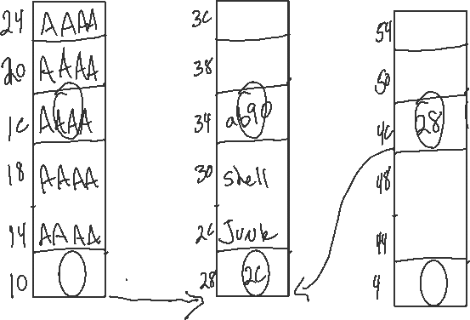
void unlink(OBJ* P){ OBJ* tBkwd; OBJ* tFwd; tBkwd=P->bk; tFwd=P->fd; tFwd->bk=tBkwd; tBkwd->fd=tFwd; }
Evil Data
Node #1
Node #2
Node #3
bk
buf
fd

Slide 14
void unlink(OBJ* P){ OBJ* tBkwd; OBJ* tFwd; tBkwd=P->bk; tFwd=P->fd; ← tFwd->bk=tBkwd; tBkwd->fd=tFwd; }
Evil Data
Node #1
Node #2
Node #3
bk
buf
ab90
2c
fd

Slide 15
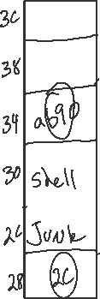
void unlink(OBJ* P){ OBJ* tBkwd; OBJ* tFwd; tBkwd=P->bk; tFwd=P->fd; ← tFwd->bk=tBkwd; tBkwd->fd=tFwd; }
Evil Data
Node #2
bk
buf
ab90
2c
fd

Slide 16

void unlink(OBJ* P){ OBJ* tBkwd; OBJ* tFwd; tBkwd=P->bk; tFwd=P->fd; tFwd->bk=tBkwd; ← tBkwd->fd=tFwd; }
Evil Data
Node #2
bk
buf
ab90
2c
fd
tFwd->bk=tBkwd *(tFwd + 12) = ab90
*(2C + 12) = ab90

Slide 17
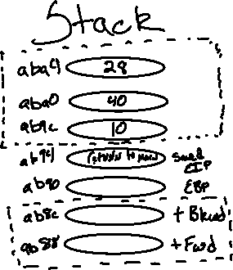
void unlink(OBJ* P){ OBJ* tBkwd; OBJ* tFwd; tBkwd=P->bk; tFwd=P->fd; tFwd->bk=tBkwd; tBkwd->fd=tFwd; ← }
Evil Data
Node #2
bk
2c
buf
ab90
2c
fd
tBkwd->fd=tFwd *(tBkwd+0) = 2c
*(ab90) = 2c

Slide 18
void unlink(OBJ* P){ OBJ* tBkwd; OBJ* tFwd; tBkwd=P->bk; tFwd=P->fd; tFwd->bk=tBkwd; tBkwd->fd=tFwd; (epilog of unlink)
leave
MOV esp to ebp
POP ebp
rtn
POP eip ←
}
Evil Data
Node #2
bk
ESP
2c
ab90
EBP
2c
fd

Slide 19
void unlink(OBJ* P){ OBJ* tBkwd; OBJ* tFwd; tBkwd=P->bk; tFwd=P->fd; tFwd->bk=tBkwd; tBkwd->fd=tFwd; main (epilog)
leave
MOV esp to ebp
POP ebp
rtn
POP eip ←
}
Evil Data
Node #2
bk
ESP
2c
ab90
EBP
2c
fd

Slide 20
main (epilog)
leave
MOV esp to ebp ←
POP ebp
rtn
POP eip
Evil Data
Node #2
bk
2c
ab90
EBP
ESP
2c
fd

Slide 21
main (epilog)
leave
MOV esp to ebp
POP ebp ←
rtn
POP eip
Evil Data
Node #2
bk
ESP
2c
ab90
2c
fd

Slide 22
main (epilog)
leave
MOV esp to ebp
POP ebp
rtn
POP eip ←
Evil Data
Node #2
bk
ESP
2c
ab90
2c
fd
Popping a Shell

Slide 23
int main(int argc, char* argv[]){ malloc(1024); OBJ* A = (OBJ*)malloc(sizeof(OBJ)); OBJ* B = (OBJ*)malloc(sizeof(OBJ)); OBJ* C = (OBJ*)malloc(sizeof(OBJ)); // double linked list: A <-> B <-> C A->fd = B; B->bk = A; B->fd = C; C->bk = B; printf("here is stack address leak: %p\n", &A); printf("here is heap address leak: %p\n", A); printf("now that you have leaks, get shell!\n"); // heap overflow! gets(A->buf); // exploit this unlink! unlink(B); return 0; }

