Slide 1
A Study of Company — Sense Time
MAFS 6010U AI IN FINANCE
Group Members
FENG Yuan LEI Qiuyue
LI Huiwen Zhao Jingru
Zhou Yunzhi
May 25th , 2019

Slide 2
Content
Introduction
Technical Analysis
Suggestion on Further Study

Slide 3
1. Introduction
1.1 Company Introduction

Slide 4
1.1 Company Introduction
Sense Time (Chinese: 商汤科技) is a artificial intelligence (AI) company. It was founded in Hong Kong with additional offices across China, Singapore, Japan, and the United States. The company has one of the highest total financing and highest valuations in the industry. It is startup company valued at over $1 billion, these are sometimes classified as unicorns.

Slide 5
2. Technical Analysis
2.1 TYC
2.2 LinkedIn Scraping
2.3 Competitors Analysis

Slide 6
2.1 TYC
Introduction
Tian Yan Cha is a commercial survey tool that can be used by everyone. It can help realize over 40 kinds of data query, such as enterprise information, enterprise development, legal risk, management risk, operating conditions, the intellectual property rights (enterprise business information, legal proceedings, the court announced patent, trademark, outward investment, branches, change information, bond, web site record, copyright, bidding, broken, abnormal operation, corporate annual reports, recruitment and news, etc.).

Slide 7
2.1 TYC
2. Automatic Update
Mainly 2 methods:
WebCrawler
Chrome web extension

Slide 8
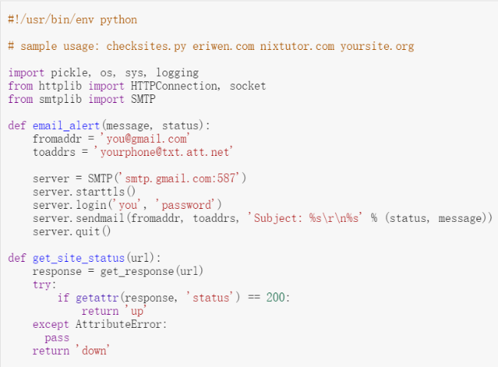
2.1 TYC
2. Automatic Update
WebCrawler

Slide 9
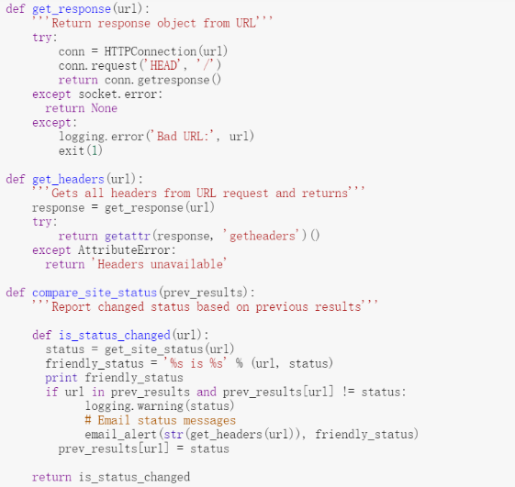
2.1 TYC
2. Automatic Update
WebCrawler

Slide 10
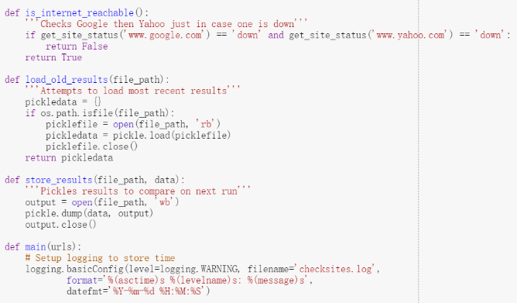
2.1 TYC
2. Automatic Update
WebCrawler

Slide 11
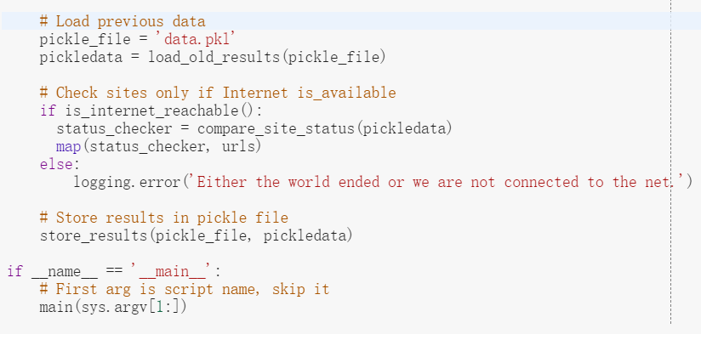
2.1 TYC
2. Automatic Update
WebCrawler

Slide 12
2.1 TYC
2. Automatic Update
WebCrawler Output
We can attempt WebCrawler but the information in TYC needs accounts and verifying code, so we quit this approach.

Slide 13
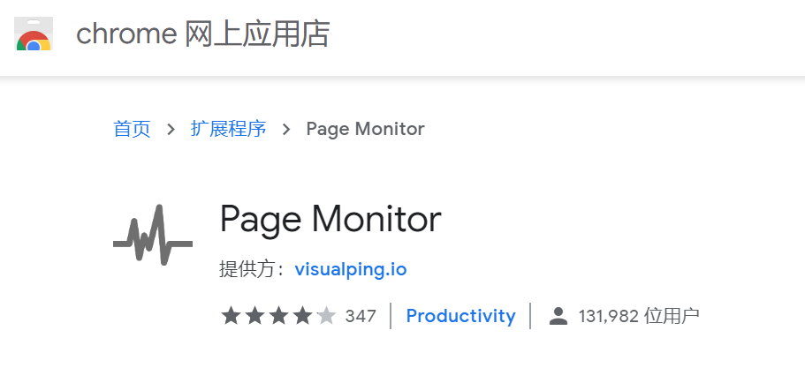
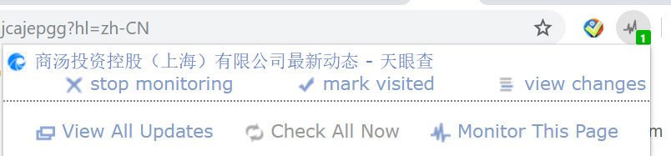
2.1 TYC
2. Automatic Update
(2) Chrome Web Extension
Using this chrome extension, we can easily get notifications of Sense Time. But the report will still be manually downloaded only.

Slide 14
2.1 TYC
3. Main features
Mainly providing professional enterprise information inquiry, enterprise relationship mining & digging services. Tian Yan Cha provides the users with a search query function, and the main information includes: industrial and commercial information, lawsuits, patent, trademark, dishonest information, enterprise change and enterprise annual reports, as well as the business associations query, etc. It has realized the integration of full volume of industrial and commercial data, trademark data, public litigation data, and in-depth exploration of corporate relations.

Slide 15
2.1 TYC
3. Main features

Slide 16
2.1 TYC
3. Main features

Slide 17
2.1 TYC
3. Main features

Slide 18
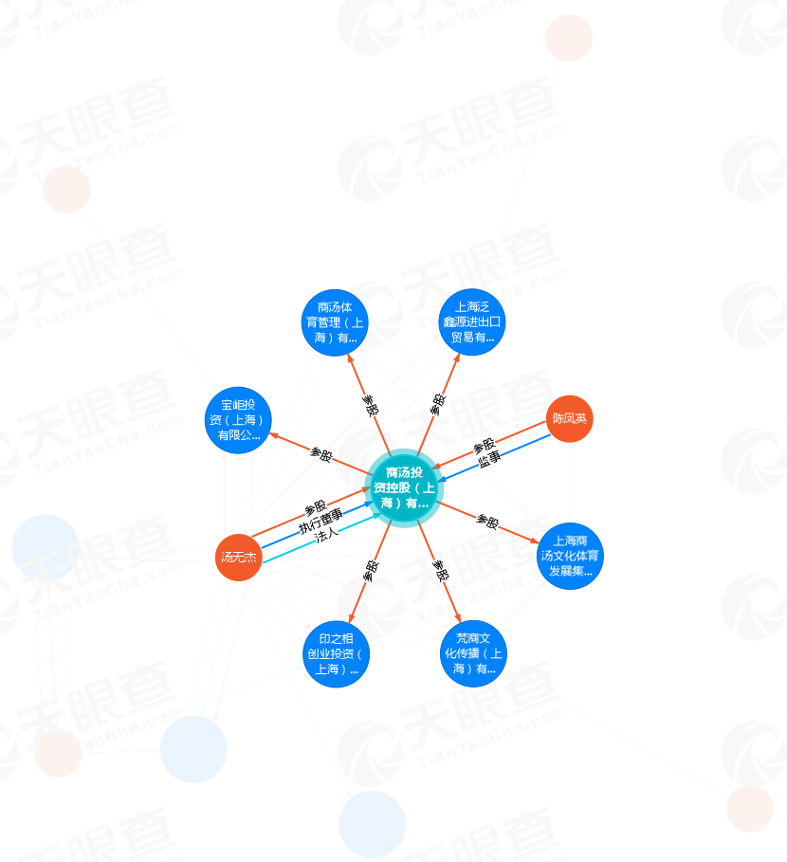
2.1 TYC
3. Main features
Some main relationship with Sense Time.

Slide 19
2.2 LinkedIn Scraping
1. Objective
(1) Collect the number of employees in the interested company to track the change in the scale of the company.
(2) From the background of employees in the company, track the potential trend of the company development.

Slide 20
2.2 LinkedIn Scraping
2. Progress
Data scraping
Data mining & analysis
Trend Tracking

Slide 21
2.2 LinkedIn Scraping
3. Challenges
Objective-wise
Data-scraping-wise
Data-analysis-wise
Trend-tracking-wise

Slide 22
2.3 Competitors Analysis
1. Market Trends of AI
A company rarely competes against just one competitor. In fact, in many cases, the biggest competition in our technology industries is coming from indirect competitors. These competitors hold a commanding position in their core market, allowing them to expand into different industries and verticals. Who would have thought that BAT would become die-hard competitors in the Artificial Intelligence market? It is almost impossible to distinguish direct and indirect competitors. In many cases everyone competes with everyone.

Slide 23
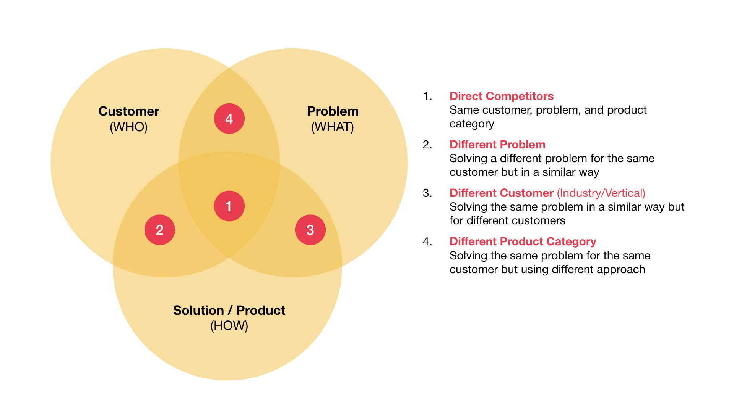
2.3 Competitors Analysis
2. Identify Competitors

Slide 24
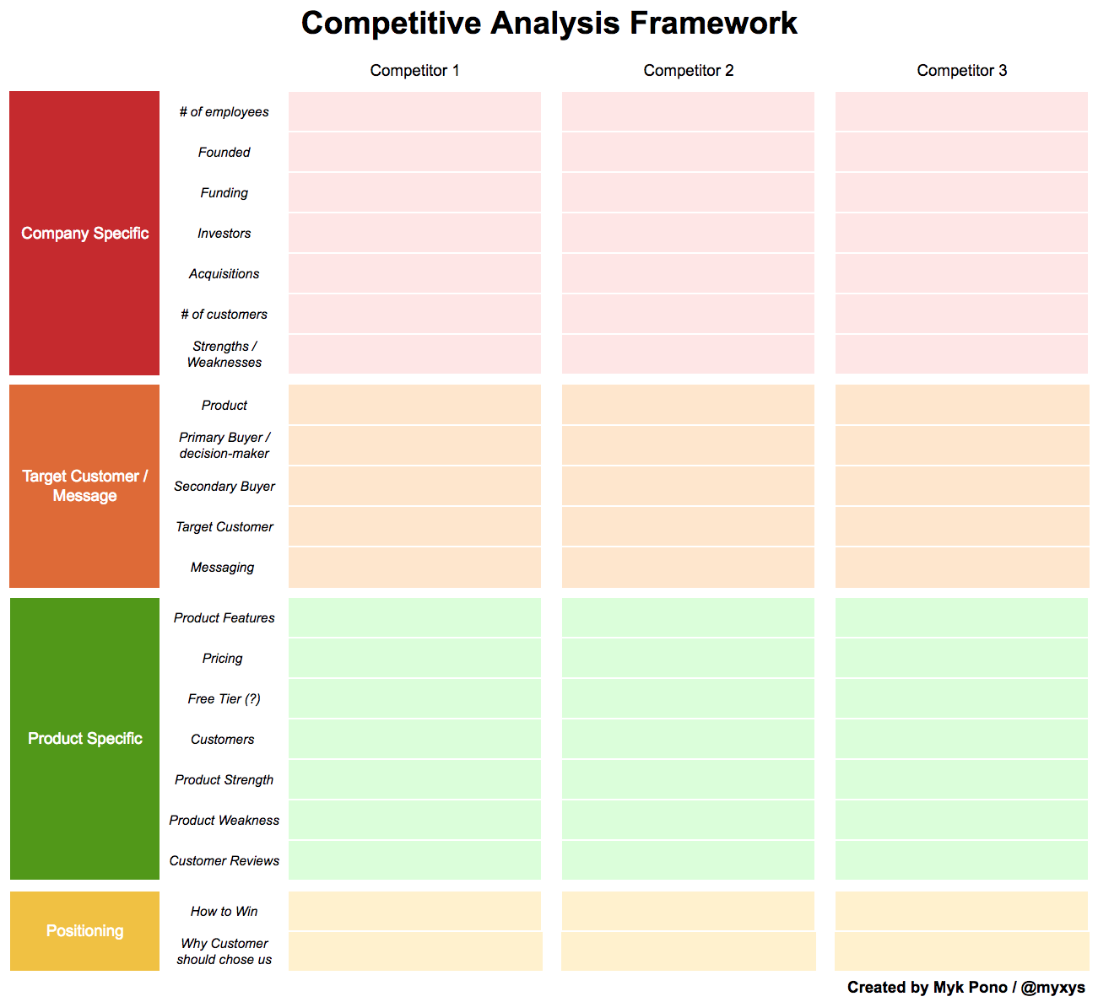
2.3 Competitors Analysis
3. Evaluate Opportunities and Analyze Threats
We conducted a framework to compare Sense Time and its competitors from the following aspects.

Slide 25
2.3 Competitors Analysis
3. Evaluate Opportunities and Analyze Threats
For instance, when the manager would like to see the change of employees number, he can just click the corresponding table and he will see a line chart as followed. Further more, he can see the comparison situation between enterprises by click the row ‘of employees’.

Slide 26
3. Suggestion on Further Study
3.1 Summary

Slide 27
3.1 Summary
In addition to what we have devised, there are plenty of Artificial Intelligence & Machine Learning techniques which could be used to track and monitor the potential investing company in order to get a thoroughly understanding about its profile and a clear insight of the investment opportunity. For example, using NLP to process the interviews and speeches videos which are given by the key manger and sort the useful information which is related to the development and important decisions.
Also, data cleaning and data analysis are of vital important. There are many new techniques and researches in these areas and challenges as well. How to dig out key words, clustering, emotion analysis, etc.
All in all, there is a lot of space that we could improve and advance in the future.

Slide 28
Thank You !
MAFS 6010U AI IN FINANCE
May 25th , 2019

