Slide 1
Company
development tracking
Group: GESHA
Li Lu
Zhou Yawen
Qiu Chuchu
Tang Mandi
Zhang Banruo

Slide 2
01
Company Introduction
02
Method introduction
03
Workflow
Content
04
Results and conclusion

Slide 3
Company Introduction

Slide 4
Sensetime
01
02
03
largely participated on Chinese market
largest “Unicorn” AI company
serving multiple industries

Slide 5
Yewno
Main business aspects:
Education, Publishing, Financial services.
Significant partnerships with notable institutions
Active media activities
Extract knowledge from an overwhelming quantity of unstructured and structured data.
Overcome the “Information Overload” problem.

Slide 6
Method introduction

Slide 7
Value Chain
Collect information and data from upstream companies, downstream companies, the cooperation or competition between them.
Monitor the business activities of the company.

Slide 8
Keywords generation-RAKE algorithm
1
use punctuation to divide documents into clauses
2
for each clause, use stop words as a separator to break the clause into several phrases
3
The final definition is:
wordScore = wordDegree(w) / wordFrequency(w)

Slide 9
Data visualization
1
For Data visualization, we use word cloud package in Python to visualize keywords.
Word cloud is a visual representation of the "keywords" that appear frequently in text data. The formation of keywords forms a cloud-like color picture, so that you can see at a glance. In python, there is a package named wordcloud. It is easy for us to do the visualization with the help of this package.

Slide 10
Workflow

Slide 11
Yewno - Workflow
Look at Yewno’s partnership with other entities in each industry.
Attempt to track Yewno’s business development in each field.
Take advantage of the media and press release resources on the website of Yewno to find its partners.

Slide 12
Sensetime - Workflow
Data source
Crawling
1
2
crawl news in Sensetime official website
news in the official website
3
4
Data visualization
Keywords generation
Rake algorithm
word cloud in Python

Slide 13
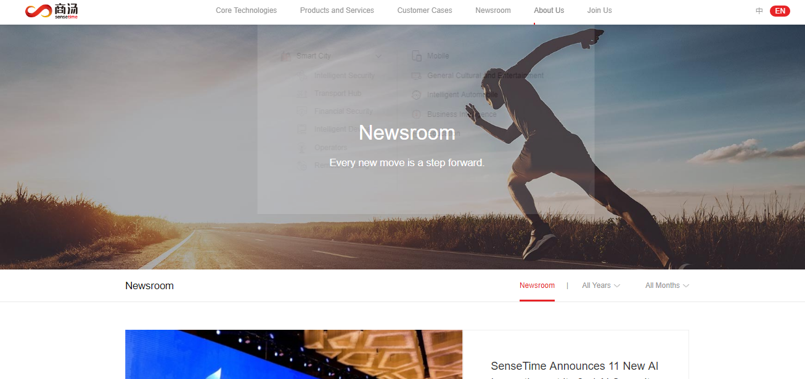
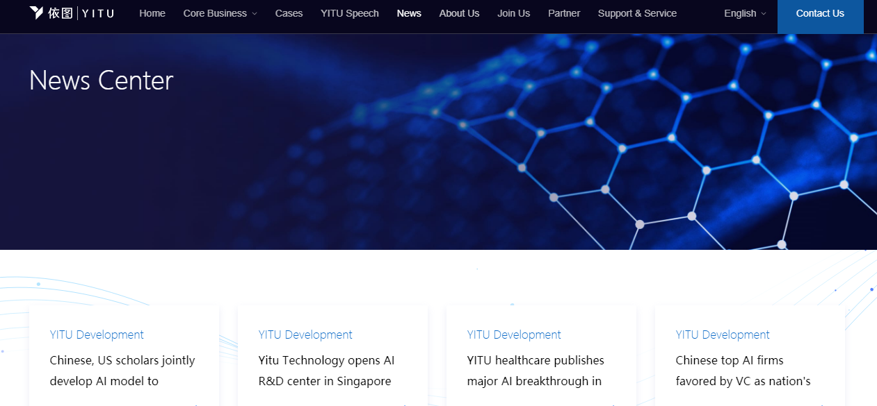
Data source
1
We crawled the news in the official website, we crawled the news between Sensetime and YiTu from 2017-2019.

Slide 14
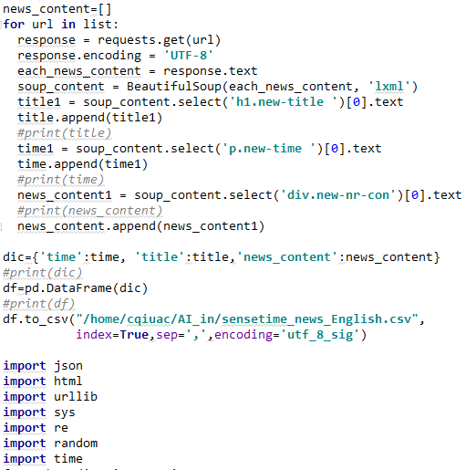
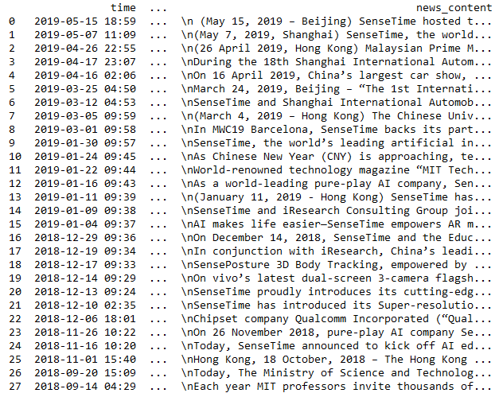
Crawling
1
We use Beautiful Soup (HTML parsers) , request package in python to crawl news in Sensetime

Slide 15
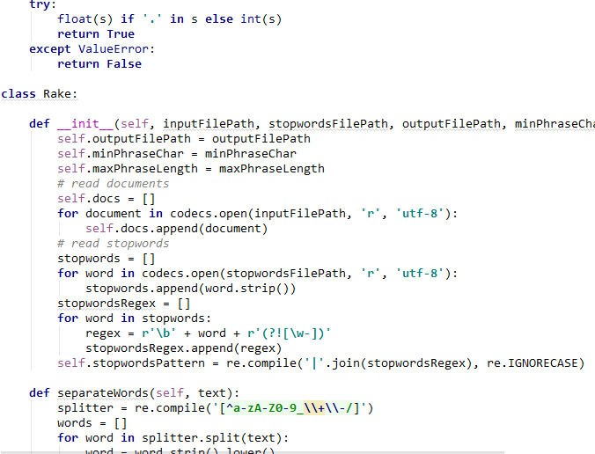
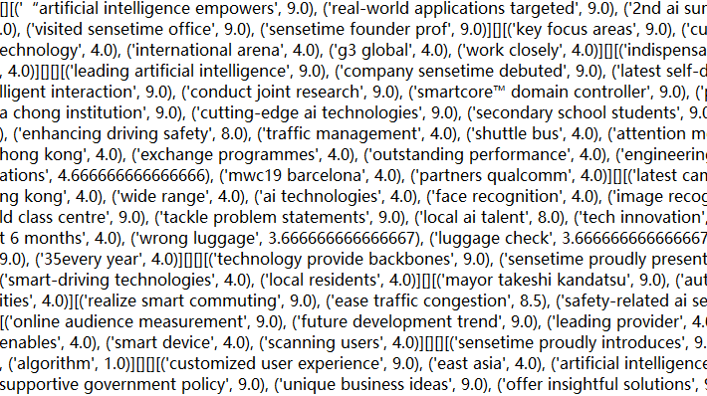
Keyword generation
1
Extract the word according to Rake, an open source algorithm from Github. We extract keyword for every company each year

Slide 16
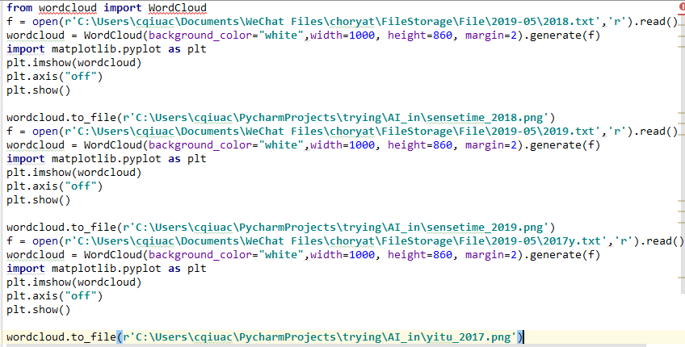
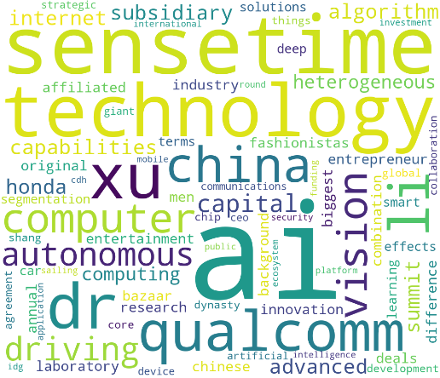
Data visualization
1
use wordcloud in Python visualize the result

Slide 17
Results and conclusion

Slide 18
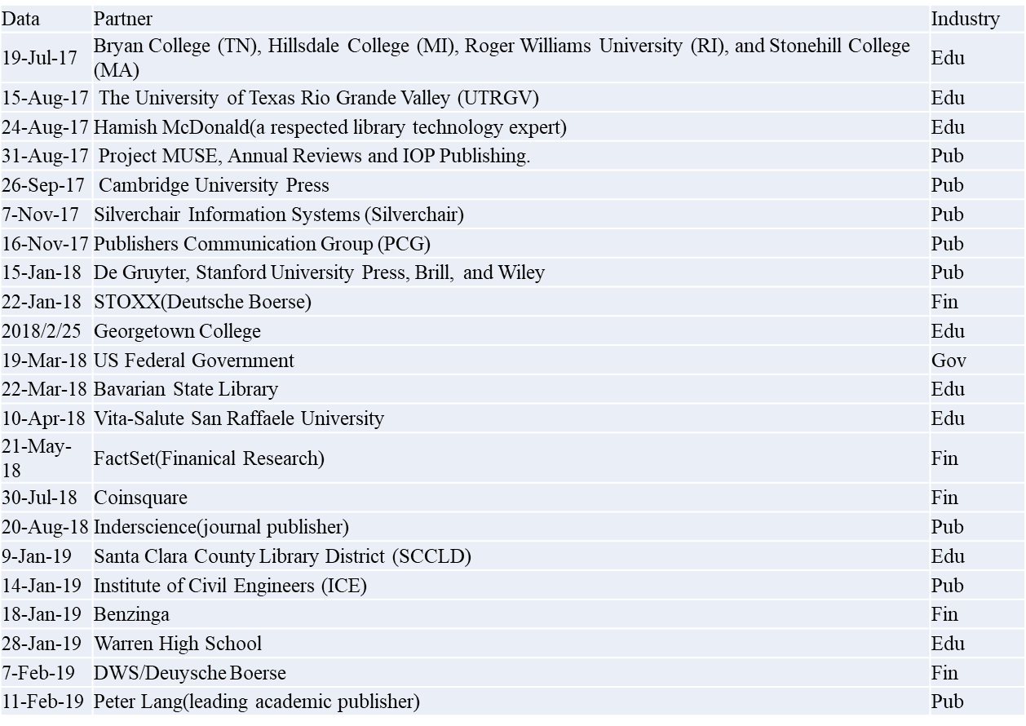
Yewno

Slide 19
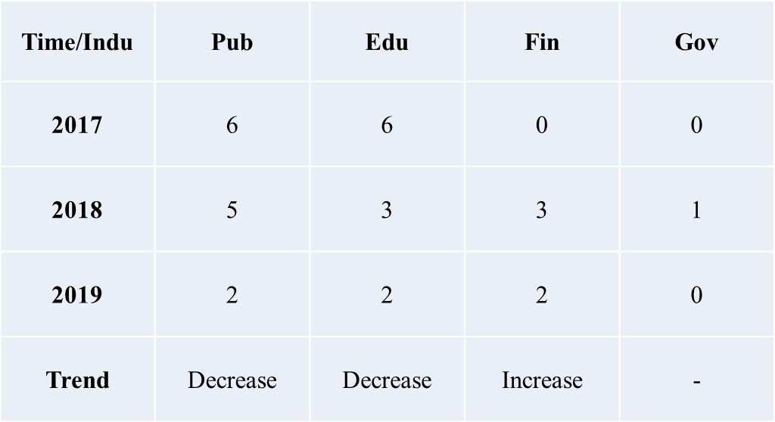
Yewno

Slide 20
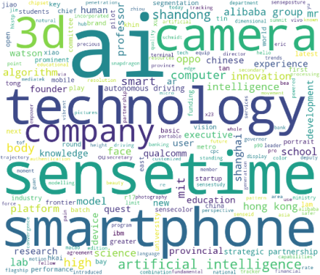
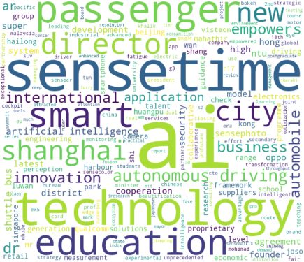
Sensetime
Vertical comparison
2018
2019
2017

Slide 21
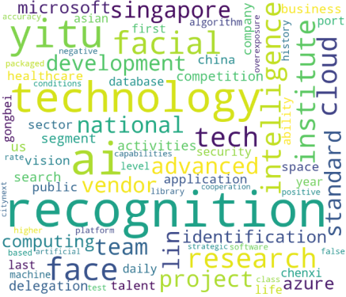
Sensetime & Yitu
Cross comparison
2017

Slide 22
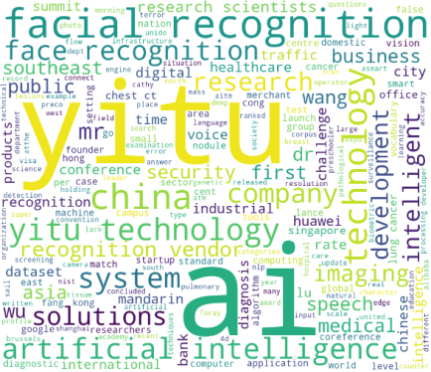
Sensetime & Yitu
Cross comparison
2018

Slide 23
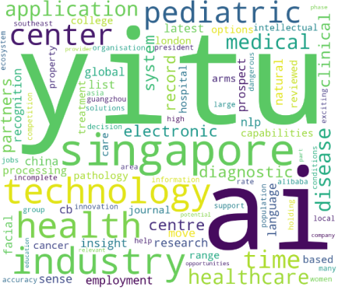
Sensetime & Yitu
Cross comparison
2019

Slide 24
THANK YOU FOR WATCHING

