Slide 1
MAFS6010U_Option B
SenseTime_ Team Orange
CHEN Shuying 20550984
GAO Jianyu 20552102
LI Ye 20538601
TIAN Lei 20552580
XU Liyuan 20549571

Slide 2
01
Background
02
Products
03
Parters
04
Competitors
CONTENTS
05
Conclusion

Slide 3
Background
01
AI industry analysis
Policy summary
About SenseTime

Slide 4
Background
AI industry analysis
Industry chain
Characteristics
Now in the period of development and future will enter the accelerated development period.
The artificial intelligence industry chain consists of three layers: the base layer, the technology layer, and the application layer. Among them, the basic layer lays the foundation for network, algorithm, hardware laying and data acquisition for the artificial intelligence industry; the technical layer starts with the intelligent related features of the human being and builds the technical path; the application layer integrates one or more types of artificial intelligence basic application technology. .
Industrial Chain of Large Companies is Widely Distributed, the Startup Company is Highly Professional.
Intelligent driving, big data and data services and artificial intelligence + field is a hot investment field in China.

Slide 5
Background
Industry analysis
AI + Finance
At present, the mature applications in the field of artificial intelligence mainly include intelligent investment, risk management and intelligent customer service. The main methods used are machine learning, natural language processing, knowledge mapping and computer vision.
Development of AI Applications
AI+ security
The size of the security market is growing rapidly. China's security market has maintained rapid growth. The security market has maintained double-digit growth for five consecutive years in 2015-2020. In 2020, the domestic security market reached more than 800 billion. According to the forecast of the Prospective Industry Research Institute, by 2022, the domestic security market will reach a scale of nearly one trillion.
.
Intelligent robot
Due to the needs of industrial development and intelligent life, the research and development of the domestic intelligent robot industry mainly focuses on three aspects: home robots, industrial enterprise services and intelligent assistants. Among the above three categories, companies engaged in home robots and smart assistants account for the vast majority.
AI + Home
Smart home is a residential platform, using advanced artificial intelligence technology, network communication technology, and integrated wiring technology to organically combine various subsystems related to home life, and make home life smarter and more comfortable through overall management.

Slide 6
Background
Policy summary
Point policy in recent years
2015
2016
2017
2018
"Made in China 2025”
"Guiding Opinions of the State Council on Actively Promoting "Internet +" Actions"
"Outline of the Thirteenth Five-Year Plan for National Economic and Social Development of the People's Republic of China“
"Robot Industry Development Plan (2016-2020)”
Etc.
Notice of the State Council on Printing and Distributing the Development Plan of a New Generation of Artificial Intelligence
19th CPC National Congress Report
Etc.
2018 Government Work Report

Slide 7
Background
Policy summary
2015 "Made in China 2025"
Accelerate the promotion of the integration of new-generation information technology and manufacturing technology, and regard intelligent manufacturing as the main direction of deep integration of two technologies; focus on the development of intelligent equipment and intelligent products and promote the intelligentization of the production process.
Specifically
2016
'13th Five-Year' National Strategic Emerging Industry Development Plan’
Develop artificial intelligence, foster the ecology of artificial intelligence industry, and promote the comprehensive integration of artificial intelligence technology into various industries.
.
2017 19th CPC National Congress Report
The artificial intelligence written into the 19th report will promote the deep integration of the Internet, big data, artificial intelligence and the real economy.
2018 Government Work Report
Artificial intelligence has once again been included in the government work report: to strengthen the development and application of a new generation of artificial intelligence; to promote "Internet +" in the fields of medical care, pension, education, culture, sports, etc.; to develop smart industry and expand smart life.

Slide 8

Background
About SenseTime
Sense time, the world’s highest-valued AI company with a valuation of over USD6 billion, which was established in 2014 and specializes in facial and image recognition technology.
Nowadays, it has become the largest algorithm supplier in the country. The company is dedicated to creating an AI ecosystem with innovation and solutions to upgrade the industries.
Advantage 1
Advantage 2
Advantage 3
Sensetime has an experienced team in computer vision and deep learning.
Sensetime independently developed the deep learning platform “Parrots” and deep learning super-calculation center.
Sensetime has an obvious advantage in image recognition and comprehensive coverage.

Slide 9
Background
About SenseTime
Financing
Round
Pre-B &
B & B+
2016 - 2017
Round
A & A+
2014 - 2016
Round
C & C+
2018
Round
D
2018
2016/12—Round Pre-B: 120 million dollars from Star VC, Wanda, CDH Investments and IDG Capital;
2017/7—Round B: 290 million dollars from CICC, China Renaissance, Stone VC, Morningside VC and so on;
2017/11—Round B+: 1.5 billion Yuan from Alibaba, Qualcomm Ventures and Green Pine Capital;
2014/11--Round A: tens of millions of dollars from IDG Capital;
2016/4--Round A+ : tens of millions of dollars from Star VC;
2018/4—Round C: 600 million dollars from Alibaba, Suning and Temasek;
2018/5—Round C+: 620 million dollars from Hopu Fund, Silver Lake, Tiger Fund, Fidelity and so on;
2018/9—Round D: 1 billion dollars from Softbank China. The valuation of Sensetime has reached 6 billion dollars due to this investment.

Slide 10
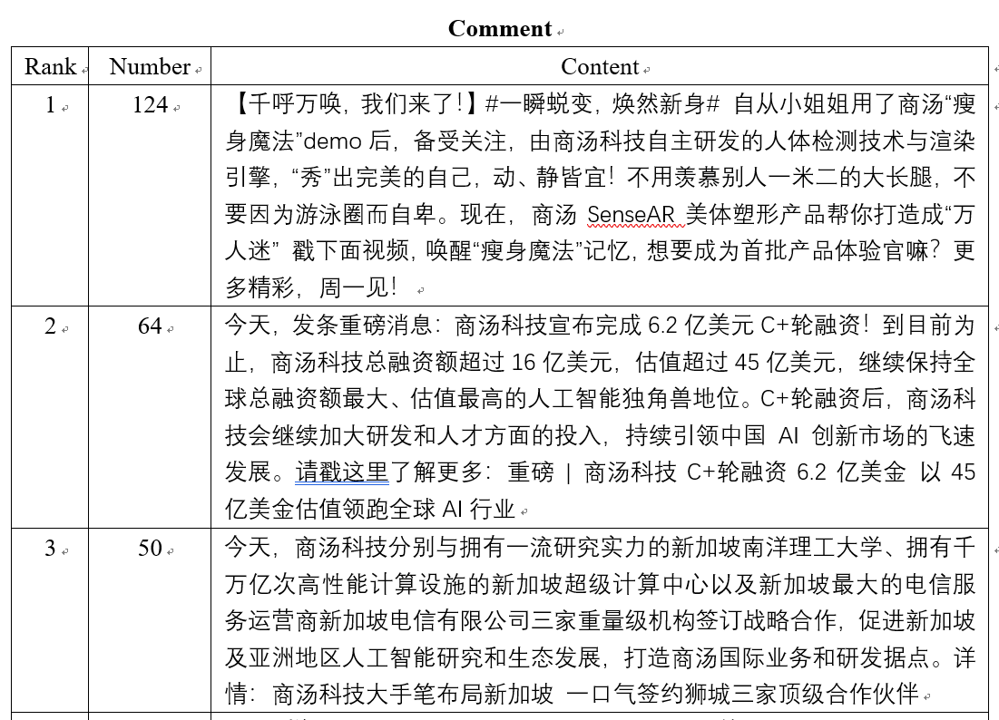
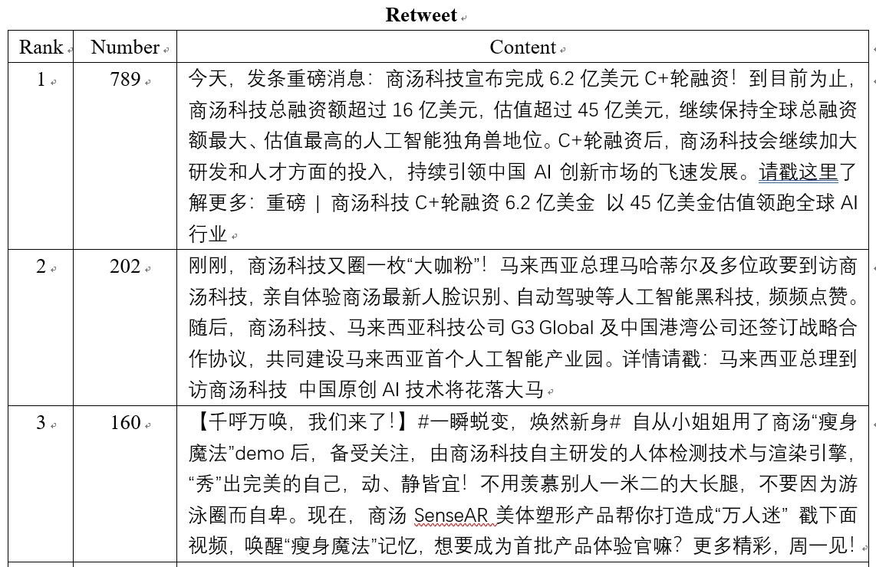
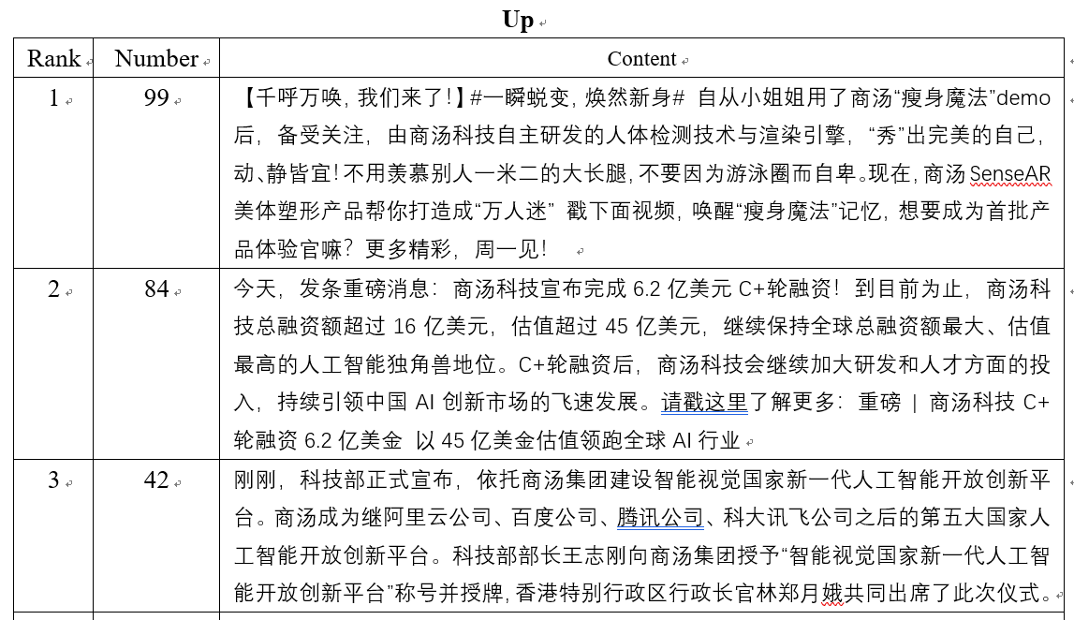
Background
About SenseTime
Information from official Weibo
Top 3

Slide 11
Products
02
Sense Keeper
Sense Photo
Sense Driver
Sense Go
Sense ID

Slide 12
Products
Introduction
Sense keeper
A face recognition device for controlling pedestrian access gates. It is mainly used for identity verification and intelligent security management in public channels. It can support multiple authentication methods such as ID card, smart IC card, QR code and face.
Sense drive
Provides complete in-car driver monitoring solutions including face detection, fatigue detection, attention detection and gesture recognition. Balanced safety, driver assistance and in-car interactive entertainment. And can be used in L3 autonomous driving man-machine control transfer (attention detection), Digital cockpit function control and entertainment interface (gesture recognition) as well as Transportation / Business Fleet Management (Fatigue Testing + Attention Detection).
Sense photo
Based on deep learning technology, it realizes face unlocking, face detection and clustering functions for intelligent terminals, and provides image processing solutions such as dual camera, background blur, heavy lighting, and smart photo album. We can use it when we process our photos and to unlock the electronic equipment using face.
Sense go
Based on computer vision technology such as face attribute recognition and customer feature detection, the consumer's various types of information are extracted from the video to form statistical analysis and analysis of consumer behavior, and statistical analysis of passenger flow is provided for large shopping malls, supermarkets, high-end cafes, etc. Big data information reference for refined operational analysis and decision making such as key customer analysis. It can be used in the supermarket or restaurant.
Sense ID
Relying on the world's leading face recognition technology, Sensetime Technology provides an integrated solution of “cloud+end”, including software SDK, cloud service and authentication hardware terminal products. Through the functions of living body detection, card identification, face comparison, etc., the authenticity of the user's identity is ensured. Reduced business risks and reduced human resource costs for customers such as the financial industry and mobile operators.

Slide 13
Products
Advantages
Sense keeper
1. The accuracy of face recognition exceeds the accuracy of the human eye and the recognition is completed within 1 second.
2. Support online, offline scenarios and remote data entry
3. Defense of 3D printing, electronic screens, masks, and hooded hackers
4. Embedded soft and hard integrated design, system maintainability
Sense drive
1. Only add a camera is enough, low cost
2. Support RGB and infrared cameras, Meet the complex lighting scene inside the car
3. The core technology is extremely optimized, Millisecond response
Sense photo
1. Leading artificial intelligence deep learning technology, big data driven image analysis algorithm.
2. Industry-leading image processing, clear and accurate image recognition
.
Sense go
1. Accuracy is greater than 99%.
2. No need of sense of experience, no need of consumer experience.
3. Not limited to a specific scene.
Sense ID
1. The all-in-one hardware terminal has high performance, low cost, easy deployment, fast integration, and flexible expansion.
2. Face recognition accuracy exceeds human eye accuracy, effectively reducing risk.
3. Supports live verification testing, effectively preventing paper pictures, screen remake, mask models and Other types of attacks.

Slide 14
Partners
03
Qualcomm
Chinese Government
Honda
Deloitte
Xiaomi, Oppo, Vivo and Huawei
Suning
Alibaba

Slide 15
Partners
Partnerships with more than 400 leading enterprises
Main cooperation
Qualcomm 01
Sensetime was received tens of millions of dollars of strategic investment by global communication giant Qualcomm and they have signed a comprehensive strategic cooperation agreement.
04 Deloitte
Sensetime and Deloitte will rely on Deloitte China's full range of professional services capabilities, as well as Sensetime’s extensive experience in the vision and image understanding field.
Chip
Finance
Chinese Government 02
The Shanghai Municipal Government will conduct comprehensive strategic cooperation with Sensetime. The total investment by Sensetime in Shanghai within 5 years is not less than 6 billion yuan.
05 Xiaomi, Oppo, Vivo and Huawei
Xiaomi 8 transparent exploration version, vivo NEX, vivo X23, OPPO Find X, Huawei nova3, one plus OnePlus6... In 2018, these famous versions of phones which have exploded the domestic network of technology circles are supported by AI technology of Sensetime.
Smart
city
AI
Smart
phone
Automatic
driving
Smart
commercial
Honda 03
Sensetime Japan announced that it has signed a long-term cooperation agreement with Japanese auto company Honda to jointly develop L4 level autopilot program suitable for passenger car scenes.
06 Suning
The innovative technology is starting to play a critical role in personalizing and optimizing products, inventory, services and experience, boosting consumer satisfaction and business benefits both online and offline.

Slide 16
Partners
Alibaba
Alibaba, Sensetime and Hong Kong Science and Technology Parks Corporation jointly set up an AI laboratory to promote the development of Hong Kong's artificial intelligence industry
The Hong Kong Artificial Intelligence Laboratory is a non-profit project dedicated to the use of cutting-edge technology and expertise to advance the development of artificial intelligence, assisting start-ups in commercializing research projects, and promoting exchanges between academics, scientists and entrepreneurs in the field of artificial intelligence.
Alibaba Entrepreneur Fund ("Fund") and Shangtang Group will jointly be responsible for the operating expenses of the "Hong Kong Artificial Intelligence Laboratory".
Two rounds of applications will be accepted each year. Each round will select about 10 potential start-ups and start-ups will be provided with funding and resource support. Sensetime will provide deep learning platforms and AI solutions for selected startups.
AI
laboratory

Slide 17
Competitors
04
YITU
MEGVII
CloudWalk
Others

Slide 18


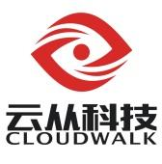
Competitors
Company introduction
Megvii has been one of SenseTime's top competitors. Megvii is headquartered in Haidian, Beijing Municipality, and was founded in 2011. Megvii generates 40% the revenue of SenseTime.
YITU is SenseTime's top competitor. YITU is a Private company that was founded in Changning, Shanghai Municipality in 2012. YITU operates in the Application Software industry. YITU has 821 fewer employees vs. SenseTime.
CloudWalk has been one of SenseTime's top competitors. It hatched in Chongqing Research Institute of Chinese Academy of Sciences and was established in 2015. The headquarter of CloudWalk is located in Dongguan, Guangdong Province.

Slide 19
Competitors
SenseTime & YITU
Team background
Some of the players are PhD and graduates from MIT, CUHK, Tsinghua University and Peking University while others are practitioners from Microsoft, Google, Lenovo, Baidu and other related fields.
Team background
Nearly 200 researchers, practitioners from Microsoft, Google, Huawei and Alibaba and first Turing Award Chinese winner --Yao Qizhi as chief adviser.
Core technology
Face recognition, video surveillance recognition algorithm, augmented reality, text recognition, automatic driving recognition algorithm, medical image recognition algorithm, etc.
Core technology
Face recognition, object detection and recognition, video intelligent analysis and pattern recognition, embedded system development, cloud computing and big data
Application fields
Security monitoring, finance, mobile phones, mobile internet, deep learning chips, etc.
Application fields
Financial security, urban security, mobile phone intelligence, industrial robots, etc.
Customers
China Mobile, UnionPay, Wanda, Huawei, Xiaomi, Weibo, banks, etc.
Customers
Didi, Foxconn, banks, sporting events, etc.

Slide 20
Competitors
MEGVII & CloudWalk
Team background
Core members from MIT, Google, Alibaba, etc.
Team background
Engineers from Huawei, Microsoft, Hewlett-Packard, IBM, Apple, Google, etc.
Core technology
Deep learning, computer vision, semantic understanding, etc
Core technology
Focus on face recognition.
Application fields
Finance, security, healthcare, smart cities, etc.
Application fields
Banks, airports, security, etc.
Customers
Chinese Unicom, China Mobile, public inspection system, banks, etc.
Customers
People's bank, the head office of the four major banks, the public security system, the major airports, etc..

Slide 21
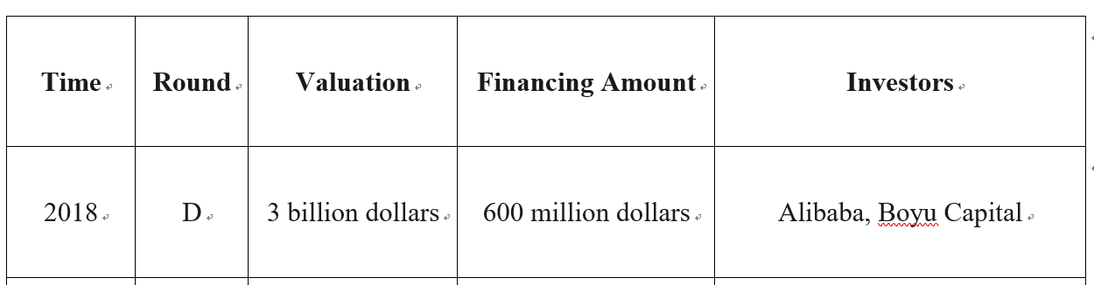
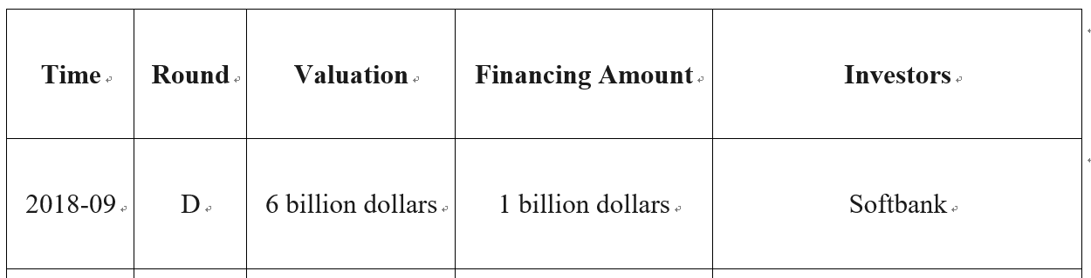
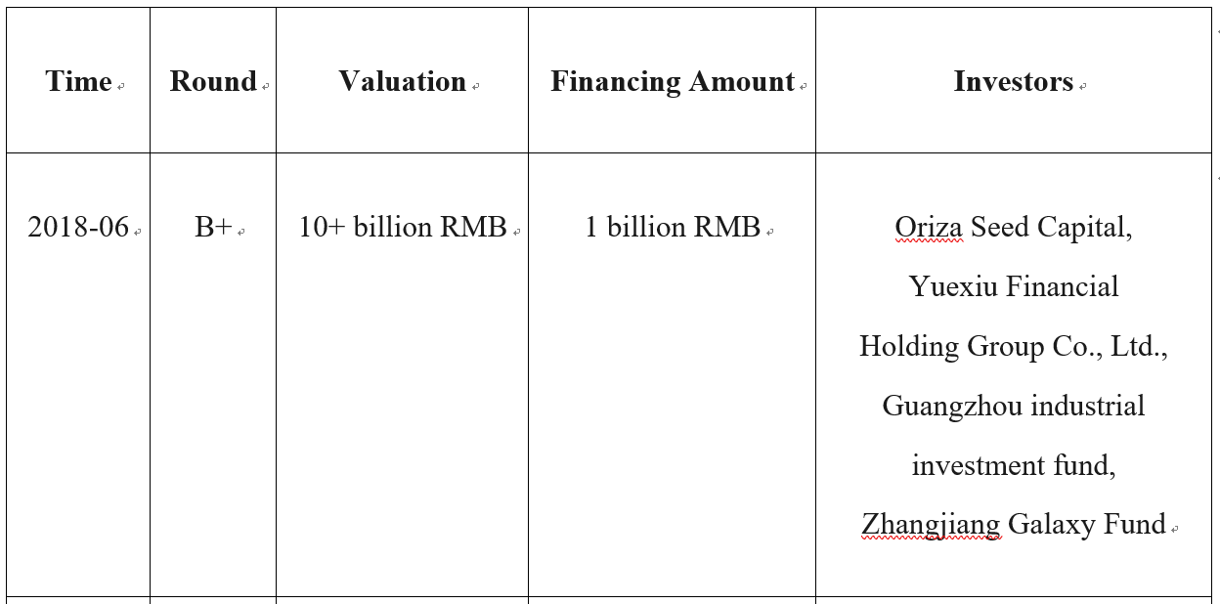
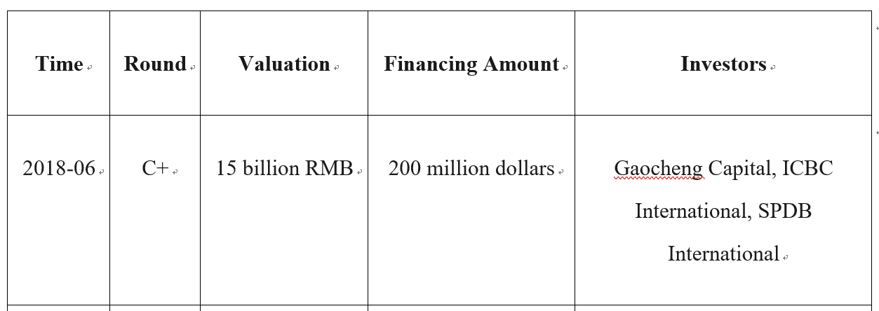
Competitors
03 MEGVII
Latest financing comparison
SenseTime01
YITU02
04 CloudWalk

Slide 22
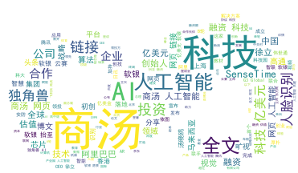


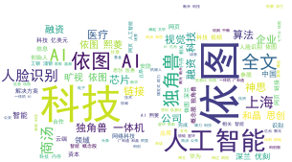
Competitors
03 MEGVII
Key words from Weibo
SenseTime01
YITU02
04 CloudWalk

Slide 23
Competitors
03 MEGVII
Key words in 2017
SenseTime01
添加标题
添加标题
添加标题
YITU02
04 CloudWalk

Slide 24
Competitors
03 MEGVII
Key words in 2018
SenseTime01
添加标题
添加标题
添加标题
04 CloudWalk
YITU02

Slide 25
Competitors
03 MEGVII
Key words in 2019
SenseTime01
添加标题
添加标题
YITU02
04 CloudWalk

Slide 26
Competitors
Others
Products
Intelligent video analytics
1. Intellivision AI-Based Intelligent Video Analytics (widest offering of AI-based IVA): Real-time AI Video Analytic Processing; The edge can be camera, servers and cloud; Extracting only valid motion and filtering out noise such as lighting changes, weather and animal movements.
2. IBM Intelligent Video Analytics (security & safety): Facial recognition and people search; Detecting changes to patterns; Video to public safety insight.
3. NVIDIA Metropolis platform: Focused on smart city application;
Transforming everyday video into valuable insight and decision making;
Including retail analytics, traffic management, smart parking, law enforcement, safety and security.
Identity verification
1. Trulioo Electronic Identity Verification: GlobalGateway verifications return comprehensive results; Not simply a match score but verification results matrix
2. TransUnion Identity Verification and Authentication Services: Verifying consumer-provided information against multiple sources; Assessing the risk of a transaction from initial interaction whether online or mobile; Deploying one of two authentication modes dynamically.
3. Jumio End-to-End ID and Identity Verification: Optimizing conversions; Deterring and detecting fraud; Simplifying authentication.
Driver monitor system
Valeo Driver monitoring: Automatically restoring its preferences and settings

Slide 27
Conclusion
05
Besides from its technological strengths, SenseTime has achieved commercial successes. It has powered many industries and with offices in different places all over the world, SenseTime has attracted top talents around the world to build a world-leading technology company – from China, for the world.
SenseTime is a corporate with development prospects and worth investing.

Slide 28
THANK YOU FOR WATCHING
Orange_25.05.2019

