Slide 1
MAFS6010U Deep Learning Trading Course Project Instruction

Slide 2

About us
Professor
YAO Yuan
Teaching Assistants:
Yifei Huang
De Lavergne Cyril
Wechat: cdldl24

Slide 3
About Data
You are provided with historical minute-level OHLCV data of 4 major crypto currencies – BTC (比特币), BCH (比特币现金), LTC (莱特币) and ETH (以太坊).
Data download address:
https://drive.google.com/drive/folders/1jBqUZgipKoATfdIlbDCTqY5nb7m3ewIw

Slide 4
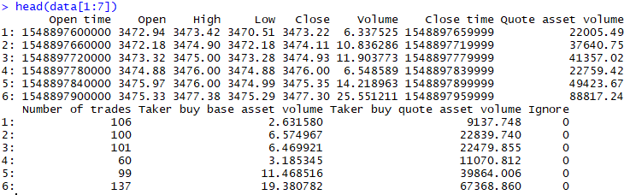
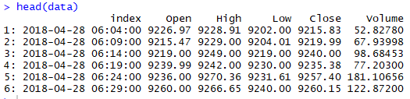
Data description
Raw:
Prepared:

Slide 5
Number of files and Trading periods
Cryptocurrencies available:
Your strategy should work for EVERY CRYPTO
Minute bar: BTC, EOS, ETH, TRX
High Frequency: BTC, BCH, ETH, LTC
Training:
High Frequency: 3weeks
Minute bar : 9months
Testing:
One week testing (immediately after data given)

Slide 6
Your job
Write a high frequency or minute-level trading strategy function. Given data from one minute, it can output its desired position next minute, which implies how will you trade (long/short) assets next minute in R or Python 3.
Input: Data[$i$th minute]
Input: Data[𝑖th minute]
Your strategy function
Your Position[$(i+1)$th minute]
Your Position[(𝑖+1)th minute]

Slide 7
Your job
for (minute_i from start_date to end_date)
Submit your strategy weekly (deadline is usually Friday mid-night) to cdldl@connect.ust.hk. TA will test your strategy’s performance using data from next week.
The testing program, several demos and this instruction are also provided to you.
Run: strategy(data[minute_i], …)
Your position at each minute
Test your strategy’s performance

Slide 8
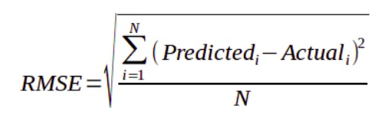
Position
Your position can be either:
1 for long
0 do nothing
-1 for short
Bonus mark for people that gives a position with a volume:
Separate modelling must be made for volume
Volume is in the interval [0,infinity]
Your volume should be as close as possible from REAL volume at time t+1. Performance metrics: RMSE

Slide 9
Trading Guideline
The initial cash is $ 100,000 (US Dollars)
At one minute, your strategy should make decision about longing / shorting different crypto currencies next minute by giving your desired position next bar (minute, hour, day).
The transaction rate is 0.0005 for each trading action. For example, suppose you strategy will short 5 BTC next minute, and the average price of BTC is $9000 next minute, then your transaction cost will be 9000*5*0.0005 = $2.5. Suppose after 1 hour, the average price turns to 9500 and you want to close your position, then you need to pay another 9500*5*0.0005 = $ 23.75 as transaction cost (TA will take care of transaction costs)

Slide 10
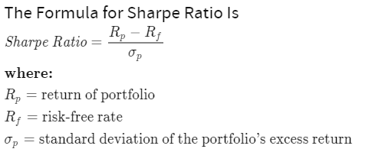
Performance evaluation

Slide 11
Grading scheme for only one crypto (100points)
Look ahead bias:
Minus 50points
High Frequency / minute bar file:
Sharpe > 10: 100points
Sharpe > 6: 70points
Sharpe >3: 30point
Bonus:
Innovative strategy: 50points
Volume within RMSE metrics: 50points
Dealing with High Frequency data: 30points

Slide 12
Work Submission
Create a folder whose name is your team name (avoid special characters)
In this folder, there must have a ““strategy.py” file. You can also add other facility files in this folder. See the comments in demos for more information.
Then zip your folder in a single .zip or .rar file. Submit it to the following mail address or my Wechat:
cdldl@connect.ust.hk

Slide 13
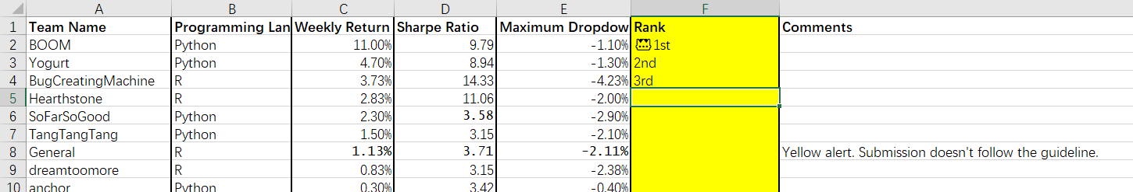
Work Submission
One week later, TA will test your strategy on new coming data and publish a leaderboard to you.

Slide 14
Demos
Moving average
R: Arima (5min bar)
Python: LSTM (1hour bar)
https://drive.google.com/drive/folders/1jBqUZgipKoATfdIlbDCTqY5nb7m3ewIw

Slide 15
About us
Professor
YAO Yuan
Teaching Assistants:
Yifei Huang
De Lavergne Cyril
Wechat: cdldl24

