Slide 1
Contributing to OpenJ9 user documentation

Slide 2
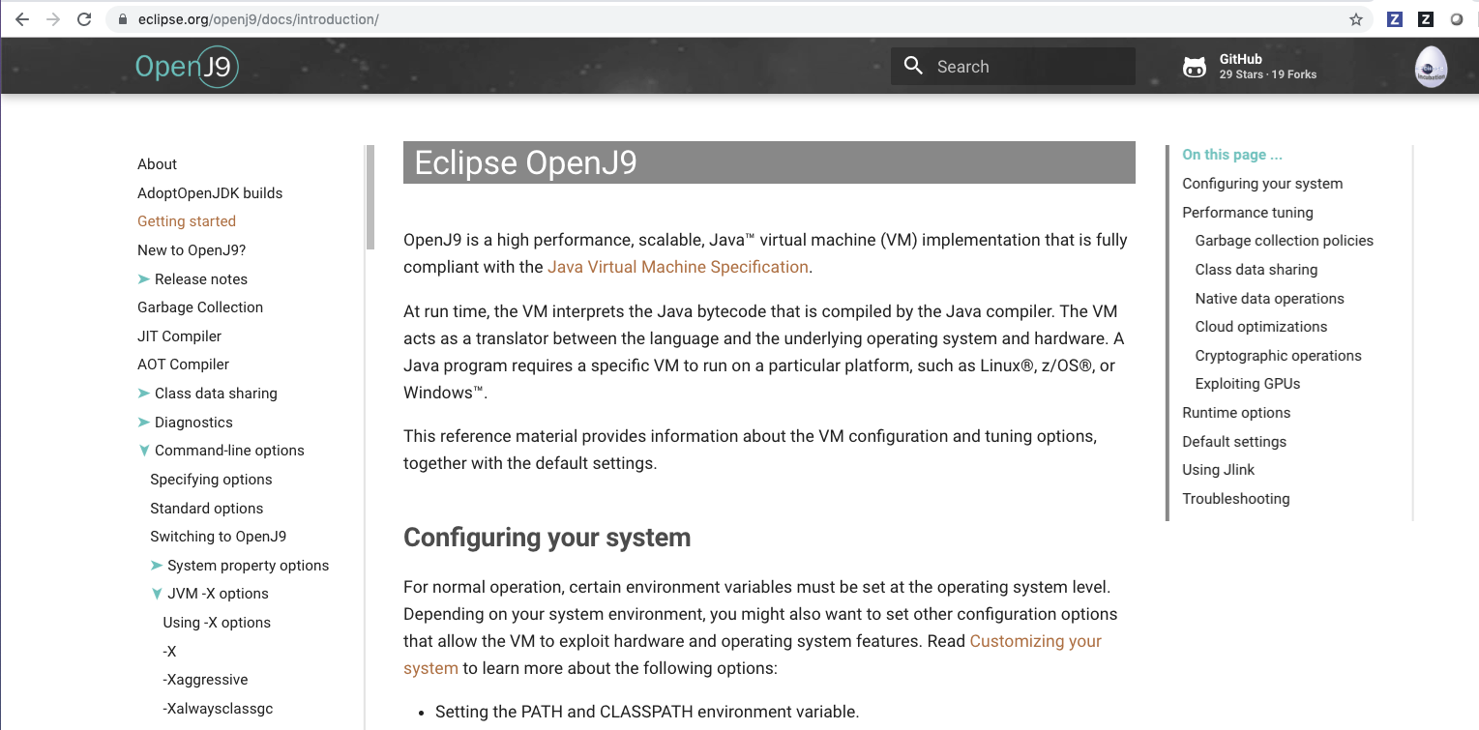

Slide 3

Eclipse OpenJ9 user documentation
The project has some dedicated resources to update and maintain the user documentation.
There are currently ~200 topics; some topics have 6000-7000 words
As the project grows, the documentation grows; the number of contributors to the docs needs to grow too
For the last 2 releases, our dedicated doc resources have struggled to ensure that the docs keep pace with the OpenJ9 code base. Help is needed!
If you work on a contribution to the OpenJ9 source, you are the best person to contribute to the documentation.
You have the technical insight into your contribution.
You know why a user would want to use your feature.
And, of course, you want users to use your feature. If the docs don’t tell people why to use it or how to use it, your efforts could be wasted.

Slide 4
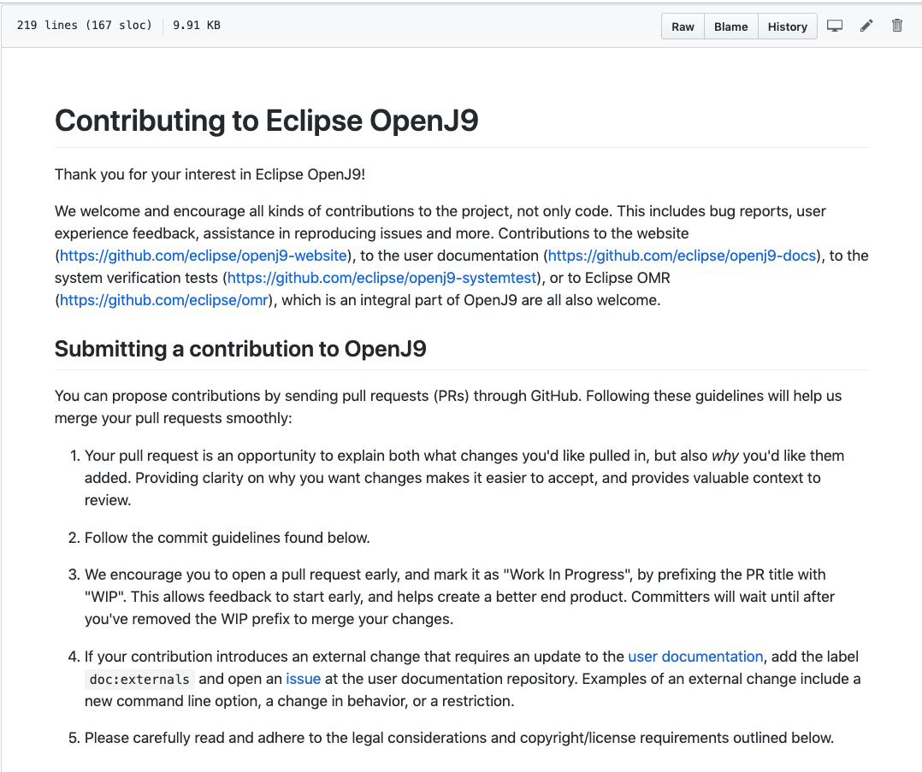
OpenJ9 contributions

Slide 5
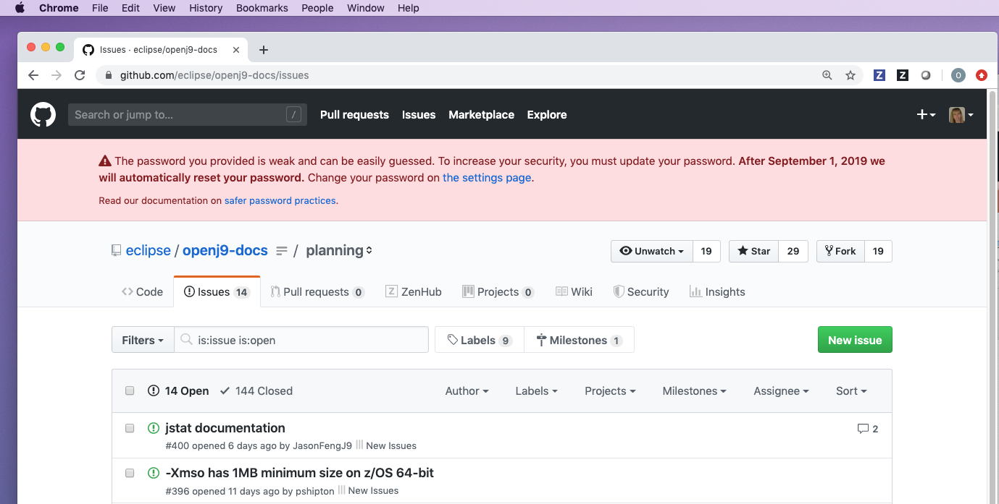

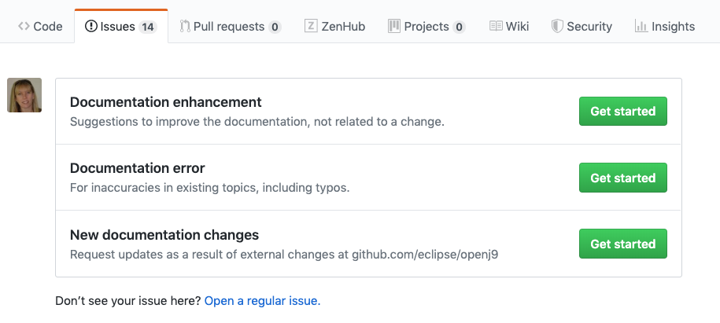
(1) Visit the openj9-docs repo
(2) Create a new issue
(3) Select template

Slide 6
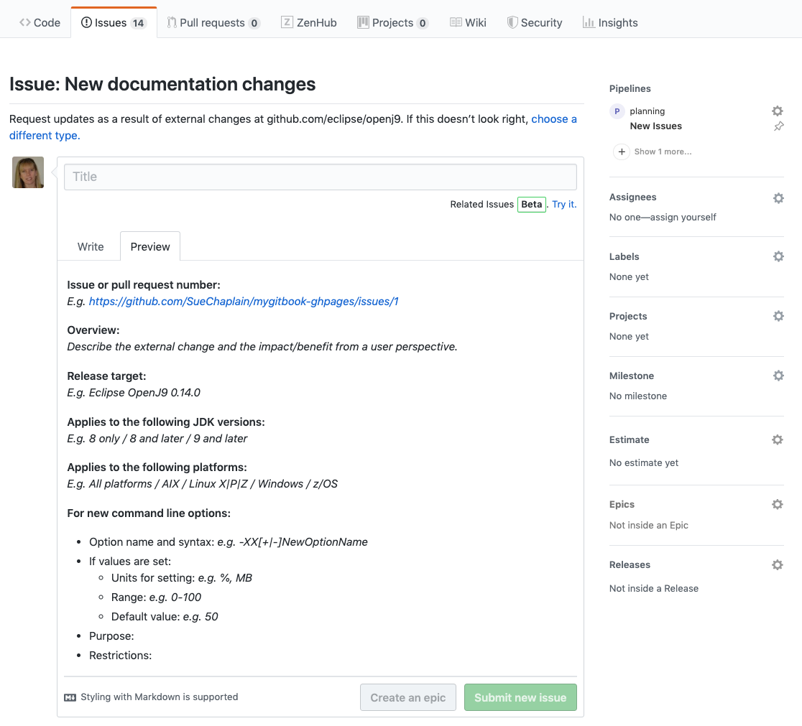
(1) Complete template
(2) Assign yourself

Slide 7
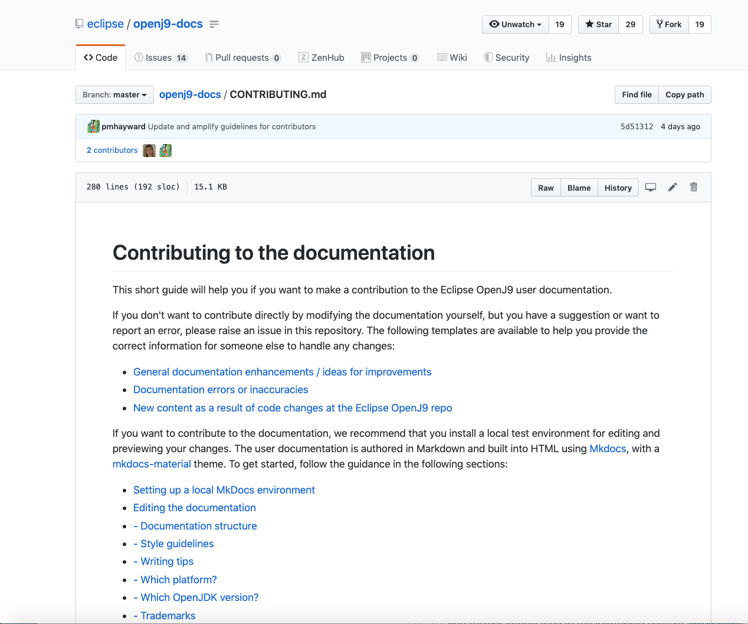
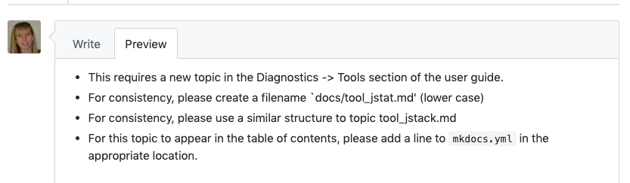
(1) Review the guidelines
(2) Read any advice posted by
the docs team in your issue
(3) Ask questions if you need
help.

Slide 8
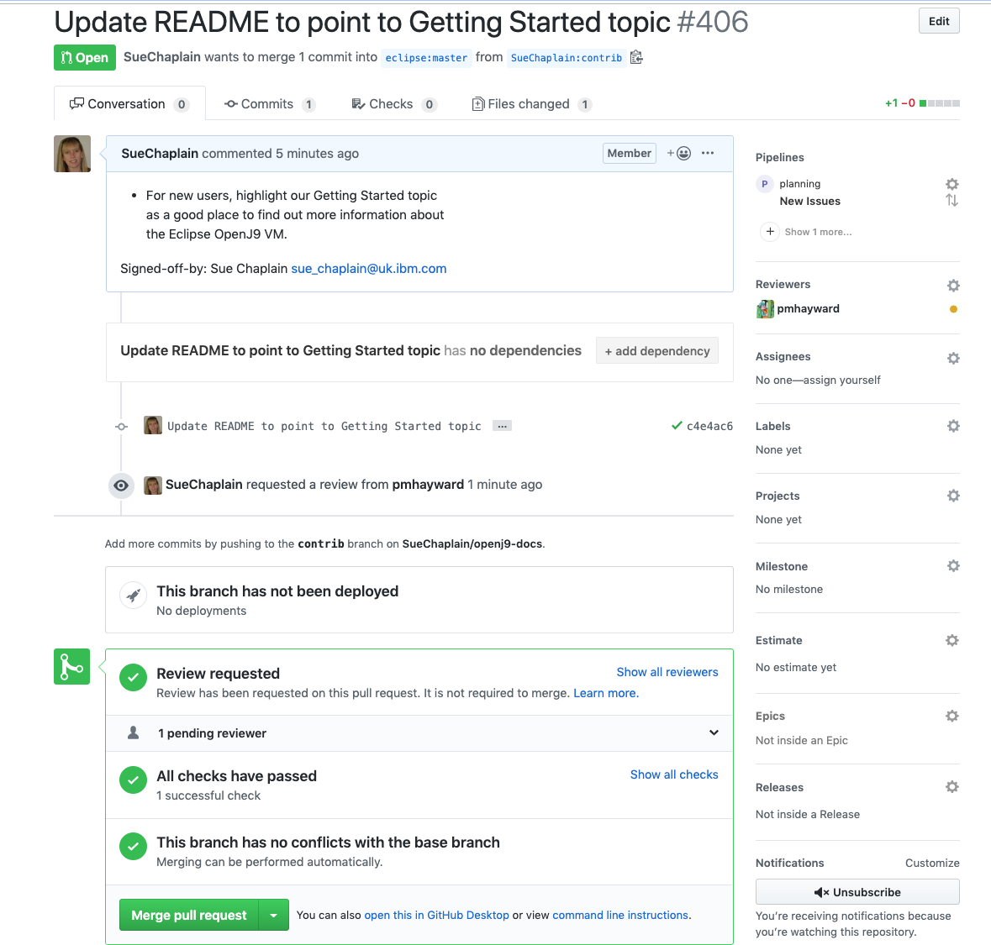
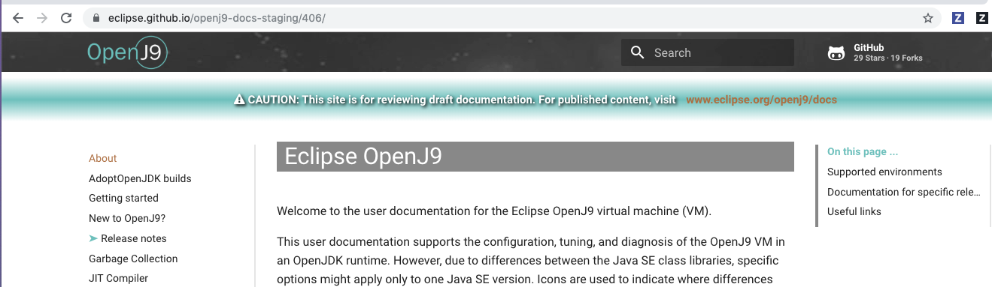
(1) Create a pull request. Add WIP
to the title until your code changes
are ready.
(2) A reviewer is assigned from
the docs team.
(3) Your changes are staged for
review.
(4) When your code changes are
ready and the doc updates are
approved, your changes are merged.

Slide 9

Top tips for contributors
Create an issue at the openj9-docs repo as soon as you know that external docs are required
Work with the docs team to establish the updates that are needed
How much work is needed?
Do you need any help?
Read the contribution guidelines to minimize any rework
Don’t wait until the last minute to start!
The issue or PR for your code should not be merged until the doc updates are ready

