Slide 1
Movie Night: Data Science - Even On Our Night Off
May 27, 2014

Slide 2
Anqi and Irene -
Math Hackers for H2O
Anqi is the in-house R expert and is responsible for K-means and PCA
Irene is the pencil and paper stats nerd and technical writer
Part of a data science team that’s 75% women, and on a technical team that’s 23% women (well above average).

Slide 3
Waterworld - what is H2O?
Same statistics - new volumes of data
On a distributed cluster models on a terabyte of data can finish in minutes.
Provide an interface to give more people the power of data science.
Also hook H2O into R and Scala

Slide 4
The <Cute title here>
Walk through the practical problem of what movie to go see together.
Examine work flow from data to prediction, and let the best model inform our choice
Extend to production setting applications with a customer use case

Slide 5
Movie Lens Data
Data is the 100,000 observation MovieLens data set
Demographic Features:
State | Age | Occupation | Gender
Factor | Integer | Factor | Factor
Levels: 62 | Range (7,73) | Levels: 21 | Levels: 2
Largest class: California | Mean: 32.9 | Largest Class: Student | M:F is about 3:1

Slide 6
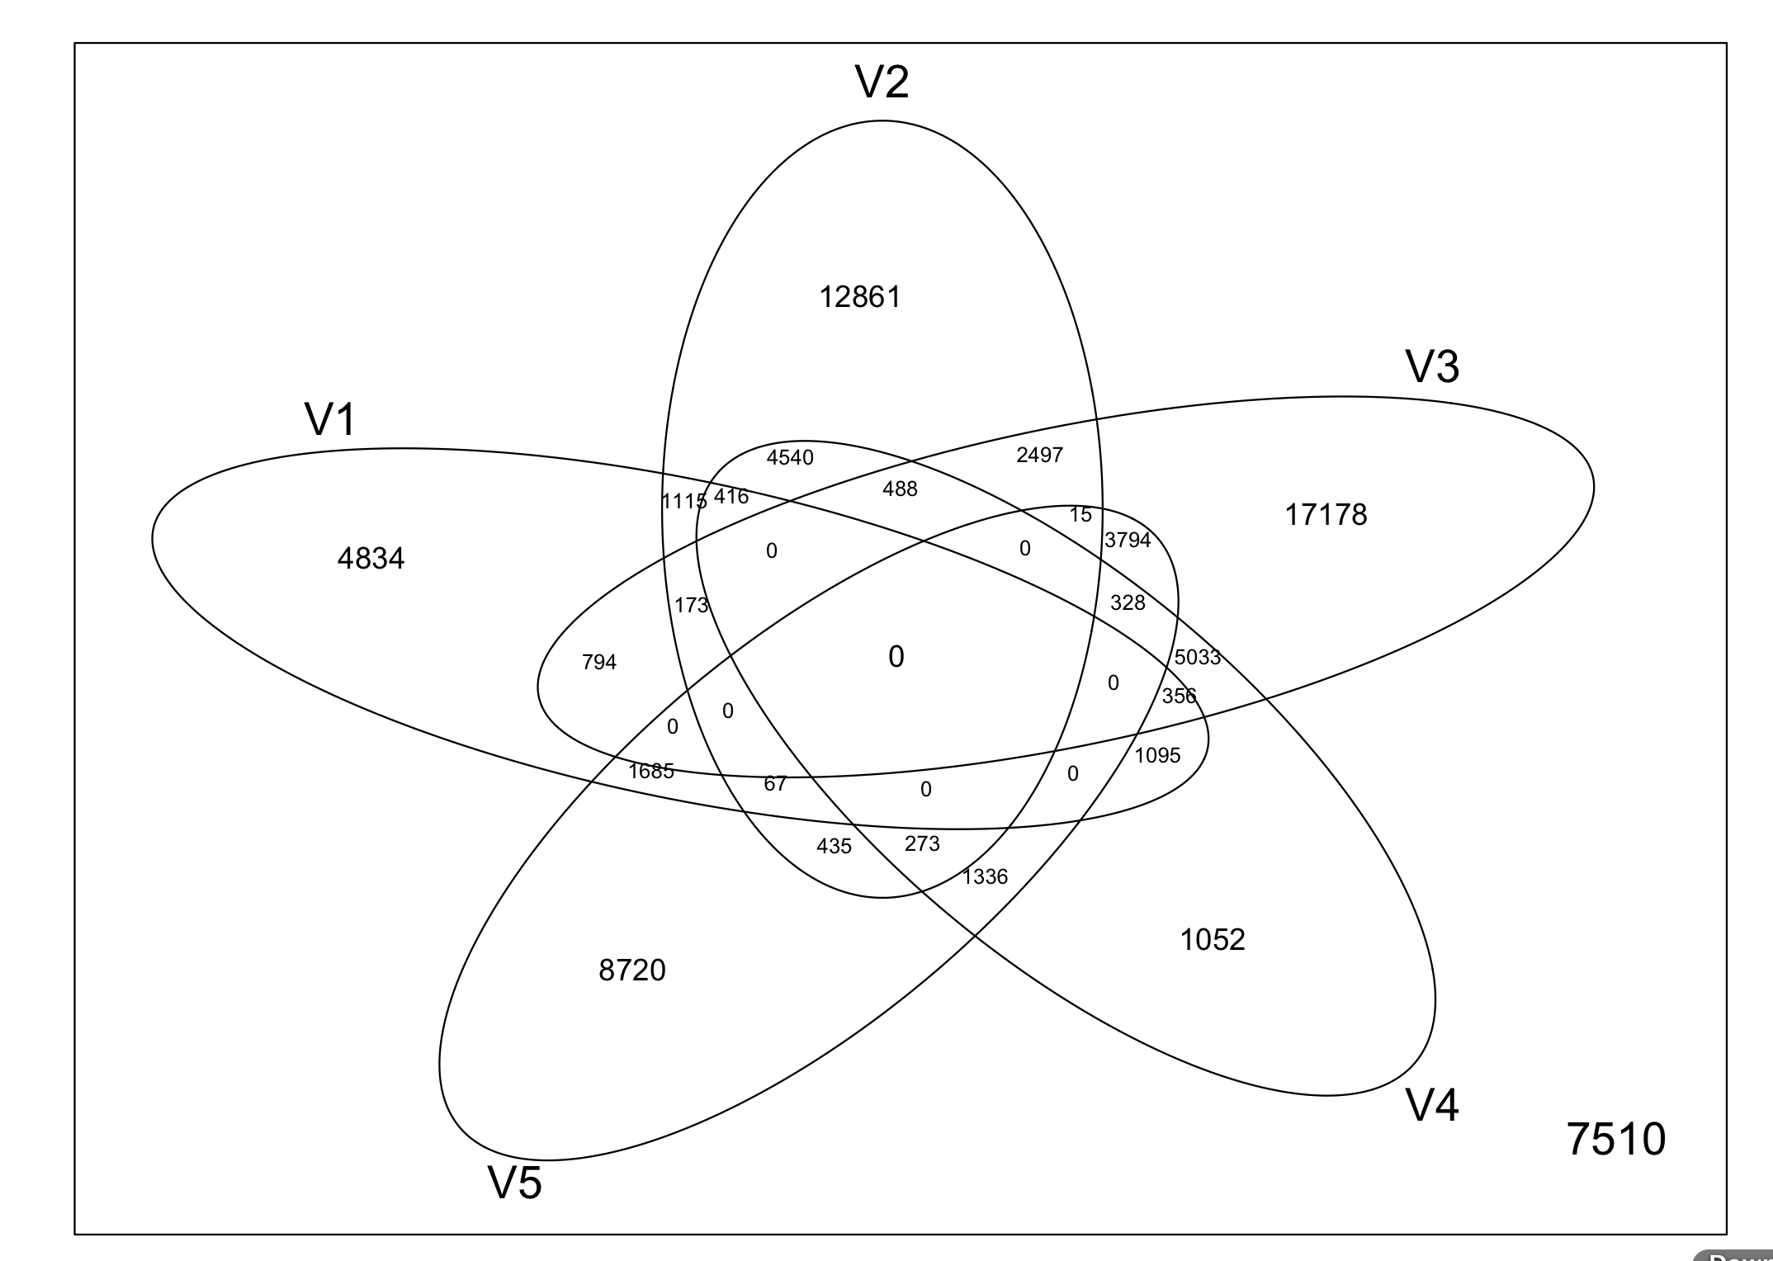
Movie Classes
Movies are classified by types, types are not exclusive. Here is a diagram of the five largest classes:

Slide 7
Dependent Variable
Users rated movies on a Likert scale of 1 to 5.
We converted this to a binomial indicator:
Ratings >= 4: recoded to 1, indicating liked movie
Ratings < 4: recoded to 0, indicating disliked the movie

Slide 8
Super Models
Both models are predicting the same dependent variable as a function of the same set of features.
Anqi modeled with tree based GBM - start simple and let the model get as complex as it needs to with depth
Irene modeled with regularized GLM - start with complexity
and let model generalize with regularization

Slide 9
WWAM: What would Anqi Model?
Using Gradient Boosted Classification on two classes
GBM is nonparametric, great when there’s no theoretical model.
Accounts for complex interaction
Control overfitting with learning rate

Slide 10
WWIM: What would Irene Model?
Logistic binomial regression
End model has interpretability
Control for overfitting introducing penalty into objective function - aids in feature selection and generalizability

Slide 11
Rubber; Meet Road
Comparison of error rates on holdout set
 | ANQI | IRENE
Error on Dislike (0) | 28% | 34%
Error on Like (1) | 18% | 50%
Overall | 22% | 43%

Slide 12
Anqi’s Predictions | Irene’s Predictions
Like: Mon Men, Need Speed, Divergent Dislike: Frz, 300, Her, Grand | Like: NeedSpeed, LoverAlive, Capt Am. Dislike: Mupps, Frz, Pebody

Slide 13
Lights Out - Some Closing Points
We didn't address a serious problem here - but this is the general process used in a production environment.
To give you a sense for the real world implementation, we’ve asked one of our users to share his use case with you.

Slide 14
Stories change people, while statistics gives
them something to argue about
- Bernie Siegel

