Slide 1
[Buffer]Overflow
0x539.us
Notes:
Good Morning everyone. My name is Chase Schultz and today I’ll be presenting my research on Python Pickles entitled “Sweet Pickles – Securing Python Serialized Objects Through Use of Modern Strong Cryptography.
On the Title Slide here you will find some information about me. I am a Network Security Student at the University of Advancing Technology.
I run a club on campus called [Buffer]Overflow that is an information security organization focusing on Cyber Security and Vulnerability Research.
Located on this slide are my email address for my school email account as well as my [Buffer]Overflow email address if you should feel the need to contact me please feel free.
Also if you are interested my Twitter and Github are also located at the bottom.

Slide 2
Sweet Pickles Securing Python Serialized Objects through use of Modern Strong Cryptography
By Chase Schultz
University of Advancing Technology – http://www.uat.edu
Network Security Student
chaschul@uat.edu
[Buffer]Overflow – President And Founder - http://www.0x539.us
Security Researcher
f47h3r@0x539.us
TWITTER - @f47h3r_b0
GITHUB – https://github.com/f47h3r

Slide 3
Background
Security Projects
Sweet Pickles
Crypto Wrapper
MS RPC Fuzzer
Application Security Research
Reverse Engineering
Vulnerability Research
Exploit Development
Source Code Analysis
Experience
Stach & Liu – Web App Penetration Tester
[Buffer]Overflow – Security Research
Programming Projects – C/C++, Python, PHP
Notes:
So this is some background information on me and some of the interests I have in the Information Assurance Field.
My focuses are primarily on application security. This includes Reverse Engineering, Vulnerability Research, Exploit Development, and Source Code Analysis.
In the private sector I have worked as a penetration tester, doing mainly web application security assessment.
In Buffer Overflow I mainly focus on Vulnerability Research and Exploit Development.
Some of the security projects I have worked on include Sweet Pickles – which I will be speaking about today. The CryptoWrapper I’ve written for use on various projects. And in the future I will be working on a fuzzer for Microsoft Remote Procedure Calls.

Slide 4
Agenda
* What Are Python’s Pickles?
* Sour Pickles at Blackhat
* How to Exploit Pickles
* Problem
* Proposed Solution
* A Few Words About Cryptography
* Practical Application of Cryptography
* Securing Python Pickles
* Introduction of Sweet Pickle Brine
* Questions
Notes:
Self Explanatory

Slide 5
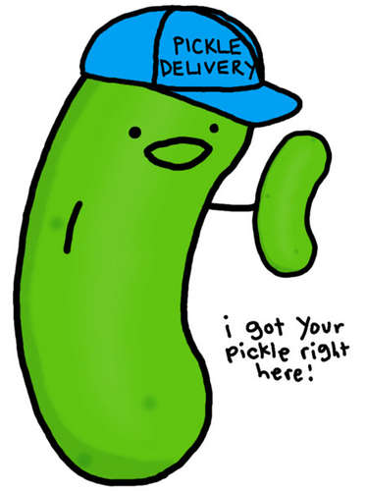
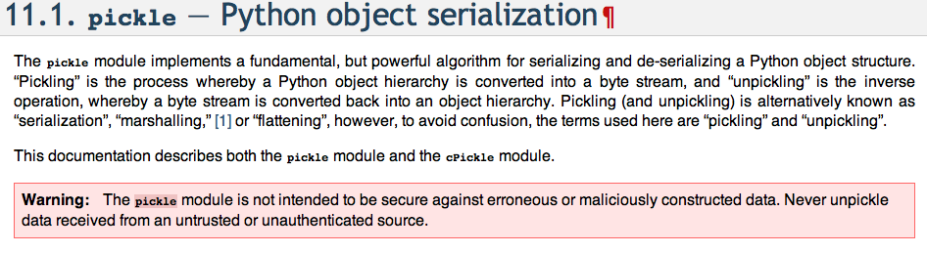
What Are Pickles ?
Python documentation even mentions insecurities
Figure 1 - http://docs.python.org/library/pickle.html
import pickle
class ObjectToBePickled:
def __init__(self, x):
self.string = ‘Hello World’
self.list = [‘objects’,’in’,’list’]
self.dict = {‘key’:’value’}
obj = OjectToBePickled();
pickledObj = pickle.dumps(obj)
import pickle
‘’’Object is Reconstructed’’’
obj = pickle.loads(pickledObj)
print obj.string
print obj.list
print obj.dict
pickledObj

Slide 6
Sour Pickles @ Blackhat
* Blackhat USA 2011 – Marco Slaviero – SensePost – “Sour Pickles”.
* Python Pickle exploitation and arbitrary code injection and vulnerabilities.
* Presentation available online:
* Slides – Blackhat Media - Sour Pickles Slides [PDF]
* Whitepaper – Blackhat Media - Sour Pickles Whitepaper [PDF]
* Tools Released for Pickle Exploitation: Anapickle.py / Converttopickle.py

Slide 7
Problem?
* Can be modified:
* In transit via Man in the Middle (MITM Attack)
* While at rest prior to unpickling (deserialization)
Absence of Features:
* Trust based model for handling pickles securely
* Libraries addressing issues using modern strong cryptography
* Projects that attempt to address these problems:
Trusted Pickles – http://trustedpickle.sourceforge.net/
* Proprietary Public Key Algorithm * No use of publicly available cryptographic methods * Confidentiality not provided
Notes:
* There is no way to Verify of the origin or authenticity of pickles
* Pickles can be modified / changed in transit or while at rest prior to unpickling (deserialization)
* There is no trust based model for handling pickles securely. There no way to establish or verify the identity of the Sender of the Pickle.
* Currently there are no other libraries address this issue using modern strong cryptography.
* A few other projects attempt to address this problem –
Trusted Pickles (Proprietary Public Key Algorithm, doesn’t use publicly available crypto methods, doesn’t provide confidentiality.)

Slide 8
A few Words about Cryptography CIA Triad of Cryptography
Confidentiality
Authentication
Integrity

Slide 9
A few Words about Cryptography Weak / Questionable / Outdated Cryptography
* Data Encryption Standard (DES) – Also known as the Lucifer Cipher(predecessor to DES) created by IBM.
* 56-bit Symmetric Key
* Created in 1973-1974
* Known attacks
* Universities of Bochum and Kiel, Germany build a
machine that can break DES within 24 hours.
* Rivest, Shamir and Adleman (RSA) – “First” Public Key or Asymmetric Cipher – Capable of Signing
* 1024-bit, 2048-bit, 4096-bit Asymmetric Key
* Published in 1978
* Known attacks

Slide 10
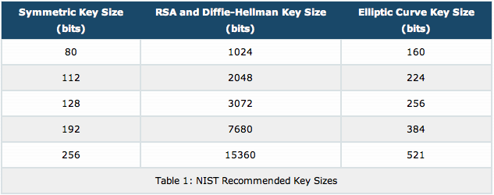
A few Words about Cryptography Security of Ciphers
Figure 2 - http://www.nsa.gov/business/programs/elliptic_curve.shtml
[3] The Case For Elliptic Curve Cryptography - http://www.nsa.gov/business/programs/elliptic_curve.shtml

Slide 11
A few Words about Cryptography Modern Strong Cryptography
* Advanced Encryption Standard (AES) – Also know as the Rijndael Cipher
* 128-bit, 192-bit, 256-bit Symmetric Key
* Published: Vincent Rijmen, Joan Daemen in 1998
* NIST FIPS 197 Encryption Standard in 2001
* Rated for SECRET(128) and TOP SECRET(256) classifications
* Elliptic Curve Cryptography (ECC) – Also Capable of Signing
* 160-bit, 224-bit, 256-bin, 384-bit, 521-bit
* Suggested: Neal Koblitz/Victor S. Miller in 1985
* Rated for SECRET(256) and TOP SECRET(384) classifications
Source [3] - http://www.nsa.gov/ia/programs/suiteb_cryptography/

Slide 12
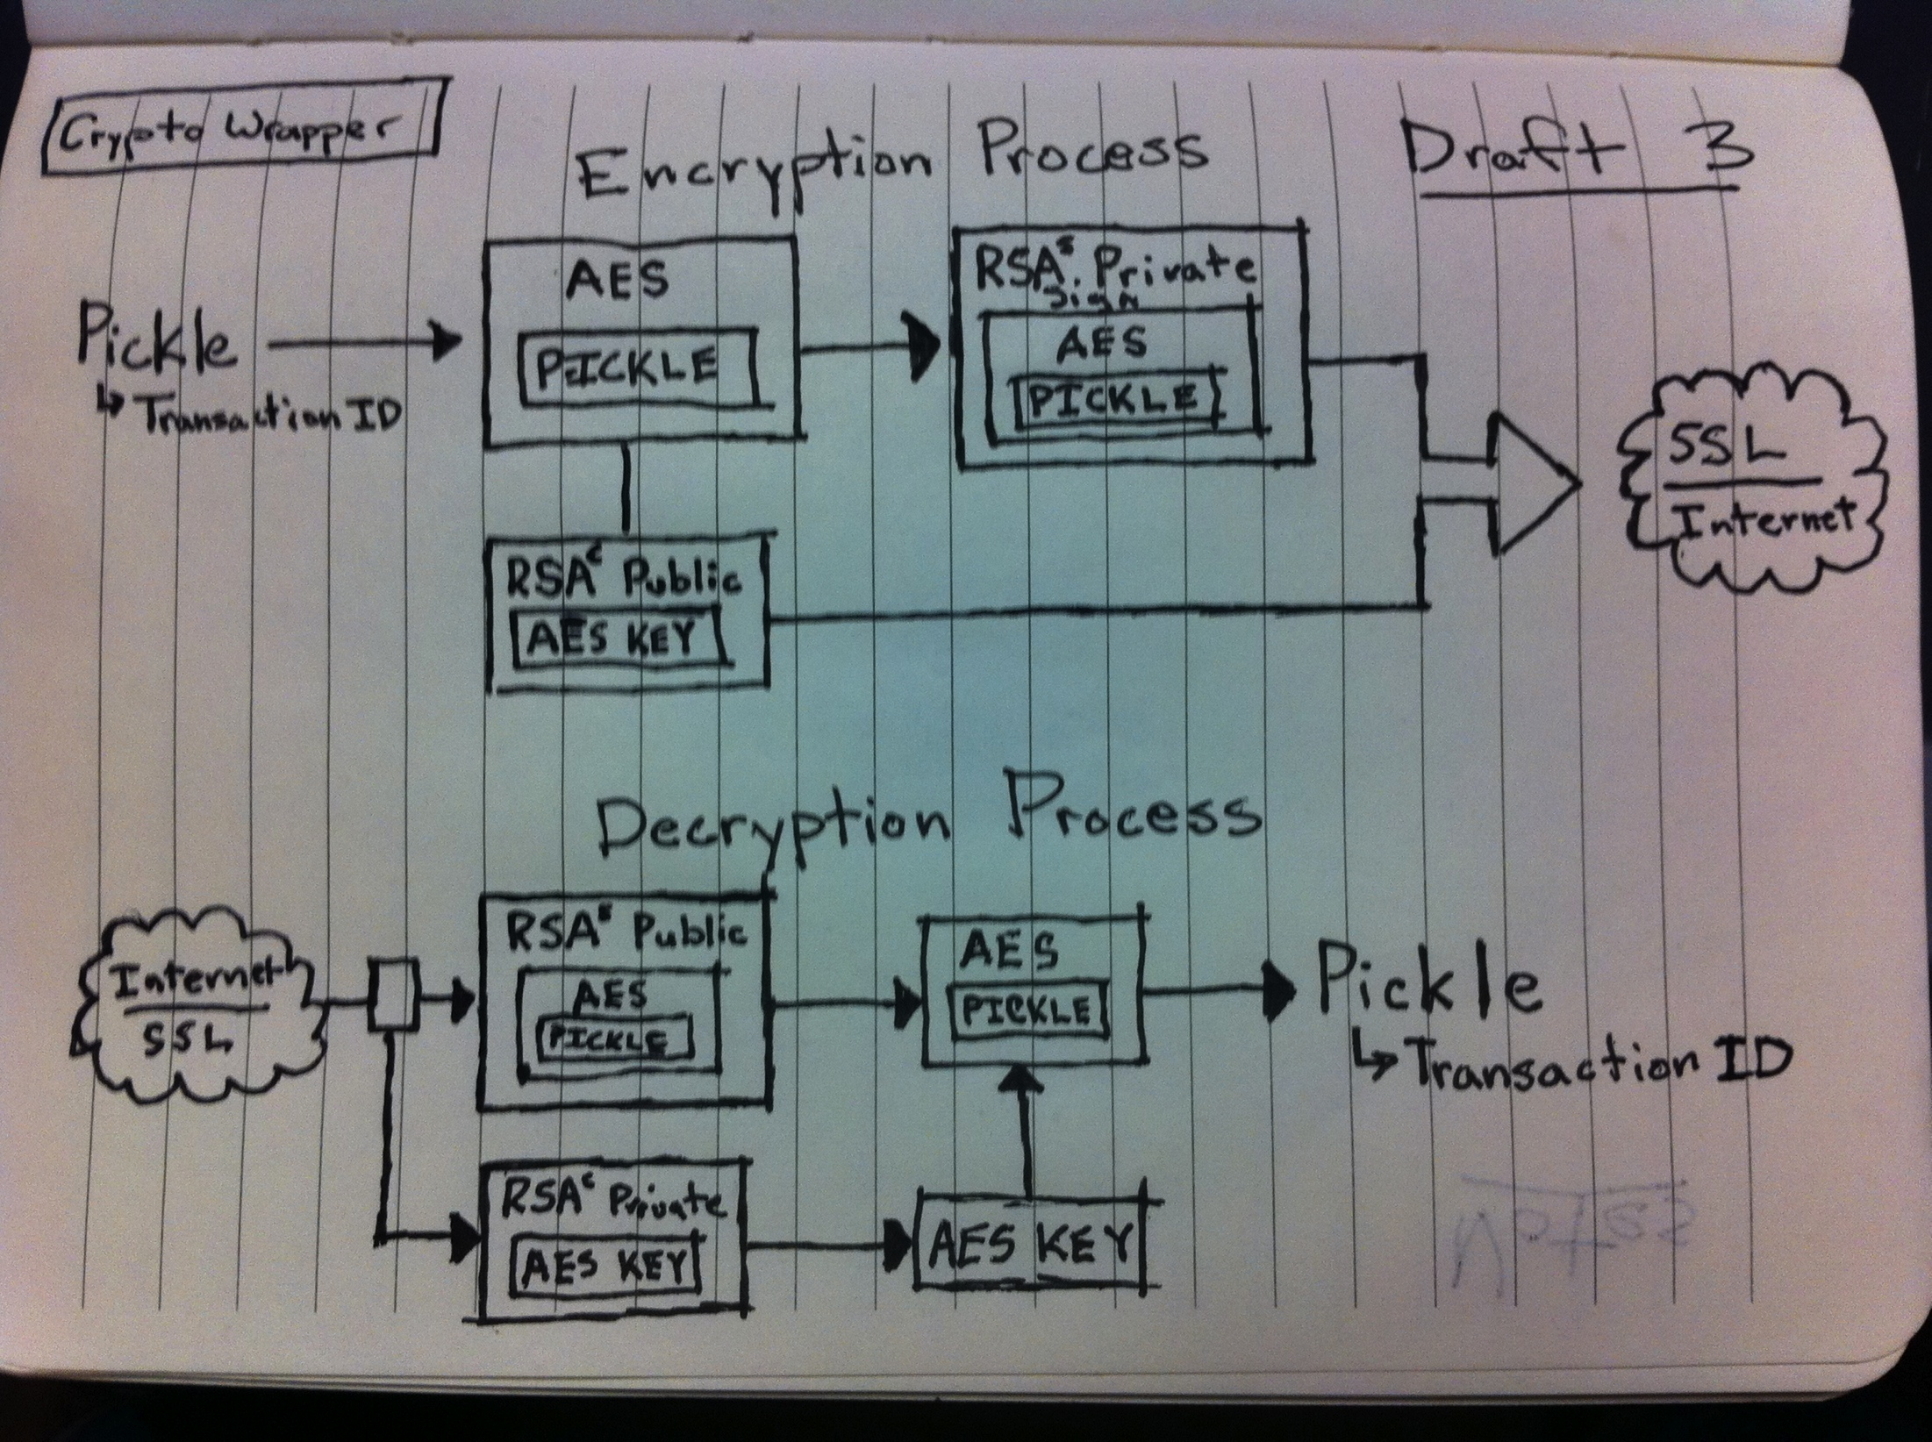
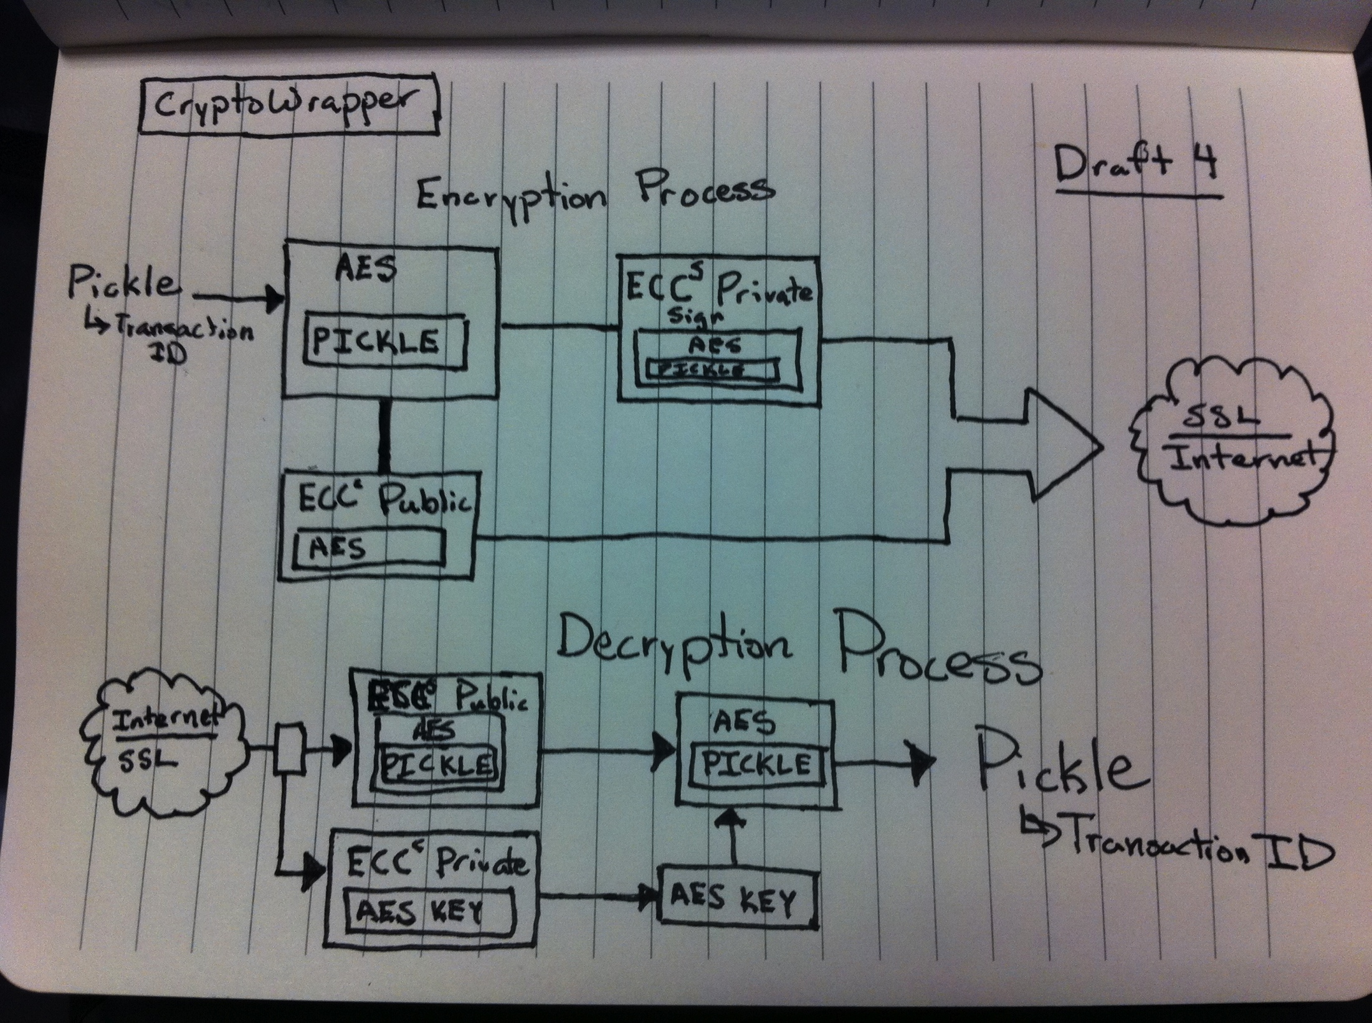
Practical Application of Cryptography

Slide 13
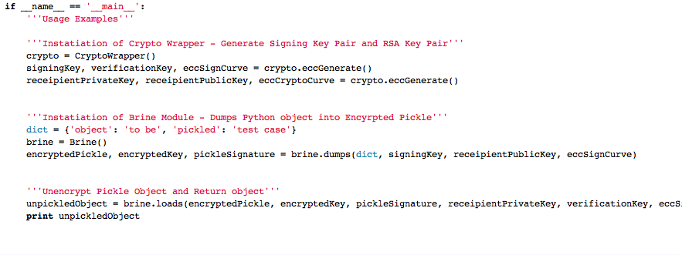
Code Implementation

Slide 14
QUICK DEMO

Slide 15

Introducing Sweet Pickle Brine
* Sweet Pickle Brine: https://github.com/f47h3r/Brine
* Completely Free Open Source GPL Licensed
* AES-256 Encryption of Pickle
* ECC-521 Encryption of AES Key
* ECC-521 Signing of Pickle
Project Dependencies: pyCrypto & PyECC

Slide 16

Questions / Comments ?
Chase Schultz
Email: chaschul@uat.edu
Twitter: @f47h3r_b0

Slide 17
Thank You!
[Buffer]Overflow
0x539.us

