Slide 1
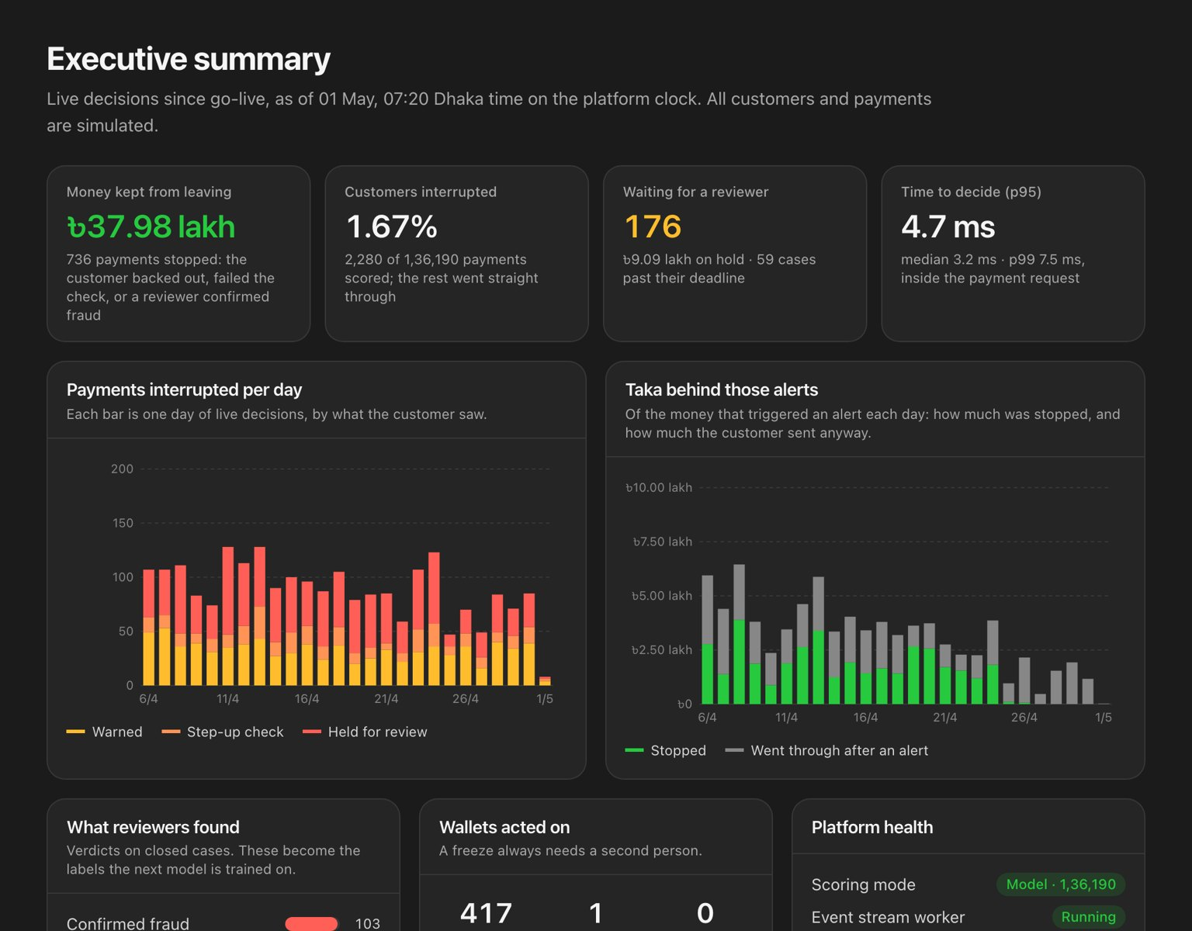

TEAM WEBNEST
FraudLens
Stop the scam before the money moves
Real-time fraud decisions for mobile money in Bangladesh. FraudLens scores every payment, and the wallet it is going to, in a few milliseconds, explains why in Bangla and English, and leaves every irreversible decision to a person.
86.9%
0.53%
3.4 ms
0
scams caught at
the warning tier
honest payments
interrupted
p95 to score,
decide, explain
served vs. evaluated
differences
Team Webnest · 2026
Notes:
Hello, we are Team Webnest. Our project is FraudLens: a real-time fraud decision system for mobile money. In one line: it stops the scam before the money moves, explains its reasons in Bangla and English, and keeps a human in charge of anything that cannot be undone. The four numbers at the bottom are from a 25-day test period on synthetic data, including a scam type the models never saw.

Slide 2





In a scam, the victim presses “send” themselves
THE PROBLEM
Scammer calls
Victim sends
Mule wallet
Agent cash-out
Poses as upay staff, a lottery office or an investment agent
Genuine phone, PIN and location: every sender check passes
Collects money from many victims, often rented or opened with stolen NIDs
Money hops once or twice, then leaves as cash within minutes
Why it is hard: the fraud signal is not on the sender. It is on the receiving wallet and its network, and the window to act is the few seconds before the money moves.
Notes:
This is what makes authorised-push-payment scams so hard. A caller pretends to be wallet staff, or offers a lottery prize or an investment. The victim uses their own phone, their own PIN, from their usual location. Every check on the sender says this is normal. The money lands in a mule wallet and is cashed out at an agent within minutes. Once it is cash, it is gone.

Slide 3

Why today’s defences fall short
THE PROBLEM
Only the sender is checked
Hand-written rules
The victim is genuine, so sender checks see a normal payment
1 in 8
Blocking is too late and too blunt
Honest customers get frozen; scammed customers get no warning
alerts are right
Warnings in English
Customers don't read them at the moment it matters
FraudLens, same alert budget
“The model said so”
8 in 10
Analysts and regulators cannot check a black box
Rules go stale
PR-AUC 0.076 → 0.834
New scam scripts appear faster than rules are written
Notes:
Most wallets today run hand-written rules. On our test data, a rules-only system is right about one alert in eight. And even when it is right, it has other problems: it looks only at the sender, it blocks bluntly, it warns in English, it can't explain itself, and it never learns.

Slide 4






One question, answered in a few milliseconds
OUR IDEA
“Is this payment going to a scammer — and if so, what is the gentlest thing that will stop it?”
Look at the receiver
Gentle, graduated
Speak Bangla
Score the receiving wallet and its network, not just the sender
allow → warn → step-up → hold; the customer decides the first two
Fixed, reviewed warning texts in Bangla and English
Explain everything
People decide
Keep learning
SHAP reasons as sentences, a rule trace, the closest past case
A hold waits for an analyst; a freeze needs two people
Verdicts become labels; challengers run in shadow mode
Notes:
FraudLens answers one question: is this payment going to a scammer, and if so, what is the gentlest thing that will stop it? Every part of the system serves that question.

Slide 5



A warning in Bangla, before the money moves
CUSTOMER EXPERIENCE
In English
Send money
“Pause before you send. Scammers pose as upay staff, lottery officials or investment agents and ask people to send money to wallets like this one. Do you know this person, and did you decide to pay them yourself?”
To 01XX-XXX-5714
Amount ৳9,130
⚠ একটু থামুন
Warn
Customer cancels, or continues knowingly
টাকা পাঠানোর আগে একটু থামুন। প্রতারকরা উপায় কর্মকর্তা, লটারি কর্তৃপক্ষ বা বিনিয়োগ এজেন্ট সেজে এ ধরনের ওয়ালেটে টাকা পাঠাতে বলে। আপনি কি এই ব্যক্তিকে চেনেন?
Step-up
Verify again, then wait out a 30-minute cooling-off
Hold
“Your money is still in your wallet” while an analyst reviews
বাতিল করুন
তবুও পাঠান
Notes:
This is what the customer sees, inside the upay app. A warning in Bangla, at the one moment it can still help. If the customer doesn't know the person, they cancel, and the money never leaves. For riskier payments, they verify again and wait out a cooling-off period. For the riskiest, they're told their money is still safe in their wallet while a person reviews it.

Slide 6
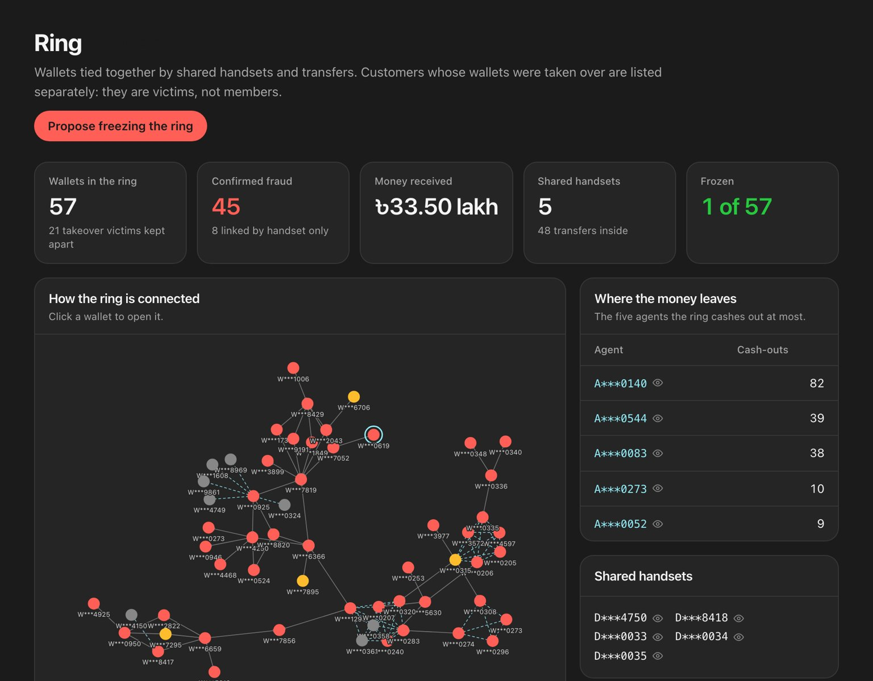
Catch the mule, not just the payment
FOLLOW THE MONEY
70
40.2 h
mule wallets flagged before any victim had paid
median warning ahead of the victim's report
94 of 145 mules detected overall
time to freeze before the next victim
34 rings
90.9%
covering 331 wallets, 94% true fraud cells
precision on agent review list, no labels
one case per mule, not per victim
finds every commission-farming agent
Notes:
Because we score receivers, we find mule wallets — 94 of 145 — and 70 of them before any victim had paid. The median lead is 40 hours before the victim's report. Rings link wallets by shared handsets and transfers: 34 rings, 331 wallets, 94% true fraud-cell members. Agent risk needs no labels and still finds every commission-farming agent. And money that got through gets a second chance at cash-out.

Slide 7
The headline numbers
RESULTS
1.45M
86.9%
0.53%
3.4 ms
0
simulated transactions
over 120 days
of scams caught at
the warning tier
of honest payments
interrupted
p95 to score, decide
and explain
differences between
served and evaluated
134,545
৳35.5 lakh
96.6%
98.5%
payments in the test period
at risk in the test period
of victims' money stopped at warn+ (incl. cash-out holds)
of payments never interrupted
Notes:
Results, from the 25-day test period: 134,545 scored payments and 35.5 lakh taka at risk, with thresholds fixed beforehand on validation data. 86.9% of scams caught at the warning tier, while interrupting only half a percent of honest payments. 3.4 milliseconds p95. And zero differences between what the live service decided and what we evaluated offline. All data is synthetic, and one scam type was hidden from training on purpose.

Slide 8






11× better ranking than hand-written rules
RESULTS
Ranking quality (PR-AUC), test period · higher is better
×11
Hand-written rules
0.076
better PR-AUC than the rules many wallets run today
Anomaly only
0.175
Mule model only
0.375
Rules
0.076
Transaction model (served)
0.834
FraudLens
0.834
Fusion of all three
0.835
Fusion only ties, so the simpler model is served.
Notes:
Ranking quality, measured as PR-AUC on the test period. Hand-written rules score 0.076. The anomaly model alone 0.175, the mule model alone 0.375. The served transaction model reaches 0.834. Fusing all three is level at 0.835 but slightly behind on validation, so we serve the simpler model and keep the comparison — an honest engineering choice.

Slide 9




Tech stack: built, tested and running
HOW WE BUILT IT
Models
API & data
Console
Ops
Python 3.12
LightGBM
scikit-learn
SHAP
FastAPI
SQLAlchemy · Alembic
PostgreSQL
Redis Streams · SSE
Next.js 16
React 19
Tailwind CSS v4
d3-force graphs
Docker Compose
Make · uv · pnpm
Playwright smoke
GitHub Actions CI
make demo
227
CI
every page
one command: build, train, replay, serve
backend tests
real Postgres + Redis, both images built
smoke-tested as every role
Notes:
Python 3.12 with LightGBM, scikit-learn and SHAP for models. FastAPI, SQLAlchemy, Alembic, Postgres, Redis Streams and server-sent events for the platform. Next.js 16, React 19, Tailwind v4 and d3-force for the console. Everything runs with one command — make demo — with 227 backend tests, lint, a Playwright smoke test of every page as every role, and CI against real Postgres and Redis.

Slide 10
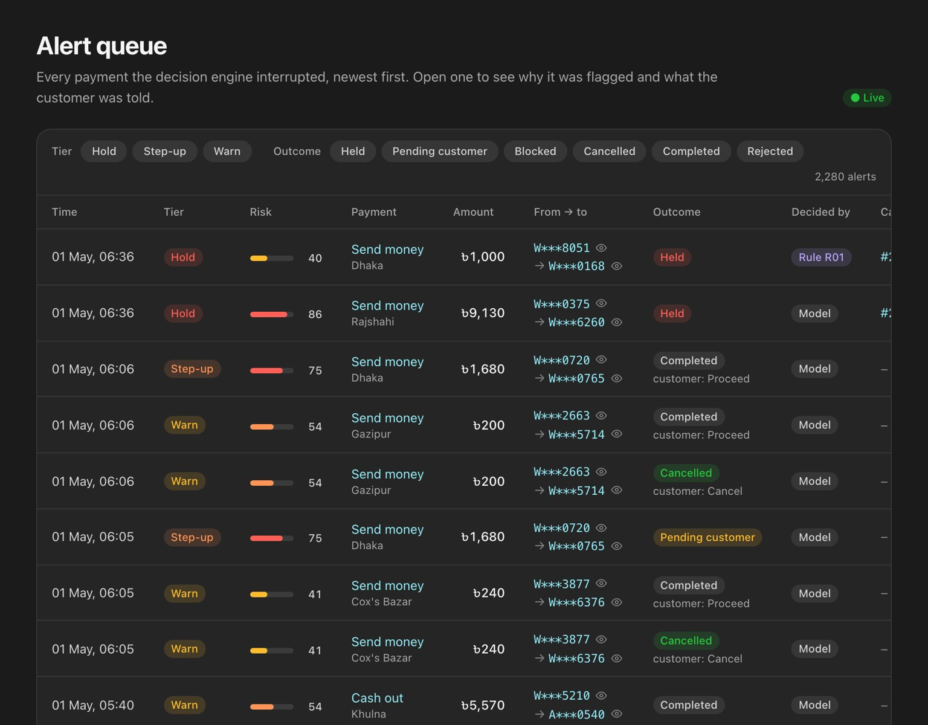
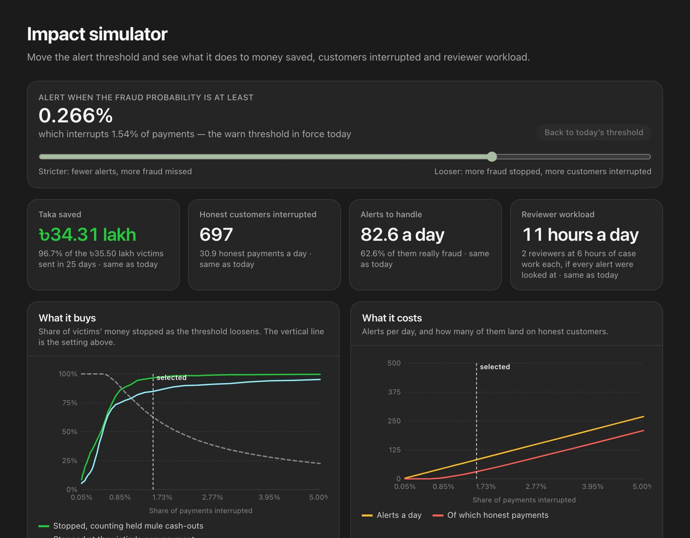
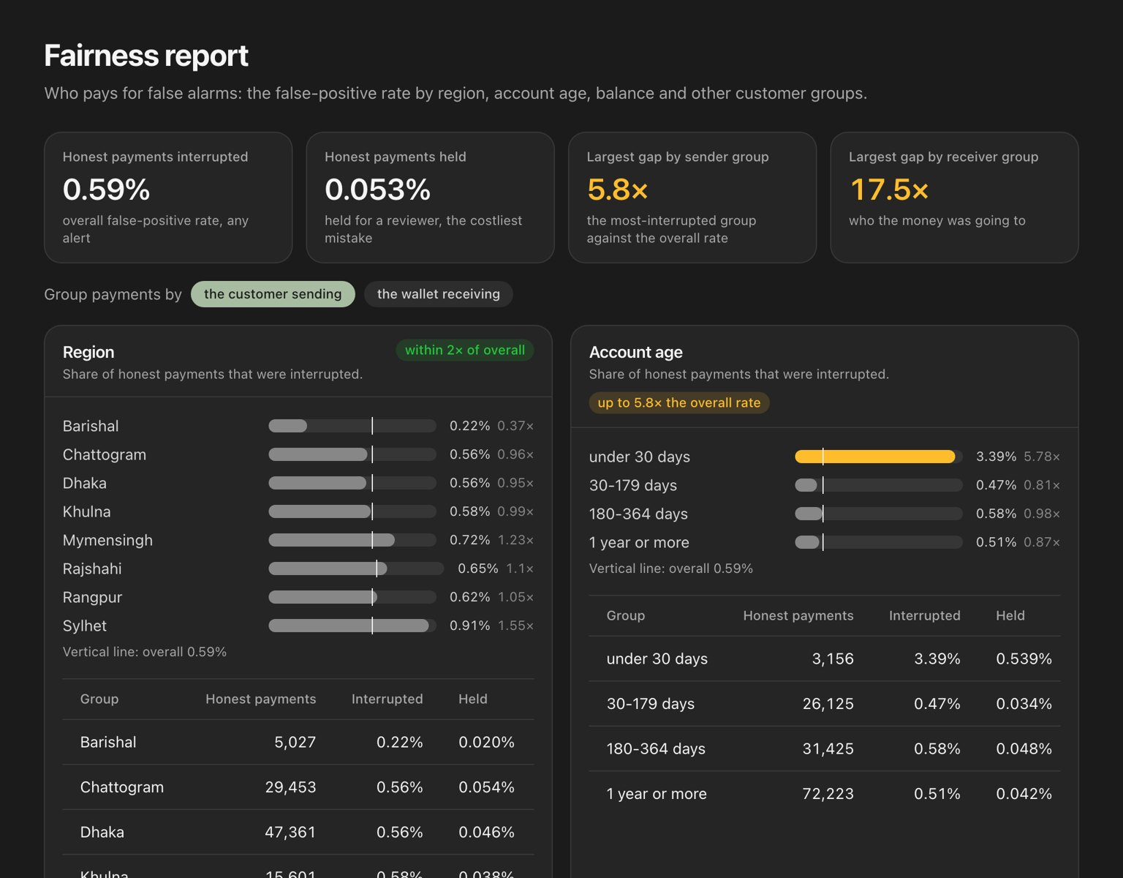
What we built: a working fraud console
LIVE DEMO
Executive summary
Alert queue
Impact simulator
Fairness report
money stopped, interruptions, latency, live
every interrupted payment over a live feed
move the threshold, see the trade-off
false alarms by region, age, balance, channel
Also: Cases · Freeze approvals · Network explorer · Mule rings · Agent risk · Model monitoring · Decision policy · Audit log · Fraud types · Customer phone demo
Notes:
A quick tour of the console. The executive summary shows money stopped, customers interrupted, reviewer queue and latency from the live service. The alert queue shows every interrupted payment over a live feed. The impact simulator lets the business move the threshold and watch money saved, customers interrupted and reviewer hours move together. And the fairness report shows who pays for false alarms.

Slide 11

Why FraudLens is a hero fraud detection system
WHY WE WIN
Capability
Rules-only
FraudLens
Looks at the receiving wallet and its network
Graduated response: warn → step-up → hold
Warnings in Bangla at the moment of payment
Exact reasons, rule trace and closest past case
Catches a scam type it has never seen (70% at warn)
Second chance at cash-out; mules found before victims pay
Human decides holds; two-person freeze; append-only audit
partial
Served = evaluated, proven on 136,180 decisions
The model ranks and explains, the customer gets the first say, and a person makes every irreversible decision.
Notes:
So why do we call it a hero? Compare it with the rules-only systems many wallets run. FraudLens looks where the fraud actually is — the receiving wallet. It responds gently instead of bluntly. It speaks Bangla. It explains every decision. It catches a scam it has never seen. It gets a second chance at cash-out. It keeps humans in charge of every irreversible action. And we proved that the system we serve is exactly the system we evaluated.

Slide 12
The victim presses send,
so look at where the money is going.
Thank you
Questions & live demo
TEAM WEBNEST
Notes:
To close: in a scam, the victim presses send, so FraudLens looks at where the money is going. The model ranks and explains, the customer gets the first say, and a person makes every irreversible decision. Thank you — we're happy to take questions or show the live demo.

