Slide 1
PREDICTING APARTMENT
RENTAL PRICES IN SWITZERLAND
A supervised machine-learning approach for the Swiss cold-rent market
DSPRO1 Final Presentation | Spring 2026 (FS26)
Team 8 | Elias Martinelli | Timo Schlumpf
Supervisor: Elena Nazarenko

Slide 2
Agenda
2 / 22
20 minutes | six chapters | pitch + technical deep-dive
1
The problem
2
Data and scraping pipeline
Why is a fair rent so hard to judge?
From 25'002 URLs to a clean modelling set
3
Modelling approach
4
Results and error analysis
Six models on the same split
What works, what doesn't, and why
5
Demo
6
Conclusions and next steps
Streamlit app with address lookup
Where we landed and what's next
DSPRO1 FS26 | Team 8 | Predicting Apartment Rental Prices in Switzerland

Slide 3
01
THE PROBLEM
Why a fair Swiss rent is hard to judge
3 / 22

Slide 4
The problem
4 / 22
You find this listing
Why is this hard to judge?
3 rooms 80 m² Zurich
Location dependency
The same apartment can cost twice as much across cantons.
Many interacting features
Living area, rooms, floor, year built, amenities, public transport …
CHF 2'400 / month
No transparent benchmark
Is this fair?
There is no public per-listing reference model on the market.
Our goal: build a supervised ML model that predicts fair rent from listing data.
DSPRO1 FS26 | Team 8 | Predicting Apartment Rental Prices in Switzerland

Slide 5
Why does it matter?
5 / 22
Three stakeholder groups benefit from a transparent estimate
Tenants
Landlords
Society
Spot overpriced listings before signing the contract; budget realistic rent ranges before moving.
Set a market-based price for vacancies; calibrate offers without paying for a private appraisal.
A transparent reference value supports the discussion around rent affordability and regional fairness.
DSPRO1 FS26 | Team 8 | Predicting Apartment Rental Prices in Switzerland

Slide 6
Hypothesis
6 / 22
"Location-related variables combined with structural apartment features contain sufficient signal to predict monthly rental prices in Switzerland with practically useful accuracy, and a Random Forest Regressor will outperform a Linear Regression model in doing so.
Source: project proposal, mid-term presentation slide 6
We test this with a baseline, a linear benchmark, and four tree-based models.
DSPRO1 FS26 | Team 8 | Predicting Apartment Rental Prices in Switzerland

Slide 7
02
DATA AND PIPELINE
From 25'002 URLs to about 4'500 modelling rows
7 / 22

Slide 8
Data source
8 / 22
Rentumo Rental Listings Switzerland v1.0 | 13 April 2026
Single-shot scrape
Why Rentumo, not Comparis?
25'002
■ Comparis requires written authorisation for scraping.
■ Comparis access cap is around 300 records, not enough for ML.
■ Rentumo was contacted by e-mail before scraping; no reply was received.
■ Data is used only for non-commercial academic purposes (HSLU DSPRO1).
URLs identified on rentumo.ch
9'994
listings successfully extracted
The remaining 15'008 pages are empty placeholder URLs. This is a property of the platform, not a scraping defect.
Single-platform bias
All listings come from rentumo.ch. Adding a second platform is the most obvious next step (see future work).
DSPRO1 FS26 | Team 8 | Predicting Apartment Rental Prices in Switzerland

Slide 9
Scraper architecture
9 / 22
ScrapeGoat: custom Rust library, two-phase pipeline
Phase 1: Listing index pages
Orchestration: Mgt
■ 750 paginated pages /mietobjekte?page={1..750}
■ CSS selectors on #listings container
■ Extracts: rooms, area, cold rent, slug
■ INSERT ... ON CONFLICT (slug) DO NOTHING
■ Up to 10 concurrent in-flight HTTP requests
■ Channel-based feedback: new request only after one completes
■ Random User-Agent per request from preloaded list
■ Optional HTTP proxies via plain-text file
■ Both phases idempotent: safe to resume or replay
Phase 2: Detail pages
■ One call per slug from the database
■ Adds address, Nebenkosten, Kaution, description
■ JSON-LD Apartment schema + Datum verfügbar
■ INSERT ... ON CONFLICT (listing_id) DO UPDATE
Bottom line
Bounded server load, full reproducibility, resumable on failure. The scraper itself is a project artefact, not a one-off script.
DSPRO1 FS26 | Team 8 | Predicting Apartment Rental Prices in Switzerland

Slide 10
Data enrichment
10 / 22
From an address to a feature row that the model can use
Address
Geocode + EGID
GWR (BFS)
swisstopo / GeoAdmin
Modelling row
Listing address from rentumo.ch detail page
GeoAdmin SearchServer returns LV95 coordinates and the EGID
Building data: year_built, ganzwhg, garea
elevation, oev_score, solar_class (1-5), population (hectare grid)
12 columns ready for the train/eval split
▶
▶
▶
▶
All enrichment is point-in-time on 13 April 2026. The pipeline is documented end-to-end in final_records.ipynb.
DSPRO1 FS26 | Team 8 | Predicting Apartment Rental Prices in Switzerland

Slide 11
From raw URLs to a usable dataset
11 / 22
Five filters reduce 25'002 candidates to about 4'500 modelling rows
URLs on rentumo.ch
25'002
Successfully extracted
9'994
After mandatory-field filter (address, price, area, rooms)
~5'000
After GWR enrichment join
~4'700
Final modelling set
~4'500
Each step is documented in final_records.ipynb (cumulative_filters.csv).
DSPRO1 FS26 | Team 8 | Predicting Apartment Rental Prices in Switzerland

Slide 12
03
MODELLING APPROACH
Six models on the same evaluation protocol
12 / 22

Slide 13
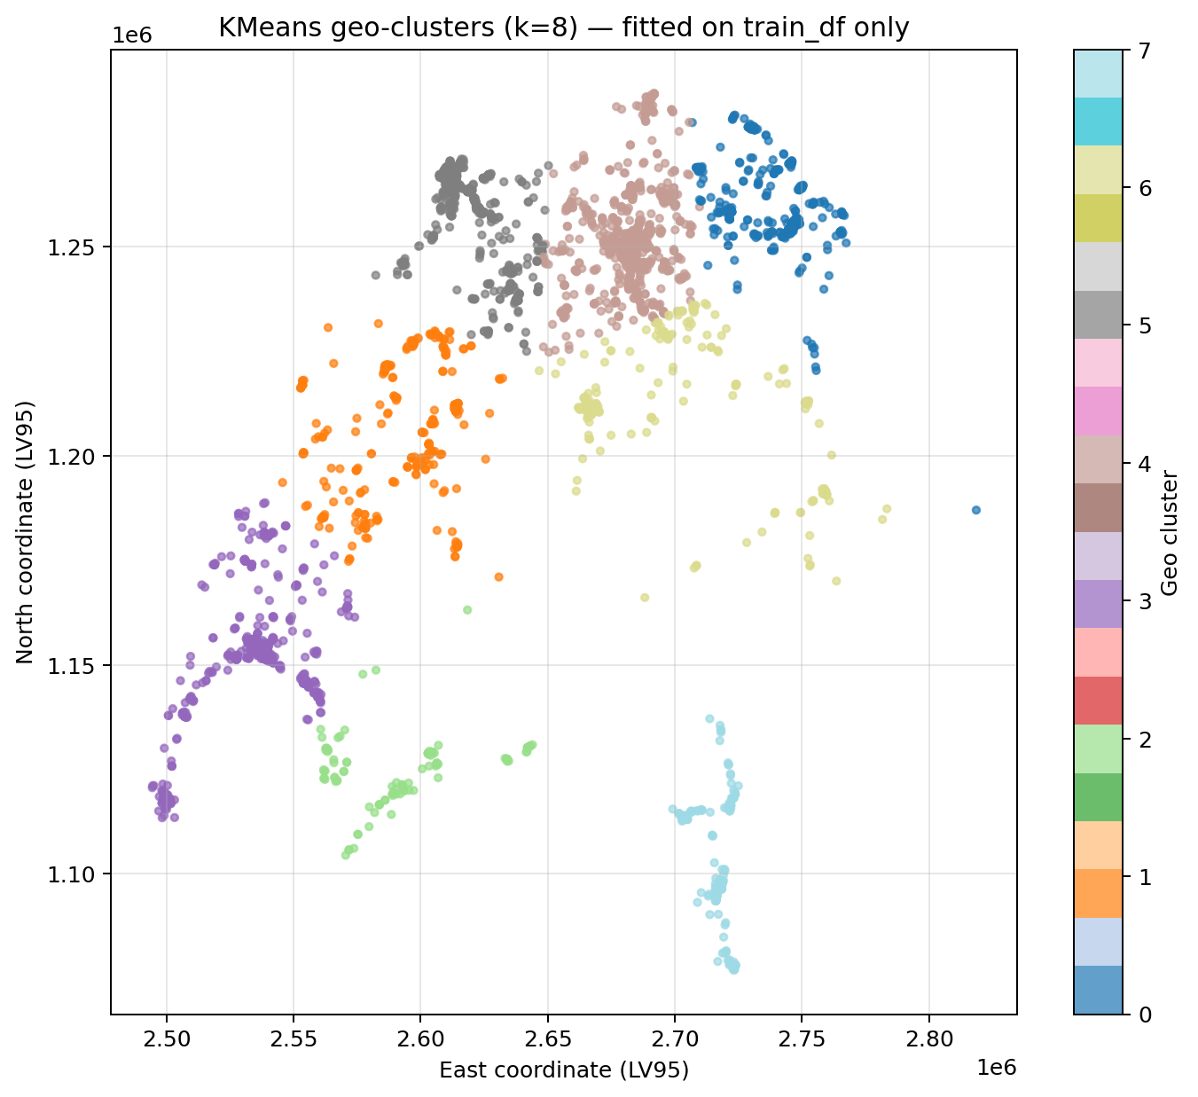
Modelling approach
13 / 22
Six models, one shared split, same evaluation protocol
Model pool
■ DummyRegressor (median): lower bound
■ Ridge with StandardScaler: linear benchmark
■ RandomForestRegressor
■ GradientBoostingRegressor
■ XGBoost
■ LightGBM (best single model)
■ StackingRegressor with Ridge meta-learner
Feature engineering
building_age, area_per_room, land_area_per_apartment, geo_cluster, knn_price_mean, knn_price_median
KMeans geo-clusters fitted on train_df only.
DSPRO1 FS26 | Team 8 | Predicting Apartment Rental Prices in Switzerland

Slide 14
Evaluation protocol
14 / 22
Single split with safety nets: cross-validation and a held-out test set
Hold-out test split (60/20/20)
Train 60%
Val 20%
Test 20%
Test is touched only once, at the very end.
MAE
RMSE
R²
Average absolute error in CHF
Quadratic error, penalises large misses
Variance explained by the model
MedAE
CV std
Bootstrap CI
Robust median absolute error
Stability across folds
Significance test for model differences
DSPRO1 FS26 | Team 8 | Predicting Apartment Rental Prices in Switzerland

Slide 15
04
RESULTS AND ANALYSIS
What works, what does not, and why
15 / 22

Slide 16
Baseline: mean-prediction strategy
16 / 22
Predicts the same training-set mean for every apartment, regardless of features
MAE
RMSE
R²
CHF 612
CHF 847
0.00
Average prediction error
Penalises large errors more
No variance explained
Any serious model must clearly beat this threshold. We set RMSE < 800 CHF as our minimum success criterion.
DSPRO1 FS26 | Team 8 | Predicting Apartment Rental Prices in Switzerland

Slide 17
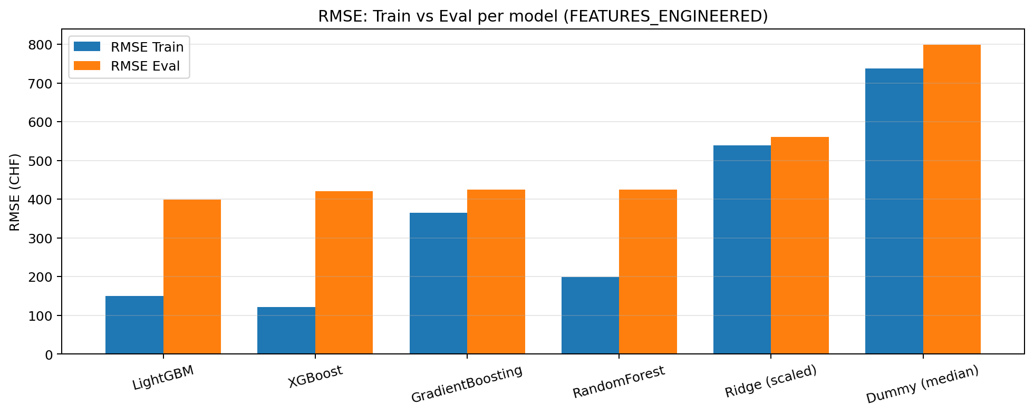
Model comparison
17 / 22
All models on the same split, FEATURES_ENGINEERED
RMSE Eval (CHF)
LightGBM
399
XGBoost
421
GradientBoosting
425
RandomForest
425
Ridge (linear)
560
Dummy (mean)
847
After adding KNN-distance features, LightGBM reaches RMSE 393 / R² 0.751.
Train vs Eval RMSE per model (Notebook Ch. 11).
DSPRO1 FS26 | Team 8 | Predicting Apartment Rental Prices in Switzerland

Slide 18
Hypothesis: confirmed
18 / 22
Tree-based models clearly outperform linear regression
Mid-term baseline
LightGBM + KNN features
CHF 847
CHF 393
RMSE on evaluation set
▶
RMSE on evaluation set
R² = 0.00
R² = 0.751
No variance explained
More than 50% improvement
DSPRO1 FS26 | Team 8 | Predicting Apartment Rental Prices in Switzerland

Slide 19
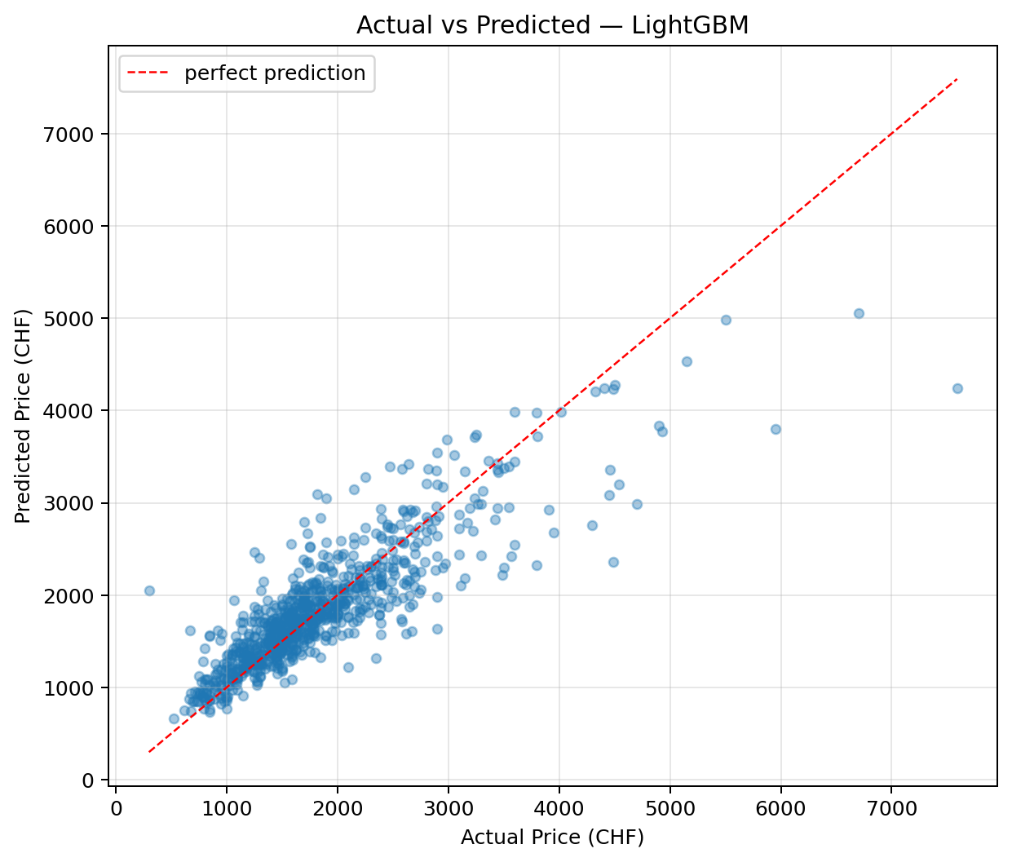
Actual vs predicted
19 / 22
Best model: LightGBM with KNN-distance features
What the scatter shows
■ Strong correlation between actual and predicted price.
■ Cluster around the diagonal up to ~3'500 CHF.
■ Tail-end apartments (luxury) show larger spread.
■ No systematic bias in the central range.
Points should cluster around the red diagonal.
DSPRO1 FS26 | Team 8 | Predicting Apartment Rental Prices in Switzerland

Slide 20
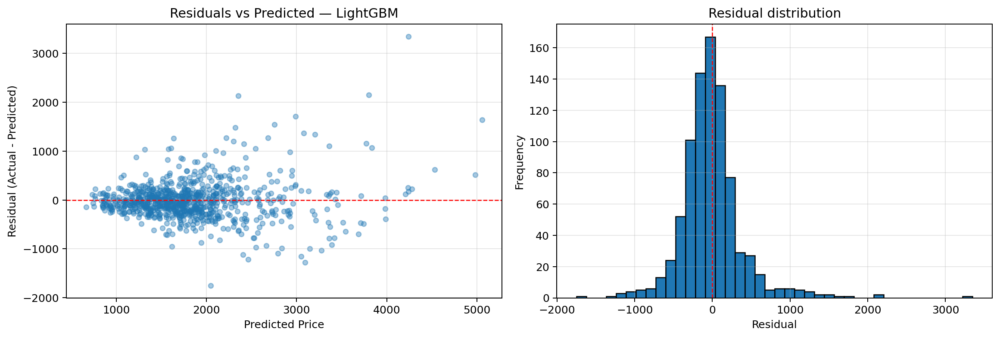
Residual analysis
20 / 22
Residual = actual rent minus predicted rent
Key observations
■ Funnel shape: errors grow with predicted price.
■ Distribution is heavier-tailed than a normal.
■ Shapiro-Wilk test rejects normality.
■ Confirms heteroscedastic, right-skewed errors.
Residual scatter + histogram.
DSPRO1 FS26 | Team 8 | Predicting Apartment Rental Prices in Switzerland

Slide 21
Error per price band
21 / 22
The most actionable finding of the project
Cheap
CHF 216
Why?
Expensive listings are underrepresented in the training set.
Medium-low
CHF 176
And many of their price drivers (lake view, penthouse, floor, finish) are not in our features.
Medium-high
CHF 221
Expensive
CHF 445
Errors on the top quartile are roughly twice as large as in the other bands.
DSPRO1 FS26 | Team 8 | Predicting Apartment Rental Prices in Switzerland

Slide 22
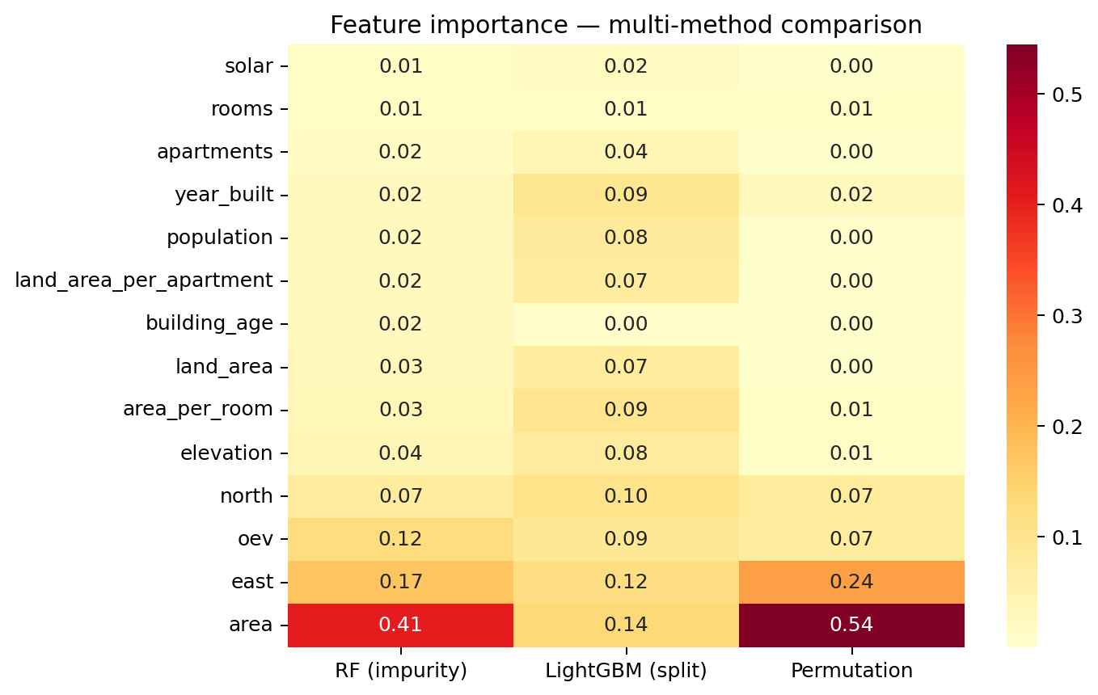
Feature importance
22 / 22
Four methods agree: location and area carry the signal
Top drivers
■ area: dominant predictor across all methods
■ knn_price_mean / knn_price_median: location proxy
■ east, north: encode the location premium
■ area_per_room beats raw rooms count
Spearman rank correlation
> 0.85
across all four methods
RF impurity, LightGBM splits, permutation importance and SHAP.
DSPRO1 FS26 | Team 8 | Predicting Apartment Rental Prices in Switzerland

Slide 23
05
DEMO
Streamlit app with address lookup
23 / 22

Slide 24
Demo: Streamlit app
24 / 22
End-to-end pipeline behind one address field
Live workflow
Estimated rent
1
Enter the apartment address
CHF 1'987
2
Look up EGID and coordinates (GeoAdmin)
3
Fetch GWR details and dwellings list
for: 80 m², 3 rooms, 8002 Zürich, EGID 12345
4
Pick the right apartment from the dropdown
Includes auto-filled GWR data
5
Enrich with swisstopo geo-data
Editable before prediction
6
RentPredictor.predict(...)
Disclaimer: advisory tool, not legally binding
DSPRO1 FS26 | Team 8 | Predicting Apartment Rental Prices in Switzerland

Slide 25
06
WRAP-UP
Limitations, next steps, take-aways
25 / 22

Slide 26
Honest limitations
26 / 22
Snapshot dataset
Urban coverage bias
Expensive apartments
One scrape on 13 April 2026. Market shifts are not reflected.
Zurich, Geneva, Basel are overrepresented; rural cantons are thin.
Top quartile MAE is roughly twice the rest. Luxury attributes are missing.
Single platform
Local-only demo
No textual features
All data from rentumo.ch. Adding a second source is the obvious next step.
Streamlit runs locally; no hosting in DSPRO1 scope.
Description field is stored but not yet used for feature extraction.
DSPRO1 FS26 | Team 8 | Predicting Apartment Rental Prices in Switzerland

Slide 27
Future work, in priority order
27 / 22
Each step targets a specific limitation from the previous slide
01
Text features from descriptions
Extract balcony, parking, renovation year, floor, view from the existing description field. Likely the highest-impact lever for the expensive band.
02
Second rental platform
Pull homegate.ch or immoscout24.ch listings. Reduces urban bias and roughly doubles the training set.
03
Prediction intervals
Move from point predictions to CHF X ± Y using conformal prediction (MAPIE). Honest and easy to read.
04
Lightweight hosting
Deploy the Streamlit demo on Streamlit Cloud or Render. Natural first deliverable for DSPRO2.
DSPRO1 FS26 | Team 8 | Predicting Apartment Rental Prices in Switzerland

Slide 28
What we take away
> 50%
0.751
RMSE reduction vs the mid-term baseline
R² on the held-out evaluation set
CHF 393
11
average RMSE of the best model
figures generated from the notebook
Tree-based models clearly beat linear regression. The hypothesis is confirmed.
The expensive-apartment gap is the most promising next target.

Slide 29
Thank you for your attention.
Questions and feedback welcome.
Team 8
Supervisor
Elias Martinelli
Elena Nazarenko
Timo Schlumpf
Repository
github.com/wadafacc/dspro1

