Slide 1
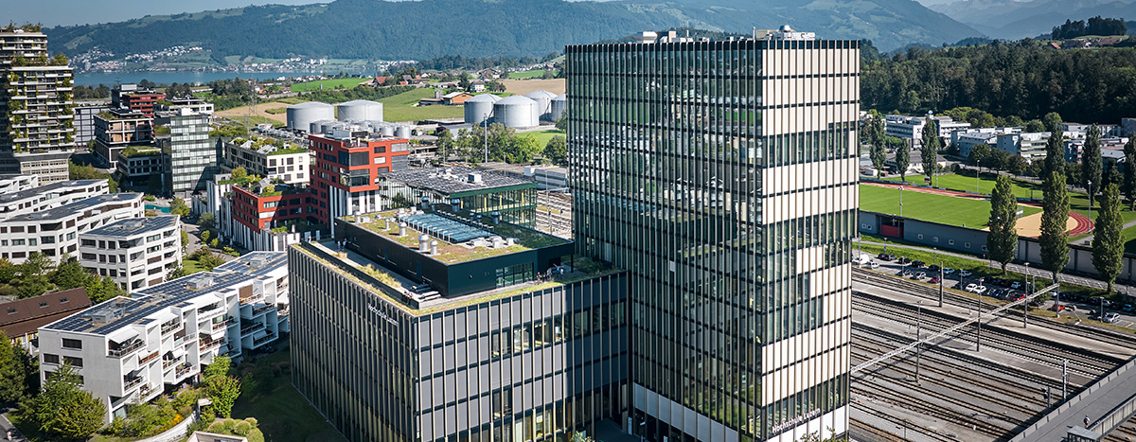
Predicting Apartment Rental Prices in Switzerland
DSPRO1 Project
Team: Elias Martinelli, Timo Schlumpf
Supervisor: Elena Nazarenko
Notes:
Welcome everyone to our mid-term presentation!
Our goal was to choose a topic that concerns everybody: the housing market. So we decided to focus on predicting apartment rental prices in Switzerland.

Slide 2
Agenda
1
The Problem
5
Results and analysis
2
Scope & Tools
6
Demo
3
Data Source & Enrichment
7
Wrap-up
4
Modelling approach
8
Questions & Feedback
Predicting Apartment Rental Prices in Switzerland
26.05.2026
Notes:
First of all, here is a short introduction to what we are going to look at.
First, we will explain the problem, why it is relevant, and what our hypothesis actually is.
Secondly, we will show you our project scope, where we are currently standing and which tool we use for project management.
Thirdly, we will look at the platform from which we scraped the data and which other relevant data we used, as well as how we fetched additional features from official government data.
Fourthly, we will discuss how we will measure whether the model is actually good, meaning how accurate it should at least be.
Last but not least, we will explain our next planned steps.
In the end, we are looking forward to your feedback and to answering your questions.

Slide 3
The problem
1
Predicting Apartment Rental Prices in Switzerland
26.05.2026
Notes:
Let’s dive into the problem we would like to solve.

Slide 4
The problem
Predicting Apartment Rental Prices in Switzerland
26.05.2026
Notes:
If you are looking for an apartment, you often do not know whether the listed price is too high, fair, or maybe even underpriced. For example, is CHF 2,400 per month a fair price for an apartment in Zurich?
In most cases, we cannot answer that right away. We need more information about the area and about similar apartments on the market. Otherwise, we have to spend a lot of time researching it ourselves or rely on expert knowledge. In the end, many people simply trust their gut feeling. That is why we asked ourselves: wouldn’t it be better to build a supervised machine learning model for this task? Such a model could save time and reduce frustration.
This is an important problem because the Swiss rental market is highly location-dependent. Prices vary strongly across cities, cantons, and neighborhoods. On top of that, many different features can influence the rent, which makes it hard to judge the price of an apartment at first glance. At the moment, there is no transparent, data-driven model that provides an objective estimate of the fair market value of a rental apartment in Switzerland. As a result, prospective tenants often struggle to assess whether the asking rent is fair compared to similar apartments currently on the market.

Slide 5



Why is it relevant?
Tenants
Landlors
Socially
Predicting Apartment Rental Prices in Switzerland
26.05.2026
Notes:
Why is this relevant?
For tenants, apartment seekers often rely on personal experience or subjective judgment. A model that transparently estimates the expected market price can help them identify overpriced listings.
For landlords, property owners and management companies need market-based reference values in order to set fair and competitive rents.
From a social perspective, the Swiss housing market is under significant pressure. More price transparency can help reduce information asymmetries between landlords and tenants.

Slide 6
hypothesis
Location-related variables combined with structural apartment features contain sufficient signal to predict monthly rental prices in Switzerland with practically useful accuracy and a Random Forest Regressor will outperform a Linear Regression model in doing so.
Predicting Apartment Rental Prices in Switzerland
26.05.2026
Notes:
Our hypothesis is:
Location-related variables (e.g., canton, city, ZIP code) combined with structural apartment features (e.g., living area in m², number of rooms) contain sufficient signal to predict monthly rental prices in Switzerland with practically useful accuracy — and a Random Forest Regressor will outperform a Linear Regression model in doing so.

Slide 7
Scope & Tools
2
Predicting Apartment Rental Prices in Switzerland
26.05.2026
Notes:
Let’s continue with our project scope and our current status.

Slide 8
Scope
In Scope
Out of Scope
Web scraping of Swiss rental listings
Data cleaning, deduplication & outlier removal
Exploratory Data Analysis (EDA)
Feature engineering (location, structure, amenities)
Baseline model → Linear Regression → Random Forest
Model evaluation: MAE, RMSE, R²
Experiment tracking with MLflow
Version control & Kanban via GitHub Projects
Cloud deployment or production-ready application
Real-time or live price feed integration
Time-series / rental price forecasting
Non-apartment property types (houses, commercial)
User-facing UI or web app
Predicting Apartment Rental Prices in Switzerland
26.05.2026

Slide 9

Project Management Tool
Backlog
Roadmap
Milestones
Predicting Apartment Rental Prices in Switzerland
26.05.2026

Slide 10
Data Source & Enrichment
3
Predicting Apartment Rental Prices in Switzerland
26.05.2026
Notes:
We will now move on to our data sources and how we add additional information to enrich the data.

Slide 11



data source
Comparis
  Lowballed, declined
Immoscout
  Not interested
Rentumo
  Contacted, no answer
Kaggle?
  Not in usable condition
CSV from 2024
  Stale data
Predicting Apartment Rental Prices in Switzerland
26.05.2026
Notes:
Go to Comparis and show them the filters => Scope only apartments NO COMMERCIAL
Comparis
Lowballed, declined
Immoscout
Not interested
Rentumo
Contacted, no answer
Kaggle?
Not in usable condition
CSV from 2024
Stale data

Slide 12
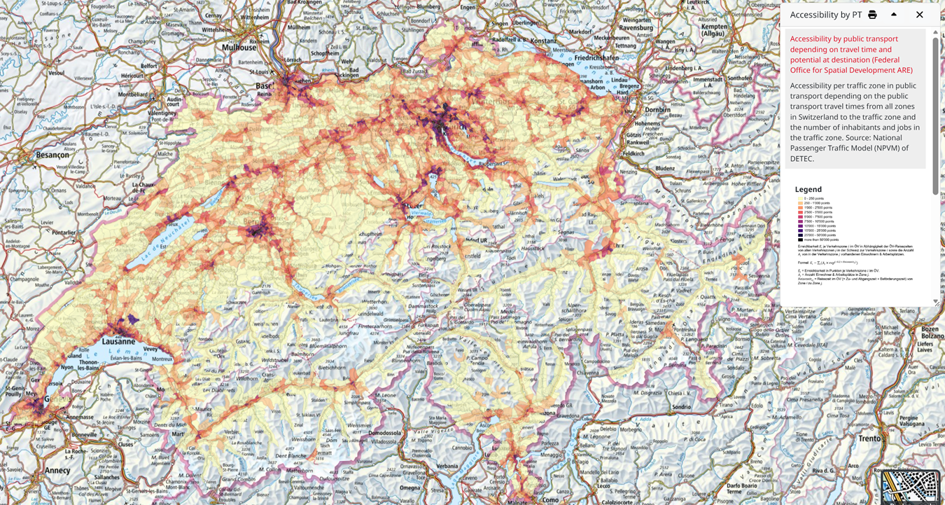
Data enrichment
Over API => geo.admin.ch
Predicting Apartment Rental Prices in Switzerland
26.05.2026

Slide 13
Data Pipline
1. Scrape listing index
750 pages on rentumo.ch · extracts rooms, area, rent, slug
2. Scrape detail pages
One call per slug · adds address, costs, description, availability
3. Enrich each address
GeoAdmin → coordinates + EGID · BFS GWR → year built, size
swisstopo → elevation, transit score, solar class, population
Predicting Apartment Rental Prices in Switzerland
26.05.2026
Notes:
Go to Comparis and show them the filters => Scope only apartments NO COMMERCIAL
Comparis
Lowballed, declined
Immoscout
Not interested
Rentumo
Contacted, no answer
Kaggle?
Not in usable condition
CSV from 2024
Stale data

Slide 14
architecture
Predicting Apartment Rental Prices in Switzerland
26.05.2026
Notes:
The data extraction part will happen all in the programm langueage Rust.
If we have enough time we would create an API Wrapper
With the clean data in the DB we can then
…………

Slide 15
Pool & Permit System
Predicting Apartment Rental Prices in Switzerland
26.05.2026

Slide 16
From urls to a dataset
25'002 URLs identified on rentumo.ch
↓ 15'008 empty placeholder URLs removed
9'994 listings successfully scraped
↓ Missing address, price, or area
~5'000 after mandatory-field filter
↓ GWR enrichment join + outlier filter
~4'500 final modelling set ← used for training

Slide 17
Modelling approach
4
Predicting Apartment Rental Prices in Switzerland
26.05.2026
Notes:
Next, we want to discuss our baseline results.

Slide 18
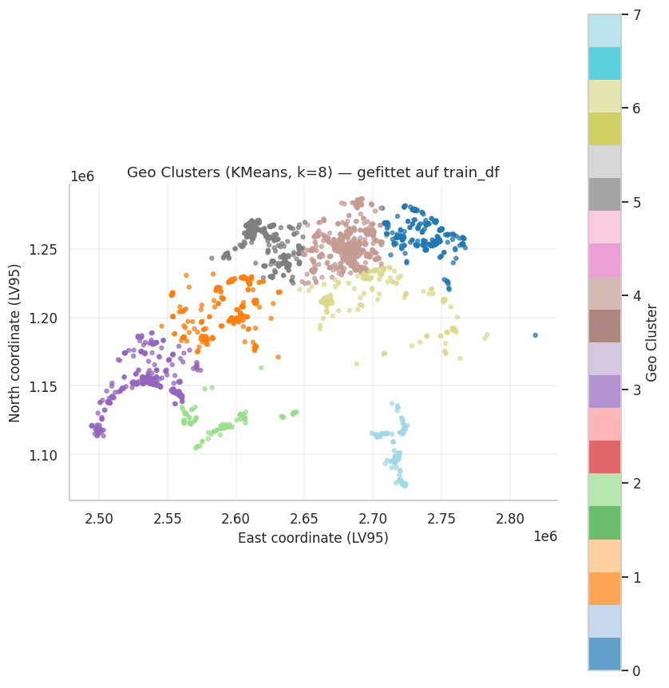
Modelling approach
Model pool:
■ DummyRegressor (median): lower bound
■ Ridge with StandardScaler: linear benchmark
■ RandomForestRegressor
■ GradientBoostingRegressor
■ XGBoost
■ LightGBM (best single model)
■ StackingRegressor with Ridge meta-learner
Predicting Apartment Rental Prices in Switzerland
26.05.2026

Slide 19
Evaluation protocol
Hold-out test split (60/20/20)
Train 60%
Val 20%
Test 20%
MAE
Average absolute error in CHF
RMSE
Quadratic error, penalizes large misses
R²
Variance explained by the model
MedAE
Robust median absolute error
CV std
Stability across folds
Bootstrap CI
Significance test for model differences

Slide 20
Results and analysis
5
Predicting Apartment Rental Prices in Switzerland
26.05.2026
Notes:
Next, we want to discuss our baseline results.

Slide 21
Basline
Predicting Apartment Rental Prices in Switzerland
26.05.2026
Notes:
As a baseline, we will first implement a simple model that predicts the mean rental price of the training data. We will then compare its performance with Linear Regression and Random Forest Regressor to assess whether more flexible machine learning models provide a meaningful improvement over simpler approaches.

Slide 22
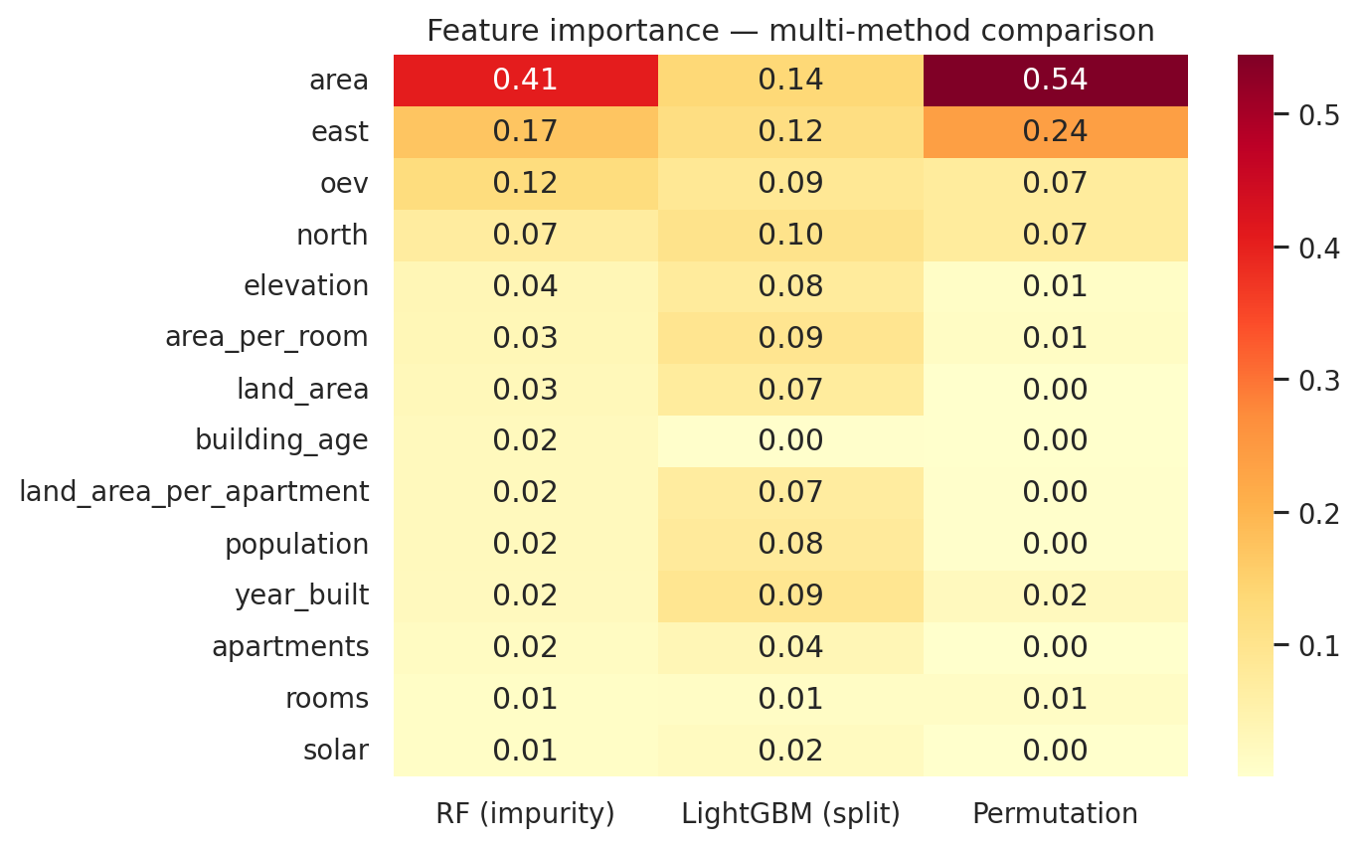
Feature importance
Notes:
Top drivers
area: dominant predictor across all methods
Knn_price_mean / median: location proxy
East, north: encode the location premium
Area_per_room beats room count

Slide 23
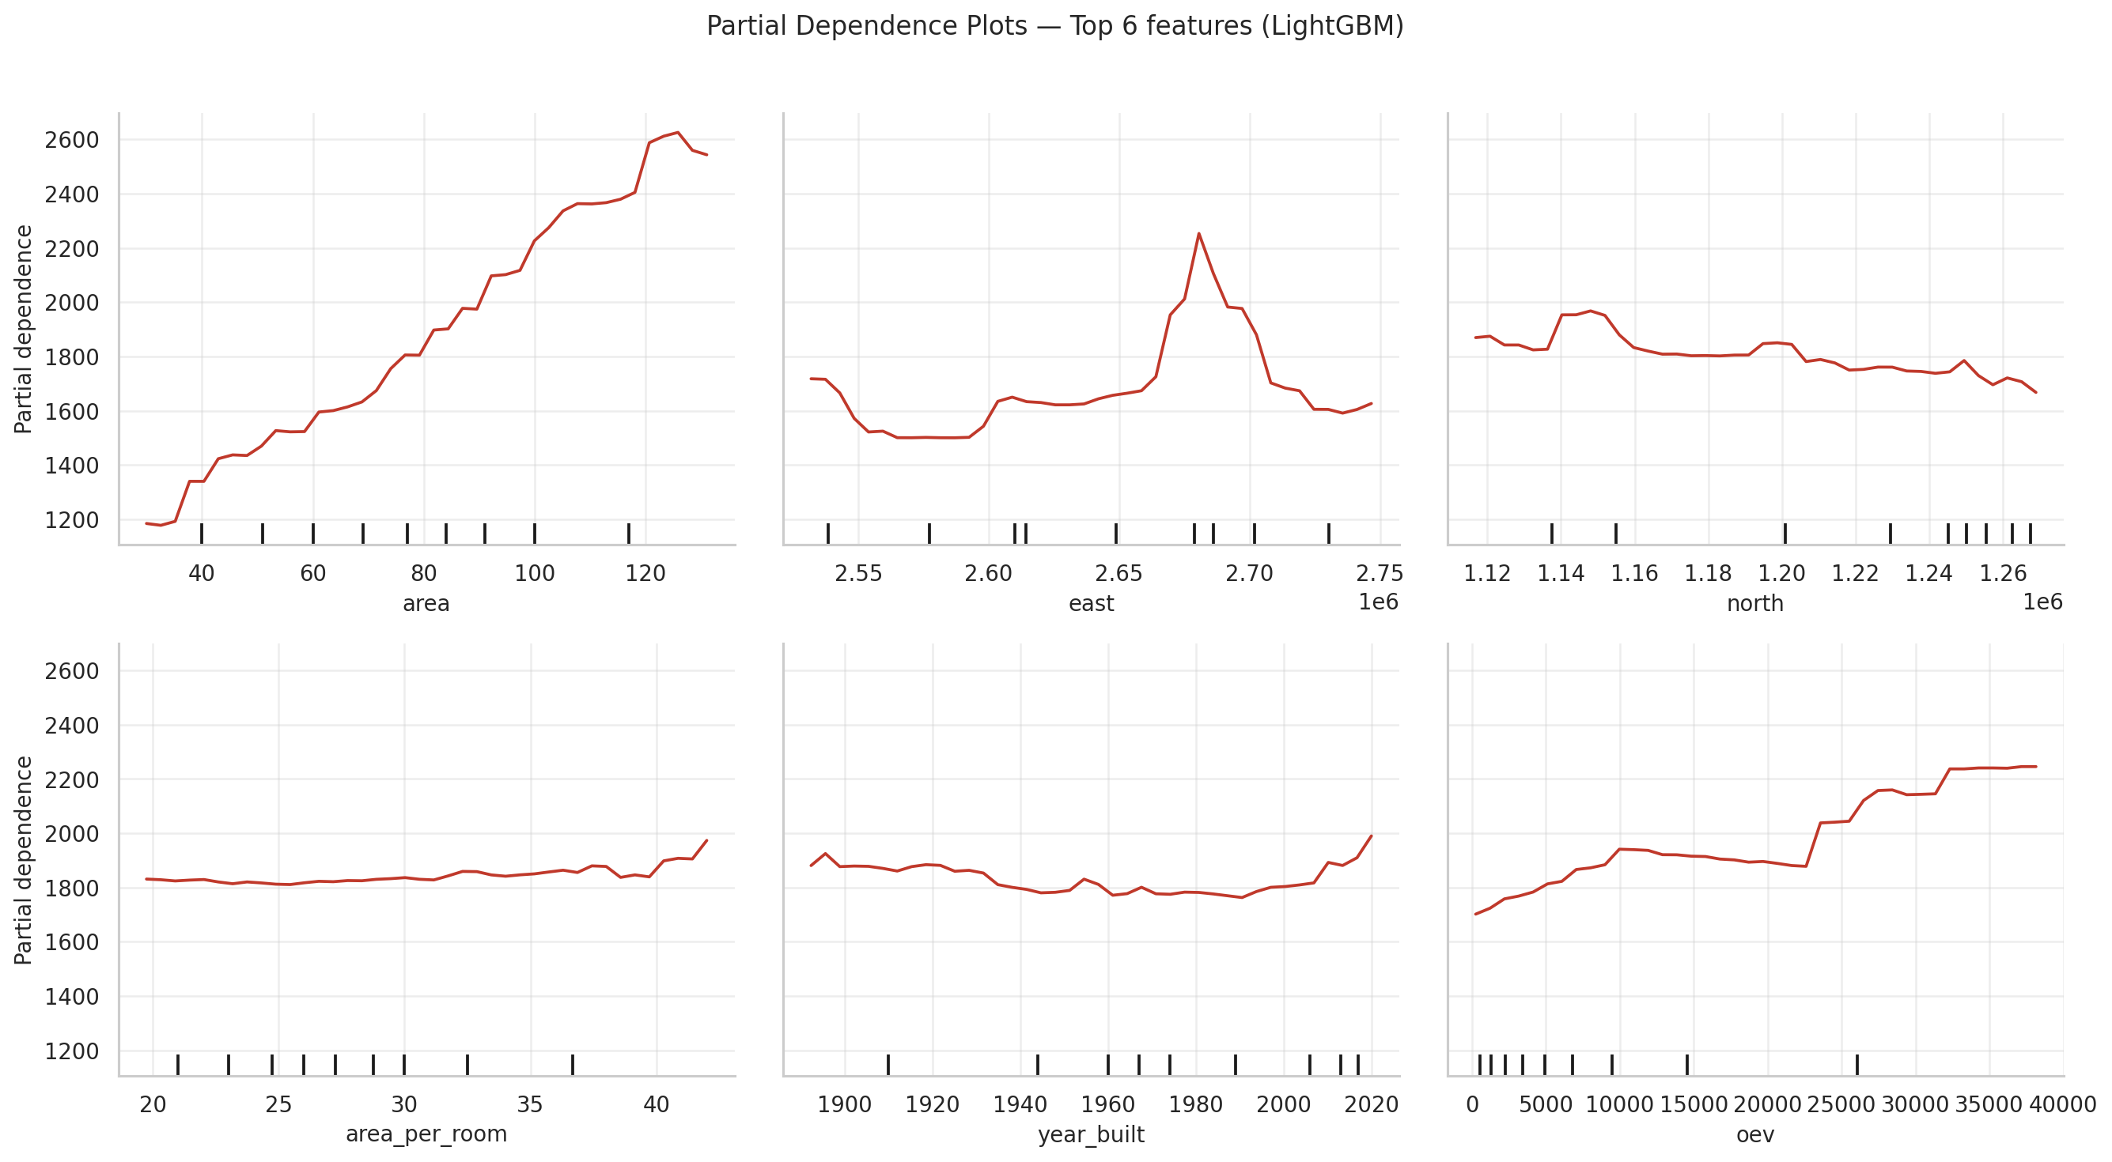
Top 6 features
Notes:
area — Strong monotonic driver. Larger properties command higher prices (1200–2600 CHF range). Most influential feature.
east — Non-linear, peaks around 2.66–2.67 coordinate. Location matters, but relationship is curved, not linear.
north — Flat/weak effect. Geographic latitude has minimal impact on predictions.
area_per_room — Essentially flat. This derived feature adds little predictive value.
year_built — Barely moves the needle. Age of building is a weak predictor in this model.
oev — Strong monotonic increase at high values. Accessibility/connectivity metric is a secondary driver alongside area.
Key takeaway: Area dominates; OEV provides secondary lift; location (geographic coords) and building age contribute minimally.

Slide 24
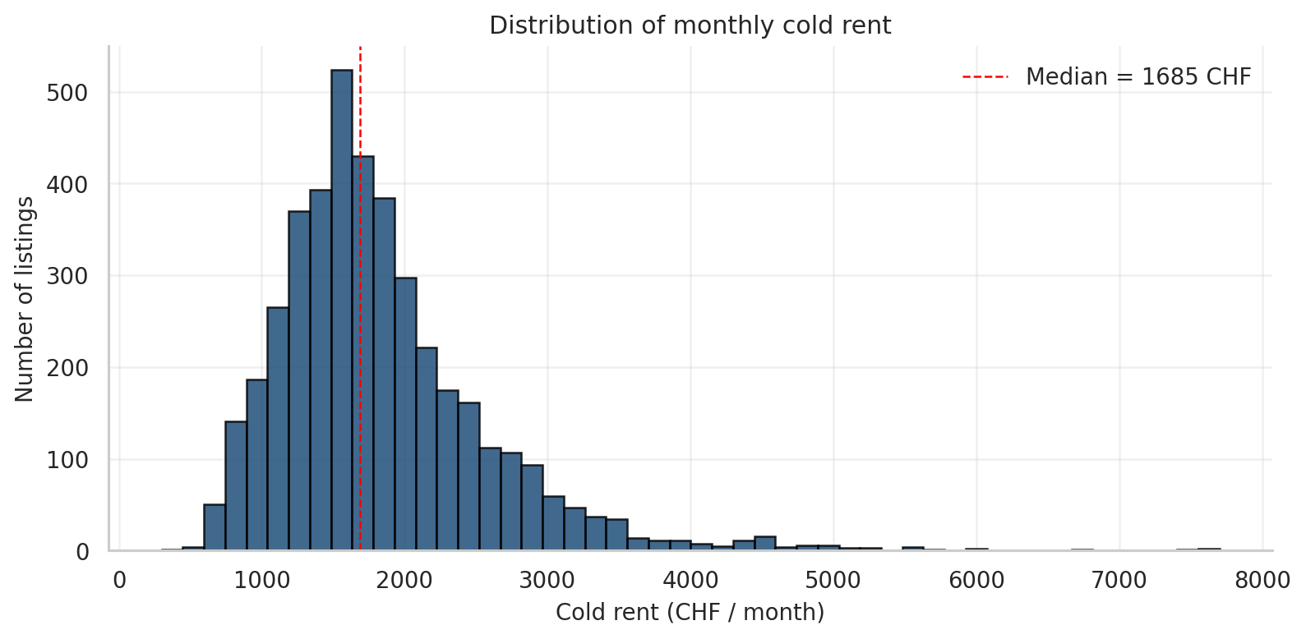
Price distribution
Notes:
Median: 1685 CHF — central tendency of the market
Shape: Right-skewed with long tail extending to ~8000 CHF
Cluster: Most listings concentrated 1000–2500 CHF range; peak around 1500–1600
Outliers: Sparse high-rent listings (4000–8000 CHF) — premium/specialty properties
Implication: Model trained on skewed target — explains why it struggles with expensive outliers and shows heteroscedastic errors

Slide 25
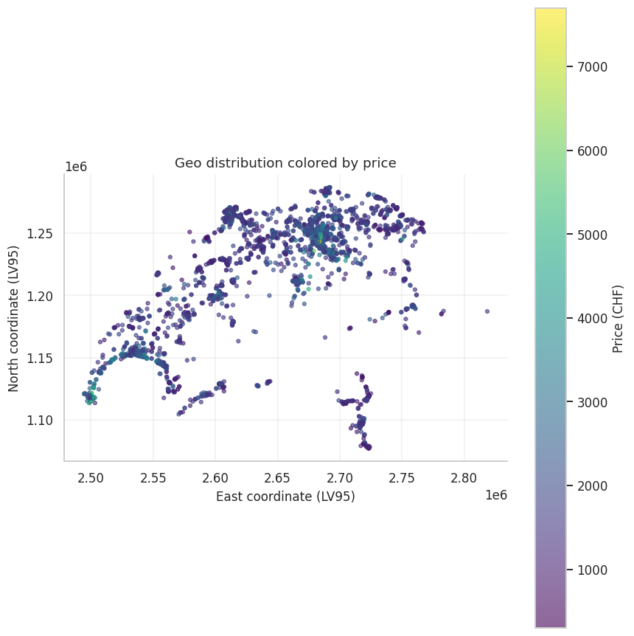
Geo Price Map

Slide 26
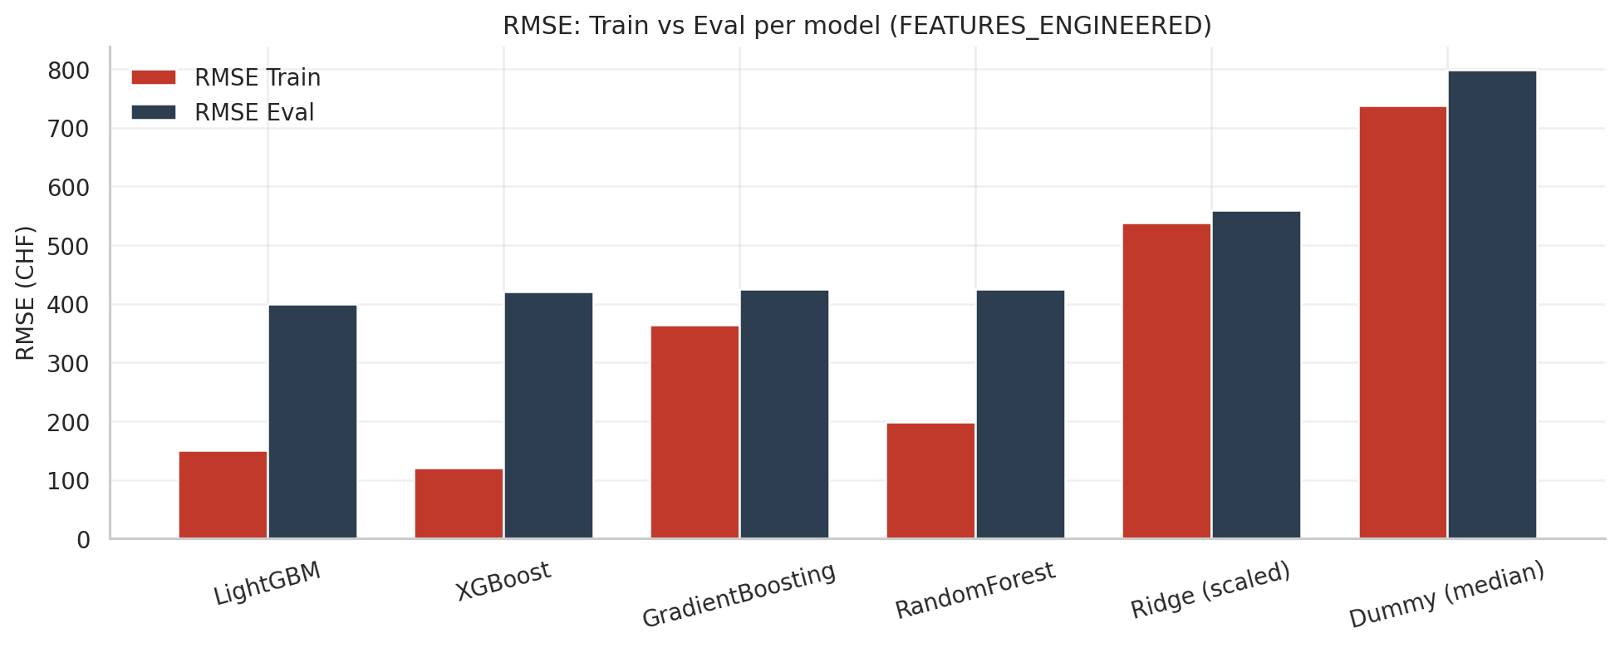
Model comparison
All models on the same split, FEATURES_ENGINEERED
Notes:
This chart compares training vs evaluation RMSE across six models. Two clear winners emerge: LightGBM with the highest accuracy and GradientBoosting with the most stable performance.

Slide 27
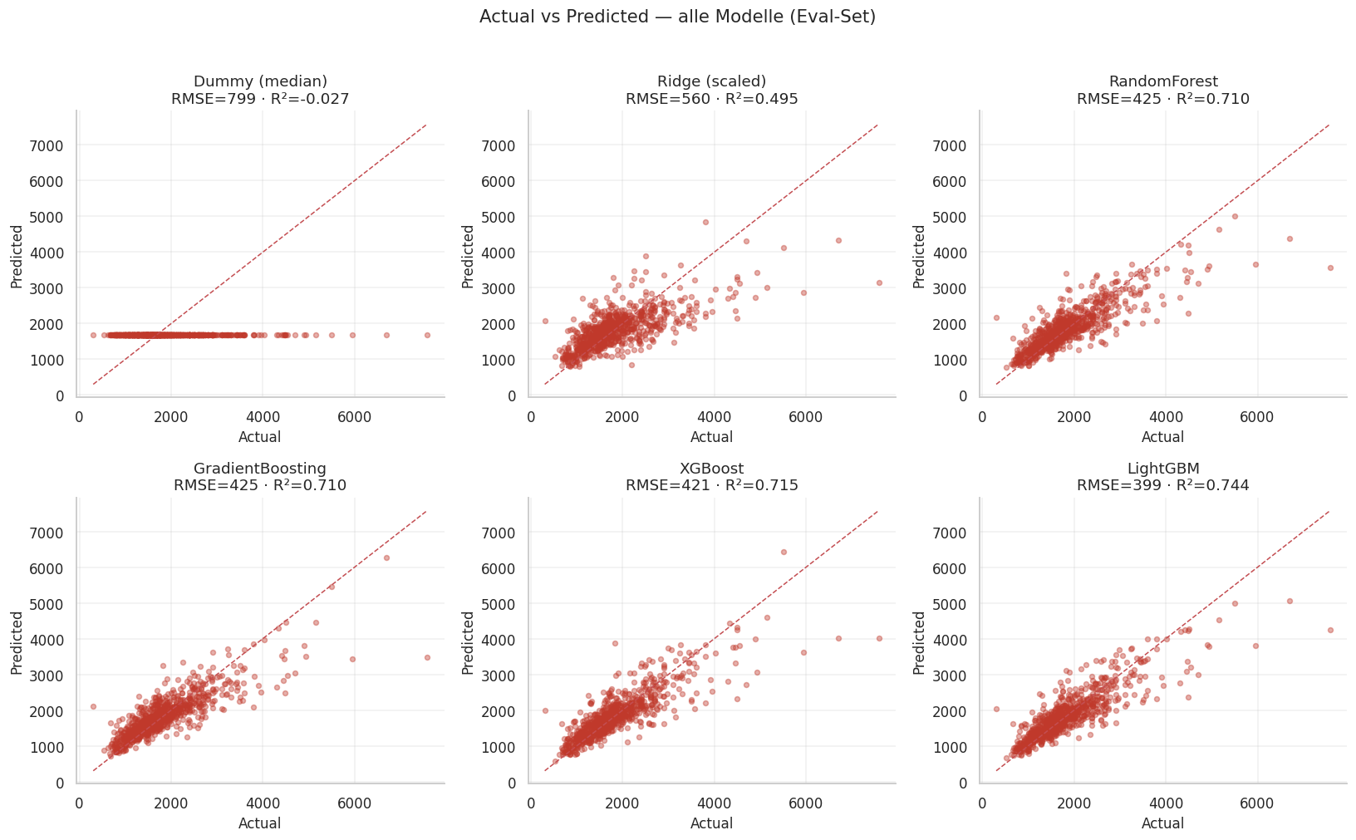
Visual Model comparison
Notes:
Model performs well on standard prices but fails on expensive items – wide scatter and systematic underprediction at the high end. A major limitation that needs addressing before production deployment.
Strong correlation between actual and predicted price.
Cluster around the diagonal up to ~3'500 CHF.
Tail-end apartments (luxury) show larger spread.
No systematic bias in the central range.

Slide 28
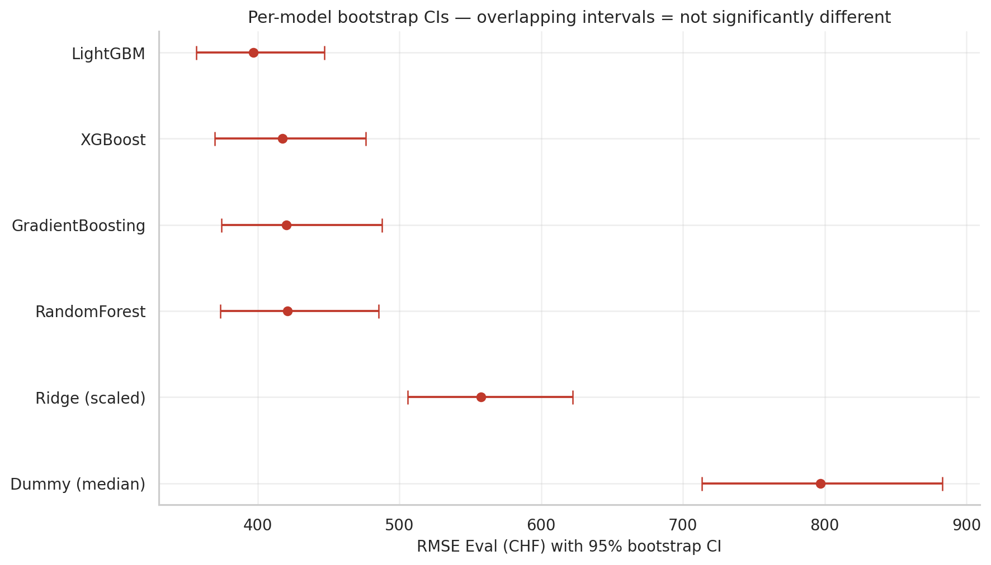
Bootstraps Cls
Notes:
LightGBM delivers the best accuracy with the tightest confidence interval. The overlap with XGBoost and GradientBoosting shows these models are statistically equivalent – clearly superior to Ridge and Dummy.

Slide 29
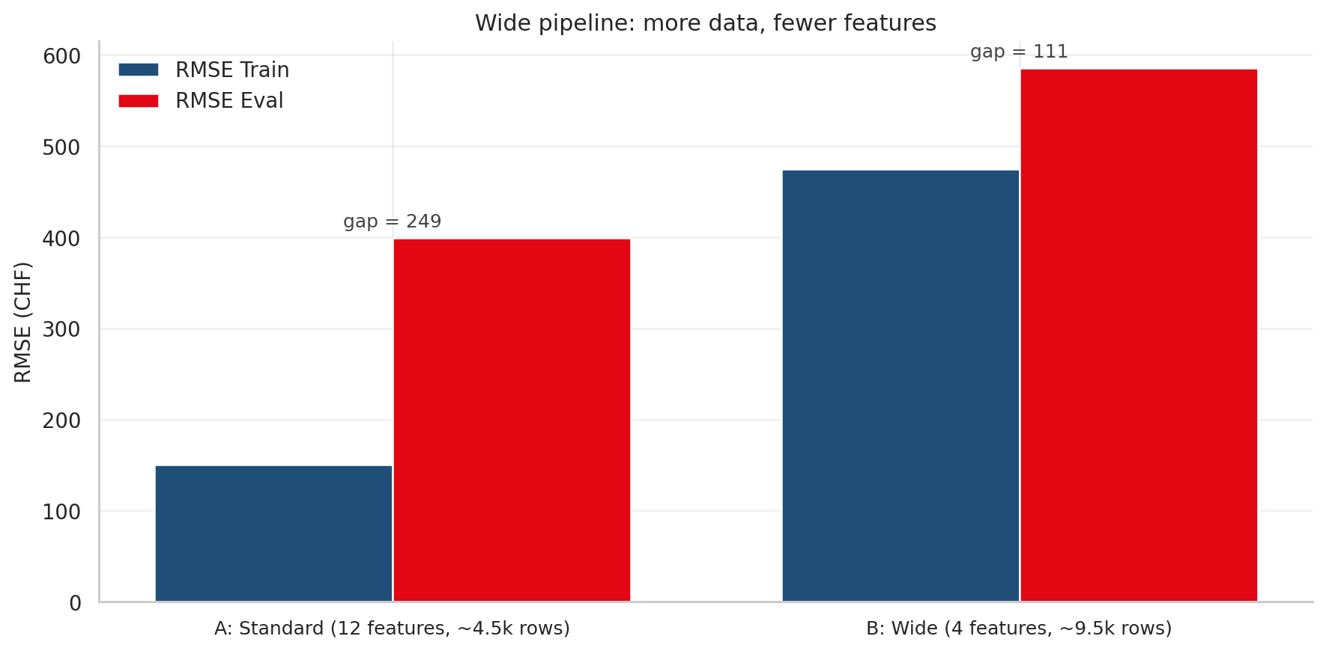
12 vs 4 features
Notes:
Pipeline A with 12 features performs better overall, but shows significant overfitting with a 249-point gap. Pipeline B trades accuracy for stability – fewer features and more data reduce the gap to 111, making it more reliable for production.

Slide 30
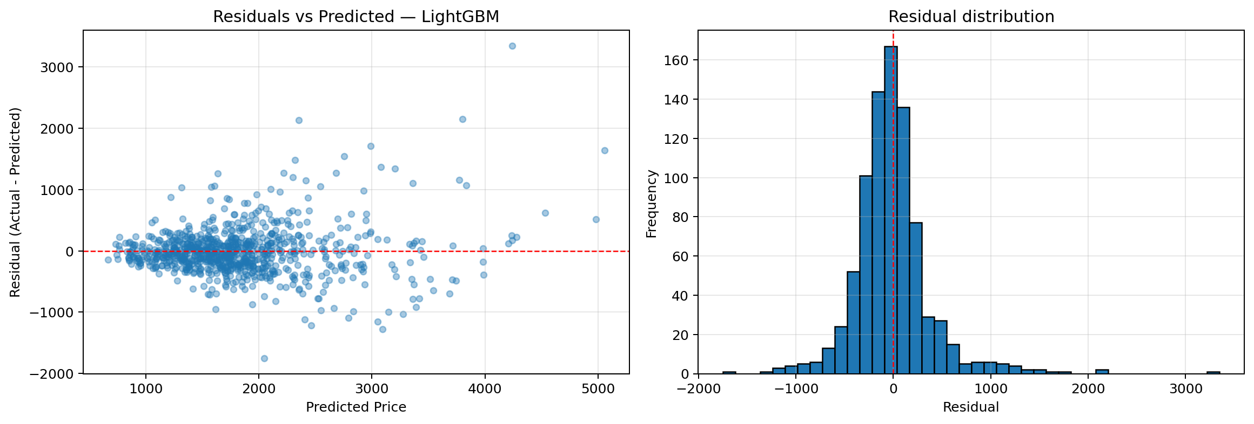
Residual analysis
Notes:
LightGBM's residuals reveal two issues: errors systematically grow with predicted price – the funnel shape indicates heteroscedasticity. The distribution is heavy-tailed and right-skewed, not normal. This suggests the model struggles more on higher-priced predictions and may benefit from transformation or stratified evaluation.
Key observations
Funnel shape: errors grow with predicted price
Distribution is heavier-tailed than normal
Shapiro-wilk test rejects normality
Confirms heteroscedastic, right-skewed errors

Slide 31
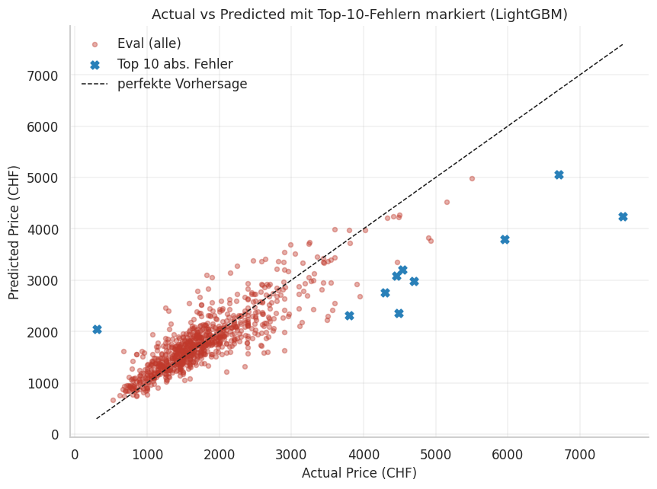
Top 10 errors

Slide 32
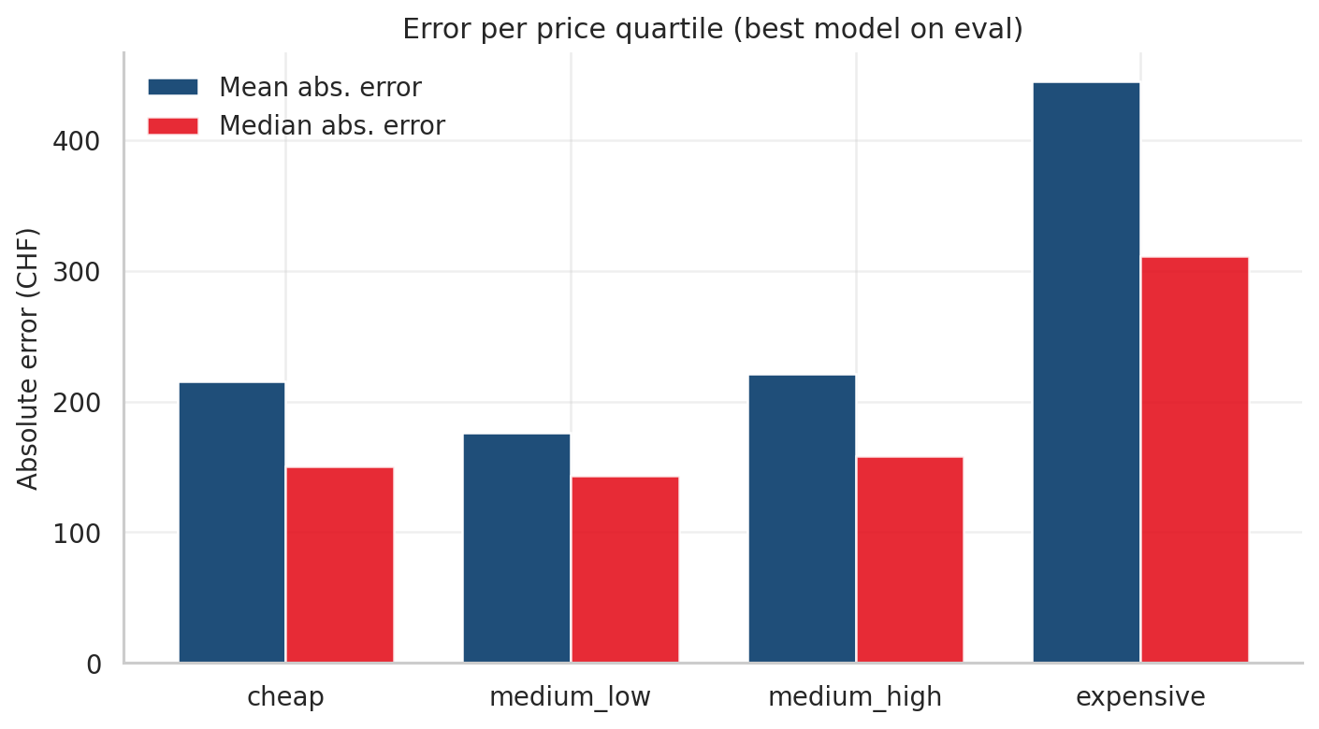
Error per price band
Notes:
Consistent performance on standard prices, but expensive items show double the error – a deployment blocker that requires segment-specific handling.

Slide 33
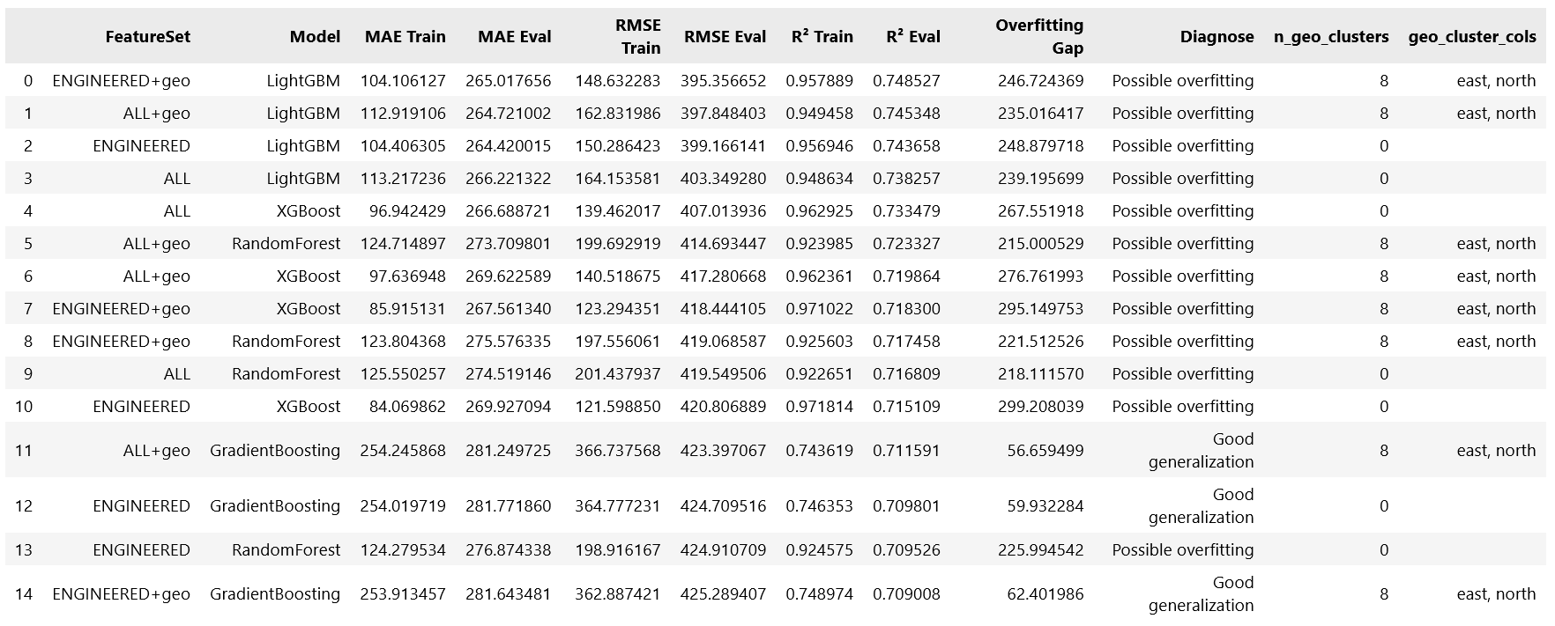
All Model comparison

Slide 34
Hypothesis confirmed
Midterm baseline
CHF 847
RMSE on evaluation set
R² = 0.00
(No variance explained)
GradientBoosting + KNN features
CHF 423 RMSE on evaluation set
R² = 0.71

Slide 35
Demo
6
Predicting Apartment Rental Prices in Switzerland
26.05.2026
Notes:
Next, we want to discuss our baseline results.

Slide 36
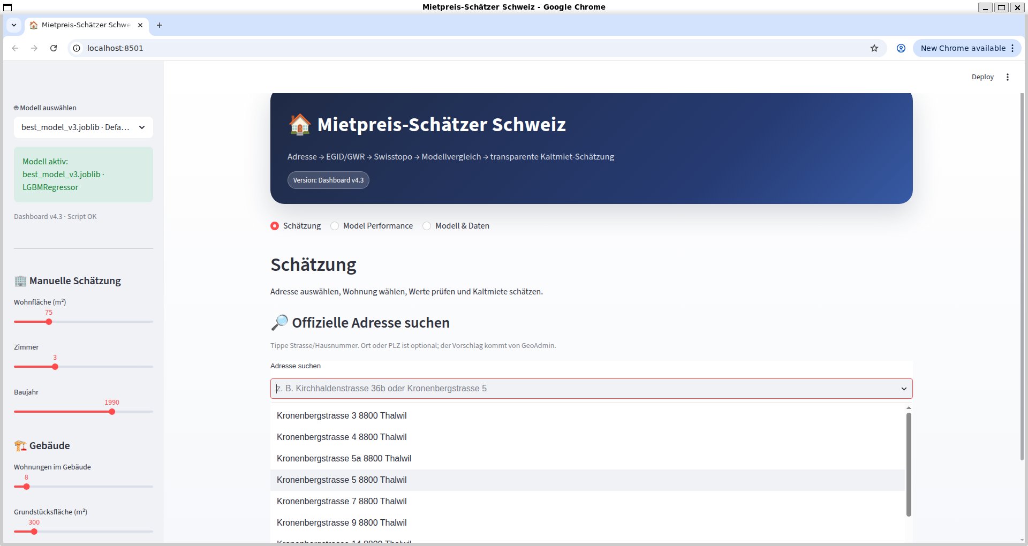
Demo: streamlit app
Notes:
Live workflow
1. Enter the apartment address
2. Look up EGID + coordinates via GeoAdmin
3. Fetch GWR details (year built, size, dwelling list)
4. Pick the right unit from the dropdown
5. Enrich with swisstopo geo-data
6. RentPredictor.predict(...) → estimated fair rent
Example output
3 rooms · 80 m² · 8002 Zürich → CHF 1'987 / month
Advisory tool — not legally binding

Slide 37
Wrap-up
7
Predicting Apartment Rental Prices in Switzerland
26.05.2026
Notes:
Next, we want to discuss our baseline results.

Slide 38
limitations
Snapshot dataset
One scrape on 13 April 2026; market shifts not reflected
Urban bias
Zurich, Geneva, Basel overrepresented; rural cantons thin
Expensive apartments
Top-quartile MAE is roughly twice the rest. Luxury attributes (view, floor, finish) missing from features

Slide 39
Next steps
1. Text features from descriptions
Extract balcony, parking, floor, view - biggest lever for expensive band
2. Second rental platform
Add homegate.ch or immoscout24 - reduces urban bias, doubles training data
3. Prediction intervals
Move from point estimates to CHF X ± Y via conformal prediction (MAPIE)
4. Lightweight hosting
Deploy Streamlit on Streamlit Cloud or Render - first DSPRO2 deliverable

Slide 40
Tl:DR
RMSE reduction vs. baseline
> 50%
Tree-based models win clearly
Best model RMSE
CHF 423
GradientBoosting + KNN features
R² on held-out set
0.71
Hypothesis confirmed
Notes:
Location and size drive rent. The expensive-apartment gap is the most promising next target.
LightGBM + KNN features

Slide 41
thank you for your attention.
We are happy to answer any questions or discuss the presented topics further.
DSPRO1 Project
Team:
Elias Martinelli
Timo Schlumpf
Supervisor:
Elena Nazarenko
Notes:
Thank you for your attention. We would now be happy to answer your questions or discuss the presented topics further.

