Slide 1
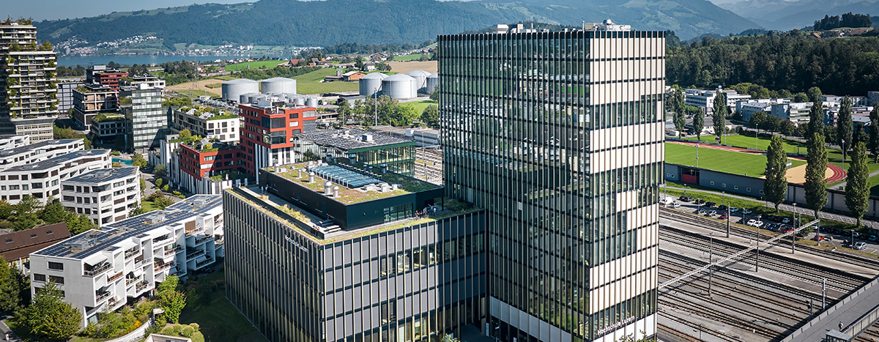
Predicting Apartment Rental Prices in Switzerland
DSPRO1 Project
Team: Elias Martinelli, Timo Schlumpf
Supervisor: Elena Nazarenko
Notes:
Welcome everyone to our mid-term presentation!
Our goal was to choose a topic that concerns everybody: the housing market. So we decided to focus on predicting apartment rental prices in Switzerland.

Slide 2
Agenda
1
The Problem
5
Next steps
2
Scope Status
6
Questions & Feedback
3
Data Source & Enrichment
4
Basline Result
Predicting Apartment Rental Prices in Switzerland
23.03.2026
Notes:
First of all, here is a short introduction to what we are going to look at.
First, we will explain the problem, why it is relevant, and what our hypothesis actually is.
Secondly, we will show you our project scope, where we are currently standing and which tool we use for project management.
Thirdly, we will look at the platform from which we scraped the data and which other relevant data we used, as well as how we fetched additional features from official government data.
Fourthly, we will discuss how we will measure whether the model is actually good, meaning how accurate it should at least be.
Last but not least, we will explain our next planned steps.
In the end, we are looking forward to your feedback and to answering your questions.

Slide 3
The problem
1
Predicting Apartment Rental Prices in Switzerland
23.03.2026
Notes:
Let’s dive into the problem we would like to solve.

Slide 4
The problem
Predicting Apartment Rental Prices in Switzerland
23.03.2026
Notes:
If you are looking for an apartment, you often do not know whether the listed price is too high, fair, or maybe even underpriced. For example, is CHF 2,400 per month a fair price for an apartment in Zurich?
In most cases, we cannot answer that right away. We need more information about the area and about similar apartments on the market. Otherwise, we have to spend a lot of time researching it ourselves or rely on expert knowledge. In the end, many people simply trust their gut feeling. That is why we asked ourselves: wouldn’t it be better to build a supervised machine learning model for this task? Such a model could save time and reduce frustration.
This is an important problem because the Swiss rental market is highly location-dependent. Prices vary strongly across cities, cantons, and neighborhoods. On top of that, many different features can influence the rent, which makes it hard to judge the price of an apartment at first glance. At the moment, there is no transparent, data-driven model that provides an objective estimate of the fair market value of a rental apartment in Switzerland. As a result, prospective tenants often struggle to assess whether the asking rent is fair compared to similar apartments currently on the market.

Slide 5



Why is it relevant?
Tenants
Landlors
Socially
Predicting Apartment Rental Prices in Switzerland
23.03.2026
Notes:
Why is this relevant?
For tenants, apartment seekers often rely on personal experience or subjective judgment. A model that transparently estimates the expected market price can help them identify overpriced listings.
For landlords, property owners and management companies need market-based reference values in order to set fair and competitive rents.
From a social perspective, the Swiss housing market is under significant pressure. More price transparency can help reduce information asymmetries between landlords and tenants.

Slide 6
hypothesis
Location-related variables combined with structural apartment features contain sufficient signal to predict monthly rental prices in Switzerland with practically useful accuracy and a Random Forest Regressor will outperform a Linear Regression model in doing so.
Predicting Apartment Rental Prices in Switzerland
23.03.2026
Notes:
Our hypothesis is:
Location-related variables (e.g., canton, city, ZIP code) combined with structural apartment features (e.g., living area in m², number of rooms) contain sufficient signal to predict monthly rental prices in Switzerland with practically useful accuracy — and a Random Forest Regressor will outperform a Linear Regression model in doing so.

Slide 7
Scope status
2
Predicting Apartment Rental Prices in Switzerland
23.03.2026
Notes:
Let’s continue with our project scope and our current status.

Slide 8
Scope
In Scope
Out of Scope
Web scraping of Swiss rental listings
Data cleaning, deduplication & outlier removal
Exploratory Data Analysis (EDA)
Feature engineering (location, structure, amenities)
Baseline model → Linear Regression → Random Forest
Model evaluation: MAE, RMSE, R²
Experiment tracking with MLflow
Version control & Kanban via GitHub Projects
Cloud deployment or production-ready application
Real-time or live price feed integration
Time-series / rental price forecasting
Non-apartment property types (houses, commercial)
User-facing UI or web app
Predicting Apartment Rental Prices in Switzerland
23.03.2026

Slide 9
status
Project Progression
Predicting Apartment Rental Prices in Switzerland
23.03.2026
Notes:
Currently we are still stuck in Data collection beacuase there is no open Dataset for the project we are doing. The

Slide 10

Project Management Tool
Backlog
Roadmap
Milestones
Predicting Apartment Rental Prices in Switzerland
23.03.2026

Slide 11
Data Source & Enrichment
3
Predicting Apartment Rental Prices in Switzerland
23.03.2026
Notes:
We will now move on to our data sources and how we add additional information to enrich the data.

Slide 12
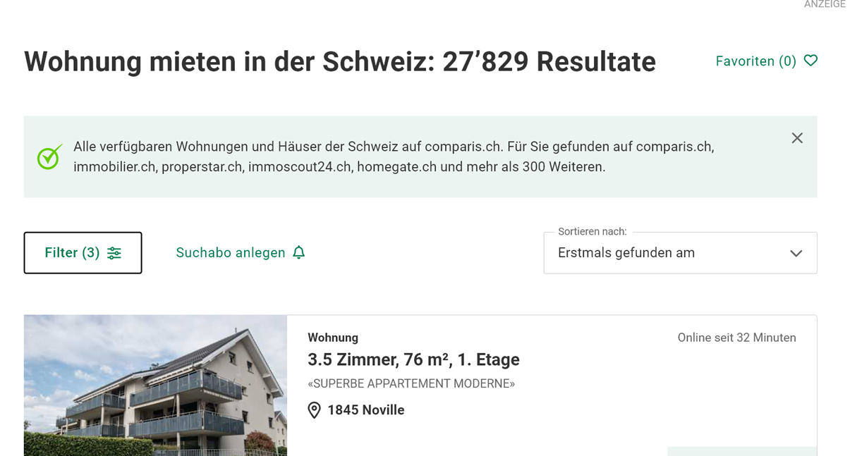

data source
Webscrapping Data from
Predicting Apartment Rental Prices in Switzerland
23.03.2026
Notes:
Go to Comparis and show them the filters => Scope only apartments NO COMMERCIAL

Slide 13
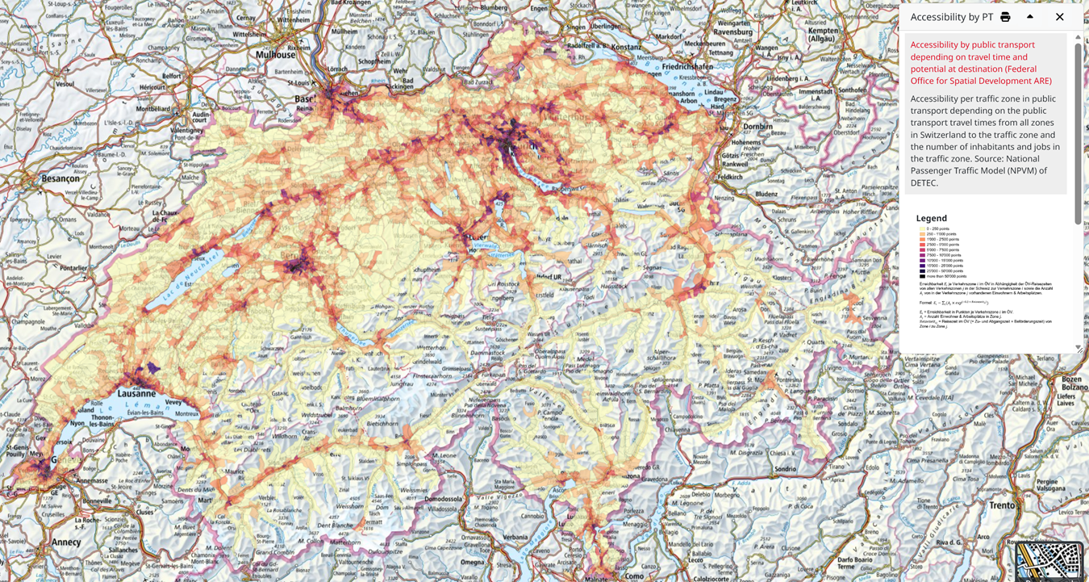
Data enrichment
Over API => geo.admin.ch
Predicting Apartment Rental Prices in Switzerland
23.03.2026

Slide 14
data pipeline High-level design
Predicting Apartment Rental Prices in Switzerland
23.03.2026
Notes:
The data extraction part will happen all in the programm langueage Rust.
If we have enough time we would create an API Wrapper
With the clean data in the DB we can then
…………

Slide 15
Pool & Permit System
Predicting Apartment Rental Prices in Switzerland
23.03.2026

Slide 16
Basline results
4
Predicting Apartment Rental Prices in Switzerland
23.03.2026
Notes:
Next, we want to discuss our baseline results.

Slide 17
Basline results
Predicting Apartment Rental Prices in Switzerland
23.03.2026
Notes:
As a baseline, we will first implement a simple model that predicts the mean rental price of the training data. We will then compare its performance with Linear Regression and Random Forest Regressor to assess whether more flexible machine learning models provide a meaningful improvement over simpler approaches.

Slide 18
Next Steps
5
Predicting Apartment Rental Prices in Switzerland
23.03.2026
Notes:
Now, we want to discuss our baseline results.

Slide 19
From listing to prediction
Predicting Apartment Rental Prices in Switzerland
23.03.2026
Notes:
We will evaluate multiple regression models, including a simple baseline model, Linear Regression, and Random Forest Regressor. This allows us to compare the predictive performance of an interpretable model with a more flexible tree-based model.
We will perform model selection using a hold-out split and cross-validation. This allows us to compare the models in a structured way while keeping the final evaluation separate from the tuning process.
The main evaluation metrics will be Mean Absolute Error (MAE), Root Mean Squared Error (RMSE), and the coefficient of determination (R²). MAE shows the average prediction error in CHF, RMSE gives more weight to larger errors, and R² shows how much of the variation in rental prices is explained by the model.
MLflow will be used for experiment tracking and model management. It will log model parameters, selected features, preprocessing settings, dataset version identifiers, evaluation metrics, and relevant artifacts such as trained models and result plots. This ensures reproducibility and allows for a systematic comparison of different model variants.

Slide 20
Model comparison strategy
Predicting Apartment Rental Prices in Switzerland
23.03.2026

Slide 21
thank you for your attention.
We are happy to answer any questions or discuss the presented topics further.
DSPRO1 Project
Team:
Elias Martinelli
Timo Schlumpf
Supervisor:
Elena Nazarenko
Notes:
Thank you for your attention. We would now be happy to answer your questions or discuss the presented topics further.

Slide 23
Titelzeile
Grafik 2
Hier steht eine Headline
auf max. zwei Zeilen
  Aufzählung 1
  Aufzählung 2
  Aufzählung 3
  Aufzählung 4
Hier steht eine Headline
auf max. zwei Zeilen
  Aufzählung 1
  Aufzählung 2
  Aufzählung 3
  Aufzählung 4
Hier steht eine Headline
auf max. zwei Zeilen
  Aufzählung 1
  Aufzählung 2
  Aufzählung 3
  Aufzählung 4
Hier steht eine Headline
auf max. zwei Zeilen
  Aufzählung 1
  Aufzählung 2
  Aufzählung 3
  Aufzählung 4
Titel der Präsentation (über Button Kopf- und Fusszeile)
23.03.2026

Slide 24
Titelzeile
Grafik 2
Hier steht eine Headline
auf max. zwei Zeilen
  Aufzählung 1
  Aufzählung 2
  Aufzählung 3
  Aufzählung 4
Hier steht eine Headline
auf max. zwei Zeilen
  Aufzählung 1
  Aufzählung 2
  Aufzählung 3
  Aufzählung 4
Hier steht eine Headline
auf max. zwei Zeilen
  Aufzählung 1
  Aufzählung 2
  Aufzählung 3
  Aufzählung 4
Hier steht eine Headline
auf max. zwei Zeilen
  Aufzählung 1
  Aufzählung 2
  Aufzählung 3
  Aufzählung 4
Titel der Präsentation (über Button Kopf- und Fusszeile)
23.03.2026

Slide 25
ANHANG
Icons Sammlung
Titel der Präsentation (über Button Kopf- und Fusszeile)
23.03.2026

Slide 26
ANHANG
Icons Sammlung
Titel der Präsentation (über Button Kopf- und Fusszeile)
23.03.2026

Slide 27
ANHANG
Icons Sammlung
Titel der Präsentation (über Button Kopf- und Fusszeile)
23.03.2026

Slide 28
ANHANG
Icons Sammlung
Titel der Präsentation (über Button Kopf- und Fusszeile)
23.03.2026

Slide 29
ANHANG
Icons Sammlung
Titel der Präsentation (über Button Kopf- und Fusszeile)
23.03.2026

Slide 30
ANHANG
Icons Sammlung
Titel der Präsentation (über Button Kopf- und Fusszeile)
23.03.2026

