Slide 1



RENTLENS: AN AI-SUPPORTED RENTAL PLATFORM
FOR TENANTS AND LANDLORDS
Explainable rent prediction combined with a quality-of-life index
DSPRO2 Project · Mid-Term Presentation
Team: Elias Martinelli, Timo Schlumpf
Supervisor: Dr. Elena Nazarenko
Notes:
Welcome. We are Team 6, Elias and Timo. Last semester we predicted rents; this semester RentLens answers two questions per flat: is the rent fair, and is it a good place to live?

Slide 2
AGENDA
1
The Problem
5
Demo: Web App Prototype
2
Goals & Approach
6
Next Steps & Open Questions
3
Current Status
7
Questions & Feedback
4
First Results (Pilot)
RentLens: Explainable Rent Prediction and Quality of Life
22.10.2026
2

Slide 3

1
THE PROBLEM
RentLens: Explainable Rent Prediction and Quality of Life
22.10.2026
3

Slide 4
THE PROBLEM
Swiss rents are opaque, and a price alone does not say whether a flat is a good place to live
You find a listing
3.5 rooms, 80 m², Zürich
What our DSPRO1 model could not answer
One global uncertainty
A constant ± band for every flat
Expensive flats underestimated
Systematic error in the top price segment
CHF 2 400 / month
Is this rent fair?
Is it a good place to live?
One snapshot, half usable
Only ≈ 4 500 of 9 994 listings fully enriched
Listing text unused
Stored in the database, never used as a feature
→ DSPRO2: rent with calibrated interval, rent-check verdict, quality-of-life and value score
RentLens: Explainable Rent Prediction and Quality of Life
22.10.2026
4
Notes:
Example: a 3.5-room flat in Zurich for CHF 2400. Two questions: is the price fair, and is the location good? DSPRO1 only gave a point estimate with one global error band, underestimated expensive flats and ignored location quality and listing text.

Slide 5



WHY IS IT RELEVANT?
• Tenants
• Landlords
• Society
Explainable verdict: is the asking rent in line with the market? With an interval, not one number
A defensible price band and a what-if view before publishing a listing
More transparency in an opaque rental market; no legal assessment, links to official advice
RentLens: Explainable Rent Prediction and Quality of Life
22.10.2026
5
Notes:
Tenants get a verdict with an interval instead of a single number; landlords get a price band they can justify; for society, more transparency in a rental market.

Slide 6
2
GOALS & APPROACH
RentLens: Explainable Rent Prediction and Quality of Life
22.10.2026
6

Slide 7
RESEARCH QUESTIONS & GOALS
What we want to find out
P1 · RQ2
Spatial model
Does boosting with spatial mixed effects (GPBoost) reduce the error in sparsely covered municipalities vs. LightGBM with an encoded municipality, and leave less spatial pattern in the errors?
P2 · RQ4
Quality of life
Can we build a valid quality-of-life index (QoLI) without ground truth? Checked against independent municipal statistics and for stability under other weights
P3 · RQ3
Price intervals
Do calibrated 80 % intervals really contain 80 % of rents, and are they narrower than one constant ± band?
Secondary · RQ1
Listing text
Does the listing description significantly improve the prediction over the tabular model?
Optional · RQ5
Usability
Do tenants and landlords find the verdict, the price band and the value score useful?
Goal by 17.12.2026: tested rent model + intervals + QoLI, delivered in a web app (tenant check, landlord band, map)
RentLens: Explainable Rent Prediction and Quality of Life
22.10.2026
7
Notes:
Three core priorities: P1 spatial model, P2 quality-of-life index, P3 per-flat intervals. Text features are secondary, a user test is optional.

Slide 8
PLANNED APPROACH
From listing to verdict
Data
Comparis listings (Apify) + building register (GWR) + geodata, OSM
Features
Size, rooms, location, municipality encoding, listing text
Rent model
LightGBM vs. GPBoost (spatial random effects)
Uncertainty
Calibrated 80 % price interval per flat (CQR)
QoLI + App
Quality-of-life index (OECD/JRC), value score, Dash web app
Why this approach makes sense
Gradient boosting
Best tabular model in DSPRO1; captures non-linear interactions (area × location)
Spatial mixed effects
Canton > district > municipality: sparse municipalities are shrunk towards their district, plus a variance per flat
Conformal calibration
Guarantees the promised coverage without assuming a price distribution
GWR = federal building and dwelling register · OSM = OpenStreetMap · CQR = conformalized quantile regression · QoLI = quality-of-life index
RentLens: Explainable Rent Prediction and Quality of Life
22.10.2026
8
Notes:
Pipeline: enrich listings, engineer features, compare two boosting models, wrap the winner in calibrated intervals, add a quality-of-life index and show all of it in a web app.

Slide 9
EVALUATION DESIGN
How we make the results trustworthy
Training 60 %
Calibration 20 %
Test 20 % (hold-out)
Split grouped by object (no flat appears in two sets), stratified by canton × price
MAE
Mean absolute error in CHF: main metric
Grouped 5-fold CV
Model selection and Optuna tuning on training data only
Paired tests
Bootstrap + Wilcoxon, Holm-corrected, α = 0.05
Moran's I
Are the errors still clustered in space?
Coverage & width
Do intervals hold 80 %, and how wide are they?
Pre-registration: we freeze the evaluation plan before the final run, so the test set is used only once
RentLens: Explainable Rent Prediction and Quality of Life
22.10.2026
9
Notes:
MAE is the average absolute error in francs. All comparisons are paired on the same test flats. Moran's I measures whether errors cluster geographically.

Slide 10
SCOPE
• In Scope
Out of Scope
✓ New Comparis listings via Apify + data freeze
✓ Enrichment with official geodata and OSM
✓ Spatial model comparison: LightGBM vs. GPBoost
✓ Calibrated price interval per flat
✓ Quality-of-life index and value score
✓ Text features from listing descriptions
✓ Dash web app: tenant check, landlord band, map
✓ Public deployment on Azure Container Apps
✓ Experiment tracking (MLflow), Kanban on GitHub
▬ Rent forecasting over time (time series)
▬ Cooperative / subsidised rents, shared-flat rooms
▬ Street-level map (privacy)
▬ Real-time price feed
▬ Legally binding rent assessment
▬ Aerial images, fused transformer (optional only)
RentLens: Explainable Rent Prediction and Quality of Life
22.10.2026
10

Slide 11
3
CURRENT STATUS
RentLens: Explainable Rent Prediction and Quality of Life
22.10.2026
11

Slide 12
STATUS
Project progression
Proposal & research plan
Pilot pipeline on DSPRO1 data
Web app prototype
Apify data & freeze
Features & text
Final models & evaluation
done
done
due 11.12.
due 06.11.
due 20.11.
due 06.12.
Done
In progress
Upcoming
Unusual order on purpose: we ran the full pipeline on DSPRO1 data first, so every research question has a tested code path before the new data arrives.
RentLens: Explainable Rent Prediction and Quality of Life
22.10.2026
12
Notes:
Green = done, orange = in progress, white = upcoming. Dates are the milestone deadlines on our GitHub board.

Slide 13
DONE VS. PLANNED
Done
In progress
Planned
✓ Project proposal, research questions and priorities
✓ Data sourcing analysis (official data, OSM, scraping limits)
✓ Cleaning pipeline: 9 405 listings → 8 125 objects
✓ End-to-end pilot for RQ2, RQ3 and RQ4, tracked in MLflow
✓ Quality-of-life index for 2 110 municipalities
✓ 600+ automated tests (pytest)
● Dash web app: tenant check, landlord price band, map
● Evaluation plan (draft, to be frozen)
○ Comparis data via Apify (with descriptions) + data freeze
○ Text features (RQ1)
○ Tune GPBoost before the final comparison
○ Confirmatory run on frozen data
○ Deployment on Azure Container Apps, CI; user test (optional)
RentLens: Explainable Rent Prediction and Quality of Life
22.10.2026
13
Notes:
Everything in the left column runs today, but only on the DSPRO1 snapshot. The right column is what turns the pilot into confirmed results.

Slide 14
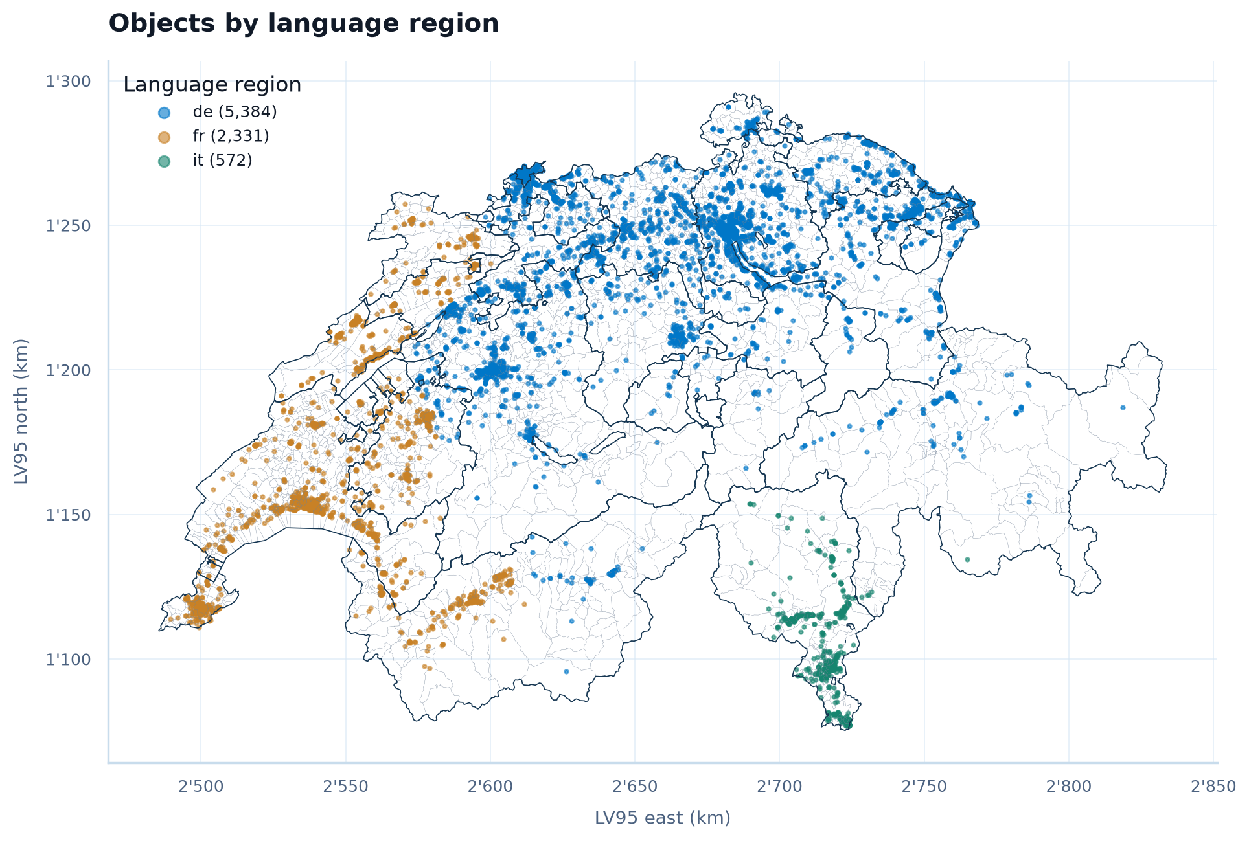
DATA SO FAR
Pilot data: DSPRO1 snapshot
9 405 Raw listings
8 298 One row per object (−1 107 duplicates)
8 280 Swiss address, plausible area and rent
8 125 Without price-per-m² outliers
Split: 4 875 train · 1 625 calibration · 1 625 test
Gaps: no listing text in the snapshot; 51.5 % of objects lack building-register data.
RentLens: Explainable Rent Prediction and Quality of Life
22.10.2026
14
Notes:
We clean in four transparent steps; most losses are duplicates. The map shows coverage: mostly German-speaking Switzerland, fewer Italian-speaking listings.

Slide 15





DATA SOURCE
From DSPRO1 to DSPRO2
Change since proposal: own incremental scraper → Apify
DSPRO1
Done
DSPRO2
Planned
Rentumo
Comparis
Own Rust scraper
Collected via Apify
9 994
listings scraped
≈ 20 000
objects (target)
1
snapshot, 13.04.2026
06.11.
data freeze
No
listing text in the training data
Yes
listing text included → RQ1
Enrichment for both
OpenStreetMap
GWR building register
geo.admin / swisstopo
BFS
BAFU
RentLens: Explainable Rent Prediction and Quality of Life
22.10.2026
15
Notes:
DSPRO1: Comparis declined (only about 300 records with approval), Immoscout was not interested, Rentumo did not answer, so we scraped rentumo.ch with our own Rust scraper: one snapshot, no listing text. DSPRO2: Comparis listings collected via Apify, including descriptions, until the data freeze on 06.11. Collection has not started yet. Enrichment stays the same, now from downloads instead of slow APIs.

Slide 16
DATA PIPELINE HIGH-LEVEL DESIGN
DSPRO2: from the sources to the app
Sources
Ingestion (rentml)
Storage
Modelling
Serving
NEW
Comparis via Apify
listings + descriptions
Clean & deduplicate
one object_id per flat, domain rules, outliers
Features + split
grouped 60/20/20, target encoding
SQL DB
neon.com
(PostgreSQL serverless)
Dash web app
Fair-Rent Check, price band, marketplace, map
Rent model
LightGBM vs. GPBoost
Anonymise text
remove contacts and prices from descriptions
Official geodata
GWR, swisstopo, ARE, BAFU, BFS
Intervals
quantile models + CQR
Enrich
spatial joins via coordinates / EGID, QoLI layers
Data freeze 06.11.
frozen snapshot for the final run
Azure Container Apps
public deployment by 11.12.
OpenStreetMap
amenities (Geofabrik)
QoLI
index + value score
live address lookup: geo.admin.ch
all runs tracked in MLflow
dated milestone
RentLens: Explainable Rent Prediction and Quality of Life
22.10.2026
16
Notes:
Same idea as in DSPRO1, updated: the listing source is new, Comparis collected via Apify instead of our own rentumo scraper. Our Python package rentml cleans, deduplicates, anonymises and enriches, Neon stores everything, then the modelling pipeline and the Dash app. The Apify import has not started yet; the pilot results still come from the DSPRO1 snapshot. Dashed boxes are dated milestones: data freeze on 06.11. and public deployment on Azure by 11.12.

Slide 17
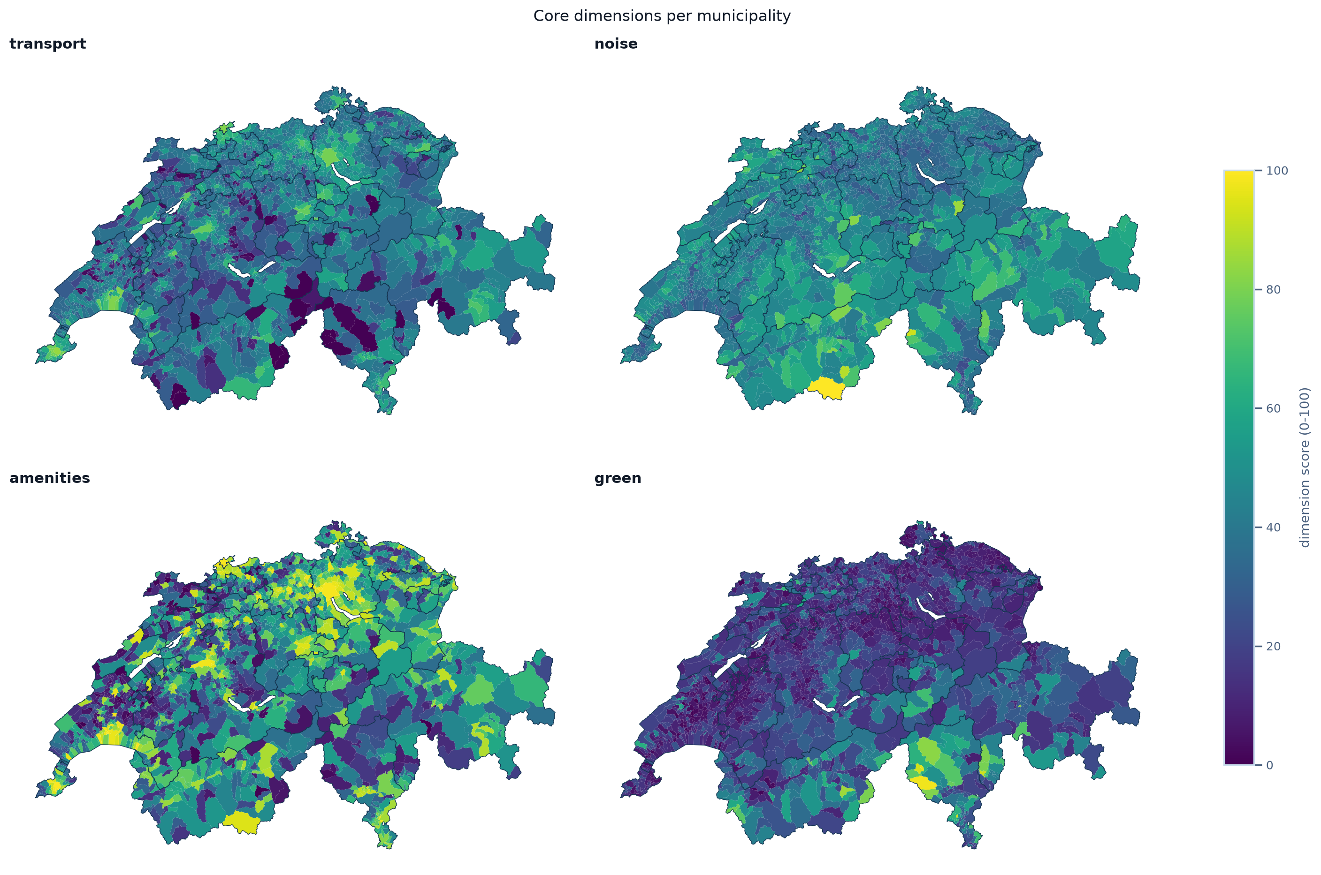
DATA ENRICHMENT
Each address gets building, location and quality-of-life data
DSPRO1: one API call per listing (frequent timeouts) → DSPRO2: official downloads, joined locally per coordinate or EGID
GWR (EGID)
year built, dwellings, building area
swisstopo
coordinates, elevation, solar, municipality
ARE
public-transport quality class, distance to stop
BAFU
road and rail noise day/night (10 m), NO₂, PM2.5
BFS
population grid, green share (land use), vacancy
OpenStreetMap
walking access to 7 amenity types (shops, doctors, schools …)
MeteoSwiss, ESTV
sunshine, tax burden (extended index)
Four core QoLI dimensions per municipality (0–100), built from these layers
RentLens: Explainable Rent Prediction and Quality of Life
22.10.2026
17
Notes:
In DSPRO1 we called geo.admin and the GWR API for every listing, which was slow and timed out. Now we download the official layers once and join them locally by coordinate or building ID. The same layers feed the rent model and the quality-of-life index; the maps show its four core dimensions per municipality.

Slide 18
4
FIRST RESULTS (PILOT)
RentLens: Explainable Rent Prediction and Quality of Life
22.10.2026
18

Slide 19
DSPRO1 BASELINE VS. DSPRO2 PILOT
MAE = mean absolute error in CHF
Baseline: DSPRO1 final model
GradientBoosting (ALL+geo)
MAE
CHF 281
avg. prediction error
RMSE
CHF 425
penalises large errors
R²
0.71
variance explained
DSPRO1 evaluation split, fully enriched listings only, train/eval gap 60 CHF (proposal, DSPRO1 report)
DSPRO2 pilot: same DSPRO1 listings, new grouped split, test set n = 1 625
Naive reference
MAE CHF 355
median CHF/m² of the municipality · R² 0.62
LightGBM, tabular
MAE CHF 302
flat, building and area features · R² 0.66
LightGBM + location
MAE CHF 261
+ encoded municipality · RMSE 483 · R² 0.74
Interpretation
Not yet a fair comparison: different split, and DSPRO1 used only fully enriched listings. As planned in the proposal, the new baseline is this GradientBoosting retrained on the new deduplicated data: the bar every DSPRO2 model has to clear.
RentLens: Explainable Rent Prediction and Quality of Life
22.10.2026
19
Notes:
The baseline is our final DSPRO1 model: GradientBoosting on ALL+geo features, MAE 281, RMSE 425, R² 0.71 on the DSPRO1 evaluation split. The DSPRO2 pilot numbers come from a new grouped split that also contains listings without building data, so the two rows are not directly comparable yet. The naive reference uses the median price per m² of the municipality.

Slide 20
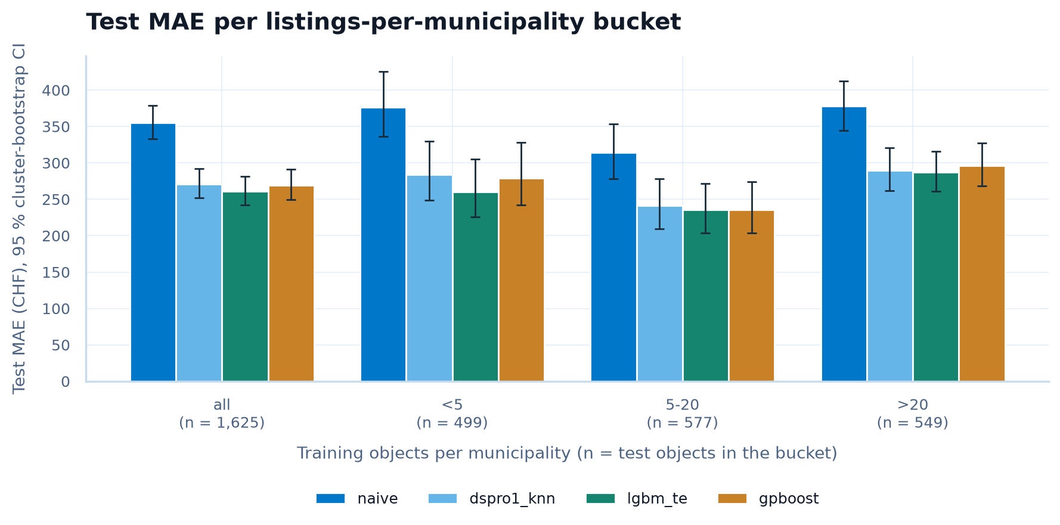
RQ2: SPATIAL MODEL
GPBoost vs. LightGBM by listings per municipality
• MAE: LightGBM 261 vs. GPBoost 269 CHF
• Difference: −8.7 CHF (95 % CI −15.0 to −2.2)
• Sparse areas (< 5 listings): −18.5 CHF, again in favour of LightGBM
• But: GPBoost errors are less clustered in space (Moran's I 0.017 vs. 0.025)
Decision
Hypothesis not supported in the pilot. GPBoost is still untuned → tune it before the final run; LightGBM is our main model for now.
RentLens: Explainable Rent Prediction and Quality of Life
22.10.2026
20
Notes:
Bars: test error per bucket of training listings per municipality, with 95 % bootstrap intervals (dspro1_knn = DSPRO1 kNN rent features refit with LightGBM). We expected GPBoost to win in sparse municipalities; in the pilot it does not. Caveat: GPBoost was not tuned yet, so this is not final.

Slide 21
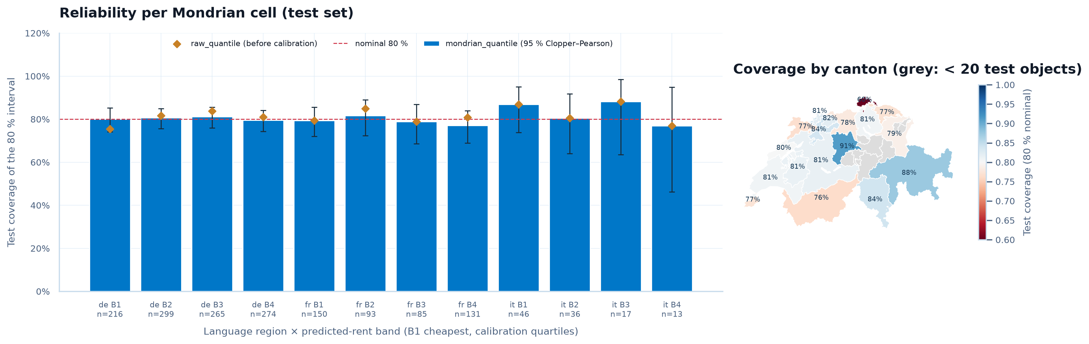
RQ3: PRICE INTERVALS
80 % interval = should contain the true rent for 8 out of 10 flats
Coverage 80.2 %
Target 80 % reached on the test set
All 12 groups OK
Language region × price band, lowest 76.9 %; a constant band falls to 46 %
18.5 % wider
Mean width CHF 851 vs. 718 for a constant band → second hypothesis not supported
RentLens: Explainable Rent Prediction and Quality of Life
22.10.2026
21
Notes:
Bars: coverage per language region and price band. The method (Mondrian conformalized quantile regression) keeps its promise everywhere, but intervals are wider on average than one constant band. That is the price of being fair to every segment.

Slide 22
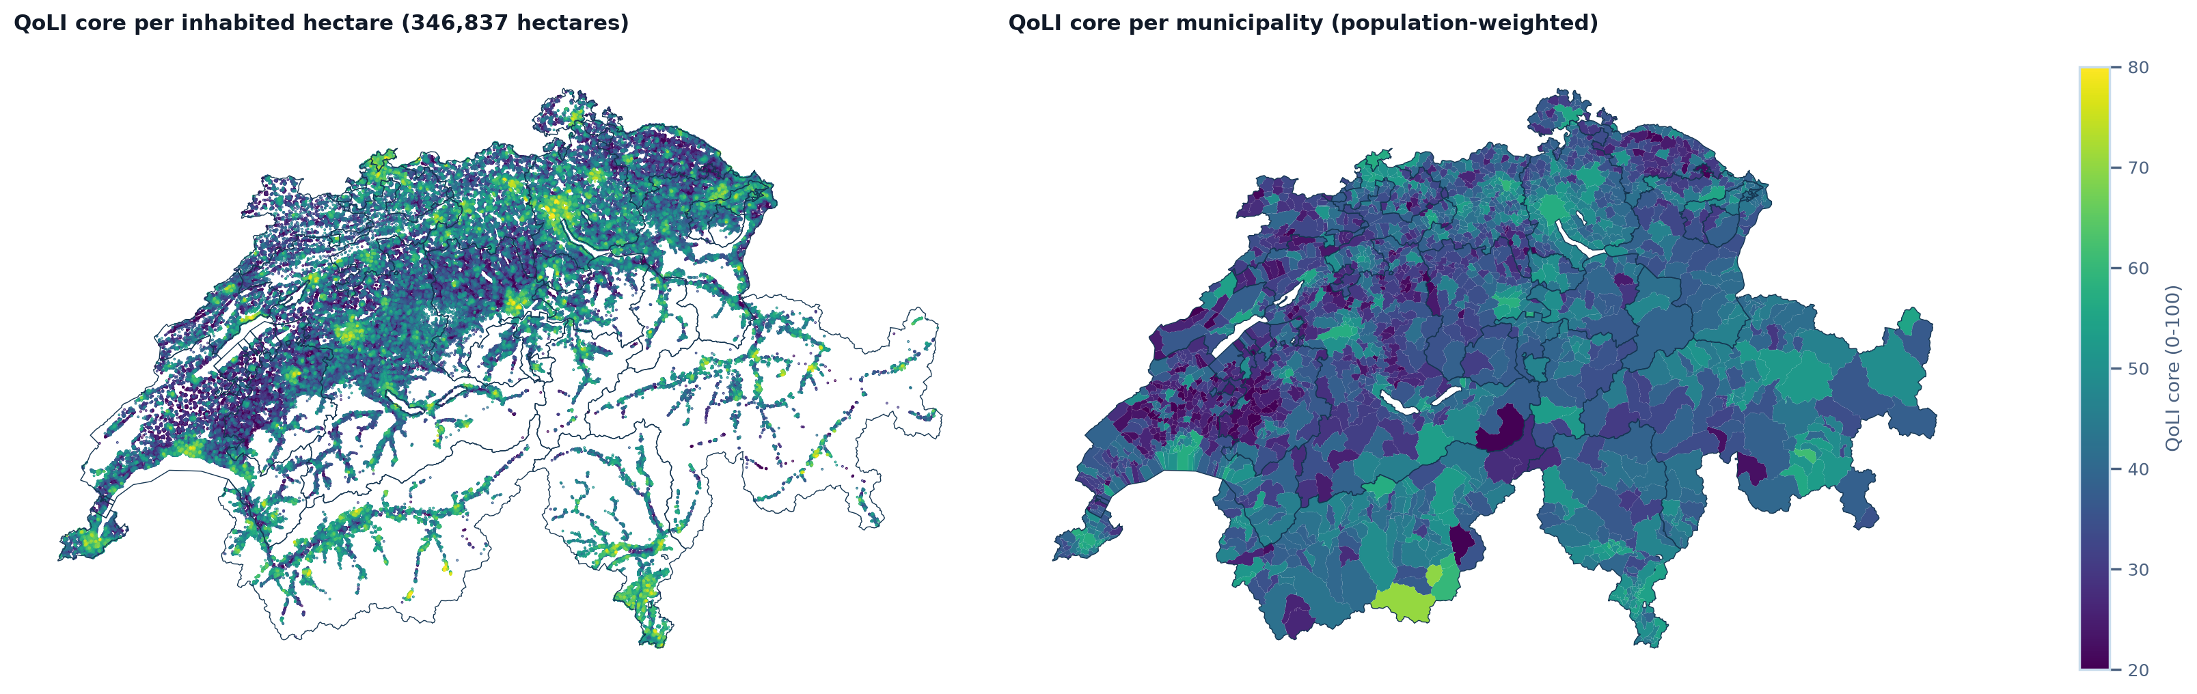
RQ4: QUALITY-OF-LIFE INDEX
Core index from open data: public transport, noise, green space, services
2 110 municipalities
Index for all 8 125 objects, 100 m resolution
Robust to weights
Median rank correlation 0.93 under random weights; worst 5 % below our threshold
Validity: 2 of 4 checks
Matches rent per m² and official accessibility; not vacancy or population growth
RentLens: Explainable Rent Prediction and Quality of Life
22.10.2026
22
Notes:
Left: index per inhabited hectare, right: per municipality. There is no ground truth for quality of life, so we check stability under weight changes and agreement with independent statistics. Answer so far: partially valid.

Slide 23
5
DEMO: WEB APP
RentLens: Explainable Rent Prediction and Quality of Life
22.10.2026
23
Notes:
Live demo, about 2 minutes. Start before the talk: uv run --extra app python -m rentml.webapp, then open http://127.0.0.1:8050/mietcheck. Enter Langstrasse 4 Zürich, 80 m², 3.5 rooms, CHF 2400 → verdict within the expected range, estimate CHF 3451. Then /vermieter (price band and what-if) and /karte. Backup: the three hidden slides after this one contain screenshots of the same steps.

Slide 24
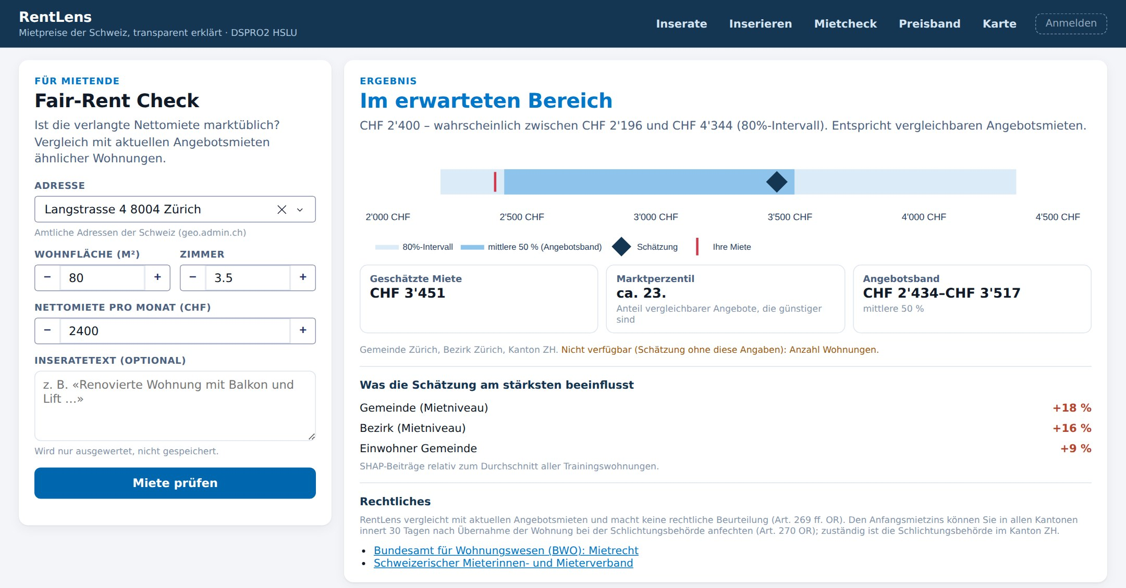
DEMO: FAIR-RENT CHECK
The example from the start: 3.5 rooms, 80 m², Zürich, CHF 2 400 per month
• Verdict: within the expected range
• Estimate: CHF 3 451, 80 % interval CHF 2 196–4 344
• Percentile: about 23rd, so cheaper than most comparable offers
• Why: municipality and district rent level (SHAP drivers)
Answers «Is this rent fair?» from slide 4; «good place to live?» comes from the QoLI
Prototype: pilot model trained on DSPRO1 data. Address lookup via geo.admin.ch; building and location data are added automatically.
RentLens: Explainable Rent Prediction and Quality of Life
22.10.2026
Notes:
Live demo: open /mietcheck, pick an address, enter 80 m², 3.5 rooms, CHF 2400. The red line is the asking rent, the diamond the estimate, the bands the 80 % interval and the middle 50 %. Backup: this screenshot.

Slide 25
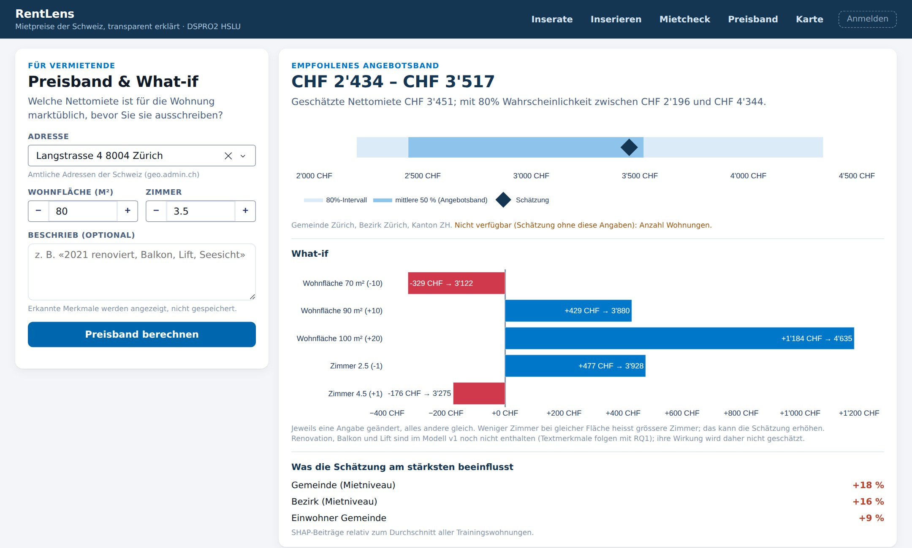
DEMO: PRICE BAND FOR LANDLORDS
Same flat, landlord view with what-if
• Suggested band: CHF 2 434–3 517 (middle 50 % of comparable offers)
• What-if: change area or rooms and see the effect on the estimate
• Transparent: shows which building data was missing
Renovation, balcony or lift as what-if needs text features (RQ1), planned after the Apify data.
RentLens: Explainable Rent Prediction and Quality of Life
22.10.2026

Slide 26
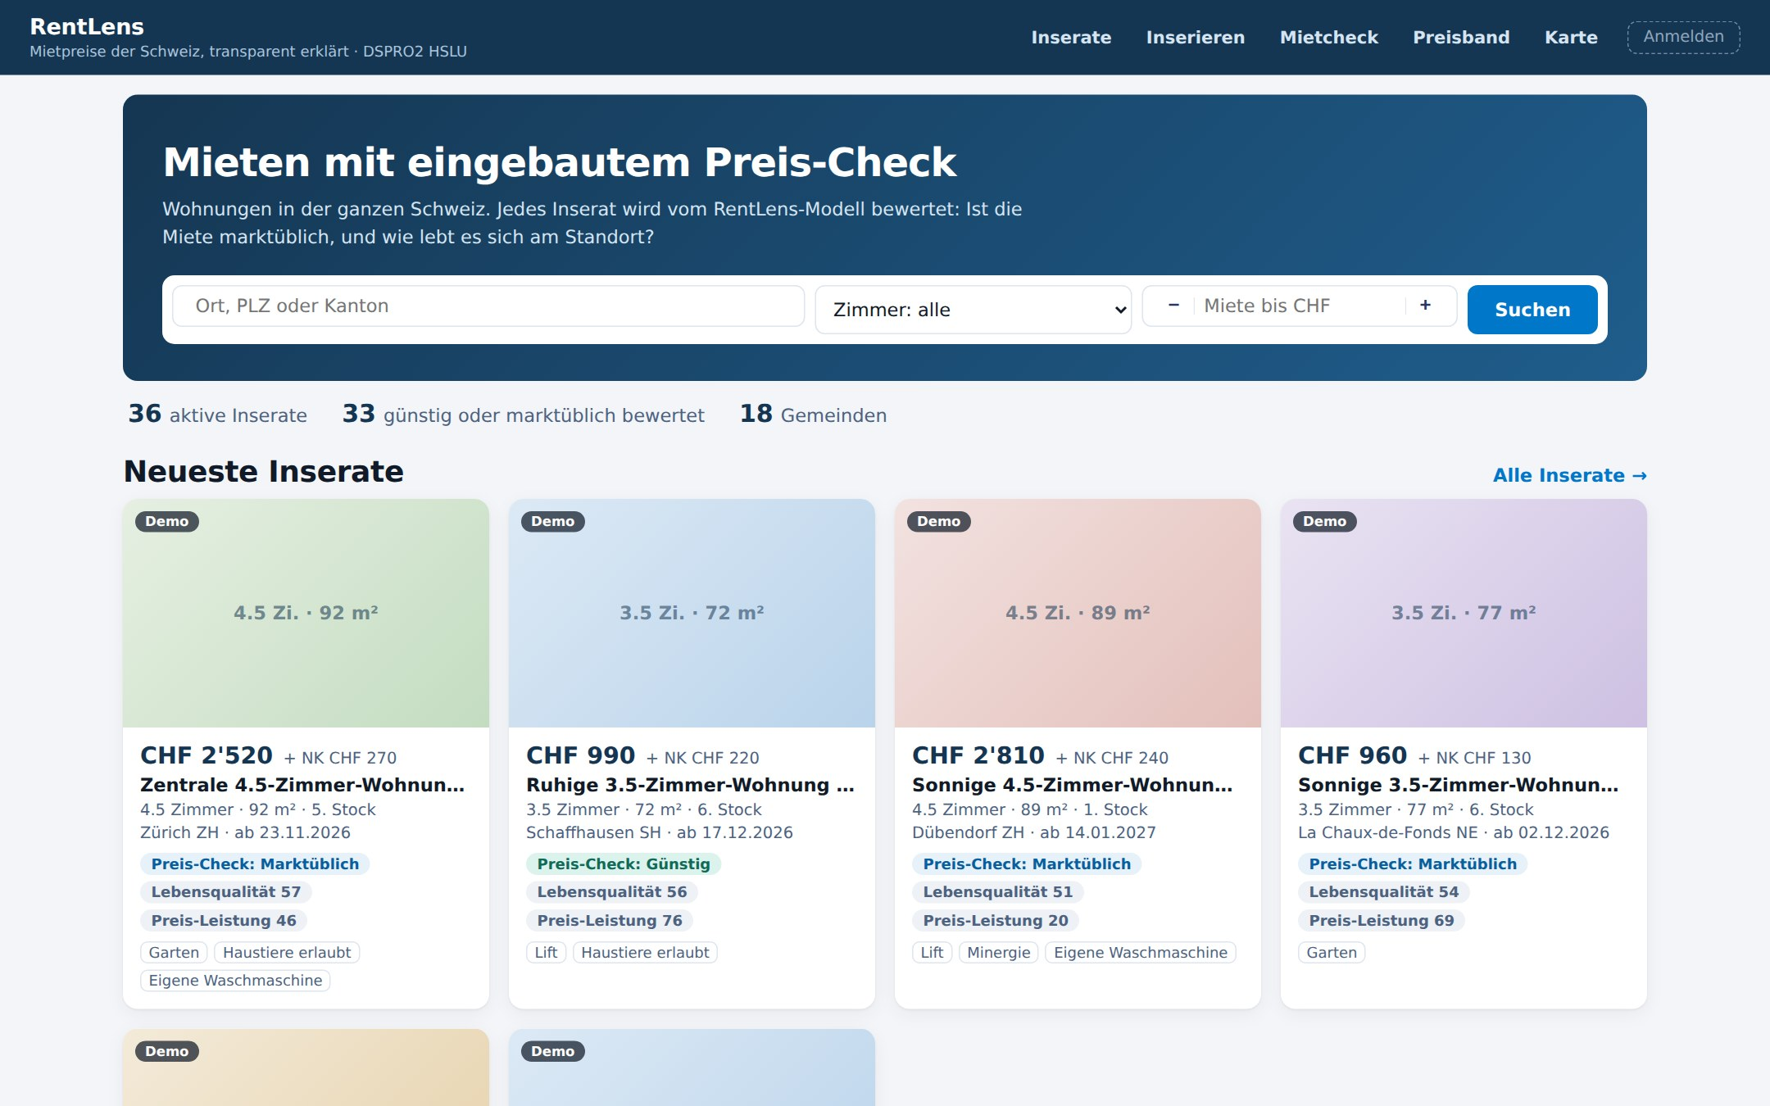
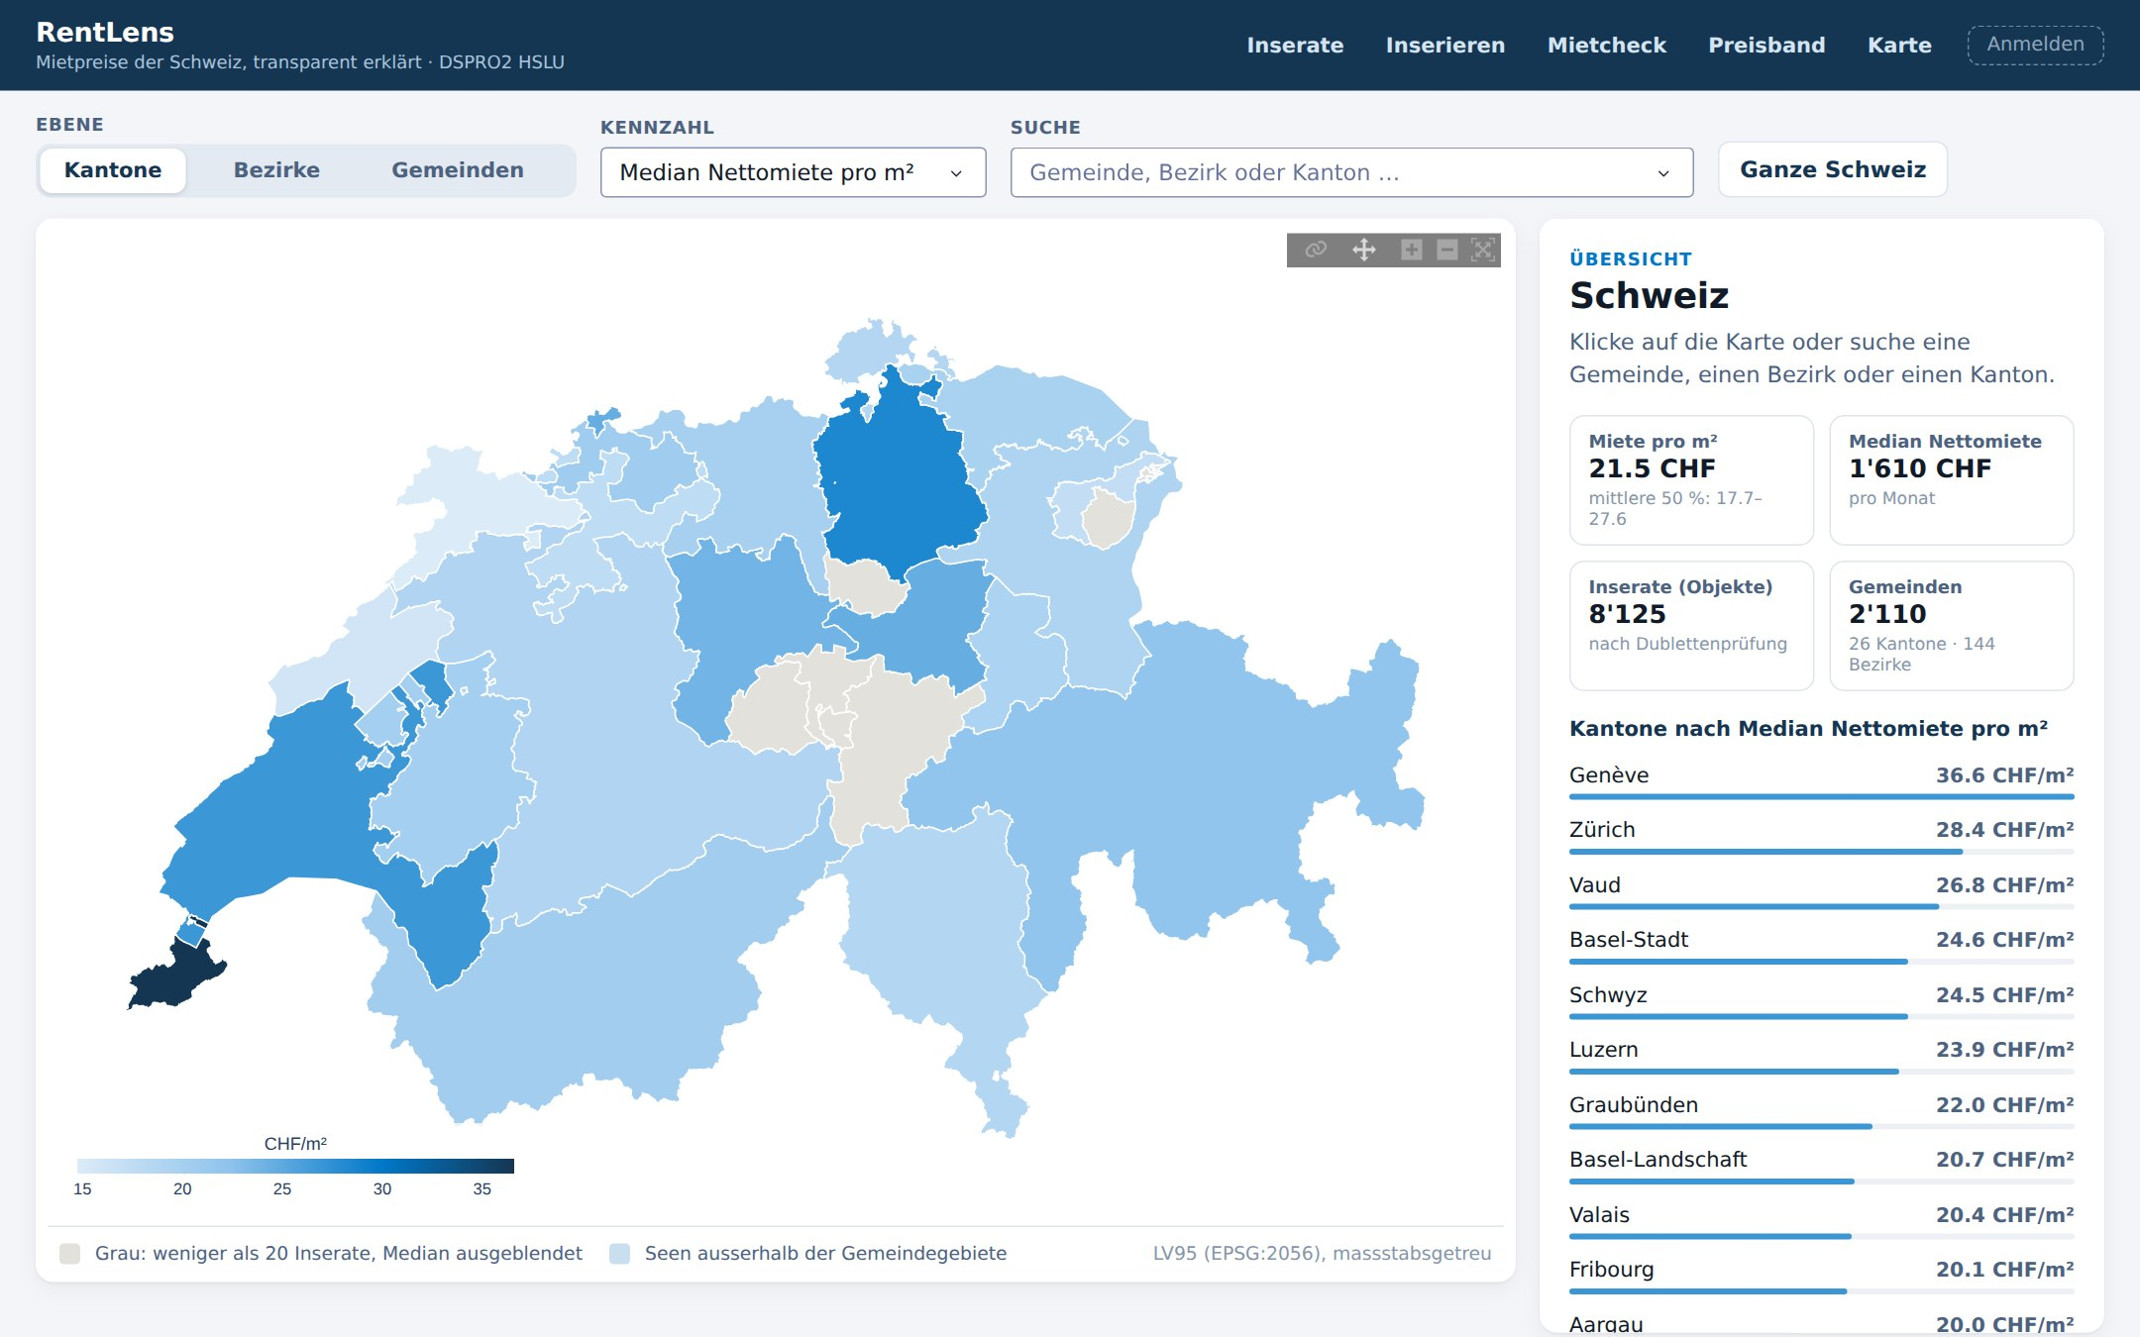
DEMO: MARKETPLACE AND MAP
Every listing gets a price check and a quality-of-life score
Marketplace: price check, quality of life and value score on every listing
Map: median rent per m² by canton, district and municipality
Status: prototype in progress. Listings shown are synthetic demo data (marked «Demo»); deployment follows by 11.12.
RentLens: Explainable Rent Prediction and Quality of Life
22.10.2026

Slide 27
6
NEXT STEPS
RentLens: Explainable Rent Prediction and Quality of Life
22.10.2026
24

Slide 28
NEXT STEPS
Road to the final presentation
until 06.11.
until 20.11.
until 06.12.
until 11.12.
17.12.
Apify data
Comparis listings with descriptions, enrichment, data freeze, datasheet
Features
Text attributes and embeddings (RQ1)
Models
Tune GPBoost, confirmatory run, evaluation
App
Dash app, deployment on Azure Container Apps
Final
Final presentation; report due 31.12.
Critical path: data freeze → confirmatory run. Everything after it reuses the pipeline that already runs on the pilot data.
RentLens: Explainable Rent Prediction and Quality of Life
22.10.2026
25

Slide 29
OPEN QUESTIONS & RISKS
Data access: Proposal excluded Comparis (formal approval needed in DSPRO1); now via Apify → clarify permission before the first run
RQ2 still open: Will GPBoost catch up once it is tuned?
Interval width: Can text features or better quantile models beat the constant band?
QoLI validation: Which external benchmark? The BILANZ/IAZI ranking is not available to us
Missing data: 51.5 % of objects lack building-register data
Feedback welcome: is P1 spatial model → P2 quality of life → P3 intervals the right focus?
RentLens: Explainable Rent Prediction and Quality of Life
22.10.2026
26

Slide 30
THANK YOU FOR YOUR
ATTENTION.
We are happy to answer any questions or discuss the presented topics further.
DSPRO2 Project
Team:
• Elias Martinelli
• Timo Schlumpf
Supervisor:
• Dr. Elena Nazarenko

