Slide 1



RENTLENS: FAIR RENT AND QUALITY OF LIFE
FOR SWISS APARTMENTS
DSPRO2 Project · Mid-Term Presentation
Team: Elias Martinelli, Timo Schlumpf
Supervisor: Dr. Elena Nazarenko
Notes:
Welcome. We are Team 6, Elias and Timo. Last semester we predicted rents; this semester RentLens answers two questions per flat: is the rent fair, and is it a good place to live?

Slide 2
AGENDA
1
The Problem
5
Next Steps & Open Questions
2
Goals & Approach
6
Questions & Feedback
3
Current Status
4
First Results (Pilot)
RentLens: Fair Rent and Quality of Life in Switzerland
22.10.2026
2

Slide 3

1
THE PROBLEM
RentLens: Fair Rent and Quality of Life in Switzerland
22.10.2026
3

Slide 4
THE PROBLEM
From DSPRO1 to DSPRO2
You find a listing
3.5 rooms, 80 m², Zürich
What our DSPRO1 model could not answer
One price, no uncertainty
The same ± error band for every flat
Expensive flats underestimated
Errors grow in the top price segment
CHF 2 400 / month
Is this rent fair?
Is it a good place to live?
Price only
Nothing about noise, transit or services nearby
Listing text unused
Descriptions were never part of the model
→ DSPRO2: fair-rent estimate + price interval per flat + quality-of-life index, in one web app
RentLens: Fair Rent and Quality of Life in Switzerland
22.10.2026
4
Notes:
Example: a 3.5-room flat in Zurich for CHF 2400. Two questions: is the price fair, and is the location good? DSPRO1 only gave a point estimate with one global error band, underestimated expensive flats and ignored location quality and listing text.

Slide 5



WHY IS IT RELEVANT?
• Tenants
• Landlords
• Society
Fair-rent check: below, within or above the market, with the main price drivers
A defensible price band and a what-if view before publishing a listing
More transparency in a market where most Swiss households rent
RentLens: Fair Rent and Quality of Life in Switzerland
22.10.2026
5
Notes:
Tenants get a verdict with an interval instead of a single number; landlords get a price band they can justify; for society, more transparency in a rental market.

Slide 6
2
GOALS & APPROACH
RentLens: Fair Rent and Quality of Life in Switzerland
22.10.2026
6

Slide 7
RESEARCH QUESTIONS & GOALS
What we want to find out
P1 · RQ2
Spatial model
Does boosting with spatial random effects (GPBoost) predict better than LightGBM with an encoded municipality, especially where only few listings exist?
P2 · RQ4
Quality of life
Can we build a valid quality-of-life index (QoLI) without ground truth, checked against independent municipal statistics?
P3 · RQ3
Price intervals
Do calibrated 80 % intervals really contain 80 % of rents, and are they narrower than one constant ± band?
Secondary · RQ1
Listing text
Does the listing description significantly improve the prediction over the tabular model?
Optional · RQ5
Usability
Do tenants and landlords find the verdict, the price band and the value score useful?
Goal by 17.12.2026: tested rent model + intervals + QoLI, delivered in a web app (tenant check, landlord band, map)
RentLens: Fair Rent and Quality of Life in Switzerland
22.10.2026
7
Notes:
Three core priorities: P1 spatial model, P2 quality-of-life index, P3 per-flat intervals. Text features are secondary, a user test is optional.

Slide 8
PLANNED APPROACH
From listing to verdict
Data
Comparis listings (Apify) + building register (GWR) + geodata, OSM
Features
Size, rooms, location, municipality encoding, listing text
Rent model
LightGBM vs. GPBoost (spatial random effects)
Uncertainty
Calibrated 80 % price interval per flat (CQR)
QoLI + App
Quality-of-life index, Dash web app
Why this approach makes sense
Gradient boosting
Best tabular model in DSPRO1; captures non-linear interactions (area × location)
Spatial random effects
Borrow information from neighbouring areas where a municipality has few listings
Conformal calibration
Guarantees the promised coverage without assuming a price distribution
GWR = federal building and dwelling register · OSM = OpenStreetMap · CQR = conformalized quantile regression · QoLI = quality-of-life index
RentLens: Fair Rent and Quality of Life in Switzerland
22.10.2026
8
Notes:
Pipeline: enrich listings, engineer features, compare two boosting models, wrap the winner in calibrated intervals, add a quality-of-life index and show all of it in a web app.

Slide 9
EVALUATION DESIGN
How we make the results trustworthy
Training 60 %
Calibration 20 %
Test 20 % (hold-out)
Split grouped by object (no flat appears in two sets), stratified by canton × price
MAE
Mean absolute error in CHF: main metric
Grouped 5-fold CV
Model selection and Optuna tuning on training data only
Paired tests
Bootstrap + Wilcoxon, Holm-corrected, α = 0.05
Moran's I
Are the errors still clustered in space?
Coverage & width
Do intervals hold 80 %, and how wide are they?
Pre-registration: we freeze the evaluation plan before the final run, so the test set is used only once
RentLens: Fair Rent and Quality of Life in Switzerland
22.10.2026
9
Notes:
MAE is the average absolute error in francs. All comparisons are paired on the same test flats. Moran's I measures whether errors cluster geographically.

Slide 10
SCOPE
• In Scope
Out of Scope
✓ New Comparis listings via Apify + data freeze
✓ Enrichment with official geodata and OSM
✓ Spatial model comparison: LightGBM vs. GPBoost
✓ Calibrated price interval per flat
✓ Quality-of-life index from open data
✓ Text features from listing descriptions
✓ Dash web app: tenant check, landlord band, map
✓ Experiment tracking (MLflow), Kanban on GitHub
▬ Rent forecasting over time (time series)
▬ Houses and commercial property
▬ Real-time price feed
▬ Legally binding rent assessment
▬ Aerial images, fused transformer (optional only)
RentLens: Fair Rent and Quality of Life in Switzerland
22.10.2026
10

Slide 11
3
CURRENT STATUS
RentLens: Fair Rent and Quality of Life in Switzerland
22.10.2026
11

Slide 12
STATUS
Project progression
Proposal & research plan
Pilot pipeline on DSPRO1 data
Web app prototype
Apify data & freeze
Features & text
Final models & evaluation
done
done
due 11.12.
due 06.11.
due 20.11.
due 06.12.
Done
In progress
Upcoming
Unusual order on purpose: we ran the full pipeline on DSPRO1 data first, so every research question has a tested code path before the new data arrives.
RentLens: Fair Rent and Quality of Life in Switzerland
22.10.2026
12
Notes:
Green = done, orange = in progress, white = upcoming. Dates are the milestone deadlines on our GitHub board.

Slide 13
DONE VS. PLANNED
Done
In progress
Planned
✓ Project proposal, research questions and priorities
✓ Data sourcing analysis (official data, OSM, scraping limits)
✓ Cleaning pipeline: 9 405 listings → 8 125 objects
✓ End-to-end pilot for RQ2, RQ3 and RQ4, tracked in MLflow
✓ Quality-of-life index for 2 110 municipalities
✓ 600+ automated tests (pytest)
● Dash web app: tenant check, landlord price band, map
● Evaluation plan (draft, to be frozen)
○ Comparis data via Apify (with descriptions) + data freeze
○ Text features (RQ1)
○ Tune GPBoost before the final comparison
○ Confirmatory run on frozen data
○ Deployment (Docker, CI); user test (optional)
RentLens: Fair Rent and Quality of Life in Switzerland
22.10.2026
13
Notes:
Everything in the left column runs today, but only on the DSPRO1 snapshot. The right column is what turns the pilot into confirmed results.

Slide 14
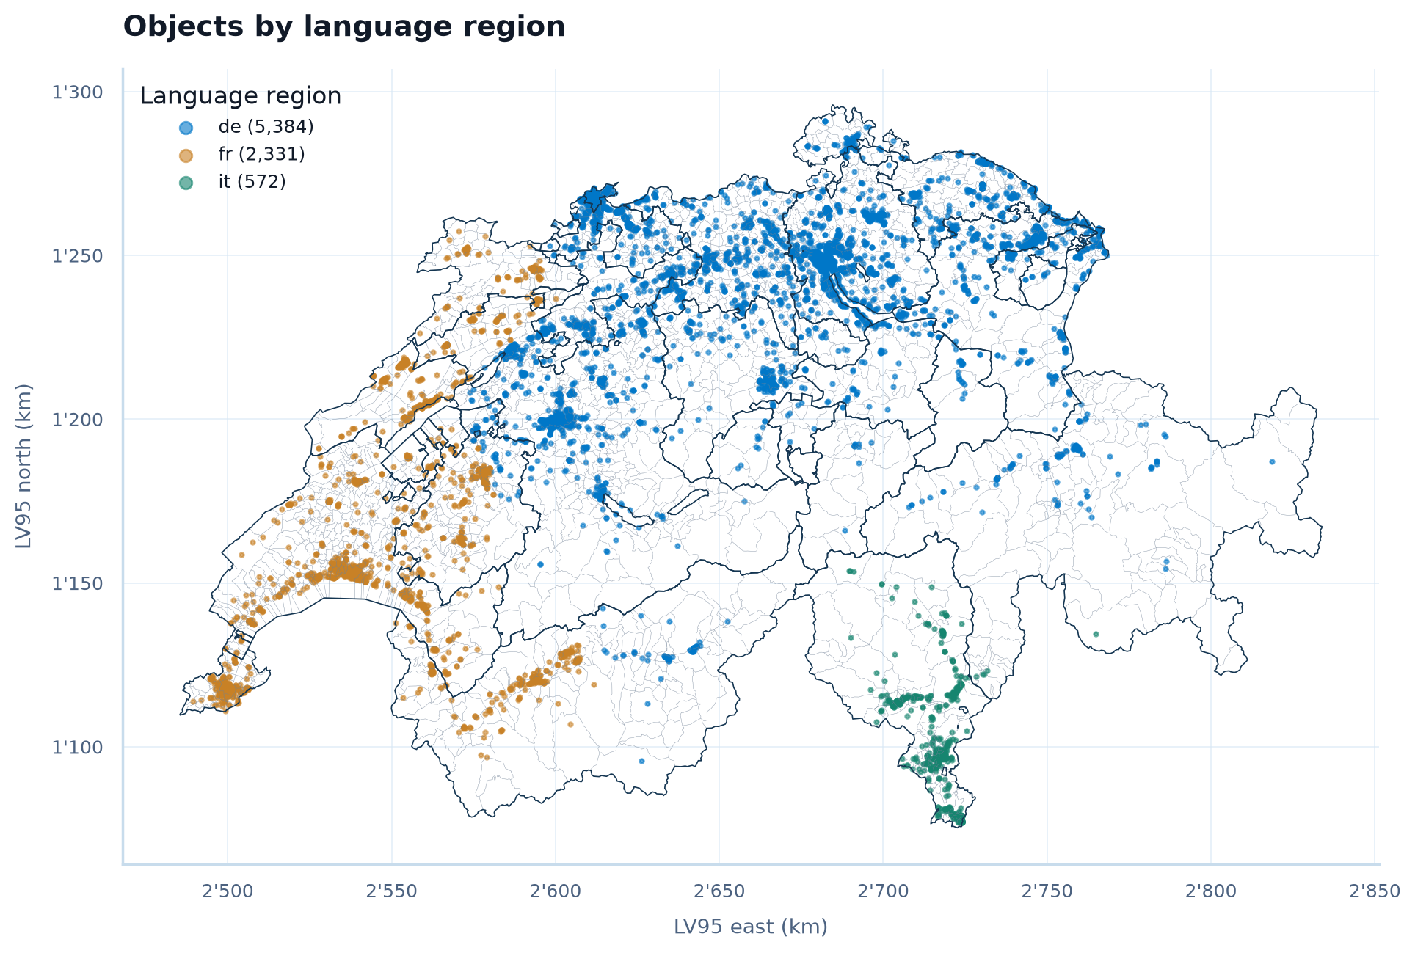
DATA SO FAR
Pilot data: DSPRO1 snapshot
9 405 Raw listings
8 298 One row per object (−1 107 duplicates)
8 280 Swiss address, plausible area and rent
8 125 Without price-per-m² outliers
Split: 4 875 train · 1 625 calibration · 1 625 test
Gaps: no listing text in the snapshot; 51.5 % of objects lack building-register data.
RentLens: Fair Rent and Quality of Life in Switzerland
22.10.2026
14
Notes:
We clean in four transparent steps; most losses are duplicates. The map shows coverage: mostly German-speaking Switzerland, fewer Italian-speaking listings.

Slide 15
DATA: DSPRO1 VS. DSPRO2
From one snapshot to Comparis data via Apify
DSPRO1 (now: pilot)
DSPRO2 (Apify)
Source
rentumo.ch, own Rust scraper
comparis.ch via an Apify scraper (actor)
Collection
One snapshot, 13.04.2026
Planned, until the data freeze on 06.11.
Size
25 002 found → 9 994 extracted → 8 125 usable
Target ≈ 20 000 objects
Listing text
Not in the training data
Included → enables RQ1
Enrichment
GWR + geo.admin via API (timeouts)
Same + OSM, BFS, BAFU as downloads
Status
Done, used for the pilot
Planned, not started
Same cleaning and modelling pipeline for both: the pilot code runs unchanged on the Apify data.
RentLens: Fair Rent and Quality of Life in Switzerland
22.10.2026
15
Notes:
DSPRO1 used one rentumo snapshot without listing text. For DSPRO2 we switch to Comparis data collected with Apify, including descriptions, so RQ1 becomes testable. Collection has not started yet; data freeze is 06.11.

Slide 16
4
FIRST RESULTS (PILOT)
RentLens: Fair Rent and Quality of Life in Switzerland
22.10.2026
16

Slide 17
DSPRO1 BASELINE VS. DSPRO2 PILOT
MAE = mean absolute error in CHF
Baseline: DSPRO1 final model
GradientBoosting (ALL+geo)
MAE
CHF 281
avg. prediction error
RMSE
CHF 423
penalises large errors
R²
0.71
variance explained
DSPRO1 evaluation split, fully enriched listings only (DSPRO1 final presentation)
DSPRO2 pilot: same DSPRO1 listings, new grouped split, test set n = 1 625
Naive reference
MAE CHF 355
median CHF/m² of the municipality · R² 0.62
LightGBM, tabular
MAE CHF 302
flat, building and area features · R² 0.66
LightGBM + location
MAE CHF 261
+ encoded municipality · RMSE 483 · R² 0.74
Interpretation
Not yet a fair comparison: different split, and DSPRO1 used only fully enriched listings. Next: score the DSPRO1 model on the same frozen test set. That is the bar every DSPRO2 model has to clear.
RentLens: Fair Rent and Quality of Life in Switzerland
22.10.2026
17
Notes:
The baseline is our final DSPRO1 model: GradientBoosting on ALL+geo features, MAE 281, RMSE 423, R² 0.71 on the DSPRO1 evaluation split. The DSPRO2 pilot numbers come from a new grouped split that also contains listings without building data, so the two rows are not directly comparable yet. The naive reference uses the median price per m² of the municipality.

Slide 18
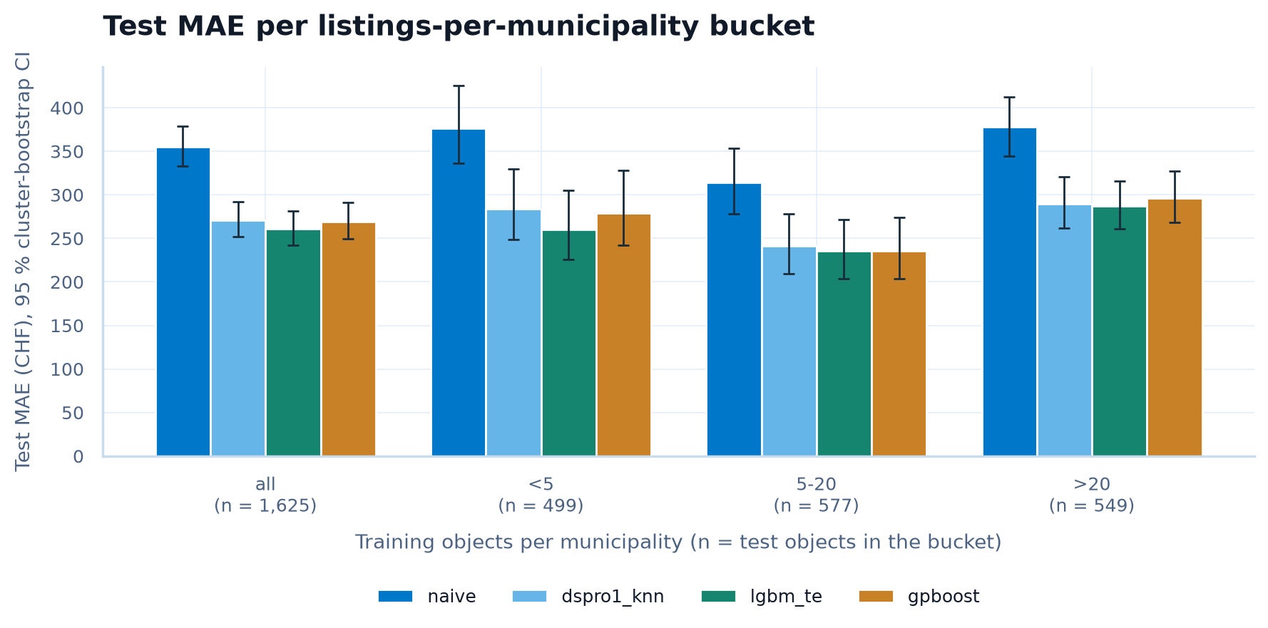
RQ2: SPATIAL MODEL
GPBoost vs. LightGBM by listings per municipality
• MAE: LightGBM 261 vs. GPBoost 269 CHF
• Difference: −8.7 CHF (95 % CI −15.0 to −2.2)
• Sparse areas (< 5 listings): −18.5 CHF, again in favour of LightGBM
• But: GPBoost errors are less clustered in space (Moran's I 0.017 vs. 0.025)
Decision
Hypothesis not supported in the pilot. GPBoost is still untuned → tune it before the final run; LightGBM is our main model for now.
RentLens: Fair Rent and Quality of Life in Switzerland
22.10.2026
18
Notes:
Bars: test error per bucket of training listings per municipality, with 95 % bootstrap intervals (dspro1_knn = DSPRO1 kNN rent features refit with LightGBM). We expected GPBoost to win in sparse municipalities; in the pilot it does not. Caveat: GPBoost was not tuned yet, so this is not final.

Slide 19
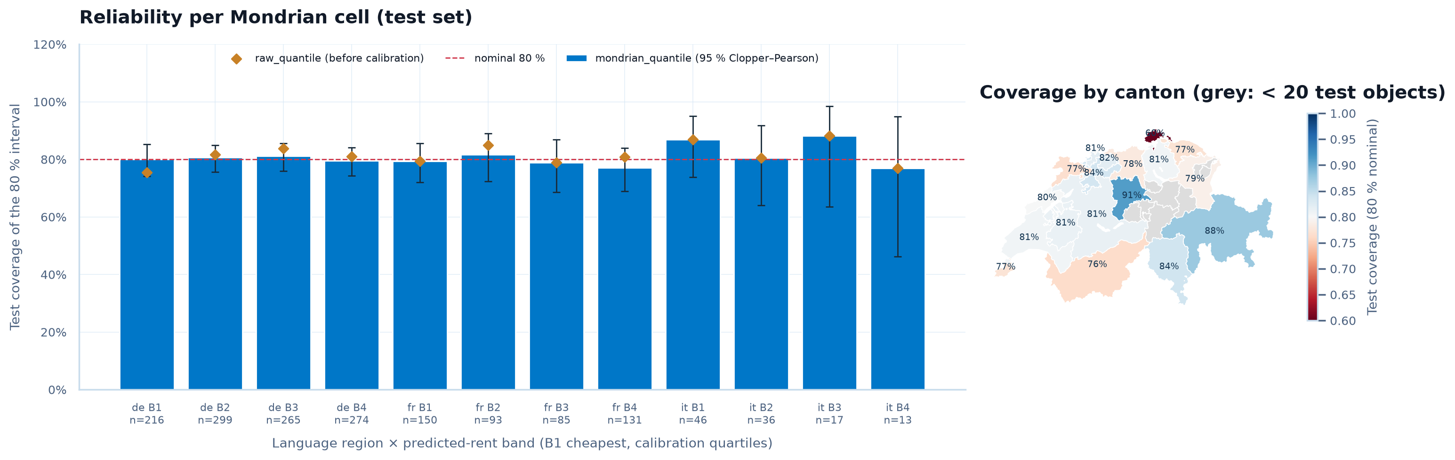
RQ3: PRICE INTERVALS
80 % interval = should contain the true rent for 8 out of 10 flats
Coverage 80.2 %
Target 80 % reached on the test set
All 12 groups OK
Language region × price band, lowest 76.9 %; a constant band falls to 46 %
18.5 % wider
Mean width CHF 851 vs. 718 for a constant band → second hypothesis not supported
RentLens: Fair Rent and Quality of Life in Switzerland
22.10.2026
19
Notes:
Bars: coverage per language region and price band. The method (Mondrian conformalized quantile regression) keeps its promise everywhere, but intervals are wider on average than one constant band. That is the price of being fair to every segment.

Slide 20
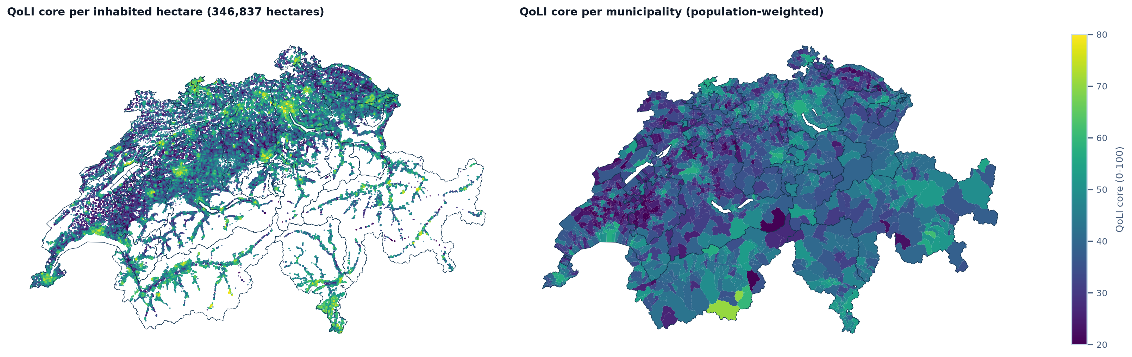
RQ4: QUALITY-OF-LIFE INDEX
Core index from open data: public transport, noise, green space, services
2 110 municipalities
Index for all 8 125 objects, 100 m resolution
Robust to weights
Median rank correlation 0.93 under random weights; worst 5 % below our threshold
Validity: 2 of 4 checks
Matches rent per m² and official accessibility; not vacancy or population growth
RentLens: Fair Rent and Quality of Life in Switzerland
22.10.2026
20
Notes:
Left: index per inhabited hectare, right: per municipality. There is no ground truth for quality of life, so we check stability under weight changes and agreement with independent statistics. Answer so far: partially valid.

Slide 21
5
NEXT STEPS
RentLens: Fair Rent and Quality of Life in Switzerland
22.10.2026
21

Slide 22
NEXT STEPS
Road to the final presentation
until 06.11.
until 20.11.
until 06.12.
until 11.12.
17.12.
Apify data
Comparis listings with descriptions, enrichment, data freeze, datasheet
Features
Text attributes and embeddings (RQ1)
Models
Tune GPBoost, confirmatory run, evaluation
App
Web app and deployment (Docker, CI)
Final
Final presentation; report due 31.12.
Critical path: data freeze → confirmatory run. Everything after it reuses the pipeline that already runs on the pilot data.
RentLens: Fair Rent and Quality of Life in Switzerland
22.10.2026
22

Slide 23
OPEN QUESTIONS & RISKS
Data access: Comparis asked for formal approval of automated collection in DSPRO1 → clarify permission before the first Apify run
RQ2 still open: Will GPBoost catch up once it is tuned?
Interval width: Can text features or better quantile models beat the constant band?
QoLI validation: Which external benchmark? The BILANZ/IAZI ranking is not available to us
Missing data: 51.5 % of objects lack building-register data
Feedback welcome: is P1 spatial model → P2 quality of life → P3 intervals the right focus?
RentLens: Fair Rent and Quality of Life in Switzerland
22.10.2026
23

Slide 24
THANK YOU FOR YOUR
ATTENTION.
We are happy to answer any questions or discuss the presented topics further.
DSPRO2 Project
Team:
• Elias Martinelli
• Timo Schlumpf
Supervisor:
• Dr. Elena Nazarenko

