Slide 1
SECURE DEVELOPMENT
Why should i develop in a secured way and how?

Slide 2
THE RISK
2013 - Adobe: data leak - 38 million customers impacted, 1million dollars in trial to 500 000 persons in 15 american states
2014 - Tesco: security breach - 9000 customers accounts were looted, fall in the stock market
2016 – DAO platform: breach in the code – 56 million dollars stolen

Slide 3
OWASP TOP 10 SECURITY BREACHES
10 – Insufficient Logging&Monitoring
9 – Using components with known vulnerabilities
8 – Insecure Deserialization
7 – Cross-Site Scripting (XSS)
6 – Security Misconfiguration
5 – Broken Access Control
4 – XML External Entities (XEE)
3 – Sensitive Data Exposure
2 – Broken Authentification
1 – Injection
Notes:
Open Web Application Security Project

Slide 4
HOW SHOULD I SET UP MY MIND?
No trust
Keep in mind that someone somewhere wants you down
Become monomaniac

Slide 5
UNIT TESTING
unit testing is a software testing method by which individual units of source code, sets of one or more computer program modules together with associated control data, usage procedures, and operating procedures, are tested to determine whether they are fit for use.

Slide 6
WHAT SHOULD WE TEST?
We have to test:
The normal behavior of our programs
The behavior « at the limit »
The behavior out of valid range

Slide 7
ADVANTAGES
Avoid the oversights
Reduce the number of bugs
Avoid regression of code when adding, refactoring modifications
Ease the teamwork : the test of other people are tested and trusted

Slide 8
UNDERSTANDINGS OF EXCEPTIONS
Try/catch is an handler which deals with exception
You have to try a method
Then catch the exception
Throw it, or deal with it

Slide 9
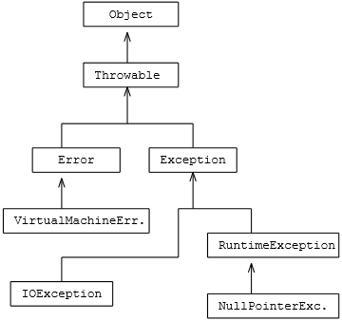
HIERARCHY OF EXCEPTIONS

Slide 10
GOOD PROGRAMMING HABITS
Write simple code
Write readable and comprehensible code
Write unit tests
Correct bugs before adding new features
Follow technologies used and their alternatives
Document and comment
Don’t optimize your code at start
Master your tools

Slide 11
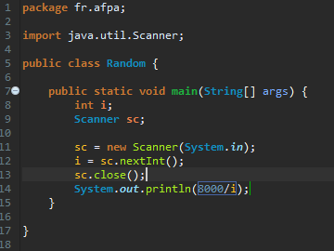
EXERCISE

