Slide 1
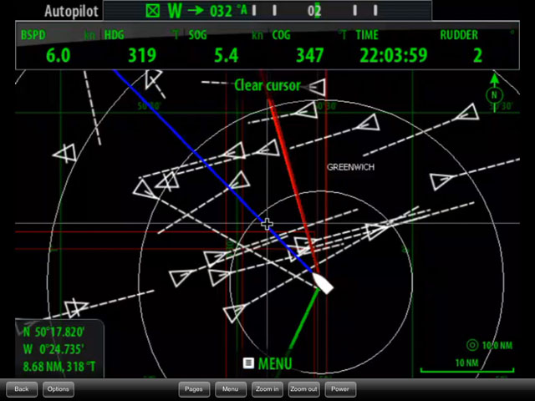
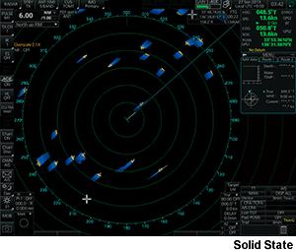
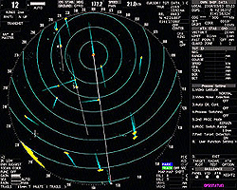
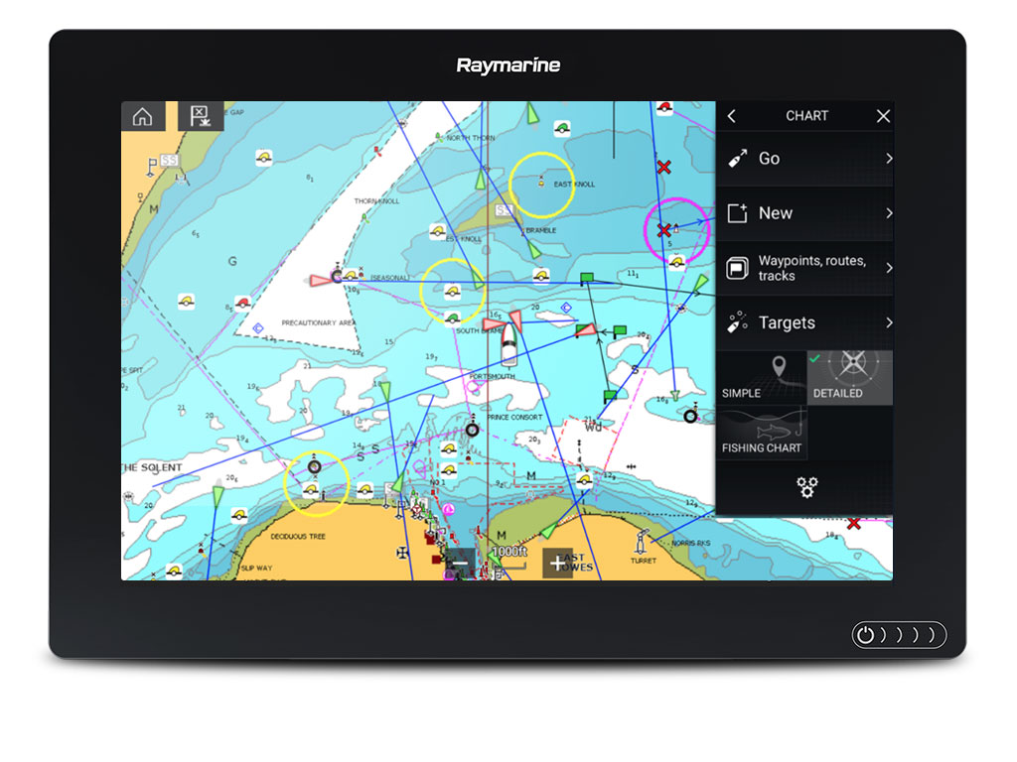
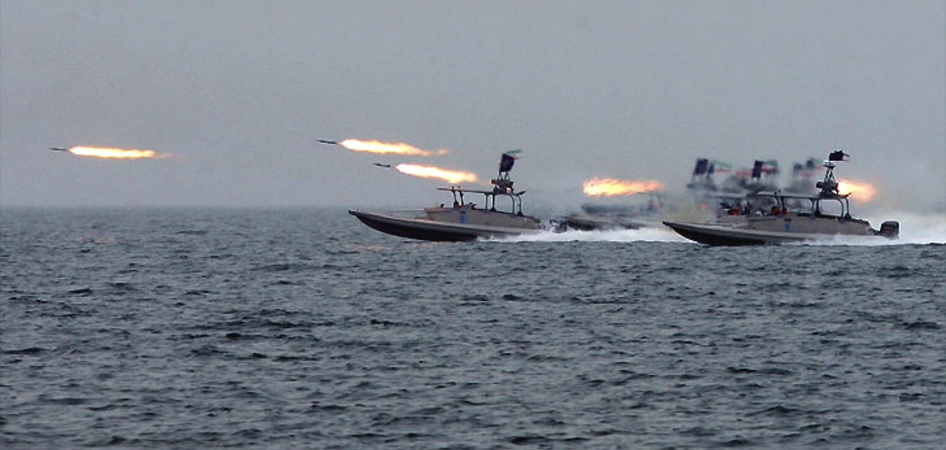
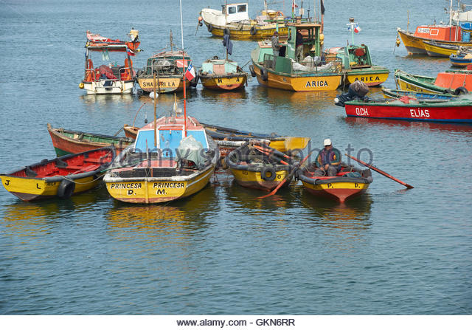

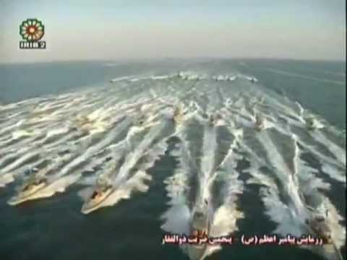
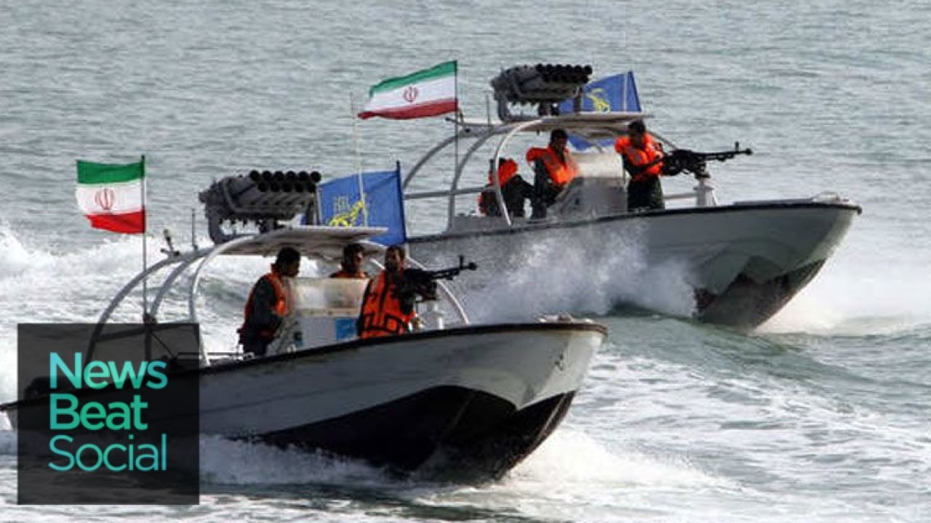
1-Page Concept Brief:
■ HEADLINE: Rule-based system for predictive warnings of high risk situations en-route
■ SITUATION
RN ships spend a lot of time in busy, cluttered, contested, littoral environments like the Persian Gulf, Gulf of Aden, and the Caribbean/Gulf of Mexico.
■ PROBLEM
RN ships are forced into close range of many unidentified vessels potentially belonging to hostile states. As many states cannot hope to win in a conventional Navy vs Navy conflict, they have developed ‘asymmetric’ doctrine. One tactic of particular concern to Western Navies is the use Fast In-shore Attack Craft hiding in cluttered waters amongst fishing vessels. They have the ability to position themselves without being detected (as a threat) and rushing a target from all directions without notice, firing shoulder launched rockets/missiles at short range.
■ PROPOSED SOLUTION
In these busy waters, the tactical surface picture will consist of many many ‘tracks’ each representing detection of a boat. These tracks may come from the ships Radar, over datalink, or AIS. Track data may include current position, speed and direction (ships transmitting on AIS show much more detail are less likely to be a threat, and small boats don’t use it).
We are assuming Naval intelligence officers have a degree of detail about hostile state tactics such as how their boats will want to set up an attack – ie manoeuvre to the right position and lay in wait until the target ship is in the middle of them - then rush from all directions once at a certain range. These situations (which may or may not be an actual attack) could be described logically by combining (AND/OR) a number of if-then statements (if there is an unknown track between these bearings, between these ranges, between these ranges, between these speeds) etc.
Rather than wait until the threat situation occurs, we could use the current ship’s intended route and speed, and all position/speed/direction of all the known tracks to predict if the situation may become true in the near future – something that may be difficult to see just by looking at the current positions.
To demonstrate the concept, we probably need track data that demonstrates an swarm attack - not sure if the data provided for the hackathon will be suitable! May have to make it up!
Idea originator(s):
First proposed: Dec 2018
Last edit: Dec 18
Rule editor
Rule 1 - Title: Swarm attack positioning
# tracks = >0, range= 1-3nm, bearing=000-090 degrees, heading=any
AND, # tracks = >0, range= 1-3nm, bearing=090-180 degrees, heading=any
AND, # tracks = >0, range= 1-3nm, bearing=180-270 degrees, heading=any
AND, # tracks = >0, range= 1-3nm, bearing=270-000 degrees, heading=any
Rule 2 - Title: Swarm attack in progress
# unknown tracks = >0, range= 0-3nm, bearing=000-090 degrees, heading=180-270
AND, # tracks = >0, range= 0-3nm, bearing=090-180 degrees, heading=270-000
AND, # tracks = >0, range= 0-3nm, bearing=180-270 degrees, heading=000-090
AND, # tracks = >0, range= 0-3nm, bearing=270-000 degrees, heading=090-180
Other location/time sensitive risks…
Rule 3 - Title: Collision / Too Close
# tracks = >0, range= 0-0.5nm, bearing=any, heading=any
Rule 4 - High Sea State on beam
Rule 5 - Shallow waters
Rule 6 – Close to sovereign waters (<12nm from coast)
Rule 7…
Idea originator(s):
First proposed: Dec 2018
Last edit: Dec 18
-15
-10
-5
NOW
+5
+10
+15
+20
+25
+30
+35
+40
+45
+50
+55
+60
Idea originator(s):
First proposed: Dec 2018
Idea originator(s):
Last edit: Dec 18
First proposed: Dec 2018
Last edit: Dec 18
Rule 1
Swarm Attack Positioning
[clear]
-15
-10
-5
NOW
+5
+10
+15
+20
+25
+30
+35
+40
+45
+50
+55
+60
-15
-10
-5
NOW
+5
+10
+15
+20
+25
+30
+35
+40
+45
+50
+55
+60

